Slide 1
WB-PIML — Figures
8 composite figures and every non-empty subplot Generated from data.xlsx

Slide 2
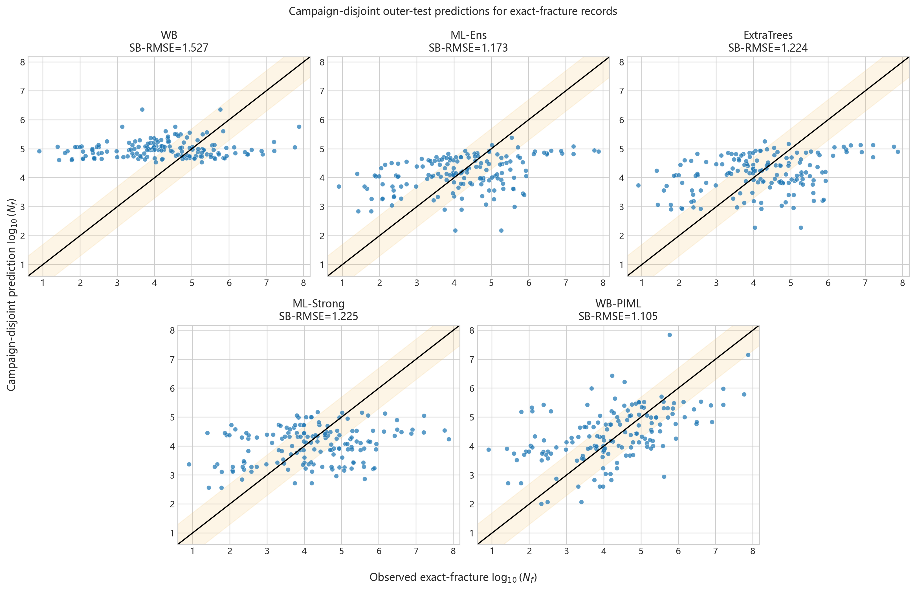
Figure 1 — Exact-fracture outer-test predictions
full figure | data.xlsx | 2/29

Slide 3
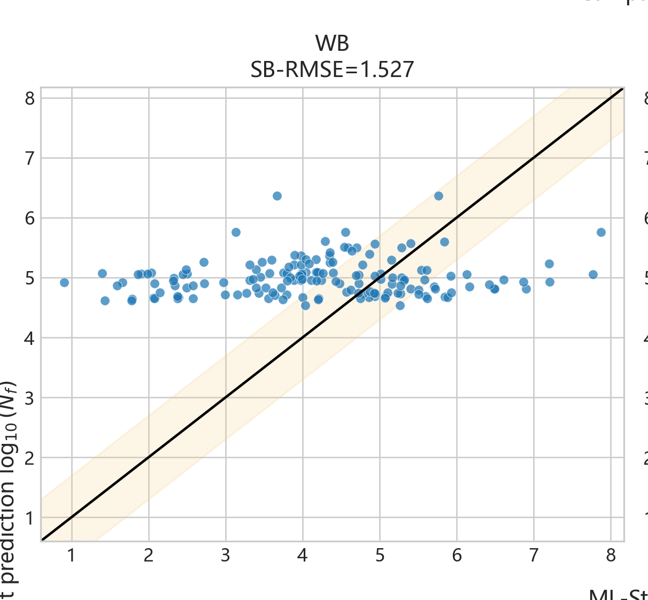
Figure 1A — WB exact-fracture predictions
individual subplot | data.xlsx | 3/29

Slide 4
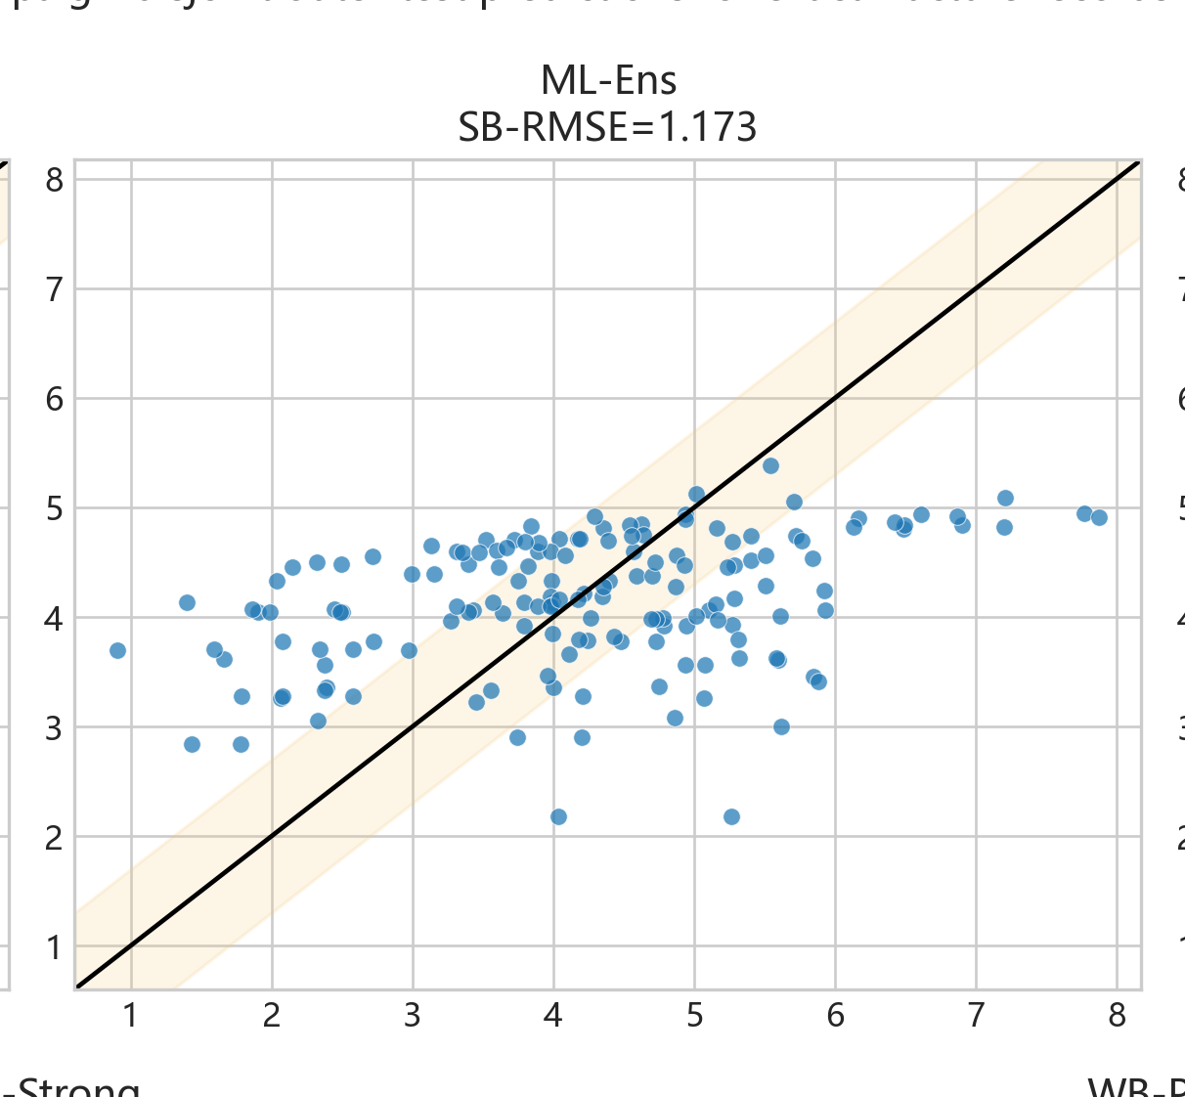
Figure 1B — ML-Ens exact-fracture predictions
individual subplot | data.xlsx | 4/29

Slide 5

Figure 1C — ExtraTrees exact-fracture predictions
individual subplot | data.xlsx | 5/29

Slide 6
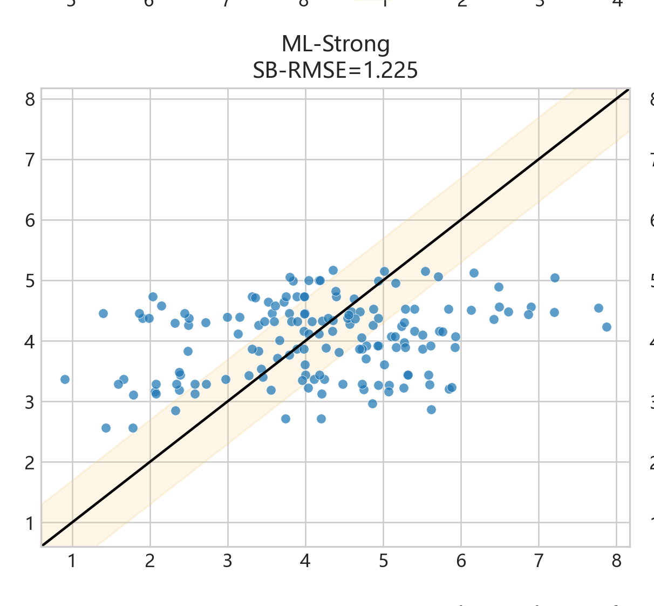
Figure 1D — ML-Strong exact-fracture predictions
individual subplot | data.xlsx | 6/29

Slide 7
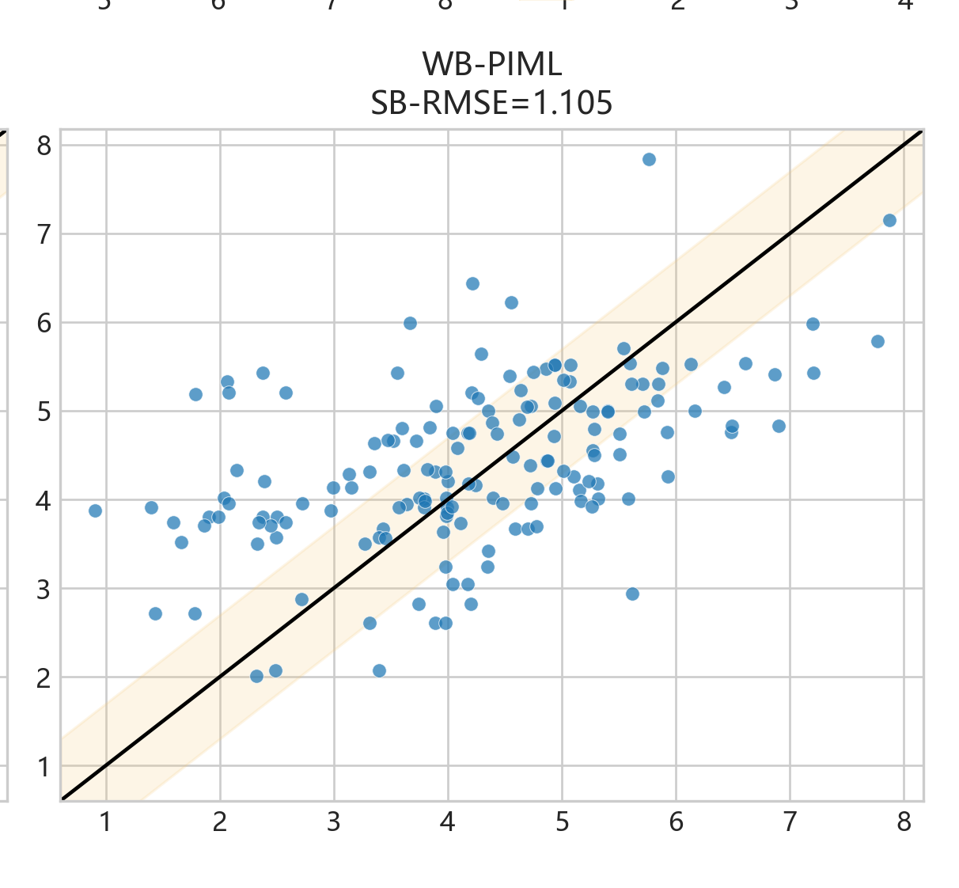
Figure 1E — WB-PIML exact-fracture predictions
individual subplot | data.xlsx | 7/29

Slide 8
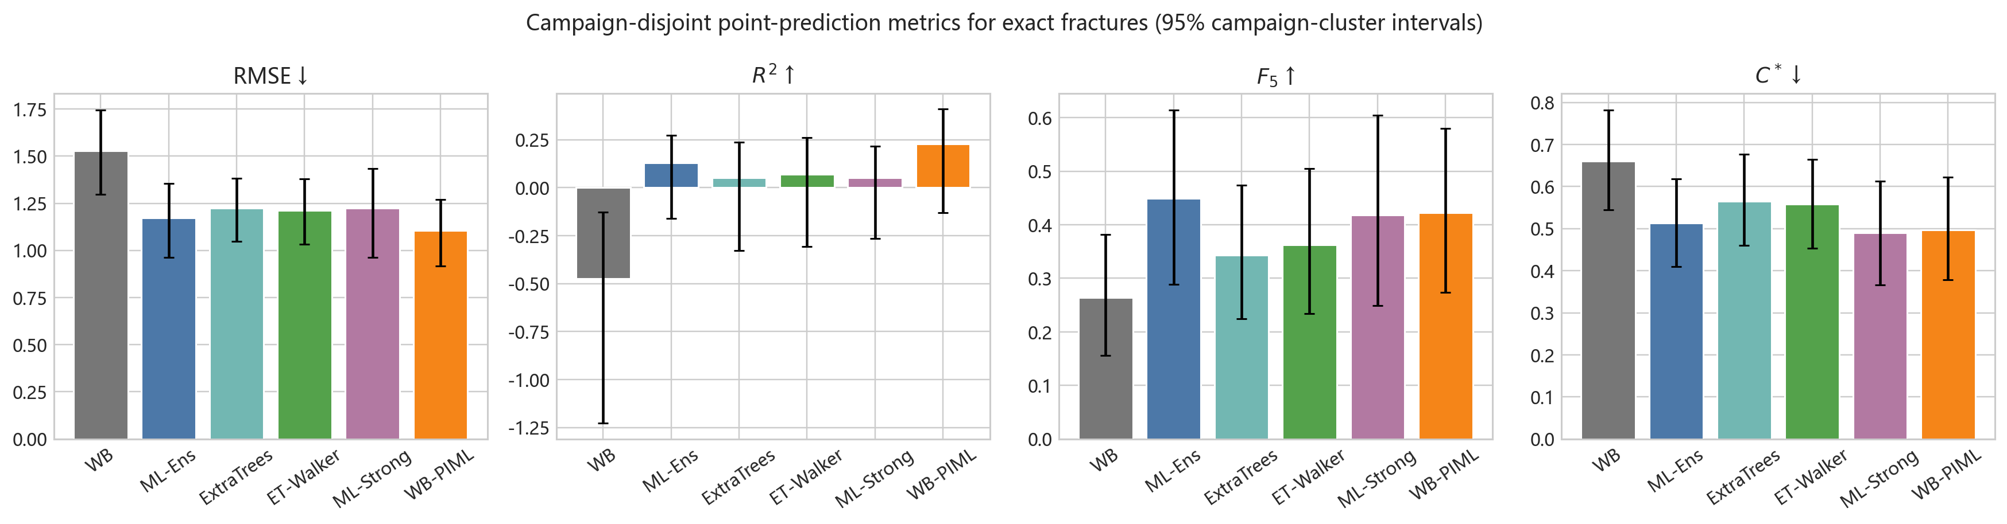
Figure 2 — Campaign-balanced primary metrics
full figure | data.xlsx | 8/29

Slide 9
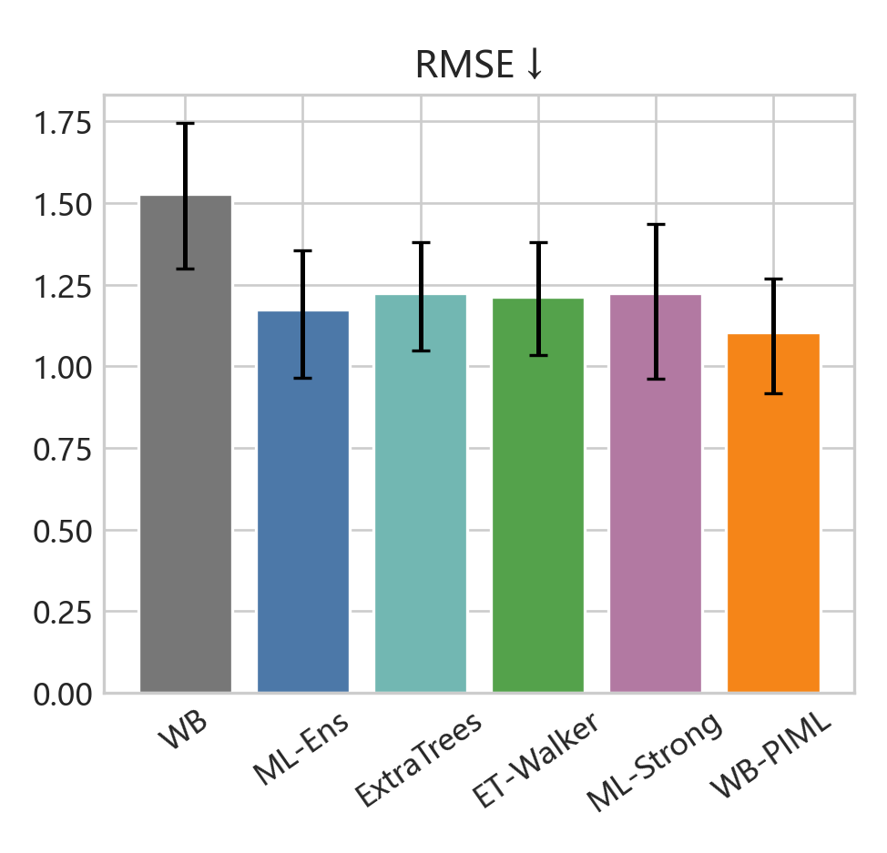
Figure 2A — RMSE ↓
individual subplot | data.xlsx | 9/29

Slide 10
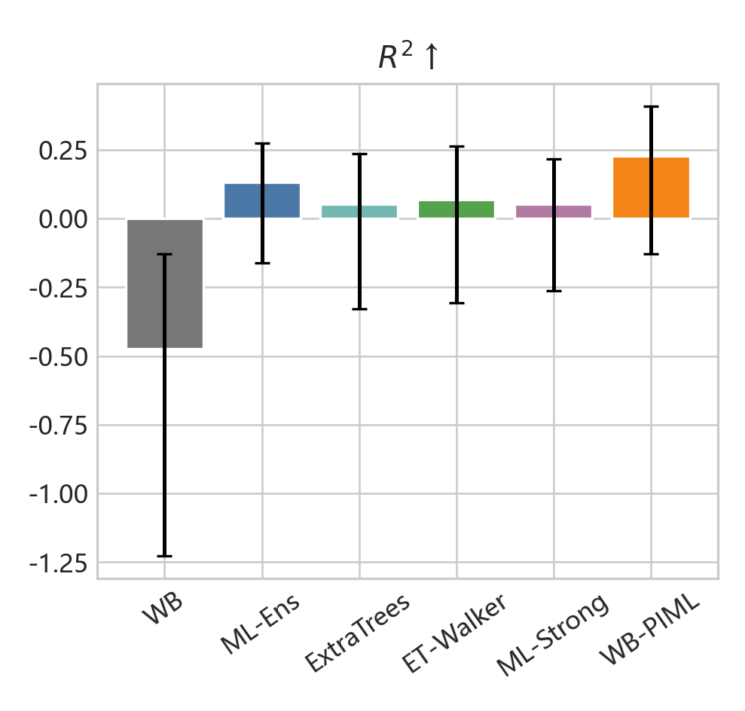
Figure 2B — $R^2$ ↑
individual subplot | data.xlsx | 10/29

Slide 11
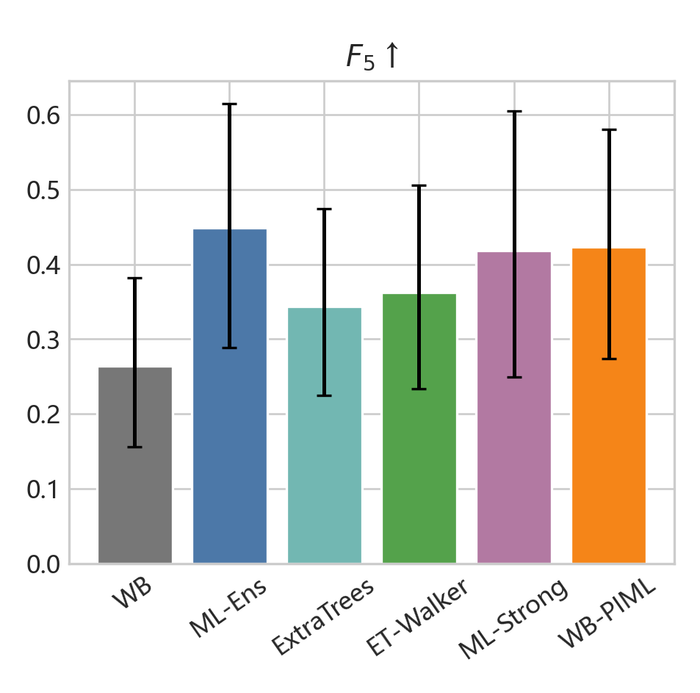
Figure 2C — $F_5$ ↑
individual subplot | data.xlsx | 11/29

Slide 12
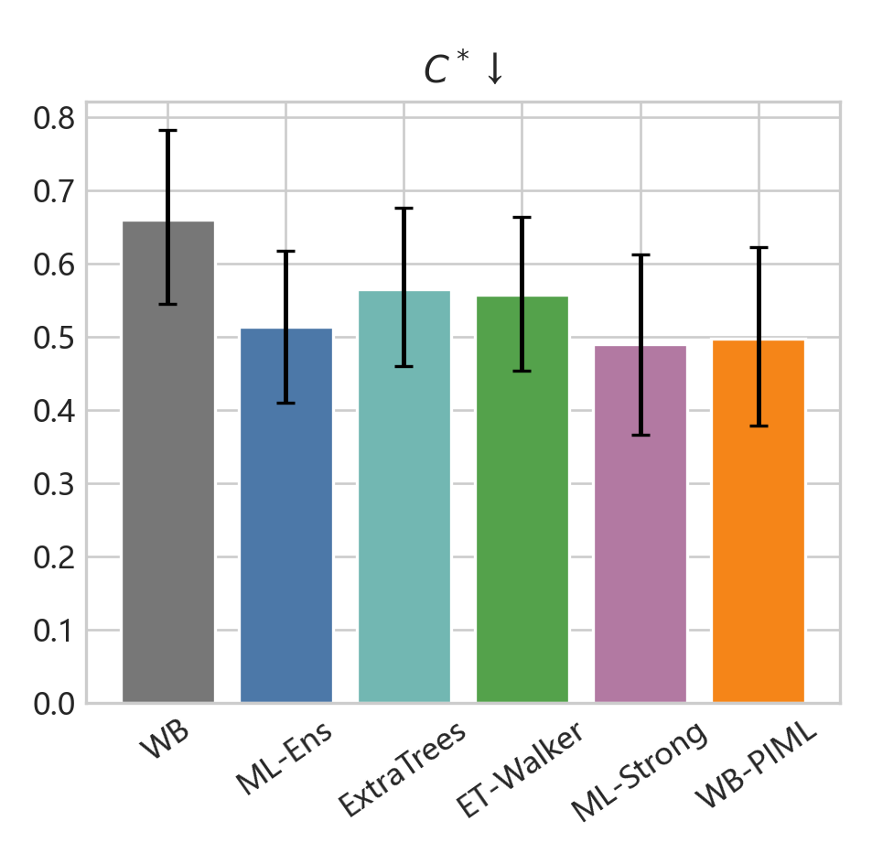
Figure 2D — $C^*$ ↓
individual subplot | data.xlsx | 12/29

Slide 13
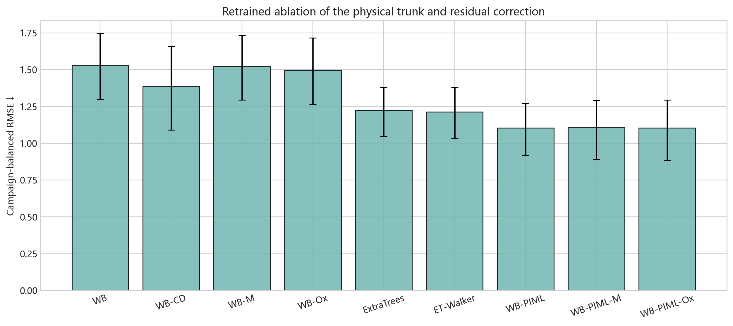
Figure 3 — Retrained model ablation
full figure | data.xlsx | 13/29

Slide 14
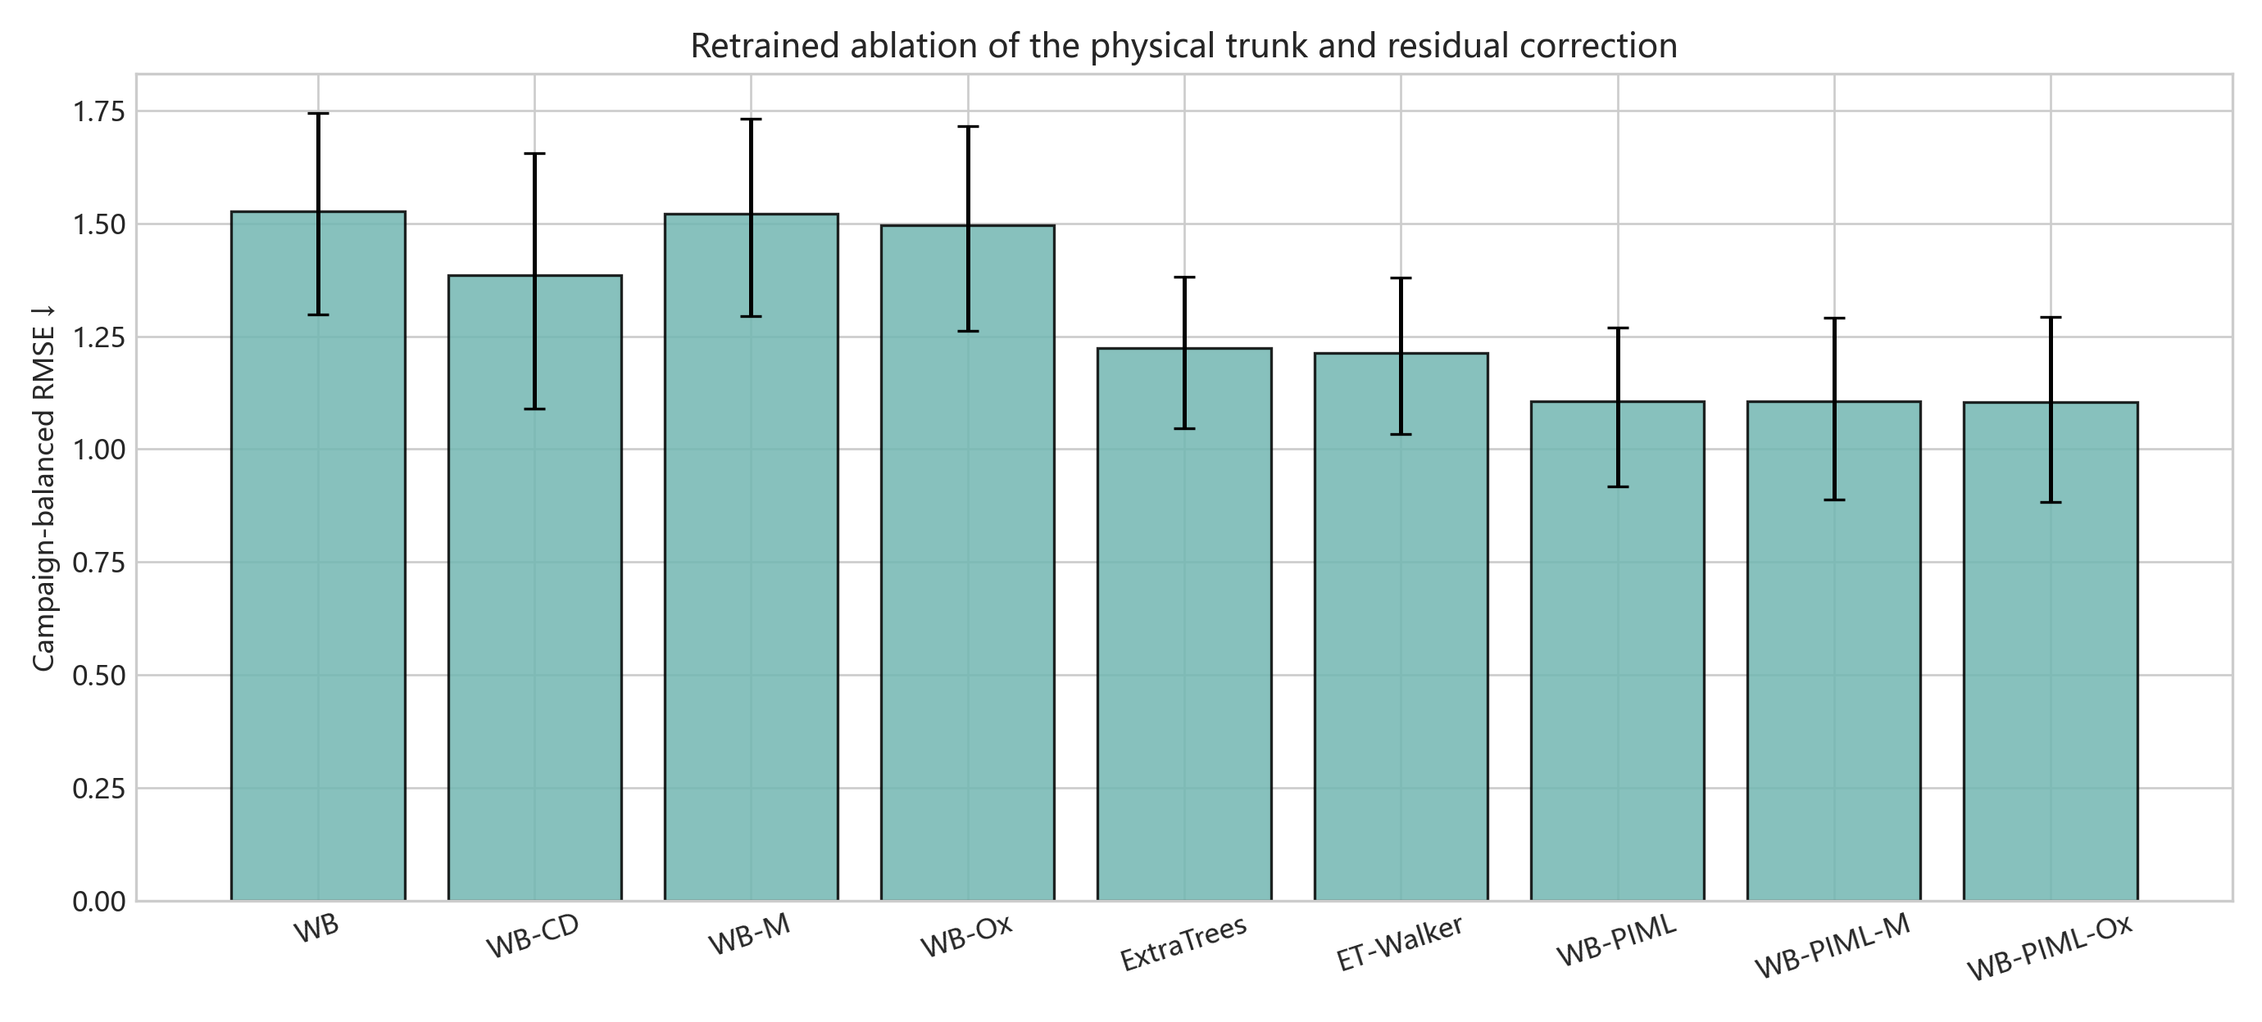
Figure 3A — Competing-damage and residual ablation
individual subplot | data.xlsx | 14/29

Slide 15
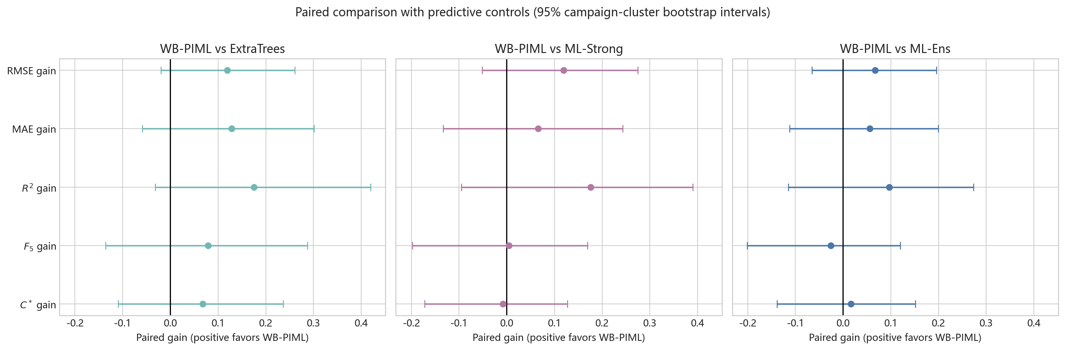
Figure 4 — Paired performance-effect intervals
full figure | data.xlsx | 15/29

Slide 16
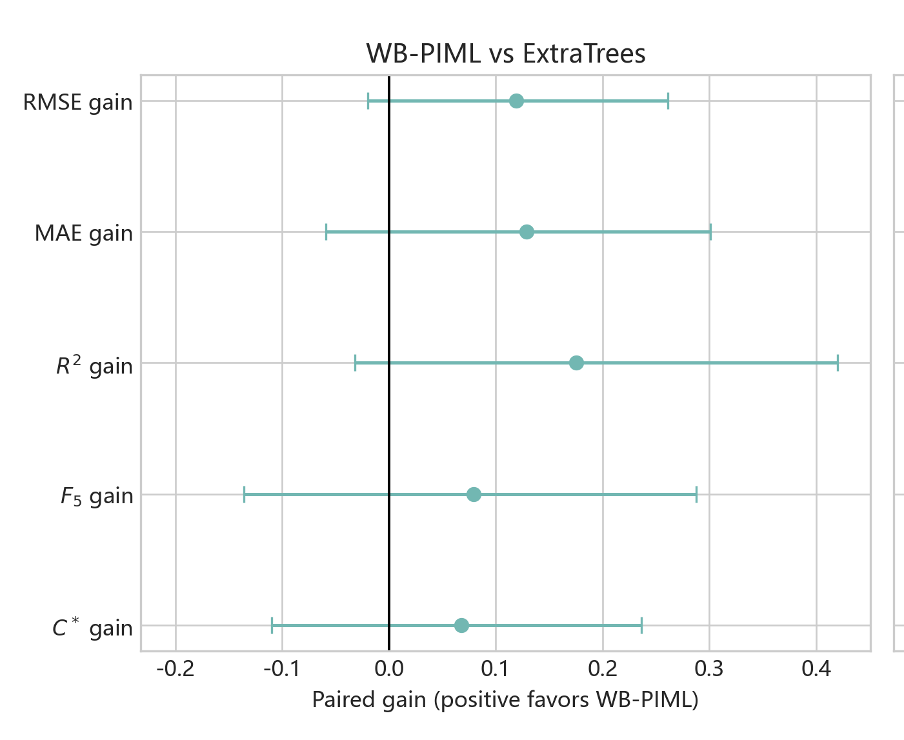
Figure 4A — WB-PIML versus ExtraTrees
individual subplot | data.xlsx | 16/29

Slide 17
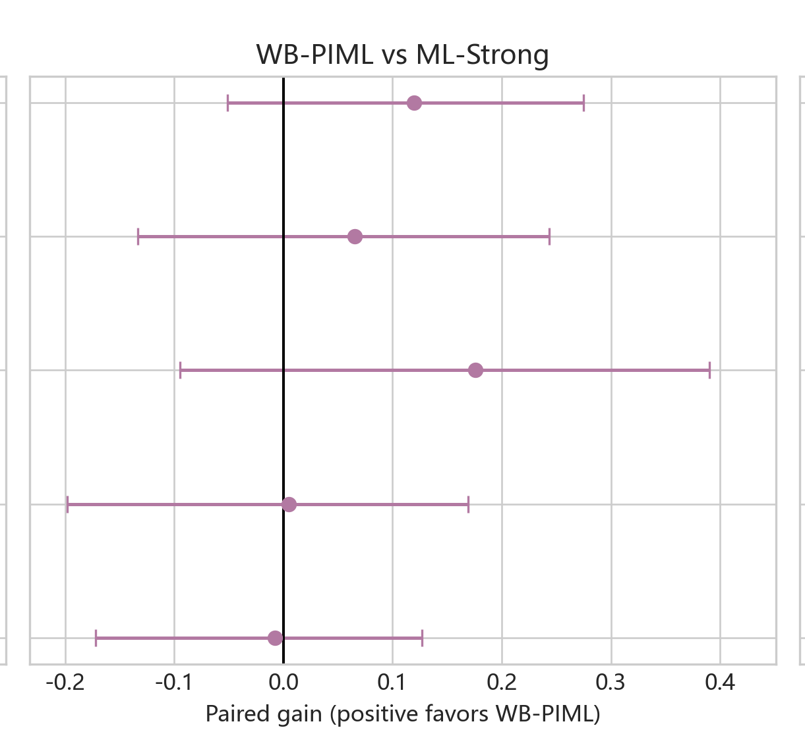
Figure 4B — WB-PIML versus ML-Strong
individual subplot | data.xlsx | 17/29

Slide 18
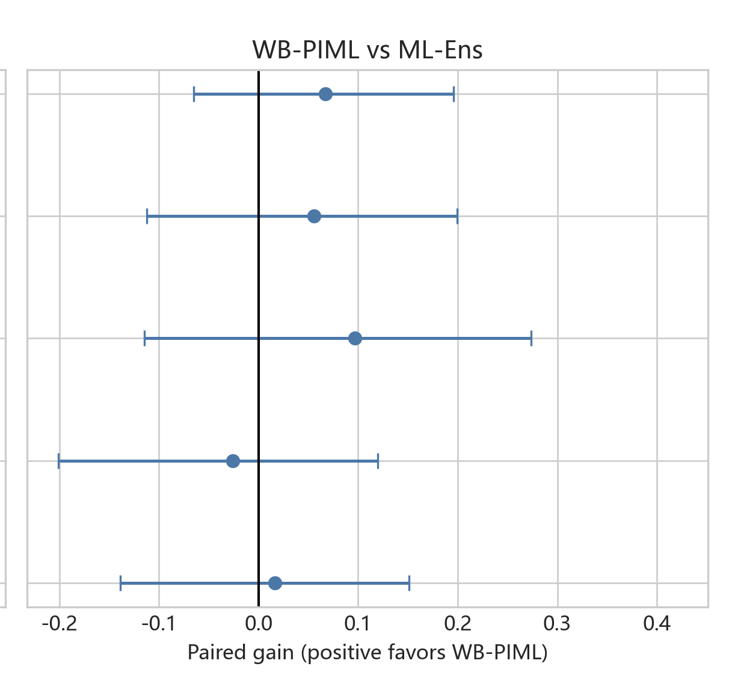
Figure 4C — WB-PIML versus ML-Ens
individual subplot | data.xlsx | 18/29

Slide 19
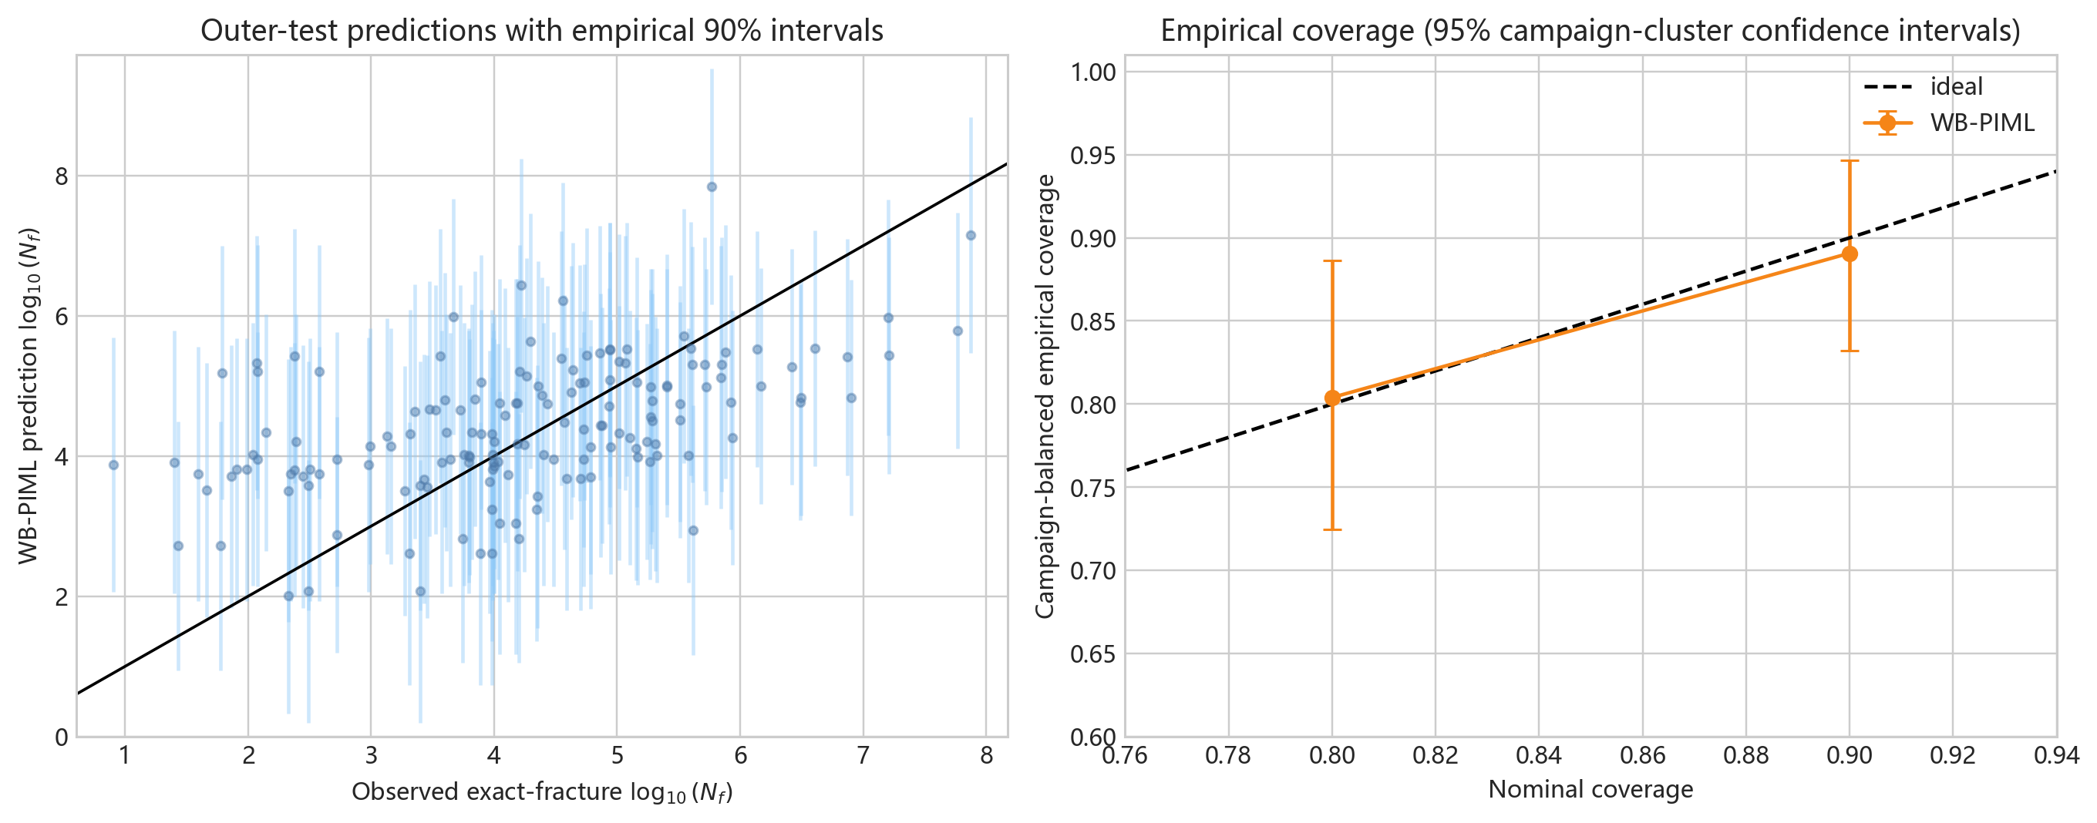
Figure 5 — Empirical prediction intervals
full figure | data.xlsx | 19/29

Slide 20
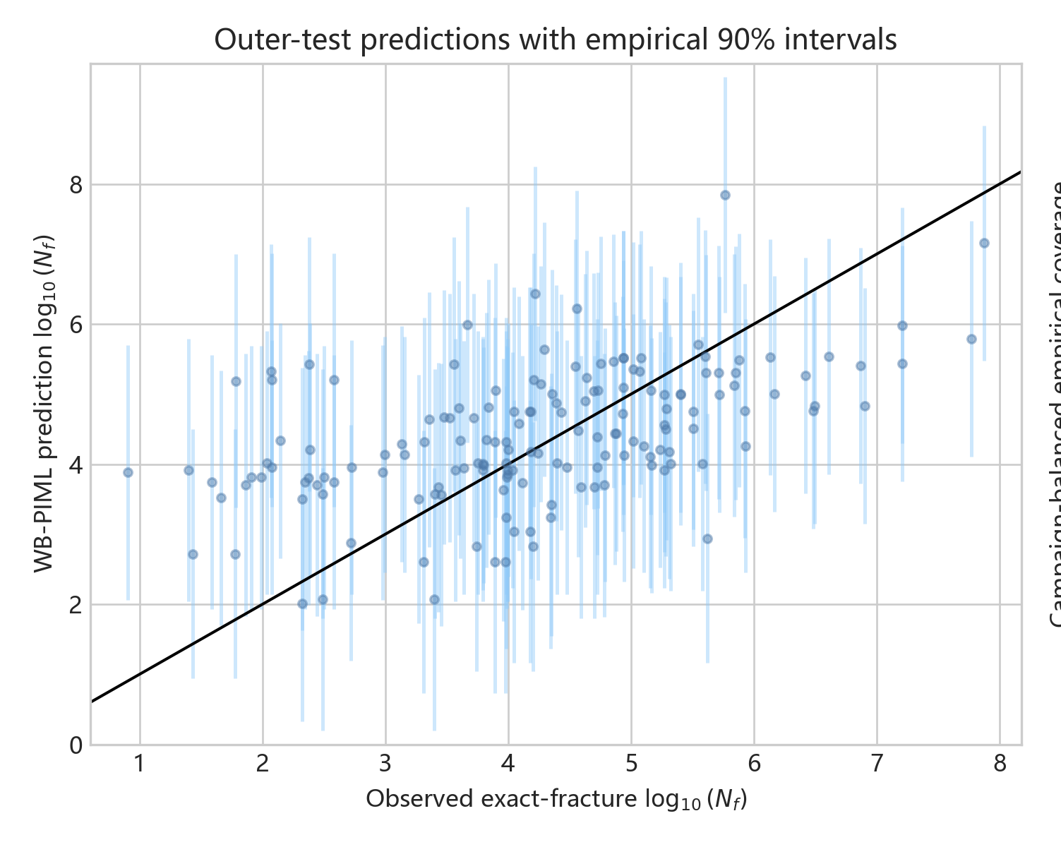
Figure 5A — Outer-test empirical 90% intervals
individual subplot | data.xlsx | 20/29

Slide 21
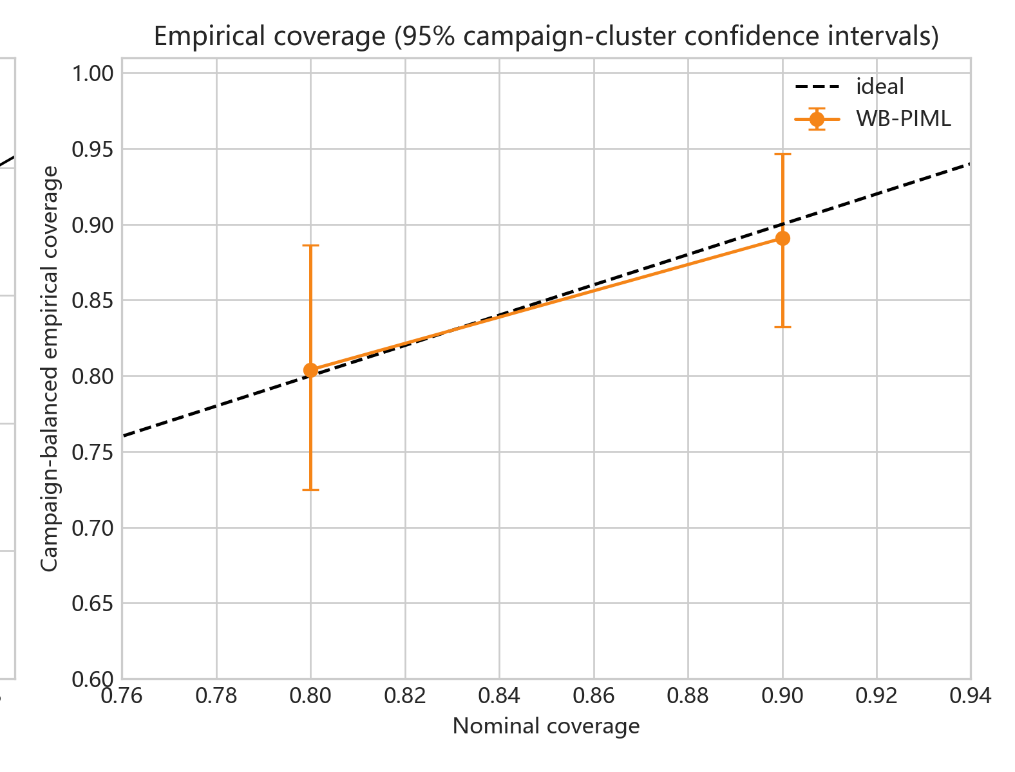
Figure 5B — Empirical interval coverage
individual subplot | data.xlsx | 21/29

Slide 22
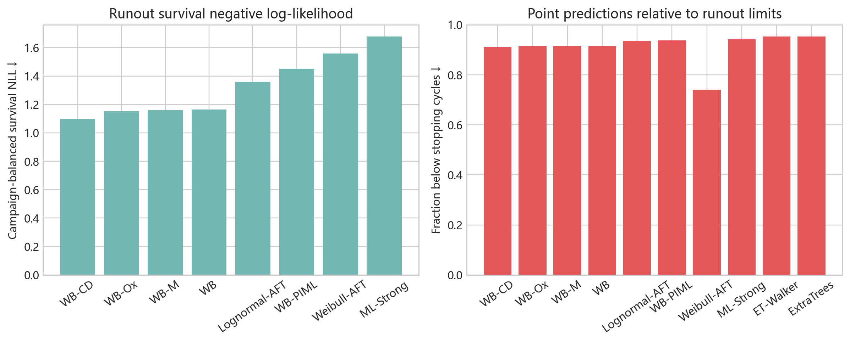
Figure 6 — Runout evaluation under right censoring
full figure | data.xlsx | 22/29

Slide 23
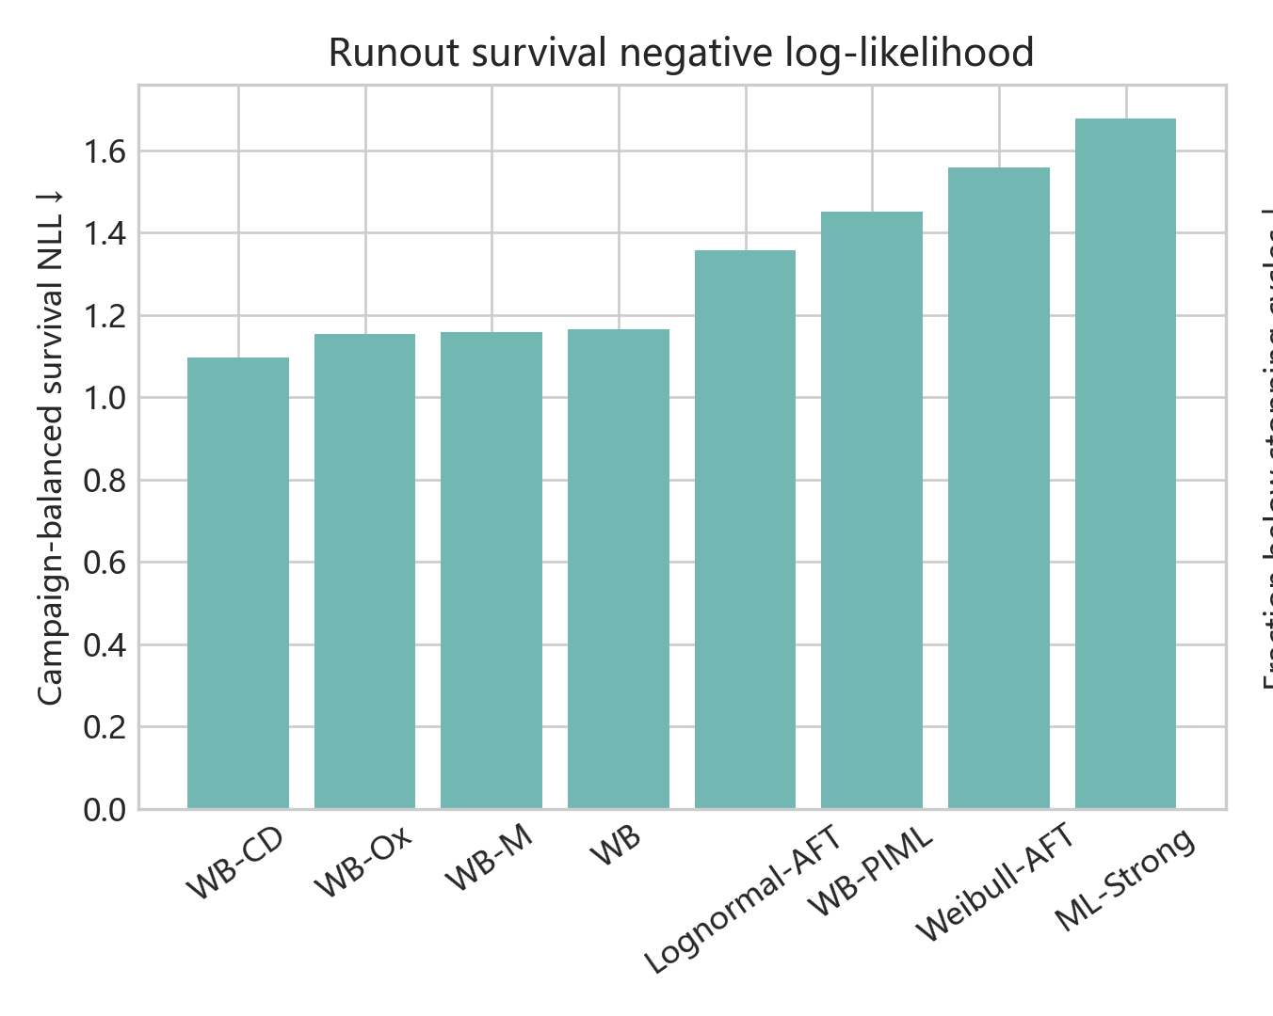
Figure 6A — Runout survival negative log-likelihood
individual subplot | data.xlsx | 23/29

Slide 24
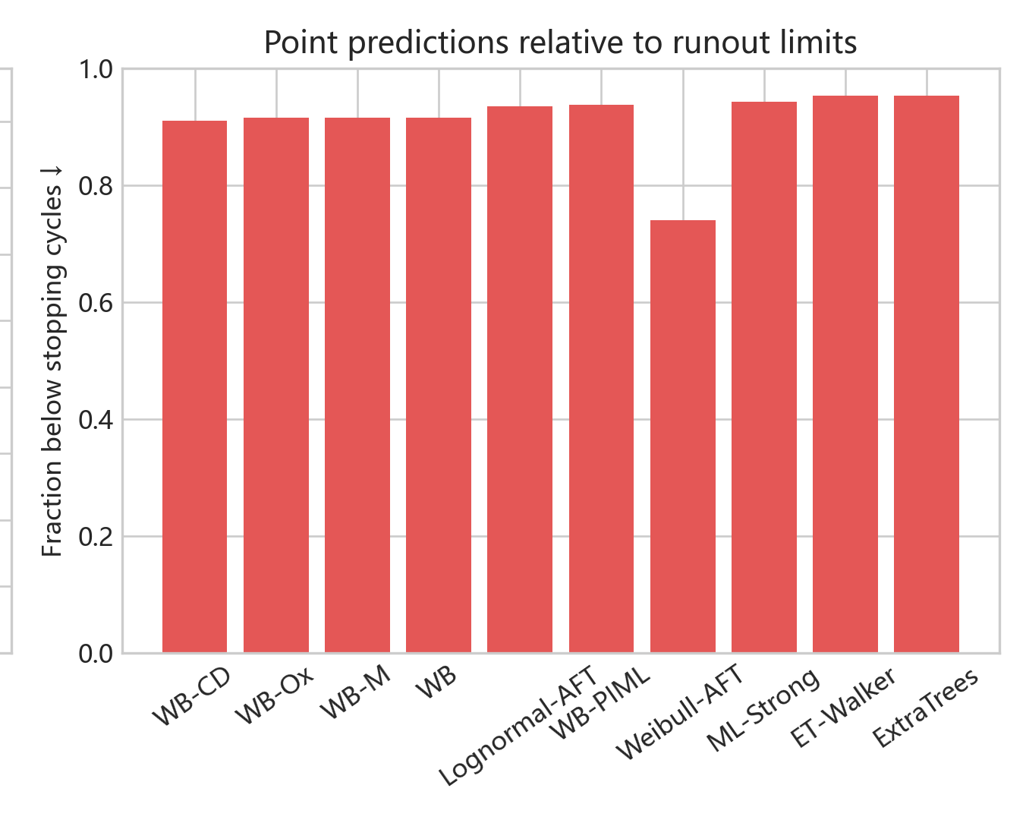
Figure 6B — Point prediction versus runout limit
individual subplot | data.xlsx | 24/29

Slide 25
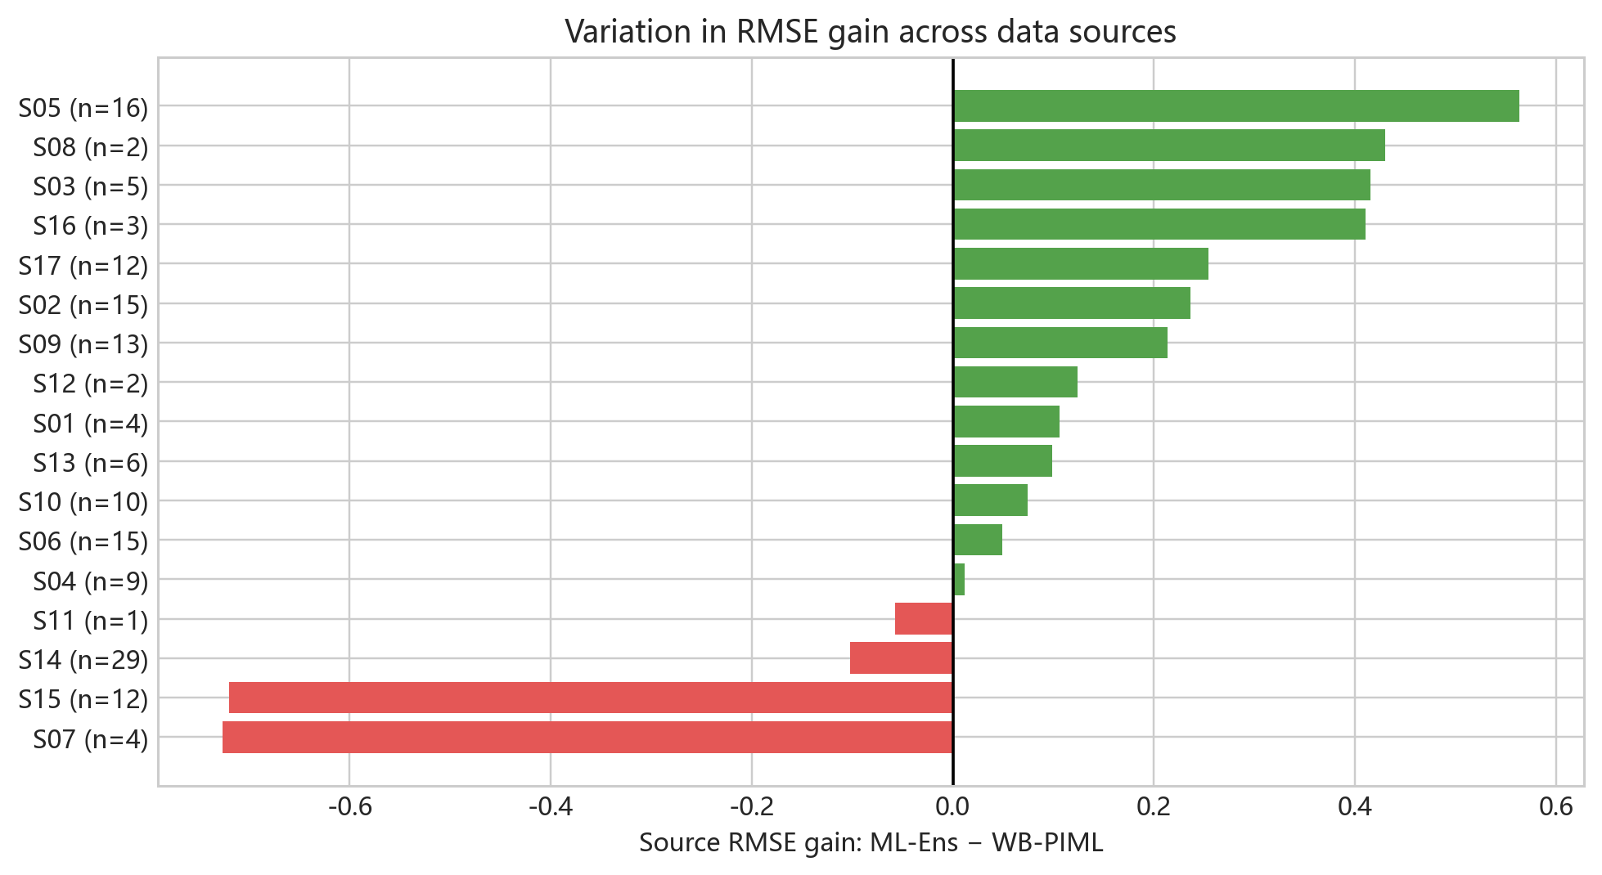
Figure 7 — Source-specific RMSE gain
full figure | data.xlsx | 25/29

Slide 26
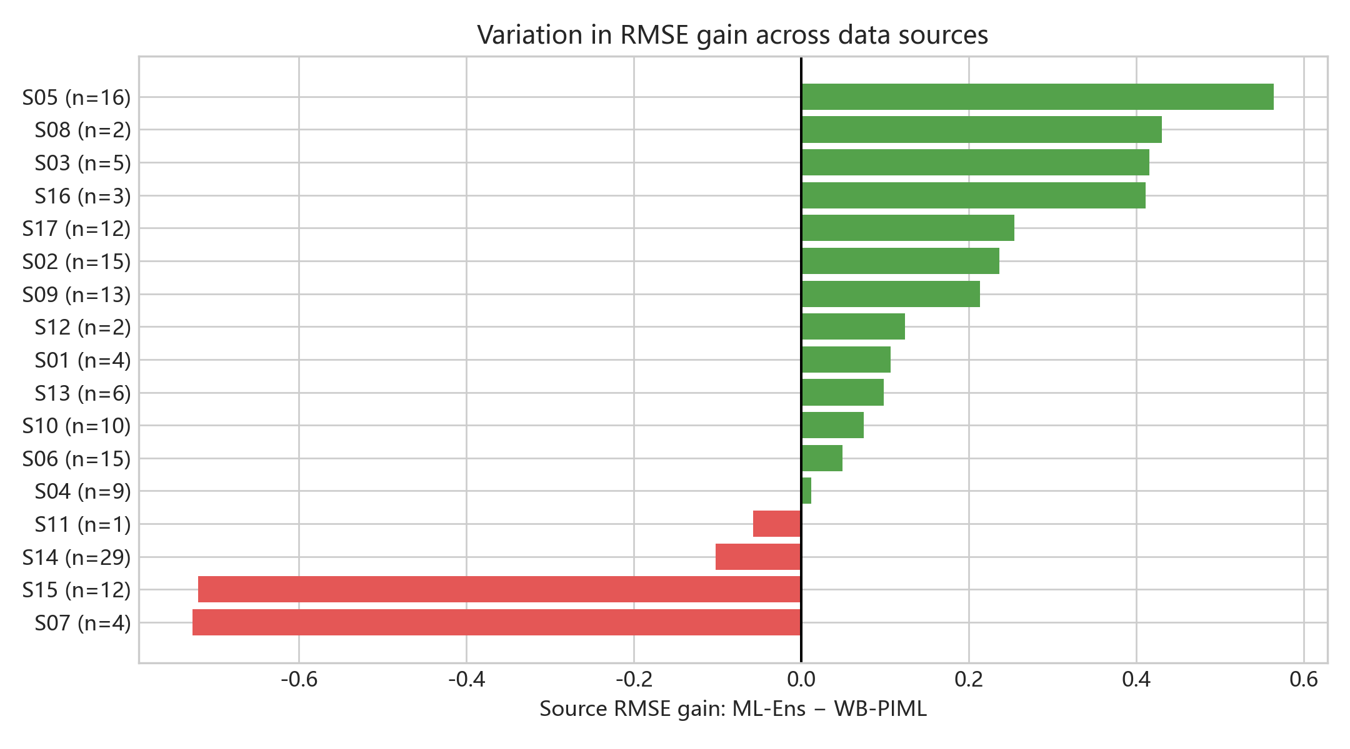
Figure 7A — Source-level RMSE gain
individual subplot | data.xlsx | 26/29

Slide 27
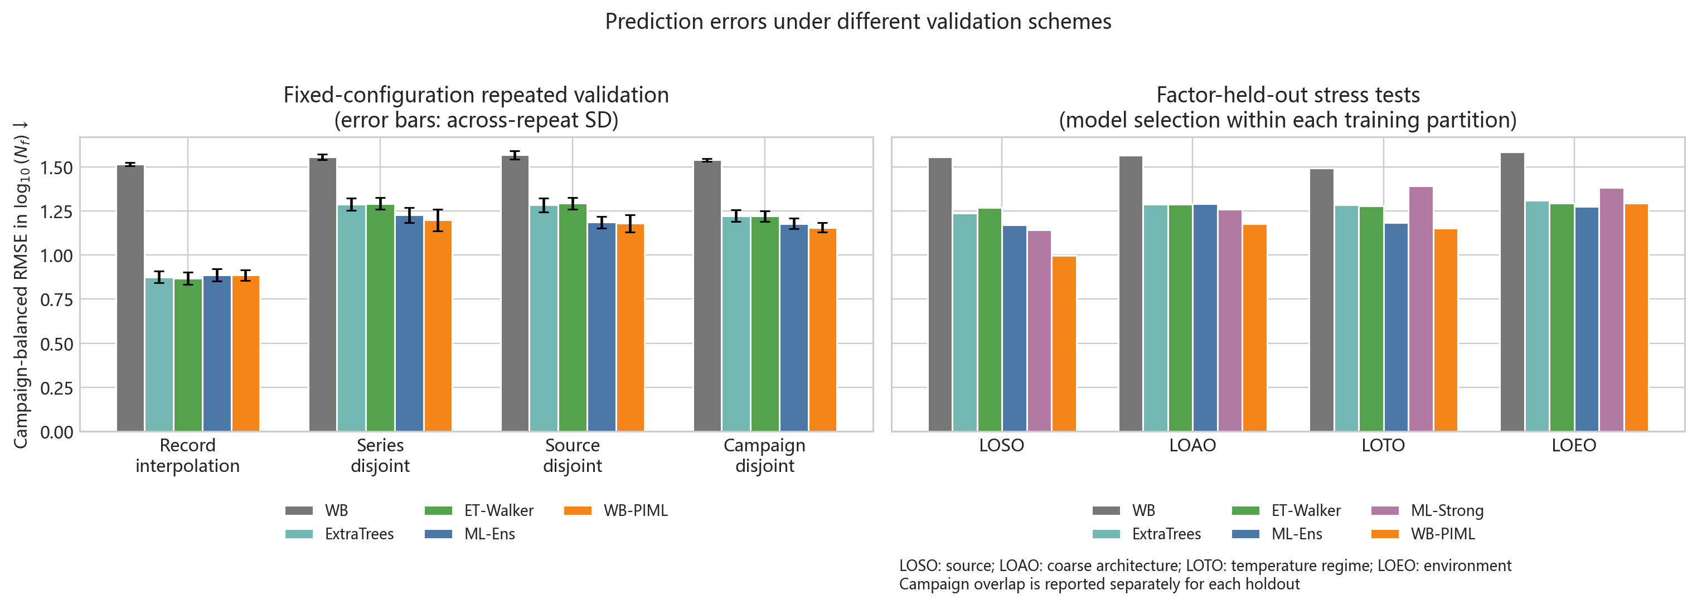
Figure 8 — Validation-scope comparison
full figure | data.xlsx | 27/29

Slide 28
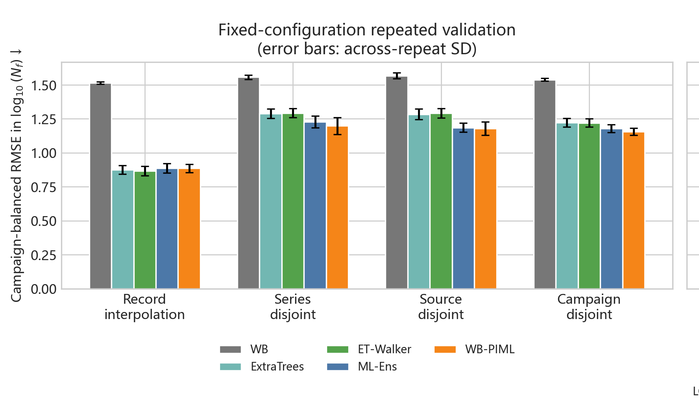
Figure 8A — Fixed-configuration repeated validation
individual subplot | data.xlsx | 28/29

Slide 29
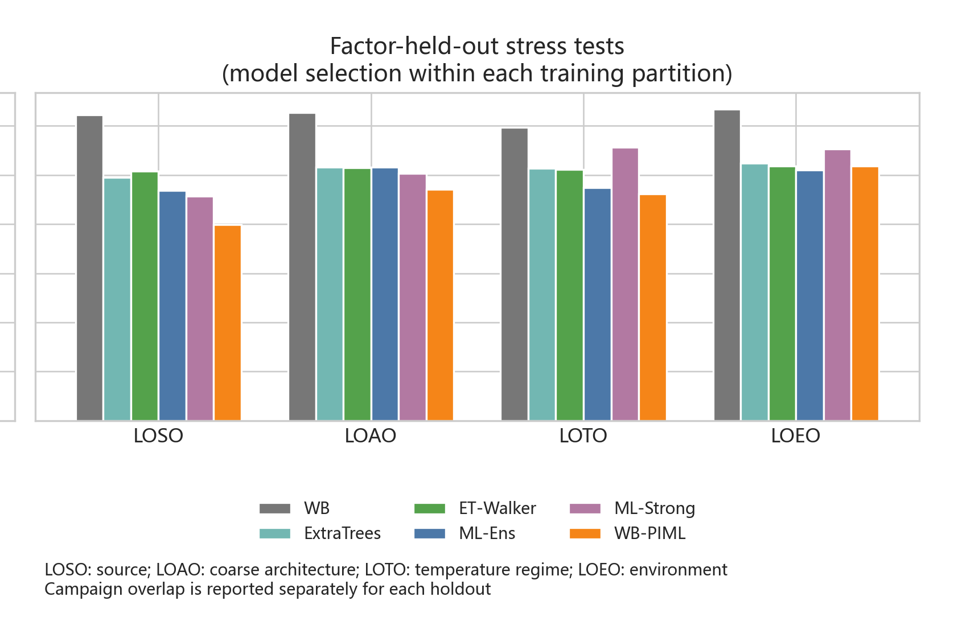
Figure 8B — Factor-held-out tests including ML-Strong
individual subplot | data.xlsx | 29/29

