Slide 1
Vocareum Exercises
By Yue Shi,
Ph.D. student in Electrical Engineering,
University of Southern California

Slide 2
Exercises
Simple reflex Agent
Model based Agent
Goal based Agent

Slide 3
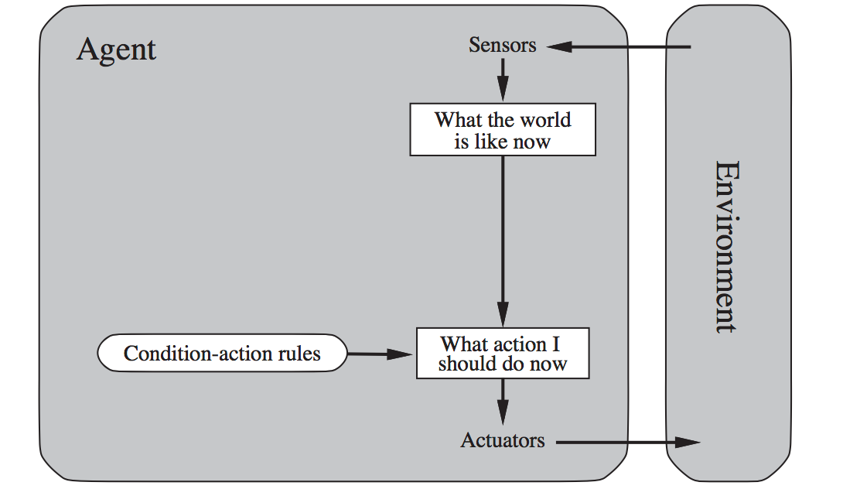
A simple reflex agent

Slide 4
A working example- Vacuume Agent
Rule:
if status = Dirty then return Suck
else if location = A then return Right
else if location = B then return Left

Slide 5
Sample input file
Sample input file(input_simplereflex.txt):
A,Clean
B,Clean
A,Dirty
A,Dirty

Slide 6
Sample output file
Sample output file(traces_actions_simplereflex.txt):
Right
Left
Suck
Suck

Slide 7
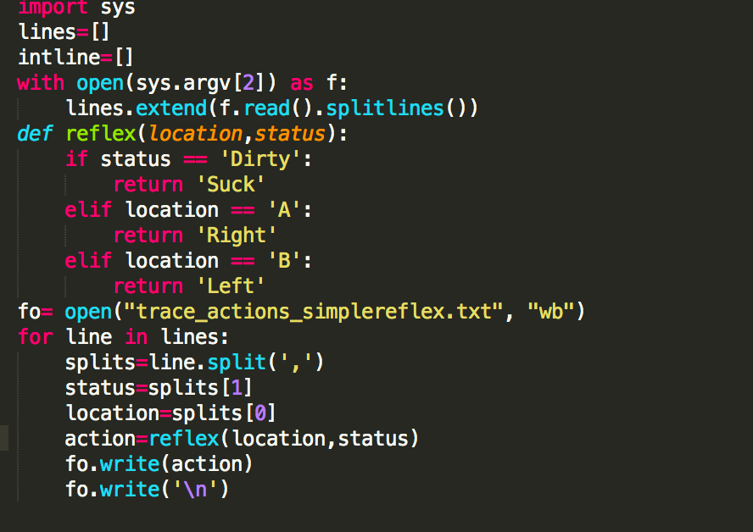
Sample code

Slide 8
Run the code
python simplereflex.py –i input_simplereflex.txt
generate the output file: trace_actions_simplereflex.txt

Slide 9
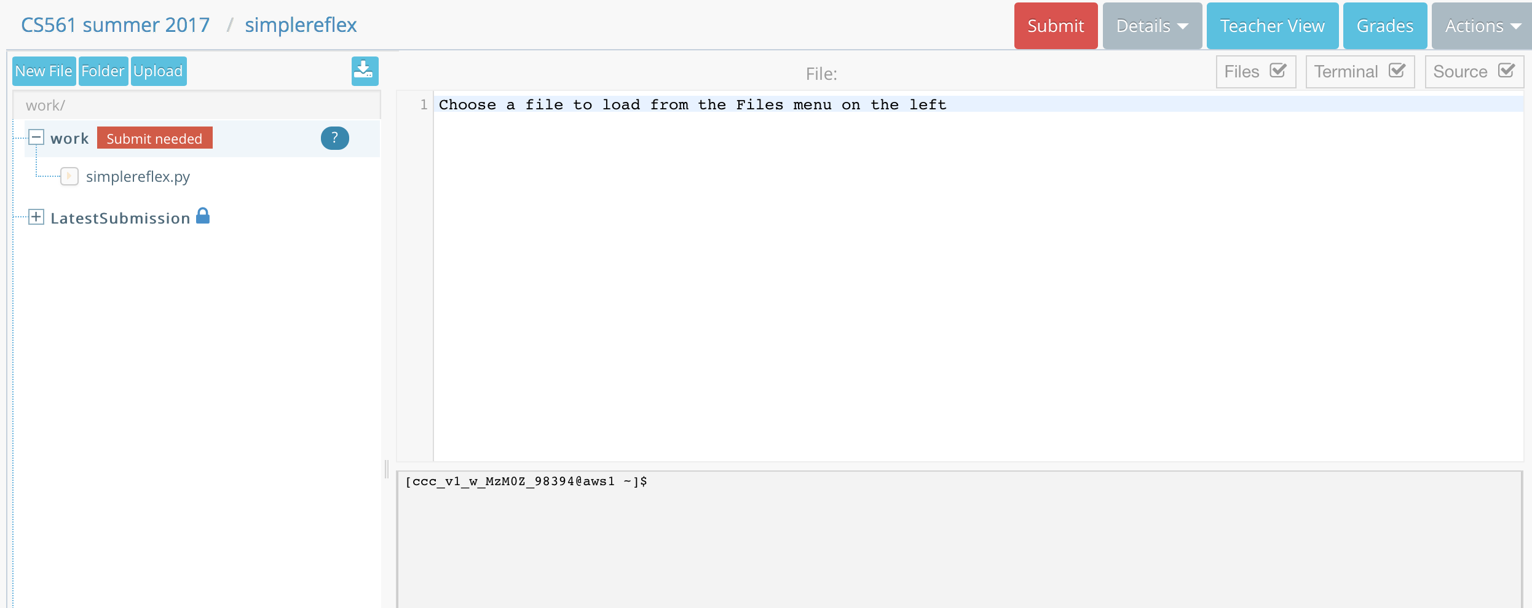
Vocareum submission

Slide 10
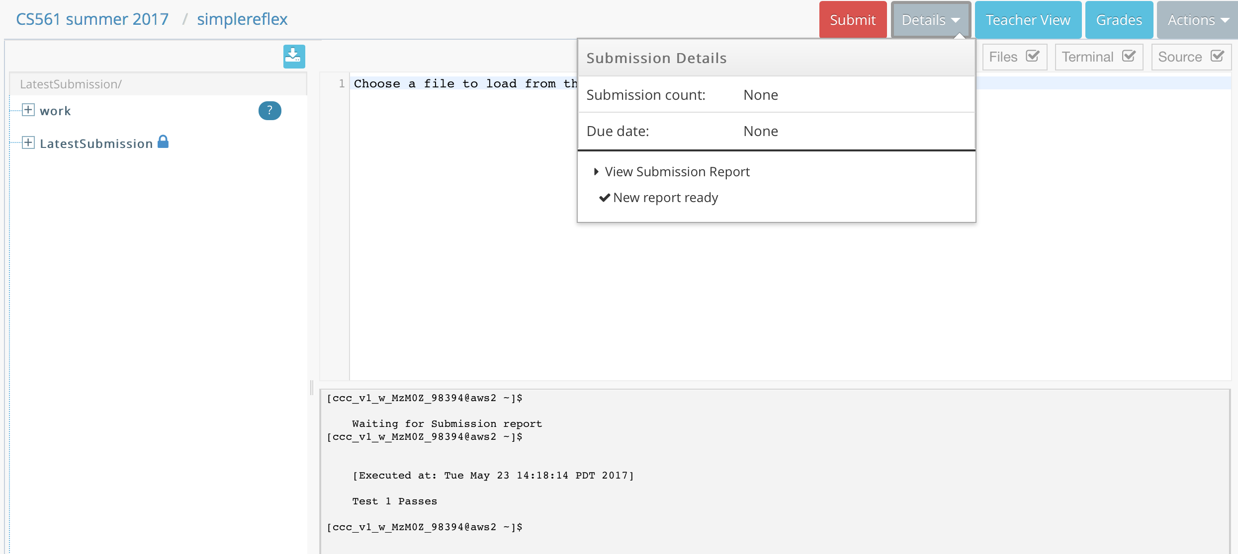
Successful submission

Slide 11
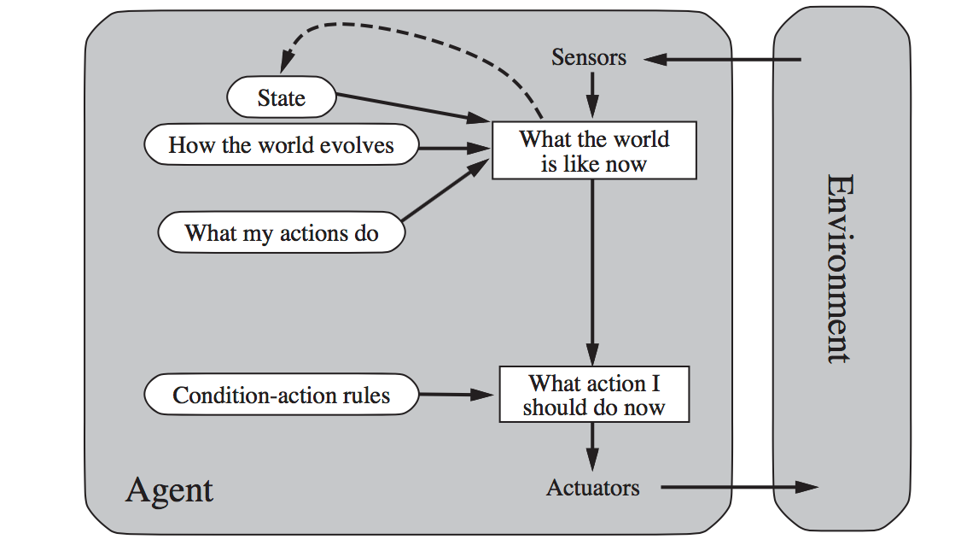
Model based agent

Slide 12
A working example: Model Based Vacuume Agent
Add a model that keeps track of what locations are clean or dirty.
Initially, model={A:None, B: None}
When percept from the environment, update the model:
Location, status=percept.
Model[location]=status
The rule is the same as simple reflex, except that:
If model[A]==model[B]==‘Clean’, NoOp returns

Slide 13
Sample input file
Sample input file(input.txt):
A,Clean
B,Clean
B,Dirty
B,Clean

Slide 14
Sample output file
Sample output file(traces_actions_modelbased.txt):
Right
NoOp
Suck
NoOp

Slide 15
Run the code
python modelbased.py –i input_modelbased.txt
generate the output file: trace_actions_modelbased.txt

Slide 16
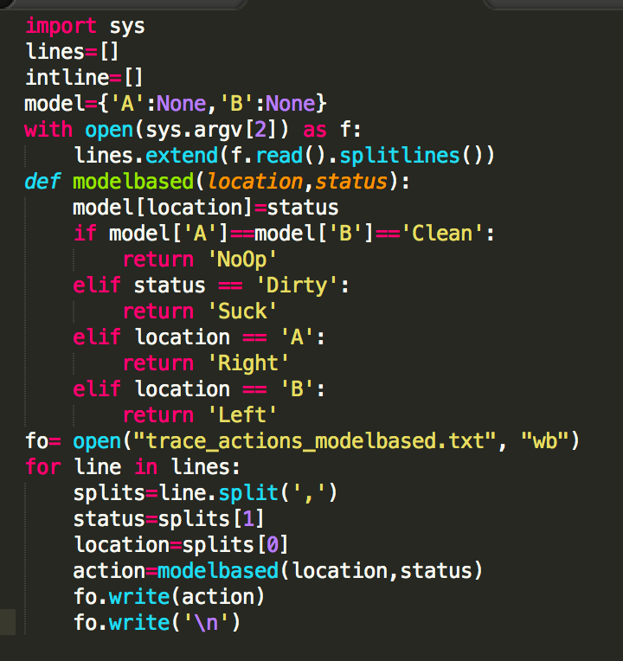
Sample Code

Slide 17
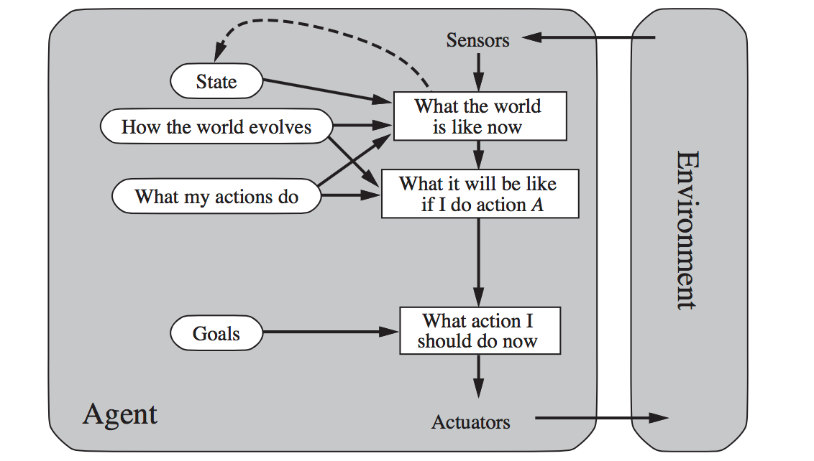
Goal based agent

Slide 18
A working example: Goal Based Vacuume Agent
Add goal test:
If both locations are clean , simply stop

Slide 19
Sample input file
Sample input file(input.txt):
A,Dirty
A,Clean
B,Clean

Slide 20
Sample output file
Sample output file(traces_actions_goalbased.txt):
Suck
Right
Stop

Slide 21
Run the code
python goalbased.py –i input_goalbased.txt
generate the output file: trace_actions_goalbased.txt

Slide 22
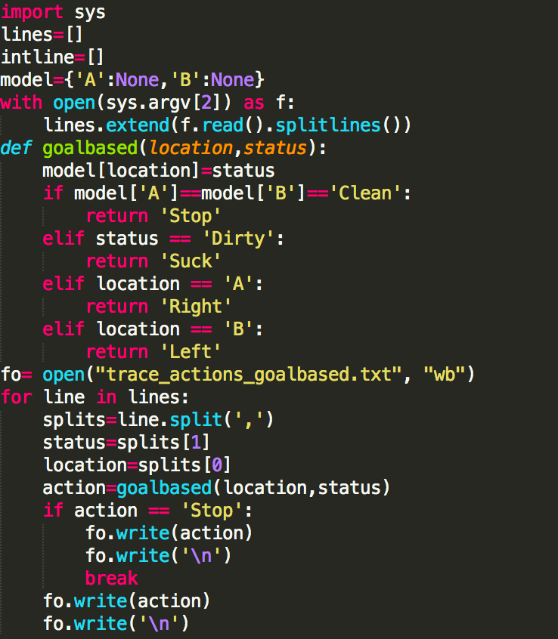
Sample Code

Slide 23
In CLASS PARTICIPATION credit(group work)
2-4 students per group, den students could work individually
Create three kinds of agents:
agent_simplereflex.py
agent_modelbased.py
agent_goalbased.py
Each has its own input file: input.txt
Run the code,e.g. : python agent_simplereflex.py –i input.txt
It should generate the output file: output.txt
Provide the solution: solution.txt
submit the source code, input.txt and solution.txt to vocareum under assignment agent_simplereflex,agent_modelbased,agent_goalbased
Submit before Thursday class (May 25, 4pm)
In the source code, have your team member names, emails, and agent description in the comment block

