Slide 1
Artificial Intelligence Lecture 12: Learning from Examples (AIMA Chapter 18 and a little bit of 20)
Summer 2017
Instructor: Prof Sheila Tejada

Slide 2
What is Learning?
No hard and fast definition
Modification of a system
by itself
Not simply programming/surgery by others
Although others (teachers?) may be involved
that improves its performance
Not random or detrimental changes (forgetting, etc.)
Although some learning may, at least temporarily, cause a performance decrement
Or the impact on performance may become apparent only later, or not at all if the right situation does not arise
for the long term
Not simply a transient change

Slide 3
Why study learning (in general)?
Understand and improve efficiency of human learning
Use to improve methods for teaching and tutoring people (e.g., better computer-aided instruction)
Discover new things or structure previously unknown
Examples: data mining, scientific discovery
Fill in skeletal or incomplete specifications about a domain
Large, complex AI systems can’t be completely built by hand and require dynamic updating to incorporate new information
Learning new characteristics expands the domain or expertise and lessens the “brittleness” of the system
Build agents that can adapt to users, other agents, and their environment

Slide 4
Why Learning (for AI)?
Critical for autonomy
i.e., for systems operating without human intervention
Essential for unknown environments
i.e., when designer lacks omniscience
Useful for system construction
i.e., expose agent to reality rather than writing it down
Central piece of human cognition
Understanding learning is key in cognitive modeling
But considered undesirable in some applications
Unpredictable outcomes, unverifiable (if learning is online) and untrustable

Slide 5
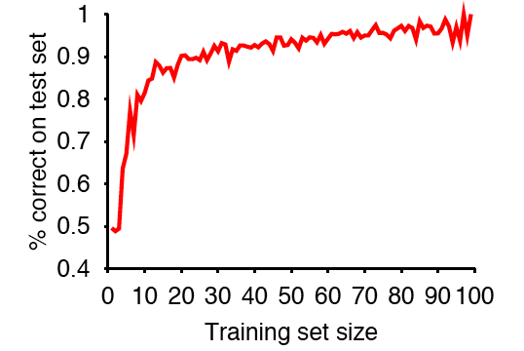
Varieties of Learning
What performance measure is being improved?
Speed
Accuracy
Robustness
Conciseness
What knowledge drives the improvement?
Experience (internal and/or external)
Examples (classified or unclassified)
Evaluations/reinforcements (immediate or delayed)
Books, lectures, conversations, experiments, reflections, …
What aspects of the system are being changed?
Reflexes, goals, operators (preconditions/effects), facts, rules, probabilities, utilities, connections, strengths, …
What algorithms convert knowledge into effective change

Slide 6
Rote Learning (Memorization)
Duck
Goose
Pig
Elephant
Horse
Azalea
Computer
Perhaps the simplest form of learning conceptually
Given a list of items to remember,
Learn the list so that can respond to queries about it
Recognition: Was Horse in list? Rhino? Goose? Azalea? Camellia?
Recall: What items did you see?
Cued Recall: What animals did you see?
Relatively simple to implement in computers (except cued)
Can improve accuracy by remembering what is perceived
Can improve efficiency by caching computations
Core research topic in human learning (semantic memory)
Memorization is a relatively difficult skill for people
Notes:
Recall: Who thinks can say the whole list
Cued Recall: Duck, goose, pig, elephant, horse
Cued might require an ontology or other background knowledge

Slide 7
Generalization
A major step beyond rote learning is to create generalizations across items seen
Adds some understanding to memorization
One aspect of larger assimilation process, of relating new knowledge/items/experiences to what is already known
Notes:
Cluster chairs and table
Classify lights (but could be lights in classroom, or lights in LA, or …)

Slide 8
Typical generalization/learning problems
Clustering (unsupervised learning)
uses commonalities and differences among items to group them in some useful way
Concept formation (supervised or inductive learning)
uses commonalities among items assigned to a class, and differences with items assigned to other classes, to develop general definitions for class membership
Semi-supervised learning
uses a small number of classifed examples with a larger number of unclassified ones
Reinforcement learning
acquires general policies for controlling behavior from external reinforcement signals concerning the utility of states reached in environment
Approaches tend to be knowledge lean in general
Notes:
Cluster chairs and table
Classify lights (but could be lights in classroom, or lights in LA, or …)

Slide 9
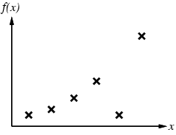
Inductive Learning
Learn a target function f from classified examples
Each example is a pair (x, f(x))
If both x and f are numeric, this is traditional function fitting
AI traditionally focused on cases where x is described discretely/symbolically and f is either Boolean or discrete
Modern methods may do both
f(Robin: WarmB & LayE & Fly)=Bird
f(Bat: WarmB & ¬LayE & Fly)=Mammal
f(Pteranodon: ColdB & LayE & Fly)=Reptile
f(Ostrich: WarmB & LayE & ¬Fly)=Bird

Slide 10
Inductive Learning Method
Construct or adjust h to agree with f on training set
h is consistent if it agrees with f on all examples
f is realizable in H if there is some h∈H that exactly represents f
Although, often must be satisfied with best approximation
Generally search through H until find a “good” h
If H is defined via a concept description language there is usually an implicit generalization hierarchy
Can search this hierarchy from specific to general, or vice versa
Or there may be a measure of simplicity on H so that can search from simple to complex
Use Ockham’s razor to choose simplest consistent, or good h
…
¬Fly
Fly
WarmB
LayE
…
¬Fly & WarmB
Fly & WarmB
WarmB & LayE
…
¬Fly & WarmB & LayE
Fly & WarmB & LayE

Slide 11
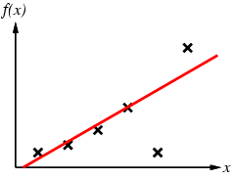
Inductive Learning
Problem:
Find a hypothesis h in Hypothesis Space (H), e.g.
Univariate polynomial functions
Boolean feature vectors
Such that h ≈ f
Given training set of examples
WarmB & LayE ⇒ Bird

Slide 12
Curve Fitting From Simple to Complex

Slide 13
Curve Fitting From Simple to Complex
Linear

Slide 14
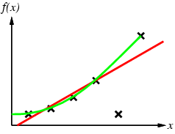
Curve Fitting From Simple to Complex
Quadratic
If willing to treat remaining point as noise, could stop here

Slide 15
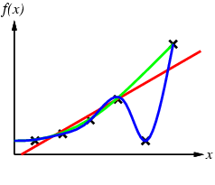
Curve Fitting From Simple to Complex

Slide 16
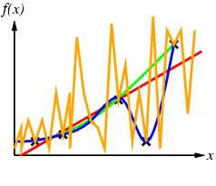
Curve Fitting From Simple to Complex
By Ockham’s razor, should prefer blue to orange

Slide 17
Decision Trees
Input Attributes:
Alternate: Is there another restaurant nearby? (Boolean)
Bar: Is there a bar to wait at? (Boolean)
Fri/Sat: Is it a Friday or Saturday? (Boolean)
Hungry: Are we hungry? (Boolean)
Patrons: How full is the restaurant? (Empty, Some, Full)
Price: How expensive is it? ($, $$, $$$)
Raining: Is it raining outside? (Boolean)
Reservation: Do we have a reservation? (Boolean)
Type: What kind of food? (French, Italian, Thai, Burger)
WaitEstimate: Estimated wait? (<10, 10-30, 30-60, >60 min.)
Output: WillWait: Are we willing to wait? (Boolean)

Slide 18
Training Set
 |  |  |  |  | Input |  |  |  |  |  | Will
 | Alt | Bar | Fri | Hun | Pat | Price | Rain | Res | Type | Est | Wait
x₁ | T | F | F | T | S | $$$ | F | T | F | <10 | T
x₂ | T | F | F | T | F | $ | F | F | T | <60 | F
x₃ | F | T | F | F | S | $ | F | F | B | <10 | T
x₄ | T | F | T | T | F | $ | T | F | T | <30 | T
x₅ | T | F | T | F | F | $$$ | F | T | F | >60 | F
x₆ | F | T | F | T | S | $$ | T | T | I | <10 | T
x₇ | F | T | F | F | E | $ | T | F | B | <10 | F
x₈ | F | F | F | T | S | $$ | T | T | T | <10 | T
x₉ | F | T | T | F | F | $ | T | F | B | >60 | F
x₁₀ | T | T | T | T | F | $$$ | F | T | I | <30 | F
x₁₁ | F | F | F | F | E | $ | F | F | T | <10 | F
x₁₂ | T | T | T | T | F | $ | F | F | B | <60 | T
~2x10²⁷⁷⁵
Possible Trees

Slide 19
Learning a Decision Tree
Do all of our examples have the same output value?
If so, create a leaf node with that value
If not, choose the best input variable to branch on
Divide examples according to their values for this variable
Start back at top with each separate subset of examples
If no more examples, this is a novel input combination
i.e., a sequence of branches that we’ve never seen before
Create a leaf node with the most common output value overall
If we have no more input variables, the rest is noise
i.e., examples containing inconsistent output values
Create a leaf node with the most common output value
AIMA Fig. 18.5

Slide 20
Choosing Attribute Tests
 |  |  |  |  | Input |  |  |  |  |  | Will
 | Alt | Bar | Fri | Hun | Pat | Price | Rain | Res | Type | Est | Wait
x₁ | T | F | F | T | S | $$$ | F | T | F | <10 | T
x₂ | T | F | F | T | F | $ | F | F | T | <60 | F
x₃ | F | T | F | F | S | $ | F | F | B | <10 | T
x₄ | T | F | T | T | F | $ | T | F | T | <30 | T
x₅ | T | F | T | F | F | $$$ | F | T | F | >60 | F
x₆ | F | T | F | T | S | $$ | T | T | I | <10 | T
x₇ | F | T | F | F | E | $ | T | F | B | <10 | F
x₈ | F | F | F | T | S | $$ | T | T | T | <10 | T
x₉ | F | T | T | F | F | $ | T | F | B | >60 | F
x₁₀ | T | T | T | T | F | $$$ | F | T | I | <30 | F
x₁₁ | F | F | F | F | E | $ | F | F | T | <10 | F
x₁₂ | T | T | T | T | F | $ | F | F | B | <60 | T
Still 50-50

Slide 21
Choosing Attribute Tests
 |  |  |  |  | Input |  |  |  |  |  | Will
 | Alt | Bar | Fri | Hun | Pat | Price | Rain | Res | Type | Est | Wait
x₁ | T | F | F | T | S | $$$ | F | T | F | <10 | T
x₂ | T | F | F | T | F | $ | F | F | T | <60 | F
x₃ | F | T | F | F | S | $ | F | F | B | <10 | T
x₄ | T | F | T | T | F | $ | T | F | T | <30 | T
x₅ | T | F | T | F | F | $$$ | F | T | F | >60 | F
x₆ | F | T | F | T | S | $$ | T | T | I | <10 | T
x₇ | F | T | F | F | E | $ | T | F | B | <10 | F
x₈ | F | F | F | T | S | $$ | T | T | T | <10 | T
x₉ | F | T | T | F | F | $ | T | F | B | >60 | F
x₁₀ | T | T | T | T | F | $$$ | F | T | I | <30 | F
x₁₁ | F | F | F | F | E | $ | F | F | T | <10 | F
x₁₂ | T | T | T | T | F | $ | F | F | B | <60 | T
Still 50-50

Slide 22
Choosing Attribute Tests
 |  |  |  |  | Input |  |  |  |  |  | Will
 | Alt | Bar | Fri | Hun | Pat | Price | Rain | Res | Type | Est | Wait
x₁ | T | F | F | T | S | $$$ | F | T | F | <10 | T
x₂ | T | F | F | T | F | $ | F | F | T | <60 | F
x₃ | F | T | F | F | S | $ | F | F | B | <10 | T
x₄ | T | F | T | T | F | $ | T | F | T | <30 | T
x₅ | T | F | T | F | F | $$$ | F | T | F | >60 | F
x₆ | F | T | F | T | S | $$ | T | T | I | <10 | T
x₇ | F | T | F | F | E | $ | T | F | B | <10 | F
x₈ | F | F | F | T | S | $$ | T | T | T | <10 | T
x₉ | F | T | T | F | F | $ | T | F | B | >60 | F
x₁₀ | T | T | T | T | F | $$$ | F | T | I | <30 | F
x₁₁ | F | F | F | F | E | $ | F | F | T | <10 | F
x₁₂ | T | T | T | T | F | $ | F | F | B | <60 | T
All
True

Slide 23
Choosing Attribute Tests
 |  |  |  |  | Input |  |  |  |  |  | Will
 | Alt | Bar | Fri | Hun | Pat | Price | Rain | Res | Type | Est | Wait
x₁ | T | F | F | T | S | $$$ | F | T | F | <10 | T
x₂ | T | F | F | T | F | $ | F | F | T | <60 | F
x₃ | F | T | F | F | S | $ | F | F | B | <10 | T
x₄ | T | F | T | T | F | $ | T | F | T | <30 | T
x₅ | T | F | T | F | F | $$$ | F | T | F | >60 | F
x₆ | F | T | F | T | S | $$ | T | T | I | <10 | T
x₇ | F | T | F | F | E | $ | T | F | B | <10 | F
x₈ | F | F | F | T | S | $$ | T | T | T | <10 | T
x₉ | F | T | T | F | F | $ | T | F | B | >60 | F
x₁₀ | T | T | T | T | F | $$$ | F | T | I | <30 | F
x₁₁ | F | F | F | F | E | $ | F | F | T | <10 | F
x₁₂ | T | T | T | T | F | $ | F | F | B | <60 | T
All
False

Slide 24
Choosing Attribute Tests
 |  |  |  |  | Input |  |  |  |  |  | Will
 | Alt | Bar | Fri | Hun | Pat | Price | Rain | Res | Type | Est | Wait
x₁ | T | F | F | T | S | $$$ | F | T | F | <10 | T
x₂ | T | F | F | T | F | $ | F | F | T | <60 | F
x₃ | F | T | F | F | S | $ | F | F | B | <10 | T
x₄ | T | F | T | T | F | $ | T | F | T | <30 | T
x₅ | T | F | T | F | F | $$$ | F | T | F | >60 | F
x₆ | F | T | F | T | S | $$ | T | T | I | <10 | T
x₇ | F | T | F | F | E | $ | T | F | B | <10 | F
x₈ | F | F | F | T | S | $$ | T | T | T | <10 | T
x₉ | F | T | T | F | F | $ | T | F | B | >60 | F
x₁₀ | T | T | T | T | F | $$$ | F | T | I | <30 | F
x₁₁ | F | F | F | F | E | $ | F | F | T | <10 | F
x₁₂ | T | T | T | T | F | $ | F | F | B | <60 | T
Split
⅓ - ⅔

Slide 25
Choosing Attribute Tests
 |  |  |  |  | Input |  |  |  |  |  | Will
 | Alt | Bar | Fri | Hun | Pat | Price | Rain | Res | Type | Est | Wait
x₁ | T | F | F | T | S | $$$ | F | T | F | <10 | T
x₂ | T | F | F | T | F | $ | F | F | T | <60 | F
x₃ | F | T | F | F | S | $ | F | F | B | <10 | T
x₄ | T | F | T | T | F | $ | T | F | T | <30 | T
x₅ | T | F | T | F | F | $$$ | F | T | F | >60 | F
x₆ | F | T | F | T | S | $$ | T | T | I | <10 | T
x₇ | F | T | F | F | E | $ | T | F | B | <10 | F
x₈ | F | F | F | T | S | $$ | T | T | T | <10 | T
x₉ | F | T | T | F | F | $ | T | F | B | >60 | F
x₁₀ | T | T | T | T | F | $$$ | F | T | I | <30 | F
x₁₁ | F | F | F | F | E | $ | F | F | T | <10 | F
x₁₂ | T | T | T | T | F | $ | F | F | B | <60 | T
All
False

Slide 26
Information
Intuition: Patrons is a “better” branch than Type
Branching on Type leaves an equal number of T/F
Branching on Patrons tells us more about T vs. F
Entropy (H): A precise measure of information
For a variable, V, its entropy is:
H(V) = −∑_{vi}P(V=v_{i}) log₂P(V=v_{i})
For a 50-50 binary variable, V:
H(V) = −0.5*log₂0.5 − 0.5*log₂0.5 = 1
No prior information; observing V gives us 1 bit of information
For a 100-0 binary variable, V:
H(V) = −1*log₂1 − 0*log₂0 = 0
We already know V; observing it gives us no information

Slide 27
Information Gain
In training set, H(WillWait) = −½ log₂½ − ½ log₂½ = 1
Branching on Type gives us 4 subsets of the training set
Burger: ⅓ of the examples, entropy = 1
French: ⅙ of the examples, entropy = 1
Italian: ⅙ of the examples, entropy = 1
Thai: ⅓ of the examples, entropy = 1
Total entropy = ⅓*1 + ⅙*1 + ⅙*1 + ⅓*1 = 1
Information Gain: 1−1 = 0
Confirms our intuition that Type is not informative

Slide 28
Information Gain
In training set, H(WillWait) = -½ log₂½ − ½ log₂½ = 1
Branching on Type gives us 4 subsets of the training set
Information Gain: 1−1 = 0
Branching on Patrons gives us 3 subsets of the training set
Empty: ⅙ of the examples, entropy = 0
Some: ⅓ of the examples, entropy = 0
Full: ½ of the examples, entropy = -⅓ log₂⅓ − ⅔ log₂⅔ = 0.92
Total entropy = ⅙·0 + ⅓·0 + ½·0.92 = 0.46
Information Gain: 1−0.46 = 0.54

Slide 29
Information Gain
In training set, H(WillWait) = -½ log₂½ − ½ log₂½ = 1
Branching on Type gives us 4 subsets of the training set
Information Gain: 1−1 = 0
Branching on Patrons gives us 3 subsets of the training set
Information Gain: 1−0.46 = 0.54
In fact, Patrons has the highest Information Gain of all
Branch on Patrons first
Divide examples into three subsets: E, S, & F
Repeat for each of the three subsets separately
Example implementation: C4.5
Ranked #1 in Top Ten Algorithms in Data Mining, 2008

Slide 30
Extending Decision Trees
Missing Data
What if we have an example that is missing Patrons?
Consider all possible values, but weight by frequency
Input Variables with Infinite Domains
Branching on split points
If WaitEstimate could be an arbitrary integer, we could still branch on WaitEstimate < 30, WaitEstimate > 40, etc.
Continuous-Valued Output Variable
Regression tree: Leaf nodes are functions of inputs
Linear regression: Linear function of inputs
e.g., WaitEstimate, Price, & WillWait are continuous; then a leaf node might be WillWait = 2*WaitEstimate − Price
Higher-order regressions: Usually solved by gradient descent

Slide 31
Extending Decision Trees
Multivalued Attributes
Increasing number of values often increases information
As number of Types increases, examples for each Type will be fewer, but more likely to be consistent
e.g., Every time we go to an Italian-Persian combination restaurant, we always wait (but it happened only once)
We run the risk of overfitting
Generally, as we add branches, we fit the data better
But our leaves become more and more specialized
x₃: “IF there’s no alternative, AND there’s a bar, AND it’s not Friday, AND we’re not hungry, AND there are only some patrons there, AND it’s cheap, AND it’s not raining, AND we have no reservation, AND the restaurant serves burgers, AND the wait<10m, THEN we will wait”
May not generalize well to new data

Slide 32
Evaluating Learning
Test on new data
Explaining the past is useful, but not our goal
We also want to be prepared for new situations
We can measure the error rate of a learned function
The percentage of mistakes made on the new data
No peeking!
Testing data mustn’t contain any training examples

Slide 33
Cross-Validation
What if we can’t wait for new data?
Holdout cross-validation
Partition our existing data into training and testing sets
Our learning never uses the examples in the test set
k-fold cross-validation
Partition our existing data into k subsets
k rounds of learning, using a different subset as test set
Leave-one-out cross-validation
k = # of examples

Slide 34
Probabilistic Classification
What if we don’t want just a T/F classification?
A function that returns a P(Output variable | Input variables)
Can we learn a Bayesian network model?
Naive Bayes
Output variable is parent of all the input variables
Ranked #9 in Top Ten Algorithms in Data Mining, 2008
Burglary
JohnCalls
MaryCalls

Slide 35
Naive Bayes
“Naively” assumes conditional independence of input
𝜃 = P(B)
𝜃_{J1} = P(J | B), 𝜃_{J2} = P(J | ¬B)
𝜃_{M1} = P(M | B), 𝜃_{J2} = P(M | ¬B)
2n + 1 parameters to learn for n binary input variables
Classification is posterior probability
P(B | J, M) = α·P(B)·P(J | B)·P(M | B)
P(B | J, M) = α·𝜃·𝜃_{J1}·𝜃_{M1}
Missing data is easy to handle: P(B | J) = α·𝜃·𝜃_{J1}

Slide 36
Maximum Likelihood
Consider possible parameter settings, h_{𝜃}
Compute probability of data given parameters
The best parameters should make the data the most likely
P(d | h_{𝜃}) = ∏_{i} P(d_{i} | h_{𝜃})
Assume all examples are generated independently
Use logarithms to turn products into sums
Easier to maximize a sum than a product

Slide 37
Maximum Likelihood
Maximizing log likelihood also maximizes likelihood
L(d | h_{𝜃}) = log ∏_{i} P(d_{i} | h_{𝜃}) = ∑_{i} log P(d_{i} | h_{𝜃})
Suppose we observe d = [ B,J,M ; B,¬J,¬M ; ¬B,¬J,¬M ]
L(B,J,M | h_{𝜃}) = log 𝜃 + log 𝜃_{J1} + log 𝜃_{M1}
L(B,¬J,¬M | h_{𝜃}) = log 𝜃 + log (1−𝜃_{J1}) + log (1−𝜃_{M1})
L(¬B,¬J,¬M | h_{𝜃}) = log (1−𝜃) + log (1−𝜃_{J2}) + log (1−𝜃_{M2})
L(d | h_{𝜃}) = L(B,J,M | h_{𝜃}) + L(B,¬J,¬M | h_{𝜃}) + L(¬B,¬J,¬M | h_{𝜃})
L(d | h_{𝜃}) = 2·log 𝜃 + log (1-𝜃) + log 𝜃_{J1}+ log (1−𝜃_{J1}) + log (1−𝜃_{J2}) + log 𝜃_{M1}+ log (1−𝜃_{M1}) + log (1−𝜃_{M2})
Solve this for its maximum
Find parameters for which the derivative is 0
Directly computable for Naive Bayes
For more general Bayesian networks, requires local search

Slide 38
Nonparametric Methods
Don’t summarize data into parameters
Why force things into a linear, tree, quadratic, etc. function?
Instead, keep your data around & use those examples directly
When we have a new input, compare against data
Find similar cases and extract an output value
Example method: k-nearest neighbors
For a new input, find k examples that are closest to it
Choose the output that appears most often in those examples
PRO: We don’t lose any information
CON: Because we keep all the data around
Ranked #8 in Top Ten Algorithms in Data Mining, 2008

Slide 39
Burglary Data
RED=¬Burglary
How bright is the street?
GREEN=Burglary
How crowded is the street?

Slide 40
5-nearest neighbors
2
1
RED=¬Burglary
3
1
2
How bright is the street?
GREEN=Burglary
How crowded is the street?

Slide 41
Classification Hypothesis 1
RED=¬Burglary
How bright is the street?
GREEN=Burglary
How crowded is the street?

Slide 42
Classification Hypothesis 2
RED=¬Burglary
How bright is the street?
GREEN=Burglary
How crowded is the street?

Slide 43
Classification
RED=¬Burglary
How bright is the street?
GREEN=Burglary
How crowded is the street?

Slide 44
Classification Hypothesis 1
RED=¬Burglary
How bright is the street?
GREEN=Burglary
How crowded is the street?

Slide 45
Classification Hypothesis 2
RED=¬Burglary
How bright is the street?
GREEN=Burglary
How crowded is the street?

Slide 46
Maximum Margin Separator
RED=¬Burglary
Maximum Margin
How bright is the street?
GREEN=Burglary
How crowded is the street?

Slide 47
Support
RED=¬Burglary
How bright is the street?
Some examples are more useful...
GREEN=Burglary
How crowded is the street?

Slide 48
Support
RED=¬Burglary
...than others
How bright is the street?
GREEN=Burglary
How crowded is the street?

Slide 49
Support Vector Machines
Nonparametric, like k-nearest neighbors
However, keep only examples that are “support vectors”
Often, a constant number per dimension
Kernel trick provides a bigger hypothesis space
Linear separators may not always exist in original space
Use kernel functions to translate space into an alternate one
With more dimensions
But where we can easily find the linear separator
The most popular machine learning algorithm today
Ranked #3 in Top Ten Algorithms in Data Mining, 2008

Slide 50
Summary of Supervised Learning
Pros
You do not need any prior knowledge
Mechanisms don’t have to know what anything means
But they can still make principled choices
Hugely successful in practice
Cons
It is hard to exploit prior knowledge (see Chapter 19)
You already know that hunger makes you not want to wait
Unlike deduction, induction is not guaranteed to be correct
You may not have anyone to “supervise” your learning system
e.g., Classifying tweets w/o knowing what people really think
Unsupervised learning: clustering (see Ch. 20.3.1)

Slide 51
Bayesian Network
Each node calculates a probabilistic function
JohnCalls
 |  | P(B|J,M)
J | M | 0.284
J | ¬M | 0.005
¬J | M | 0.007
¬J | ¬M | 0.002
Burglary
MaryCalls

Slide 52
Decision Tree
Each node calculates a logical function
JohnCalls
 |  | B
J | M | T
J | ¬M | F
¬J | M | F
¬J | ¬M | F
Burglary
MaryCalls

Slide 53
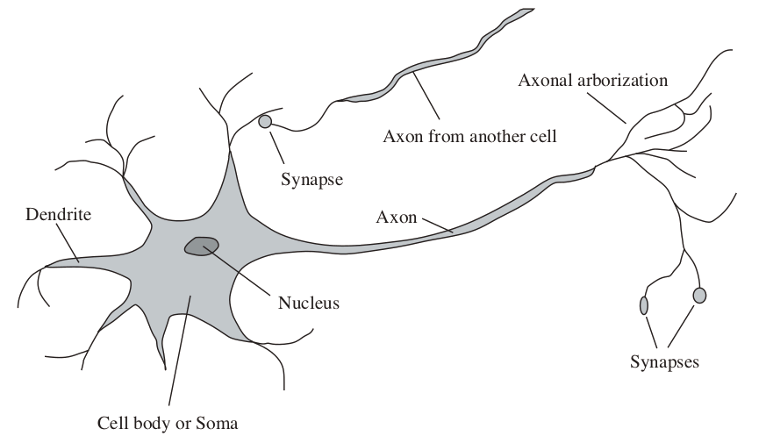
The Brain
Each node calculates a neural function
JohnCalls
MaryCalls

Slide 54
Neurons
How do we create a computational version?
for decision-making?
for learning?

Slide 55
Neurons
Connectionism
Activation is passed along links from neuron to neuron
Neuron becomes a computational unit
Output is determined as a function of incoming activation
Input Activation Output

Slide 56
Activation, a
Represents how strongly True or False a variable is
Continuous values that can be positive or negative
Input Activation, in
Each link from node i to node j has a weight, w_{ij}
Strength of influence that node i has on node j
Node 0 is typically a dummy input
Assumed to always have activation a₀ = 1
in_{j} = ∑_{i} w_{ij}a_{i}
Weighted sum
Activation function, g
Translates input activation into output activation
a_{j} = g(in_{j}) = g(∑_{i} w_{ij}a_{i})

Slide 57
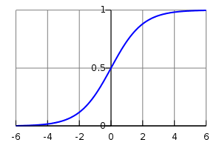
Example Activation Functions
Threshold
a_{j} = 1 if and only if in_{j} ≥ 0
Sigmoid function
a_{j} = 1 / (1+e^{-inj})
Nonlinear functions
Not restricted to representing just linear functions
Sigmoid is differentiable

Slide 58
Perceptrons
Single-layer, feed-forward with threshold activation
Output nodes have an activation of either 0 or 1
Output node is 1 if and only if weighted sum of its inputs ≥ 0
Similar to a Noisy OR, but different
Input nodes can be any real value
Weights on links do not necessarily have probabilistic meaning

Slide 59
Perceptrons
Can represent some logical functions
AND of n binary variables
w_{i(n+1)} = 1; w_{0(n+1)} = −n
a_{n+1} = 1 if and only if a₁+a₂+...+a_{n}−n ≥ 0
OR of n binary variables
w_{i(n+1)} = 1; w_{0(n+1)} = -1
a_{n+1} = 1 if and only if a₁+a₂+...+a_{n}−1 ≥ 0
NOT of 1 binary variable
w_{i(n+1)} = -1; w_{0(n+1)} = 0; a_{n+1} = 1 if and only if −a_{i} ≥ 0
Perceptrons can also represent any linear inequality
A weighted sum and a threshold
i.e., an n-dimensional hyperplane

Slide 60
Majority Function
1 if and only if > ½ of n binary variables are 1
Representable within a perceptron
w_{i(n+1)} = 1
w_{0(n+1)} = −(n ∕ 2) if n is even
a_{n+1} = 1 if and only if a₁+a₂+...+a_{n} −(n ∕ 2) ≥ 0
But a decision tree needs an exponential number of branches
One branch for each combination with a majority of Trues
e.g., IF a₁=1 AND a₂=1 AND… a_{n/2}=1 AND a_{n/2+1}=1 THEN 1
ELSE IF a₁=0 AND a₂=1 AND… a_{n/2+1}=1 AND a_{n/2+2}=1 THEN 1

Slide 61
Linear Separability
RED=¬Burglary
Linear Separator
How bright is the street?
GREEN=Burglary
How crowded is the street?

Slide 62
Perceptron Learning
Parametric Learning
We find weights for all the links in the network
We don’t need to keep any data or even support vectors
Iterative refinement of weights
Start with some random initial weights, w
For each data point, with input x and output y:
Compare perceptron output on x against real output y
If they do not match, then update w to correct error
Repeat until convergence
An entire round with no (or very little) change to w

Slide 63
Perceptron Learning Rule
Compare against real output y and update weights w
Perceptron output: h_{w}(x) = 1 if w∗x ≥ 0; otherwise, 0
w_{i} ← w_{i} + ⍺(y−h_{w}(x))∗x_{i}
If h_{w}(x) = y:
No need to change w
w_{i} ← w_{i} + ⍺(y−h_{w}(x))∗x_{i}
If y = 0, but h_{w}(x) = 1:
Decrease weights on positive inputs, increase on negative
w_{i} ← w_{i} + ⍺(y−h_{w}(x))∗x_{i}
If y = 1, but h_{w}(x) = 0:
Decrease weights on negative inputs, increase on positive
w_{i} ← w_{i} + ⍺(y−h_{w}(x))∗x_{i}

Slide 64
Perceptron Learning Rule
Compare against real output y and update weights w
Perceptron output: h_{w}(x) = 1 if w∗x ≥ 0; otherwise, 0
w_{i} ← w_{i} + ⍺(y−h_{w}(x))∗x_{i} for learning rate ⍺
If h_{w}(x) = y:
No need to change w
w_{i} ← w_{i} + ⍺(y−h_{w}(x))∗x_{i} = w_{i} + ⍺∗0∗x_{i} = w_{i}
If y = 0, but h_{w}(x) = 1:
Decrease weights on positive inputs, increase on negative
w_{i} ← w_{i} + ⍺(y−h_{w}(x))∗x_{i} = w_{i} − ⍺x_{i}
If y = 1, but h_{w}(x) = 0:
Decrease weights on negative inputs, increase on positive
w_{i} ← w_{i} + ⍺(y−h_{w}(x))∗x_{i} = w_{i} + ⍺x_{i}

Slide 65
Linear Inseparability
How bright is the street?
How crowded is the street?

Slide 66
Linear Inseparability
Linear separability is rare
Even among purely Boolean functions
Consider XOR: A is True or B is True, but not both
(A∨B)∧¬(A∧ B)
Not linearly separable in a single perceptron
Perceptrons cannot represent inseparable functions
Support Vector Machines solve by transforming dimensions
Neural networks solve by adding more layers

Slide 67
Network Structures
Recurrent networks
Directed cycles are allowed
Activation flows and hopefully settles into a stable state
Feed-forward networks
Links flow in one direction
No directed cycles
Units are sorted into layers
Input (evidence) variables are in the first layer
Output (query) variables are in the last layer
All other variables are hidden units
Links go from nodes in one layer to nodes in the next

Slide 68
Feed-Forward Networks
One Layer
JohnCalls
Burglary
MaryCalls
Earthquake

Slide 69
Feed-Forward Networks
Two Layers
JohnCalls
Burglary
Hidden Node
MaryCalls
Earthquake

Slide 70
Not a Bayesian Network
JohnCalls
Burglary
Alarm
MaryCalls
Earthquake

Slide 71
Multilayer Neural Networks
Introduce hidden nodes
Expands the possible functions the network can capture
Although the hidden nodes have no real-world meaning
Therefore it is hard to know how many layers and nodes
Our data does not include values for hidden nodes
Otherwise, they would be input or output nodes
But we can “blame” hidden nodes for errors in the next layer
Eventually reaching output nodes
Assign blame based on the strength of their influence
i.e., proportional to the weight on the link

Slide 72
Back Propagation
Start from output nodes
Perceptron: w_{i} ← w_{i} + ⍺(y−h_{w}(x))∗x_{i}
Multilayer: w_{i,j} ← w_{i,j} + ⍺Δ_{j}∗a_{i}
Input activation a_{i} instead of input value x_{i}
Modified error Δ_{j} = (y_{j}−[h_{w}(x)]_{j})∗g(in_{j})
Takes into account activation function g
Assign blame to hidden nodes
Based on error in next layer
Modified error becomes Δ_{j} = g(in_{j})∑_{k}w_{j,k}Δ_{k}
Increases with error in next layer
Increases with weight on link to next layer

Slide 73
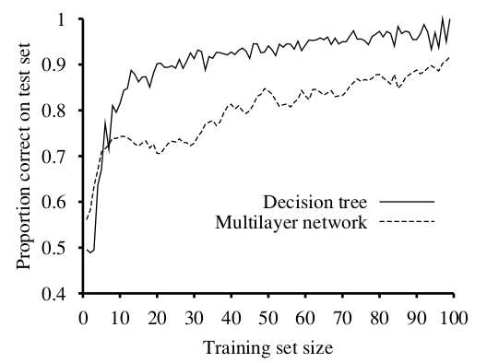
Waiting at a Restaurant
Multilayer network learns
But not as fast as decision trees
Not quite fair, because the data came from a decision tree

Slide 74
Deep Learning
Multilayer neural networks are one form
Train each layer as if it were a standalone neural network
A hierarchy of loosely connected learning systems
Basic principles are the same as what you’ve learned
But with newer methods for dealing with larger data sets
Finding representations and structures similar to the brain’s
e.g., for facial recognition
And exploiting steady increases in computing power

Slide 75
Data Mining
1) C4.5 and other decision trees (AIMA 18.3.3)
Finite domains for the attributes
2) k-means
Unsupervised, nonparametric like k-nearest neighbors
3) SVMs (AIMA 18.9)
Minimize data needed to store, transform nonlinear into linear
4) Apriori
Unsupervised, learn association rules from databases
5) EM (AIMA 20.3)
Learn probabilities, even over unlabeled variables

Slide 76
Data Mining
6) PageRank (AIMA 22.3.4)
The kind of data determines the kind of learning
7) AdaBoost (AIMA 18.10)
Learn multiple classifiers and then combine their output
8) k-Nearest Neighbors (AIMA 18.8.1)
Use the data as a map of the classification space
9) Naive Bayes (AIMA 20.2.2)
Assume probabilistic independence among influences
10) CART (AIMA 18.3.6)
Extend decision trees into regression trees (i.e., real values)

