Slide 1
CSCI561 Summer 2017 Midterm Review
Prof Sheila Tejada stejada@usc.edu

Slide 2
Material covered by midterm
Covers everything studied in class up to and including CSP (chap. 1-6)
Lectures vs book: what to know?
if a topic is studied in lecture and is also in the book: need to know both.
if a topic is studied in lecture/discussion only and is not in the book: know what was studied in class.
if a topic is in the book but was not covered at all in class: no need to know.
Opening the exam before you are given the go signal will result in automatic filing of a case with the office of student judicial affairs.
Cheating during the exam will result in automatic filing of a case with the office of student judicial affairs.
Continuing to write after the stop signal will result in automatic filing of a case with the office of student judicial affairs.

Slide 3
Midterm 1 Instructions:
Thursday 4-5:20pm, June 8 THH 201
Maximum credits/points for this midterm: 100 points.
Credits/points for each question is indicated before the question.
Closed book.
No books (or any other material) are allowed.
Write down name, student ID and USC email address.
No questions during the exam.
Be brief: a few words are often enough if they are precise and use the correct vocabulary studied in class.
Just bring a pen or pencil. Nothing else on table.
Scratch paper: use the reverse side of the exam pages.

Slide 4
Midterm Review: What is AI?
The exciting new effort to make computers thinks … machine with minds, in the full and literal sense”
(Haugeland 1985)
“The study of mental faculties through the use of computational models”
(Charniak et al. 1985)
“The art of creating machines that perform functions that require intelligence when performed by people” (Kurzweil, 1990)
A field of study that seeks to explain and emulate intelligent behavior in terms of computational processes” (Schalkol, 1990)
Systems that think like humans
Systems that think rationally
Systems that act like humans
Systems that act rationally
Association for the Advancement of Artificial Intelligence (AAAI):
“The scientific understanding of the mechanisms underlying thought and
intelligent behavior and their embodiment in machines.”
Notes:
Which category is Deep Blue? Robot Soccer? Ada and Grace? Watson? Google Cars? Computer vision?

Slide 5
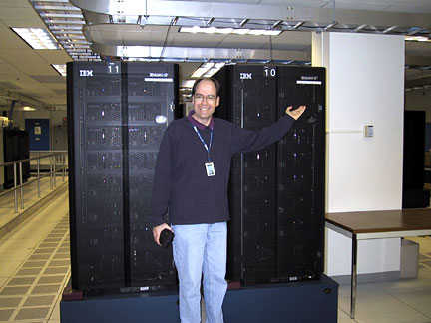
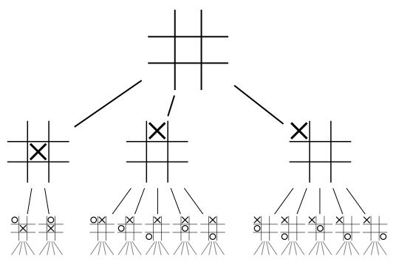
Deep Blue Chess Champion
Parallel and special purpose hardware
A 30-node IBM RS/6000, enhanced with
480 special purpose VLSI chess chips
A heuristic game-tree search algorithm
Capable of searching 200M positions/sec
Searched 6-12 moves deep on average, sometimes to 40
Chess knowledge
An opening book of 4K positions and 700K GM games
An endgame database for when only 5-6 pieces left
A positional evaluation function with 8K parts and many parameters that were tuned by learning over thousands of Master games
Notes:
What are PEAS or PAGE for Deep Blue?

Slide 6
What you should know
What is AI? Why study AI?
What is a performance measure? Rational action? Why are they important for an agent?
What is the relationship between the agent and task environment? How does the environment affect the agent design?
Why is the boundary between agent and environment important?
How is this demonstrated by the recent AI successes?

Slide 7

Eugene Goostman – Turing Test 2014
Interview
What do you think? Was the test really passed?
What effect did context, that is, saying that the computer was playing a 13-year-old Ukranian boy for whom English was a second language, have on the results?
What does that tell us about the Turing test as a test of artificial intelligence?
What would be a better test?
http://www.princetonai.com/bot/

Slide 8
What you should know
What is the Turing Test? How has it shaped the field of AI?
What does it mean that a search algorithm is complete? optimal? Why do we care about these criteria?
Why do we study the complexity of an algorithm?
What is the difference between time and space complexity?
How does complexity affect the Turing Test?

Slide 9
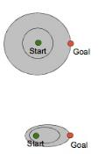
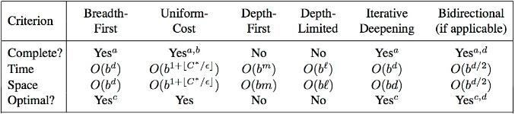
What you should know
UCS
What is the difference between uninformed and
informed search? Which ones are optimal?
What are the advantages and disadvantages of depth-first search?
Why does a search heuristic need to be “admissible”?
Be familiar with the differences between search strategies shown in Figure 3.21
A*
Notes:
http://cse.unl.edu/~choueiry/S03-476-876/searchapplet/
https://courses.cs.washington.edu/courses/cse473/06sp/MazeRunnerDemo/search/applet.html
http://www.briangrinstead.com/files/astar/
http://www.cs.rmit.edu.au/AI-Search/Product/

Slide 10
What you should know
What are the characteristics of local search? Is it complete? Optimal? Time and Space complexity?
What problem domains are well-suited to each type of search technique? Ill-suited? Why?
Know how to compare their performance in general and in a specific domain or problem.
What are the characteristics of Adversarial Search? Why is meta-reasoning important in this type of search?

Slide 11
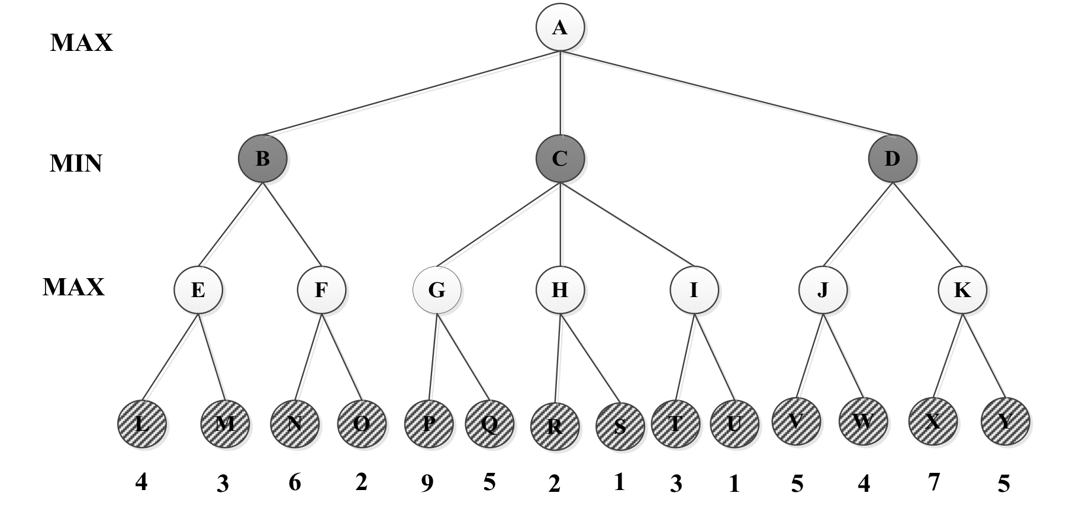
=5
β = +∞
v = 5
=-∞
β = +∞
v = -∞
=4
β = +∞
v = 4
= 4
β = +∞
v = ∞
= 4
β = 9
v = 9
= 4
β = 9
v = 2
= 4
β = +∞
v = ∞
=-∞
β = +∞
v = ∞
= 4
β = 5
v = 5
=-∞
β = 4
v = 4
=4
β = ∞
v = -∞
=9
β = ∞
v = 9
=4
β = +∞
v = 4
=-∞
β = +∞
v = -∞
=4
β = +∞
v = 4
=4
β = 5
v = -∞
=4
β = 9
v = -∞
=4
β = ∞
v = -∞
=4
β = 5
v = 7
=-∞
β = 4
v = -∞
=4
β = 9
v = 2
=5
β = ∞
v = 5
=-∞
β = 4
v = 6
Max Node
Min Node

Slide 12
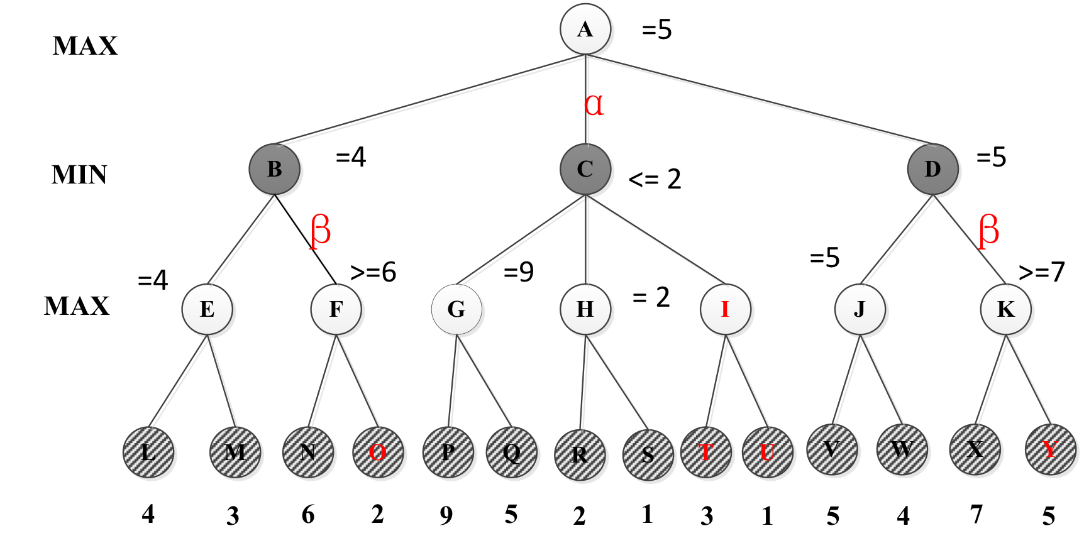

Slide 13
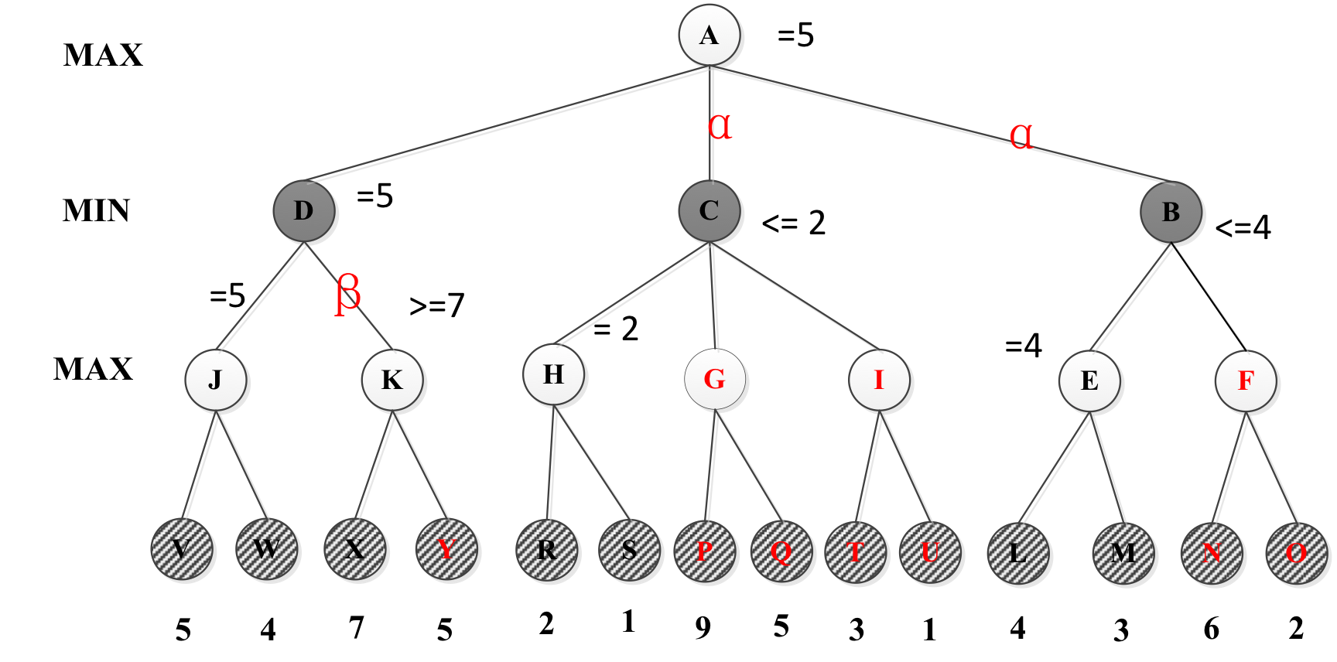

Slide 14
CSP Example: Map Coloring
NT
NT
Q
Q
WA
WA
SA
SA
NSW
NSW
V
V
T
T
7 variables {WA,NT,SA,Q,NSW,V,T}
Each variable has the same domain {red, green, blue}
No two adjacent variables have the same value:
WA≠NT, WA≠SA, NT≠SA, NT≠Q, SA≠Q, SA≠NSW, SA≠V,Q≠NSW, NSW≠V

Slide 15
Backtracking Search: Map Coloring
{}
WA=red
WA=green
WA=blue
WA=red
NT=green
WA=red
NT=blue
NT
Q
WA
WA=red
NT=green
Q=red
WA=red
NT=green
Q=blue
SA
NSW
V
T

Slide 16
Constraint Propagation
Which variable X should be assigned a value next?
In which order should its values be tried?
Variable Selection:
“Most constrained variable” or “Minimum Remaining Values”
Degree: variable involved in most constraints on others (tiebreaker)
Value Selection:
Least constraining value
NT
NT
Q
WA
WA
SA
NSW
V
{blue}
T

Slide 17
When to Use CSP Techniques?
When the problem can be expressed by a set of variables with constraints on their values
When constraints are relatively simple (e.g., binary)
When constraints propagate well (AC3 eliminates many values)
Local Search: when the solutions are “densely” distributed in the space of possible assignments

Slide 18
Sample exam Questions
General AI
Search Concepts
Comparing Strategies
Game playing
CSP
AI Applications

Slide 19
____ The Turing test defines the conditions under which a machine can be said to be “intelligent”.
____ A* is an admissible algorithm.
____ DFS is faster than BFS.
____ DFS has lower asymptotic space complexity than BFS.
____ When using the correct temperature decrease schedule, simulated annealing is guaranteed to find the global optimum in finite time.
F
F
F
T
F

Slide 20
____ Alpha-beta pruning accelerates game playing at the cost of being an approximation to full minimax.
____ Hill-climbing is an entirely deterministic algorithm.
____ The exact evaluation function values do not affect minimax decision as long as the ordering of these values is maintained.
____ A perfectly rational backgammon-playing agent never loses
____ Hill climbing search is best used for problem domains with densely packed goals
F
F
T
F
T

Slide 21
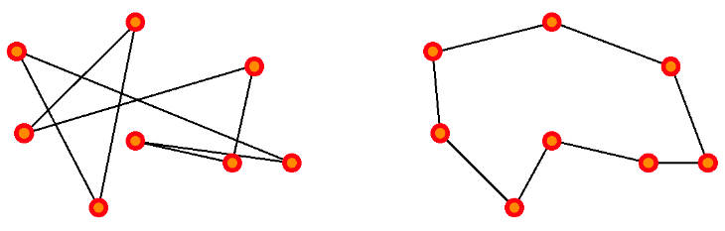
A suitable representation for states:
The initial state of the problem:
A good goal test to use in this problem:
Good operators to use for search:
Which search algorithm would be the most appropriate to use here if we want to minimize the distance of the tour found?
permutation of all cities in the tour
<A, B, C, D, E>
random permutation of all cities
minimize the distance travelled
permute 2 cities
Local Search - GA/SA/hill climbing, etc…
Suboptimal solution (long path) Optimal solution

Slide 22
Search strategies
Notes:
Greedy: S , B , F , G1 Goal: G1
Ucs:S , B , E , D , C , F , A , G2 Goal : G2
Ids:S , S , B , C , S , B , E , F , C , G1 Goal: G1
A*:S , B , E , D , F , G2 Goal: G2

Slide 23
Minimax
Notes:
b) O , I, T , U , Y
c) Yes, the best order will be D , B , C .
Pruned nodes will be : Y , F , N , O , I , T , U

Slide 24
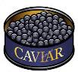










You are designing a menu for a special event. The domains of the variables are as follows:
(A)ppetizer: (v)eggies, (c)aviar (B)everage: (w)ater, (s)oda, (m)ilk
(C)ourse: (f)ish, (b)eef, (p)asta (D)essert: (a)pple, (i)ce cream, (ch)eese
Constraints:
Vegetarian options: The appetizer must be veggies or the main course must be pasta or fish (or both).
Total budget: If you serve the caviar, you cannot afford any beverage other than water.
Calcium requirement: You must serve at least one of milk, ice cream, or cheese
Draw the constraint graph over the variables A, B, C, and D.
Imagine we first assign A=c. What values remain for each variable after forward checking?

Slide 25
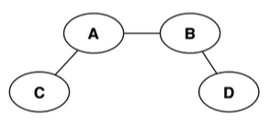



A [ c ] B [ w ]
C [ f p ] D [ a i ch ]
Again imagine we first assign A=c. What values remain for each variable after arc consistency has been enforced. Give a solution for this CSP or state that none exists.
A [ c ] B [ w ]
C [ f p ] D [ i ch ]
Multiple solutions exist. One is A=c, B=w, C=f, and D=i.

Slide 26
Which AI application has a discrete, deterministic environment?
Robocup Soccer robots
Google Self-driving car
IBM’s Deep Blue
All of the above
None of the above
Using local search is the preferred method to find a solution for the problem of assigning seats during an exam for N students in a room with N rows of N columns of chairs, where no two students can sit in the same row, column or diagonal, because:
Local search is always the preferred search method for CSP
There are no local minima or maxima in this problem domain
This problem domain has densely packed goals
All of the above
None of the above
IBM’s Deep Blue
This problem domain has densely packed goals

Slide 27
Though none of these AI applications have passed the Turing test, which is considered a rational agent?
Robocup soccer robots
Google Maps
IBM’s Deep Blue
All of the above
None of the above
An admissible heuristic for route planning in Google Maps could be?
Straight-line distance
Manhattan distance
h(n)=1
All of the above
None of the above
All of the above
Straight-line distance

