Slide 1
CSCI 561 Foundations of Artificial Intelligence Lecture 6: Propositional Logic (Chapter 7)
Summer 2017
Instructor: Prof. Sheila Tejada

Slide 2
Knowledge-Based Agent
Agent that uses prior or acquired knowledge to achieve its goals
Can make more efficient decisions
Can make informed decisions
Knowledge Base (KB): contains a set of representations of facts about the Agent’s environment
Each representation is called a sentence
Use some knowledge representation language, to TELL it what to know e.g., (temperature 72F)
ASK agent to query what to do
Agent can use inference to deduce new facts from TELLed facts
Domain independent algorithms
ASK
Inference engine
TELL
Knowledge Base
Domain specific content

Slide 3
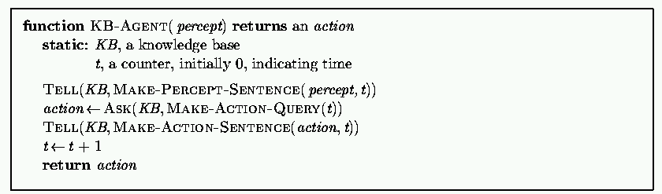
Generic knowledge-based agent
TELL KB what was perceived Uses a KRL to insert new sentences, representations of facts, into KB
ASK KB what to do. Uses logical reasoning to examine actions and select best.

Slide 4
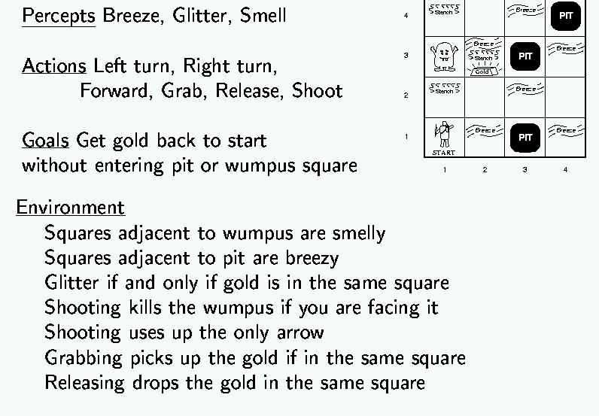
Wumpus world example

Slide 5
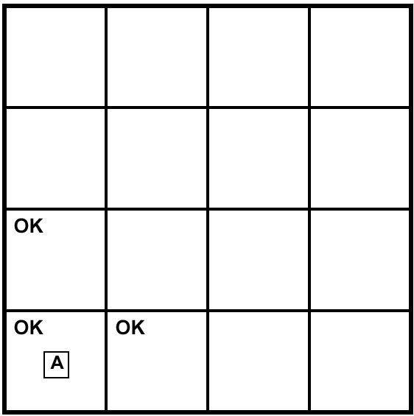
Exploring a Wumpus world
A= Agent
B= Breeze
S= Smell
P= Pit
W= Wumpus
OK = Safe
V = Visited
G = Glitter

Slide 6
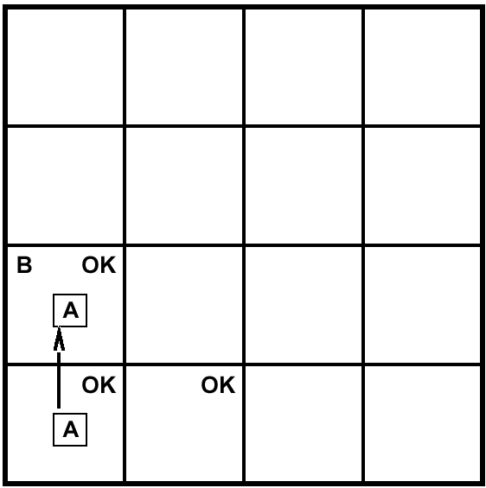
Exploring a Wumpus world
A= Agent
B= Breeze
S= Smell
P= Pit
W= Wumpus
OK = Safe
V = Visited
G = Glitter

Slide 7
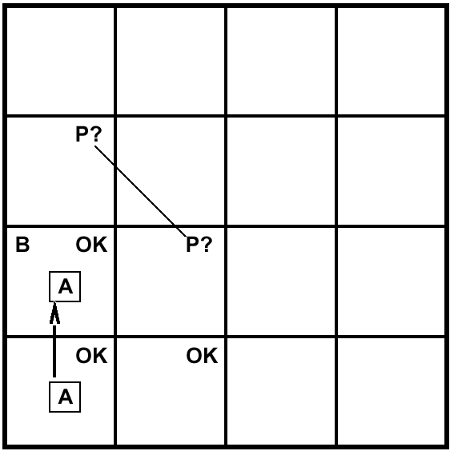
Exploring a Wumpus world
A= Agent
B= Breeze
S= Smell
P= Pit
W= Wumpus
OK = Safe
V = Visited
G = Glitter

Slide 8
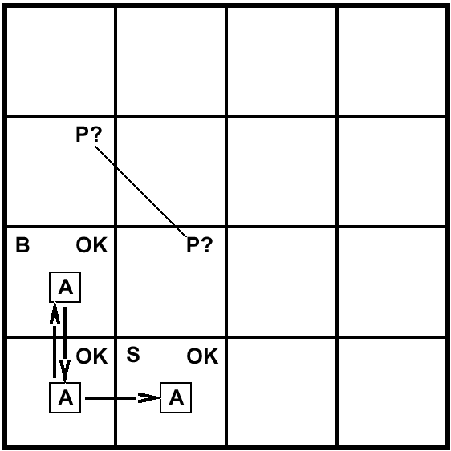
Exploring a Wumpus world
A= Agent
B= Breeze
S= Smell
P= Pit
W= Wumpus
OK = Safe
V = Visited
G = Glitter

Slide 9
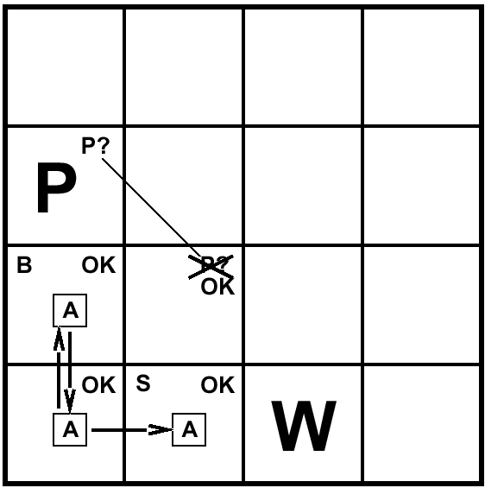
Exploring a Wumpus world
A= Agent
B= Breeze
S= Smell
P= Pit
W= Wumpus
OK = Safe
V = Visited
G = Glitter

Slide 10

Exploring a Wumpus world
A= Agent
B= Breeze
S= Smell
P= Pit
W= Wumpus
OK = Safe
V = Visited
G = Glitter

Slide 11
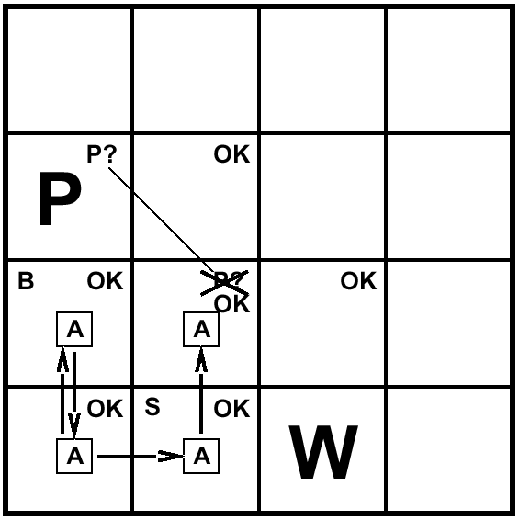
Exploring a Wumpus world
A= Agent
B= Breeze
S= Smell
P= Pit
W= Wumpus
OK = Safe
V = Visited
G = Glitter

Slide 12
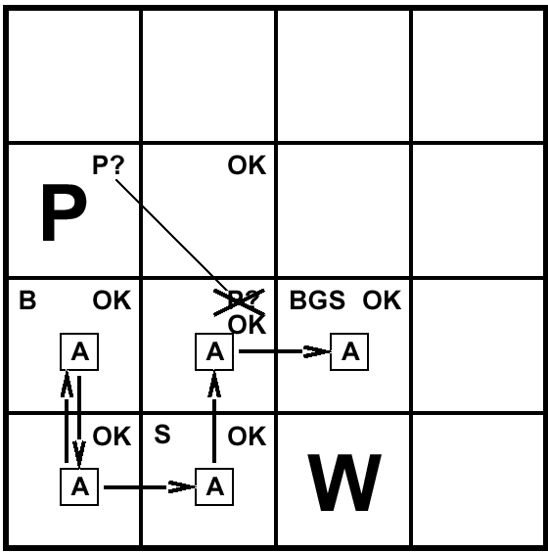
Exploring a Wumpus world
A= Agent
B= Breeze
S= Smell
P= Pit
W= Wumpus
OK = Safe
V = Visited
G = Glitter

Slide 13
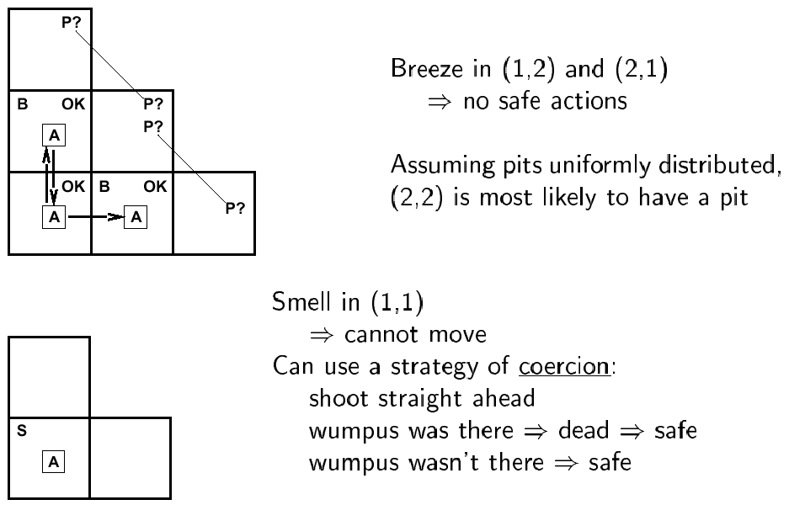
Other tight spots

Slide 14
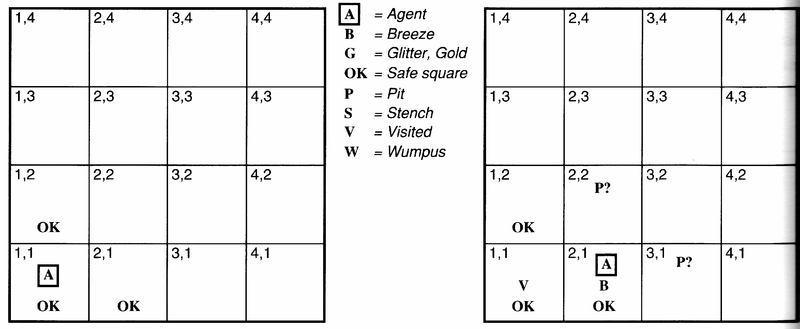
Another example solution
No perception → 1,2 and 2,1 OK
Move to 2,1
B in 2,1 → 2,2 or 3,1 P?
1,1 V → no P in 1,1
Move to 1,2 (only option)

Slide 15
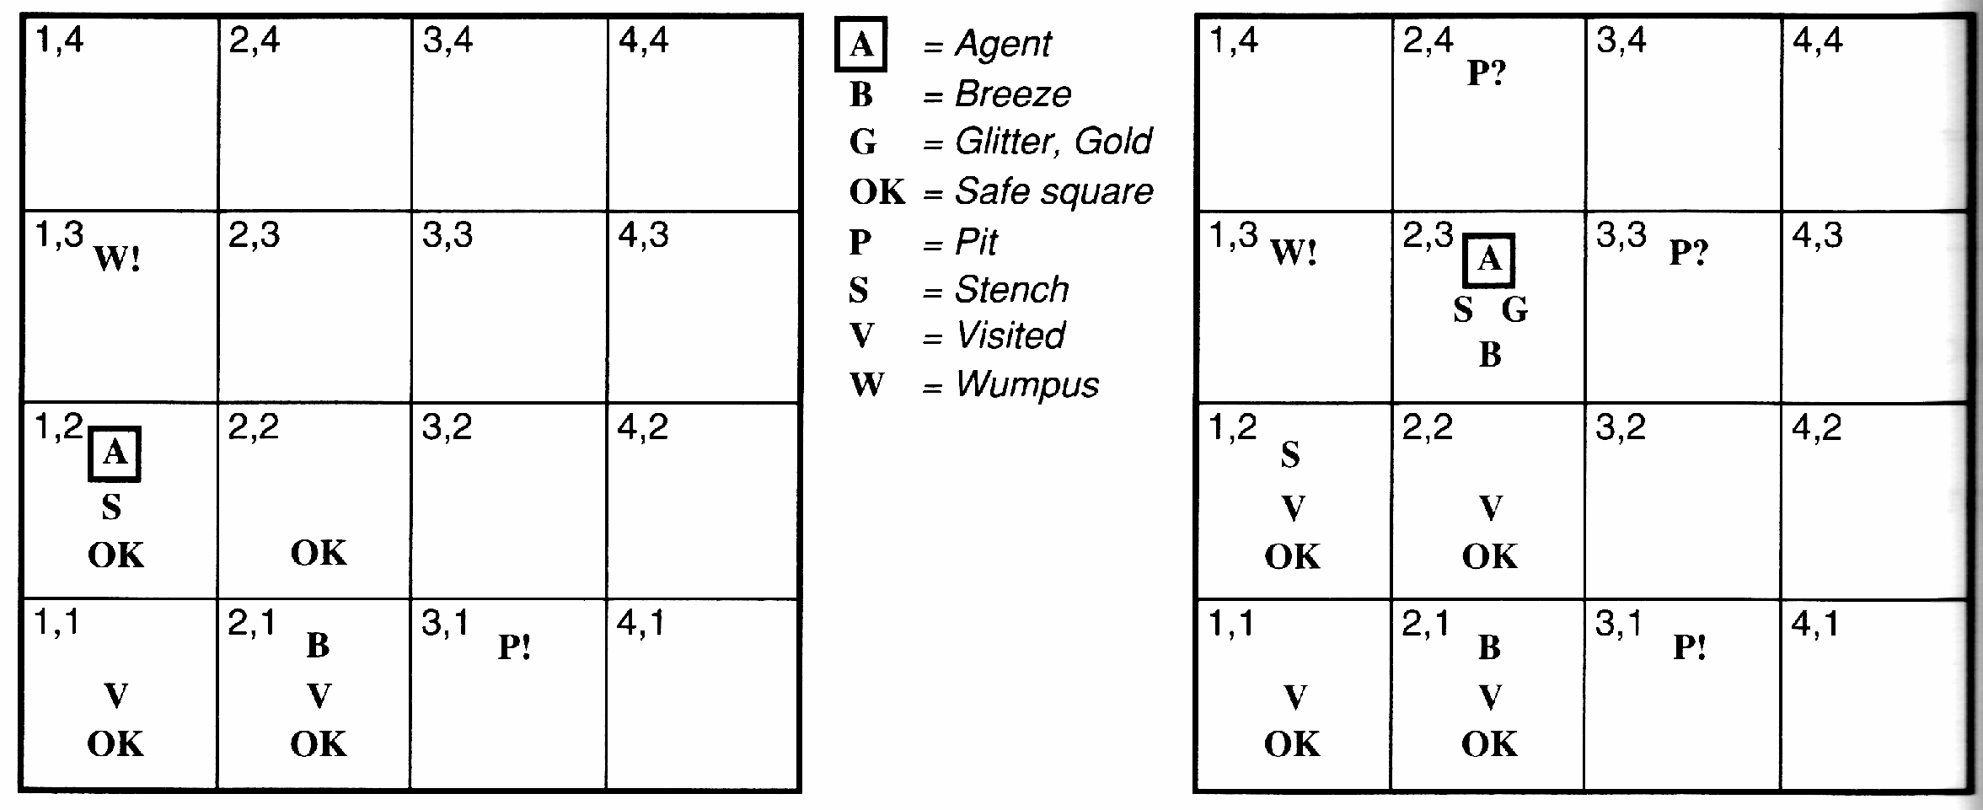
Example solution
S and No S when in 2,1 → 1,3 or 1,2 has W
1,2 OK → 1,3 W
No B in 1,2 → 2,2 OK & 3,1 P

Slide 16
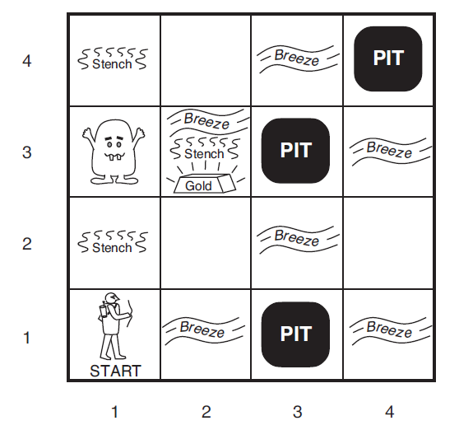
Logic concepts
Entailment ⊨
Inference ⊢

Slide 17
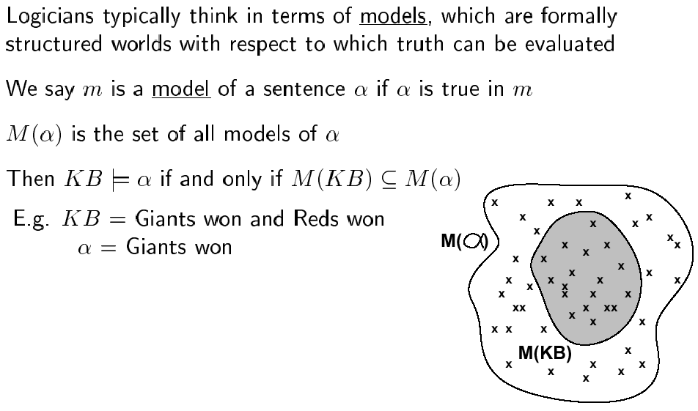
Models

Slide 18
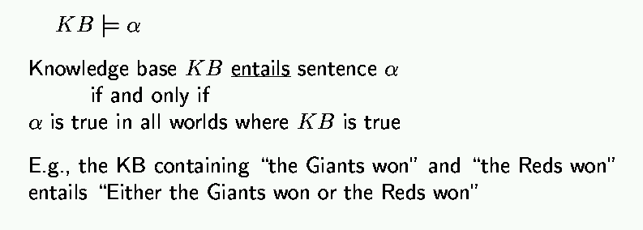
Entailment
Entailment means it is impossible for this case to occur:
premises are true and the consequence is false.

Slide 19
Entailment in wumpus world
α₁ = ¬P_{1,2}
α₂ = ¬P_{2,2}

Slide 20
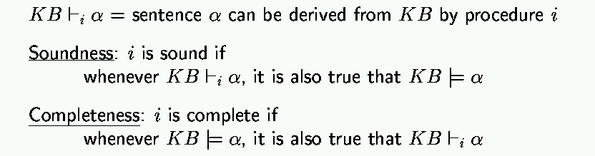
Inference

Slide 21

Comparing Logic concepts
Entailment and Inference
In understanding entailment and inference, it might help to think of the set of all consequences of a KB as a haystack and of α as a needle.
Entailment is like the needle being in the haystack;
Inference is like finding it.

Slide 22
Basic symbols
Expressions only evaluate to either “true” or “false.”
P “P is true”
¬P “P is false” negation
P V Q “either P is true or Q is true or both” disjunction
P ^ Q “both P and Q are true” conjunction
P => Q “if P is true, then Q is true” implication
P ⬄ Q “P and Q are either both true or both false” equivalence

Slide 23
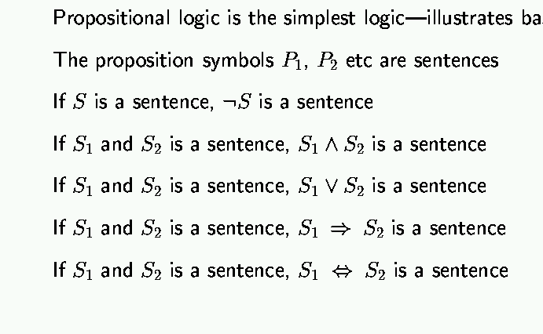
Propositional logic: syntax

Slide 24
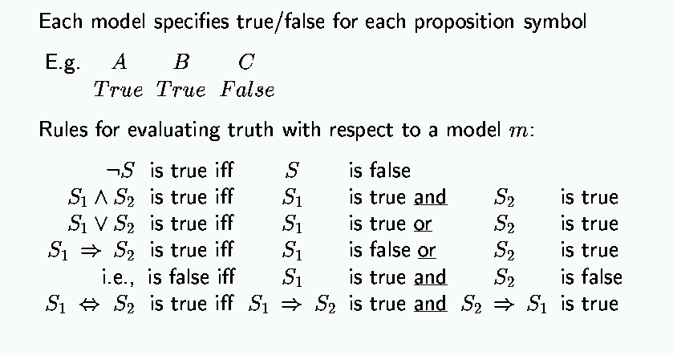
Propositional logic: semantics

Slide 25
Truth tables
A lookup table to determine the truth value of a sentence.
Columns: One for each propositional symbol, One for the sentence.
Rows: Enumerated possible truth values of each propositional symbol
Model: A single row in this table.
P | Q | P ⋁ Q
True | True | True
True | False | True
False | True | True
False | False | False

Slide 26
Truth table for basic connectives
P | Q | ¬P | P ⋀ Q | P ⋁ Q | P ⇒ Q | P ⟺ Q
False | False | True | False | False | True | True
False | True | True | False | True | True | False
True | False | False | False | True | False | False
True | True | False | True | True | True | True

Slide 27
Logical equivalence
Two sentences are logically equivalent if they have identical columns a truth table.
Example: Are these two equivalent? P ⇒ Q, ¬P ⋁ Q
Yes! An implication is equivalent to the disjunction of the consequent and the negation of the antecedent (implication elimination)
P | Q | P ⇒ Q | ¬P ⋁ Q
False | False | True | True
False | True | True | True
True | False | False | False
True | True | True | True

Slide 28
Tautology
A sentence that is necessarily True, in all models (rows of a truth table)
Because P ⇒ Q is equivalent to ¬P ⋁ Q, the following is a tautology:
(P ⇒ Q) ⟺ (¬P ⋁ Q)
It is also a tautology for any pair of sentences, α and β:
(α ⇒ β) ⟺ (¬α ⋁ β)
There are many important tautologies, some with their own special names.

Slide 29
Important tautologies
α ⋀ β | ⟺ | β ⋀ α | Commutativity of ⋀
α ⋁ β | ⟺ | β ⋁ α | Commutativity of ⋁
(α ⋀ β) ⋀ γ | ⟺ | α ⋀ (β ⋀ γ) | Associativity of ⋀
(α ⋁ β) ⋁ γ | ⟺ | α ⋁ (β ⋁ γ) | Associativity of ⋁
¬(¬α) | ⟺ | α | Double-negation elimination
α ⇒ β | ⟺ | ¬β ⇒ ¬α | Contraposition
α ⇒ β | ⟺ | ¬α ⋁ β | Implication elimination
α ⟺ β | ⟺ | (α ⇒ β) ⋀ (β ⇒ α) | Biconditional elimination
¬(α ⋀ β) | ⟺ | ¬α ⋁ ¬β | De Morgan
¬(α ⋁ β) | ⟺ | ¬α ⋀ ¬β | De Morgan
α ⋀ (β ⋁ γ) | ⟺ | (α ⋀ β) ⋁ (α ⋀ γ) | Distributivity of ⋀ over ⋁
α ⋁ (β ⋀ γ) | ⟺ | (α ⋁ β) ⋀ (α ⋁ γ) | Distributivity of ⋁ over ⋀

Slide 30
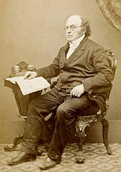
The De Morgan Laws
Interesting because they show how to express either connective ⋀ and ⋁ in terms of the other.
That means that we could “rewrite” any sentence to a logically equivalent one that did not involve the ⋁ connective.
Example:
(P ⋀ Q) ⋁ (R ⋀ S) Given
¬(¬(P ⋀ Q)) ⋁ ¬(¬(R ⋀ S)) Double-negation elimination
¬(¬P ⋁ ¬Q) ⋁ ¬(¬R ⋁ ¬S) De Morgan
Augustus De Morgan (1806-1871)

Slide 31
Clause
A disjunction of literals. Example:
¬P ⋁ Q ⋁ ¬R ⋁ S
Definite clause
A clause with exactly one positive literal. Example:
¬P ⋁ ¬Q ⋁ ¬R ⋁ S
(equivalent to: P ⋀ Q ⋀ R ⇒ S)
Horn clause
A clause with at most one positive literal. Example:
¬P ⋁ ¬Q ⋁ ¬R ⋁ ¬S
(equivalent to: P ⋀ Q ⋀ R ⇒ ¬S)

Slide 32
Conjunctive Normal Form
When a logical sentence is expressed as a conjunction of clauses.
Examples:
(¬P ⋁ ¬Q) ⋀ (Q ⋁ ¬R ⋁ ¬S)
(¬P ⋁ ¬Q) ⋀ (Q ⋁ ¬R ⋁ ¬S ⋁ T ⋁ U) ⋀ (P ⋁ S ⋁ ¬U)
Extreme examples:
¬P ⋁ ¬Q only one conjunct.
¬P ⋀ ¬Q conjunction of two clauses each with one literal
¬P only one conjunct, a clause with one literal

Slide 33
CNF conversion
Every sentence of propositional logic is logically equivalent to a conjunction of clauses (CNF). Convert using these tautologies:
Biconditional elimination (to remove ⟺) (α ⟺ β) ⟺ (α ⇒ β) ⋀ (β ⇒ α)
Implication elimination (to remove ⇒) (α ⇒ β) ⟺ (¬α ⋁ β)
De Morgan laws (to push negations downward) ¬(α ⋀ β) ⟺ (¬α ⋁ ¬β) ¬(α ⋁ β) ⟺ (¬α ⋀ ¬β)
Double-negation elimination (to remove ¬ where possible) ¬(¬α) ⟺ α
Distributivity of ⋁ over ⋀ (to push disjunctions downward) α ⋁ (β ⋀ γ) ⟺ (α ⋁ β) ⋀ (α ⋁ γ)

Slide 34
Validity
A sentence is valid if it is true in all models.
Valid sentences are Tautologies.
Satisfiability
A sentence is satisfiable if it is true in at least one model.
α is valid if and only if ¬α is unsatisfiable.
α is satisfiable if and only if ¬α is not valid.

Slide 35
Exercise 7.4
False |= True.
True |= False.
(A∧B)|=(A ⇔ B).
A ⇔ B |= A ∨ B .
A ⇔ B|=¬A∨B.
(A∧B) ⇒ C|=(A ⇒ C)∨(B ⇒ C). (C∨(¬A∧¬B))≡((A ⇒ C)∧(B ⇒ C)).
(A∨B)∧(¬C∨¬D∨E)|=(A∨B).
(A∨B)∧(¬C∨¬D∨E)|=(A∨B)∧(¬D∨E).
(A∨B)∧¬(A ⇒ B) is satisfiable.
(A ⇔ B)∧(¬A∨B) Is satisfiable.
(A ⇔ B) ⇔ C has the same number of models as (A ⇔ B) for any fixed set of proposition symbols that includes A, B, C.
Notes:
In all cases, the question can be resolved easily by referring to the definition of entail- ment.
False |= True is true because False has no models and hence entails every sentence AND because True is true in all models and hence is entailed by every sentence.
True |= False is false.
(A ∧ B) |= (A ⇔ B) is true because the left-hand side has exactly one model that is one of the two models of the right-hand side.
A ⇔ B|=A∨BisfalsebecauseoneofthemodelsofA ⇔ BhasbothAandB false, which does not satisfy A ∨ B.
A ⇔ B|=¬A∨BistruebecausetheRHSisA ⇒ B,oneoftheconjunctsinthe definition of A ⇔ B.
(A∧B) ⇒ C |= (A ⇒ C)∨(B ⇒ C) is true because the RHS is false only when both disjuncts are false, i.e., when A and B are true and C is false, in which case the LHS is also false. This may seem counterintuitive, and would not hold if ⇒ is interpreted as “causes.”
(C ∨(¬A∧¬B)) ≡ ((A ⇒ C)∧(B ⇒ C)) is true; proof by truth table enumeration, or by application of distributivity (Fig 7.11).
(A∨B)∧(¬C∨¬D∨E)|=(A∨B)istrue;removingaconjunctonlyallowsmore models.
(A∨B)∧(¬C∨¬D∨E)|=(A∨B)∧(¬D∨E)isfalse;removingadisjunctallows fewer models.
(A∨B)∧¬(A ⇒ B)issatisfiable;modelhasAand¬B. (A ⇔ B) ∧ (¬A ∨ B) is satisfiable; RHS is entailed by LHS so models are those of A ⇔ B.
l.(A ⇔ B) ⇔ Cdoeshavethesamenumberofmodelsas(A ⇔ B);halfthe models of (A ⇔ B) satisfy (A ⇔ B) ⇔ C, as do half the non-models, and there are the same numbers of models and non-models.

Slide 36
Exercise 7.4
False ⊨ True.
Notes:
In all cases, the question can be resolved easily by referring to the definition of entail- ment.
False |= True is true because False has no models and hence entails every sentence AND because True is true in all models and hence is entailed by every sentence.
True |= False is false.
(A ∧ B) |= (A ⇔ B) is true because the left-hand side has exactly one model that is one of the two models of the right-hand side.
A ⇔ B|=A∨BisfalsebecauseoneofthemodelsofA ⇔ BhasbothAandB false, which does not satisfy A ∨ B.
A ⇔ B|=¬A∨BistruebecausetheRHSisA ⇒ B,oneoftheconjunctsinthe definition of A ⇔ B.
(A∧B) ⇒ C |= (A ⇒ C)∨(B ⇒ C) is true because the RHS is false only when both disjuncts are false, i.e., when A and B are true and C is false, in which case the LHS is also false. This may seem counterintuitive, and would not hold if ⇒ is interpreted as “causes.”
(C ∨(¬A∧¬B)) ≡ ((A ⇒ C)∧(B ⇒ C)) is true; proof by truth table enumeration, or by application of distributivity (Fig 7.11).
(A∨B)∧(¬C∨¬D∨E)|=(A∨B)istrue;removingaconjunctonlyallowsmore models.
(A∨B)∧(¬C∨¬D∨E)|=(A∨B)∧(¬D∨E)isfalse;removingadisjunctallows fewer models.
(A∨B)∧¬(A ⇒ B)issatisfiable;modelhasAand¬B. (A ⇔ B) ∧ (¬A ∨ B) is satisfiable; RHS is entailed by LHS so models are those of A ⇔ B.
l.(A ⇔ B) ⇔ Cdoeshavethesamenumberofmodelsas(A ⇔ B);halfthe models of (A ⇔ B) satisfy (A ⇔ B) ⇔ C, as do half the non-models, and there are the same numbers of models and non-models.

Slide 37
Exercise 7.4
False ⊨ True. TRUE
False has no models and hence entails every sentence
True is true in all models and hence is entailed by every sentence.
Notes:
In all cases, the question can be resolved easily by referring to the definition of entail- ment.
False |= True is true because False has no models and hence entails every sentence AND because True is true in all models and hence is entailed by every sentence.
True |= False is false.
(A ∧ B) |= (A ⇔ B) is true because the left-hand side has exactly one model that is one of the two models of the right-hand side.
A ⇔ B|=A∨BisfalsebecauseoneofthemodelsofA ⇔ BhasbothAandB false, which does not satisfy A ∨ B.
A ⇔ B|=¬A∨BistruebecausetheRHSisA ⇒ B,oneoftheconjunctsinthe definition of A ⇔ B.
(A∧B) ⇒ C |= (A ⇒ C)∨(B ⇒ C) is true because the RHS is false only when both disjuncts are false, i.e., when A and B are true and C is false, in which case the LHS is also false. This may seem counterintuitive, and would not hold if ⇒ is interpreted as “causes.”
(C ∨(¬A∧¬B)) ≡ ((A ⇒ C)∧(B ⇒ C)) is true; proof by truth table enumeration, or by application of distributivity (Fig 7.11).
(A∨B)∧(¬C∨¬D∨E)|=(A∨B)istrue;removingaconjunctonlyallowsmore models.
(A∨B)∧(¬C∨¬D∨E)|=(A∨B)∧(¬D∨E)isfalse;removingadisjunctallows fewer models.
(A∨B)∧¬(A ⇒ B)issatisfiable;modelhasAand¬B. (A ⇔ B) ∧ (¬A ∨ B) is satisfiable; RHS is entailed by LHS so models are those of A ⇔ B.
l.(A ⇔ B) ⇔ Cdoeshavethesamenumberofmodelsas(A ⇔ B);halfthe models of (A ⇔ B) satisfy (A ⇔ B) ⇔ C, as do half the non-models, and there are the same numbers of models and non-models.

Slide 38
Exercise 7.4
True ⊨ False.
Notes:
In all cases, the question can be resolved easily by referring to the definition of entail- ment.
False |= True is true because False has no models and hence entails every sentence AND because True is true in all models and hence is entailed by every sentence.
True |= False is false.
(A ∧ B) |= (A ⇔ B) is true because the left-hand side has exactly one model that is one of the two models of the right-hand side.
A ⇔ B|=A∨BisfalsebecauseoneofthemodelsofA ⇔ BhasbothAandB false, which does not satisfy A ∨ B.
A ⇔ B|=¬A∨BistruebecausetheRHSisA ⇒ B,oneoftheconjunctsinthe definition of A ⇔ B.
(A∧B) ⇒ C |= (A ⇒ C)∨(B ⇒ C) is true because the RHS is false only when both disjuncts are false, i.e., when A and B are true and C is false, in which case the LHS is also false. This may seem counterintuitive, and would not hold if ⇒ is interpreted as “causes.”
(C ∨(¬A∧¬B)) ≡ ((A ⇒ C)∧(B ⇒ C)) is true; proof by truth table enumeration, or by application of distributivity (Fig 7.11).
(A∨B)∧(¬C∨¬D∨E)|=(A∨B)istrue;removingaconjunctonlyallowsmore models.
(A∨B)∧(¬C∨¬D∨E)|=(A∨B)∧(¬D∨E)isfalse;removingadisjunctallows fewer models.
(A∨B)∧¬(A ⇒ B)issatisfiable;modelhasAand¬B. (A ⇔ B) ∧ (¬A ∨ B) is satisfiable; RHS is entailed by LHS so models are those of A ⇔ B.
l.(A ⇔ B) ⇔ Cdoeshavethesamenumberofmodelsas(A ⇔ B);halfthe models of (A ⇔ B) satisfy (A ⇔ B) ⇔ C, as do half the non-models, and there are the same numbers of models and non-models.

Slide 39
Exercise 7.4
True ⊨ False. FALSE
False is not true in any models
Notes:
In all cases, the question can be resolved easily by referring to the definition of entail- ment.
False |= True is true because False has no models and hence entails every sentence AND because True is true in all models and hence is entailed by every sentence.
True |= False is false.
(A ∧ B) |= (A ⇔ B) is true because the left-hand side has exactly one model that is one of the two models of the right-hand side.
A ⇔ B|=A∨BisfalsebecauseoneofthemodelsofA ⇔ BhasbothAandB false, which does not satisfy A ∨ B.
A ⇔ B|=¬A∨BistruebecausetheRHSisA ⇒ B,oneoftheconjunctsinthe definition of A ⇔ B.
(A∧B) ⇒ C |= (A ⇒ C)∨(B ⇒ C) is true because the RHS is false only when both disjuncts are false, i.e., when A and B are true and C is false, in which case the LHS is also false. This may seem counterintuitive, and would not hold if ⇒ is interpreted as “causes.”
(C ∨(¬A∧¬B)) ≡ ((A ⇒ C)∧(B ⇒ C)) is true; proof by truth table enumeration, or by application of distributivity (Fig 7.11).
(A∨B)∧(¬C∨¬D∨E)|=(A∨B)istrue;removingaconjunctonlyallowsmore models.
(A∨B)∧(¬C∨¬D∨E)|=(A∨B)∧(¬D∨E)isfalse;removingadisjunctallows fewer models.
(A∨B)∧¬(A ⇒ B)issatisfiable;modelhasAand¬B. (A ⇔ B) ∧ (¬A ∨ B) is satisfiable; RHS is entailed by LHS so models are those of A ⇔ B.
l.(A ⇔ B) ⇔ Cdoeshavethesamenumberofmodelsas(A ⇔ B);halfthe models of (A ⇔ B) satisfy (A ⇔ B) ⇔ C, as do half the non-models, and there are the same numbers of models and non-models.

Slide 40
Exercise 7.4
(A∧B) ⊨ (A ⇔ B).
Notes:
In all cases, the question can be resolved easily by referring to the definition of entail- ment.
False |= True is true because False has no models and hence entails every sentence AND because True is true in all models and hence is entailed by every sentence.
True |= False is false.
(A ∧ B) |= (A ⇔ B) is true because the left-hand side has exactly one model that is one of the two models of the right-hand side.
A ⇔ B|=A∨BisfalsebecauseoneofthemodelsofA ⇔ BhasbothAandB false, which does not satisfy A ∨ B.
A ⇔ B|=¬A∨BistruebecausetheRHSisA ⇒ B,oneoftheconjunctsinthe definition of A ⇔ B.
(A∧B) ⇒ C |= (A ⇒ C)∨(B ⇒ C) is true because the RHS is false only when both disjuncts are false, i.e., when A and B are true and C is false, in which case the LHS is also false. This may seem counterintuitive, and would not hold if ⇒ is interpreted as “causes.”
(C ∨(¬A∧¬B)) ≡ ((A ⇒ C)∧(B ⇒ C)) is true; proof by truth table enumeration, or by application of distributivity (Fig 7.11).
(A∨B)∧(¬C∨¬D∨E)|=(A∨B)istrue;removingaconjunctonlyallowsmore models.
(A∨B)∧(¬C∨¬D∨E)|=(A∨B)∧(¬D∨E)isfalse;removingadisjunctallows fewer models.
(A∨B)∧¬(A ⇒ B)issatisfiable;modelhasAand¬B. (A ⇔ B) ∧ (¬A ∨ B) is satisfiable; RHS is entailed by LHS so models are those of A ⇔ B.
l.(A ⇔ B) ⇔ Cdoeshavethesamenumberofmodelsas(A ⇔ B);halfthe models of (A ⇔ B) satisfy (A ⇔ B) ⇔ C, as do half the non-models, and there are the same numbers of models and non-models.

Slide 41
Exercise 7.4
(A∧B) ⊨ (A ⇔ B). TRUE
The left-hand side (A∧B) has exactly one model: A=True and B=True then (A∧B)=True
That model is one of the two models of the right-hand side (A ⇔ B). Two models:
A=True and B=True then (A ⇔ B) =True
A=False and B=False then (A ⇔ B) =True
Notes:
In all cases, the question can be resolved easily by referring to the definition of entail- ment.
False |= True is true because False has no models and hence entails every sentence AND because True is true in all models and hence is entailed by every sentence.
True |= False is false.
(A ∧ B) |= (A ⇔ B) is true because the left-hand side has exactly one model that is one of the two models of the right-hand side.
A ⇔ B|=A∨BisfalsebecauseoneofthemodelsofA ⇔ BhasbothAandB false, which does not satisfy A ∨ B.
A ⇔ B|=¬A∨BistruebecausetheRHSisA ⇒ B,oneoftheconjunctsinthe definition of A ⇔ B.
(A∧B) ⇒ C |= (A ⇒ C)∨(B ⇒ C) is true because the RHS is false only when both disjuncts are false, i.e., when A and B are true and C is false, in which case the LHS is also false. This may seem counterintuitive, and would not hold if ⇒ is interpreted as “causes.”
(C ∨(¬A∧¬B)) ≡ ((A ⇒ C)∧(B ⇒ C)) is true; proof by truth table enumeration, or by application of distributivity (Fig 7.11).
(A∨B)∧(¬C∨¬D∨E)|=(A∨B)istrue;removingaconjunctonlyallowsmore models.
(A∨B)∧(¬C∨¬D∨E)|=(A∨B)∧(¬D∨E)isfalse;removingadisjunctallows fewer models.
(A∨B)∧¬(A ⇒ B)issatisfiable;modelhasAand¬B. (A ⇔ B) ∧ (¬A ∨ B) is satisfiable; RHS is entailed by LHS so models are those of A ⇔ B.
l.(A ⇔ B) ⇔ Cdoeshavethesamenumberofmodelsas(A ⇔ B);halfthe models of (A ⇔ B) satisfy (A ⇔ B) ⇔ C, as do half the non-models, and there are the same numbers of models and non-models.

Slide 42
Exercise 7.4
A ⇔ B ⊨ A ∨ B.
Notes:
In all cases, the question can be resolved easily by referring to the definition of entail- ment.
False |= True is true because False has no models and hence entails every sentence AND because True is true in all models and hence is entailed by every sentence.
True |= False is false.
(A ∧ B) |= (A ⇔ B) is true because the left-hand side has exactly one model that is one of the two models of the right-hand side.
A ⇔ B|=A∨BisfalsebecauseoneofthemodelsofA ⇔ BhasbothAandB false, which does not satisfy A ∨ B.
A ⇔ B|=¬A∨BistruebecausetheRHSisA ⇒ B,oneoftheconjunctsinthe definition of A ⇔ B.
(A∧B) ⇒ C |= (A ⇒ C)∨(B ⇒ C) is true because the RHS is false only when both disjuncts are false, i.e., when A and B are true and C is false, in which case the LHS is also false. This may seem counterintuitive, and would not hold if ⇒ is interpreted as “causes.”
(C ∨(¬A∧¬B)) ≡ ((A ⇒ C)∧(B ⇒ C)) is true; proof by truth table enumeration, or by application of distributivity (Fig 7.11).
(A∨B)∧(¬C∨¬D∨E)|=(A∨B)istrue;removingaconjunctonlyallowsmore models.
(A∨B)∧(¬C∨¬D∨E)|=(A∨B)∧(¬D∨E)isfalse;removingadisjunctallows fewer models.
(A∨B)∧¬(A ⇒ B)issatisfiable;modelhasAand¬B. (A ⇔ B) ∧ (¬A ∨ B) is satisfiable; RHS is entailed by LHS so models are those of A ⇔ B.
l.(A ⇔ B) ⇔ Cdoeshavethesamenumberofmodelsas(A ⇔ B);halfthe models of (A ⇔ B) satisfy (A ⇔ B) ⇔ C, as do half the non-models, and there are the same numbers of models and non-models.

Slide 43
Exercise 7.4
A ⇔ B ⊨ A ∨ B. FALSE
(A ⇔ B) has two models:
A=True and B=True then (A ⇔ B) =True
A=False and B=False then (A ⇔ B) =True
(A V B) is not True in this model
A=False and B=False then (A V B) = False
Notes:
In all cases, the question can be resolved easily by referring to the definition of entail- ment.
False |= True is true because False has no models and hence entails every sentence AND because True is true in all models and hence is entailed by every sentence.
True |= False is false.
(A ∧ B) |= (A ⇔ B) is true because the left-hand side has exactly one model that is one of the two models of the right-hand side.
A ⇔ B|=A∨BisfalsebecauseoneofthemodelsofA ⇔ BhasbothAandB false, which does not satisfy A ∨ B.
A ⇔ B|=¬A∨BistruebecausetheRHSisA ⇒ B,oneoftheconjunctsinthe definition of A ⇔ B.
(A∧B) ⇒ C |= (A ⇒ C)∨(B ⇒ C) is true because the RHS is false only when both disjuncts are false, i.e., when A and B are true and C is false, in which case the LHS is also false. This may seem counterintuitive, and would not hold if ⇒ is interpreted as “causes.”
(C ∨(¬A∧¬B)) ≡ ((A ⇒ C)∧(B ⇒ C)) is true; proof by truth table enumeration, or by application of distributivity (Fig 7.11).
(A∨B)∧(¬C∨¬D∨E)|=(A∨B)istrue;removingaconjunctonlyallowsmore models.
(A∨B)∧(¬C∨¬D∨E)|=(A∨B)∧(¬D∨E)isfalse;removingadisjunctallows fewer models.
(A∨B)∧¬(A ⇒ B)issatisfiable;modelhasAand¬B. (A ⇔ B) ∧ (¬A ∨ B) is satisfiable; RHS is entailed by LHS so models are those of A ⇔ B.
l.(A ⇔ B) ⇔ Cdoeshavethesamenumberofmodelsas(A ⇔ B);halfthe models of (A ⇔ B) satisfy (A ⇔ B) ⇔ C, as do half the non-models, and there are the same numbers of models and non-models.

Slide 44
Exercise 7.4
(A ⇔ B)∧(¬A∨B) is satisfiable.
Notes:
In all cases, the question can be resolved easily by referring to the definition of entail- ment.
False |= True is true because False has no models and hence entails every sentence AND because True is true in all models and hence is entailed by every sentence.
True |= False is false.
(A ∧ B) |= (A ⇔ B) is true because the left-hand side has exactly one model that is one of the two models of the right-hand side.
A ⇔ B|=A∨BisfalsebecauseoneofthemodelsofA ⇔ BhasbothAandB false, which does not satisfy A ∨ B.
A ⇔ B|=¬A∨BistruebecausetheRHSisA ⇒ B,oneoftheconjunctsinthe definition of A ⇔ B.
(A∧B) ⇒ C |= (A ⇒ C)∨(B ⇒ C) is true because the RHS is false only when both disjuncts are false, i.e., when A and B are true and C is false, in which case the LHS is also false. This may seem counterintuitive, and would not hold if ⇒ is interpreted as “causes.”
(C ∨(¬A∧¬B)) ≡ ((A ⇒ C)∧(B ⇒ C)) is true; proof by truth table enumeration, or by application of distributivity (Fig 7.11).
(A∨B)∧(¬C∨¬D∨E)|=(A∨B)istrue;removingaconjunctonlyallowsmore models.
(A∨B)∧(¬C∨¬D∨E)|=(A∨B)∧(¬D∨E)isfalse;removingadisjunctallows fewer models.
(A∨B)∧¬(A ⇒ B)issatisfiable;modelhasAand¬B. (A ⇔ B) ∧ (¬A ∨ B) is satisfiable; RHS is entailed by LHS so models are those of A ⇔ B.
l.(A ⇔ B) ⇔ Cdoeshavethesamenumberofmodelsas(A ⇔ B);halfthe models of (A ⇔ B) satisfy (A ⇔ B) ⇔ C, as do half the non-models, and there are the same numbers of models and non-models.

Slide 45
Exercise 7.4
(A ⇔ B)∧(¬A∨B) is satisfiable. TRUE
This sentence (A ⇔ B)∧(¬A∨B) is True, when A=True and B=True
Notes:
In all cases, the question can be resolved easily by referring to the definition of entail- ment.
False |= True is true because False has no models and hence entails every sentence AND because True is true in all models and hence is entailed by every sentence.
True |= False is false.
(A ∧ B) |= (A ⇔ B) is true because the left-hand side has exactly one model that is one of the two models of the right-hand side.
A ⇔ B|=A∨BisfalsebecauseoneofthemodelsofA ⇔ BhasbothAandB false, which does not satisfy A ∨ B.
A ⇔ B|=¬A∨BistruebecausetheRHSisA ⇒ B,oneoftheconjunctsinthe definition of A ⇔ B.
(A∧B) ⇒ C |= (A ⇒ C)∨(B ⇒ C) is true because the RHS is false only when both disjuncts are false, i.e., when A and B are true and C is false, in which case the LHS is also false. This may seem counterintuitive, and would not hold if ⇒ is interpreted as “causes.”
(C ∨(¬A∧¬B)) ≡ ((A ⇒ C)∧(B ⇒ C)) is true; proof by truth table enumeration, or by application of distributivity (Fig 7.11).
(A∨B)∧(¬C∨¬D∨E)|=(A∨B)istrue;removingaconjunctonlyallowsmore models.
(A∨B)∧(¬C∨¬D∨E)|=(A∨B)∧(¬D∨E)isfalse;removingadisjunctallows fewer models.
(A∨B)∧¬(A ⇒ B)issatisfiable;modelhasAand¬B. (A ⇔ B) ∧ (¬A ∨ B) is satisfiable; RHS is entailed by LHS so models are those of A ⇔ B.
l.(A ⇔ B) ⇔ Cdoeshavethesamenumberofmodelsas(A ⇔ B);halfthe models of (A ⇔ B) satisfy (A ⇔ B) ⇔ C, as do half the non-models, and there are the same numbers of models and non-models.

Slide 46
Exercise 7.4
False |= True.
True |= False.
(A∧B)|=(A ⇔ B).
A ⇔ B |= A ∨ B .
A ⇔ B|=¬A∨B.
(A∧B) ⇒ C|=(A ⇒ C)∨(B ⇒ C). (C∨(¬A∧¬B))≡((A ⇒ C)∧(B ⇒ C)).
(A∨B)∧(¬C∨¬D∨E)|=(A∨B).
(A∨B)∧(¬C∨¬D∨E)|=(A∨B)∧(¬D∨E).
(A∨B)∧¬(A ⇒ B) is satisfiable.
(A ⇔ B)∧(¬A∨B) Is satisfiable.
(A ⇔ B) ⇔ C has the same number of models as (A ⇔ B) for any fixed set of proposition symbols that includes A, B, C.
Notes:
In all cases, the question can be resolved easily by referring to the definition of entail- ment.
False |= True is true because False has no models and hence entails every sentence AND because True is true in all models and hence is entailed by every sentence.
True |= False is false.
(A ∧ B) |= (A ⇔ B) is true because the left-hand side has exactly one model that is one of the two models of the right-hand side.
A ⇔ B|=A∨BisfalsebecauseoneofthemodelsofA ⇔ BhasbothAandB false, which does not satisfy A ∨ B.
A ⇔ B|=¬A∨BistruebecausetheRHSisA ⇒ B,oneoftheconjunctsinthe definition of A ⇔ B.
(A∧B) ⇒ C |= (A ⇒ C)∨(B ⇒ C) is true because the RHS is false only when both disjuncts are false, i.e., when A and B are true and C is false, in which case the LHS is also false. This may seem counterintuitive, and would not hold if ⇒ is interpreted as “causes.”
(C ∨(¬A∧¬B)) ≡ ((A ⇒ C)∧(B ⇒ C)) is true; proof by truth table enumeration, or by application of distributivity (Fig 7.11).
(A∨B)∧(¬C∨¬D∨E)|=(A∨B)istrue;removingaconjunctonlyallowsmore models.
(A∨B)∧(¬C∨¬D∨E)|=(A∨B)∧(¬D∨E)isfalse;removingadisjunctallows fewer models.
(A∨B)∧¬(A ⇒ B)issatisfiable;modelhasAand¬B. (A ⇔ B) ∧ (¬A ∨ B) is satisfiable; RHS is entailed by LHS so models are those of A ⇔ B.
l.(A ⇔ B) ⇔ Cdoeshavethesamenumberofmodelsas(A ⇔ B);halfthe models of (A ⇔ B) satisfy (A ⇔ B) ⇔ C, as do half the non-models, and there are the same numbers of models and non-models.

Slide 47
Exercise 7.10
Decide whether each of the following sentences is valid, unsatisfiable, or neither.
Smoke ⇒ Smoke
Smoke ⇒ Fire
(Smoke ⇒ Fire) ⇒ (¬Smoke ⇒ ¬Fire)
Smoke ∨ Fire ∨ ¬Fire
((Smoke ∧ Heat) ⇒ Fire) ⇔ ((Smoke ⇒ Fire) ∨ (Heat ⇒ Fire))
(Smoke ⇒ Fire) ⇒ ((Smoke ∧ Heat) ⇒ Fire)
Big∨Dumb∨(Big ⇒ Dumb)
Notes:
Valid.
Neither.
Neither.
Valid.
Valid.
Valid.
Valid.

Slide 48
Exercise 7.10
Decide whether each of the following sentences is valid, unsatisfiable, or neither.
Smoke ⇒ Smoke
Notes:
Valid.
Neither.
Neither.
Valid.
Valid.
Valid.
Valid.

Slide 49
Exercise 7.10
Decide whether each of the following sentences is valid, unsatisfiable, or neither.
Smoke ⇒ Smoke Valid
Convert to ¬Smoke V Smoke
When Smoke=True then ¬Smoke V Smoke = True
When Smoke=False then ¬Smoke V Smoke = True
Always True = Valid.
Notes:
Valid.
Neither.
Neither.
Valid.
Valid.
Valid.
Valid.

Slide 50
Exercise 7.10
Decide whether each of the following sentences is valid, unsatisfiable, or neither.
Smoke ⇒ Fire
Notes:
Valid.
Neither.
Neither.
Valid.
Valid.
Valid.
Valid.

Slide 51
Exercise 7.10
Decide whether each of the following sentences is valid, unsatisfiable, or neither.
Smoke ⇒ Fire Neither
Convert to ¬Smoke V Fire
When Smoke=True and Fire=True then ¬Smoke V Fire = True
When Smoke=True and Fire=False then ¬Smoke V Fire =False
Not always True and not always False
Notes:
Valid.
Neither.
Neither.
Valid.
Valid.
Valid.
Valid.

Slide 52
Exercise 7.10
Decide whether each of the following sentences is valid, unsatisfiable, or neither.
Smoke ⇒ Smoke
Smoke ⇒ Fire
(Smoke ⇒ Fire) ⇒ (¬Smoke ⇒ ¬Fire)
Smoke ∨ Fire ∨ ¬Fire
((Smoke ∧ Heat) ⇒ Fire) ⇔ ((Smoke ⇒ Fire) ∨ (Heat ⇒ Fire))
(Smoke ⇒ Fire) ⇒ ((Smoke ∧ Heat) ⇒ Fire)
Big∨Dumb∨(Big ⇒ Dumb)
Notes:
Valid.
Neither.
Neither.
Valid.
Valid.
Valid.
Valid.

Slide 53
Entailment as satisfiability
α ⊨ β if and only if the sentence (α ⇒ β) is valid.
(α ⇒ β) is valid if and only if ¬(α ⇒ β) is unsatisfiable.
¬(α ⇒ β) ⟺ (α ⋀ ¬β)
α ⊨ β if and only if the sentence (α ⋀ ¬β) is unsatisfiable.
Proof by contradiction
Latin: reductio ad absurdum (“reduction to an absurd thing”)
To prove that β follows logically from α, assume ¬β and derive a contradiction.

Slide 54
Proofs using truth tables
To prove a sentence, β
Start with the set of true sentences, the “knowledge base”
Join them all together as one big conjunction, α
Create a truth table for (α ⇒ β)
Verify that this sentence is True in all models.
Similar to the algorithm TT-ENTAILS in AIMA textbook.
Algorithm is sound: it directly implements the definition of entailment.
Algorithm is complete: it works for any sentence and always terminates.
However, you need 2^{n} rows, where n is the number of proposition symbols. For sentences with lots of symbols, we need a better approach.

Slide 55
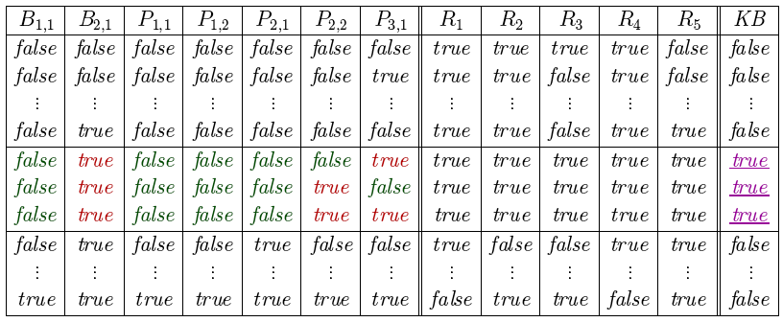
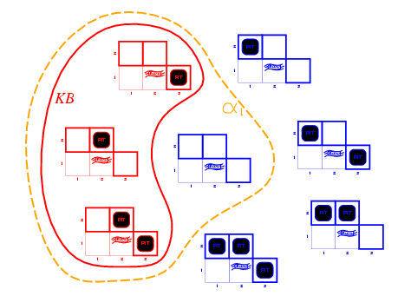
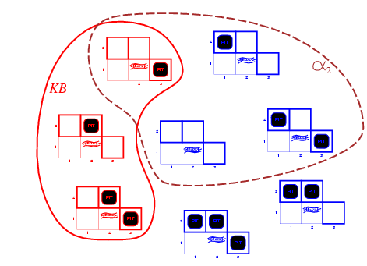
Using Truth Tables in Inference
R₅
R₃
R₃
R₂
R₁
α₁= ¬P_{1,2}
α2= ¬P_{2,2}
KB
R₁: ¬P_{1,1}
R₂: B_{1,1} ⇔ (P_{1,2} ∨ P_{2,1})
R₃: B_{2,1} ⇔ (P_{1,1} ∨ P_{2,2} ∨ P_{3,1})
R₄: ¬B_{1,1}
R₅: B_{2,1}
Notes:
First find models in which KB is true, and see if alpha is true in each
Need a better story on how figure out which rows are models of KB, particularly of biconditionals

Slide 56
Example
Does ((¬P ⋁ Q) ⋀ P) entail Q?
P | Q | (¬P ⋁ Q) ⋀ P | ((¬P ⋁ Q) ⋀ P) ⇒ Q
False | False | False | True
False | True | False | True
True | False | False | True
True | True | True | True
Yes!
α entails β if and only if, in every model in which α is True, β is also True.
α entails β if and only if, (α ⇒ β) is True in every model.

Slide 57
Logical inference
The derivation of logical conclusions from premises known or assumed to be true.
Logical proof
A chain of conclusions that leads from premises to the desired goal via logical inference.

Slide 58
Some inference rules
Modus ponens
“The way that affirms by affirming”
Modus tollens
“The way that denies by denying”
α ⇒ β, α
β
α ⇒ β, ¬β
¬α

Slide 59
Some more inference rules
And-Elimination
“simplification”
Or-Introduction
“addition”
α ⋀ β
α
α
α ⋁ β

Slide 60
Even more inference rules…
Tautologies are also inference rules, and can be used in both directions.
Contraposition
A conditional statement is logically equivalent to its “contrapositive.”
(α ⇒ β) ⟺ (¬β ⇒ ¬α)
α ⇒ β
¬β ⇒ ¬α
¬α ⇒ ¬β
β ⇒ α

Slide 61
The resolution rule
Two clauses containing complimentary literals can be combined to create a new clause containing all the literals of the two original clauses except the two complementary literals.
Clause: a disjunction of literals, e.g. (P ⋁ ¬Q ⋁ R)
Complimentary literals: any literal and its negation, e.g. ¬Q and Q.
Example:
(P ⋁ ¬Q ⋁ R), (Q ⋁ ¬S ⋁ ¬T)
(P ⋁ R ⋁ ¬S ⋁ ¬T)

Slide 62
Resolution theorem proving
To prove that KB ⊨ α, we show that (KB ⋀ ¬α) is unsatisfiable.
Convert (KB ⋀ ¬α) to Conjunctive Normal Form
Apply the resolution rule wherever possible and add the result as an additional clause in the conjunction.
Repeat step 2 until either:
No new clauses can be added: KB does not entail α.
Two clauses resolve to yield the empty clause: KB entails α.
Unit clause: a clause with only one literal, e.g. (¬Q)
Empty clause: a clause with no literals. Arises only through the resolution of two unit clauses with complimentary literals. Indicates a contradiction, e.g. (¬Q) ⋀ (Q)

Slide 63
Convert sentence to CNF
Using some of the basic manipulation rules below.
Write down which rule number used for each
step in the conversion.
B <=> (P₁ V P₂)
1. Eliminate ⇔ using which rule ___
2. Eliminate => using which rule __
3. CNF requires ¬ to only appear in literals using which rule ____
4. Flatten to have conjunction of disjunctive clauses using which rule ____
¬(¬A) = A Double negation
B. ¬(A ^ B) = (¬A) V (¬B)
C. ¬(A V B) = (¬A) ^ (¬B)
D. A ^ (B V C) = (A ^ B) V (A ^ C)
Distributivity of ^ on V
E. A V (B ^ C) = (A V B) ^ (A V C)
Distributivity of V on ^
F. A => B = (¬A) V B by definition
G. ¬(A => B) = A ^ (¬B)
H. A <=> B = (A => B) ^ (B => A)
I. ¬(A <=> B) = (A ^ (¬B))V(B ^ (¬A))
H
(B => (P₁ V P₂)) ^ ((P₁ V P₂) => B)
F
(¬B V P₁ V P₂) ^ (¬(P₁ V P₂) V B)
C
(¬B V P₁ V P₂) ^ (¬P₁ ^ ¬P₂) V B)
E
(¬B V P₁ V P₂) ^ (¬P₁ V B) ^ (¬P₂ V B)

Slide 64
Example 1
Prove: ((P ⇒ Q) ⋀ P) ⊨ Q
Show: (((P ⇒ Q) ⋀ P) ⋀ ¬Q) is unsatisfiable
CNF: (¬P ⋁ Q) ⋀ (P) ⋀ (¬Q)
1 | (¬P ⋁ Q) | given
2 | (P) | given
3 | (¬Q) | given

Slide 65
Example 1
Prove: ((P ⇒ Q) ⋀ P) ⊨ Q
Show: (((P ⇒ Q) ⋀ P) ⋀ ¬Q) is unsatisfiable
CNF: (¬P ⋁ Q) ⋀ (P) ⋀ (¬Q)
1 | (¬P ⋁ Q) | given
2 | (P) | given
3 | (¬Q) | given
4 | (¬P) | Resolution of 1,3

Slide 66
Example 1
Prove: ((P ⇒ Q) ⋀ P) ⊨ Q
Show: (((P ⇒ Q) ⋀ P) ⋀ ¬Q) is unsatisfiable
CNF: (¬P ⋁ Q) ⋀ (P) ⋀ (¬Q)
1 | (¬P ⋁ Q) | given
2 | (P) | given
3 | (¬Q) | given
4 | (¬P) | Resolution of 1,3
5 | () | Resolution of 2,4
We derived the Empty clause (a clause with no literals).
This indicates a contradiction. The given sentence is not satisfiable.
Therefore: ((P ⇒ Q) ⋀ P) ⊨ Q

Slide 67
Example 2
Prove: ((S ⟺ Q ⋀ R) ⋀ ¬Q) ⊨ ¬S
Show: (((S ⟺ Q ⋀ R) ⋀ ¬Q) ⋀ S) is unsatisfiable
CNF: (¬S ⋁ Q) ⋀ (¬S ⋁ R) ⋀ (¬Q ⋁ ¬R ⋁ S) ⋀ (¬Q) ⋀ (S)
1 | (¬S ⋁ Q) | given
2 | (¬S ⋁ R) | given
3 | (¬Q ⋁ ¬R ⋁ S) | given
4 | (¬Q) | given
5 | (S) | given

Slide 68
Example 2
Prove: ((S ⟺ Q ⋀ R) ⋀ ¬Q) ⊨ ¬S
Show: (((S ⟺ Q ⋀ R) ⋀ ¬Q) ⋀ S) is unsatisfiable
CNF: (¬S ⋁ Q) ⋀ (¬S ⋁ R) ⋀ (¬Q ⋁ ¬R ⋁ S) ⋀ (¬Q) ⋀ (S)
1 | (¬S ⋁ Q) | given
2 | (¬S ⋁ R) | given
3 | (¬Q ⋁ ¬R ⋁ S) | given
4 | (¬Q) | given
5 | (S) | given
6 | (¬S) | Resolution of 1, 4
7

Slide 69
Example 2
Prove: ((S ⟺ Q ⋀ R) ⋀ ¬Q) ⊨ ¬S
Show: (((S ⟺ Q ⋀ R) ⋀ ¬Q) ⋀ S) is unsatisfiable
CNF: (¬S ⋁ Q) ⋀ (¬S ⋁ R) ⋀ (¬Q ⋁ ¬R ⋁ S) ⋀ (¬Q) ⋀ (S)
1 | (¬S ⋁ Q) | given
2 | (¬S ⋁ R) | given
3 | (¬Q ⋁ ¬R ⋁ S) | given
4 | (¬Q) | given
5 | (S) | given
6 | (¬S) | Resolution of 1, 4
7 | () | Resolution of 5, 6

Slide 70
Converting to CNF
Convert the following propositional sentence into CNF. Your answer must be as simplified as much as possible and must exactly match the CNF form. (10 points)
~((A => B) => (((P^B) => Q) v R))
(¬A v B) ʌ P ʌ B ʌ ¬Q ʌ ¬R

Slide 71
Resolution
From the sentence "Heads I win, tails you lose," prove using resolution that "Iwin."
1. First build the KB, from the sentence "Heads I win, tails you lose," using the true or false variables Heads, Tails, IWin, YouLose and write the sentence in terms of disjunctions clauses. Add to KB the general knowledge that the outcome of a coin toss must be Head or Tails and the general knowledge that if YouLose then IWin and, if IWin then YouLose.
"Heads I win, tails you lose.”
(Heads => IWin) or in CNF ( ¬ Heads ∨ Iwin)
(Tails => YouLose) or in CNF ( ¬ Tails ∨ YouLose)
Add some general knowledge axioms about coins, winning, and losing:
(Heads v Tails)
(YouLose => IWin) or in CNF ( ¬ YouLose ∨ IWin)
(IWin => YouLose) or in CNF ( ¬ IWin ∨ YouLose)

Slide 72
Resolution continued
2. Prove the Goal sentence: “IWin” via the Resolution method.

Slide 73
What you should know
What is entailment and inference? How do they differ?
What are examples of sound or complete inference techniques?
What does satisfiable or valid mean?
What is propositional logic? Basic manipulation rules? Inference rules? What are some of its limitations?

Slide 74
Want More?
Check out some of these exercises in the book:
7.1, 7.5-8

