Slide 1
CSCI 561 Foundations of Artificial Intelligence Lecture 5: Adversarial Search (Games) (Chapter 5)
Summer 2017
INSTRUCTOR:
PROF. SHEILA TEJADA (STEJADA@USC.EDU)

Slide 2
Games
Games are a form of multiagent environment
It matters what other agents do and how this affects success
Other agents can add nondeterminism: don’t know what they’ll do
Cooperative vs. competitive vs. mixed multiagent environments
Cooperative: identical goals
Competitive: opposing goals
Mixed: cooperative and competitive
Competitive multiagent environments give rise to adversarial search, a.k.a. games

Slide 3
Why Study Games?
Fun
Easy to define but difficult to play well
Chess: b = 35, m=100 ⇒ nodes = 35 ¹⁰⁰ if each node takes about 1 ns to explore then each move will take about 10 ⁵⁰ millennia to calculate.
Chance to interact with people
A significant component of the history/success of AI
Machines have had considerable success here
Focus here is mostly on traditional board games
Video games require other things, such as virtual humans
One aspect of multiagent systems

Slide 4
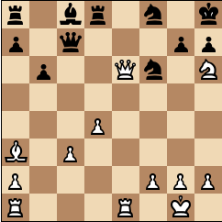
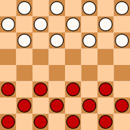
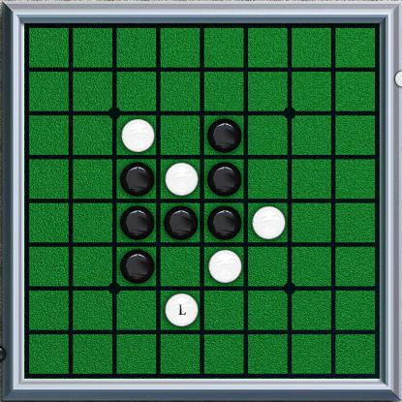
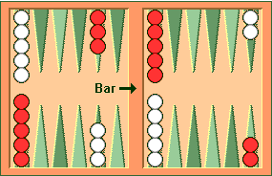
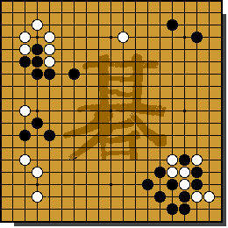
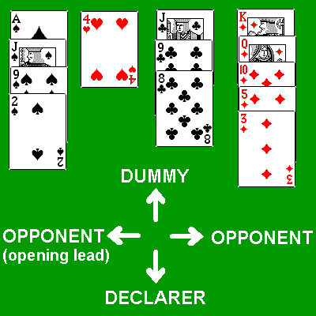
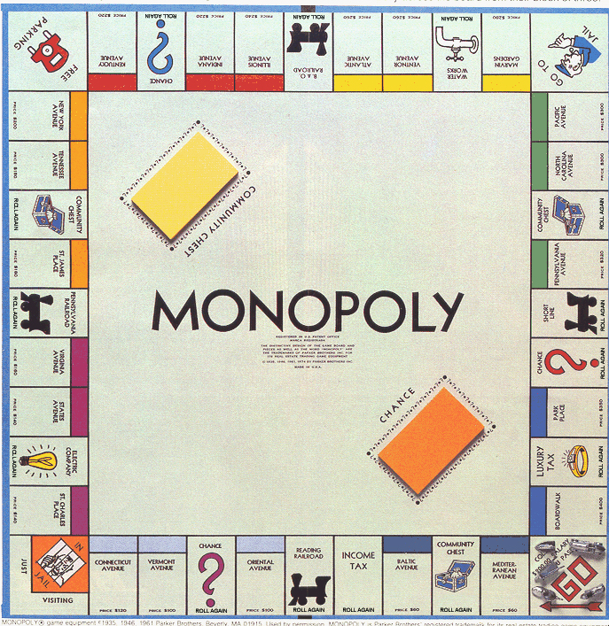
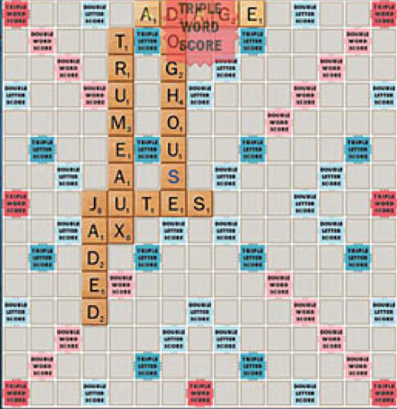
Games and Search
What we have seen so far is single-agent search
Solution is usually a single path to a goal state
Focus is frequently on finding optimal solutions
f(n) is an estimate of cost from start to goal through given node
Examples: path planning, scheduling, puzzles
Games are two-or-more person adversarial search
Solution usually a branching (tree) contingency plan: need to consider all your opponent might do
Examples: chess, checkers/draughts, othello/reversi, backgammon, go, bridge, poker, monopoly, scrabble

Slide 5
Searching for the next move
Resource (e.g., time, memory) limit: optimal solution not feasible/possible, thus must approximate
Pruning: makes the search more efficient by discarding portions of the search tree that cannot improve quality result.
Evaluation functions: heuristics to evaluate utility of a state without exhaustive search.

Slide 6
Types of Games
Deterministic
Stochastic
chess, checkers, go, othello, … | backgammon, monopoly, …
Battleship, above with time/space limits | Bridge, poker, scrabble, …
Perfect
Information
Imperfect
Information
Notes:
Differentiate whether game itself is stochastic versus uncertainty due to other players.
Differentiate whether all information is available to players versus some hidden.

Slide 7
Generate Game Tree

Slide 8
Generate Game Tree
MAX
x
x
 | x
 |  | x

Slide 9
Generate Game Tree
MAX
 | x
MIN
 | x | o
 | x
 | o
o | x
 | x
o

Slide 10
Generate Game Tree
MAX
 | x
1 ply
MIN
1 move
 | x | o
 | x
 | o
o | x
 | x
o

Slide 11
A subtree
x
o
x
o
x
o
win
MAX
lose
x
o
x
x
o
x
x
o
x
draw
x
o
x
o
x
o
x
MIN
o
x
o
x
o
x
o
x
x
o
x
x
o
x
x
o
x
x
o
x
x
o
x
x
o
x
x
o
x
o
o
x
o
x
o
o
x
o
x
o
o
o
o
x
o
x
o
o
x
o
o
x
o
MAX
x
o
x
x
o
x
x
o
x
x
o
x
x
o
x
o
o
x
o
o
x
x
o
x
o
x
o
x
x
o
x
x
o
o
x
o

Slide 12
What is a good move?
x
o
x
o
x
o
win
MAX
lose
x
o
x
x
o
x
x
o
x
draw
x
o
x
o
x
o
x
MIN
o
x
o
x
o
x
o
x
x
o
x
x
o
x
x
o
x
x
o
x
x
o
x
x
o
x
x
o
x
o
o
x
o
x
o
o
x
o
x
o
o
o
o
x
o
x
o
o
x
o
o
x
o
MAX
x
o
x
x
o
x
x
o
x
x
o
x
x
o
x
o
o
x
o
o
x
x
o
x
o
x
o
x
x
o
x
x
o
o
x
o

Slide 13
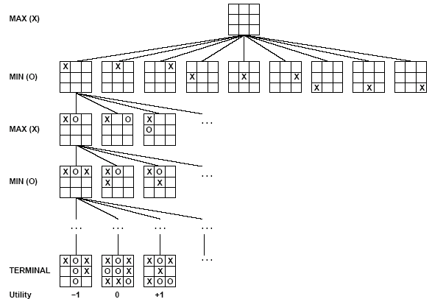
Partial Game Tree for Tic-Tac-Toe
Max tries to maximize utility (from X’s perspective) of move
Min tries to minimize utility (from X’s perspective) of move

Slide 14
Optimal Strategies
Find a contingent strategy for MAX assuming infallible MIN
Assumption: Both players play optimally
Given a game tree, the optimal strategy can be determined by using the minimax value of each node:
MINIMAX-VALUE(n)=
UTILITY(n) If n is a terminal
max_{s ∈ successors(n)} MINIMAX-VALUE(s) If n is a max node
min_{s ∈ successors(n)} MINIMAX-VALUE(s) If n is a min node
Implicitly defines a recursive search algorithm (Minimax)

Slide 15
Minimax
3
12
8
2
4
6
14
5
2
Minimize opponent’s chance
Maximize your chance

Slide 16
Minimax
3
2
2
MIN
3
12
8
2
4
6
14
5
2
Minimize opponent’s chance
Maximize your chance

Slide 17
Minimax
3
MAX
3
2
2
MIN
3
12
8
2
4
6
14
5
2
Minimize opponent’s chance
Maximize your chance

Slide 18
Minimax
3
MAX
3
2
2
MIN
3
12
8
2
4
6
14
5
2
Minimize opponent’s chance
Maximize your chance

Slide 19
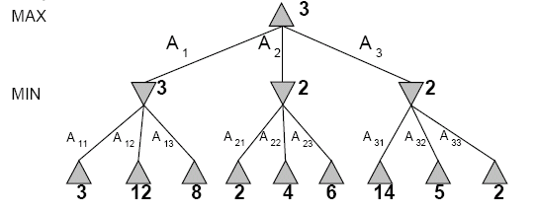
Two-Ply Game Tree
Search proceeds depth first
Backing up values as it completes search of successors
Minimax does its best for MAX under the assumption that MIN will do its worst
Notes:
End up at bottom left if both play optimally

Slide 20
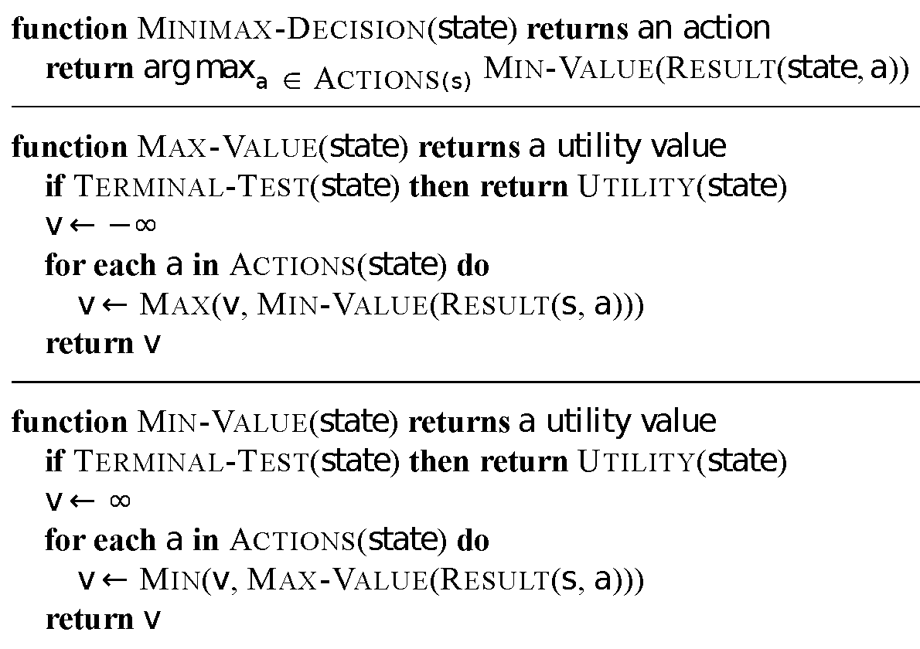
Minimax Algorithm

Slide 21
Evaluation of Minimax
Completeness
Yes (exhaustive)
Optimality
Yes (exhaustive)
Time complexity
O(b^{m})
Space complexity
O(bm) or O(m)
Time Complexity is the Big Problem

Slide 22
More on the α-β algorithm
MAX
…
MIN
5 10 6 2 8 7

Slide 23
More on the α-β algorithm
MAX
…
MIN
5 10 6 2 8 7

Slide 24
More on the α-β algorithm
MAX
…
MIN
5 10 6 2 8 7

Slide 25
More on the α-β algorithm
MAX
5
…
MIN
5 10 6 2 8 7

Slide 26
More on the α-β algorithm
Remember: MAX can get at least 5
MAX
5
…
MIN
5 10 6 2 8 7

Slide 27
More on the α-β algorithm
Remember: MAX can get at least 5
MAX
5
…
MIN
5 10 6 2 8 7

Slide 28
More on the α-β algorithm
Remember: MAX can get at least 5
MAX
5
…
MIN
5 10 6 2 8 7

Slide 29
More on the α-β algorithm
Remember: MAX can get at least 5
MAX
5
…
MIN
5 10 6 2 8 7

Slide 30
More on the α-β algorithm
Remember: MAX can get at least 5
MAX
5
…
MIN
5 10 6 2 8 7
MIN will only give MAX 2 if this subtree chosen

Slide 31
More on the α-β algorithm
Remember: MAX can get at least 5
MAX
5
…
MIN
5 10 6 2 8 7
MIN will only give MAX 2 if this subtree chosen

Slide 32
More on the α-β algorithm
Remember: MAX can get at least 5
MAX
5
…
MIN
5 10 6 2 8 7
MIN will only give MAX 2 if this subtree chosen
Don’t need to consider these nodes

Slide 33
Minimax Algorithm

Slide 34
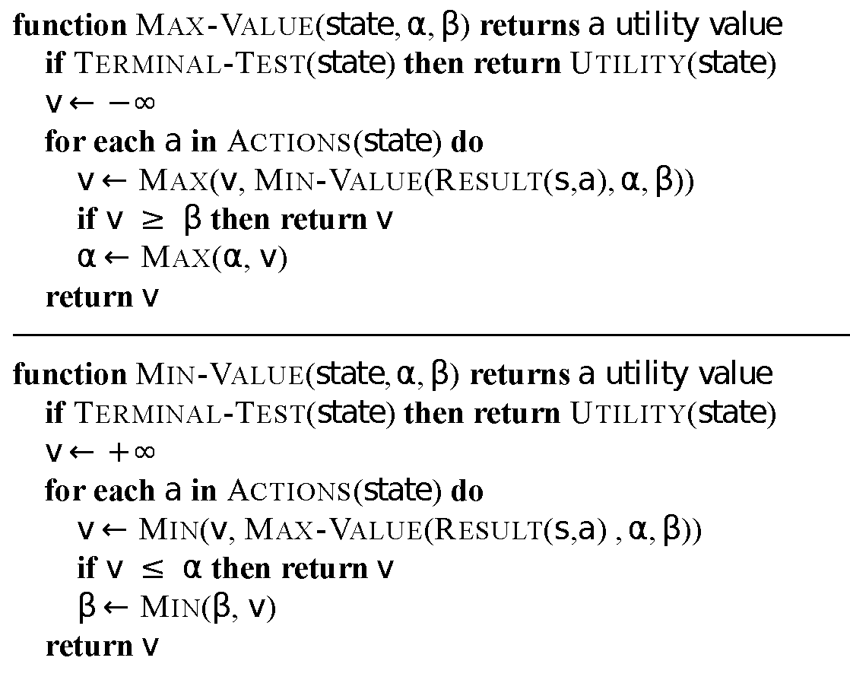
More on the α-β algorithm: start from Minimax

Slide 35
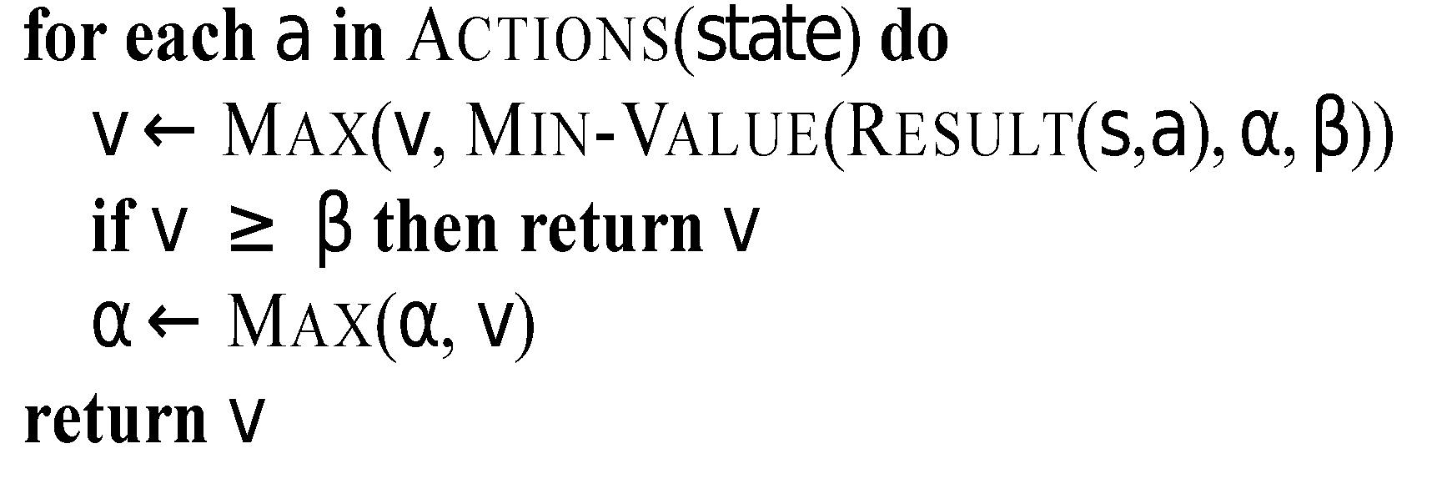
α = -∞
β = +∞
In Max-Value:
Max-Value loops
over these nodes
MAX
…
MIN
α = -∞
β = +∞
MAX
5 10 6 2 8 7

Slide 36
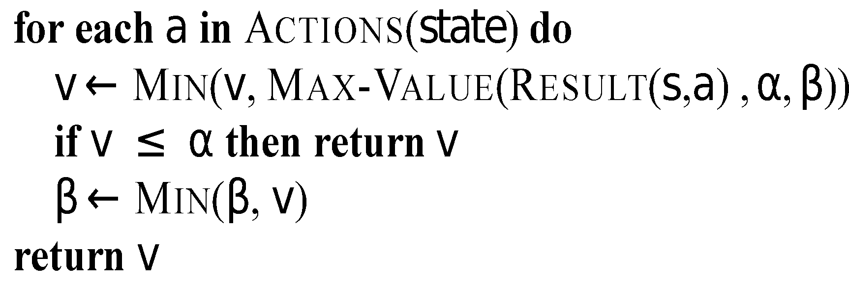
More on the α-β algorithm
α = -∞
β = +∞
MAX
In Min-Value:
MIN
…
α = -∞
β = +∞
Min-Value loops
over these nodes
MAX
5 10 6 2 8 7

Slide 37
More on the α-β algorithm
α = -∞
β = +∞
MAX
In Min-Value:
MIN
…
Min-Value loops
over these nodes
MAX
5 10 6 2 8 7

Slide 38
More on the α-β algorithm
α = -∞
β = +∞
MAX
In Min-Value:
MIN
…
α = -∞
β = 5
Min-Value loops
over these nodes
MAX
5 10 6 2 8 7

Slide 39
More on the α-β algorithm
α = -∞
β = +∞
MAX
In Min-Value:
MIN
…
α = -∞
β = 5
Min-Value loops
over these nodes
MAX
5 10 6 2 8 7

Slide 40
More on the α-β algorithm
In Max-Value:
MAX
α = 5
β = +∞
MIN
…
MAX
5 10 6 2 8 7

Slide 41
More on the α-β algorithm
In Max-Value:
MAX
Max-Value loops
over these nodes
α = 5
β = +∞
MIN
…
MAX
5 10 6 2 8 7

Slide 42
More on the α-β algorithm
MAX
α = 5
β = +∞
MIN
…
Min-Value loops
over these nodes
MAX
5 10 6 2 8 7

Slide 43
More on the α-β algorithm
In Min-Value:
MAX
α = 5
β = +∞
MIN
…
Min-Value loops
over these nodes
MAX
5 10 6 2 8 7

Slide 44
More on the α-β algorithm
In Min-Value:
MAX
α = 5
β = +∞
MIN
…
Min-Value loops
over these nodes
MAX
5 10 6 2 8 7

Slide 45
More on the α-β algorithm
In Min-Value:
MAX
α = 5
β = +∞
MIN
…
Min-Value loops
over these nodes
MAX
5 10 6 2 8 7

Slide 46
More on the α-β algorithm
In Min-Value:
MAX
= 5
β = +∞
v = 2
MIN
…
Min-Value loops
over these nodes
MAX
5 10 6 2 8 7

Slide 47
More on the α-β algorithm
In Min-Value:
MAX
= 5
β = +∞
v = 2
MIN
…
Min-Value loops
over these nodes
MAX
5 10 6 2 8 7
v <= α
End loop
Return 2

Slide 48
More on the α-β algorithm
MAX
Max-Value loops
over these nodes
MIN
…
MAX
5 10 6 2 8 7
β <= α
End loop
Return 5

Slide 49
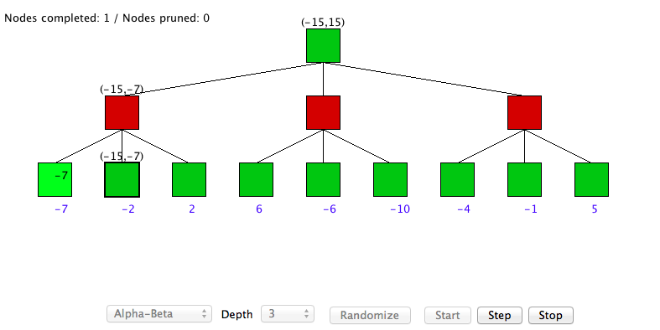
α-β algorithm DEMO
http://www.ocf.berkeley.edu/~yosenl/extras/alphabeta/alphabeta.html

Slide 50
Comments on Alpha-Beta
Pruning does not affect final results
Entire subtrees can be pruned
Good move ordering improves effectiveness of pruning
Want to look at best child first
With “perfect ordering,” time complexity is O(b^{m/2})
Search is effectively only half as deep [b^{(m/2)}]
Can look twice as far as minimax in the same amount of time
Various other improvements are also possible
However, still not good enough to reach end of any significant games in real time!

Slide 51
Making Game Search Tractable Shifting to Heuristic/Imperfect Information
Minimax and alpha-beta pruning require too much search to reach leaf nodes of game
Usually impractical within reasonable time bounds
Although recent approaches are doing huge searches offline and storing tables for use during games
Alternative
Cut off search earlier (replace TERMINAL-TEST by CUTOFF-TEST)
Apply heuristic evaluation function EVAL to replace the utility function of alpha-beta
Deal with other consequences of cutting off search

Slide 52
Cutting Off Search
Change:
if TERMINAL-TEST(state) then return UTILITY(state)
into
if CUTOFF-TEST(state,depth) then return EVAL(state)
Introduces a fixed-depth limit depth
Depth usually set by time available
When cuttoff occurs, the evaluation is performed

Slide 53
Heuristic EVAL
EVAL idea: produce an estimate of the expected value of the game at a given position
Performance depends critically on quality of EVAL
Desiderata:
EVAL should order terminal nodes in same way as UTILITY
Computing EVAL should not take too long
Whatever time is spent in EVAL isn’t spent searching other nodes
For non-terminal states, EVAL should be strongly correlated with the actual chance of winning

Slide 54
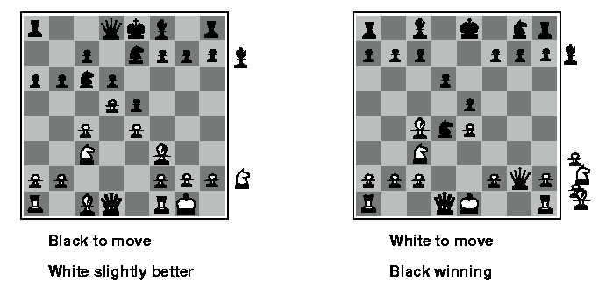
Evaluation functions
Weighted linear evaluation function: to combine n heuristics f = w₁f₁ ₊ w₂f_{2 + … +} w_{n}f_{n}
E.g, w’s could be the values of pieces (1 for prawn, 3 for bishop etc.) f’s could be the number of type of pieces on the board

Slide 55
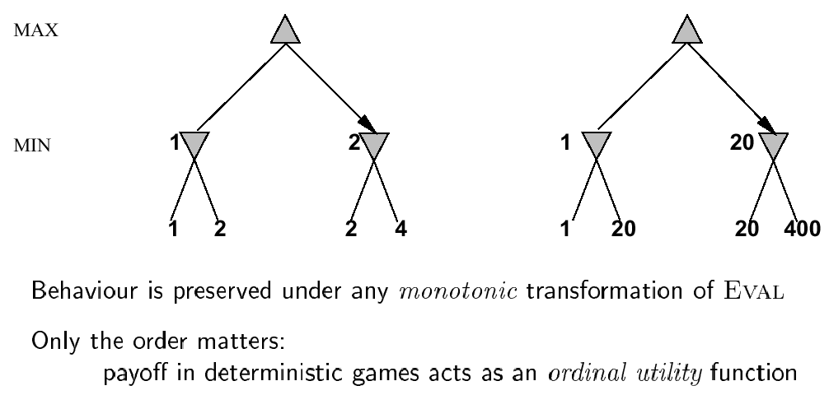
Note: exact values do not matter

Slide 56
General EVAL Considerations
Factors like material, mobility (options), stability (security) matter in many games
Cost of performing EVAL is critical
Trade off with searching more nodes
Capture as much as possible into tables ahead of time
Learning of parameters and patterns can be crucial for high performance

Slide 57
Key Problem with Cutoff/EVAL
Can’t see what happens beyond cutoff
Can overvalue a position where disaster will happen immediately after last ply actually searched
E.g., in chess, where queen is taken on next move
Can add useless or counterproductive delaying moves to push disasters past cutoff
Called the horizon effect
Searching deeper helps avoid both problems
There are also approaches for going deeper selectively
E.g., Quiescence search and singular extensions
Notes:
Quiescence search: Search active positions (evaluation more labile) than quiet positions
Singular extensions: Extend search one ply for moves that are relevant and look much better than alternatives

Slide 58
Beyond α-β and EVAL
Techniques for reducing search further
Better algorithms or better orderings for α-β
Time management
Allocation across moves (based on criticality/need)
Anytime algorithm – produces ok solution quickly then improves
Iterative deepening helps with both search and time
Use results from previous iterations to order later searches
When time elapses, use result from last completed iteration
Opening books and endgame tables
Store information about what to do in key positions
Either precomputed or gathered from experts
Deep Blue went in for this big time
In the extreme, can solve a game
Checkers (~10²⁰ positions) was solved in 2007 after 10¹⁴ calculations over 18 years
It is a draw if played perfectly by both sides

Slide 59
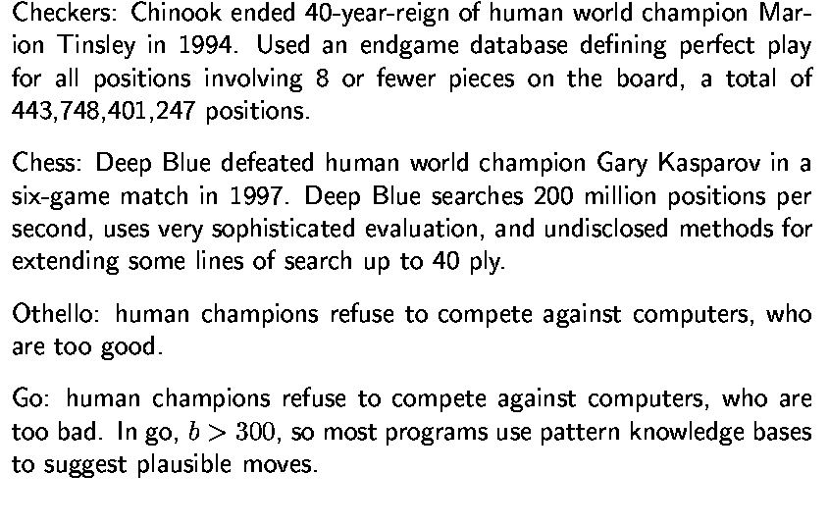
State-of-the-art for deterministic games

Slide 60
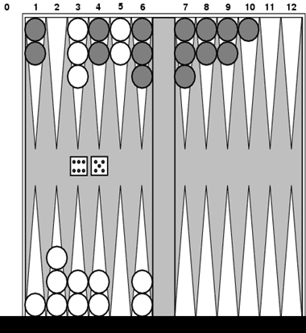
Games Involving Chance (Backgammon)
White moves clockwise from top-left to bottom-left
Black moves counter-clockwise from bottom-left to top-left
Roll of dice determines legal moves
Can move disks to any point that doesn’t have multiple opponents
Possible moves for White here:
(5-10,5-11), (5-11,19-24),(5-10,10-16) and (5-11,11-16)
To win, move all pieces off board, once have all in home area
There is more complexity than this really

Slide 61
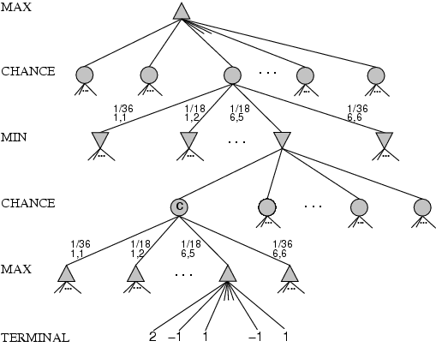
Games Involving Chance
chance nodes
Dice rolls: [1,1], …, [6,6] occur 1/36, all others occur 1/18
Can not calculate definite minimax value, only expected value

Slide 62
Expected Minimax
EXPECTIMINIMAX(s)=
UTILITY(s) If TERMINAL-TEST(s)
max_{a} EXPECTIMINIMAX(RESULT(s, a)) If PLAYER(s)=MAX
min_{a} EXPECTIMINIMAX(RESULT(s, a)) If PLAYER(s)=MIN
∑_{r} P(r)*EXPECTIMINIMAX(RESULT(s, r)) If PLAYER(s)=CHANCE
These equations can be backed-up recursively to the root of the game tree, just as with regular minimax
Time complexity is O(b^{m}n^{m}), where n is number of distinct rolls
Analogues of alpha-beta exist
Notes:
R is a random choice

Slide 63
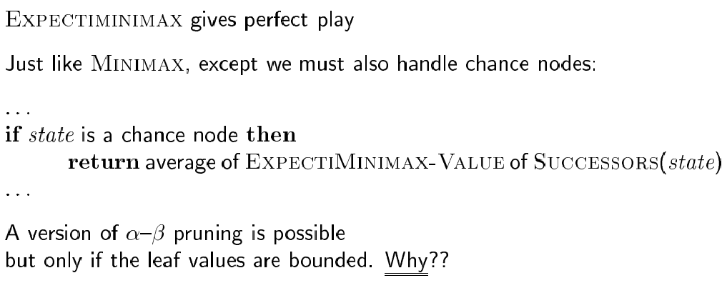
Algorithm for nondeterministic games

Slide 64
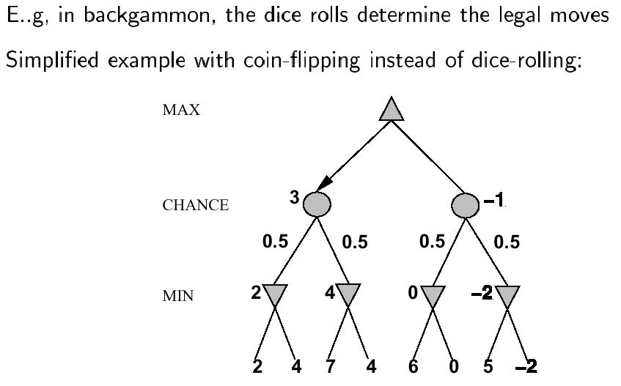
Nondeterministic games

Slide 65
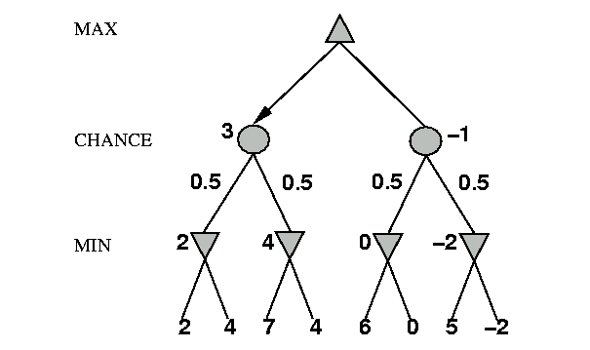
Nondeterministic games: the element of chance
expectimax and expectimin, expected values over all possible outcomes
CHANCE
?
0.5
0.5
3
?
?
8
17
8

Slide 66
Nondeterministic games: the element of chance
4= 0.5*3 + 0.5*5
Expectimax
CHANCE
0.5
0.5
5
3
5
Expectimin
8
17
8

Slide 67
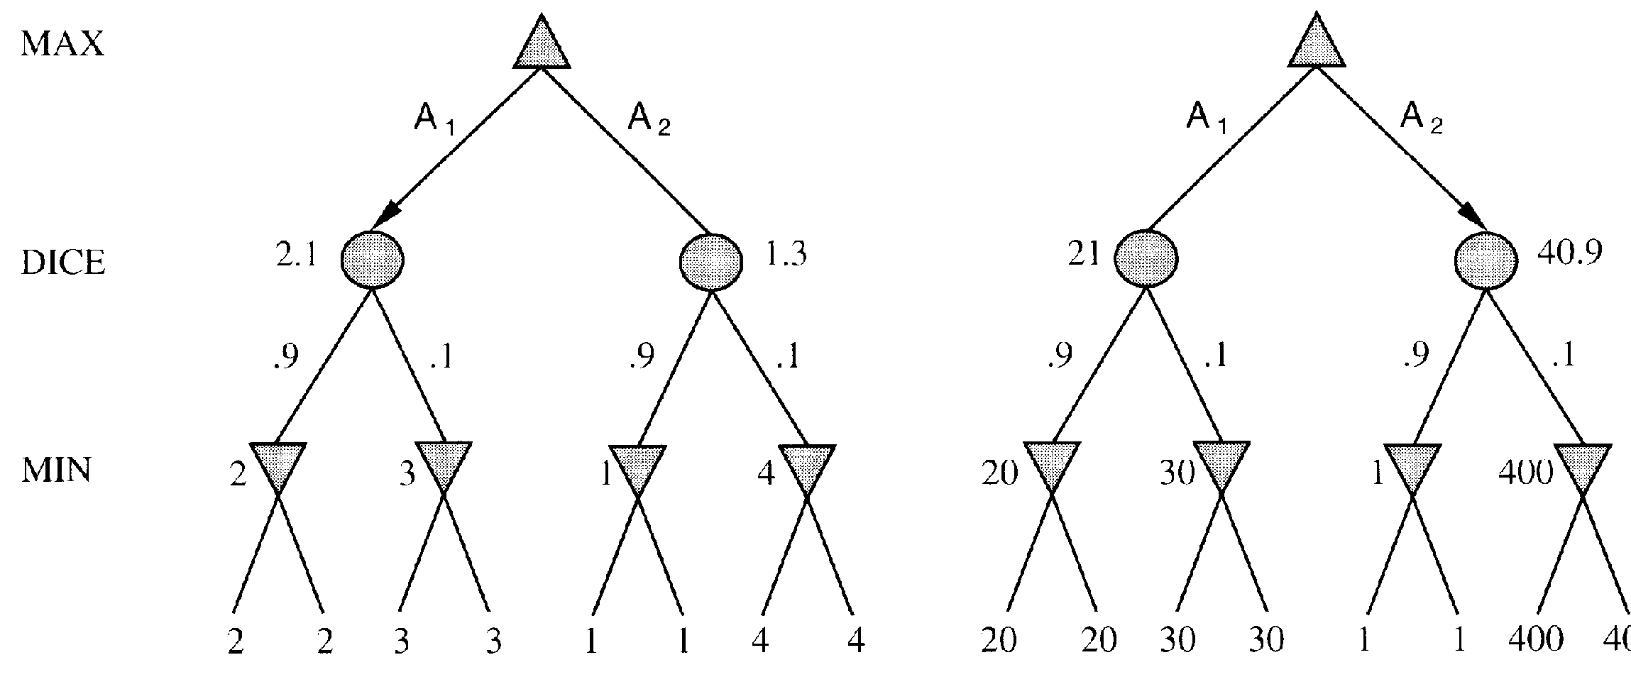
Evaluation functions: Exact values DO matter
Order-preserving transformation do not necessarily behave the same!
400

Slide 68
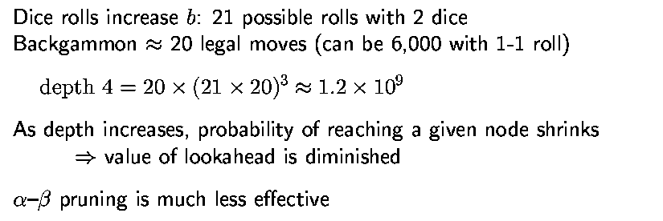
Isssues for nondeterministic games

Slide 69
Summary
Games are fun to work on!
Illustrate key points about AI:
Perfection not possible => Must approximate!
Important to have multiple ways of doing something e.g. To answer “what move to make?” can use:
Search
Evaluation function
Must operate in an uncertain world
For next time: Chapter 6: Constraint Satisfaction Problems

Slide 70
CSCI 561 Foundations of Artificial Intelligence Constraint Satisfaction Problems (Chapter 6)
Summer 2017
INSTRUCTOR:
PROF. SHEILA TEJADA (STEJADA@USC.EDU)

Slide 71
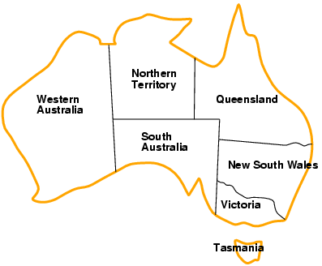
Example: map coloring problem
Variables: WA, NT, Q, NSW, V, SA, T
Domains: D_{i} = {red, green, blue} (one for each variable)
Constraints: C_{i} = <scope, rel > where scope is a tuple of variables and rel is the relation over the values of these variables
E.g., here, adjacent regions must have different colors e.g., WA ≠ NT, or (WA,NT) in {(red,green), (red,blue), (green,red), (green,blue), (blue,red), (blue,green)}

Slide 72
Example: map coloring problem
Assignment: values are given to some or all variables
Consistent (legal) assignment: assigned values do not violate any constraint
Complete assignment: every variable is assigned
Solution to a CSP: a consistent and complete assignment

Slide 73
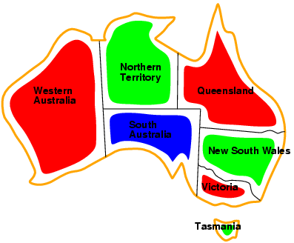
Example: map coloring problem
Solutions are complete and consistent assignments,
e.g., WA = red, NT = green, Q = red, NSW = green, V = red, SA = blue, T = green

Slide 74
So what?
What’s the big deal about CSPs?

Slide 75
Here’s what!
Many problems are naturally formulated as CSPs
Way easier to use an off-the-shelf CSP solver than build (and debug) your own representations and software
CSP solvers can be much faster than state-space searchers
Eliminate choices quickly

Slide 76
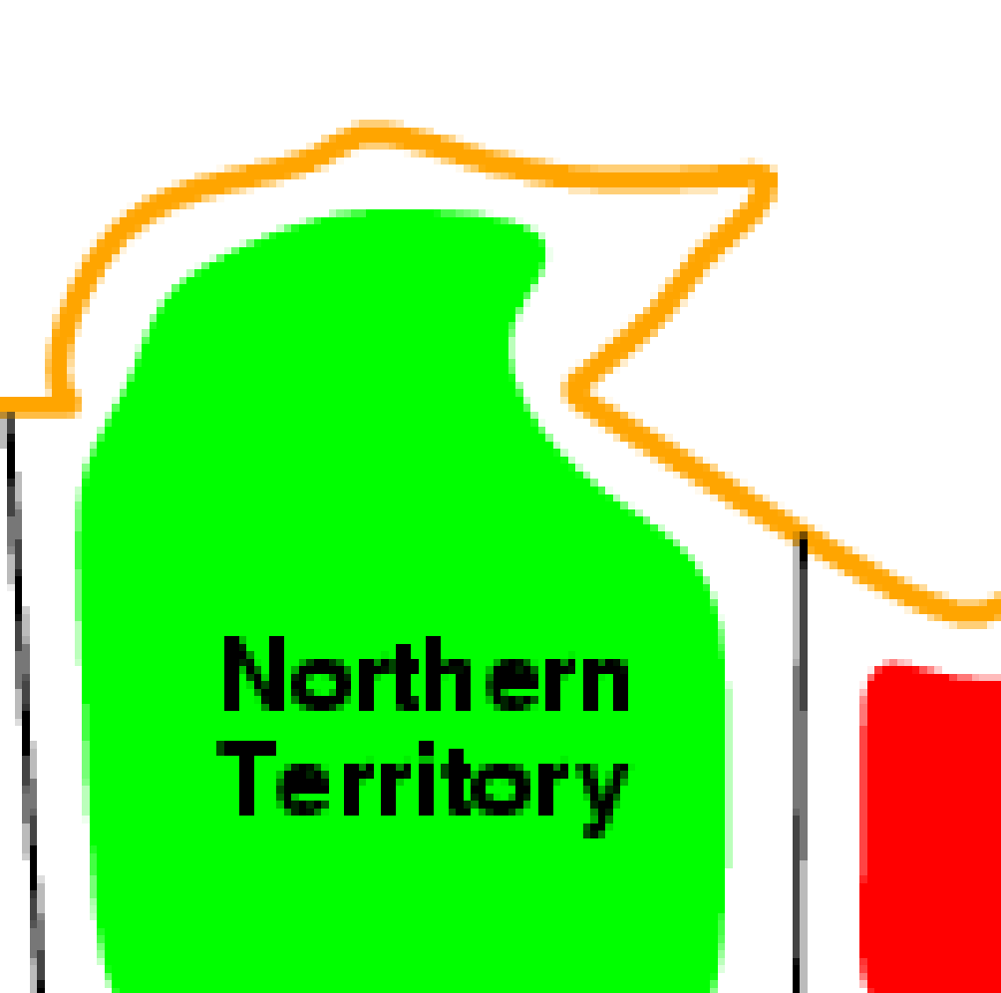
Here’s what!
CSP solvers can be much faster than state-space searchers
Eliminate choices quickly
Make SA = BLUE
Nothing touching can be blue
State space searchers would consider 3⁵ choices
With constraint propagation in CSP only consider 2⁵, an 87% reduction

Slide 77
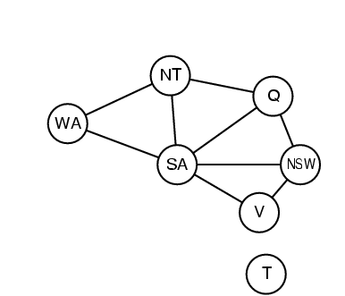
Constraint graph
Binary constraint: each constraint relates two variables
Constraint graph: nodes are variables, arcs are constraints

Slide 78
Varieties of CSPs
Discrete variables
finite domains:
n variables, domain size d → O(d^{n}) complete assignments
e.g., Boolean CSPs, incl.~Boolean satisfiability (NP-complete)
infinite domains:
integers, strings, etc.
e.g., job scheduling, variables are start/end days for each job
need a constraint language, e.g., StartJob₁ + 5 ≤ StartJob₃
Continuous variables
e.g., start/end times for Hubble Space Telescope observations

Slide 79
Varieties of constraints
Unary constraints involve a single variable,
e.g., SA ≠ green
Binary constraints involve pairs of variables,
e.g., SA ≠ WA
Higher-order (sometimes called global) constraints involve 3 or more variables,
e.g. ALL_DIFFERENT(SA, WA, Q)

Slide 80
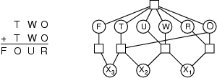
Example: cryptarithmetic
Variables: F T U W R O X₁ X₂ X₃
Domains: {0,1,2,3,4,5,6,7,8,9}
Constraints: Alldiff (F,T,U,W,R,O)
O + O = R + 10 · X₁
X₁ + W + W = U + 10 · X₂
X₂ + T + T = O + 10 · X₃
X₃ = F, T ≠ 0, F ≠ 0
Constraint hypergraph
Circles: nodes for variable
Squares: hypernodes for n-ary constraints

Slide 81
Real-world CSPs
Assignment problems
e.g., who teaches what class
Timetabling problems
e.g., which class is offered when and where?
Transportation scheduling
Factory scheduling
Many real-world problems involve real-valued variables

Slide 82
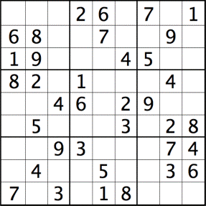
Example: sudoku
?
Variables: each square (81 variables)
Domains: [1 .. 9]
Constraints: each column, each row, and each of the nine 3×3 sub-grids that compose the grid contain all of the digits from 1 to 9

Slide 83
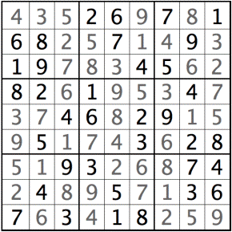
Example: sudoku
Variables: each square (81 variables)
Domains: [1 .. 9]
Constraints: each column, each row, and each of the nine 3×3 sub-grids that compose the grid contain all of the digits from 1 to 9

Slide 84
Formulation as a search problem
Let's start with the straightforward approach, then fix it
States are defined by the values assigned so far
Initial state: the empty assignment { }
Successor function: assign a value to an unassigned variable that does not conflict with current assignment
→ fail if no legal assignments
Goal test: the current assignment is complete
This is the same for all CSPs
Every solution appears at depth n with n variables → use depth-first search
Path is irrelevant, so can be discarded
b = (n - l )d at depth l, hence n! · d^{n} leaves

Slide 85
Backtracking search
Variable assignments are commutative, i.e.,
[ WA = red then NT = green ] same as [ NT = green then WA = red ]
Only need to consider assignments to a single variable at each node
→ b = d and there are d^{n} leaves
Depth-first search for CSPs with single-variable assignments is called backtracking search
Backtracking search is the basic uninformed algorithm for CSPs
Can solve n-queens for n ≈ 25

Slide 86
Backtracking Search
empty assignment
1st variable
2nd variable
3rd variable
Assignment = {}

Slide 87
Backtracking Search
empty assignment
1st variable
2nd variable
3rd variable
Assignment = {(var1=v11)}

Slide 88
Backtracking Search
empty assignment
1st variable
2nd variable
3rd variable
Assignment = {(var1=v11),(var2=v21)}

Slide 89
Backtracking Search
empty assignment
1st variable
2nd variable
3rd variable
Assignment = {(var1=v11),(var2=v21),(var3=v31)}

Slide 90
Backtracking Search
empty assignment
1st variable
2nd variable
3rd variable
Assignment = {(var1=v11),(var2=v21),(var3=v32)}

Slide 91
Backtracking Search
empty assignment
1st variable
2nd variable
3rd variable
Assignment = {(var1=v11),(var2=v22)}

Slide 92
Backtracking Search
empty assignment
1st variable
2nd variable
3rd variable
Assignment = {(var1=v11),(var2=v22),(var3=v31)}

Slide 93
Improving backtracking efficiency
General-purpose methods can give huge gains in speed (like using heuristics in informed search):
Which variable should be assigned next?
In what order should its values be tried?
Can we detect inevitable failure early?

Slide 94

Most constrained variable
Most constrained variable:
choose the variable with the fewest legal values
a.k.a. minimum remaining values (MRV) heuristic

Slide 95

Most constraining variable
Tie-breaker among most constrained variables
Most constraining variable:
choose the variable with the most constraints on remaining variables

Slide 96
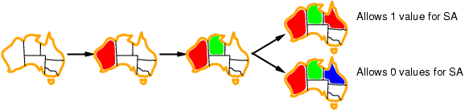
Least constraining value
Given a variable, choose the least constraining value:
the one that rules out the fewest values in the remaining variables
Combining these heuristics makes 1000 queens feasible

Slide 97
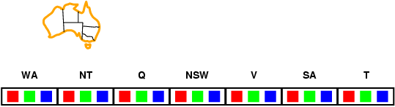
Forward checking
Idea:
Keep track of remaining legal values for unassigned variables (inference step)
Terminate search when any variable has no legal values

Slide 98
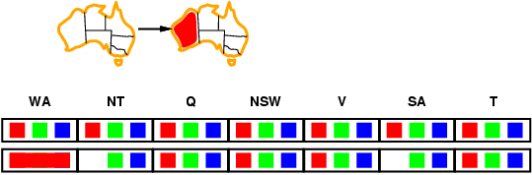
Forward checking
Idea:
Keep track of remaining legal values for unassigned variables (inference step)
Terminate search when any variable has no legal values

Slide 99
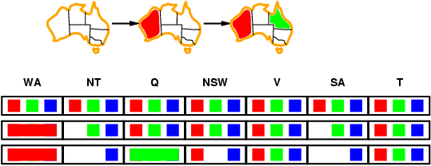
Forward checking
Idea:
Keep track of remaining legal values for unassigned variables
Terminate search when any variable has no legal values

Slide 100
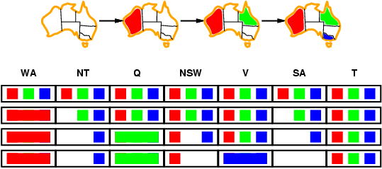
Forward checking
Idea:
Keep track of remaining legal values for unassigned variables
Terminate search when any variable has no legal values

Slide 101
Forward Checking Limitations
Forward checking propagates information from assigned to unassigned variables, but doesn't provide early detection for all failures:
NT and SA are next to each other and cannot both be blue!
Constraint propagation repeatedly enforces constraints locally

Slide 102
Node and Arc consistency
A single variable is node-consistent if all the values in its domain satisfy the variable’s unary constraints
A variable is arc-consistent if every value in its domain satisfy the binary constraints
i.e., Xi arc-consistent with Xj if for every value in Di there exists a value in Dj that satisfies the binary constraints on arc (Xi, Xj)
A network is arc-consistent if every variable is arc-consistent with every other variable.
Arc-consistency algorithms: reduce domains of some variables to achieve network arc-consistency.

Slide 103
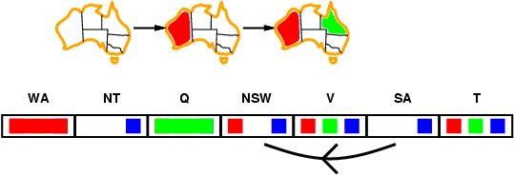
Arc consistency
Simplest form of propagation makes each arc consistent
X →Y is consistent iff
for every value x of X there is some allowed y

Slide 104
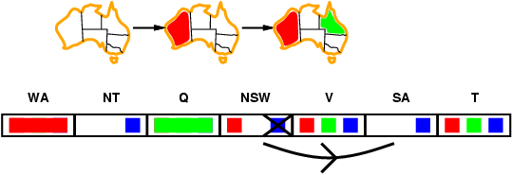
Arc consistency
Simplest form of propagation makes each arc consistent
X →Y is consistent iff
for every value x of X there is some allowed y

Slide 105
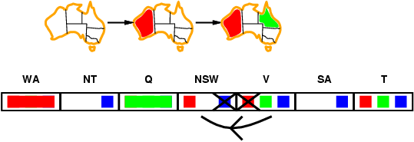
Arc consistency
Simplest form of propagation makes each arc consistent
X →Y is consistent iff
for every value x of X there is some allowed y
If X loses a value, neighbors of X need to be rechecked

Slide 106
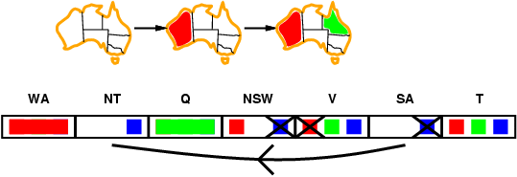
Arc consistency
Simplest form of propagation makes each arc consistent
X →Y is consistent iff
For every value x of X there is some allowed y
If X loses a value, neighbors of X need to be rechecked
Arc consistency detects failure earlier than forward checking
After running AC-3, either every arc is arc-consistent or some variable has empty domain, indicating the CSP cannot be solved.
Can be run as a preprocessor or after each assignment

Slide 107
Arc consistency algorithm AC-3
Start with a queue that contains all arcs
Pop one arc (Xi, Xj) and make Xi arc-consistent with respect to Xj
If Di was not changed, continue to next arc,
Otherwise, Di was revised (domain was reduced), so need to check all arcs connected to Xi again: add all connected arcs (Xk, Xi) to the queue. (this is because the reduction in Di may yield further reductions in Dk)
If Di is revised to empty, then the CSP problem has no solution.

Slide 108
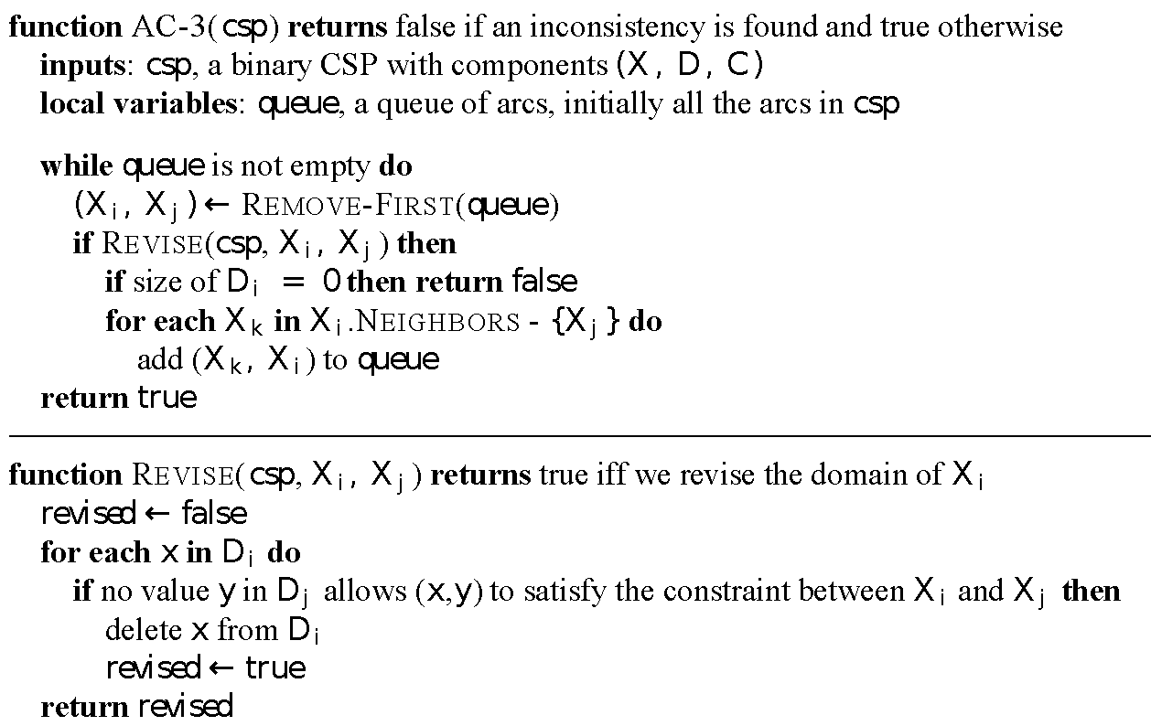
Arc consistency algorithm AC-3
Time complexity: ? (n variables, d values)

Slide 109
Arc consistency algorithm AC-3
Time complexity: O(n²d³) (n variables, d values)
(each arc can be queued only d times, n² arcs (at most), checking one arc is O(d²))

Slide 110
Local search for CSPs
Hill-climbing, simulated annealing typically work with "complete" states, i.e., all variables assigned
To apply to CSPs:
allow states with unsatisfied constraints
operators reassign variable values
Variable selection: randomly select any conflicted variable Value selection by min-conflicts heuristic:
choose value that violates the fewest constraints
i.e., hill-climb with h(n) = total number of violated constraints

Slide 111
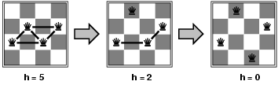
Example: 4-Queens
States: 4 queens in 4 columns (4⁴ = 256 states)
Actions: move queen in column
Goal test: no attacks
Evaluation: h(n) = number of attacks
Given random initial state, can solve n-queens in almost constant time for arbitrary n with high probability (e.g., n = 10,000,000)

Slide 112
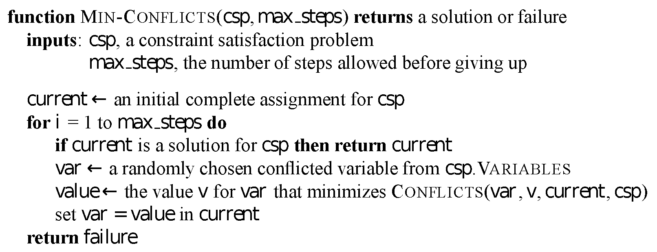
Example: 4-Queens

Slide 113
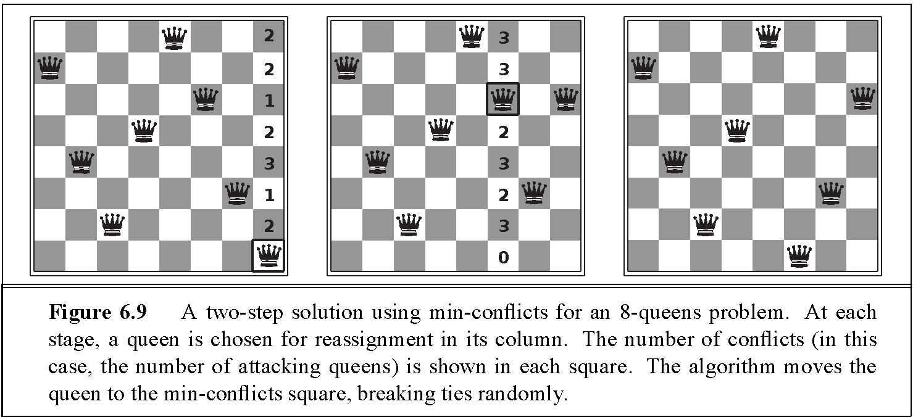
Example: 4-Queens

Slide 114
Summary
CSPs are a special kind of problem:
states defined by values of a fixed set of variables
goal test defined by constraints on variable values
Backtracking = depth-first search with one variable assigned per node
Variable ordering and value selection heuristics help significantly
Forward checking prevents assignments that guarantee later failure
Constraint propagation (e.g., arc consistency) does additional work to constrain values and detect inconsistencies
Iterative min-conflicts is often surprisingly effective in practice

Slide 115
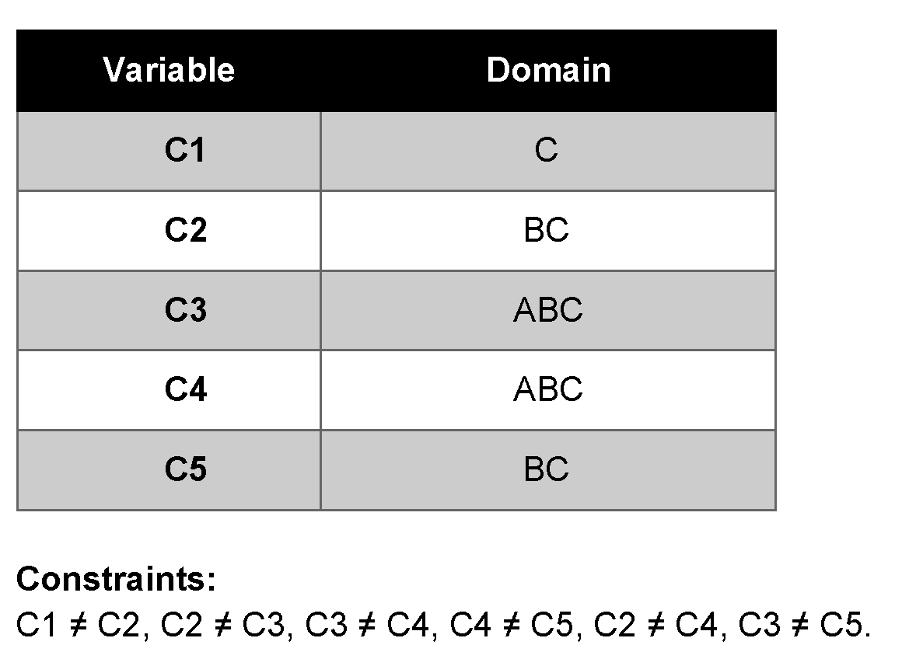
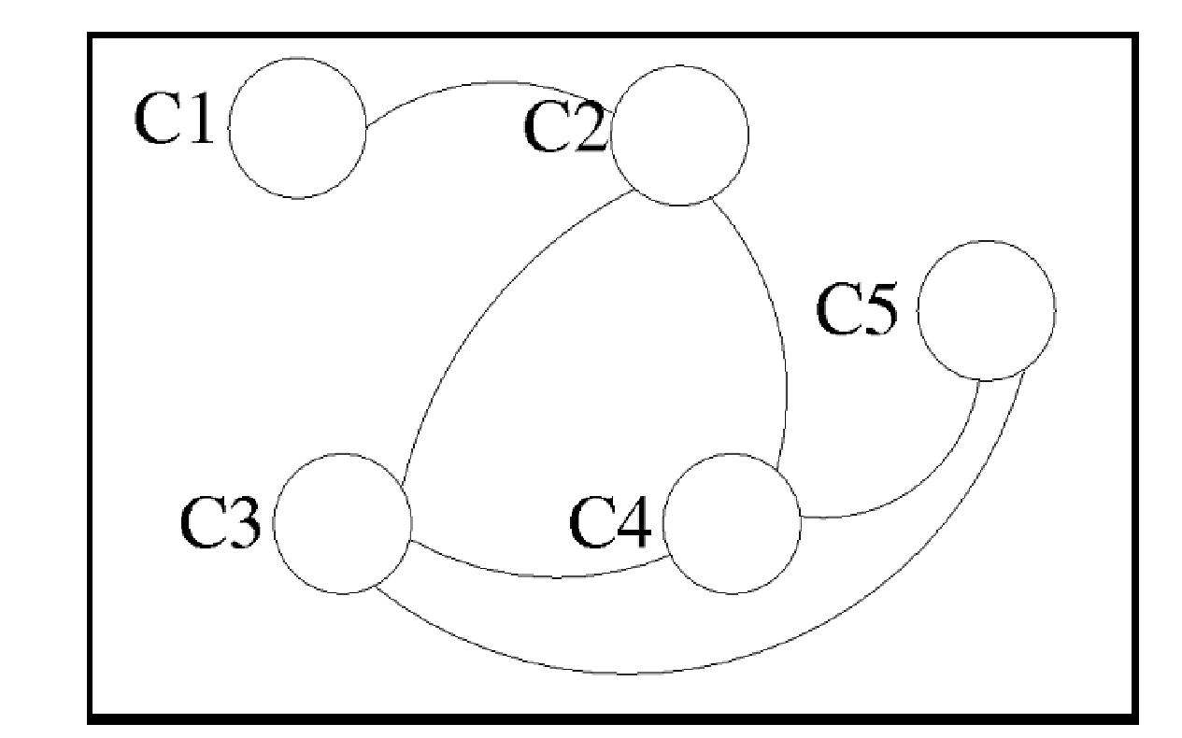
The schedules of the customers are:
Company 1: Webflix: 8:00-9:00am
Company 2: Anazon: 8:30-9:30am
Company 3: Pied Piper: 9:00-10:00am
Company 4: Hooli: 9:00-10:00am
Company 5: Gulu: 9:30-10:30am
Using Company as variable, formulate this problem as a CSP problem with variables, domains, and constraints. Constraints should be specified formally and precisely, but may be implicit rather than explicit. Draw the constraint graph associated with your CSP.
The profiles of your engineers are:
Albacore can maintain Pied Piper and Hooli.
Bosam can maintain all companies, but Webflix.
Coleslaw can maintain all companies.

Slide 116
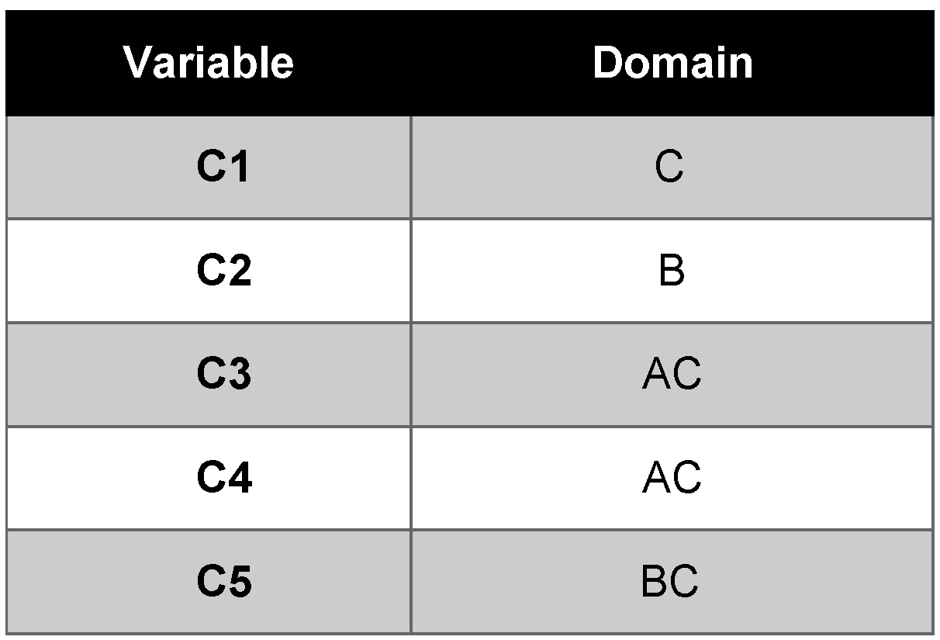
Show the domains of the variables after running arc-consistency on this initial graph (after having already enforced any unary constraints).
Give one solution to this CSP.

