Slide 1
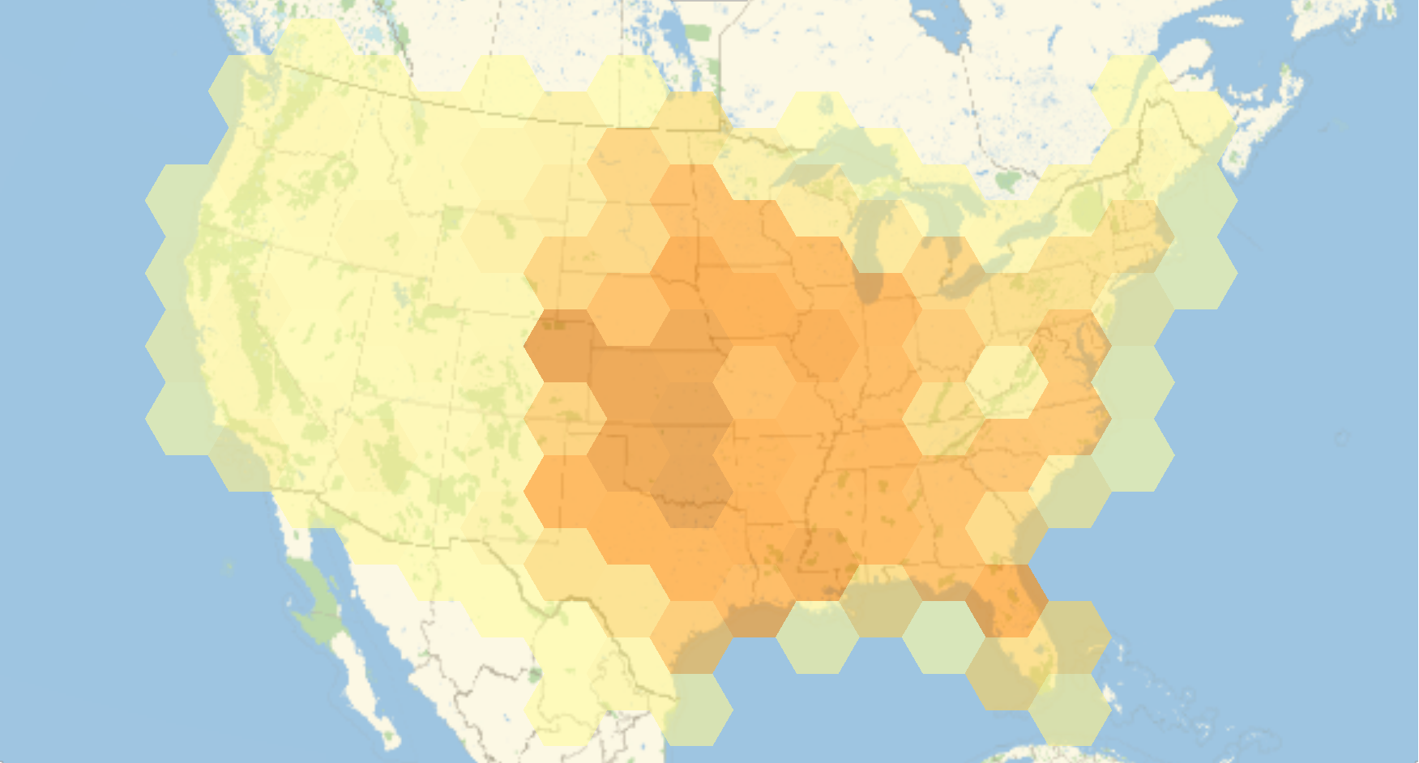
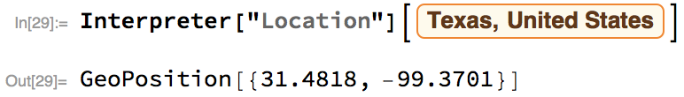
Dataset and problem
The dataset contains the tornadoes in the U.S., 1950-2015
Zhangliang Dong
We have 51, 192 records measured in Fujita Scale and 10, 025 records in Enhanced Fujita Scale. We only consider the data in Fujita scale.
March, April, and May are more likely to have tornadoes.
I extract year, month and day from date.
Tornadoes are strongly related to location. We change the Location labels into geo positions.

Slide 2
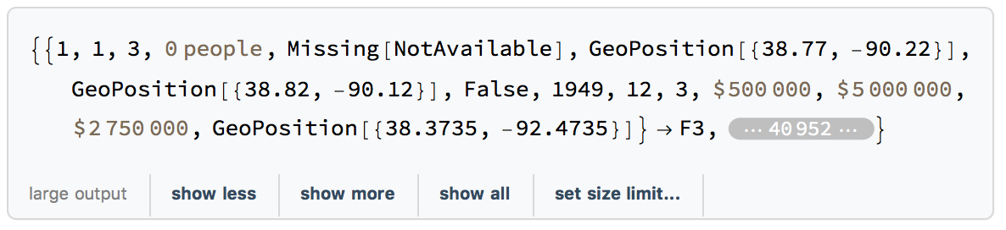
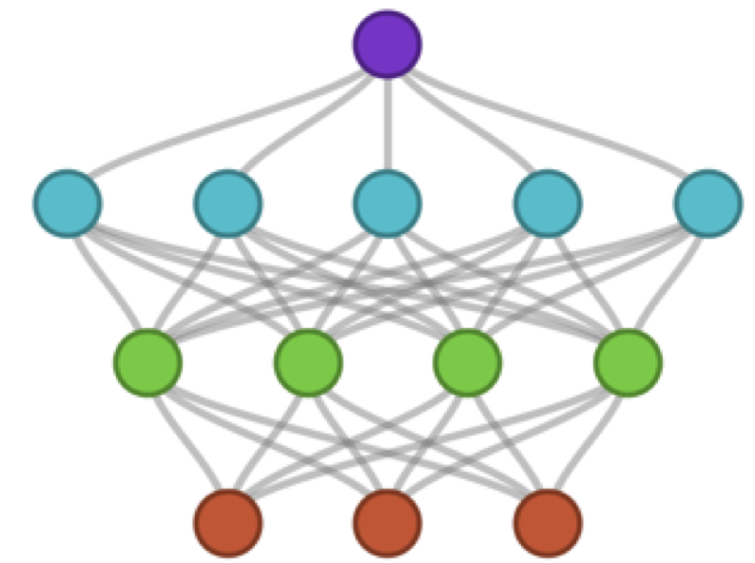
Classify
The training dataset.
Neural Network
Random Forest
Nearest Neighbors
Training time
630.54 s
643.07 s
652.79 s
Advantages
Neural Network is good at capturing some particular patterns in the data. It is a general approximate function good to handle the nonlinear data.
A random forest is simply a collection of decision trees. It takes each feature as the step for making the decision. It works just like how people decide the magnitude of the tornadoes
Nearest Neighbor divides the data into different cells. This method may be a good match with the fact that tornadoes are strongly related to month and location.

Slide 3
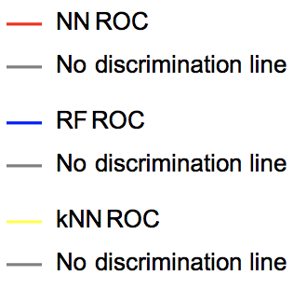
Result & Comparison
In these ROC curves on the right, the random forest also shows the best performance.
F0
F1
F2
The random forest model performs the best in term of precision in each class.
F3
F4
F5
Neural Network | 62.54%
Random Forest | 67.07%
Nearest Neighbors | 55.30%
Again, the random forest beats the other two in accuracy.

