Slide 1
Artificial Intelligence Lecture 11: Quantifying Uncertainty (Uncertain Knowledge and Reasoning, Chapter 13&14)
Summer 2017
Instructor: Prof sheila Tejada
Notes:
Earlier dealt with uncertainty to a limited extent via such things as defaults and nonmonotonicity in logic
Here take a dramatically different approach that has reshaped much of the field in the past few decades
As when started with logic, will be introducing a bunch of new terminology today

Slide 2
Uncertainty Coping with What You Don’t Grasp
Outside scope of awareness
Beyond range of sensors (partial observability)
In the future and incompletely predictable
In the past but prehistoric (no relevant memory)
Too complex to reason about in complete detail
Reasoning may need to be incomplete
Reasoning may need to be abstracted
Too expensive or risky to ensure certainty
E.g., medical diagnostic procedures or military questions
Problem/information has inherent randomness

Slide 3


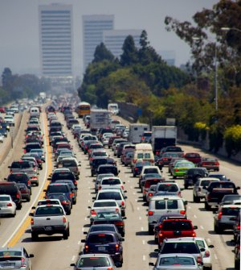
Example When to Leave for Airport?
Requires understanding how long it is likely to take to get there (mean), and how likely there is to be a significant deviation from this expectation (variance)
Leads to decision making under significant uncertainty
A range of possible causes for this uncertainty
Partial observability
State of roads, other drivers’ plans, etc.
Noisy sensors (introducing errors, not just lack of info)
Traffic reports, etc.
Uncertainty in action outcomes
Flat tire, accident, etc.
Uncertainty about how traffic will evolve over time
Complexity of modeling and predicting traffic

Slide 4
Logic and Uncertainty
Logic generally talks in terms of certainty
A fact is either true or false
Although may be unknown as a very generic form of uncertainty
A rule applies to all cases or not
Need at times to be able to talk instead about how (un)certain you are about something
Default Logics enable one form of this
Can talk about something as being consistent, as a weaker statement than that something is true
But often need more shades of meaning than this
Risk either stating things as true that are false or leaving as unknown something about which key information is known

Slide 5
Airport Example (Cont.)
Can we state with certainty that leaving for the airport 30 minutes ahead will get us there on time?
No!
Must we leave for the airport 5 hours ahead because we can’t state with certainty that leaving earlier will get us there on time?
I hope not!
Instead need to represent and reason about likelihoods of various events and outcomes
Probability is the standard means of formalizing and reasoning about likelihood

Slide 6
Probability
“Probability is the chance that something is likely to happen or be the case.” (Wikipedia)
This is objective probability
E.g., P(heads)=P(tails)=1/2
Our focus will be on subjective probability
An agent’s estimated likelihood of the truth of a sentence
Modal/meta-level knowledge about a sentence, rather than knowledge directly about the world
E.g., ‘I believe that the chance is .35 that the sentence “It will take 25 minutes to get to the airport” is true’
Probabilistic assertions summarize effects of
Laziness: failure to enumerate exceptions, qualifications, etc.
Ignorance: lack of relevant facts, initial conditions, etc.
Approach is to summarize over all of these effects even without fully understanding them
“Quantifying ignorance”

Slide 7

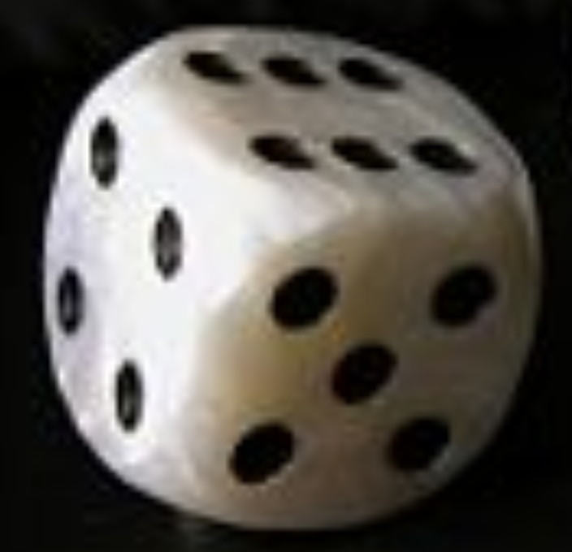
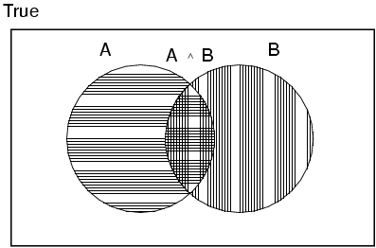
Basic Concepts of Probability
1.
P(x) is a real number in [0, 1]
that represents the likelihood that x is true
P(x)=1 ⇒ Certainty
P(true)=1
P(x)=0 ⇒ Impossibility
P(false)=0
0<P(x)<1 ⇒ Uncertainty (varying levels)
For a fair coin, P(heads)=P(tails)=.5
For a fair die, P(1)=…=P(6)=.166…
P(A ∨ B) = P(A) + P(B) - P(A ∧ B)
.
Notes:
How many have had a previous introduction to probability?

Slide 8
More on Probability
P(x∧y)=P(x)P(y) if x and y are independent
P(heads¹∧heads²)=P(heads¹)P(heads²)=.5*.5=.25
P(AinCourse∧Raining)=P(AinCourse)P(Raining)
No general way to compute when not independent, except…
P(x∧y)=0 if x and y are mutually exclusive
P(AinCourse∧BinCourse)=0
P(x∧¬x)=0
Makes P(x∨y)=P(x)+P(y) by Axiom 3
P(x)=P(y) if x=y (logically equivalent)
P(x₁∨…∨x_{n})=1 if the x_{i}’s are exhaustive
P(heads ∨ tails)=1
P(x∨¬x)=1
P(¬x)=1-P(x)
1=P(x∨¬x)=P(x)+P(¬x)-P(x∧¬x)
1=P(x)+P(¬x)-0
In general, summing probabilities over any partition yields 1

Slide 9
Random Variables
Degrees of belief (probabilities) are applied to propositions
Essentially a modal extension to propositional logic
Basic language element is the random variable
Refers to a part of the world of interest
E.g., CourseGrade, CoinSideUp, Weather
A random variable has a value, but we are uncertain as to what this value is
Does Weather=sunny or Weather=cloudy or …?
Does AinCourse=true or AinCourse=false?
Analogous to a function with zero arguments in FOL
The values of a random variable come from a domain

Slide 10
Domains of Random Variables
Boolean random variables have domain <true, false>
e.g., AinCourse or CoinIsHeads
Discrete random variables have countable domains
Weather has domain <sunny,rainy,cloudy,snow>
CourseGrade has domain <A,B,C,D,F>
Boolean random variables are a special case
Continuous random variables have real domains
Temperature (K) is in [0,∞]
Domain values must provide a partition
The values must be exhaustive and mutually exclusive
The sum of p over the domain must yield 1

Slide 11
Constructing Propositions from Random Variables
Elementary propositions are constructed as a test of a value of a random variable
E.g., AinCourse=true, Weather=sunny, Temperature≥200
Can abbreviate when unambiguous
Boolean
Instead of AinCourse=true, just use aincourse
Instead of AinCourse=false, just use ¬aincourse
Discrete
Instead of Weather=sunny, just use sunny
Complex propositions are formed from elementary propositions and standard logical connectives
e.g., Weather=sunny ∨ Cavity=false

Slide 12
Atomic Events
An atomic event is a complete specification of state of the world about which agent is uncertain
E.g., if the world consists of only two Boolean random variables, Cavity and Toothache, then there are 4 distinct atomic events:
Cavity=false ∧Toothache=false
Cavity=false ∧ Toothache=true
Cavity=true ∧ Toothache=false
Cavity=true ∧ Toothache=true
Atomic events are analogous to models in logic
Each atomic event entails the truth of every proposition with respect to that world
E.g., in AE4, cavity⇒toothache is true
The set of possible atomic events is a partition

Slide 13
Probability Distributions
A probability distribution for a random variable specifies probabilities for all values in its domain
Defines a normalized (sums to 1) vector of values
Given the domain of Weather as <sunny,rain,cloudy,snow>, could specify probabilities for domain elements as:
P(Weather=sunny)=.72, P(Weather=rain)=.1,
P(Weather=cloudy)=.08, P(Weather=snow)=.1
Or, as a vector of values: P(Weather) = <.72,.1,.08,.1>
For continuous domains, get a probability density function
Every precise value has essentially a zero probability, but density function shows how mass is distributed
Will not focus on continuous case here

Slide 14
Joint Probability Distribution
A joint probability distribution for a set of random variables gives the probability of every atomic event on those random variables
P(Weather,AinClass) = a 4 × 2 matrix of values:
Weather = sunny rainy cloudy snow
AinClass = true 0.144 0.02 0.016 0.02
AinClass = false 0.576 0.08 0.064 0.08
A full joint probability distribution covers all of the random variables used to describe the world
Weather, Temperature, Cavity, Toothache, AinClass, etc.
Every question about world is answerable by full joint distribution

Slide 15

Probabilistic Inference by Enumeration
Can perform probabilistic inference by enumerating over (full) joint probability distribution
Analogous to model checking in propositional logic, but here we are summing probabilities over all action events rather than checking for satisfiability in one or all of the models
Start with the joint probability distribution P(Cavity,Toothache,Catch)
For any proposition φ, sum p for atomic events where true
P(φ) = Σ_{ω:ω╞φ} P(ω)
P(toothache)
= .108 + .012 + .016 + .064 = .2
P(cavity)
= .108 + .012 + .72 +.08 = .2
Catch refers to Dentist’s
instrument catching on tooth
Called marginal probability of toothache
The overall process is called marginalization or summing out: [P(Y) = Σ_{z}P(Y,z)]

Slide 16
Inference of Complex Propositions
Can also infer values of complex propositions in the same manner
Sum over all action events in which proposition is true
P(toothache ∨ cavity)
= .108 + .012 + .016 + .064 + .072 + .008 = .28
P(toothache ∧ cavity)
= .108 + .012 = .12
P(toothache ⇒ cavity)
= .108 +.012 +.072 + .008 + .144 + .576 = .92
P(cavity ⇒ toothache)
= .108 +.012 +.016 + .064 + .144 + .576 = .92

Slide 17
Probabilities and Evidence
Degrees of belief (subjective probabilities) are centrally affected by evidence
Prior probability refers to degree of belief before see any evidence
P(sunny)=.5
P(aincourse)=.45
Conditional probability refers to degree of belief conditioned on seeing (only) particular evidence
P(sunny | losangeles,july)=.9
P(sunny | pittsburgh)=.1
P(aincourse | aonmidterm)=.6

Slide 18
Conditional Probability (Cont.)
Definition of conditional probability:
P(a | b) = P(a ∧ b) / P(b) if P(b) > 0
E.g. P(cavity | toothache) = P(cavity ∧ toothache)/P(toothache)
What percentage of cases with toothache have a cavity?
Product rule gives an alternative formulation:
P(a ∧ b) = P(a | b) P(b) = P(b | a) P(a)
A general version holds for distributions
P(X,Y) = P(X | Y) P(Y)
E.g., P(Weather,Cavity) = P(Weather | Cavity) P(Cavity)
Equivalent to a 4 × 2 set of equations, not matrix multiplication
P(sunny,cavity) = P(sunny | cavity) P(cavity)
P(sunny,¬cavity) = P(sunny | ¬cavity) P(¬cavity)
P(rainy,cavity) = P(rainy | cavity) P(cavity)
…
CP may also be referred to as posterior probability
Probability after have seen evidence
Comma (,) equivalent to AND (∧)

Slide 19
Inference w/ Conditional Probabilities
Can compute conditional probabilities by enumerating over joint distribution via:
P(a | b) = P(a ∧ b) / P(b)
P(cavity | toothache)
= P(cavity ∧ toothache)/P(toothache)
= (.108 + .012)/(.108 + .012 + .016 + .064) = .12/.2 = .6
P(¬cavity | toothache)
= P(¬cavity ∧ toothache)/P(toothache)
= (.016 + .064)/(.108 + .012 + .016 + .064) = .08/.2 = .4
1/P(toothache) is the normalization constant (α) for the distribution
P(Cavity | toothache)
Ensures it sums to 1

Slide 20
Inference w/ Conditional Probabilities
Can compute conditional probabilities by enumerating over joint distribution via:
P(a | b) = P(a ∧ b) / P(b)
P(cavity | toothache)
= P(cavity ∧ toothache)/P(toothache)
= (.108 + .012)/(.108 + .012 + .016 + .064) = .12/.2 = .6
P(¬cavity | toothache)
= P(¬cavity ∧ toothache)/P(toothache)
= (.016 + .064)/(.108 + .012 + .016 + .064) = .08/.2 = .4
1/P(toothache) is the normalization constant (α) for the distribution P(Cavity | toothache)
Ensures it sums to 1

Slide 21
Normalized Inference Procedure
General inference procedure for cond. distributions:
P(X | e) = P(X,e)/P(e) = αP(X,e) = αΣ_{y}P(X,e,y)
X is a single query variable
e is a vector of values of the evidence variables E
y is a vector of values for the remaining unobserved variables Y
P(X,e,y) is a subset of values from the joint probability distribution
Dentistry example
P(Cavity | toothache)
= P(Cavity,toothache)/P(toothache)
= αP(Cavity,toothache)
= α[P(Cavity,toothache,catch)+P(Cavity,toothache,¬catch)]
= (1/.2)[⟨.108,0.016⟩ + ⟨.012,.064⟩] = 5⟨.12,.08⟩ = ⟨.6,.4⟩
Only problem, but a big one, is that this does not scale well
If there are n Boolean variables, space and time are O(2^{n})
Will look shortly at independence as a means of dealing with this

Slide 22
Multiple Sources of Evidence
As more sources of evidence accumulate, the conditional probability of cavity will adjust
E.g., if catch is also given, then have:
P(cavity | toothache,catch)
= P(cavity ∧ toothache ∧ catch)/P(toothache ∧ catch) = .87 (up from .6)
In general, as evidence accumulates over time, such as data from an x-ray, the conditional probability of cavity would continue to evolve
Probabilistic reasoning is inherently non-monotonic
However, if evidence is irrelevant, may simply ignore
P(cavity | toothache,sunny)
= P(cavity | toothache) = 0.6
Such reasoning about independence can be essential in making probabilistic reasoning tractable

Slide 23
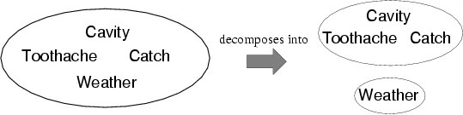
Independence
A and B are independent iff
P(A|B) = P(A) or P(B|A) = P(B) or P(A, B) = P(A) P(B)
E.g., P(Toothache, Catch, Cavity, Weather)
= P(Toothache, Catch, Cavity) P(Weather)
Reduces 2x2x2x4=32 entries to 2x2x2+4=12
For n independent coin tosses, O(2^{n})→O(n)
Analogous to goal decomposition in planning
Absolute (or marginal) independence is powerful but rare
E.g., dentistry is a large field with hundreds of variables, none of which are absolutely independent
What to do?

Slide 24
Conditional Independence
Two dependent variables may become conditionally independent when conditioned on a third variable
Consider Catch and Toothache
P(catch)=.34 while P(catch | toothache)=.62, so dependent
The problem is that while neither causes the other, they correlate because both caused by single underlying hidden variable (cavity)

Slide 25
Conditional Independence
Two dependent variables may become conditionally independent when conditioned on a third variable
If condition both Catch and Toothache on Cavity, conditional probabilities become independent
P(toothache, catch | cavity) = P(toothache | cavity) P(catch | cavity) = .54
P(toothache, catch | ¬cavity) = P(toothache | ¬cavity) P(catch | ¬cavity) = .02
Catch is conditionally independent of Toothache given Cavity:
P(Toothache, Catch | Cavity) = P(Toothache | Cavity) P(Catch | Cavity)
Additional equivalent statements:
P(Catch | Toothache,Cavity) = P(Catch | Cavity)
P(Toothache | Catch, Cavity) = P(Toothache | Cavity)

Slide 26
Conditional Independence…
General rule is P(X,Y | Z) = P(X | Z) P(Y | Z)
Or P(X | Y,Z) = P(X | Z) or P(Y | X,Z) = P(Y | Z)
With conditional independence can decompose individual large tables into sets of smaller ones, e.g.:
P(Toothache, Catch, Cavity)
= P(Toothache, Catch | Cavity) P(Cavity) [product rule]
= P(Toothache | Cavity) P(Catch | Cavity) P(Cavity) [cond. independence]
The use of conditional independence can reduce the size of the representation of the joint distribution from exponential in n to linear in n
For example, if there are many symptoms all caused by cavities
One of the most significant recent advances in AI, as has made probabilistic reasoning tractable where previously understood not to be so
Conditional independence is our most basic and robust form of knowledge about uncertain environments

Slide 27
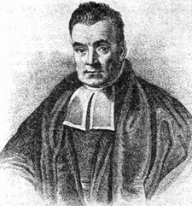
Bayes' Rule
Product rule: P(a ∧ b) = P(a | b) P(b)
P(a ∧ b) = P(b | a) P(a)
P(a | b) P(b) = P(b | a) P(a)
⇒ Bayes' rule: P(a | b) = P(b | a) P(a) / P(b)
Rev. Thomas Bayes
c. 1701 - 1761

Slide 28
Bayes' Rule
Bayes' rule: P(a | b) = P(b | a) P(a) / P(b)
Or in distribution form (with normalization factor)
P(Y | X) = P(X | Y) P(Y) / P(X) = αP(X | Y) P(Y)
Useful for deriving diagnostic probabilities from causal probabilities:
P(Cause | Effect) = P(Effect | Cause) P(Cause) / P(Effect)
E.g., let M be meningitis and S be stiff neck:
P(m | s) = P(s | m) P(m) / P(s) = 0.8 × 0.0001 / 0.1 = 0.0008
Although the probability of having a stiff neck is very high if have meningitis (.8), posterior probability of meningitis given a stiff neck is still very small (.0008)!

Slide 29
Bayes' Rule
Bayes' rule: P(a | b) = P(b | a) P(a) / P(b)
Or in distribution form (with normalization factor)
P(Y | X) = P(X | Y) P(Y) / P(X) = αP(X | Y) P(Y)
Useful for deriving diagnostic probabilities from causal probabilities:
Causal (and prior) probabilities often easier to obtain than diagnostic ones
Also may be more robust under shifts in baselines
E.g., in an epidemic P(m) may skyrocket, and estimates of P(m | s) based on pre-epidemic observation will be wrong.
But: P(s | m) remains fixed (causally determined)

Slide 30
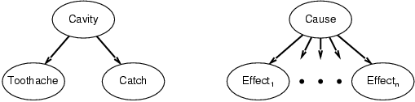
Combining Evidence (for Diagnosis) via Bayes' Rule and Conditional Independence
P(Cavity | toothache,catch)
= αP(toothache ∧ catch | Cavity) P(Cavity) [Bayes’ Rule]
= αP(toothache | Cavity) P(catch | Cavity) P(Cavity) [Cond. Ind.]
This is an example of a naïve Bayes model:
P(Cause,Effect₁, … ,Effect_{n}) = P(Cause) π_{i}P(Effect_{i}|Cause)
Cost of diagnostic reasoning now grows linearly rather than exponentially in number of conditionally independent effects
Called naïve, because often used when the effects are not completely conditionally independent given the cause
Such Bayesian classifiers can work surprisingly well even in the absence of complete conditional independence
Often focus of learning efforts

Slide 31
Decision Making under Uncertainty
Suppose I believe the following:
P(A₂₅ gets me there on time | …) = 0.04
P(A₉₀ gets me there on time | …) = 0.70
P(A₁₂₀ gets me there on time | …) = 0.95
P(A₁₄₄₀ gets me there on time | …) = 0.9999
Where A_{n} means leave for airport n minutes before flight
Which action should I choose?
Depends on preferences for missed flight vs. waiting time
Utility theory is generally used to represent and infer preferences
Numeric desirability values are assigned to outcomes
Although other approaches are possible
E.g. “prefer A to B”
Decision theory = probability theory + utility theory

Slide 32
Core of Decision Theory
Choose action/option w/ highest expected utility
For each action/option, sum across all possible outcomes reachable via it; weighting the utility of each outcome by the probability of reaching it
Agent chooses
Expected U:
5.8
A
-1
B
-2.4
C
Chance
.2
.4
.4
.3
.7
.1
.3
.6
D
E
F
G
H
I
J
K
Utilities: 5 2 10 -50 20 0 4 -6
Weighted U:
1
.8
4
-15
14
0
1.2
-3.6
Notes:
WU: Weighted Utility
EU: Expected Utility

Slide 33
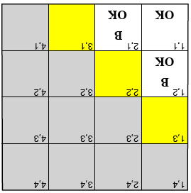
Return to Wumpus World
Any of [1,3], [2,2] or [3,1] may have a pit, but are any riskier/safer than others to try if pits are relatively rare?
Either [1,3] or [3,1] should be less risky than [2,2] because most probable pattern given the evidence is one pit at [2,2]
Need a probabilistic rather than a logical model
P_{ij} = true iff [i,j] contains a pit
B_{ij} = true iff [i,j] is breezy
For simplicity, will include only B₁₂,B₂₁,P₁₁,…P₄₄ in probability model
Boolean random variables

Slide 34
Probability Model
Full joint probability distribution:
P(B₁₂,B₂₁,P₁₁,…,P₄₄)
Using product rule get:
P(B₁₂,B₂₁ | P₁₁,…,P₄₄) P(P₁₁,…,P₄₄)
First term is 1 whenever there is a pit adjacent to each breeze and 0 otherwise
Second term is uniform under assumption that pits are placed randomly (with P(p_{ij})=.2 for all i,j):
P(P₁₁,…,P₄₄) = π_{i,j} P(P_{ij})
Probability of a pit in one cell is independent of others

Slide 35
Observations and Query
Have observed these facts:
b = b₁₂ ∧ b₂₁
known = ¬p₁₁ ∧ ¬p₁₂ ∧ ¬p₂₁
Query is P(P₁₃ | known,b)
Would also want to query P₂₂ and P₃₁
Define unknown = set of P_{ij}s other than P₁₃ & known
For inference by enumeration, we have
P(P₁₃ | known,b) = αΣ_{unknown}P(P₁₃,unknown,known,b)
Grows exponentially with number of squares

Slide 36
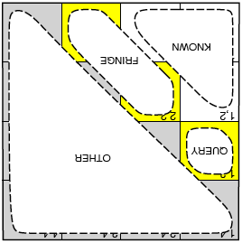
Conditional Independence to the Rescue!
Basic Insight: if partition unknown variables into fringe and other, then observed breezes are conditionally independent of other variables, given known, query and fringe variables
Reformulate query into usable form
If Unknown = Fringe ∪ Other then
P(b | P₁₃,Known,Unknown) =
P(b | P₁₃,Known,Fringe)
Use to convert: P(P₁₃ | known,b)
= αΣ_{unknown}P(P₁₃,unknown,known,b)
Into (via sequence of transformations)
= α’ P(P₁₃) Σ_{fringe}P(b | known,P₁₃,fringe) P(fringe)
[where α’ = αP(known)]
Greatly reduces computation
Notes:
Use definition of conditional probability

Slide 37
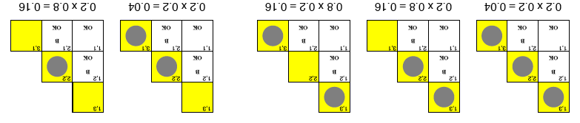
Results
P(P₁₃ | known,b) = α’ P(P₁₃) Σ_{fringe}P(b | known,P₁₃,fringe) P(fringe)
P(b | known,P₁₃,fringe) is 0 or 1 depending on if fringe is consistent with b
P(fringe) is shown in figure for situations in which fringe is consistent with b
Now need to partition action events according to whether P₁₃ is true or false
= α’⟨.2(.04 + .16 + .16), 0.8(.04 + .16)⟩
≈ ⟨.31, .69⟩
P(P₂₂ | known,b) ≈ ⟨.86, .14⟩
P₁₃ = true
P₁₃ = false
Notes:
Fringe is only p22 and p31. Doesn’t include p13, as is query variable rather than fringe.
If p13 then three possible forms of fringe that are consistent.
If not p13 then only two forms of fringe that are consistent

Slide 38
Exercise 13.3
For each of the following statements, either prove it is true or give a counterexample.
If P(a|b,c) = P(b|a,c), then P(a|c) = P(b|c)
True. By the product rule we know P (b, c)P (a|b, c) = P (a, c)P (b|a, c), which by assumption reduces to P (b, c) = P (a, c). Dividing through by P (c) gives the result.
b. If P(a|b,c) = P(a), then P(b|c) = P(b)
False. The statement P (a|b, c) = P (a) merely states that a is independent of b and c, it makes no claim regarding the dependence of b and c. A counter-example: a and b record the results of two independent coin flips, and c = b.
c. If P(a|b) = P(a), then P(a|b,c) = P(a|c)
False. While the statement P (a|b) = P (a) implies that a is independent of b, it does not imply that a is conditionally independent of b given c. A counter-example: a and b record the results of two independent coin flips, and c equals the xor of a and b.

Slide 39
Exercise 13.12
Show that the three forms of independence in Equation (13.11) are equivalent.
P(a|b)=P(a) or P(b|a)=P(b) or P(a∧b)=P(a)P(b). (13.11)
Independence is symmetric: that is, a and b are independent iff b and a are independent
So P(a|b) = P(a) is the same as P(b|a) = P(b).
So we need only prove that P(a|b) = P(a) is equivalent to P(a ∧ b) = P(a)P(b).
The product rule, P(a ∧ b) = P(a|b)P(b), can be used to rewrite
P (a ∧ b) = P (a)P (b) as P (a|b)P (b) = P (a)P (b),
which simplifies to P (a|b) = P (a).

Slide 40
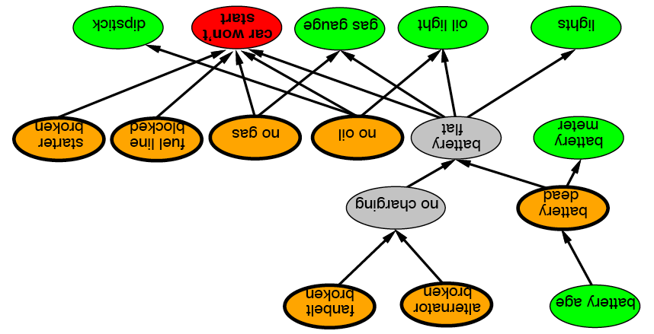

Bayesian Network (Chap. 14) (14.5 & 14.6 optional)
Graphical notation for (conditional) independence
Compact specification of full joint probability distribution
Also called belief networks, probabilistic networks, directed graphical models, causal networks (especially when used without probabilities) and knowledge maps
Notes:
Car diagnosis
Think of the causal relationships

Slide 41
Syntax
A set of nodes, one per variable
Links between nodes encoding direct influences
Yielding a directed, acyclic graph
A conditional distribution for each node given its parents:
P (X_{i} | Parents(X_{i}))
In simplest case, represented as a conditional probability table (CPT)
Provides distribution over X_{i} for each combination of parent values
Reduces to prior probabilities for nodes with no parents
City | Month | sunny | rainy
Pittsburgh | January | .4 | .2
Pittsburgh | February | .3 | .3
Los Angeles | January | .7 | .2
City
Month
…
Weather
.
.
.

Slide 42
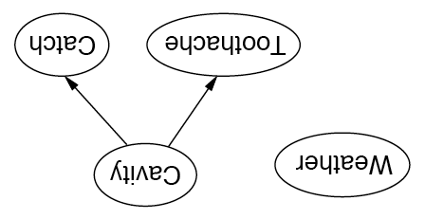
Independence in Bayesian Networks
Topology of network encodes (conditional) independence assertions:
Weather is independent of the other variables
Toothache and Catch are conditionally independent given Cavity

Slide 43
Alarm Example
My burglar alarm is fairly reliable, but is sometimes set off by a minor earthquake. Neighbors John and Mary promise to call if they hear the alarm, but sometimes make errors (John may call when he hears the phone ringing and Mary may miss the alarm when listening to music).
John has just called, but Mary hasn’t. Is there a burglar?
The evidence is subject to errors of both omission and commission
Variables
Burglary, Earthquake, Alarm, JohnCalls, MaryCalls
Could also have PhoneRang and ListeningToMusic, etc.
Network topology reflects "causal" knowledge:
A burglar can set off the alarm
An earthquake can set off the alarm
The alarm can cause Mary to call
The alarm can cause John to call

Slide 44
Alarm Example (Cont.)
Only one value needed for X_{i} in each row because, for boolean variables, P(false)=1-P(true)
All factors (possibly infinite) not explicitly mentioned are implicitly incorporated into probabilities
Bird could fly through window pane, power could fail, …
Notes:
Qualification problem

Slide 45
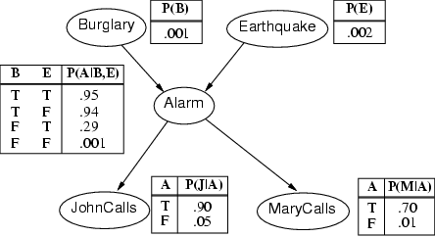
Compactness/Efficiency
A Conditional Probability Table (CPT) for Boolean X_{i} with k Boolean parents has 2^{k} rows for the combinations of parent values
If each of the n variables has no more than k parents, the complete network requires O(n · 2^{k}) numbers
I.e., grows linearly with n vs. O(2^{n}) for the full joint distribution
For burglary net, 1+1+4+2+2=10 numbers (vs. 2⁵-1=31)

Slide 46
Semantics
If correct, the network represents the full joint distribution: P(x₁, … ,x_{n}) = π_{i=1} P(x_{i} | parents(X_{i}))
n

Slide 47
P(x₁, … ,x_{n}) = π_{i=1} P(x_{i} | parents(X_{i}))
E.g., the probability of a complete false alarm (no burglary or earthquake) with two calls is:
P(j, m, a, ¬b, ¬e)
= P(j | a) P(m | a) P(a | ¬b, ¬e) P(¬b) P(¬e)
= .9 x .7 x .001 x .999 x .998 ≈ .000063
n

Slide 48
The Chain Rule and Network Semantics
The chain rule
P(x₁,…,x_{n}) = P(x_{n} | x_{n-1},…,x₁) P(x_{n-1},…,x₁) [Product rule]
= P(x_{n} | x_{n-1},…,x₁) P(x_{n-1} | x_{n-2},…,x₁) P(x_{n-2},…,x₁)
= P(x_{n} | x_{n-1},…,x₁) P(x_{n-1} | x_{n-2},…,x₁) … P(x₂ | x₁) P(x₁)
= π_{i=1} P(x_{i} | x_{i-1},…,x₁)
The equation for network semantics is equivalent to the chain rule with the restriction that for every variable X_{i} in the network:
P(X_{i} | X_{i-1},…,X₁) = P(X_{i} | parents(X_{i})),
given that Parents(X_{i}) ⊆ {X_{i-1},…,X₁}
Requires labeling variables consistently with partial order of graph
n
Notes:
This is how to assure that the network does yield the full joint probability table

Slide 49
Constructing Bayesian Networks
Need a method for which locally testing conditional independence guarantees semantics
P(X₁,… ,X_{n}) = π_{i =1} P(X_{i} | X₁,… , X_{i-1}) = π_{i =1}P(X_{i} | Parents(X_{i}))
Choose an ordering of variables X₁, … ,X_{n}
Preferably one where earlier variables do not depend causally on later ones
For i = 1 to n
Add X_{i} to the network
Select parents from X₁,… ,X_{i-1} such that
P(X_{i} | Parents(X_{i})) = P(X_{i} | X₁, ... X_{i-1})
n
n

Slide 50
Example: B, E, A, J, M
Notes:
E does not depend on B
A depends on both B and E
J depends on A but not on B and E given A
M depends on A, but not on any of the others given A

Slide 51
What if Choose Bad Causal Ordering?
E.g.: M, J, A, B, E

Slide 52
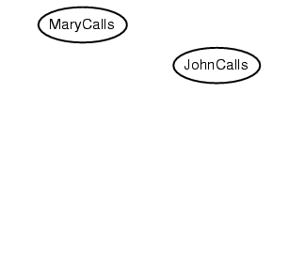
Bad Causal Ordering
M, J, A, B, E

Slide 53
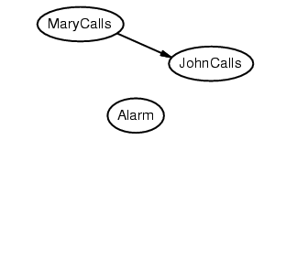
Bad Causal Ordering
M, J, A, B, E

Slide 54
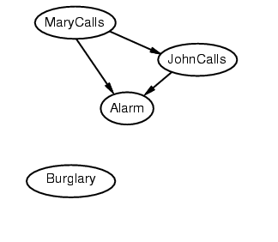
Bad Causal Ordering
M, J, A, B, E

Slide 55
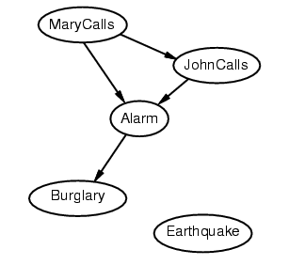
Bad Causal Ordering
M, J, A, B, E

Slide 56
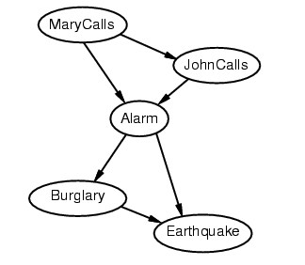
Bad Causal Ordering
M, J, A, B, E
Notes:
If there is an alarm, more likely for an earthquake than not
If an alarm, less likely earthquake if there is a burglary

Slide 57
Comments on Bad Ordering
Deciding conditional independence is hard in noncausal (e.g., diagnostic) directions
As may be assigning probabilities in this direction
Network is less compact: 1+2+4+2+4=13 numbers needed
Yet it still computes the same joint distribution

Slide 58
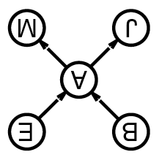
Enumeration in Bayesian Networks
Compute probabilities from Bayesian network as if from FJPT, but without explicitly constructing the table
Otherwise would lose benefit of decomposing full table into network
Consider simple query on burglary network
P(b | j,m)
= P(b,j,m)/P(j,m)
= αP(b,j,m)
= αΣ_{e}Σ_{a}P(b,e,a,j,m)
= αΣ_{e}Σ_{a}P(b) P(e) P(a | b,e) P(j | a) P(m | a)
= αP(b)Σ_{e} P(e) Σ_{a} P(a | b,e) P(j | a) P(m | a)
Compute by proceeding through terms in a depth-first fashion, multiplying and adding CPT entries as we go

Slide 59
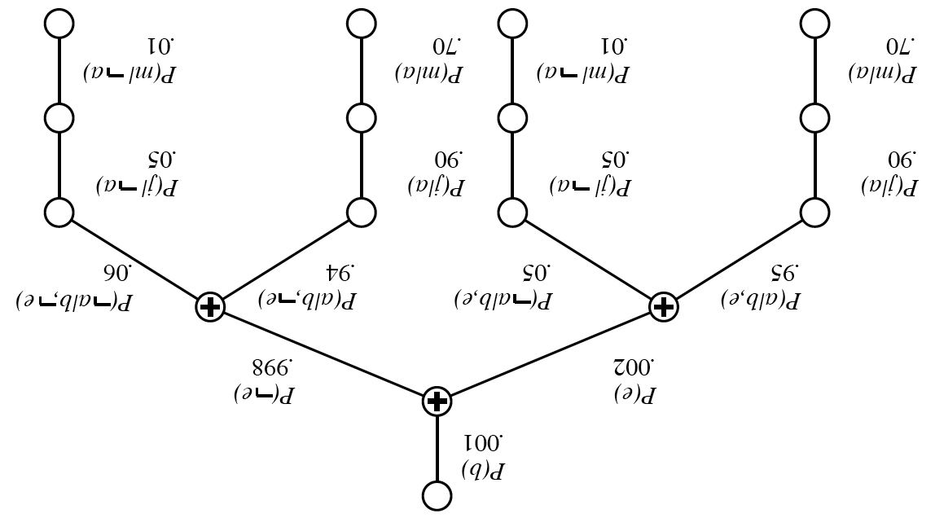
Evaluation Tree for P(b | j,m)
P(b)Σ_{e} P(e) Σ_{a} P(a | b,e) P(j | a) P(m | a) = .00059224
.00059224
.59224
.59853
.59223
Notes:
Computing just the positive value
Each link is a multiplication

Slide 60
Evaluation Tree for P(b | j,m)
P(b)Σ_{e} P(e) Σ_{a} P(a | b,e) P(j | a) P(m | a) = .00059224
P(¬b)Σ_{e} P(e) Σ_{a} P(a | ¬b,e) P(j | a) P(m | a) = .0014919
P(B | j,m) = α(0.00059224, 0.0014919) ≈ (0.284, 0.716)
So P(b | j,m) ≈ 0.284
Notes:
Computing just the positive value
Each link is a multiplication

Slide 61
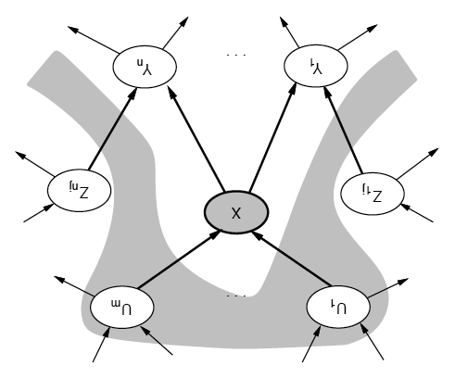
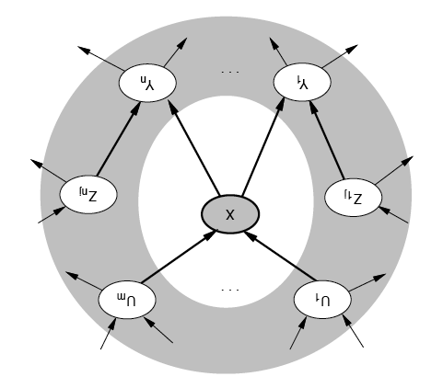
Conditional Independence of Nodes
A node is conditionally independent of its nondescendents given its parents
A node is conditionally independent of all others given its Markov blanket
Parents, children and children’s parents

Slide 62
Exercise 14.1
We have a bag of three biased coins a, b, and c with probabilities of coming up heads of 20%, 60%, and 80%, respectively. One coin is drawn randomly from the bag (with equal likelihood of drawing each of the three coins), and then the coin is flipped three times to generate the outcomes X₁^{, X}₂^{, and X}₃.
a. Draw the Bayesian network corresponding to this setup and define the necessary CPTs.
b. Calculate which coin was most likely to have been drawn from the bag if the observed flips come out heads twice and tails once.

Slide 63
Exercise 14.1
With the random variable C denoting which coin {a, b, c} we drew, the network has C at the root and X1, X2, and X3 as children.
The CPT for C is:
C
x1
x2
xx33
^{The CPT for X}_{i} given C are the same, and equal to:

Slide 64
Exercise 14.1
The coin most likely to have been drawn from the bag given this sequence is the value of C with greatest posterior probability P(C|2 heads, 1 tails).
P(C|2 heads, 1 tails) = P(2 heads, 1 tails|C)P(C)/P(2 heads, 1 tails)
1/P (2 heads, 1 tails) is independent of C
^{∝ P(2heads,1tails|C)P(C)}
P(C) is independent of the value of C, ^{by hypothesis, equal to 1/3.}
^{∝ P(2 heads, 1 tails|C)}

Slide 65
Exercise 14.1
^{X}₁^{, X}₂^{, and X}₃ are conditionally independent given C, so for example
^{P (X}₁ ^{= tails, X}₂ ^{= heads, X}₃ ^{= heads|C = a)}
^{= P(X}₁ ^{= tails|C = a)P(X}₂ ^{= heads|C = a)P(X}₃ ^{= heads|C = a)}
^{= 0.8×0.2×0.2=0.032}
P (2heads, 1tails|C = a) = 3 × 0.032 = 0.096.
Note that we would get the same probability above for any ordering of 2 heads and 1 tails.
P (2heads, 1tails|C = b) = 0.432
P (2heads, 1tails|C = c) = 0.384
showing that coin b is most likely to have been drawn.
Alternatively, one could directly compute the value of P(C|2 heads, 1 tails).

Slide 66
Exercise 14.4
Consider the Bayesian network in Figure 14.2.
a. If no evidence is observed, are Burglary and Earthquake independent? Prove this from the numerical semantics and from the topological semantics.
b. If we observe Alarm = true , are Burglary and Earthquake independent? Justify your answer by calculating whether the probabilities involved satisfy the definition of conditional independence.

Slide 67
Exercise 14.4
a. If no evidence is observed, are Burglary and Earthquake independent? Prove this from the numerical semantics and from the topological semantics.
Yes. Numerically one can compute that
^{P (B, E) = P (B)P (E).}

Slide 68
Exercise 14.4
Consider the Bayesian network in Figure 14.2.
b. If we observe Alarm = true , are Burglary and Earthquake independent? Justify your answer by calculating whether the probabilities involved satisfy the definition of conditional independence.

Slide 69
Exercise 14.4
b. We check whether P (B, E|a) = P (B|a)P (E|a). First computing P (B, E|a)
where α is a normalization constant.
Checking whether P (b, e|a) = P (b|a)P (e|a) we find
P (b, e|a) = 0.0008 ̸= 0.0863 = 0.3736 × 0.2311 = P (b|a)P (e|a) showing that B and E are not conditionally independent given A.

Slide 70
What you should know
What are the sources for uncertainty?
How can we use probability to reason about uncertainty?
What is a random variable? Atomic events? How are they used for inference?
What is independence? What is conditional independence? Why are they needed for reasoning about uncertainty?
What is Bayes rule? How is this addressing combining evidence for diagnosis?
Bayesian networks provide a natural representation for (causally induced) conditional independence
Topology + CPTs = compact representation of joint distribution

Slide 71
Want more?
Try exercise 13.4,7,8,13,15, 14.2,8 in AIMA

