Slide 1

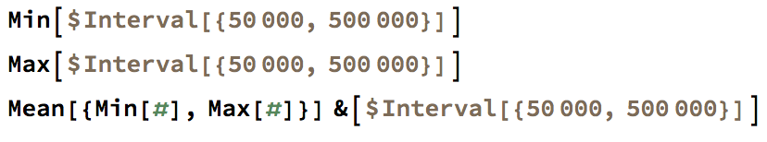
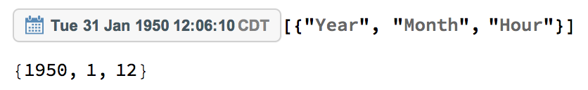
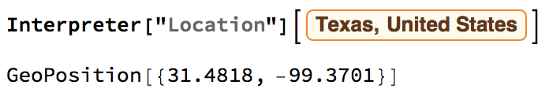
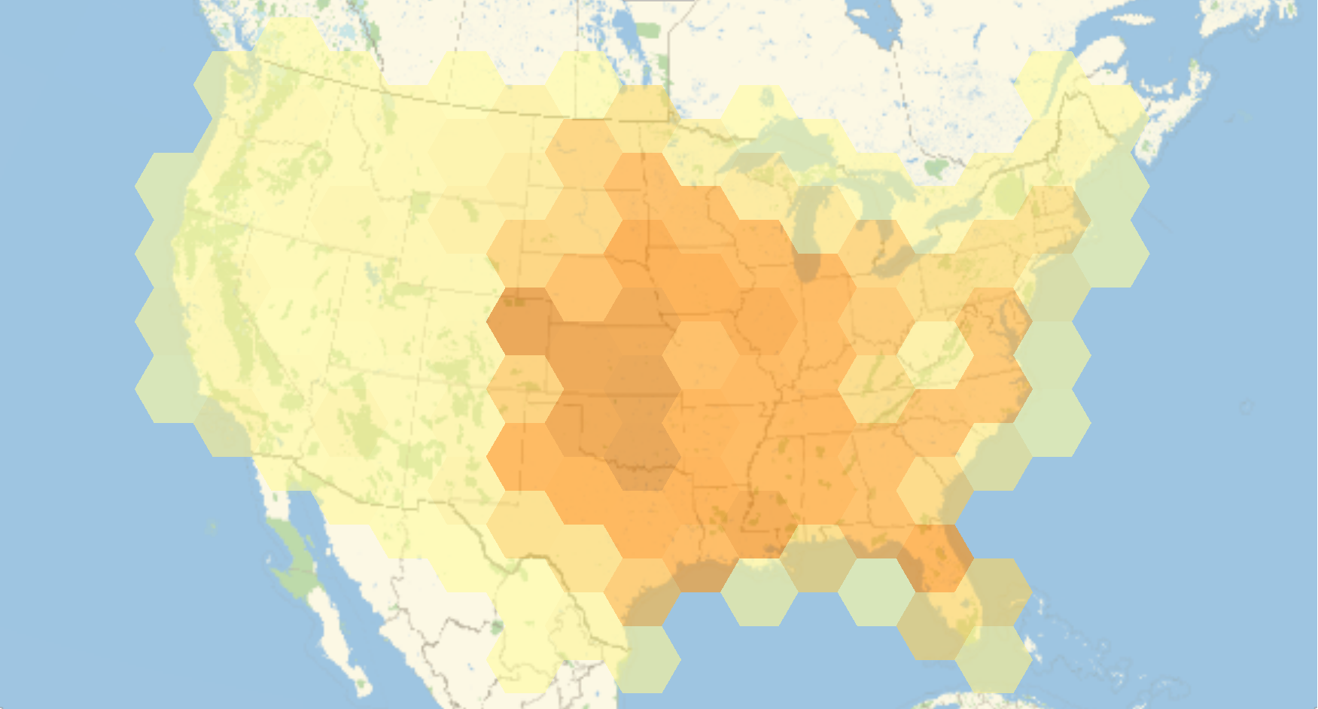
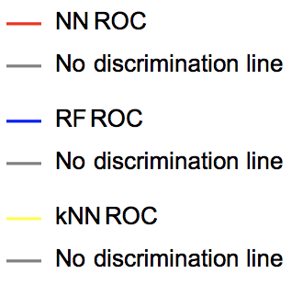
Machine learning with Mathematica
for Tornadoes in the U.S., 1950-2015
Zhangliang Dong
Keying Zhou
Yueran Cai
HOMEWORK FOR USC CSCI561 FOUNDATIONS OF AI
BACKGROUND: The dataset contains records of tornadoes. We are going to use 5 different
methods to classify them into its magnitudes.
2. Preprocessing the dataset. Transform the Location labels into geoPostions. Remove missing data. Extract the year, month and hours from dateObject. Replace the interval with min, max and mean.
METHODS
Neural Network
Random Forest
Nearest Neighbor
Naïve Bayes
Support vector machine
3. Training
Methods | Training Time
Neural Network | 630.54 s
Random Forest | 643.07 s
Naïve Bayes | 755.00s
Support Vector Machine | 551.15s
Nearest Neighbors | 652.79 s
HOW TO BEGIN
1. Explore the dataset
4. Result and comparison
Methods | Accuracy
Neural Network | 62.54%
Random Forest | 67.07%
Naïve Bayes | 58.00%
SVM | 49.60%
Nearest Neighbors | 55.30%
Month histogram of Tornadoes
F0
F1
F2
F3
F4
F5
Geographical histogram of Tornadoes
The random forest model performs the best in term of precision in each class.
In these ROC curves above, the random forest shows the best.

