Slide 1
CSCI 561 Foundations of Artificial Intelligence Lectures 10: Planning (Planning, Chapter 10)
Summer 2017
Instructor: Prof. Sheila Tejada
Notes:
This lecture is short.

Slide 2
Outline
The planning problem
STRIPS-style planning
Partial-order planning
Planning Graphs

Slide 3
What is Planning?
Generating sequences of actions to perform tasks and achieve objectives
Assist humans in range of practical applications
Design and manufacturing, military operations, games, etc.
Control robots in critical environments
Space exploration, battlefields, etc.
Combines search & knowledge representation
From search: states, actions and goals are key
From logic: representation of states, actions and goals
Enables reasoning about which actions to perform
Will focus on the classical planning environment
Fully observable, deterministic, finite, static, discrete

Slide 4
Actions, events, and change
Planning requires a representation of time
to express & reason about sequences of actions
to express the effects of actions on the world
Propositional Logic
does not offer a representation for time
Situation Calculus (AIMA Section 10.4.2)
Is based on FOL
Each time step is a ‘situation’
Allows to represent plans and reason about actions & change

Slide 5
Situation Calculus: Ontology
Situations
Fluents
Atemporal (or eternal) predicates & functions
AIMA Section 10.4.2

Slide 6
Situation Calculus: Ontology
Situations
Initial state: S₀
A function Result(a.s) gives the situation resulting from applying action a in situation s
Fluents
Functions & predicates whose truth values can change from one situation to the other
Example: ¬Holding(G₁,S₀)
Atemporal (or eternal) predicates and functions
Example: Gold(G₁), LeftLegOf(Wumpus)

Slide 7
Situation Calculus
Sequence of actions
Result([],s)=s
Result([a | seq],s)=Result(seq,Result(a,s))
Projection task
Deducing the outcome of a sequence of actions
Planning task
Find a sequence of actions that achieves a desired effect

Slide 8
Example: Wumpus World
Fluents
At(o,p,s), Holding(o,s)
Agent is in [1,1], gold is in [1,2]
At(Agent,[1,1],S₀) ∧ At(G₁,[1,2],S₀)
In S₀, we also need to have:
At(o,x,S₀) ⇔ [(o=Agent) ∧ x=[1,1]] ∨ [(o=G₁) ∧ x=[1,2]]
¬Holding(o,S₀)
Gold(G₁) ∧ Adjacent([1,1],[1,2]) ∧ Adjacent([1,2],[1,1])
The query is:
∃ seq At(G₁,[1,1],Result(seq,S₀))
The answer is
At(G1,[1,1],Result(Go([1,1],[1,2]),Grab(G₁),Go([1,2],[1,1]),S₀))

Slide 9
Classical Issues
Frame problem
Representing all things that stay the same from one situation to the next
Inferential and representational
Qualification problem
Defining the circumstances under which an action is guaranteed to work
Example: what if the gold is slippery or nailed down, etc.
Ramification problem
Proliferation of implicit consequences of actions as actions may have secondary consequences
Examples: How about the dust on the gold?

Slide 10

Planning Languages
Languages must represent
States
Goals
Actions
Languages must be
Expressive for ease of representation
Flexible for manipulation by algorithm
Core is based on STRIPS, an early but still key system
Controlled Shakey, the first reasoning mobile robot

Slide 11
Shakey – 45 years ago (!)

Slide 12
Shakey – 45 years ago (!)

Slide 13
Planning Language
Core is based on STRIPS, an early but still key system
Controlled Shakey, the first reasoning mobile robot
Representing states
A conjunction of positive literals
Propositional: Poor ∧ Unknown
First order: Poor(Fred) ∧ Knows(Fred, Barney)
Must be grounded (no variables) and function free
Closed world assumption
If not explicitly mentioned as true, assumed false

Slide 14
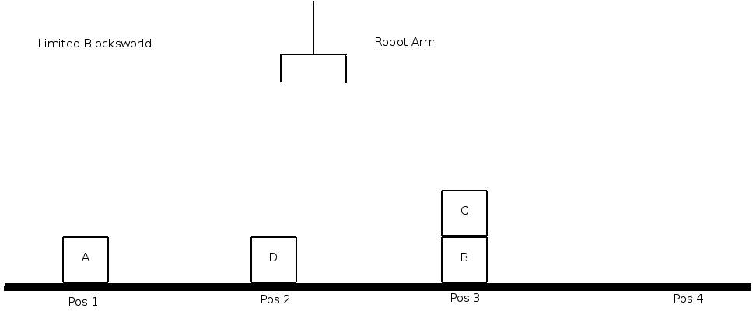
Planning Language
Core is based on STRIPS, an early but still key system
Controlled Shakey, the first reasoning mobile robot
Representing states
A conjunction of positive literals
Propositional: Poor ∧ Unknown
First order: Poor(Fred) ∧ Knows(Fred, Barney)
Must be grounded (no variables) and function free
Closed world assumption
If not explicitly mentioned as true, assumed false
Unlike situation calculus, no situation constant
Representing goals
A conjunction of positive literals: On(A,B) ∧ On(B,C)
Generally a partial state specification; I.e., omits some conjuncts
Grounded and function free, as with states
A goal is satisfied if state contains all literals in goal

Slide 15

Planning Language (Cont.)
Representing actions
An action is specified by a name, a list of parameters, a precondition and an effect
Action(Fly(p,from,to),
PRECOND: At(p,from) ∧ Plane(p) ∧ Airport(from) ∧ Airport(to)
EFFECT: ¬At(p,from) ∧ At(p,to))
PRECOND: Must be true in state for action to execute
Conjunction of function-free positive literals
EFFECT: Changes to state when action executes
Conjunction of function-free literals
Positive literals add facts, negated literals remove facts
Alternatively, can represent EFFECT as two lists
ADD: At(p,to))
DELETE: At(p,from)
Fly example is actually an action schema
The variables p, from and to must be instantiated for an action
E.g., θ ={p/P₁, from/JFK, to/LAX}

Slide 16

Flight Example (Cont.)
State:
At(P₁,JFK) ∧ At(P₂,LAX) ∧ Plane(P₁) ∧ Plane(P₂) ∧ Airport(JFK) ∧ Airport(LAX)
Action:
Action(Fly(p,from,to),
PRECOND: At(p,from) ∧ Plane(p) ∧ Airport(from) ∧ Airport(to)
EFFECT: ¬At(p,from) ∧ At(p,to))
Checking action applicability:
θ₁ ={p/P₁, from/JFK, to/LAX} or θ₂ ={p/P₂, from/LAX, to/JFK}
Could actually have to and from bound same as well!
Executing action (w/ θ₂):
At(P₁,JFK) ∧ At(P₂,LAX) ∧ At(P₂,JFK) ∧ Plane(P₁) ∧ Plane(P₂) ∧ Airport(JFK) ∧ Airport(LAX)
STRIPS assumption
Every literal not modified by EFFECT remains unchanged
Avoids representational frame problem

Slide 17
Flight Example (Cont.)
State:
At(P₁,JFK) ∧ At(P₂,LAX) ∧ Plane(P₁) ∧ Plane(P₂) ∧ Airport(JFK) ∧ Airport(LAX)
Action:
Action(Fly(p,from,to),
PRECOND: At(p,from) ∧ Plane(p) ∧ Airport(from) ∧ Airport(to)
EFFECT: ¬At(p,from) ∧ At(p,to))
Checking action applicability:
θ₁ ={p/P₁, from/JFK, to/LAX} or θ₂ ={p/P₂, from/LAX, to/JFK}
Could actually have to and from bound same as well!
Executing action (w/ θ₂):
At(P₁,JFK) ∧ At(P₂,LAX) ∧ Plane(P₁) ∧ Plane(P₂) ∧ Airport(JFK) ∧ Airport(LAX) ∧ At(P₂,JFK)
STRIPS assumption
Every literal not modified by EFFECT remains unchanged
Avoids representational frame problem

Slide 18
Planning Domain Definition Language (PDDL)
Slightly More Expressive (as described in book)
Allows negative literals in goals and preconditions

Slide 19
Comments on Languages
Neither language allows functions
Enabling them to have finite propositionalizations
Neither deals with the ramification problem
Any implied effects, such as that all of the people and cargo in the plane move with it, must be mentioned explicitly in effects
Neither deals with the qualification problem
Any possible reasons why might actually not be able perform action must be stated in preconditions (or ignored)
For example, that there are no broken parts, or that weather hasn’t grounded all aircraft, etc.

Slide 20
Planning with State-Space Search
Forward: Progression planner
What operators can apply to states?
Backward: Regression planner
What operators will achieve goals?

Slide 21
Progression Algorithm
Formulate problem for state-space search
Initial state = initial state of the planning problem
Literals not appearing are false (with STRIPS assumption)
Actions = grounded templates with satisfied preconditions
Add positive effects (ADDs), delete negative effects (DELETEs)
Goal test = description contained in (or unifies with) state
Step cost = each action costs 1
Any complete graph-search algorithm, such as A* or iterative deepening, will work
Without functions, the state space is finite
Quickly bogs down without a good heuristic

Slide 22
Regression Algorithm
Determine which operators are relevant to the goal(s)
An operator is relevant if it achieves a goal conjunct
Goal(On(A,B) ∧ On(B,C))
Action(Move(b,x,y)
PRECOND: On(b,x) ∧ Clear(b) ∧ Clear(y) ∧ Block(b) ∧ (b≠x) ∧ (b≠y) ∧ (x≠y)
EFFECT: On(b,y) ∧ Clear(x) ∧ ¬On(b,x) ∧ ¬Clear(y))
Action(MoveToTable(b,x)
PRECOND: On(b,x) ∧ Clear(b) ∧ Block(b) ∧ (b≠x)
EFFECT: On(b,Table) ∧ Clear(x) ∧ ¬On(b,x))
Move(A,x’,B) & Move(B,x’’,C)
Determine the predecessor goal(s) for relevant operators
For Move(A,x’,B) new goal set is:
On(B,C) ∧ On(A,x’) ∧ Clear(A) ∧ Clear(B) ∧ Block(A) ∧ (A≠x’) ∧ (A≠B) ∧ (x’≠B)
Termination occurs when predecessor satisfied by initial state
satisfaction may require a substitution

Slide 23
Comments on Regression
Need to determine not only if actions are relevant, but also if consistent
Should not undo other desired literals
But could potentially reachieve them somehow?
Main advantage of regression over progression is that only relevant actions are considered
Branching factor may be much lower
As with progression, any standard search algorithm can be used to perform the search
How to reduce search further is still key

Slide 24
Reducing Search in Planning
Both progression and regression are still NP hard
Important part of planning research is coping with this
Least commitment (partial-order planning)
Notes:
Look at these in turn

Slide 25
Planning Example
The monkey-and-bananas problem is faced by a monkey in a laboratory with some bananas hanging out of reach from the ceiling.
A box is available that will enable the monkey to reach the bananas if he climbs on it.
Initially, the monkey is at A, the bananas at B, and the box at C.
The monkey and box have height Low, but if the monkey climbs onto the box he will have height High, the same as the bananas.
[4%] Write down the initial state description.
At(Monkey,A) ∧ At(Bananas,B) ∧ At(Box,C) ∧
Height(Monkey,Low) ∧ Height(Box,Low) ∧ Height(Bananas,High) ∧
Pushable(Box) ∧ Climbable(Box)

Slide 26
The actions available to the monkey include Go from one place to another, Push an object from one place to another, ClimbUp onto or ClimbDown from an object, and Grasp or Ungrasp an object.
The result of a Grasp is that the monkey holds the object if the monkey and object are in the same place at the same height.
Write the six action schemas with preconditions and effects
Action(ACTION:Go(x,y), PRECOND:At(Monkey,x), EFFECT:At(Monkey,y) ∧¬(At(Monkey,x)))
Action(ACTION:Push(b,x,y), PRECOND:At(Monkey,x) ∧ Pushable(b), EFFECT:At(b,y) ∧ At(Monkey,y) ∧¬At(b,x) ∧¬At(Monkey,x))
Action(ACTION:ClimbUp(b), PRECOND:At(Monkey,x) ∧At(b,x) ∧ Climbable(b), EFFECT:On(Monkey,b) ∧¬Height(Monkey,Low)^Height(Monkey,High))
Action(ACTION:Grasp(b), PRECOND:Height(Monkey,h) ∧Height(b,h) ∧At(Monkey,x) ∧ At(b,x), EFFECT:Have(Monkey,b))
Action(ACTION:ClimbDown(b), PRECOND:On(Monkey,b) ∧ Height(Monkey,High), EFFECT:¬On(Monkey,b) ∧¬Height(Monkey,High) ∧ Height(Monkey,Low)
Action(ACTION:UnGrasp(b), PRECOND:Have(Monkey,b), EFFECT:¬Have(Monkey,b))

Slide 27
What is the plan to achieve the goal Have(Monkey, Banana)?
Go(A,C) -> Push(Box, C, B) -> ClimbUp(Box) -> Grasp(Banana)

Slide 28
Partial-Order Planning
Add flexibility to plan representation so can express partial order on operators rather than just total order
Take advantage of flexibility to allow working on different portions of plan at different times (rather than being forced to work forwards from start or backwards from end)
Allow operators to be anywhere (or “nowhere”) as useful
Also take advantage of flexibility to delay decisions until must be made (least commitment)
Avoids need for premature, possibly incorrect, commitment
Partial-Order Planning (POP)
Add operators to plan as useful
Add ordering constraints among operators as necessary
Add causal links (protection intervals) to plan as required

Slide 29
Shoe Example
Goal(RightShoeOn ∧ LeftShoeOn)
Init()
Action(RightShoe,
PRECOND: RightSockOn
EFFECT: RightShoeOn)
Action(RightSock,
PRECOND:
EFFECT: RightSockOn)
Action(LeftShoe,
PRECOND: LeftSockOn
EFFECT: LeftShoeOn)
Action(LeftSock,
PRECOND:
EFFECT: LeftSockOn)
Planner combines two action sequences (1) [LeftSock, LeftShoe]; (2) [RightSock, RightShoe]
Notes:
These are actions rather than schemas
Init is initial state

Slide 30
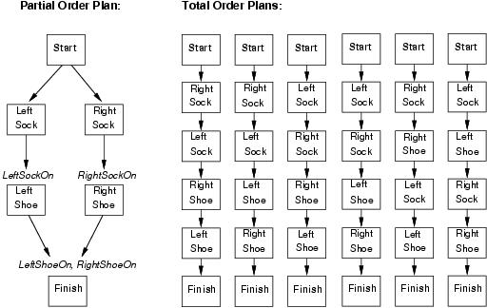
Partial and Total Order Plans
To make everything uniform, can insist that all plans (even empty plans) contain Start and Finish actions
Start has effects that generate initial state and no preconditions
EFFECT:
Finish has preconditions corresponding to goal and no effects
CONDITION: RightShoeOn ∧ LeftShoeOn
No need now to specially distinguish initial state and goal(s)

Slide 31
POP as a Search Problem
States are (usually partially completed) plans
Searching over states in plan space rather than states in ground problem space
Initial state is empty plan (only Start and Finish actions)
Goal is a state/plan that is applicable to problem’s initial state (I.e., to effects of Start action) and that will generate a goal state for problem (I.e., achieve preconditions of Finish action)
Each plan(/state) has 4 components
A set of actions (steps in the plan)
A set of ordering constraints: A < B (A before B)
Cycles (A < B < A) represent contradictions
A set of causal links (protection intervals):
Action A achieves precondition p of action B
Conflict if a new action C could come between A and B and assert ¬p
A set of open preconditions (goals)
Preconditions of actions in plan not achieved by other actions in plan

Slide 32
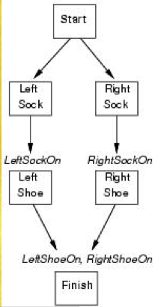


Shoe Initial and Goal States/Plans
Initial State
Actions={Start, Finish}
Orderings={Start<Finish}
Links={}
Open={RightShoeOn,LeftShoeOn}
Goal state (plan found)
Actions={Start,Finish,RightSock,Rightshoe,LeftSock,LeftShoe}
Orderings={RightSock<RightShoe, LeftSock<LeftShoe}
Also ones to ensure every action is after Start and before Finish
Links={RightSock-RightSockOn->RightShoe, LeftSock-LeftSockOn->LeftShoe, RightShoe-RightShoeOn->Finish, LeftShoe-LeftShoeOn->Finish}
Open={}

Slide 33
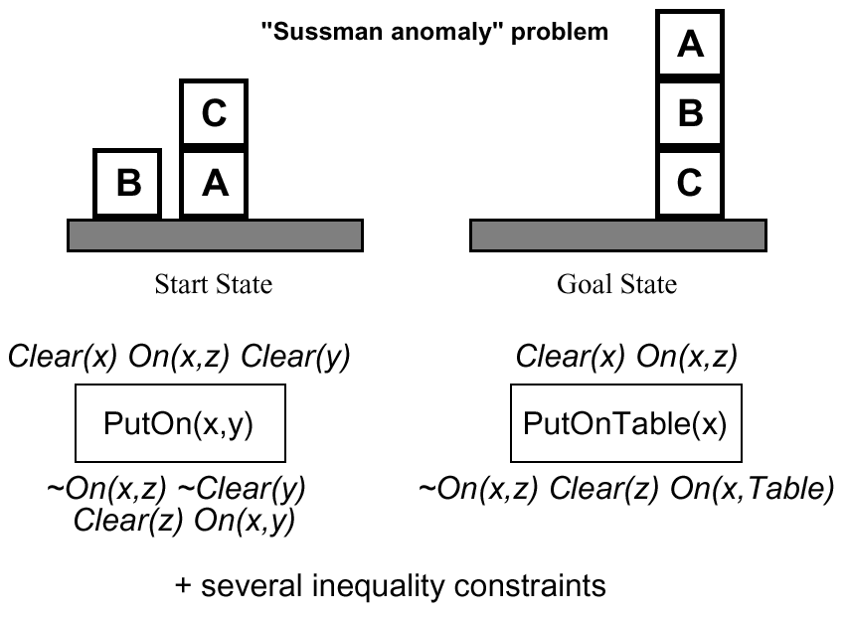
Example: block world

Slide 34
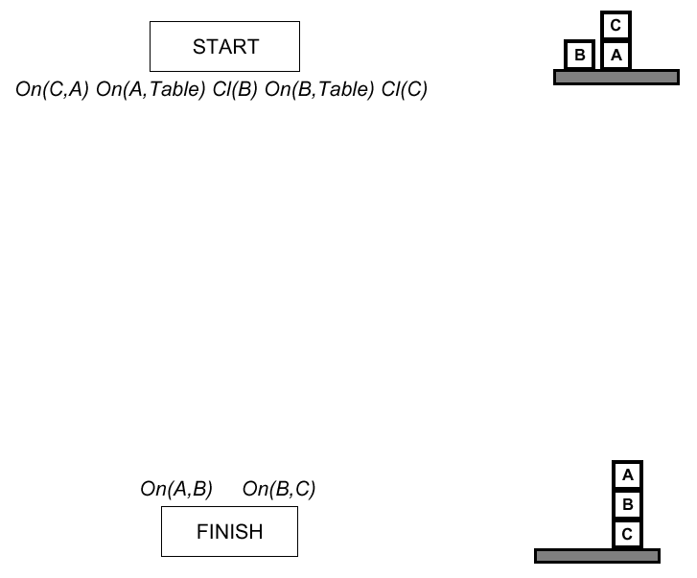
Example (cont.)

Slide 35
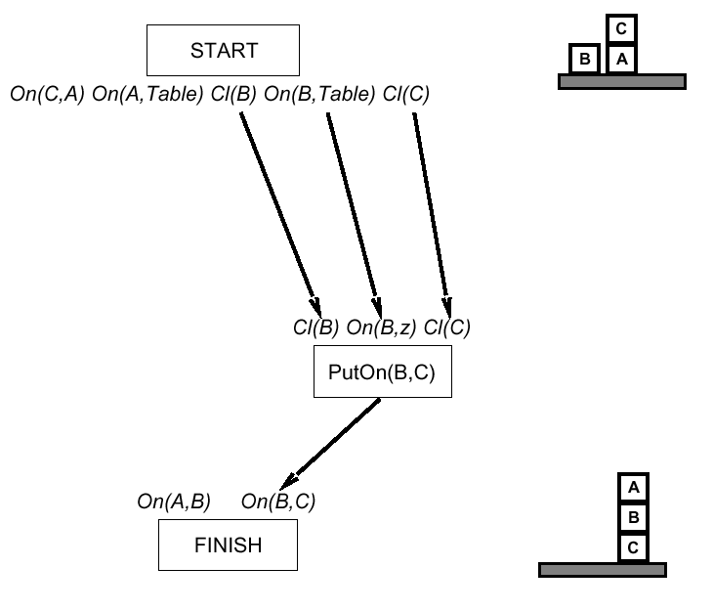
Example (cont.)

Slide 36
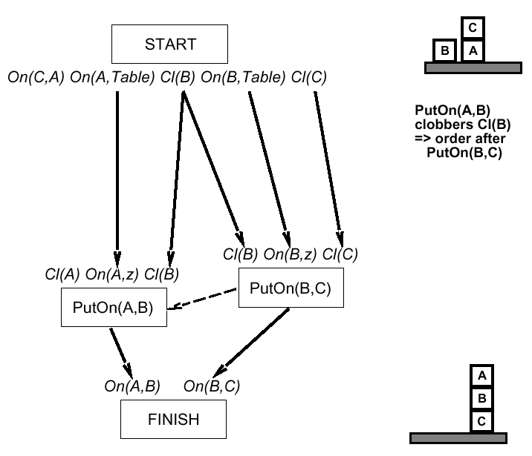
Example (cont.)

Slide 37
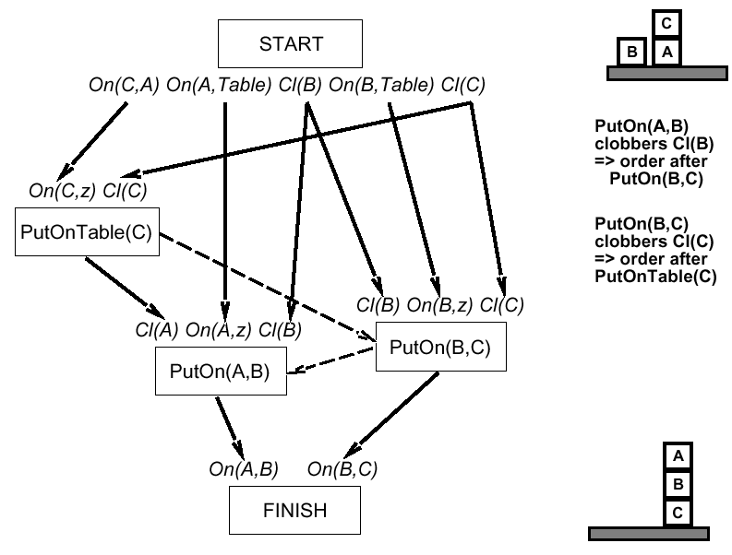
Example (cont.)

Slide 38
Example: Spare Tire Problem
See Figure 10.2
Initial State
Goal State
Actions:
Remove(Spare,Trunk), Remove(Flat, Axle)
PutOn(Spare,Axle)
LeaveOvernight
Note
the negated precondition ¬At(Flat,Axle) not allowed in STRIPS.
Could be easily replaced with Clear(Axle), adding one more predicate to the language

Slide 39
Example of POP: Flat tire problem
See problem description in Fig 10.13 page 391
Only one open precondition
Only 1 applicable action
Start
At(Spare,Trunk), At(Flat,Axle)
At(Spare,Ground), ¬At(Flat,Axle)
PutOn(Spare,Axle)
Pick up At(Spare,Ground)
Choose only applicable action Remove(Spare,Trunk)
At(Spare,Axle)
Finish

Slide 40
Add causal link between Remove(Spare,Trunk) and PutOn(Spare,Axle)
Pick up ¬At(Flat,Axle)
There are 2 applicable actions: LeaveOvernight and Remove(Flat,Axle)
Choose LeaveOvernight
LeaveOvernight has effect ¬At(Spare,Ground), which conflicts with the causal link
We remove the conflict by forcing LeaveOvernight to occur before Remove(Spare,Trunk)
Conflicts with effects of Remove(Spare,Trunk)
The only way to resolve the conflict is to undo LeaveOvernightuse the action Remove(Flat,Axle)

Slide 41
This time, we choose Remove(Flat,Axle)
Pick up At(Spare,Trunk) and choose Start to achieve it
Pick up At(Flat,Axle) and choose Start to achieve it.
We now have a complete consistent partially ordered plan

Slide 42
ADL Example for Planning Graph Have Cake and Eat It Too
Init(Have(Cake) ∧ ¬Eaten(Cake))
Goal(Have(Cake) ∧ Eaten(Cake))
Action(Eat(Cake),
PRECOND: Have(Cake)
EFFECT: ¬Have(Cake) ∧ Eaten(Cake))
Action(Bake(Cake),
PRECOND: ¬Have(Cake)
EFFECT: Have(Cake))

Slide 43
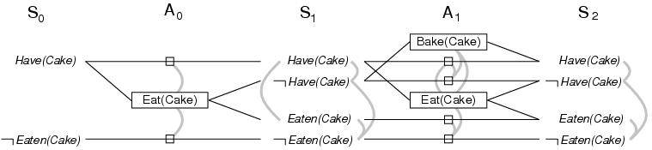
Planning Graphs
A planning graph consists of a sequence of levels that correspond to steps in the plan

Slide 44
Planning Graphs
A planning graph consists of a sequence of levels that correspond to steps in the plan
Each level consists of a set of literals and a set of actions
Literals = all those that could be true at that time step, based on the actions executed at preceding time steps
Level 0 is the initial state
Actions = all those actions that could have their preconditions satisfied at that time step, based on which literals actually hold

Slide 45
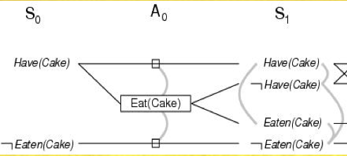
Cake Example
Start at state level S₀ and determine action level A₀ and state level S₁
S₀ = all literals in initial state
A₀ = all actions whose preconditions are satisfied in S₀
S₁ = all literals that could result from executing actions in A₀
Connect preconditions of actions in A₀ to S₀ and effects to S₁
Inaction is represented by persistence actions (like frame axioms)

Slide 46
Conflicts
Conflicts between actions or literals at a step are denoted by mutex links
What can’t be done or true simultaneously (how computed on next slide)
Can’t have your cake and eat it too (at least at S₁)
S₁ implicitly defines multiple alternative states
The mutex links are constraints that determine the alternatives
Have(Cake)∧¬Eaten(Cake) or ¬Have(Cake)∧Eaten(Cake)
Analogous to ATMS in keeping track of consistent subsets

Slide 47
Adding Mutex Relations
A mutex relation holds between two actions when:
Inconsistent effects: one action negates the effect of another
Interference: an effect of one action negates a precondition of the other
Competing needs: a precondition of one action is mutually exclusive with a precondition of the other
A mutex relation holds between two literals when:
One is the negation of the other OR
Each possible action pair that could achieve the literals is mutex
Referred to as inconsistent support
Notes:
Inconsistent effects: Indeterminate effect if execute at same time, so must think about ordering
Interference: Must really think about ordering between them to figure out what result of both is
Competing needs: Really aren’t eligible to execute at the same time

Slide 48
Cake Example (Cont.)
Continue generating levels in same fashion
Can have cake and eat it in S₂
There is a competing needs issue here
Stop when two consecutive levels are identical
Process has leveled off
Since process doesn’t choose among actions, complexity is (a low-order) polynomial rather than exponential
Notes:
Competing needs: Between complementary pairs of persistence actions; and between Bake and Eat

Slide 49
Example of GRAPHPLAN Execution (1)
At(Spare,Axle) is not in S₀
No need to extract solution
Expand the plan
Start
At(Spare,Trunk), At(Flat,Axle)

Slide 50
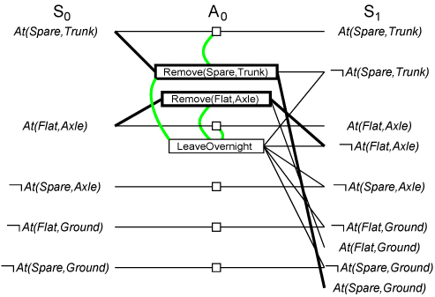
Example of GRAPHPLAN Execution (2)
Three actions are applicable
3 actions and 5 noops are added
Mutex links are added
At(Spare,Axle) still not in S₁
Plan is expanded

Slide 51
Example of GRAPHPLAN Execution (3)
Illustrates well mutex links: inconsistent effects, interference, competing needs, inconsistent support

Slide 52
Solution Extraction (Backward)
Solve a Boolean CSP: Variables are actions, domains are {0=out of plan, 1=in plan), constraints are mutex
Search problem from last level backward

Slide 53
Termination of GRAPHPLAN
GRAPHPLAN is guaranteed to terminate
Literal increase monotonically
Actions increase monotonically
Mutexes decrease monotinically
A solution is guaranteed not to exist when
The graph levels off with all goals present & non-mutex, and
EXTRACTSOLUTION fails to find solution

Slide 54
Next Week
Review for Exam 2
Exam2 on Thursday, June 29 4-5:20pm in THH 201
Homework2 due Monday 26

