Slide 1
COMP 482: Design and Analysis of Algorithms
Spring 2013
Lecture 5
Prof. Swarat Chaudhuri

Slide 2
3.4 Testing Bipartiteness

Slide 3
Bipartite Graphs
Def. An undirected graph G = (V, E) is bipartite if the nodes can be colored red or blue such that every edge has one red and one blue end.
Applications.
  Stable marriage: men = red, women = blue.
  Scheduling: machines = red, jobs = blue.
a bipartite graph

Slide 4
Testing Bipartiteness
Testing bipartiteness. Given a graph G, is it bipartite?
  Many graph problems become:
    easier if the underlying graph is bipartite (matching)
    tractable if the underlying graph is bipartite (independent set)
  Before attempting to design an algorithm, we need to understand structure of bipartite graphs.
v₂
v₂
v₃
v₁
v₄
v₆
v₅
v₄
v₃
v₅
v₆
v₇
v₁
v₇
a bipartite graph G
another drawing of G

Slide 5
An Obstruction to Bipartiteness
Lemma. If a graph G is bipartite, it cannot contain an odd length cycle.
Pf. Not possible to 2-color the odd cycle, let alone G.
bipartite
(2-colorable)
not bipartite
(not 2-colorable)

Slide 6
Bipartite Graphs
Lemma. Let G be a connected graph, and let L₀, …, L_{k} be the layers produced by BFS starting at node s. Exactly one of the following holds.
  (i) No edge of G joins two nodes of the same layer, and G is bipartite.
  (ii) An edge of G joins two nodes of the same layer, and G contains an
  odd-length cycle (and hence is not bipartite).
L₁
L₂
L₃
L₁
L₂
L₃
Case (i)
Case (ii)

Slide 7
Bipartite Graphs
Lemma. Let G be a connected graph, and let L₀, …, L_{k} be the layers produced by BFS starting at node s. Exactly one of the following holds.
  (i) No edge of G joins two nodes of the same layer, and G is bipartite.
  (ii) An edge of G joins two nodes of the same layer, and G contains an
  odd-length cycle (and hence is not bipartite).
Pf. (i)
  Suppose no edge joins two nodes in the same layer.
  By previous lemma, this implies all edges join nodes on successive levels.
  Bipartition: red = nodes on odd levels, blue = nodes on even levels.
L₁
L₂
L₃
Case (i)

Slide 8
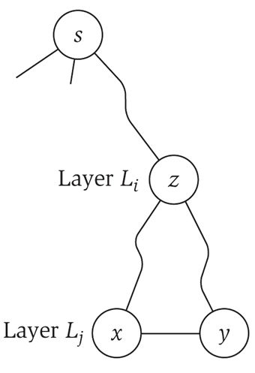
Bipartite Graphs
Lemma. Let G be a connected graph, and let L₀, …, L_{k} be the layers produced by BFS starting at node s. Exactly one of the following holds.
  (i) No edge of G joins two nodes of the same layer, and G is bipartite.
  (ii) An edge of G joins two nodes of the same layer, and G contains an
  odd-length cycle (and hence is not bipartite).
Pf. (ii)
  Suppose (x, y) is an edge with x, y in same level L_{j}.
  Let z = lca(x, y) = lowest common ancestor.
  Let L_{i} be level containing z.
  Consider cycle that takes edge from x to y,
  then path from y to z, then path from z to x.
  Its length is 1 + (j-i) + (j-i), which is odd. ▪
z = lca(x, y)
(x, y)
path from
y to z
path from
z to x

Slide 9
Obstruction to Bipartiteness
Corollary. A graph G is bipartite iff it contain no odd length cycle.
5-cycle C
bipartite
(2-colorable)
not bipartite
(not 2-colorable)

Slide 10
Q1: Destroying paths
Suppose that an n-node undirected graph G = (V, E) contains two nodes s and t such that the distance between s and t is strictly greater than n/2. Show that there must exist some node v, not equal to either s or t, such that deleting v from G destroys all s-t paths.
Give an algorithm with running O(m+n) to find such a node.

Slide 11
Answer
Run BFS starting from s. Let d be the layer where you encounter t. By assumption, d > n/2.
Now we claim that one of the layers L₁,…, L_{d-1} has a single node. Why? Because if not, then they account for at least 2(n/2) = n nodes. But G has only n nodes, and s and t are not in these layers.
Now let L_{i} be the layer containing a single node v. Suppose we delete v. Consider the set X of all nodes in layers 0,…,i-1. This set cannot contain t.
Any edge out of these nodes can only lead to a node in L_{i} or stay in X, by the properties of BFS. But v is the only node in L_{i}.

Slide 12
Q2: Interference-free paths
Consider the following robotics question. You have an undirected graph G = (V,E) that represents the floor plan of a building, and there are two robots located at nodes a and b. The robot at node a wants to move to node c; the robot at node b wants to move to location d.
This is done using a schedule: a function that at each time step, specifies that a robot moves across a single edge. A schedule is interference-free if there is no point at which the two robots occupy nodes that are at a distance ≤ r from one another. (We assume that a-b and c-d are sufficiently far apart.)
Give an algorithm to tell if there is an interference-free schedule that the robots can use.

Slide 13
Answer
Don’t consider the graph G but the “product” H of G with itself.
Nodes of H: pairs (u,v) where u, v are nodes of G.
Edges of H: ((u,v), (u’, v’)) where
Either u = u’ and there is an edge between v and v’ in G
Or v = v’ and there is an edge between u and u’ in G
Now delete from H all nodes where there would be interference, getting a graph H’.
Check if there is a path from (a,b) to (c,d) in H’.
Complexity: O(mn + n²)

Slide 14
3.5 Connectivity in Directed Graphs

Slide 15
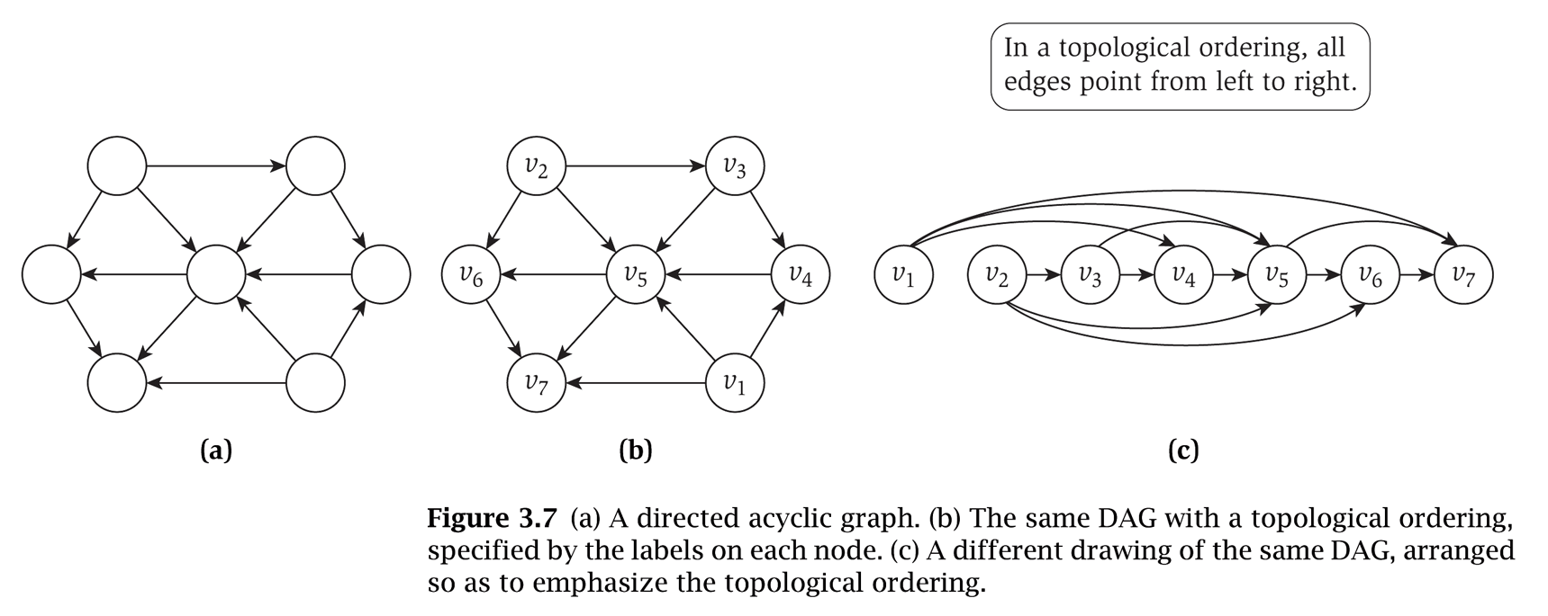
Directed Graphs
Directed graph. G = (V, E)
  Edge (u, v) goes from node u to node v.
Ex. Web graph - hyperlink points from one web page to another.
  Directedness of graph is crucial.
  Modern web search engines exploit hyperlink structure to rank web pages by importance.

Slide 16
Graph Search
Directed reachability. Given a node s, find all nodes reachable from s.
Directed s-t shortest path problem. Given two node s and t, what is the length of the shortest path between s and t?
Graph search. BFS extends naturally to directed graphs.
Web crawler. Start from web page s. Find all web pages linked from s, either directly or indirectly.

Slide 17
Strong Connectivity
Def. Node u and v are mutually reachable if there is a path from u to v and also a path from v to u.
Def. A graph is strongly connected if every pair of nodes is mutually reachable.
Lemma. Let s be any node. G is strongly connected iff every node is reachable from s, and s is reachable from every node.
Pf. ⇒ Follows from definition.
Pf. ⇐ Path from u to v: concatenate u-s path with s-v path.
Path from v to u: concatenate v-s path with s-u path. ▪
ok if paths overlap
s
u
v
Notes:
Theorem. [Tarjan 1972] Can decompose a graph into its
"strong components" in O(m + n) time.

Slide 18
Strong Connectivity: Algorithm
Theorem. Can determine if G is strongly connected in O(m + n) time.
Pf.
  Pick any node s.
  Run BFS from s in G.
  Run BFS from s in G^{rev}.
  Return true iff all nodes reached in both BFS executions.
  Correctness follows immediately from previous lemma. ▪
reverse orientation of every edge in G
strongly connected
not strongly connected
Notes:
Question: how do you break a graph into strongly connected components?
Theorem. [Tarjan 1972] Can decompose a graph into its
"strong components" in O(m + n) time.

Slide 19
3.6 DAGs and Topological Ordering

Slide 20
Directed Acyclic Graphs
Def. An DAG is a directed graph that contains no directed cycles.
Ex. Precedence constraints: edge (v_{i}, v_{j}) means v_{i} must precede v_{j}.
Def. A topological order of a directed graph G = (V, E) is an ordering of its nodes as v₁, v₂, …, v_{n} so that for every edge (v_{i}, v_{j}) we have i < j.
v₂
v₃
v₆
v₅
v₄
v₁
v₂
v₃
v₄
v₅
v₆
v₇
v₇
v₁
a DAG
a topological ordering

Slide 21
Precedence Constraints
Precedence constraints. Edge (v_{i}, v_{j}) means task v_{i} must occur before v_{j}.
Applications.
  Course prerequisite graph: course v_{i} must be taken before v_{j}.
  Compilation: module v_{i} must be compiled before v_{j}. Pipeline of computing jobs: output of job v_{i} needed to determine input of job v_{j}.

Slide 22
Directed Acyclic Graphs
Lemma. If G has a topological order, then G is a DAG.
Pf. (by contradiction)
  Suppose that G has a topological order v₁, …, v_{n} and that G also has a directed cycle C. Let's see what happens.
  Let v_{i} be the lowest-indexed node in C, and let v_{j} be the node just before v_{i}; thus (v_{j}, v_{i}) is an edge.
  By our choice of i, we have i < j.
  On the other hand, since (v_{j}, v_{i}) is an edge and v₁, …, v_{n} is a topological order, we must have j < i, a contradiction. ▪
the directed cycle C
v₁
v_{i}
v_{j}
v_{n}
the supposed topological order: v₁, …, v_{n}

Slide 23
Directed Acyclic Graphs
Lemma. If G has a topological order, then G is a DAG.
Q. Does every DAG have a topological ordering?
Q. If so, how do we compute one?

Slide 24
Directed Acyclic Graphs
Lemma. If G is a DAG, then G has a node with no incoming edges.
Pf. (by contradiction)
  Suppose that G is a DAG and every node has at least one incoming edge. Let's see what happens.
  Pick any node v, and begin following edges backward from v. Since v has at least one incoming edge (u, v) we can walk backward to u.
  Then, since u has at least one incoming edge (x, u), we can walk backward to x.
  Repeat until we visit a node, say w, twice.
  Let C denote the sequence of nodes encountered between successive visits to w. C is a cycle. ▪
w
x
u
v

Slide 25

Directed Acyclic Graphs
Lemma. If G is a DAG, then G has a topological ordering.
Pf. (by induction on n)
  Base case: true if n = 1.
  Given DAG on n > 1 nodes, find a node v with no incoming edges.
  G - { v } is a DAG, since deleting v cannot create cycles.
  By inductive hypothesis, G - { v } has a topological ordering.
  Place v first in topological ordering; then append nodes of G - { v }
  in topological order. This is valid since v has no incoming edges. ▪
DAG
v

Slide 26
Topological Sorting Algorithm: Running Time
Theorem. Algorithm finds a topological order in O(m + n) time.
Pf.
  Maintain the following information:
    count[w] = remaining number of incoming edges
    S = set of remaining nodes with no incoming edges
  Initialization: O(m + n) via single scan through graph.
  Update: to delete v
    remove v from S
    decrement count[w] for all edges from v to w, and add w to S if c count[w] hits 0
    this is O(1) per edge ▪
Notes:
Alternative. Order nodes in reverse order that DFS finishes visiting them.

Slide 27
Question
Can you have multiple topological orderings for a graph?
v₂
v₃
v₆
v₅
v₄
v₇
v₁

Slide 28
Q3: Reachability game
Suppose you have a bipartite directed graph with nodes in the two partitions colored red and blue, and two players: Red and Blue.
Red and Blue play a game where a token gets moved along edges of the graph. At each point, the player whose name matches the color of the current node pushes the token. Initially the token is at s (a red node).
The objective of the game is that Red wants the token to avoid a certain set of blue nodes X. Blue wants the token to get to X at some point in the game; Red wants to avoid this. If the token gets to X at any point, the game is over and Blue wins. Aside from this there is no time bound on the game.
Can you give an algorithm that, given
the graph, s, and X, can tell if Red
has a strategy to win this game?

Slide 29
Strongly connected components
Theorem. Can determine if G is strongly connected in O(m + n) time.
Pf.
  Do a DFS in G, ranking nodes u in decreasing order of finishing time f(u).
  Run DFS in G^{rev} with root nodes selected in order according to the above rank.
  Return each DFS tree in the second DFS as a separate component. ▪
Notes:
Key proof idea: Let C and C’ be distinct SCCs in G. If there is an edge (u,v) in G, then f(u) > f(v). Graph of SCCs is a DAG, and we are exploring this graph in a topological order.

