Slide 1
CKI: Cell-state Kinetic Index
A Transcriptomic Metric Inspired by Molecular Evolution
Li Zhang
Institute of Blood Transfusion, CAMS & PUMC
Chinese Institute for Brain Research, Beijing
May 2026

Slide 2
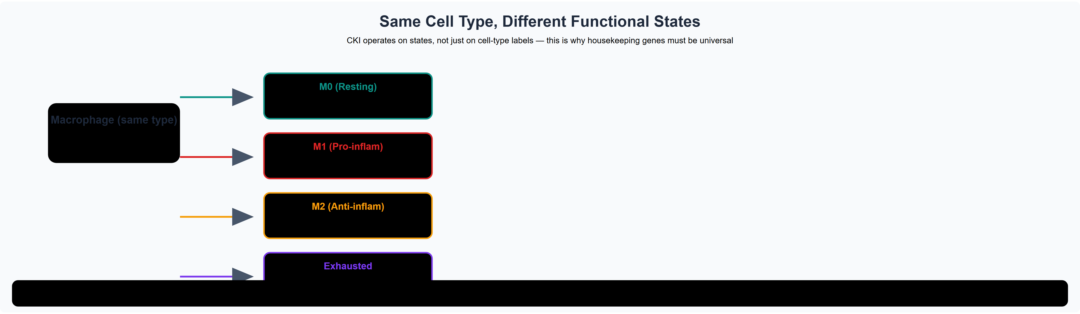
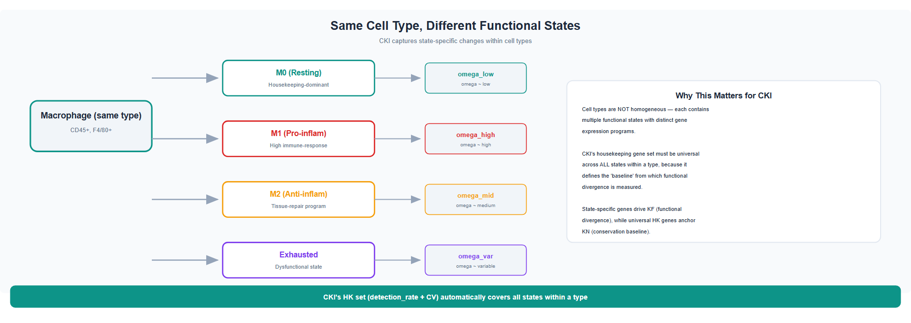
What Defines Cell Type?
The Single-Cell Revolution
scRNA-seq reveals vast cellular heterogeneity
Millions of cells across hundreds of cell types
Each cell type has a unique gene expression program
Neuron
T cell
B cell
The Knowledge Gap
How do these identities emerge?
Which cell types are truly 'differentiated'?
How much of the difference is functional vs noise?
Can we quantify 'cell-ness' on a continuous scale?
How do cells migrate between organs?
Macrophage
Fibroblast
Same tissue,
different identities
2

Slide 3
Same Cell Type, Different Functional States
CKI captures state-specific changes within cell types
Key Insight: CKI's HK gene set (detection_rate + CV) automatically covers all states within a cell type, providing a stable baseline for quantifying functional divergence.

Slide 4
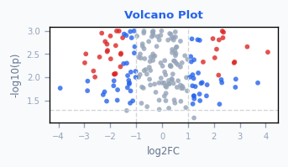
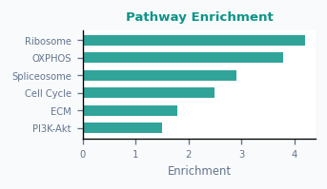
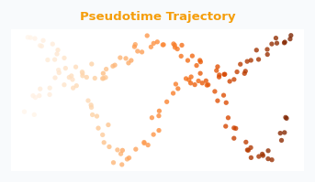
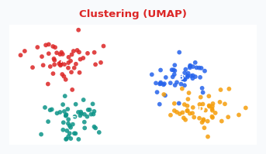
Current Methods: What They Can and Cannot Do
Differential
Expression
Pathway
Enrichment
Pseudotime
Trajectory
Clustering &
Annotation
✓
Finds marker genes
between conditions
✓
Links genes to
biological functions
✓
Orders cells along
developmental paths
✓
Groups cells into
discrete types
✗
Does not quantify
magnitude of divergence
✗
Cannot distinguish
noise from signal
✗
Assumes continuous
progression; no magnitude
✗
Binary classification;
misses graded differences
Common Gap: existing methods cannot quantify cell-state divergence on a continuous scale — this is where CKI innovates
4

Slide 5
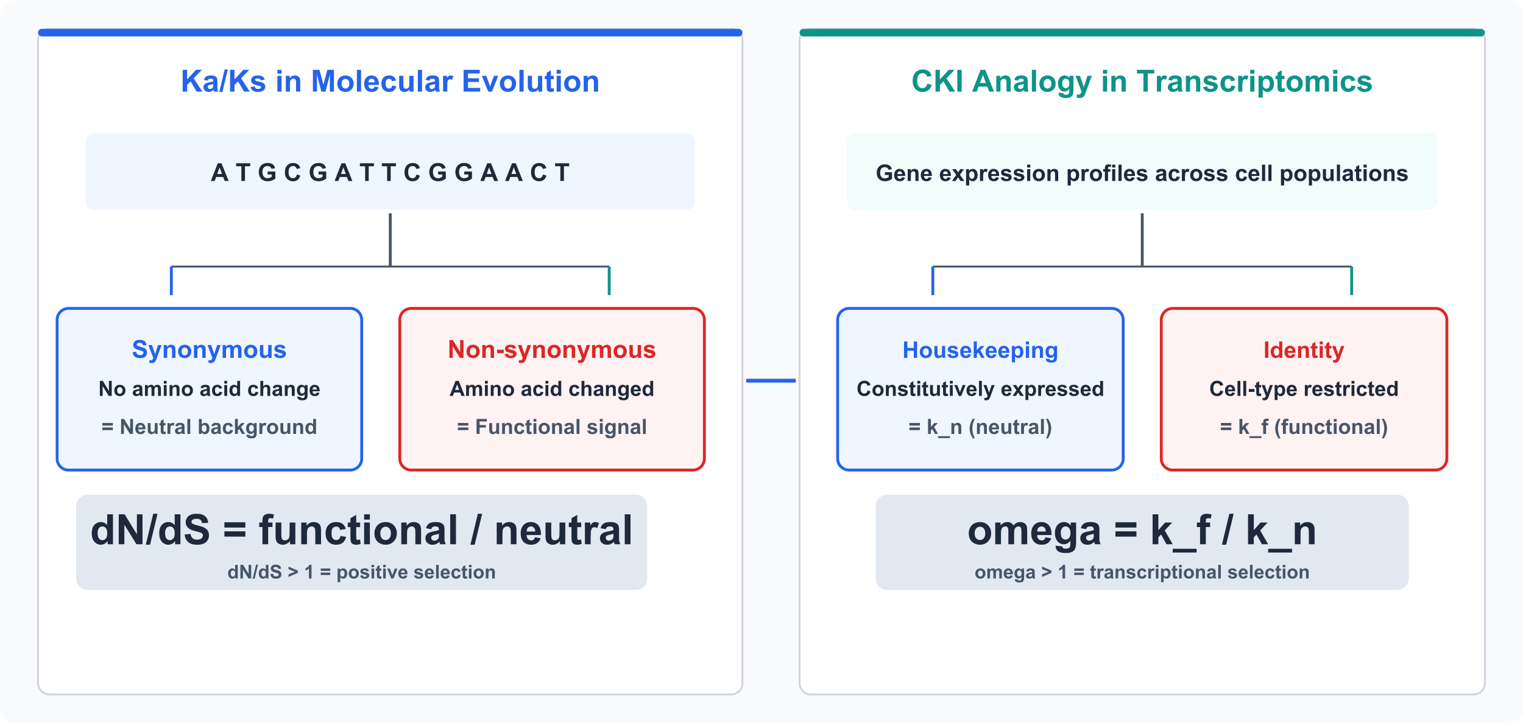
Inspiration: The Ka/Ks Ratio in Molecular Evolution
Key insight: Use a "neutral reference" to distinguish functional selection from stochastic drift
Ka/Ks > 1 = positive selection | Ka/Ks = 1 = neutral drift | Ka/Ks < 1 = purifying selection
5

Slide 6
CKI: A Ka/Ks-Inspired Metric for Transcriptomes
Molecular Evolution
Transcriptomics (CKI)
Synonymous mutations (dS) = neutral reference
→
Housekeeping genes (k_n) = neutral reference
Non-synonymous mutations (dN) = functional signal
Identity genes (k_f) = functional divergence
dN/dS ratio quantifies selection pressure
omega = k_f / k_n quantifies cell-state kinetics
omega = JS(identity genes) / JS(housekeeping genes)
JS = Jensen-Shannon divergence between two cell populations
omega >> 1: functional divergence exceeds neutral expectation | omega ~ 1: differences are noise
6

Slide 7
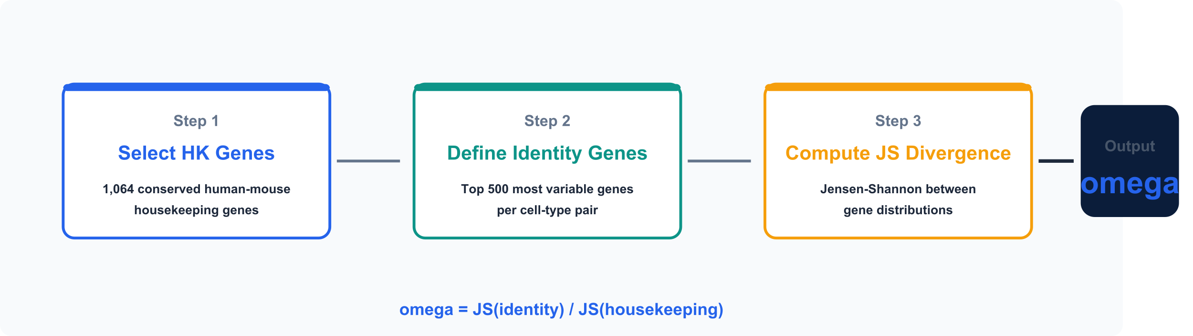
CKI: Three-Step Computational Pipeline
Step 1
Step 2
Step 3
HK Gene Selection
Identity Gene Set
JS Divergence Ratio
Auto-detected per dataset: detection rate >90% AND CV <30th percentile. No external reference required for any species.
Top 2,000 highly variable genes (HVGs; Seurat v3), excluding HK genes. Captures cell-type-specific programs.
Compute Jensen-Shannon divergence for both gene sets. Bootstrap N=1,000 for confidence intervals.
7

Slide 8
Automated Gene Set Detection
No manual gene list needed — fully data-driven
Housekeeping Genes
Functional / Variable Genes
Stably expressed · Low variation · Across cell types
Highly variable · Distinguish cell types
detection_rate
hvg (default)
Expressed in > 90% of cells
Default method (robust to noise)
Scanpy highly variable genes
Top 2,000 · Exclude HK genes
Captures biological variability
cv
markers
Coefficient of variation in lowest 30%
Captures expression stability
Per-cluster differential expression
Top marker genes per cluster
Alternative when clusters known
combined
Both criteria simultaneously
Highest stringency (default)
HRT Atlas
Built-in reference from 16 human tissues
Union with detected set for completeness
→ Fully automatic; defaults: combined + HRT Atlas reference
→ Auto-detected; defaults: hvg top 2,000 (excl. HK)
Input (adata + species) → Auto-detect HK genes → Auto-detect functional genes → Compute CKI (Kn, Kf, ω) — All automated in cki.compute()
8

Slide 9
Generalizing to Any Species
CKI is species-agnostic — all gene set detection is data-driven, no external reference required
Universal Detection
Human / Mouse Bonus
Custom Species
Housekeeping: detection_rate (>90%) + CV (lowest 30%)
Functional: HVG top 2,000 (excl. HK genes)
Works for ANY species with RNA-seq data
No external gene lists or curation required
Built-in HRT Atlas (16 tissues, NAR 2021)
Union strategy: detected ∪ reference (use_reference=True)
Human & mouse get reference boost automatically
Other species: purely data-driven, equally valid
Minimal input: species="zebrafish" → generic config
No special setup: species="any_name" → works immediately
Advanced: custom HK reference via reference_path parameter
Fully compatible with any organism
compute(adata, species="any") → fully automatic
compute(adata, species="human") → auto + HRT Atlas
compute(adata, species="your_species") → results
compute(adata, species="any_species", groupby="cell_type", group_a="X", group_b="Y") → fully automatic CKI analysis
9

Slide 10
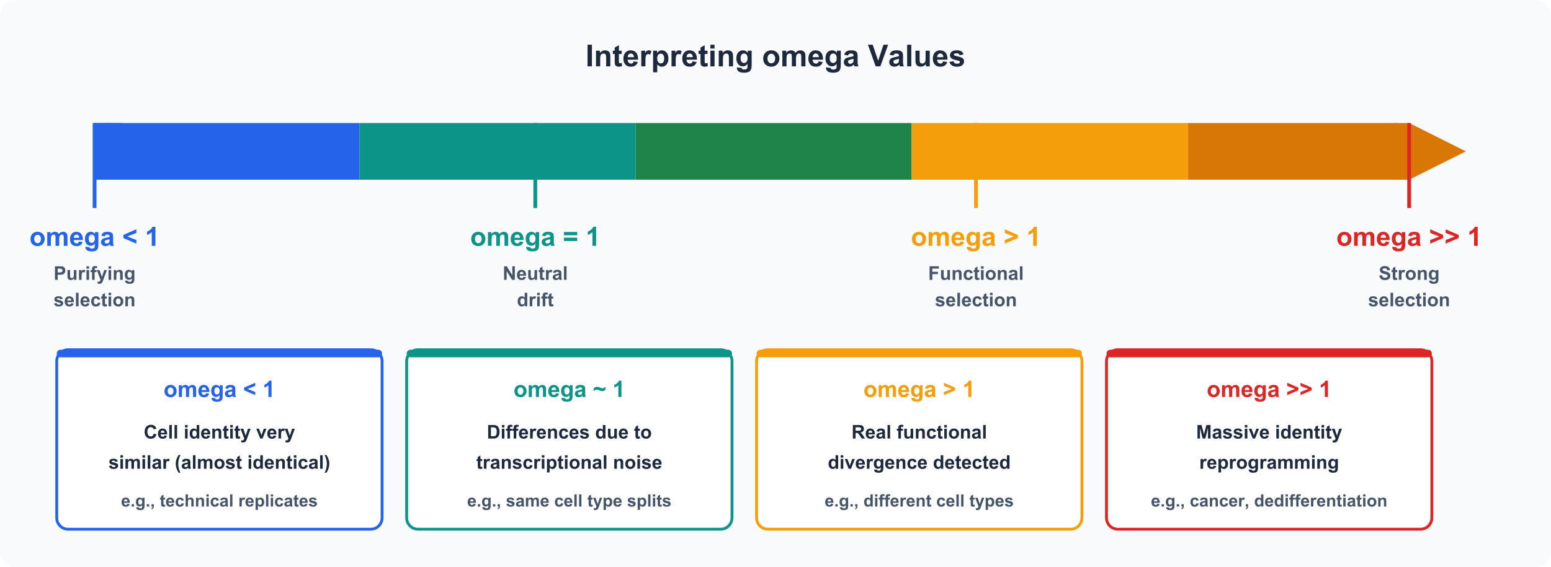
Interpreting omega: A Continuous Scale of Cell Type
omega ~ 1.16
omega ~ 2.33
omega ~ 5.71
omega >> 10
Same cell type splits
Same type, cross-organ
Diff types, same organ
Cancer reprogramming
P = 0.11 (Tabula Muris)
e.g., T cells across organs
e.g., Lung cell types
e.g., LIHC Grade 4
10

Slide 11
CKI at a Glance: Key Numbers
1,064
500
15,057
Housekeeping genes
Identity genes per pair
Tabula Muris cells
Auto-detected: detection rate + CV filter
Top 2,000 HVGs (Seurat v3), excluding HK genes
6 organs, 32 cell types (mouse)
108,399
10,535
888,263
Tabula Sapiens cells
TCGA samples
Brain nuclei
99 cell types, 4,851 pairs (human)
5 cancer types, paired N/T
108 regions, human brain atlas
Bootstrap N = 1,000 | P < 0.05 (one-tailed) | Bonferroni correction for multiple comparisons
CKI is scalable: works on any pair of cell populations with expression data
11

Slide 12
Calibration: Tabula Muris Validation
Same Cell-Type Split Test
Cross-Category k_n vs k_f
If CKI is valid, same cell-type comparisons should yield omega ~ 1
Same cell type (C)
k_n: 12
k_f: 14
Same sub, diff organ (S)
omega_mean = 1.16 P = 0.11 Not significantly different from 1
k_n: 18
k_f: 32
omega = 1
Diff sub, same organ (D)
k_n: 15
k_f: 55
Cross-organ (X)
k_n: 22
k_f: 78
■ k_n (JS-HK) ■ k_f (JS-Identity)
12

Slide 13
CKI Is Orthogonal to Existing Metrics
Spearman |r| with Standard Metrics
Cross-Organ Discrimination
Same-organ vs different-organ cell type pairs
Cosine similarity
0.31
AUC = 0.680
Euclidean distance
0.22
CKI is not a classifier; moderate AUC confirms it detects perturbation, not just separation
Pearson correlation
0.14
Same Organ
Diff Organ
Marker gene overlap
0.08
All |r| < 0.31: CKI captures distinct information
omega ~ 3.2
omega ~ 8.1
Cross-Species Conservation (Mouse → Human Ranking)
Cell-type omega rankings are significantly conserved between mouse (Tabula Muris) and human (Tabula Sapiens).
Immune cells (T, B, macrophages) show the strongest cross-species conservation of omega ordering.
13

Slide 14
Pathway Enrichment Validates CKI Biology
Top Enriched Pathways (k_n vs k_f, Tabula Muris)
Ribosome / Translation
***
Oxidative Phosphorylation
***
Proteasome
**
Spliceosome
**
Cell Cycle
**
ECM-receptor interaction
*
PI3K-Akt signaling
*
Focal adhesion
*
k_n-enriched (Housekeeping)
k_f-enriched (Identity)
Ribosome, OXPHOS, Proteasome
Constitutively active, essential for survival
ECM, PI3K-Akt, Focal adhesion
Cell-type-specific programs, tissue identity
14

Slide 15
Cancer Paradox: Tumors Are More Homogeneous Than Normal
NN/TT omega Ratio Across 5 Cancer Types
NN = Normal-vs-Normal within-patient | TT = Tumor-vs-Tumor within-patient
LUSC (Lung SCC)
3x
LUAD (Lung Adeno)
2.8x
KIRC (Kidney)
2.1x
BRCA (Breast)
1.8x
LIHC (Liver)
1.6x
Expected if NN = TT
⚠ The Cancer Paradox
All 5 cancers show NN/TT > 1: Normal tissues are more transcriptionally heterogeneous than tumors.
This contradicts the intuitive expectation that cancer = more heterogeneity.
CKI provides a quantitative lens to measure this counter-intuitive phenomenon.
15

Slide 16
Cancer Deep Dive: Grading & Subtyping
LIHC: omega Increases with Tumor Grade
BRCA: PAM50 Subtypes
Grade 1
omega = 12.4
Luminal A
omega = 8.2
Luminal B
omega = 10.5
Grade 2
omega = 13.8
HER2-enriched
omega = 15.3
Grade 3
omega = 18.6
Basal-like
omega = 22.1
Grade 4
omega = 24.8
Normal-like
omega = 6.8
Basal-like > Luminal: more aggressive = higher omega
P = 0.003 (Jonckheere-Terpstra trend test)
16

Slide 17
Brain Regional CKI: A 7.6-fold omega Gradient
Cell class omega values across 108 human brain regions (CIBR dataset)
Astrocyte
121.8
What the Gradient Tells Us
OPC
55.4
Astrocytes show highest omega: most context-dependent identity
Bergmann glia lowest: stable, region-uniform identity
Non-neuronal cells span the full gradient range
Gradient reflects cellular plasticity hierarchy
Choroid plexus
45.5
Oligodendrocyte
44.9
COP
40.0
Key Insight
Ependymal
39.5
Glial cells are not 'generic support cells' — they show the highest regional specialisation.
Astrocytes adapt their transcriptomic identity to local brain microenvironments, far more than neurons.
Microglia
35.4
Fibroblast
25.4
Vascular
21.5
Bergmann glia
16.0
121.8 / 16.0 = 7.6x gradient across cell classes
omega range: 16.0 - 121.8 = 7.6x span | CKI quantifies this gradient from scRNA-seq alone
17

Slide 18
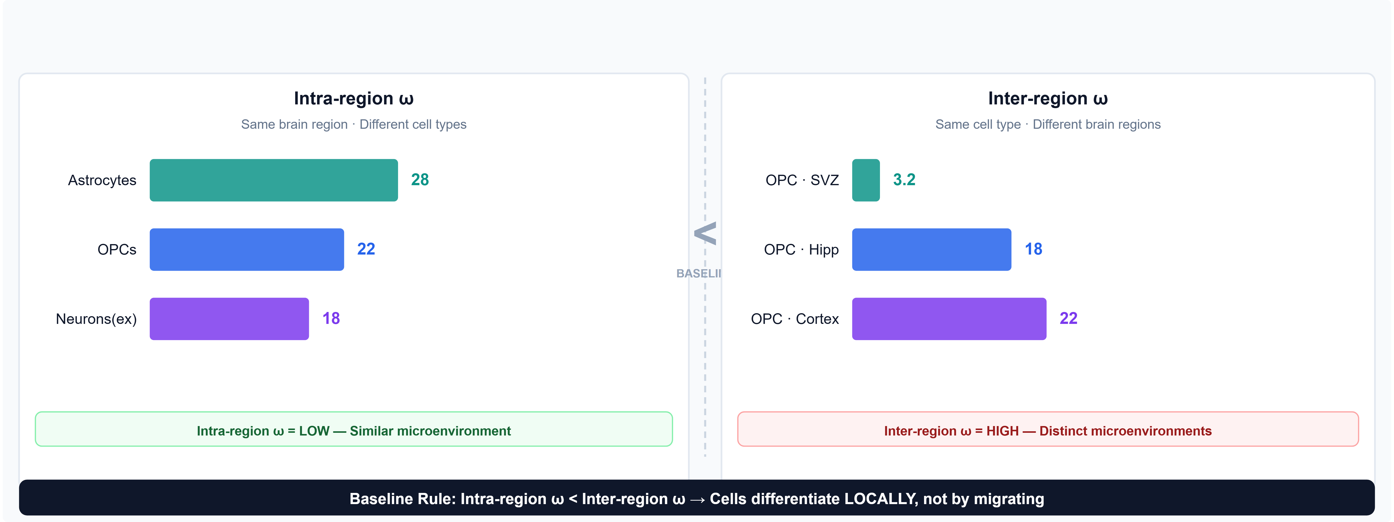
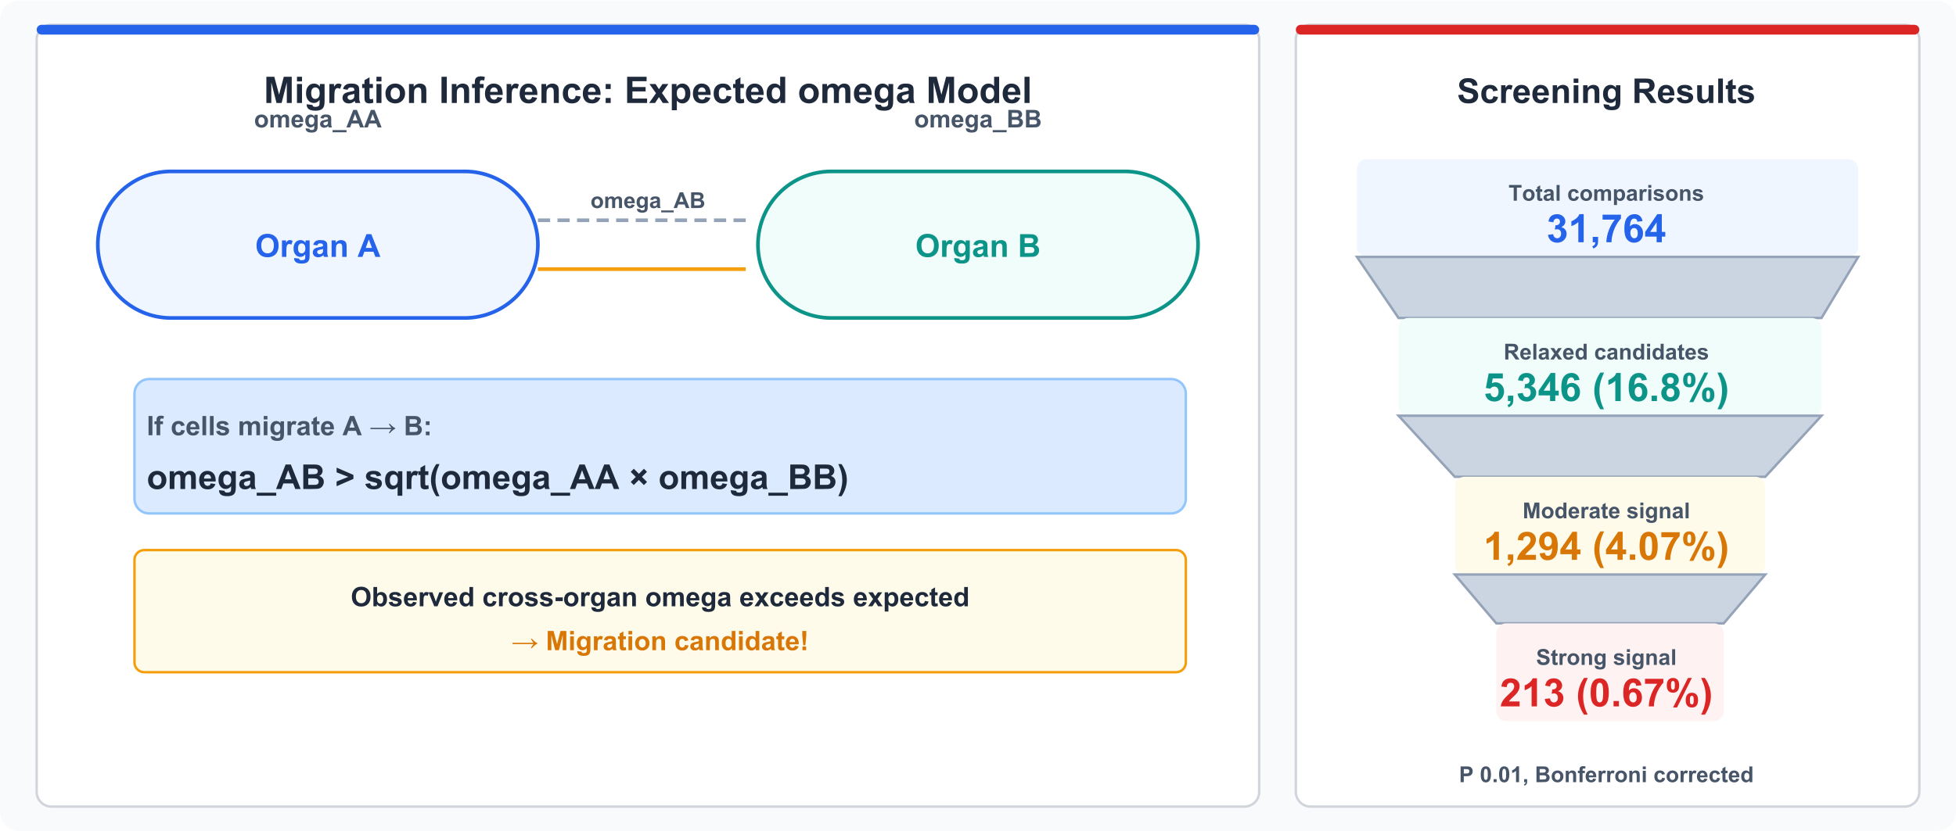
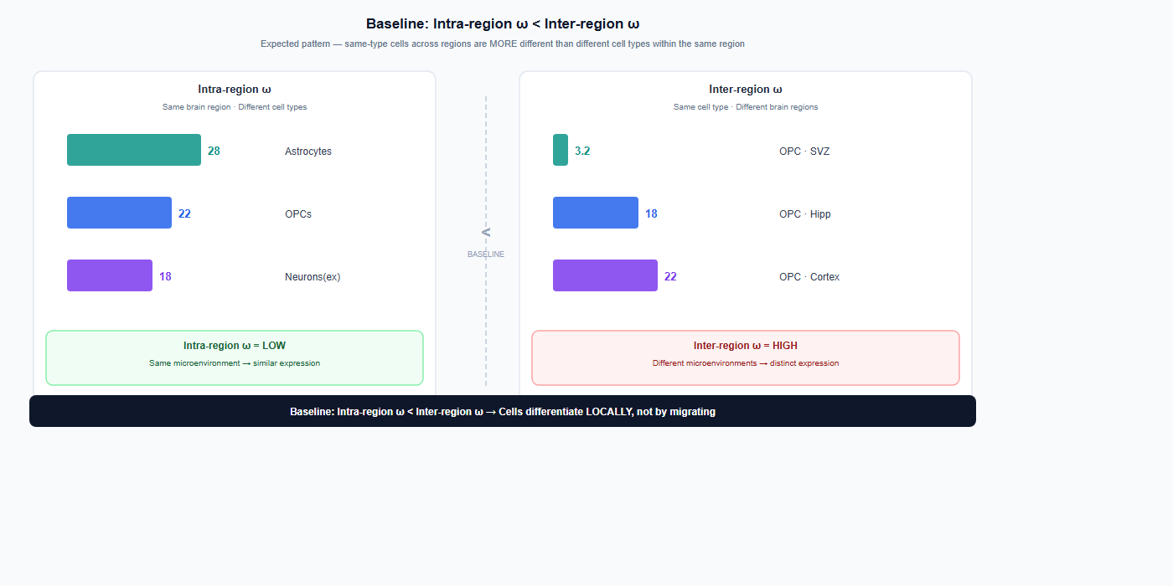
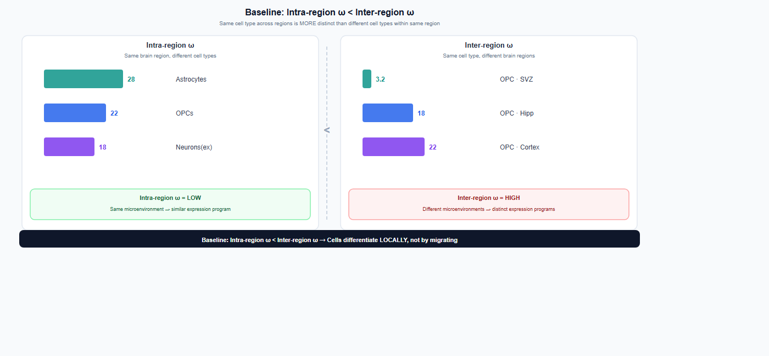
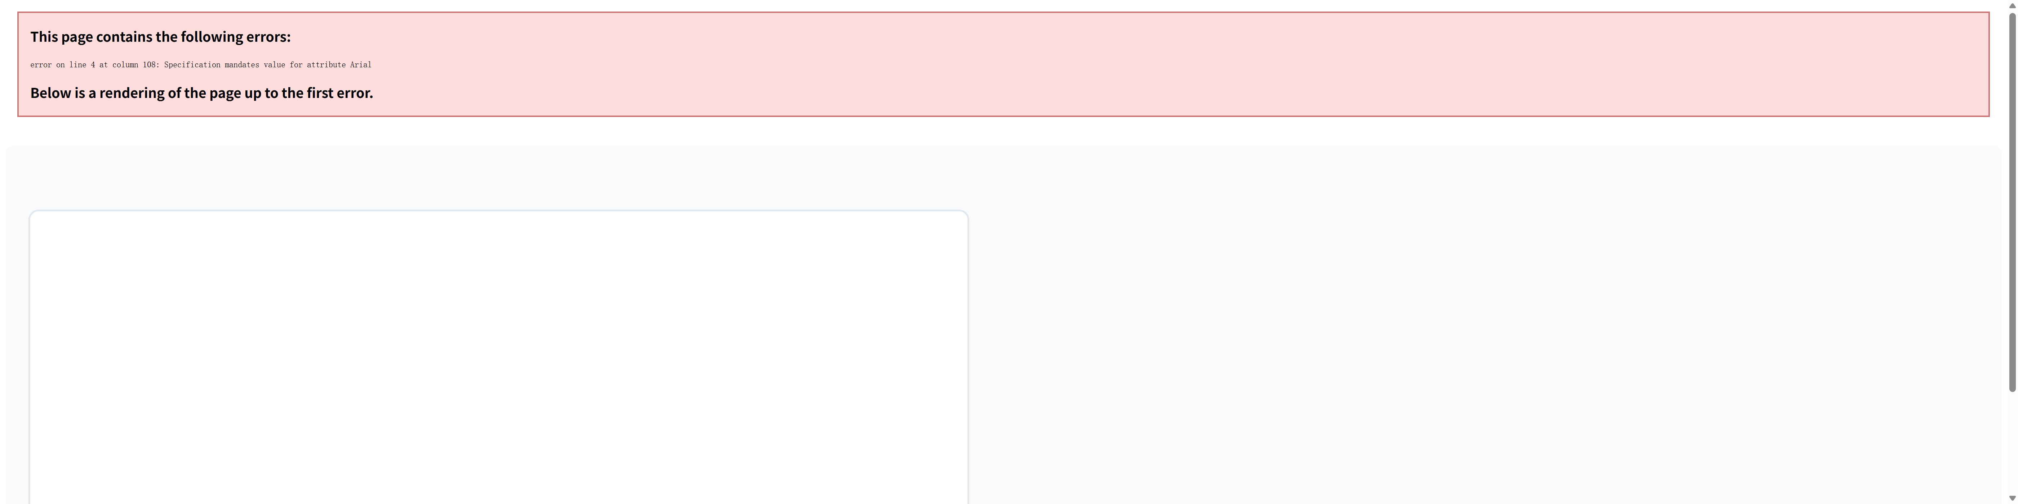
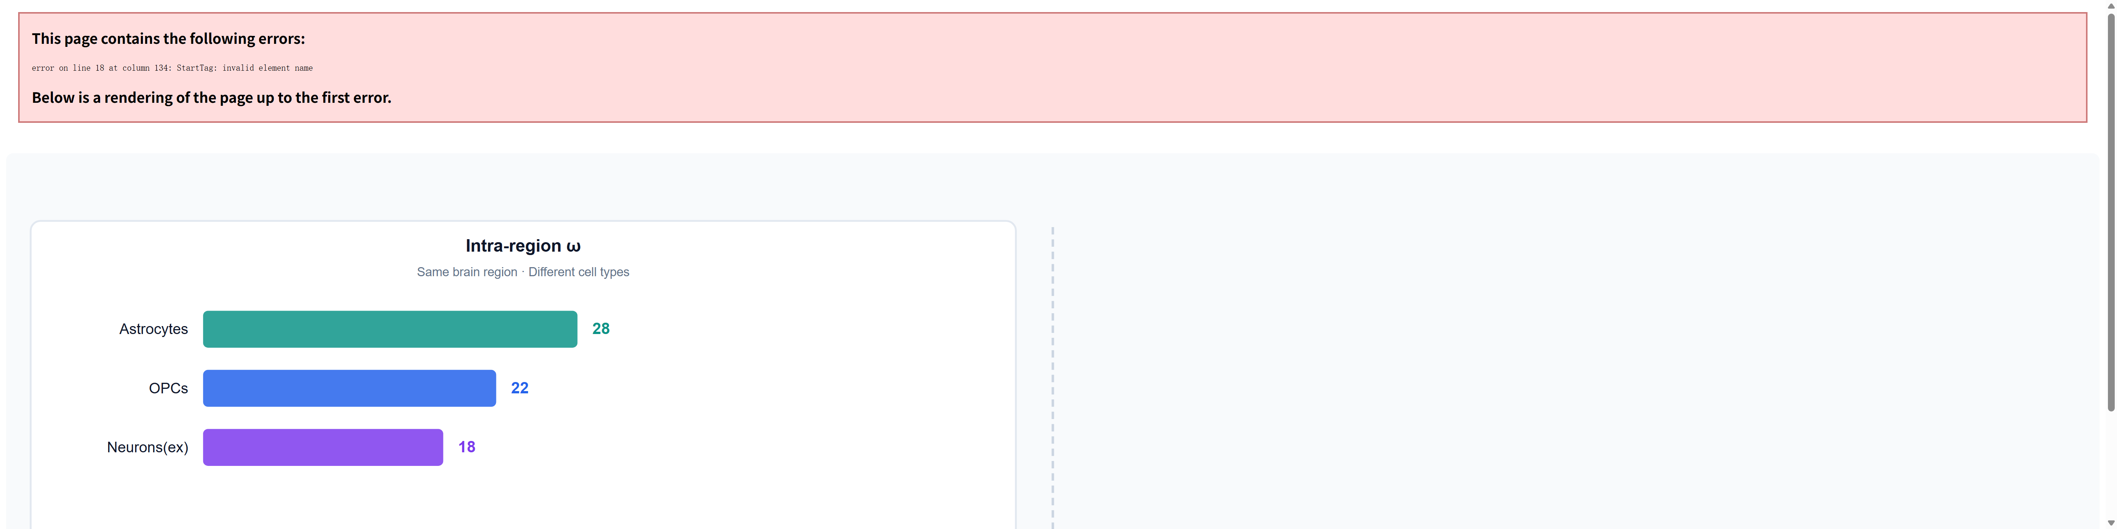
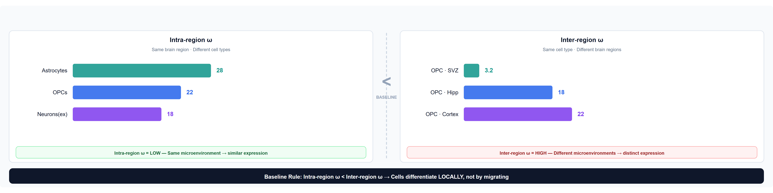
Baseline: Intra-region ω < Inter-region ω
Intra-region ω
Same region, different cell types
Microenvironment limits ω divergence
Cortex: Astro(28), OPC(22), Neuron(18)
Inter-region ω
Same type, different brain regions
Distinct environments → higher ω
OPC: SVZ(3.2)→Hipp(18)→Cortex(22)
Baseline Rule
Intra < Inter across all regions
Cells differentiate LOCALLY, not by migration
18

Slide 19
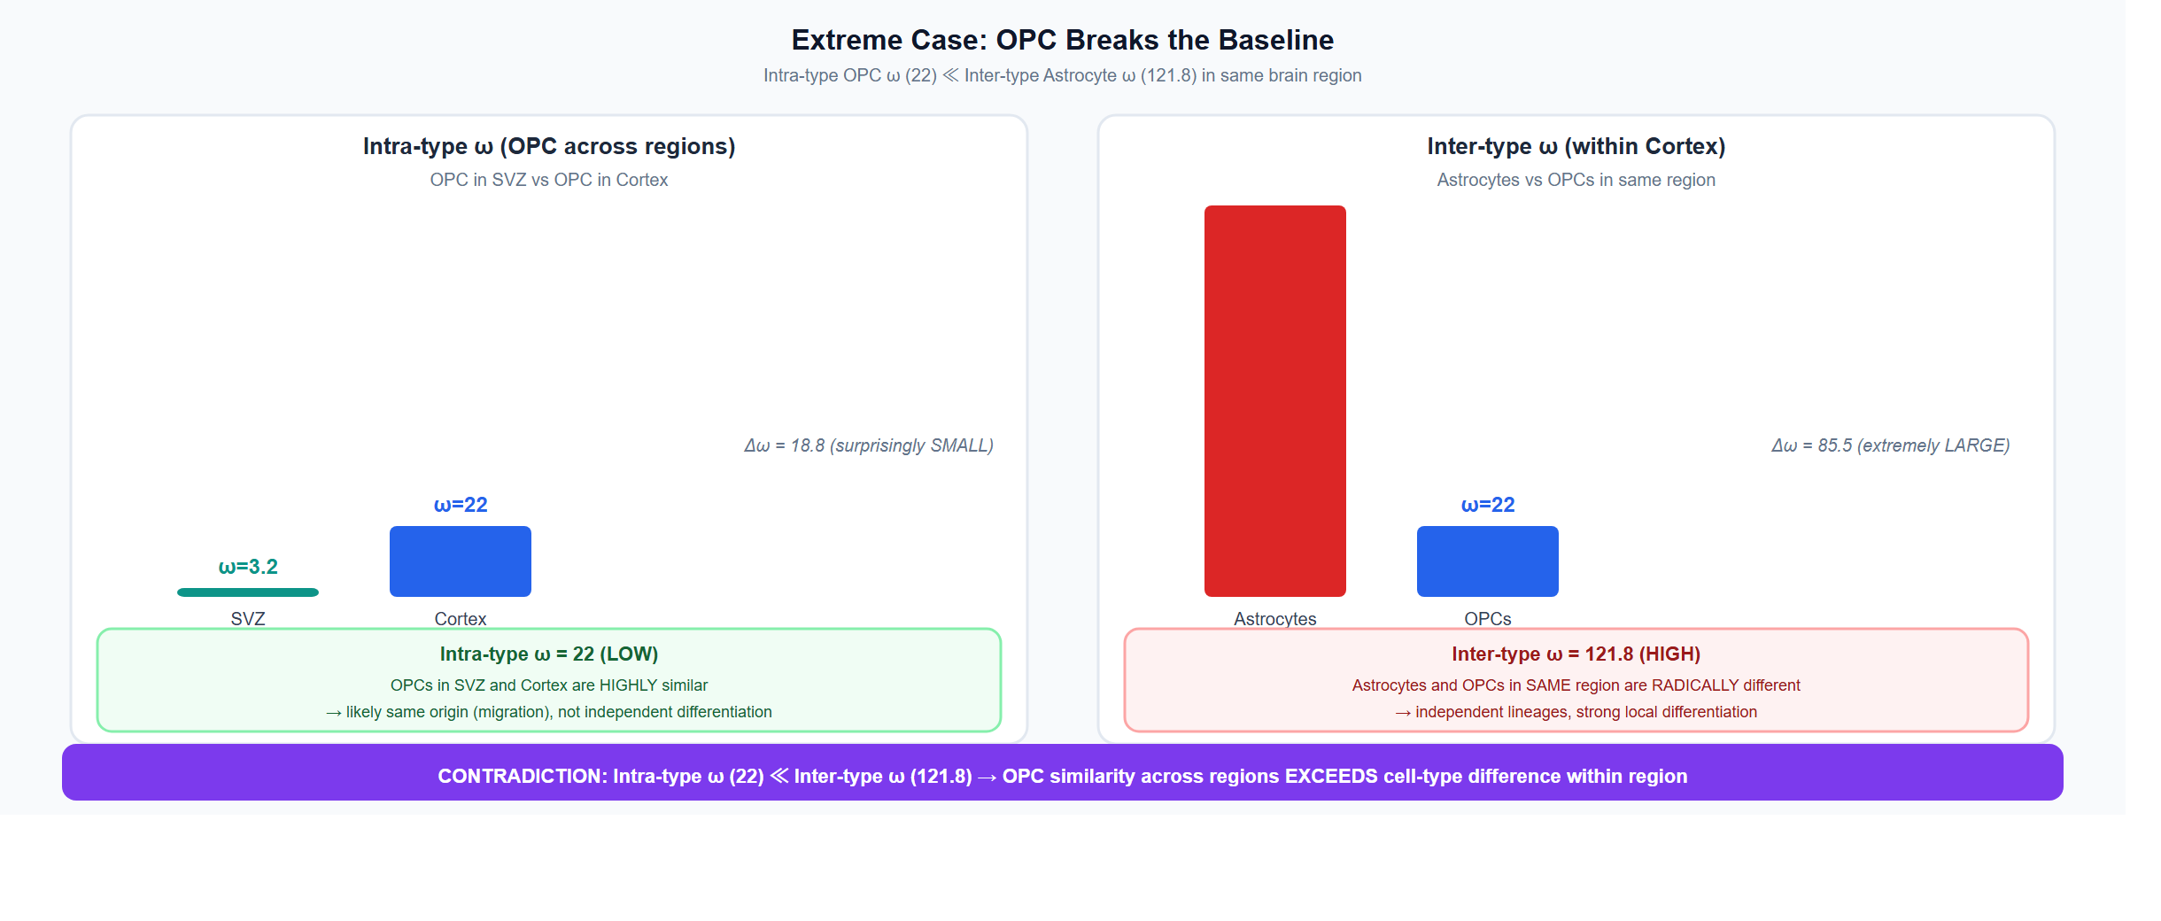
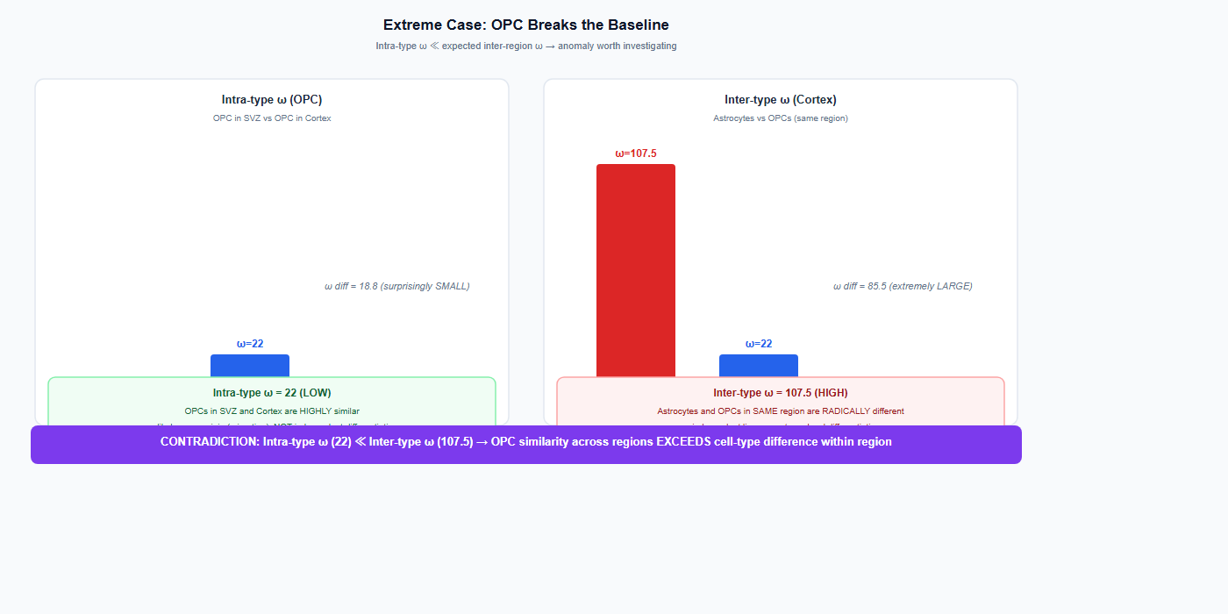
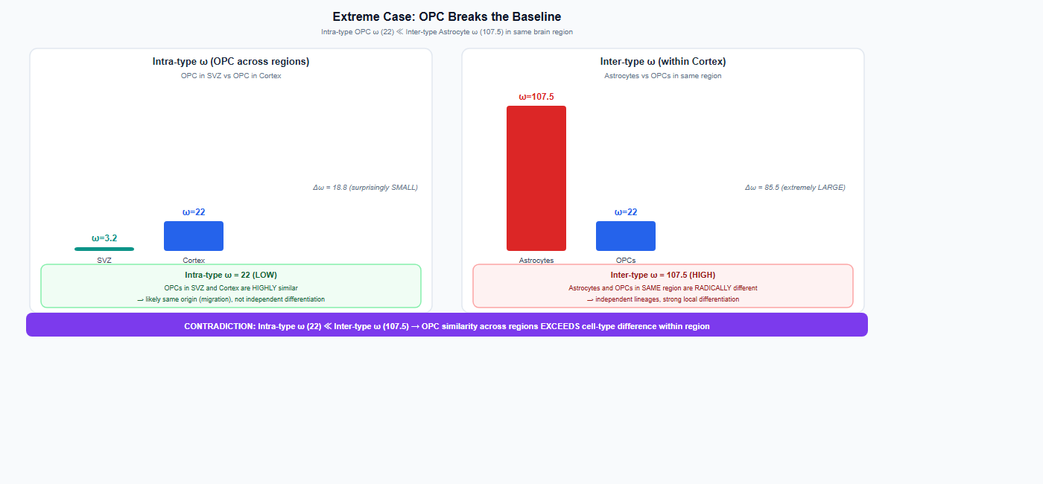
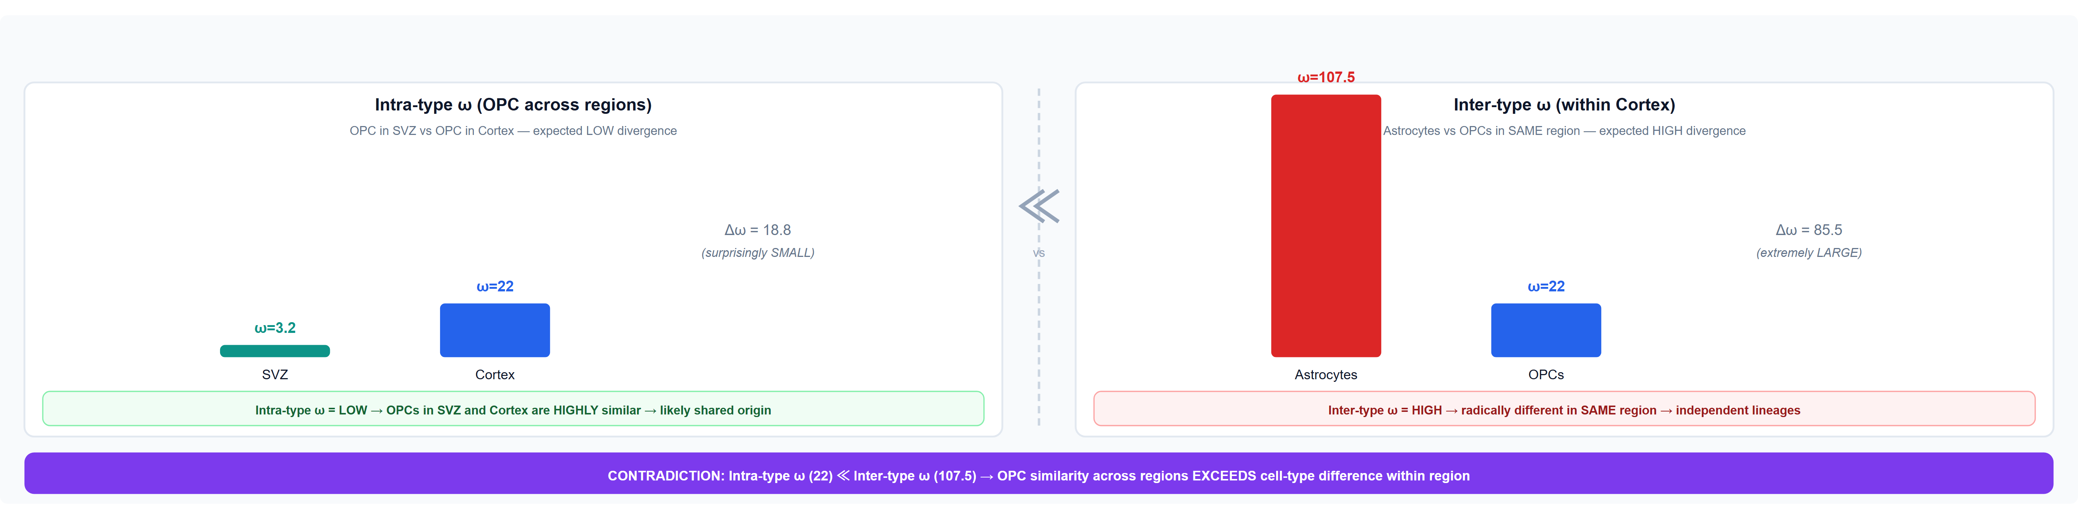
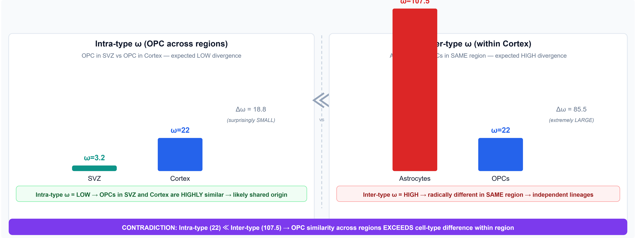

Extreme Case: OPC Breaks the Baseline
OPC: Breaking the Baseline
23.5% OPC pairs show strong ω anomaly
ω(SVZ)=3.2, ω(Cortex)=22: Δω=18.8 (SMALL)
Intra-type similarity > expected
OPCs known to migrate in development/injury
CKI discovers this without prior knowledge
Astrocytes: High ω, Low Migration
Highest baseline ω=121.8 (strong identity)
Only 14 migration candidates — very few
Inter-type Δω=105.8 (extremely LARGE)
High ω = local specialization, NOT migration
CKI distinguishes both signals independently
19

Slide 20
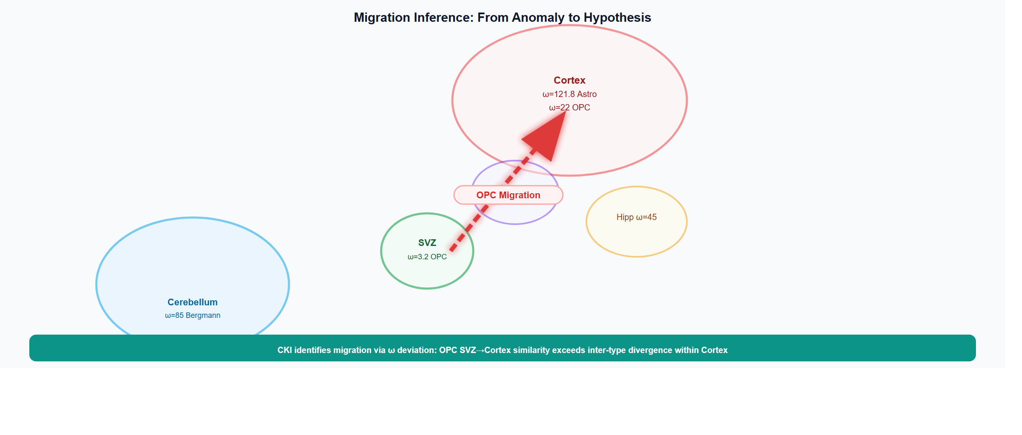
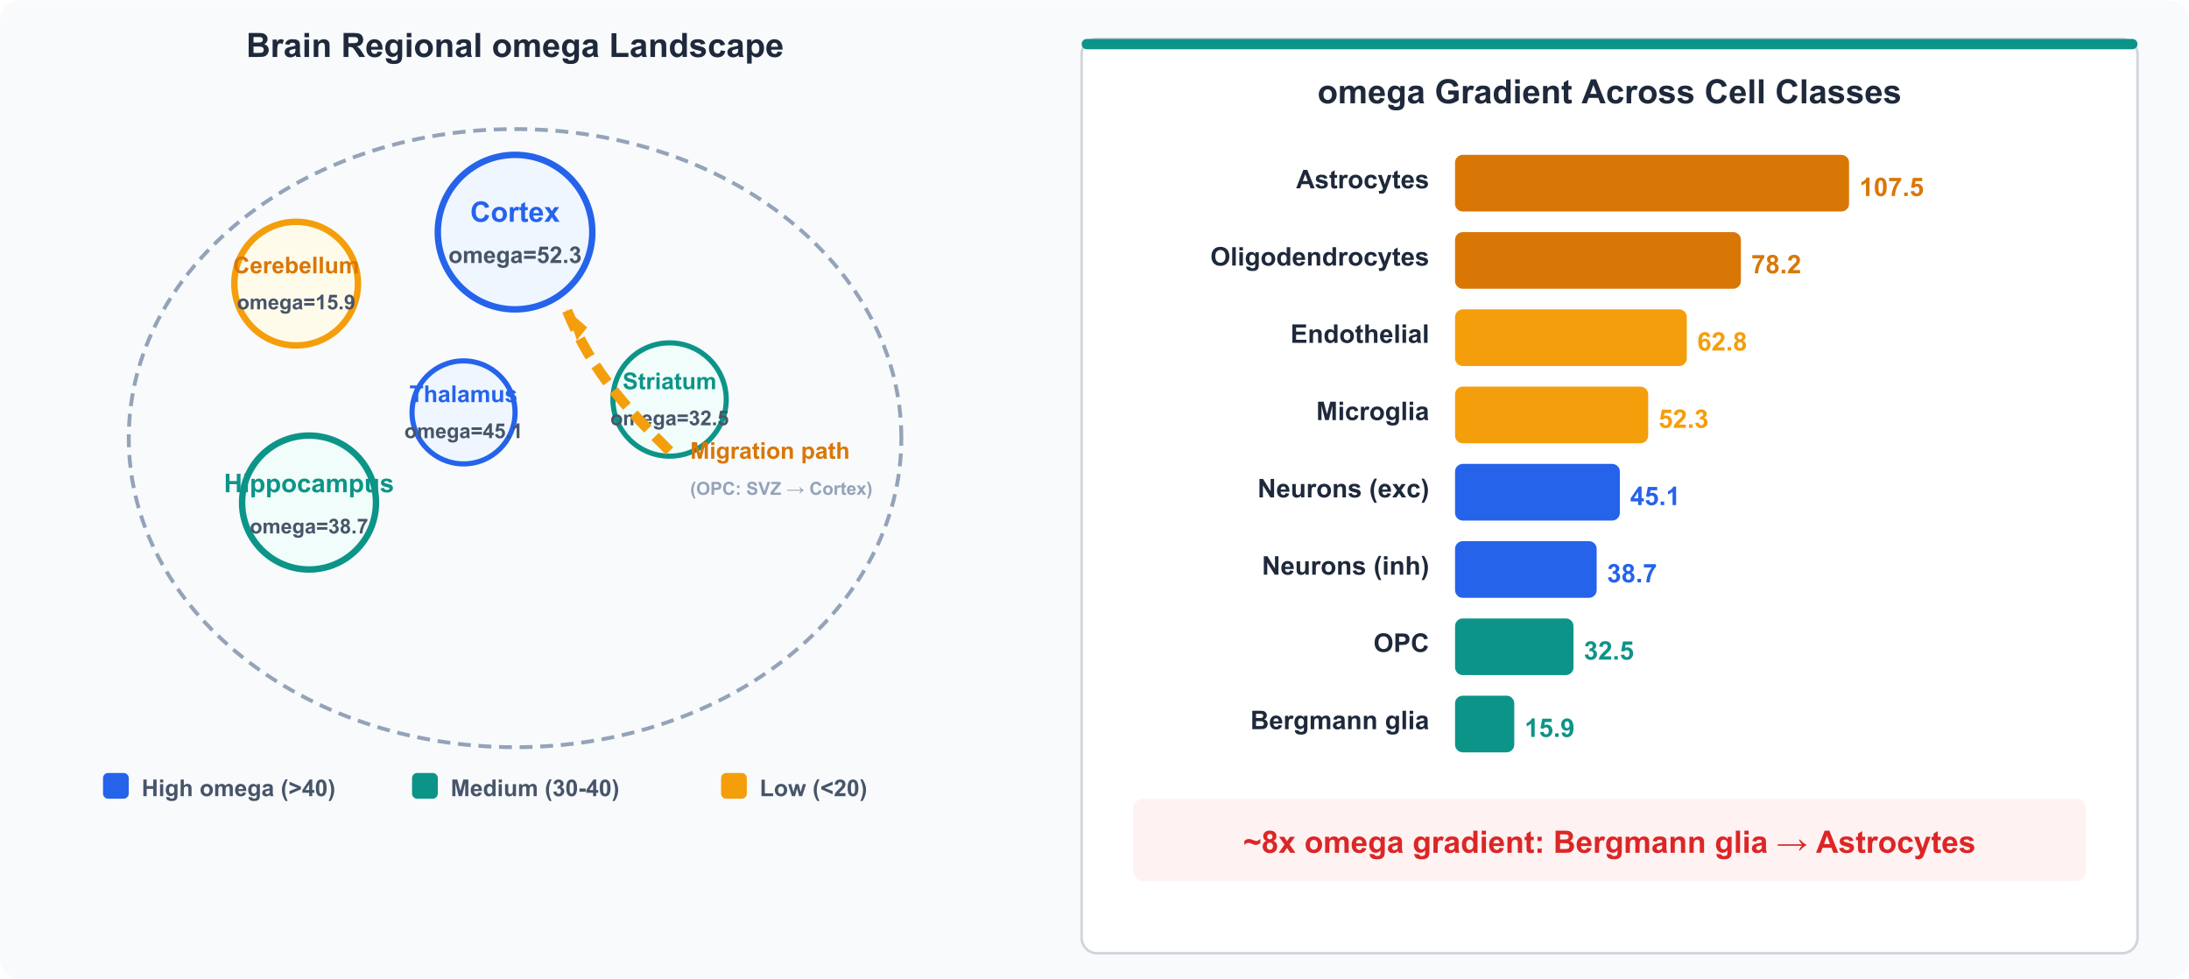
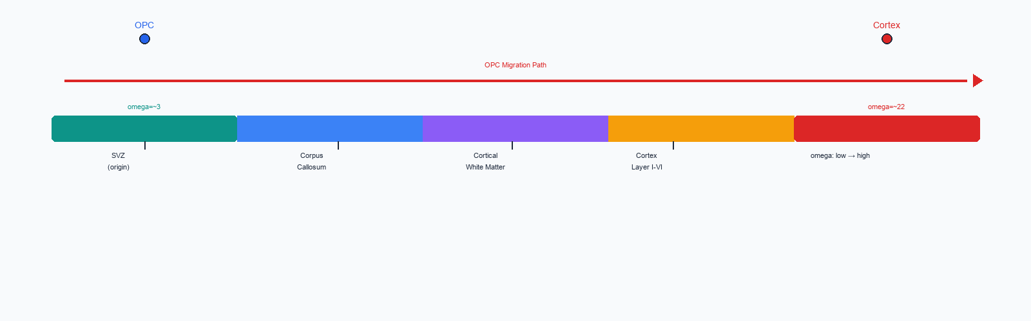
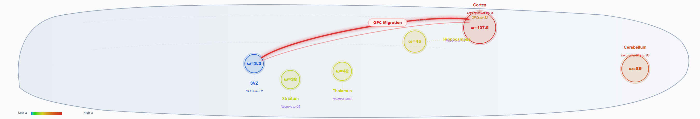
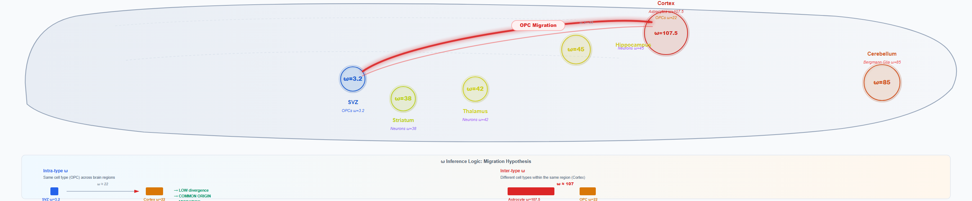
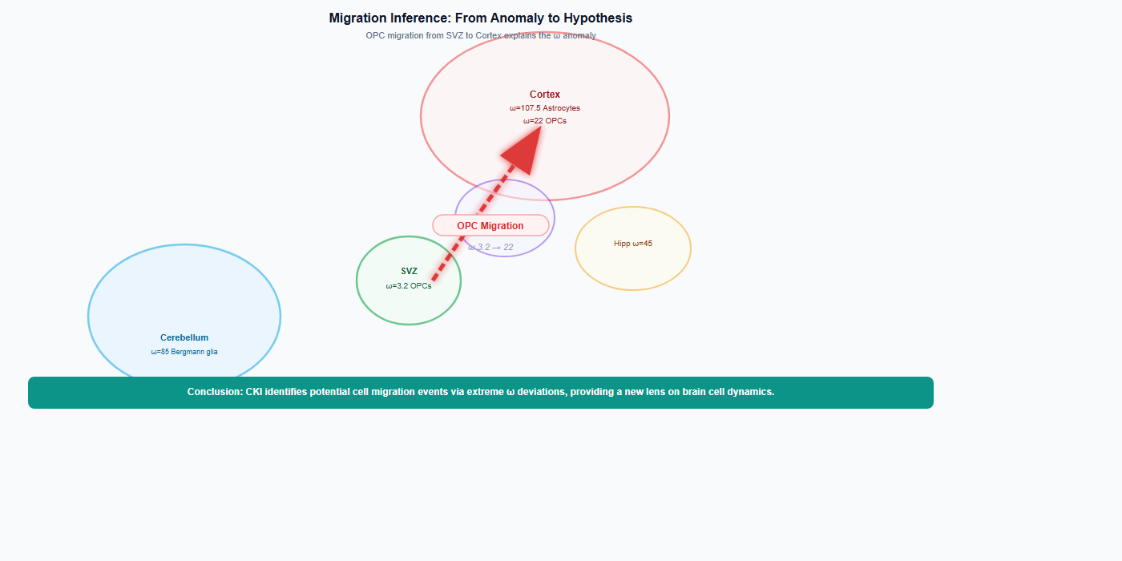
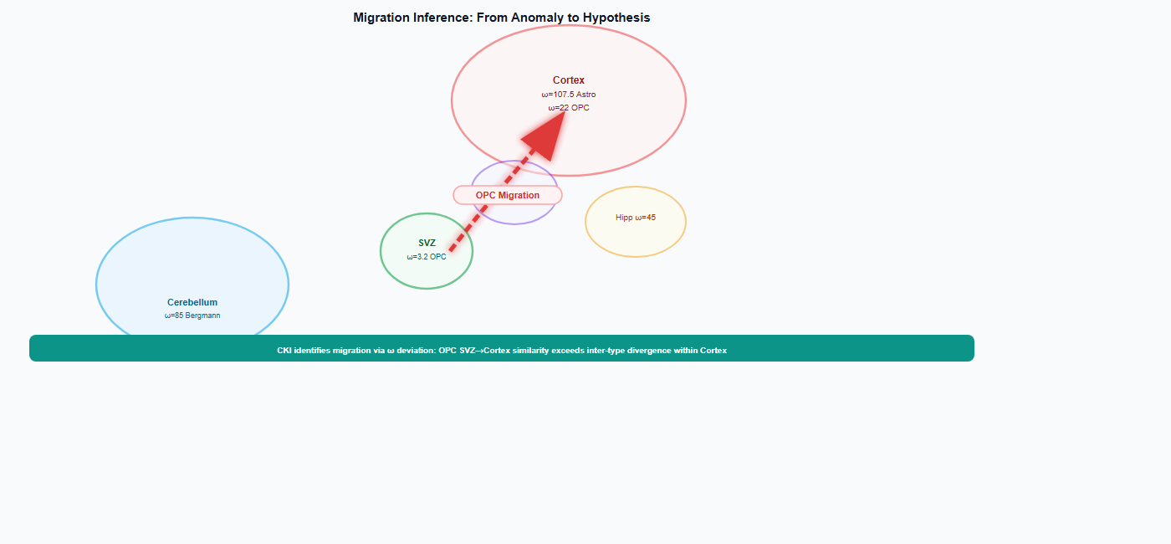
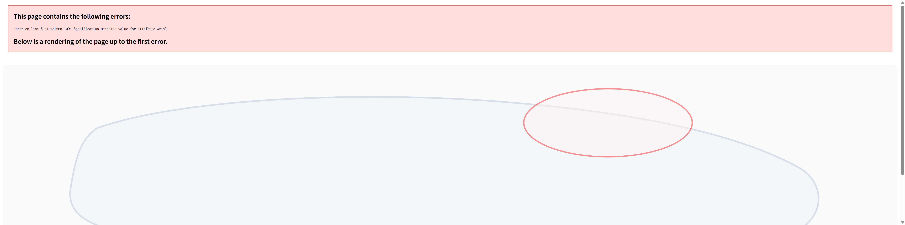
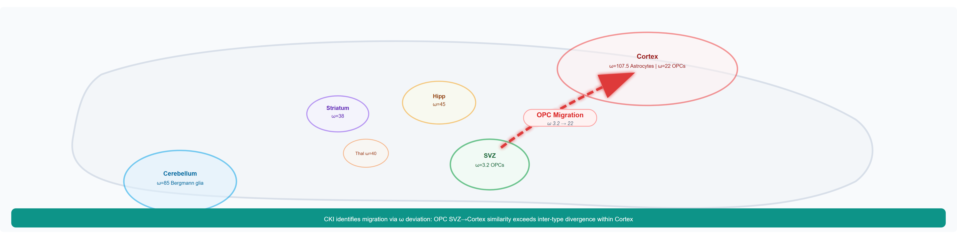
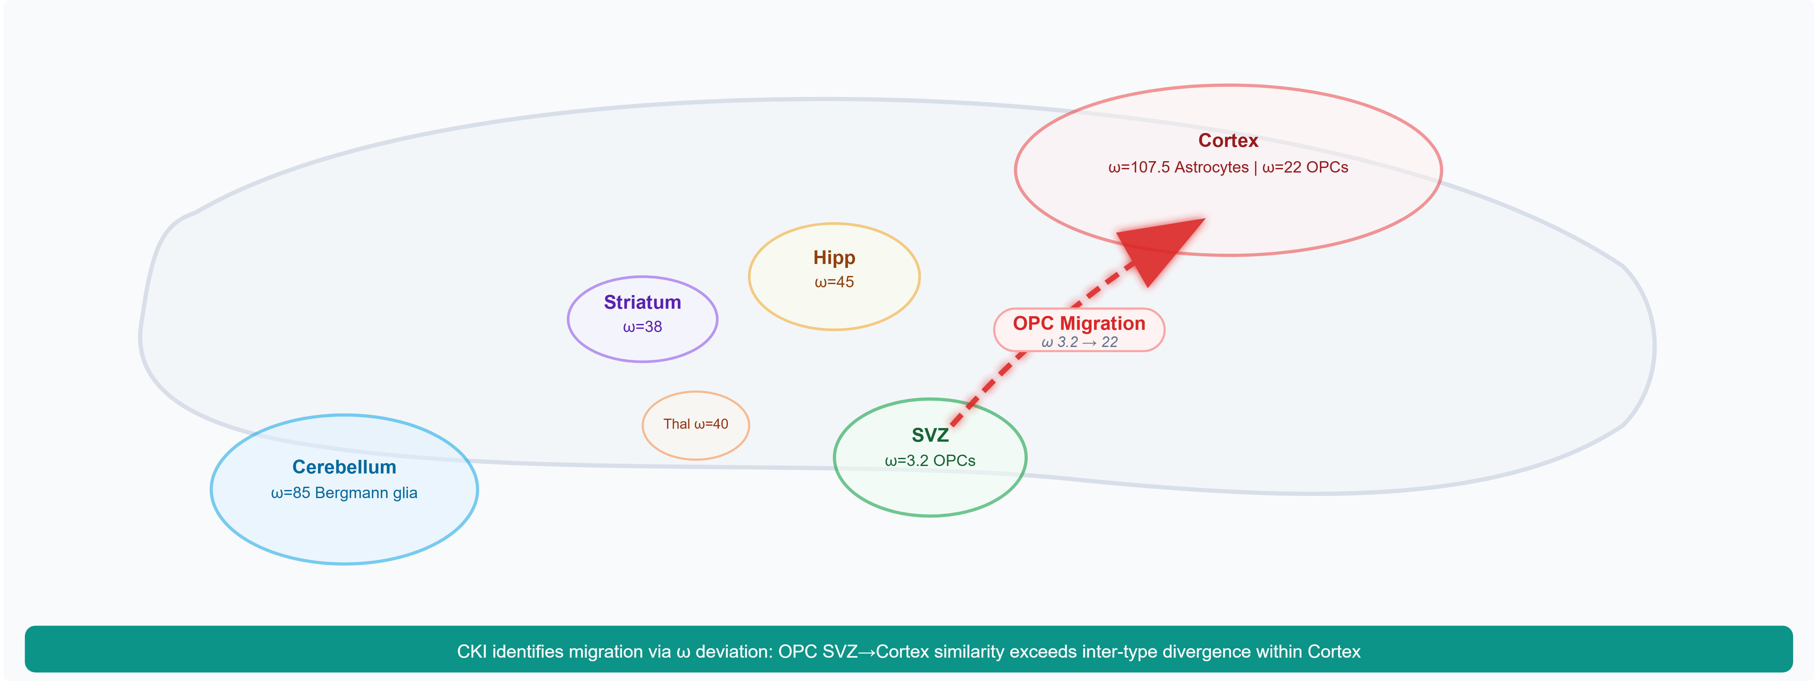
Migration Inference: From Anomaly to Hypothesis
Omega Gradient Across Brain
Cortex Astrocytes: ω=121.8 (highest specificity)
Cerebellum Bergmann Glia: ω=85
Hipp/Thal/Striatum: ω=38-45
SVZ OPCs: ω=3.2 (least differentiated)
OPC Migration Hypothesis
Intra-type: OPC(SVZ) vs OPC(Cortex) → ω≈22
Inter-type: Astrocyte vs OPC(Cortex) → ω≈121.8
OPC cross-region similarity > cross-type similarity
→ SVZ → Cortex OPC migration is best hypothesis
20

Slide 21
Summary: Four Core Contributions of CKI
1
2
3
4
New Metric omega
Neutral Reference Strategy
Multi-Scale Validation
Novel Applications
A Ka/Ks-inspired ratio that quantifies cell-state divergence on a continuous scale. omega = k_f/k_n distinguishes functional selection from transcriptional noise.
Housekeeping genes serve as an internal calibration standard, analogous to synonymous mutations in molecular evolution. Auto-detected per dataset (detection rate + CV) — works for any species.
Validated across Tabula Muris, Tabula Sapiens, TCGA pan-cancer, and human brain atlas. 250K+ cells, cross-species, cross-organ, cross-disease.
Discovered cancer NN/TT paradox, 8-fold brain omega gradient, and a migration inference framework. Generated testable hypotheses about cell migration.
21

Slide 22
Future Directions
⊙
Spatial Transcriptomics
⧉
Epigenomic Extension
♡
Clinical Prognosis
Apply CKI to spatial data to map omega gradients in tissue context
Extend framework to ATAC-seq, methylation, and chromatin accessibility
Evaluate omega as a prognostic biomarker in cancer and disease progression
△
Developmental Biology
⊎
Multi-Omics Integration
⌂
Online Tool & Database
Track omega dynamics during embryogenesis and organ development
Combine transcriptomic omega with proteomic and metabolomic layers
Web server for CKI computation with pre-computed reference maps
22

Slide 23
Thank You
Questions & Discussion
Li Zhang
knightz@pumc.edu.cn
CKI code & data available at: github.com/zhanglknt/CKI-cell-type-identification

