Slide 1
在java中使用redis

Slide 2
Jar包
jedis-2.9.0.jar

Slide 3
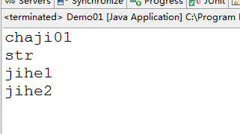
连接redis
Jedis jd = new Jedis("localhost");
jd.select(1); // 选取1号库 redis中0-16编号
Set<String> set = jd.keys("*");
Iterator<String> it = set.iterator();
while (it.hasNext()) {
System.out.println(it.next());
}

Slide 4
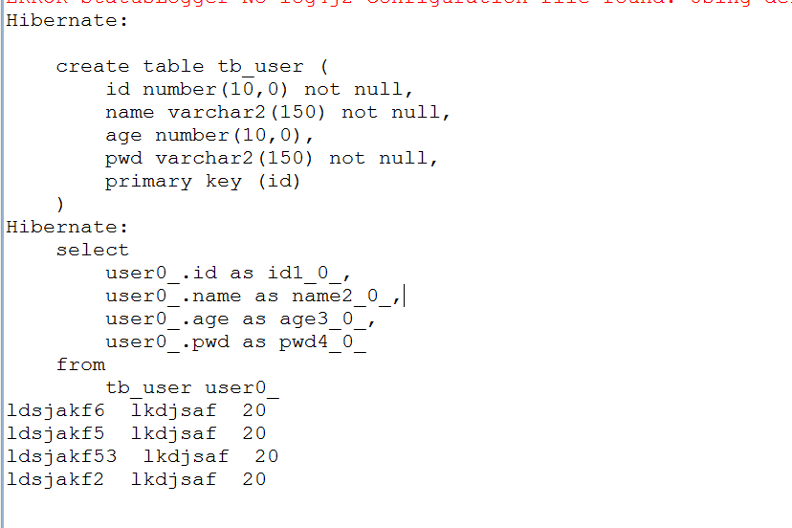
把对象存放在散列中
ApplicationContext app = new ClassPathXmlApplicationContext( "applicationConfig.xml"); UserService us = (UserService) app.getBean("userService"); // us.add(new User(0, "ldsjakf2", 20, "lkdjsaf")); // us.add(new User(0, "ldsjakf53", 20, "lkdjsaf")); // us.add(new User(0, "ldsjakf5", 20, "lkdjsaf")); // us.add(new User(0, "ldsjakf6", 20, "lkdjsaf")); // 查询数据 List<User> list = us.query(); // 连接redis Jedis jedis = new Jedis("localhost"); // 把数据存放在redis hash里面 for (int i = 0; i < list.size(); i++) { HashMap<String, String> hm = new HashMap<String, String>(); hm.put("id", list.get(i).getId() + ""); hm.put("name", list.get(i).getName()); hm.put("pwd", list.get(i).getPwd()); hm.put("age", list.get(i).getAge() + ""); // 存放 jedis.hmset("user" + list.get(i).getId(), hm); } // 获取 键名为user*的数据 Set<String> s = jedis.keys("user*"); Iterator i = s.iterator(); while (i.hasNext()) { String key = i.next().toString(); System.out.println(jedis.hget(key, "name")+" "+jedis.hget(key, "pwd")+" "+jedis.hget(key, "age")); }

Slide 5
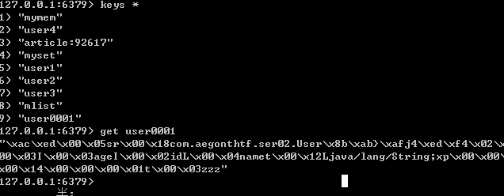
对象序列化存放在String中

Slide 6
结束

