Slide 1
Santander Value Prediction Challenge
Team 18: Alex Jacques, Maggie Li, Mikey Pedersen, Ben Zhang

Slide 2
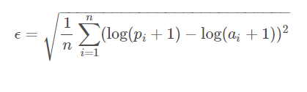
Overview
Santander Group: Spanish multinational commercial bank and financial services company based in Madrid and Santander in Spain
Objective: Identify the value of transactions for each potential customer
Evaluation: Root Mean Squared Logarithmic Error Minimization
https://www.kaggle.com/c/santander-value-prediction-challenge/overview

Slide 3
Data Set
Provided files
train.csv: 4,459 rows; 4,993 features including target
test.csv: 49,342 rows; 4,992 features
sample_submission.csv: 49,342 rows; 2 columns [ID, target]
Data Structure
ID in first column of both test.csv and train.csv
No meaningful feature names due to anonymity
All features are numerical, however contains many 0’s

Slide 4
Notebook 1
“Extra Trees Minimal Starter” Notebook
Published by JohnM
Ran regression using Python with a regression tree
Private score of 1.52693, Public score of 1.55368
Code is on the following slide...

Slide 5
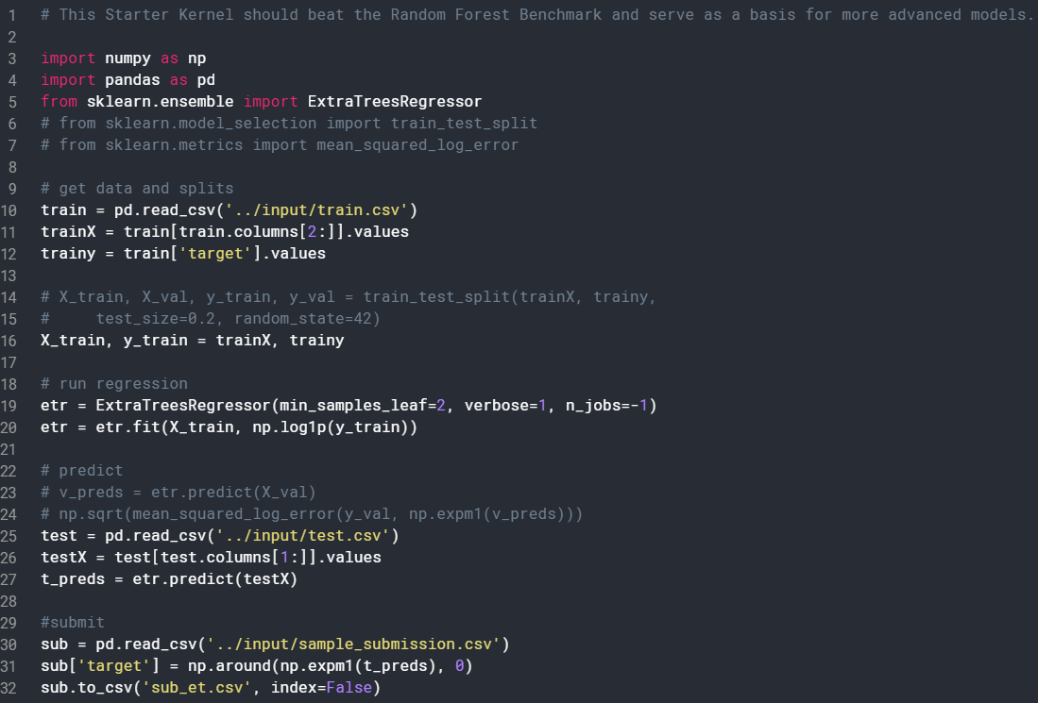

Slide 6
Notebook 1
Feedback
This Model: Regression Tree
“min_samples_leaf” argument
No cross-validation to prune trees
- Alternative Model: Boosting
- Small sample points towards need to sequentially build tree
- Boosting method will allow us to tune more parameters for learning
- More powerful learning method then a naive approach
Notes:
“min_samples_leaf” argument indicates the number of samples at a leaf node. It is set to 2 right now which is quite low for predictive accuracy.

Slide 7
Notebook 2
“An idiot's guide to a not horrible score” Notebook
Published by Thomas Melson
Ran regression using Python with XGBoost
Private score of 1.48471, Public score of 1.53806
Code is on the following slide...

Slide 8
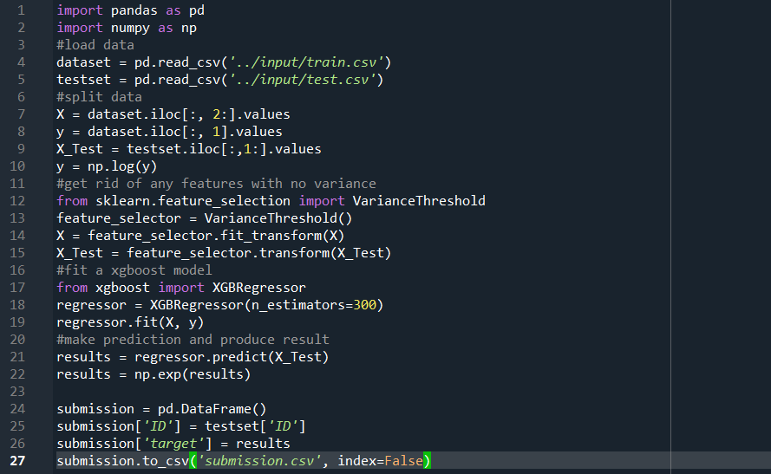

Slide 9
Notebook 2
Feedback
This Model: XGBoost Regression
No exploratory data analysis to detect data type, distribution, outliers, and missing values.
Hasty feature selection: only eliminated features with no variance
- Alternatives:
- implement more complex feature selection approach:
- by feature importance from various regressors
- by setting selection threshold to feature RMSE
Notes:
“min_samples_leaf” argument indicates the number of samples at a leaf node. It is set to 2 right now which is quite low for predictive accuracy.

Slide 10
Our Model
XGBoost Tree Based Model
Read in Data
Clean Data Initially
Build Initial Model and Try Different CV values
Write Necessary Metrics to Minimize Loss Function
Prepare Data For Final Best Model
Train Model with Necessary Parameters
Write to CSV

Slide 11
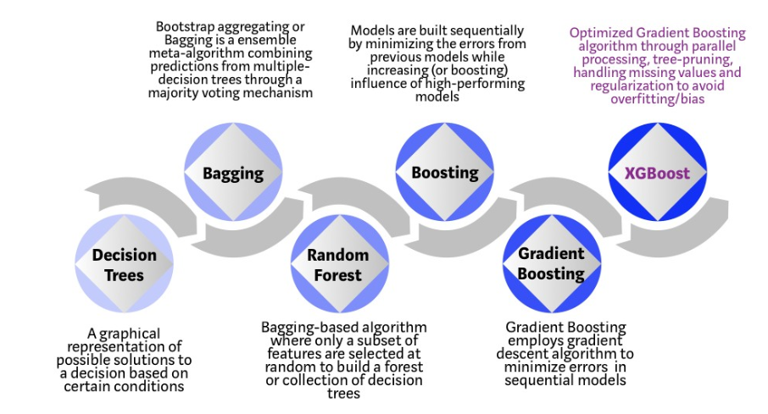
Insight on the XGBoost Model

Slide 12
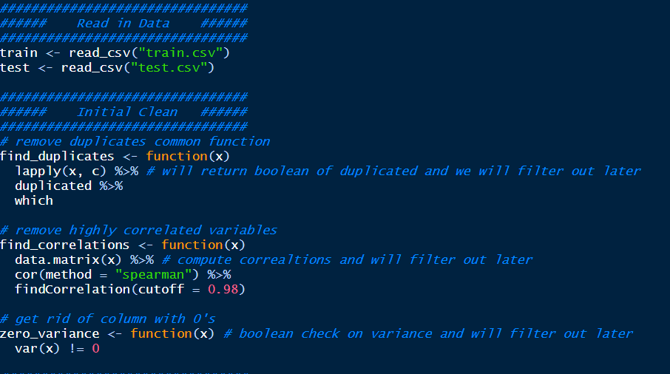

Slide 13
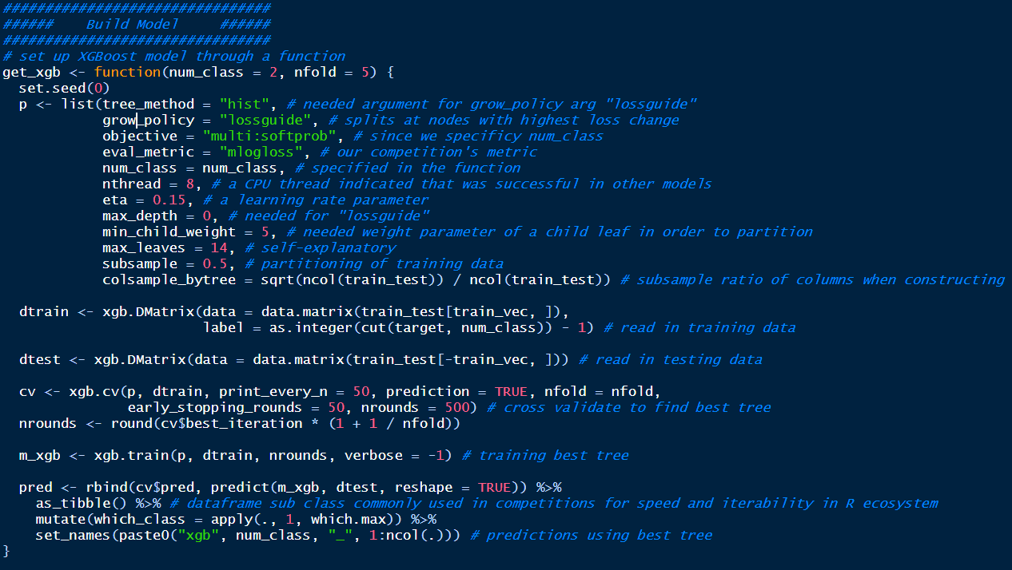

Slide 14
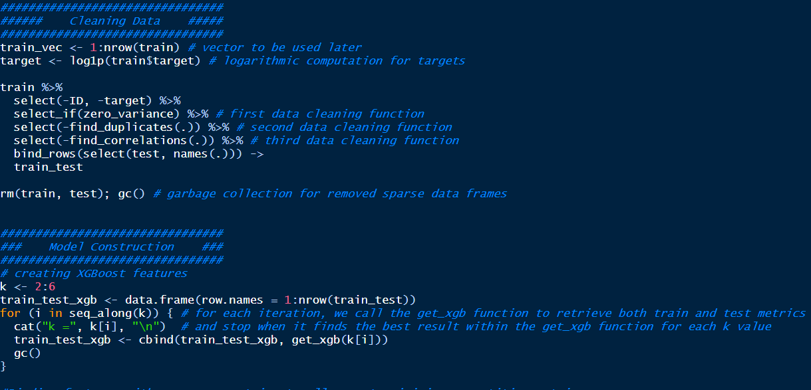

Slide 15
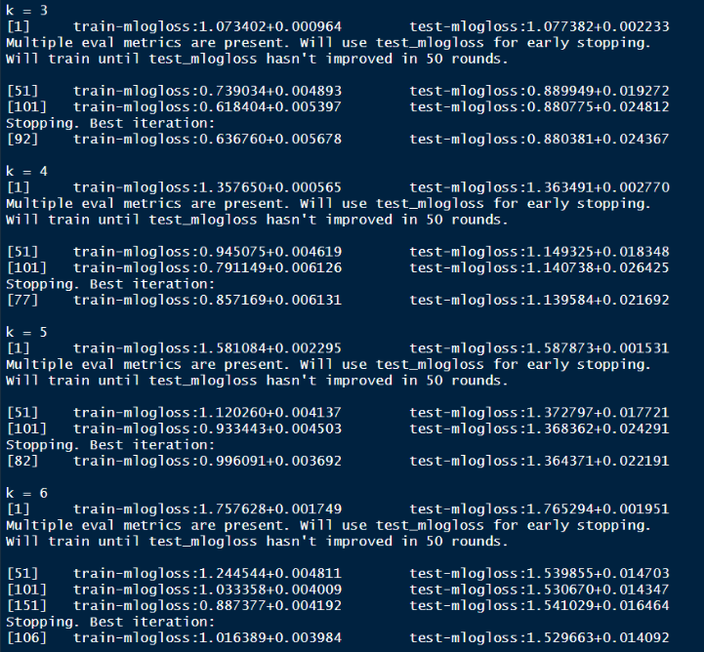

Slide 16
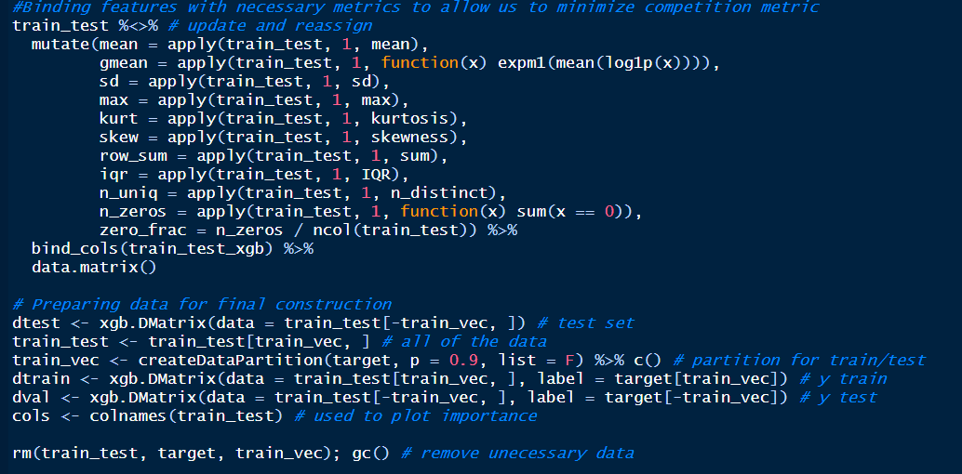

Slide 17
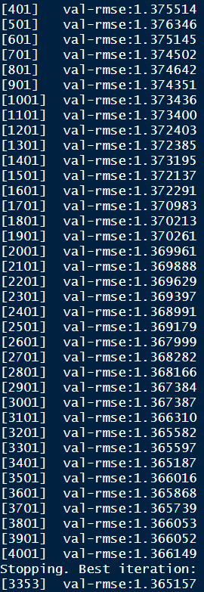
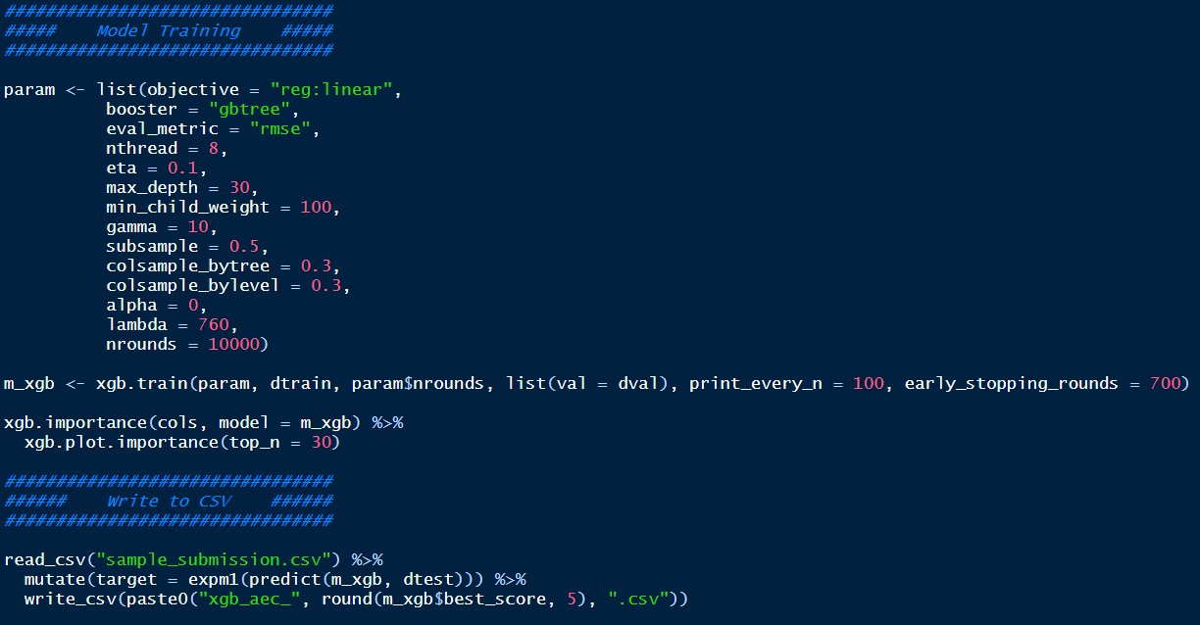

Slide 18
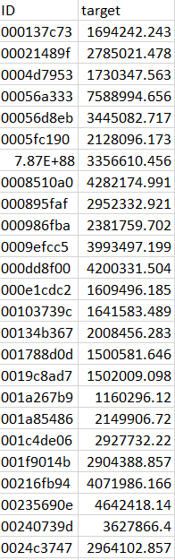
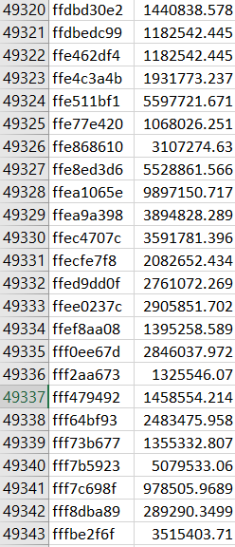
Final RMSLE 1.3656

Slide 19
Thank you!

