Slide 1
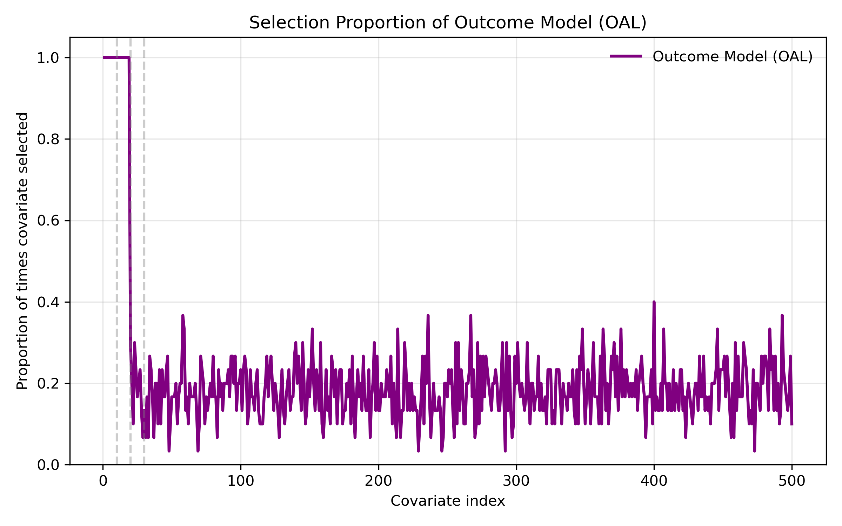
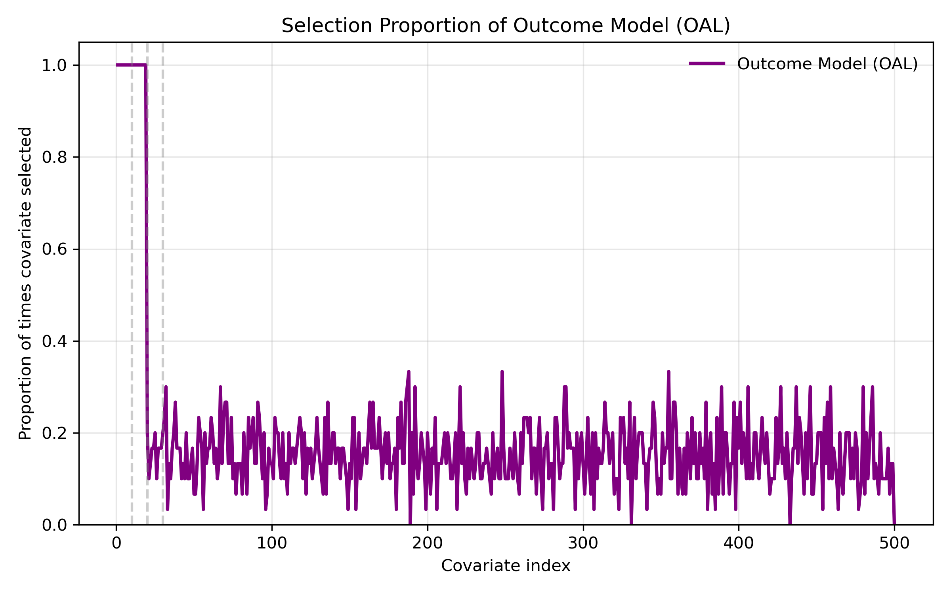
a) independent covariates
b) dependent covariates (cov(x_i, x_j)=0.3)

Slide 2
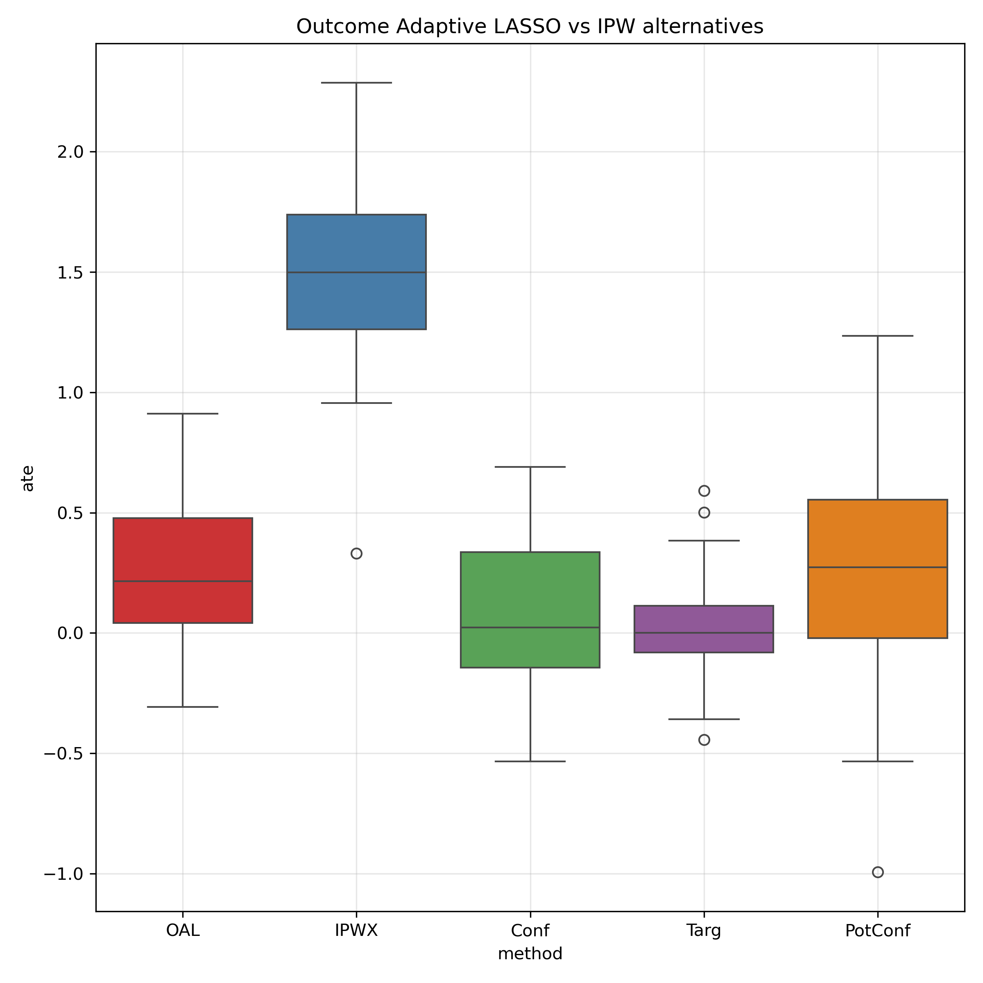
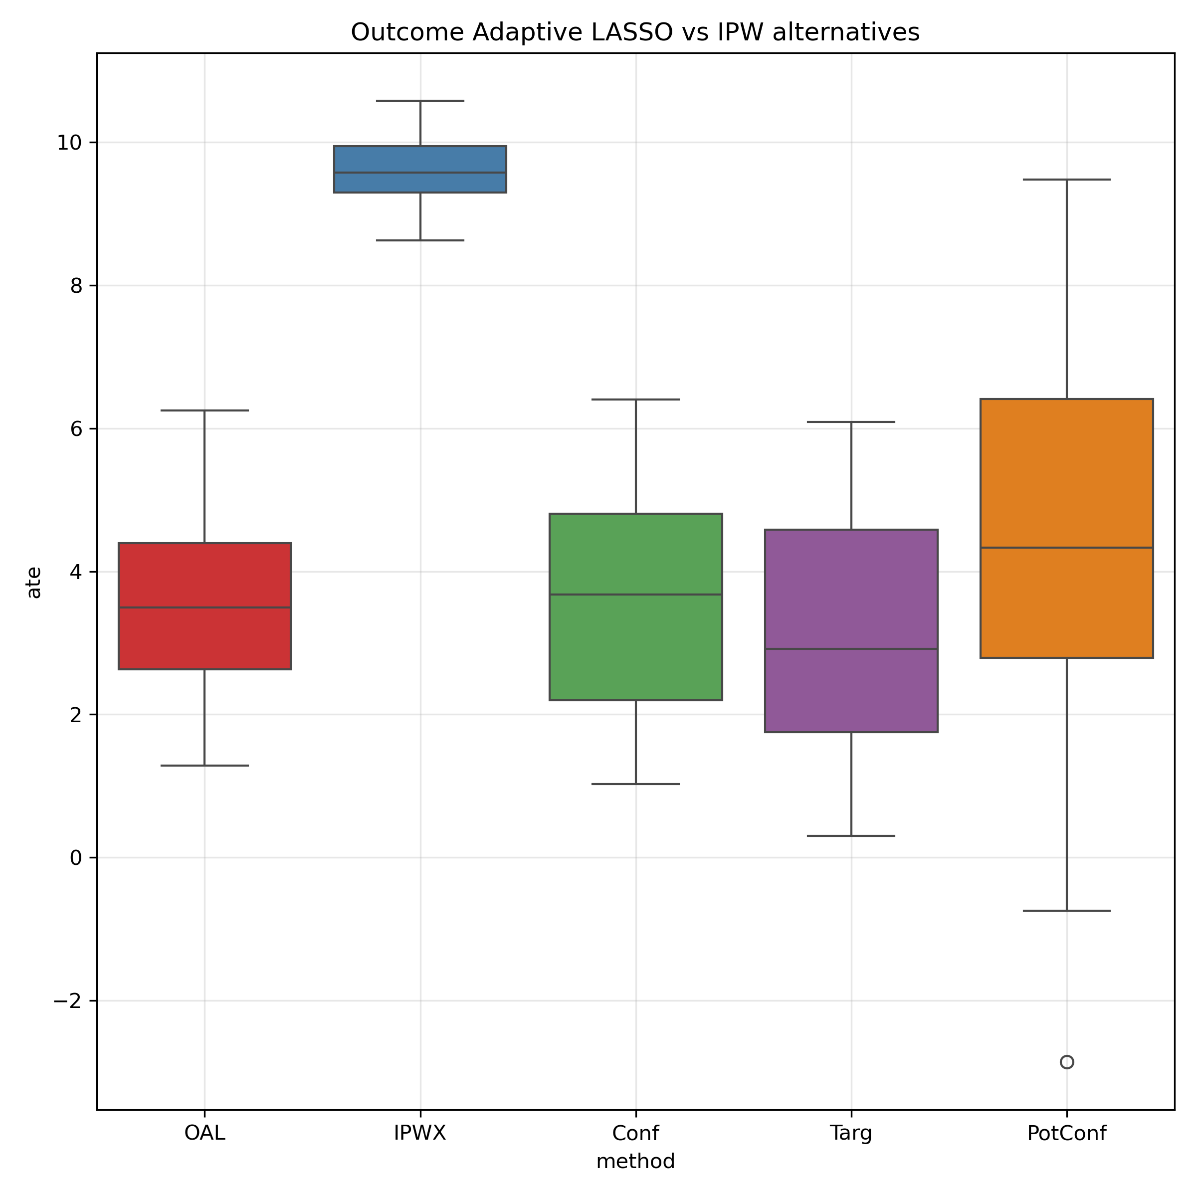
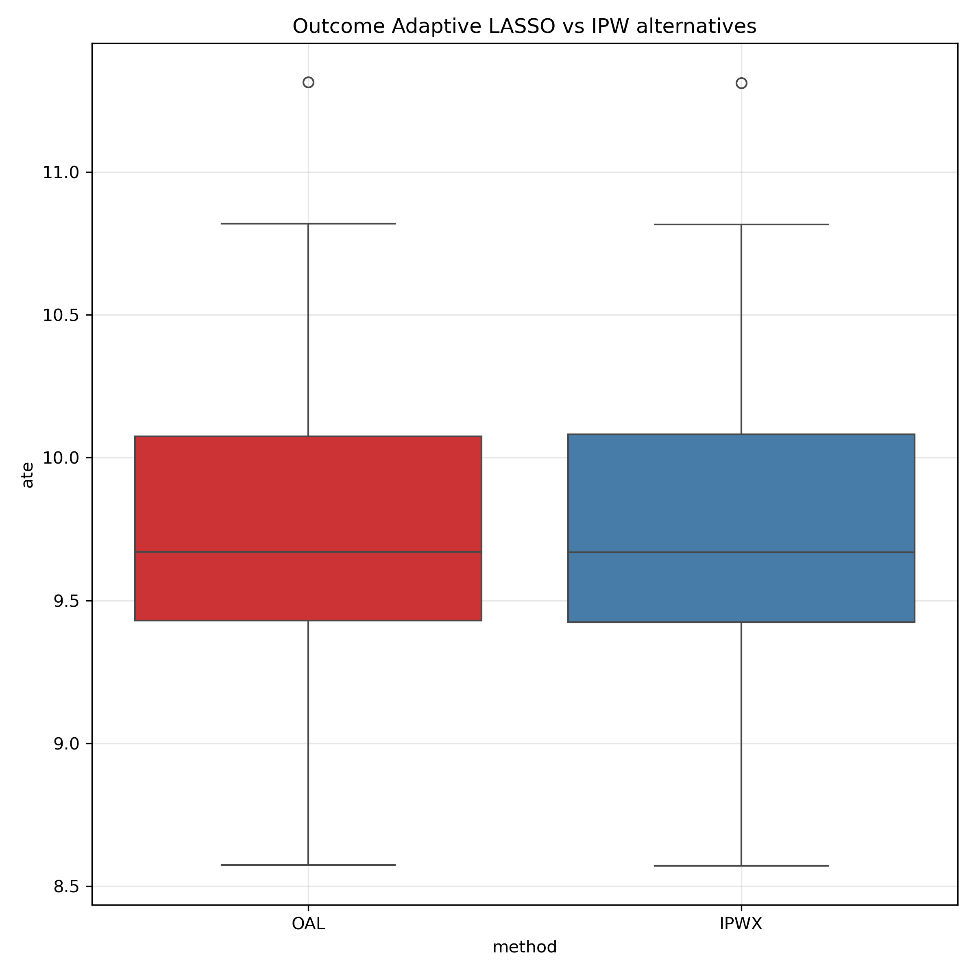
N=200, d=500, true_ATE=0, n_conf=n_pred=n_instr = 10(ie., 2%*d)
c) dependent +PCA
(num_PC=min(N,d)
a) independent covariates
b) dependent covariates (cov(x_i, x_j)=0.3)

