Slide 1
Knowledge-Based Word Sense Disambiguation in Pediatric Journals Using Topic Models
Katherine Schlosser, MD
Jiayao Wang, MS
Linying Zhang, MS

Slide 2
What is the problem?
Word sense disambiguation (WSD) is a critical step in any mapping into structured language.
Currently this task is limited by
Small word sense inventories
Need for intensive manual review

Slide 3
A snippet of sentences with “cold”
An additional 11 weeks of cold (5-7 degrees C) …
Local cold application to the pancreas …
Growth and melting of droplets in cold vapors.
…systematic long-term noliprel therapy of chronic obstructive lung disease (COLD) complicated by chronic pulmonary heart …
for the treatment of sore throat and pharyngitis associated with common cold.
Unexpected infant deaths associated with use of cough and cold medications.
The effects of a hot drink on nasal airflow and symptoms of common cold…
[C0009264]
Cold Temperature
[C0024117]
Chronic Obstructive Lung Disease
[C0009443]
the Common Cold

Slide 4
What do we propose?
Leverage the UMLS Metathesaurus
locate potential ambiguous words and their senses.
find synonym sets.
Build and train an unsupervised probabilistic machine learning algorithm to automatically disambiguate word sense.
Manually assign sense to several instances from each cluster by medical expert.

Slide 5
What data will we use?
the Unified Medical Language System (UMLS) Metathesaurus.
PubMed abstracts from the journal Pediatrics for the last 10 years.
For evaluation purpose, we will use MSH WSD dataset (with annotated sense)
a total of 97 ambiguous entities.

Slide 6
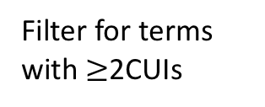
Workflow
Intersection
Words to disambiguate
UMLS Metathesaurus
Filter for terms with $≥$2CUIs
Potential ambiguous terms
Topic models
Assign sense (CUI) to each word
Abstracts from Pediatrics
Filter by
frequency
Frequent words
subsample
Evaluation by medical experts

Slide 7
Synonym sets (“topics”)
Topic proportions per abstract
Sense
assignment
Abstracts
temperature
degree
C
…
…chronic obstructive lung disease (COLD) complicated by chronic pulmonary heart … bronchial asthma…
[C0024117]
Chronic
Obstructive
Lung Disease
pulmonary
lung
bronchial
…
An additional 11 weeks of cold (5-7 degrees C)
[C0009264]
Cold Temperature
nasal
airflow
cough
…
The effects of a hot drink on nasal airflow and symptoms of common cold…
[C0009443]
the Common
Cold

Slide 8
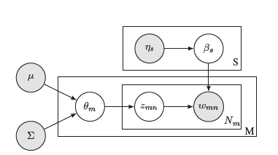

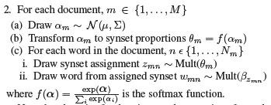
LDA with modifications
Word proportions in synonym sets
assign a word to a synonym set
Synonym set proportions in each doc
(derived from UMLS synonym list)

Slide 9
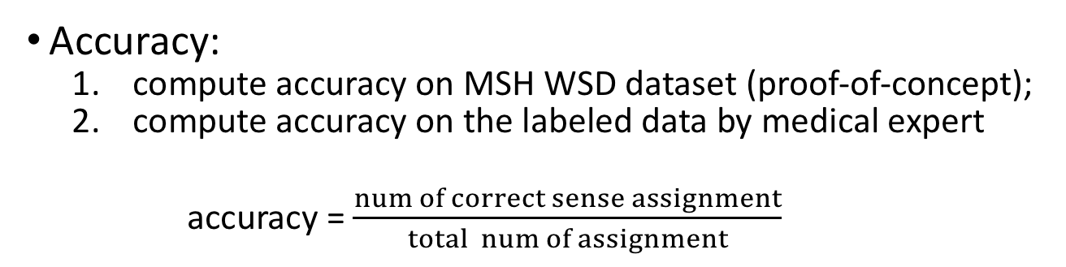
How will we evaluate this?
Accuracy:
compute accuracy on MSH WSD dataset (proof-of-concept);
compute accuracy on the labeled data by medical expert
accuracy = $\frac{num of correct sense assignment}{total num of assignment}$

Slide 10
What will we deliver?
Source code for topic model for use by other researchers to perform similar analysis on a different set of text.
A dataset of 5-10 manually annotated ambiguous terms (+ algorithm labeled terms).

Slide 11
Who is our team?
Katherine – define the scope of text to analyze, perform manual evaluation/review of word instances of each cluster, write final report (introduction and results evaluation), presentation.
Linying – build, train and evaluate a topic model to cluster words, write final report (methods)
Jiayao – scrape abstracts from PubMed, preprocess unstructured text into a structured representation, feature engineering, write final report (data set).

