Slide 1
Lecture 1: Introduction
Harbin Institute of Technology（Shenzhen）
School of Computer Science and Technology Zhang Meishan (mason.zms@gmail.com)
Copyright：Harbin Institute of Technology，Su Xiaohong， sxh@hit.edu.cn

Slide 2
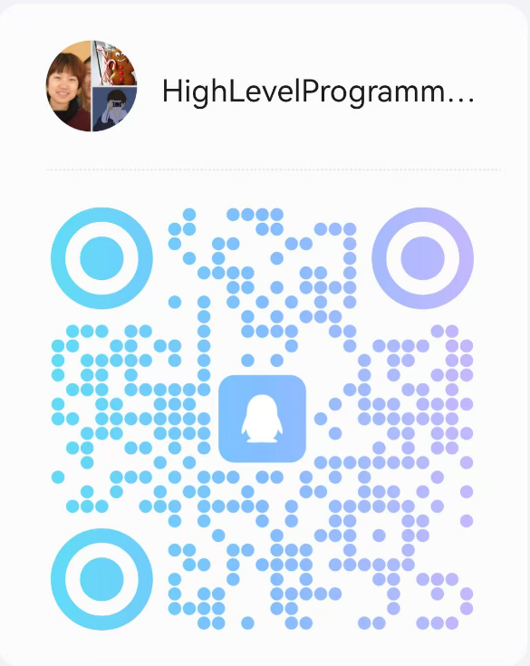
Basic Information
School of Computer Science and Technology
Teacher：Zhang Meishan
https://zhangmeishan.github.io/
Teacher Assistant：Jiaxin Xu， Jinpeng Huang，Yan Luo
Yangbin Sun
Office：L1922
Course group number ： 892362595
Main textbooks ：《Learn C++ through English and Chinese》
--Paul Kelly, Su Xiaohong
Score：homework 20 points + experiment 40 points + final exam 40 points

Slide 3


Course Teaching Objectives
Mastering the fundamental approach to solving problems using computers
Mastering the basic knowledge of high-level language programming
Mastering the fundamental methods of computer software design and implementation
Having the ability to solve practical problems using computers and possessing basic programming debugging skills
How to Think
Like a Computer Scientist
How to program
Like a Computer Scientist

Slide 4
First Lesson： Overview
What is a computer program?
How to develop a computer program?
The brief history of the C++ language
The common basic standards in the C++
How to use the online programming tool, e.g. "onlinegdb“
How to use the C++ programming tool
How to learn C++

Slide 5
1.1 What is a computer program?
computer program ：A computer performs all of these tasks by following a predefined set of instructions.
compiler
computer program
programming language
(high-level languages)
machine language
(low-level languages)
computer
cooker
recipe
nature language

Slide 6
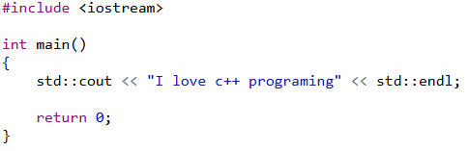
1.1 What is a computer program?
program language：
natural language：
Please print “I love c++ programing” onto the screen.

Slide 7
1.2 Developing a computer program
Developing a computer program:
define and understand the problem to be solved----analysis phase
how is it to be done? -----design phase
writing, compiling and testing C++ programs.

Slide 8
1.2 Developing a computer program
Program development cycle
Step 1: Design the program.
Each program has to be individually designed to implement the overall solution developed at the analysis and design phases.
check its logic before starting to write the program
Step 2: Write the program.
the C++ program instructions are typed into a file using a text editor
source code or the program code source file

Slide 9
1.2 Developing a computer program
Step 3: Compile the program.
translate the C++ program instructions to machine instructions through a compiler--object code, and stores the object code in an object file.
errors ---- compile-time syntax error: missing punctuation , misspellings,…
warning message: not as serious as a syntax error, not prevent the program from being compiled, may be a problem and should be investigated
Step 4: Link the program.
combining the object file of the program with other object files from the C++ run-time library to form an executable file

Slide 10
1.2 Developing a computer program
Step 5: Test the program.
run-time error—causes the program to stop before it has completed its task
logic errors(bugs)---The program may complete its task but produce incorrect results
Step 6: Debug the program.
The process of locating and correcting program errors is called debugging
Many compilers have tools that can be used to help locate bugs
Correcting bugs involves going back to step 2, try to catch errors as early as possible

Slide 11
1.2 Developing a computer program
Program development cycle
Design
propose an overall solution
Write
write C++ program instructions→source file
correct run-time error
translates C++ program instructions into machine instructions→object file
Compile
Link
combines the object file with the C++ run-time library files→executable file
Correct
Test
verify program errors (bugs)
Debug
locate and correct bugs

Slide 12
1.3 Brief history of C++
1972，AT&T, Bell Lab. Dennis Ritche, C programming language
1980, Bell Lab. Bjarne Stroustrup, “C with Classes”
1983, C++ was developed by Bjarne Strostrup at AT&T Bell Laboratories
1985, the first commercial version of C++
1997, ANSI (American National Standards Institute) C++ (standard C++)
C++ is always evolving !!!

Slide 13
1.4 Common standards in the C++
The example programs used in this book conform to the ANSI/ISO C++ standard.
Not all compilers conform to this standard, so some compilers may not correctly compile the example programs.
Some of the example programs may have to be modified for use with these other compilers.
See the web site for details.

Slide 14
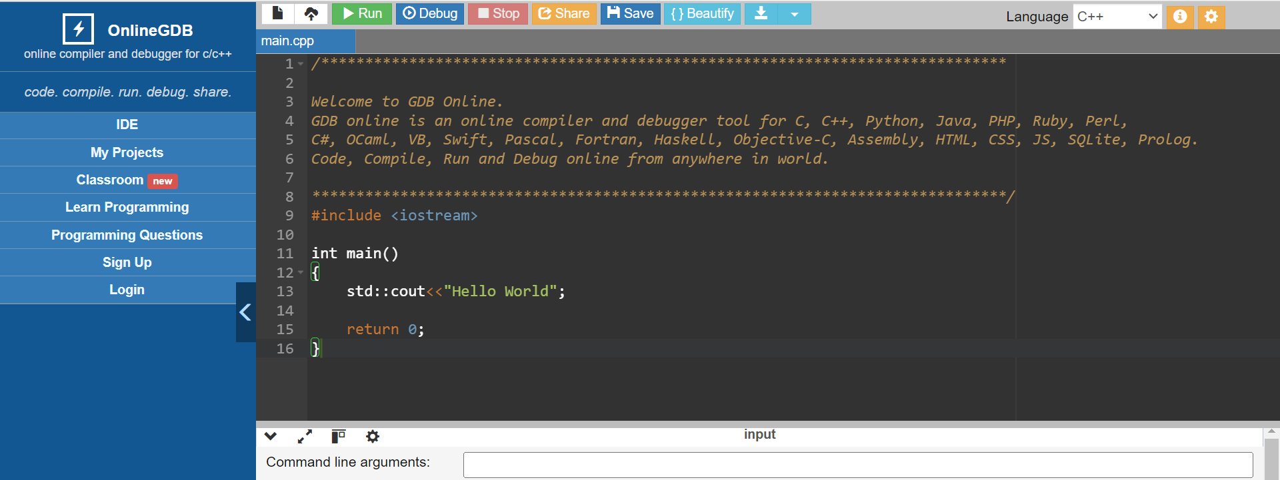
1.5 Online Programming
onlinegdb: https://www.onlinegdb.com/

Slide 15
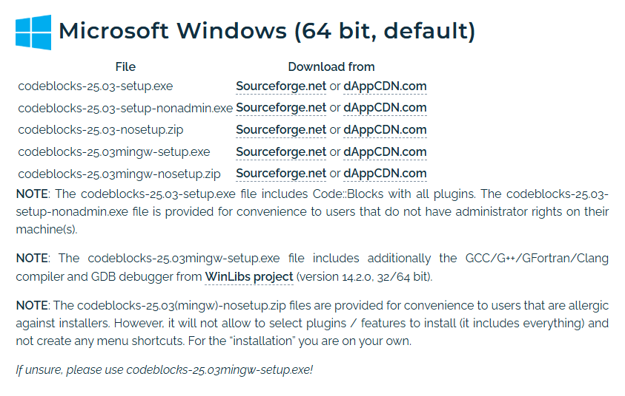
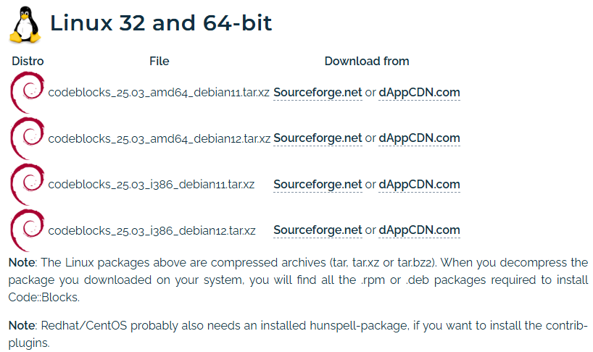

1.6 Offline Programming
CodeBlocks
download CodeBlocks and install it

Slide 16
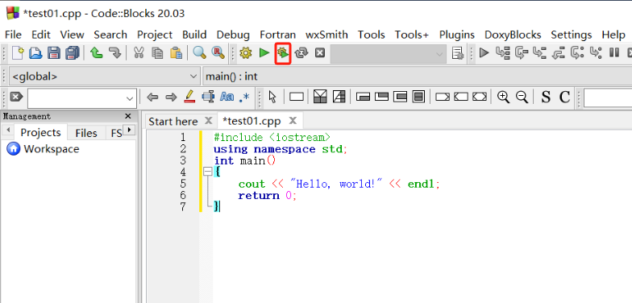
1.6 Offline Programming
CodeBlocks
The installation package includes the compilation environment, and the installation will automatically find the environment path. Therefore, you can directly create new files to write and run C++ programs.

Slide 17
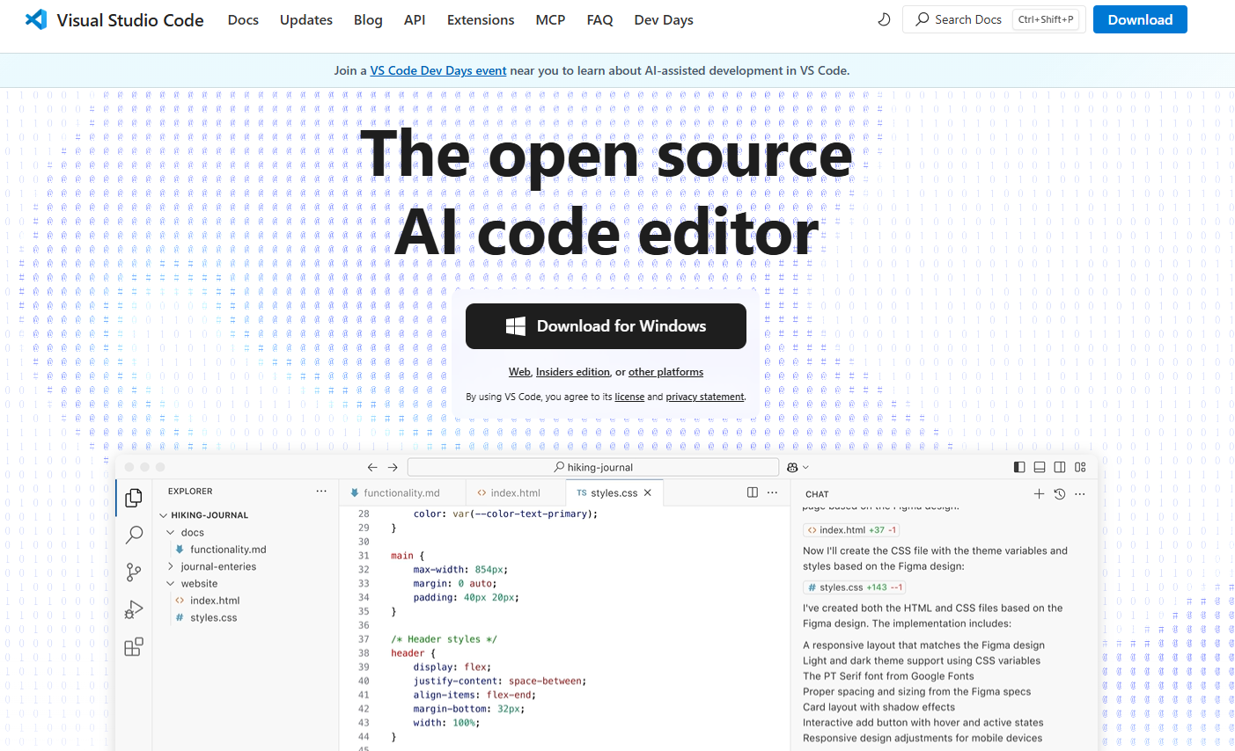
1.6 Offline Programming
Visual Studio Code
1. download Visual Studio Code and install it

Slide 18
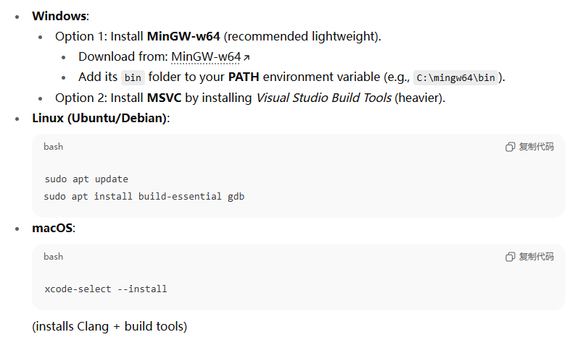
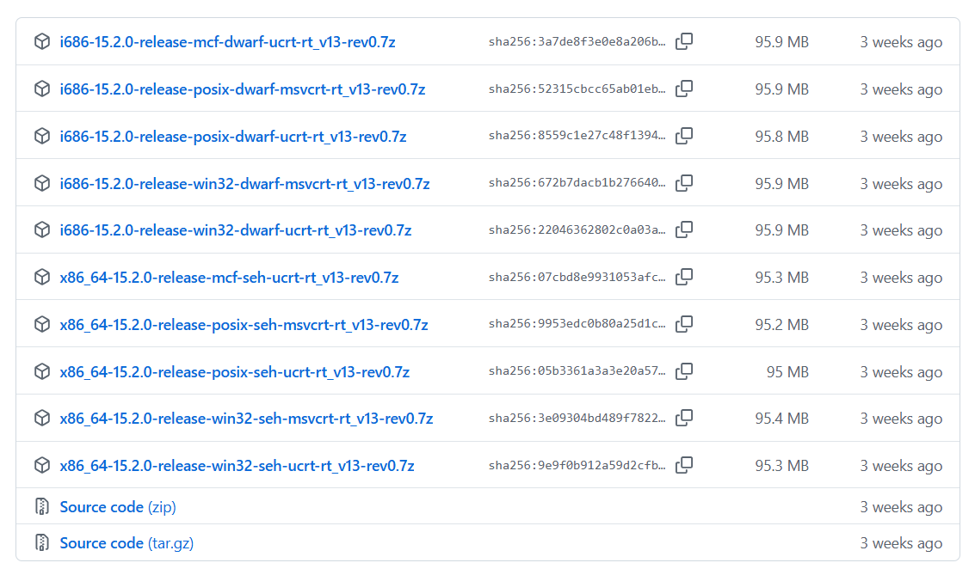
1.6 Offline Programming
2. download MinGW-W64 and install it
VS Code is just an editor — you need a compiler:

Slide 19
1.6 Offline Programming
3. After finishing the installation, open MSYS2 and enter the following command to install the toolchain:
4. Configure system environment variables
pacman -S --needed base-devel mingw-w64-ucrt-x86_64-toolchain
Open the Control Panel
Click "System and Security"
Click "System"
Click "Advanced system settings"
Click " environment variables "
Add MSYS2 bin path to user variables path
MSYS2 bin path : installation path of MSYS2 + ucrt64\bin
for example, C:\msys64\ucrt64\bin

Slide 20
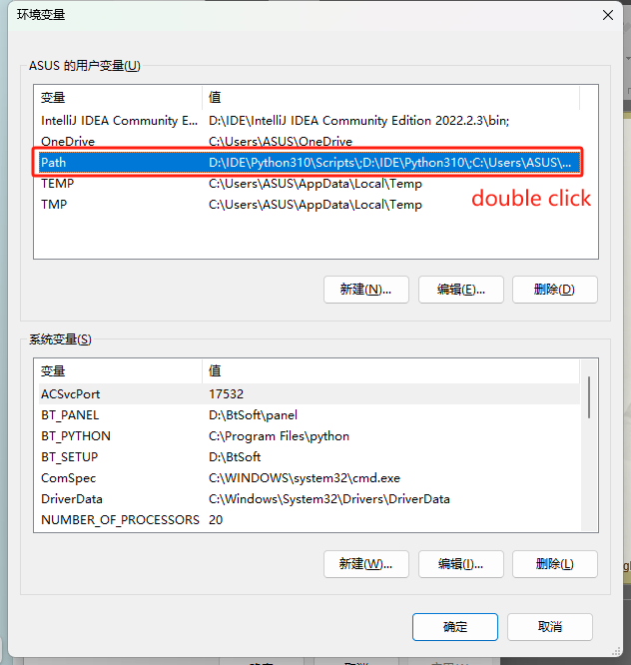
1.6 Offline Programming

Slide 21
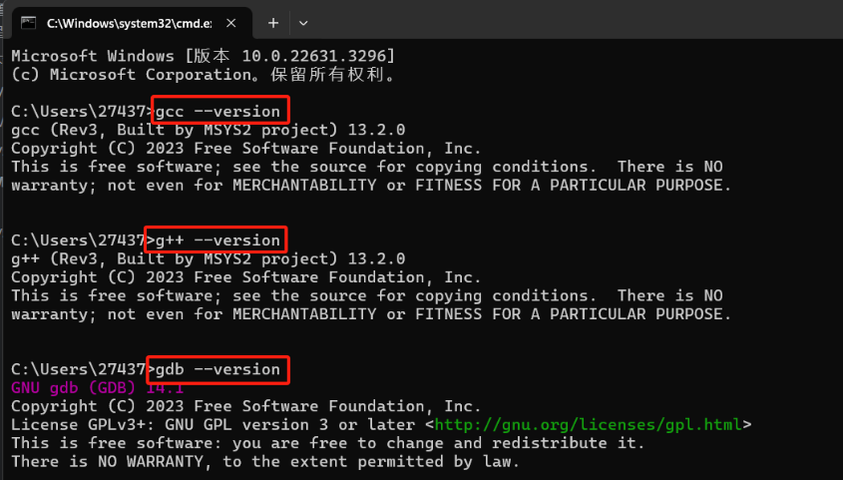
1.6 Offline Programming
5. use the following commands to test the installation of environment:

Slide 22
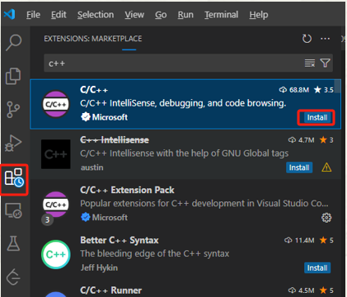
1.6 Offline Programming
6. open Visual Studio Code, search for "C++" in extensions and install it:
Open VS Code → go to Extensions (Ctrl+Shift+X) → install:
C/C++ (by Microsoft) → provides IntelliSense, debugging.
C/C++ Extension Pack (optional, includes debugger and more).
Code Runner (optional, for quick running code).

Slide 23
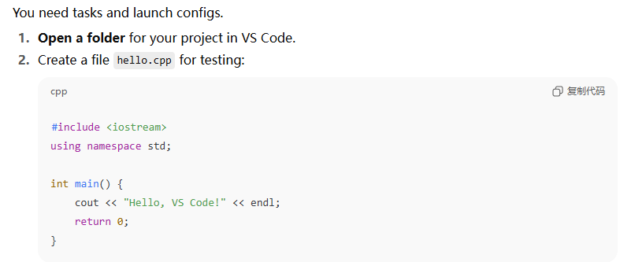
1.6 Offline Programming
7. test whether vscode can run c++ files

Slide 24
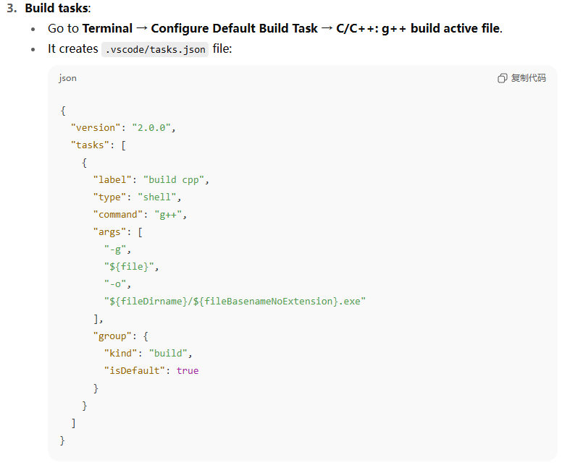
1.6 Offline Programming
7. test whether vscode can run c++ files

Slide 25
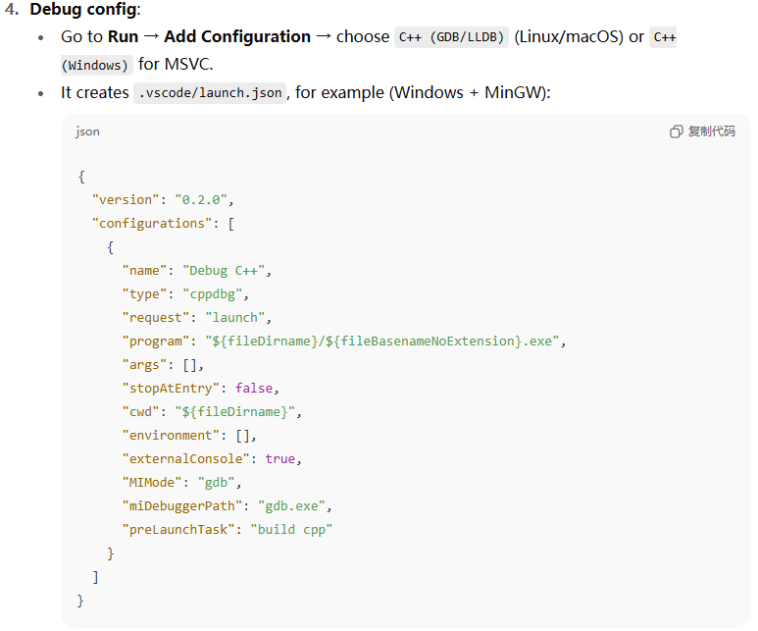
1.6 Offline Programming
7. test whether vscode can run c++ files

Slide 26
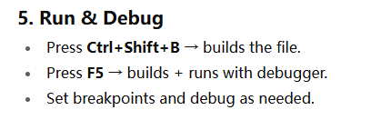
1.6 Offline Programming
7. test whether vscode can run c++ files

Slide 27
1.7 Learning C++
A successful approach to learning to program in C++ depends on large amounts of practice.
exercises at the end of each chapter.
solutions to selected exercises are at the web site for this book
http://www.hxedu.com.cn.
Other learning materials
Learn C++ – Skill up with our free tutorials (learncpp.com)
https://www.bilibili.com/video/BV1oD4y1h7S3/?spm_id_from=333.337.search-card.all.click&vd_source=1e2cfa9e6c262e6d189fe4a48f2c1aac
Learn C++ | Codecademy

Slide 28

Thank you for
your attention !
Q&A
ZhangMeiShan

Slide 29
Homework
1. How to develop a C++ program?
2. Use CodeBlocks, Visual Studio Code or online programming to write a C++ program:
Display the following two sentences on the screen:
Hello C++.
I like programming.
The output is formatted as two lines.

