Slide 1
Lecture 10: Pointers and Memories
Harbin Institute of Technology（Shenzhen）
School of Computer Science and Technology Zhang Meishan (mason.zms@gmail.com)
Copyright：Harbin Institute of Technology，Su Xiaohong， sxh@hit.edu.cn

Slide 2
Overview
Addresses and pointers
Pointers and arrays
Pointers to classes
Pointers as function arguments
Dynamic memory allocation

Slide 3
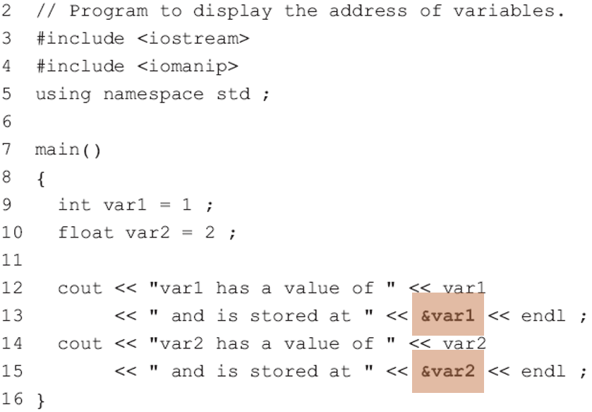

10.1 Addresses and Pointers
Every variable and object used in a C++ program is stored in a specific place in memory.
Each location in memory has a unique address
uses & to get the address of a variable

Slide 4
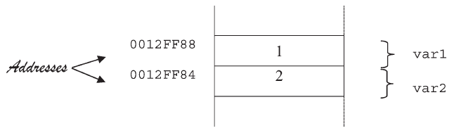
10.1 Addresses and Pointers
How the variables var1 and var2 are stored in memory?
Different computers may give different addresses from the ones above.
Various computers and operating systems will store variables at different memory locations.
The addresses are in hexadecimal (base 16).

Slide 5

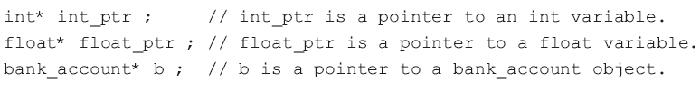



10.1 Addresses and Pointers
A pointer variable is a variable that holds the address of another variable.
data_type is any data type (such as char, int, float, a struct, a class and so on)
variable_name is any valid variable name.
Whitespace in a pointer definition is not relevant.

Slide 6
10.1 Addresses and Pointers
Pointer definitions are read backwards from the variable name, replacing * with the words “is a pointer”.
int* int_ptr means that int_ptr is a pointer to an int
float* float_ptr means that float_ptr is a pointer to a float.

Slide 7
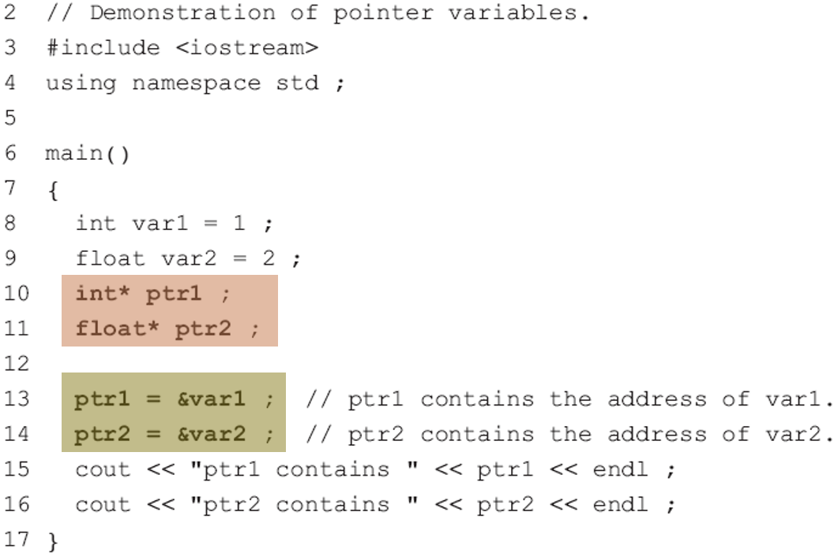
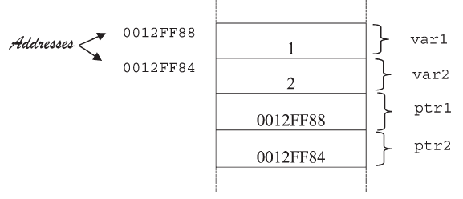

10.1 Addresses and Pointers
The two variables ptr1 and ptr2 are used to store the addresses of the other two variables, var1 and var2.

Slide 8
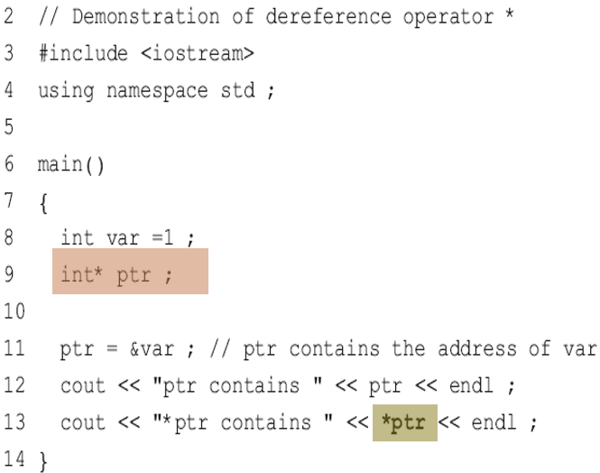

10.1 Addresses and Pointers
The dereference operator * is used to access the value of a variable, whose address is stored in a pointer
*ptr means the value of the variable at the address stored in the pointer variable ptr
Line 13 displays the value at the address held in ptr by using the dereference operator *. This is called dereferencing the pointer ptr.
The value of *ptr is the same as the value of var.
In line 9, the * is used to define ptr as a pointer to an int.
In line 13, the * is used to access the value of the memory location, the address of which is in ptr.

Slide 9




10.1 Addresses and Pointers
When defining a pointer, the pointer itself, the value it points to or both can be made constant. The position of const in the definition determines which of these apply.
The definition reads as “p is a pointer to an integer constant”.
The integer is constant and cannot be changed using pointer p
The value of i can be changed
The pointer may be changed

Slide 10

10.1 Addresses and Pointers
This definition of p reads as “p is a pointer to a constant integer”.
this means that the integer is constant and cannot be changed using pointer p.
This definition of p reads, “p is a constant pointer to an integer”.
This means that the pointer is a constant but not what it points to.

Slide 11

10.1 Addresses and Pointers
This definition of p reads, “p is a constant pointer to an integer constant”.
This means that both the pointer and the integer it points to are constants.

Slide 12

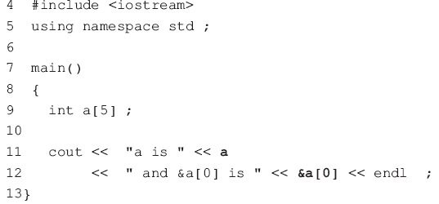

10.2 Pointers and Arrays
The name of an array is a pointer to the first element of the array.
The elements of this array are: a[0], a[1], a[2], a[3], a[4]
The name of the array a is equivalent to the address of the first element; a is the same as &a[0]
a + 1 is the address of the second element
a + 2 is the address of the third element
….

Slide 13
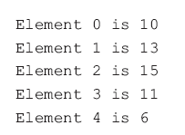
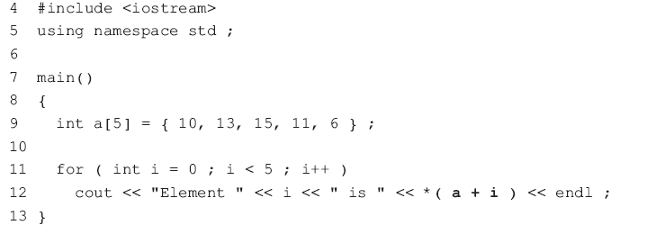
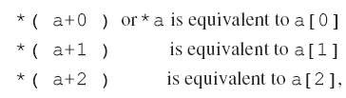
10.2 Pointers and Arrays
As the name of an array is a pointer to the first element of the array, the dereference operator * can be used to access the elements of the array
the expression *( a+i ) is not equal to the expression *a+i

Slide 14
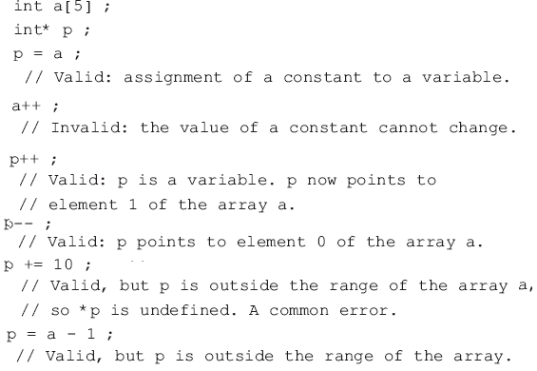

10.2 Pointers and Arrays
Use pointers to access the elements of any array
numbers[i] is equivalent to *( numbers + i ).
Although the name of an array is a pointer to the first element of the array, you cannot change its value; this is because it is a constant pointer.
a++ or numbers+=2 are invalid

Slide 15
10.2 Pointers and Arrays
A constant may be added to or subtracted from the value of a pointer, allowing access to different memory locations.
Not all arithmetic operations are permissible on pointers.
The multiplication of two pointers is illegal, because the result would not be a valid memory address.

Slide 16


10.2 Pointers and Arrays
Access the elements of a multi-dimensional array using pointers---increasingly complex
A two-dimensional array is stored as an ‘array of arrays’.
This means that a is a one-dimensional array whose elements are themselves a one-dimensional arrays of integers
The name of a two-dimensional array is a pointer to the first element of the array.
-------a is equivalent to &a[0]
a[0] is itself an array of two integers
-------a[0] is equivalent to &a[0][0]

Slide 17
10.2 Pointers and Arrays
a[0], a[1] and a[2] are pointers (data type is int*) and a is a pointer to a pointer (data type is int **).
a[0] is the address of the first element in the first row of the array. *a[0] is a[0][0], which is 4.
a[1] is the address of the first element in the second row. *a[1] is a[1][0], which is 1.
a[2] is the address of the first element in the third row. *a[2] is a[2][0], which is 9.

Slide 18
10.2 Pointers and Arrays
a[0], a[1] and a[2] are pointers (data type is int*) and a is a pointer to a pointer (data type is int **).
a[0]+1 is the address of the second element in the first row. *(a[0]+1) is a[0][1], which is 6.
*(a[1]+1) is a[1][1], which is 3.
a[2]+1 is the address of the second element in the third row. *(a[2]+1) is a[2][1], which is 7.
a[1]+1 is the address of the second element in the second row.

Slide 19
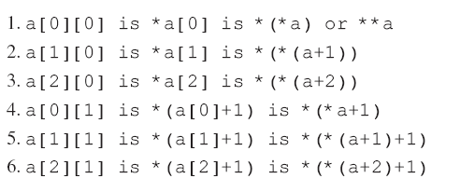
10.2 Pointers and Arrays
*a is the same as a[0]
*(a+1) is the same as a[1]
*(a+2) is the same as a[2]

Slide 20

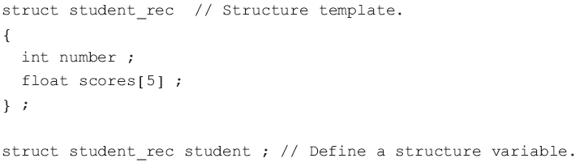
10.3 Pointers to classes
Define a pointer to a variable of a type defined by struct or class
The general format for defining a pointer to a structure
tag_name is the structure tag
variable_name is the name of the pointer variable
Example

Slide 21



10.3 Pointers to classes
Define a pointer ptr to the student_rec structure
A value can be assigned to ptr by using the address operator &
The members of a structure variable can be referenced by using the dereference operator *.
Note that it is the address of the structure variable student and not the address of the structure tag student_rec that is assigned to ptr
The parentheses are necessary, because the selection operator. has a higher priority than the dereference operator *

Slide 22


10.3 Pointers to classes
For accessing the members of a structure, the arrow notation -> ( - and > together ) can be used in place of the dot notation
The expression ptr->number reads as “the member number of the structure pointed to by ptr”.

Slide 23

10.3 Pointers to classes
Defining a pointer to a class object is similar to defining a pointer to a structure variable.
class_name is the name of the class
variable_name is the name of the pointer variable.

Slide 24
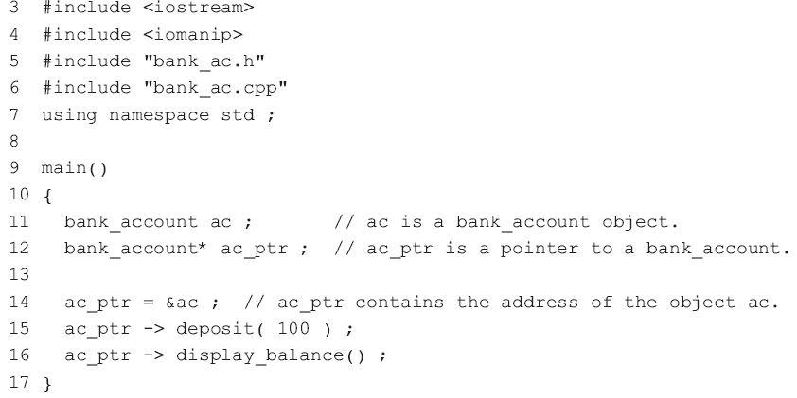
10.3 Pointers to classes
Line 12 defines ac_ptr as a pointer to a bank_account object
Line 14 assigns the address of the bank_account object ac to ac_ptr.

Slide 25



10.3 Pointers to classes
The public members of a class object may be accessed by using the dereference operator *.
The first pair of parentheses are necessary, because the selection operator. has a higher priority than the dereference operator *.
The arrow notation -> can be used in place of the dot notation
-> is more convenient and common.

Slide 26
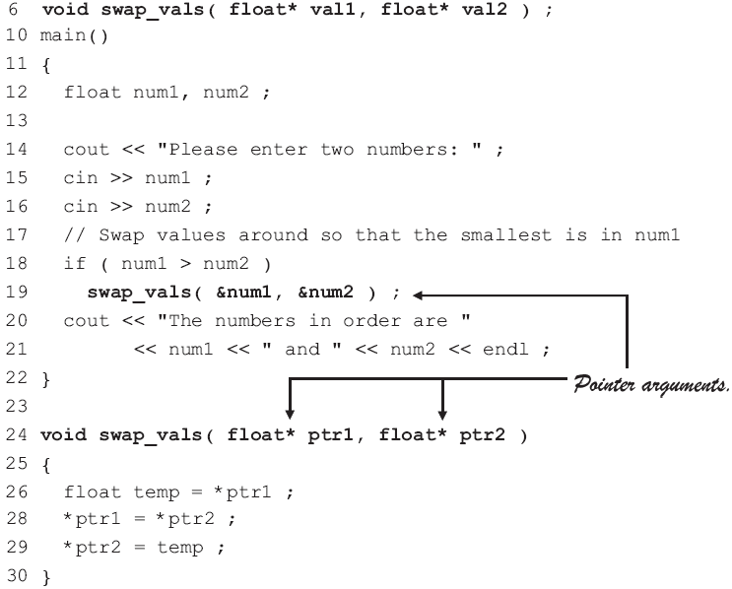

10.4 Pointers as function arguments
Program Example: uses pointers in place of references
Line 19 passes the addresses of the two floating-point variables num1 and num2 to the function swap_vals().
These addresses are received by the parameters ptr1 and ptr2, declared as pointers to floats in the function header on line 24.
Line 26 stores the value of num1 ( = *ptr1 ) in the variable temp
Line 28 is equivalent to num1 = num2 ;
Line 29 assigns the value of temp (12.1) to num2, because *ptr2 is the same as num2.

Slide 27
10.4 Pointers as function arguments
It is easier to use references rather than pointers
& must be used to pass the address of the variables to the function
Within the function the dereference operator * must be used to access the value of each of the numbers.
The number of library functions use pointers as parameters
ctime(), converting the time in seconds to a character string containing the date and time.

Slide 28
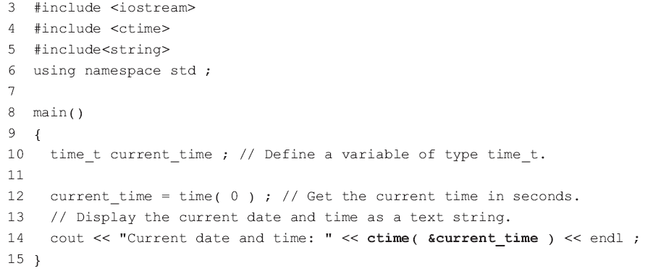
10.4 Pointers as function arguments
Program Example

Slide 29
10.5 Dynamic memory allocation
Problem:
When defining an array, the number of elements in the array must be specified in advance of the program execution. Sometimes, either all the elements specified are not used or more elements than were originally anticipated are required.
C++ has the ability to allocate memory while a program is executing
Using the memory allocation operator new.

Slide 30

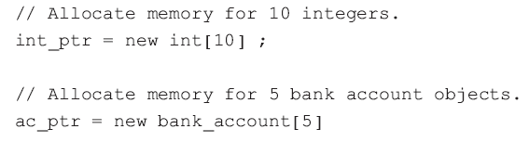
10.5 Dynamic memory allocation
Allocating memory dynamically for an array
The new memory allocation operator can be used to allocate a contiguous block of memory for an array of any data type, whether the data type is built-in or is a user-defined structure or class.
pointer is a pointer to the allocated memory
data_type is the data type of the array
size is the number of elements in the array

Slide 31
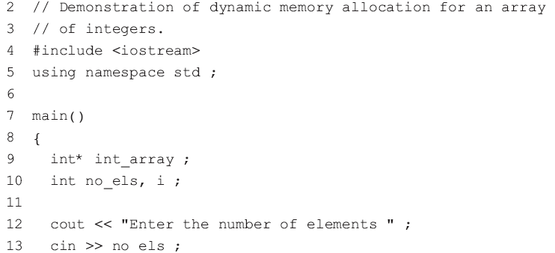
10.5 Dynamic memory allocation
When allocating memory for an array of class objects, there must be a default constructor for the class so that the elements of the array get initialized.

Slide 32

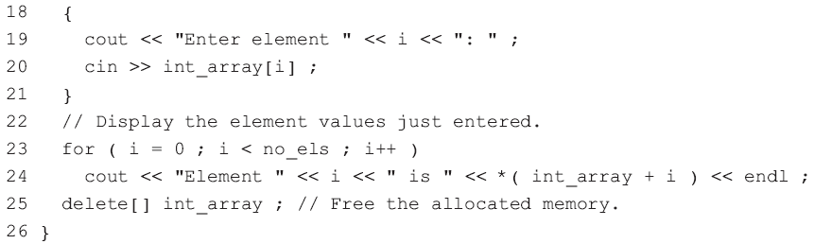
10.5 Dynamic memory allocation
Program Example
Line 15 uses new to allocate the exact number of elements required
The elements of the newly allocated array can be accessed using either a pointer or an index
The allocated memory is freed using the delete operator.
IMPORTANT: Include the square brackets [] when freeing memory for a previously allocated array. Without the square brackets, only the first element of the array will be deleted.

Slide 33


10.5 Dynamic memory allocation
Initialization with new
When allocating memory for an array of class objects, the default constructor for the class initializes the elements of the array.
Default constructor for the bank account class being called five times
No initialization is done for dynamically allocated arrays of built-in data types

Slide 34


10.5 Dynamic memory allocation
Single instances of any data type (built-in, a user-defined structure or a class) can be initialized using a second form of the new operator.
pointer is a pointer to the allocated memory
The initial value is optional
Allocate memory for an integer, with an initial value of 100.
Allocate memory for an integer, with no initial value.
Allocate memory for a bank account object. The default class constructor is called to do the initialization.
Allocate memory for a bank account object. A constructor is called to assign initial values to account number and balance.

Slide 35
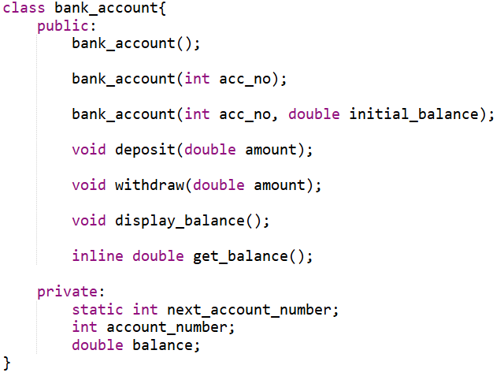
10.5 Dynamic memory allocation
bank_ac.h:

Slide 36
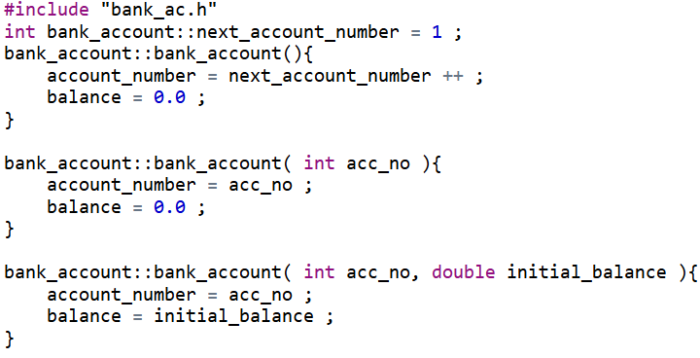
10.5 Dynamic memory allocation
bank_ac.cpp:

Slide 37
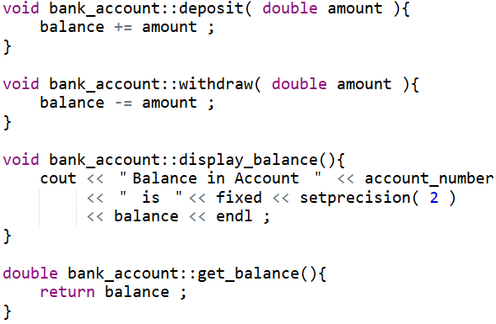
10.5 Dynamic memory allocation
bank_ac.cpp:

Slide 38
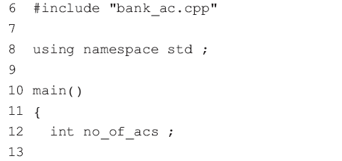
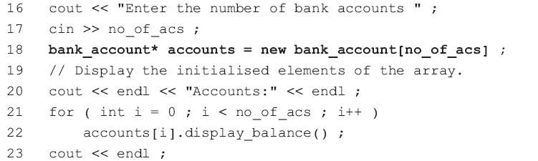
10.5 Dynamic memory allocation

Slide 39
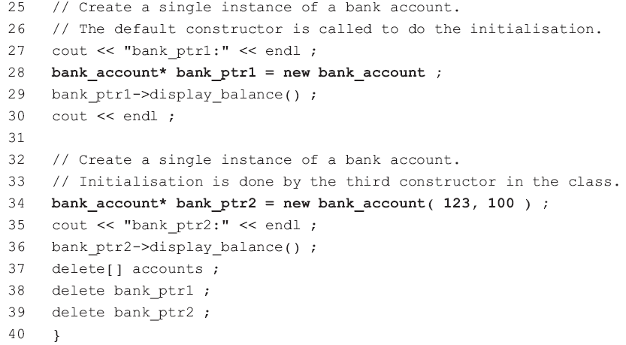
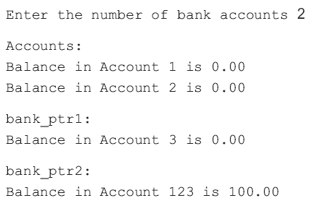
10.5 Dynamic memory allocation

Slide 40
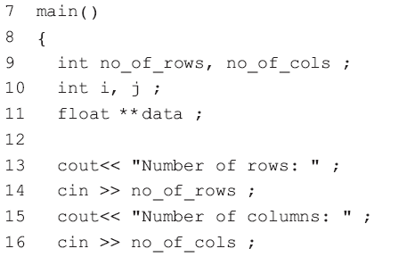
10.5 Dynamic memory allocation
Allocating memory for multi-dimensional arrays
In C++, multi-dimensional arrays are implemented as ‘arrays of arrays’.

Slide 41
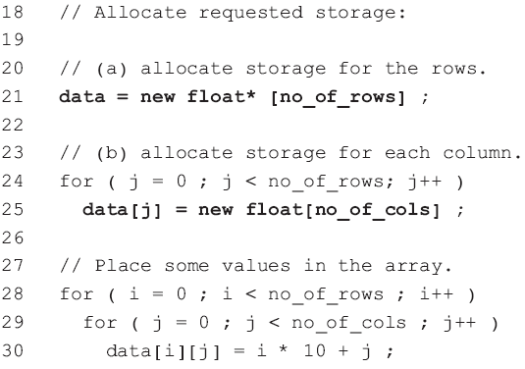
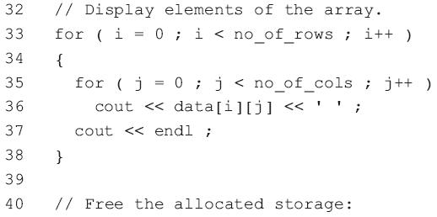
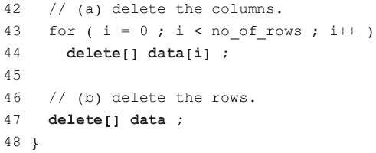
10.5 Dynamic memory allocation
Lines 44 and 47 free the memory allocated in lines 21 and 25 separately.
For each pointer returned from new in lines 21 and 25 there is a corresponding call to delete with that pointer in lines 47 and 44.

Slide 42
10.5 Dynamic memory allocation
Out of memory error
it was assumed that the memory requested with new was allocated, regardless of whether memory was available or not.
C++ handles insufficient memory errors produced by new by calling a function specified in set_new_handler().

Slide 43
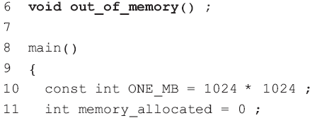
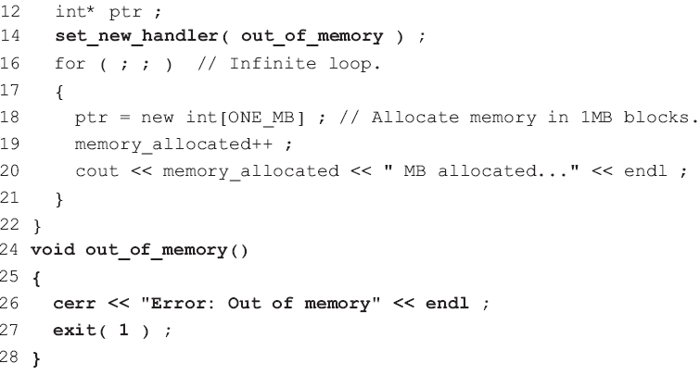
10.5 Dynamic memory allocation
Line 27 terminates the program and exits to the operating system with a status code of 1.
A non-zero status code is usually used to indicate an abnormal exit from a program.

Slide 44
10.5 Dynamic memory allocation
The function out_of_memory() inserts an error message into the stream cerr rather than into cout.
The stream cerr is typically used for error messages while cout is used for displaying the results of a program.
Like cout, cerr is, by default, connected to the screen.
The output for cout is often redirected to a device other than the screen (e.g. a disk file). In this case cout is unsuitable for error messages that may require immediate attention, so cerr is used instead.
Redirecting output streams to different devices is done by the operating system commands, not by C++.

Slide 45

Thank you for
your attention !
Q&A
ZhangMeiShan

Slide 46
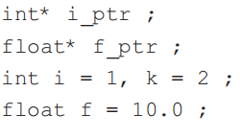
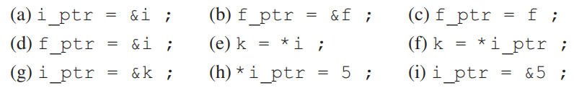
Homework
1. Given the following:
which of these statements are valid?

Slide 47
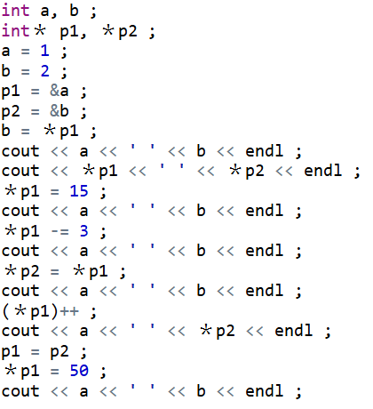
Homework
2. What does this program segment display?

Slide 48
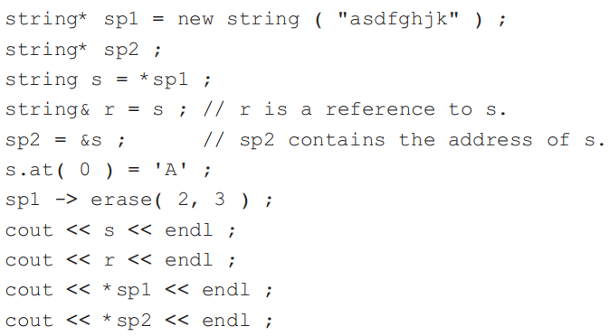
Homework
3. What is the output from the following?

Slide 49
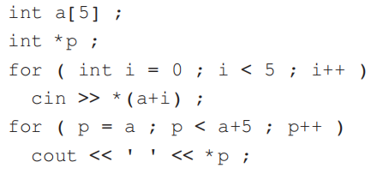
Homework
4. What does this program segment do?

Slide 50
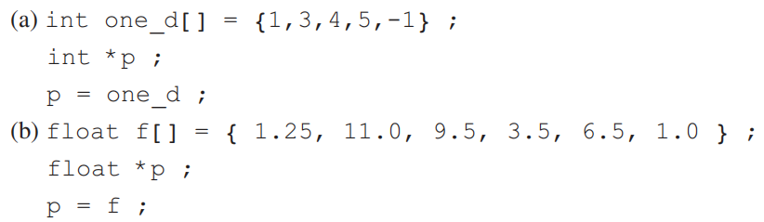
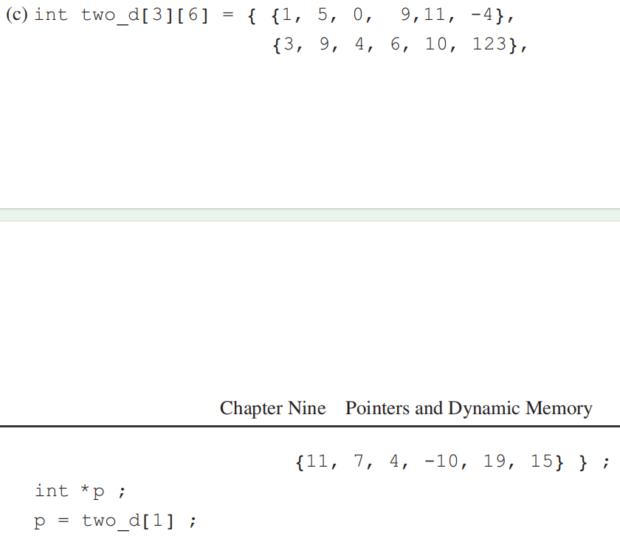
Homework
5. What is the value of ＊p, ＊p+4 and ＊(p+4) in each of the following?

Slide 51

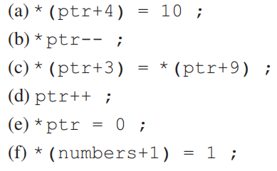
Homework
6. Given the following definitions:
what is in the array numbers after each of the following?

