Slide 1
Lecture 11: Polymorphism
Harbin Institute of Technology（Shenzhen）
School of Computer Science and Technology Zhang Meishan (mason.zms@gmail.com)
Copyright：Harbin Institute of Technology，Su Xiaohong， sxh@hit.edu.cn

Slide 2
Overview
Polymorphism: basic idea
Operator Overloading
Templates
Virtual function
Abstract base classes

Slide 3
11.1 What is polymorphism
The word polymorphism is derived from a Greek word meaning “many forms”.
Polymorphism is one of the most important features in object-oriented programming and refers to the ability of different objects to respond differently to the same command (or ‘message’ in object-oriented programming terminology).

Slide 4
11.1 What is polymorphism
Polymorphism is used widely in our everyday language.
For example, the command ‘open’ means different things when applied to different objects.
Opening a bank account is very different from opening a window, which is different from opening a window on a computer screen.
The command (‘open’) is the same, but depending on what it is applied to (the object) the resultant actions are different.

Slide 5
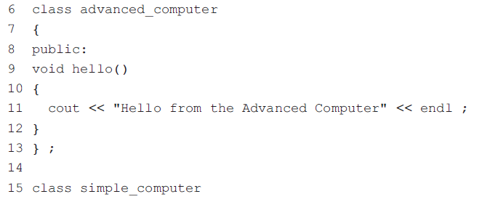
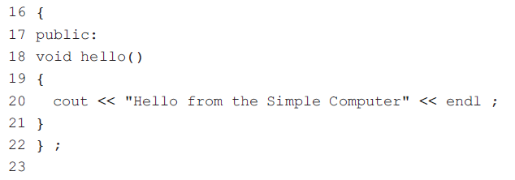
11.1 What is polymorphism

Slide 6
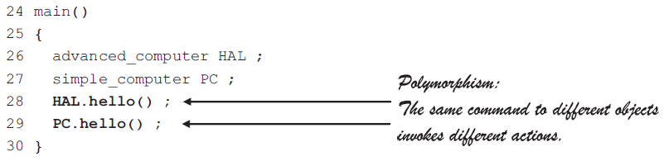
11.1 What is polymorphism
Polymorphism:
The same command to different objects invokes different actions.
It can be seen from the output that the objects HAL and PC have responded differently to the same hello() command sent to them on lines 28 and 29.

Slide 7
11.1 What is polymorphism
Polymorphism can be divided into two broad categories: static (or compile-time) and dynamic (or run-time) polymorphism.
Static polymorphism occurs when the program is being compiled, dynamic polymorphism when the program is actually running.
static or early binding: normally, which function a call refers to is made at compile time. The compiler knows which function to call based on the object that calls it.
dynamic or late binding: it is left until run-time to determine which function should be called. This decision is based on the object making the call.

Slide 8
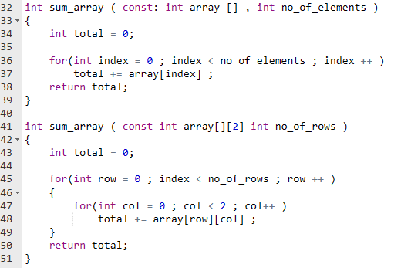
11.1 What is polymorphism
C++ has three static polymorphism mechanisms:
function overloading
operator overloading
Templates
Dynamic polymorphism of C++: virtual function
function overloading
Functions with the same names and different parameter lists mean function overloading.

Slide 9
11.2 Operator Overloading
Programmer can use some operator symbols to define special member functions of a class, providing convenient notations for object behaviors
The + operator, for example, is appropriate for strings as well and is taken to mean concatenation. This means that the operator + has a different meaning for numeric data types than for string data types.
When you create a new class you can redefine or overload existing operators such as +
Existing operators are overloaded for specific use in a class use by writing operator functions for the class.

Slide 10
11.2 Operator Overloading
The C++ built-in arithmetic (+, *, / etc.) and relational operators (>, <,==, !=) work with built-in data types (int, float, etc.).
Not all the built-in operators can be used with every data type: for example, multiplication is not a valid operation for strings and % can only be used with integer data types.

Slide 11
11.2 Operator Overloading
2 // Demonstration of an overloaded + operator.
3 #include <iostream>
4 using namespace std ;
5
6 class time24 // A simple 24-hour time class.
7 {
8 public:
9 time24( int h = 0, int m = 0, int s = 0 ) ;
10 void set_time( int h, int m, int s ) ;
11 void get_time( int& h, int& m, int& s ) const ;
12 time24 operator+( int secs ) const ;
13 private:
14 int hours ; // 0 to 23
15 int minutes ; // 0 to 59
16 Int seconds ; // 0 to 59
17 }
The prototype for the overloaded + operator is on line 12.

Slide 12
11.2 Operator Overloading
18 // Constructor.
19 time24::time24( int h, int m, int s ) : hours( h ), minutes( m ), seconds( s ) {}
20
21 // Mutator function.
22 void time24::set_time( int h, int m, int s )
23 {
24 hours = h ; minutes = m ; seconds = s ;
25 }
26
27 // Inspector function.
28 void time24::get_time( int& h, int& m, int& s ) const
29 {
30 h = hours ; m = minutes ; s = seconds ;
31 }

Slide 13
11.2 Operator Overloading
32 // Overloaded + operator.
33 time24 time24::operator+( int secs ) const
34 {
35 // Add secs to class member seconds and calculate the new time.
36 time24 temp ;
37 temp.seconds = seconds + secs ;
38 temp.minutes = minutes + temp.seconds / 60 ;
39 temp.seconds %= 60 ;
40 temp.hours = hours + temp.minutes / 60 ;
41 temp.minutes %= 60 ;
42 temp.hours %= 24 ;
43 return temp ; // Return the new time.
44 }
define the overloaded + operator for adding an integer number of seconds to a time24 object and returning the result.

Slide 14
11.2 Operator Overloading
45 main()
46 {
47 int h, m, s ;
48 time24 t1( 23, 59, 57 ) ; // t1 represents 23:59:57
49 time24 t2 ;
50 t2 = t1 + 4 ; // t2 should now be 0:0:1
51 t2.get_time ( h, m, s ) ;
52 cout << "Time t2 is " << h << ":" << m << ":" << s << endl ;
53 }
it can be called like any other function; line 50 can also be written as: t2 = t1.operator+( 4 ) ;

Slide 15
11.2 Operator Overloading
5 class time24 // A simple 24-hour time class.
6 {
7 public:
8 time24( int h = 0, int m = 0, int s = 0 ) ;
9 void set_time( int h, int m, int s ) ;
10 void get_time( int& h, int& m, int& s ) const ;
11 time24 operator+( int secs ) const ;
12 time24 operator+( const time24& t ) const ;
13 private:
14 int hours ; // 0 to 23
15 int minutes ; // 0 to 59
16 Int seconds ; // 0 to 59
17 }
The prototype for the overloaded + operator is on line 12

Slide 16
11.2 Operator Overloading
32 // Overloaded + operator.
33 time24 time24::operator+( int secs ) const
34 {
35 // Add secs to class member seconds and calculate the new time.
36 time24 temp ;
37 temp.seconds = seconds + secs ;
38 temp.minutes = minutes + temp.seconds / 60 ;
39 temp.seconds %= 60 ;
40 temp.hours = hours + temp.minutes / 60 ;
41 temp.minutes %= 60 ;
42 temp.hours %= 24 ;
43 return temp ; // Return the new time.
44 }
define the overloaded + operator for adding an integer number of seconds to a time24 object and returning the result.

Slide 17
11.2 Operator Overloading
45 // Overloaded + operator.
46 time24 time24::operator+( const time24& t ) const
47 {
48 // Add total seconds in t to seconds and calculate the new time.
49 time24 temp ;
50 int secs = t.hours * 3600 + t.minutes * 60 + t.seconds ;
51 temp.seconds = seconds + secs ;
52 temp.minutes = minutes + temp.seconds / 60 ;
53 temp.seconds %= 60 ;
54 temp.hours = hours + temp.minutes / 60 ;
55 temp.minutes %= 60 ;
56 temp.hours %= 24 ;
57 return temp ; // Return the new time.
58 }
define the overloaded + operator for adding an a time24 object of seconds to a time24 object and returning the result.

Slide 18
11.2 Operator Overloading
66 main()
67 {
68 int h, m, s ;
69 time24 start_time( 23, 0, 0 ) ;
70 time24 elapsed_time( 1, 2, 3 ) ;
71 time24 finish_time ;
72 finish_time = start_time + elapsed_time ;
73 finish_time.get_time( h, m, s ) ;
74 cout << "Finish Time is “ << h << ":" << m << ":" << s << endl ;
75 time24 t1( 23, 59, 57 ) ; // t1 represents 23:59:57
76 time24 t2 ;
77 t2 = t1 + 4 ;
78 t2.get_time ( h, m, s ) ;
79 cout << "Time t2 is " << h << ":" << m << ":" << s << endl ;
80 }
it can be called like any other function; line 72 can also be written as: start_time.operator+(elapsed_time) ;

Slide 19
11.2 Operator Overloading
The following rules apply to operator overloading:
New operators cannot be invented. For example, it is not possible to overload < > to mean ‘not equal to’’.
The overloaded operator must have the same number of operands as the corresponding predefined operator. For example, an overloaded equivalent == must have two operands.
The priority of an overloaded operator remains the same as its corresponding predefined operator. For example, regardless of whether * is overloaded or not, it will always have a higher precedence than + and -.
Overloaded operators cannot have default arguments.
The operators for the built-in data types, e.g. int, float and so on, cannot be redefined.

Slide 20
11.3 Template
A template is a framework for generating a class or a function.
Instead of explicitly specifying the data types used in a class or a function, parameters are used.
When actual data types are assigned to the parameters, the class or function is generated by the compiler.

Slide 21
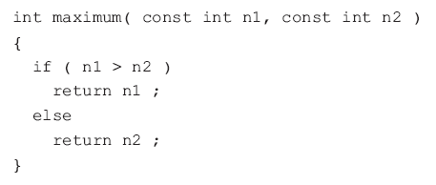
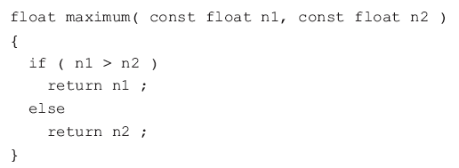
11.3 Templates
A function to find the maximum of two integer values
A function to find the maximum of two floating-point values a nearly identical
The reason two different functions are required is simply that the function header is different in the two functions.

Slide 22
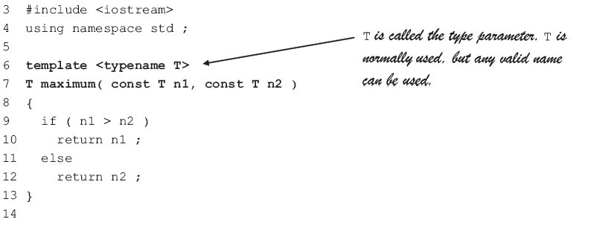
11.3 Templates
Function templates allow both of these functions to be replaced by a single function in which the parameter data types are replaced by a parameter T (for type) giving a generic or type-less function that can be used for all data types.
T is called the type parameters. T is normally used, but any valid name can be used.

Slide 23
11.3 Templates
A function template declaration consists of the keyword template and a list of one or more data type parameters.
The data type parameter is preceded by either the keyword class or the more meaningful keyword typename.
Type parameters are enclosed within angle brackets < and >. When multiple data type parameters are used, they are separated by commas.

Slide 24
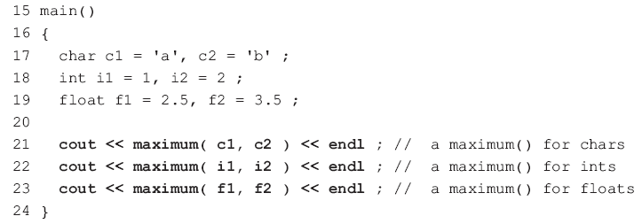
11.3 Templates
This process is called instantiation of the template and the result is a conventional function generated by the compiler.
Line 21 has the effect of replacing the type parameter T in line 6 with the data type of the arguments c1 and c2, i.e. char. The compiler generates a function with the prototype.

Slide 25
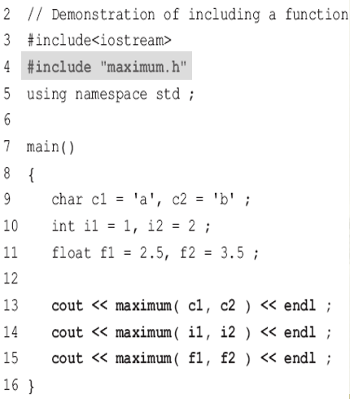
11.3 Templates
Instead of using three separate functions in the program, a single function template is used.
The program source file is smaller, but since the compiler generates three separate functions from the template, the executable file size remains the same.
Template definitions can be placed in a header file

Slide 26
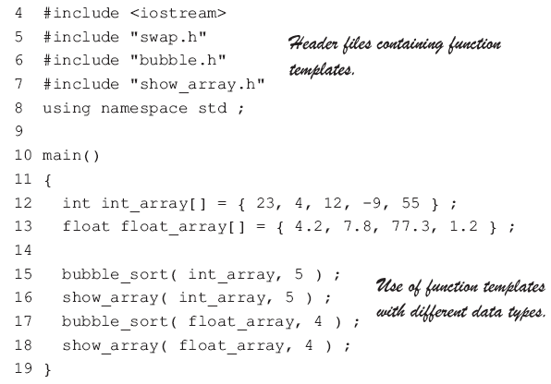
11.3 Templates
Function templates to sort the elements of an array
Header files containing functions template.
Use of function templates with different data types.

Slide 27
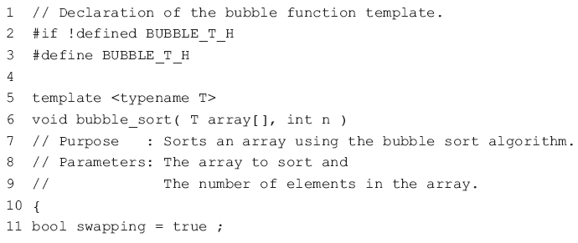
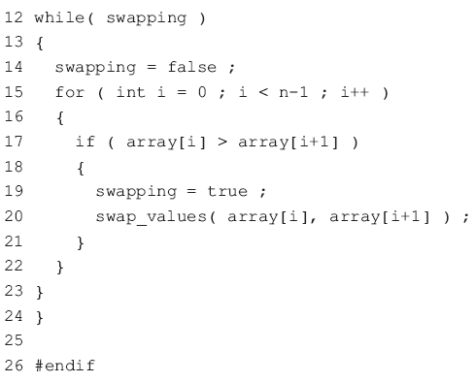
11.3 Templates
Contents of bubble.h :

Slide 28
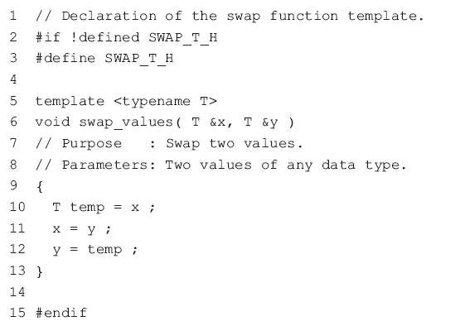
11.3 Templates
Contents of swap.h:

Slide 29
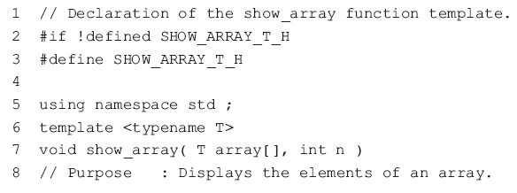
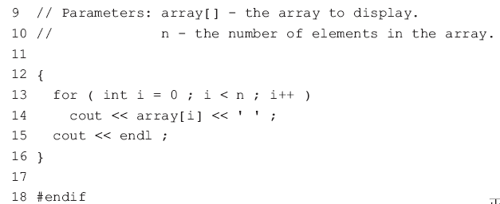
11.3 Templates
Contents of show_array.h:
As with previous uses of header files, the preprocessor statements are used in each of these header files to prevent the header file from being inadvertently included more than once in a program.

Slide 30
11.3 Templates
Templates can be also used for generating entire C++ classes.
templates allow one class to be written for all data types
Class templates are also known as parameterized types. A parameterized type is a data type defined in terms of other data types, some of which are unspecified.

Slide 31
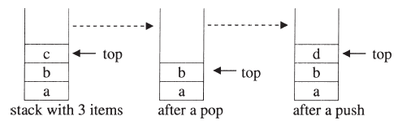
11.3 Templates
Two principal operations for a stack data structure:
push: adds an item to the top of the stack.
pop : retrieves the most recently pushed item from the stack.
A simple way to implement a stack is to use an array to hold the items and a variable to hold the index value of the ‘top’ of the array.
a stack of plates, whereby plates are only added and removed from the top of the stack

Slide 32

11.3 Templates
A stack can be defined as a class template with a type parameter that specifies the data type of the items to be stored on the stack and an integer variable to indicate the current top of the stack.
The definition of a stack class template is stored in a header file stack.h

Slide 33
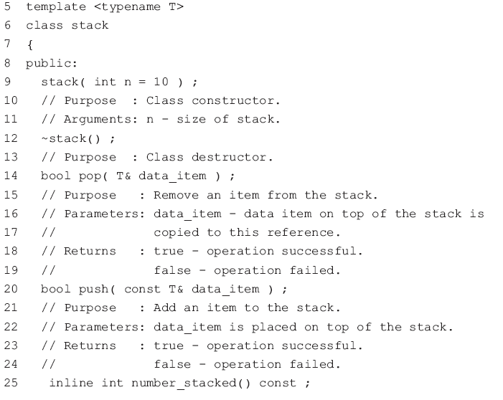
11.3 Templates
stack.h…continued

Slide 34
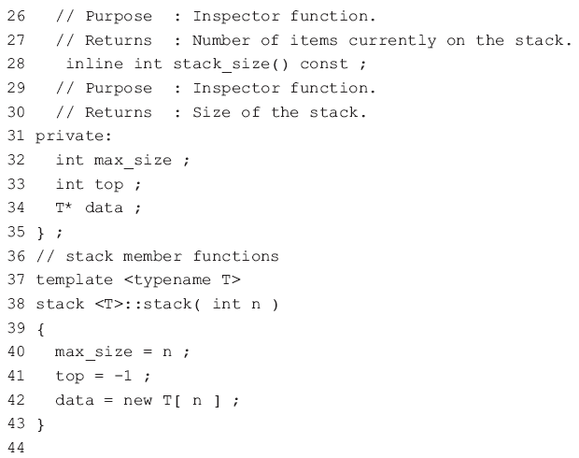
11.3 Templates
stack.h…continued

Slide 35
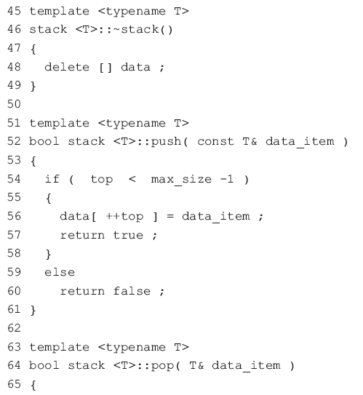

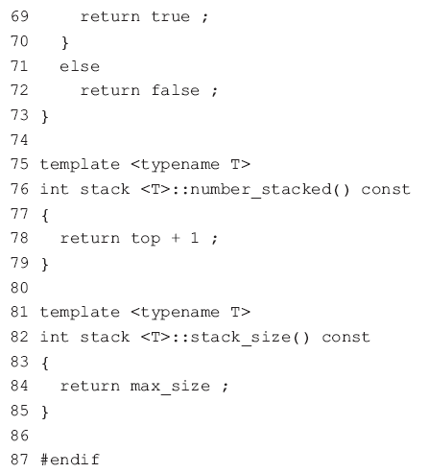
11.3 Templates
stack.h…continued

Slide 36
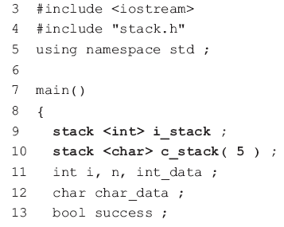
11.3 Templates
A reference to a class template must include its parameter list.
The definition of the member functions use stack <T> instead of just stack, which would be used if the class were not a template.
The data type of the stack data is specified between < and >.
Line 9 generates a stack class from the class template to process up to ten integer data.
Line 10 generates a stack class from the class template to process up to five character data items.
Technically, a class generated from a class template is known as a template class.

Slide 37

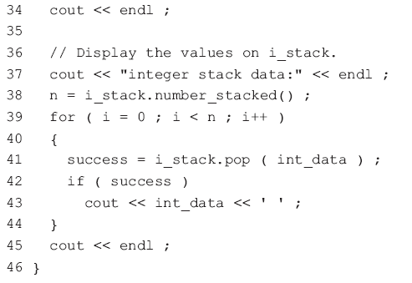
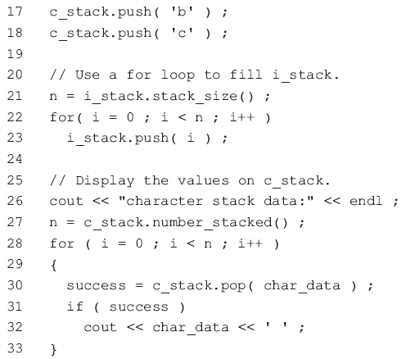
11.3 Templates
Lines 16 to 18 and lines 22 to 23 push some sample data items onto each of the stack objects c_stack and i_stack.
Lines 28 to 33 and lines 39 to 44 pop and display data from each of the stacks.

Slide 38
11.3 Templates
To create templates, first write a non-template data type specific version of the function or class.
When the data type specific version is working satisfactorily, replace the specific data types with template parameters.

Slide 39
11.4 Virtual functions
C++ uses virtual functions to implement dynamic binding.
Virtual functions allow polymorphism to work in all situations.
The keyword virtual is optional in the derived classes, although it is probably a good idea to include it for the sake of clarity.

Slide 40
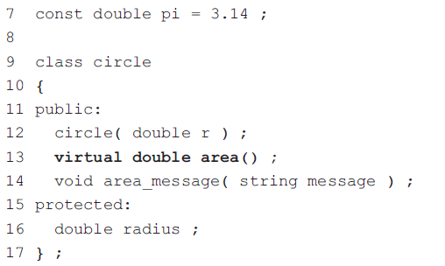
11.4 Virtual functions
This example clearly shows that the virtual function area() and the object calling it are not bound together until run-time

Slide 41
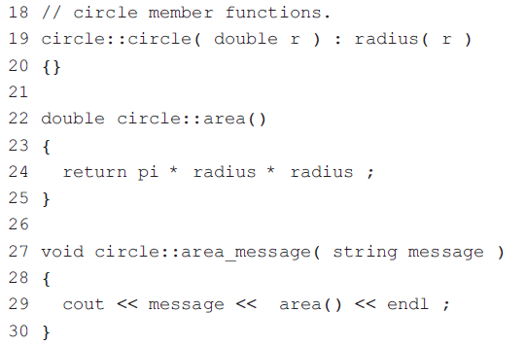
11.4 Virtual functions

Slide 42
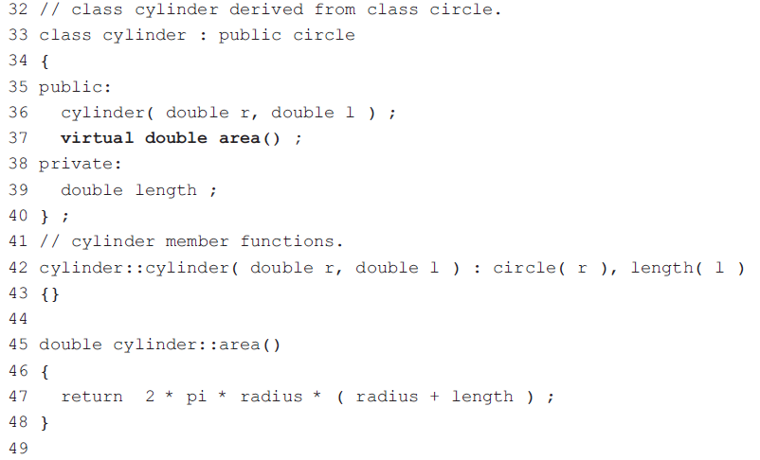
11.4 Virtual functions

Slide 43
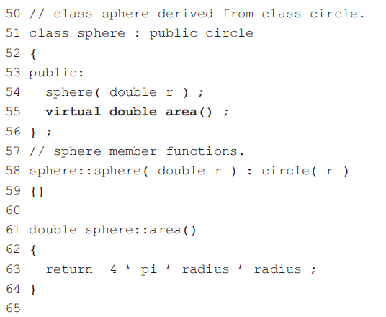
11.4 Virtual functions

Slide 44
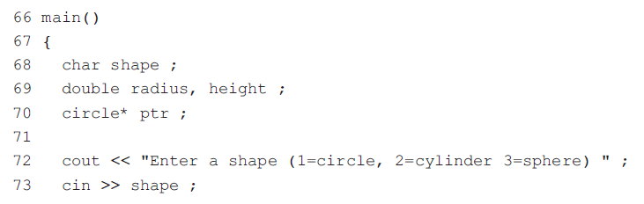
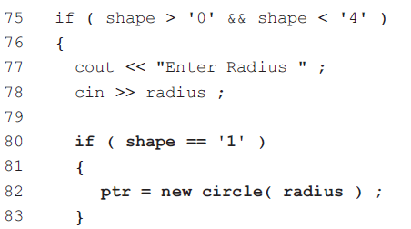
11.4 Virtual functions
Line 70 defines ptr to be a pointer to the base class circle.
Normally, a pointer to one type of data cannot be used to point to data of another type, e.g. a pointer to an int data type cannot point to a float data type.
However, a pointer to a base class can also be used as a pointer to an object of a class derived from that base class.

Slide 45
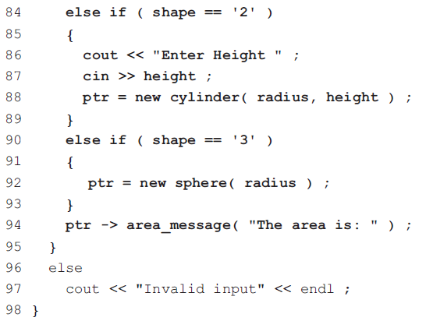
11.4 Virtual functions
This is why ptr can be used in lines 82, 88 and 92 as a pointer to any of the newly created objects.
Line 94 uses ptr (which can be pointing to any of the objects) to call the member function message_area().

Slide 46
11.4 Virtual functions
When to use virtual functions
There are memory and execution time overheads associated with virtual functions, so be judicious in the choice of whether a base class function is virtual or not.
In general, declare a base class member function as virtual if it may be overridden in a derived class.
Overriding and overloading
Overloading is a compiler technique that distinguishes between functions with the same name but with different parameter lists. Function overloading is covered in lecture 8.
Overriding occurs in inheritance when a member function of a derived class has the same name and the same parameters as a member function of its base class.

Slide 47
11.5 Abstract base classes
A base class that contains a pure virtual function is called an abstract base class.
virtual function.
The base class member function has no code and is assigned to 0.
virtual void display_details() = 0 ;
A class member function defined in this way is called a pure virtual function.
A pure virtual function is required by the compiler but doesn’t actually do anything.
A pure virtual function is overridden in all the derived classes and hence there is no need to implement it.

Slide 48
11.5 Abstract base classes
Abstract base classes (ABCs) are not used to create objects, but exist solely as a base for deriving other classes.
It is not possible to define an object of an abstract base class, i.e. objects of an abstract base class cannot be instantiated.
Although a class hierarchy does not have to contain an abstract base class, typically one is defined during the first stage of developing a class hierarchy.

Slide 49
11.5 Abstract base classes
Example: Shape class hierarchy
Shape
inherits (isa)
Rectangle
Circle
• • • •
Triangle
Square

Slide 50
11.5 Abstract base classes
class Shape //Abstract
{ public : //Pure virtual Function virtual void get_area() = 0;
};
Abstract Classes & Pure Virtual Functions
Shape s; // error : variable of an abstract class
A class with one or more pure virtual functions is an Abstract Class
Shape makes sense only as a base of some classes derived from it.
Serves as a “category”
Objects of abstract class can’t be created

Slide 51
Derived Class Circle
11.5 Abstract base classes
Circle:: Circle( double r )
{
radius = r;
}
double Circle:: get_area()
{
const double pi=3.14;
return pi*radius*radius;
}
class Circle: public Shape
{
public:
Circle( double r );
double get_area();
private:
double radius;
};

Slide 52
11.5 Abstract base classes
Derived Class Rectangle
class Rectangle: public Shape
{
public:
Rectangle(double w, double l);
double get_area();
private:
double width, length;
};
Rectangle::Rectangle(double w, double l)
{
width = w;
length = l;
}
double Rectangle::get_area()
{
return width*length;
}

Slide 53
How to sum different Shape?
11.5 Abstract base classes
Static Binding
int main()
{
Circle circle(3);
Rectangle rect(4, 5);
double sum = 0;
sum += circle.get_area();
sum += rect.get_area();
return 0;
}

Slide 54
How to sum different Shape?
11.5 Abstract base classes
Dynamic Binding
int main()
{
Shape *shapes[2] = {new Circle(3), new Rectangle(4, 5)};
double sum = 0;
for(int i = 0; i < 2; i++)
{
sum += shapes[i]->get_area();
}
cout << sum << endl;
return 0;
}

Slide 55

Thank you for
your attention !
Q&A
ZhangMeiShan

Slide 56
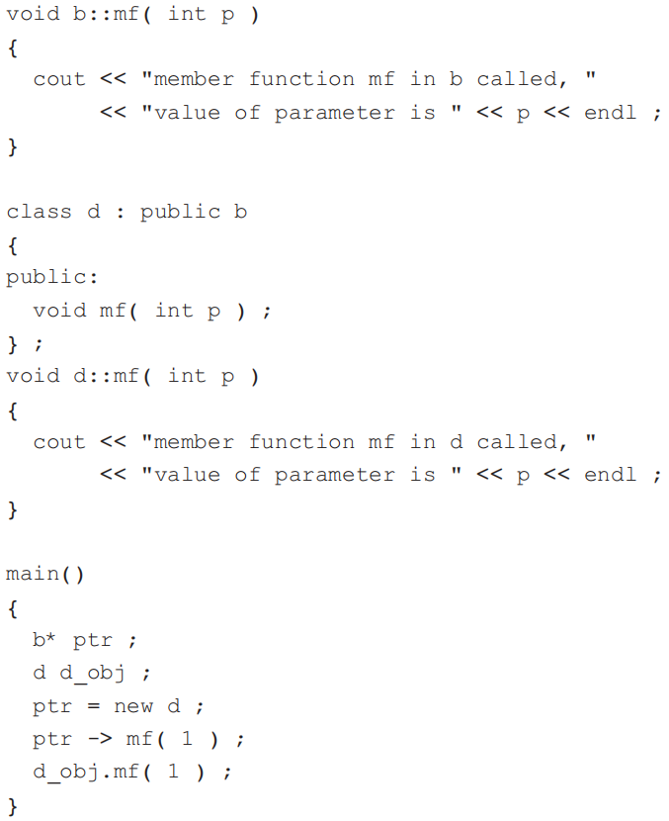
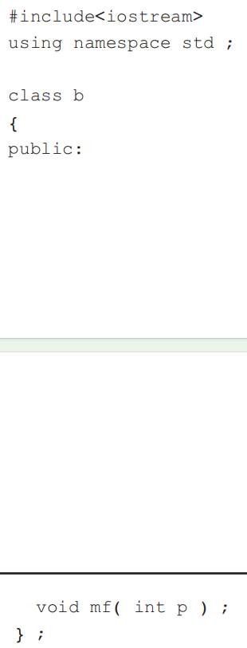
Homework
1. What is the output from (a) and (b)?
(a)

Slide 57
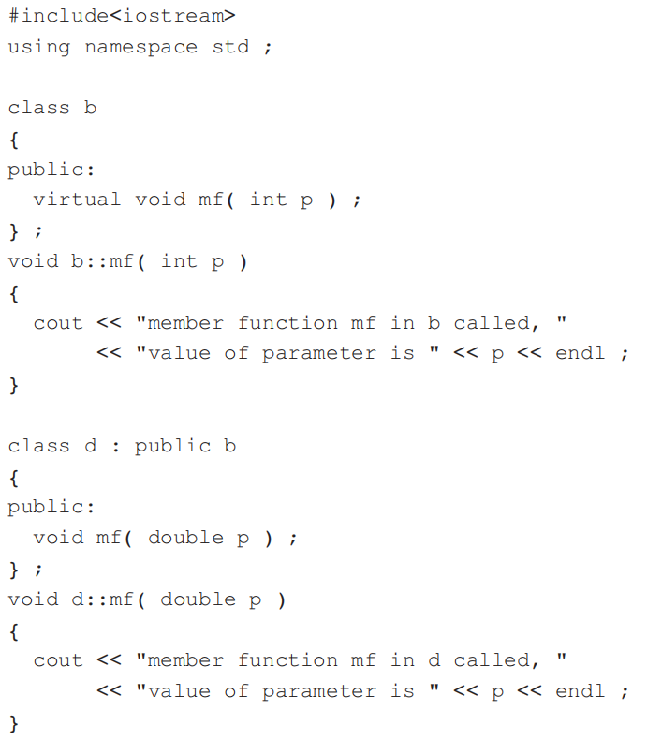
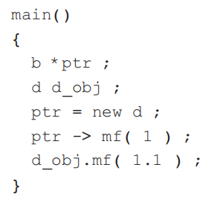
Homework
(b)

Slide 58
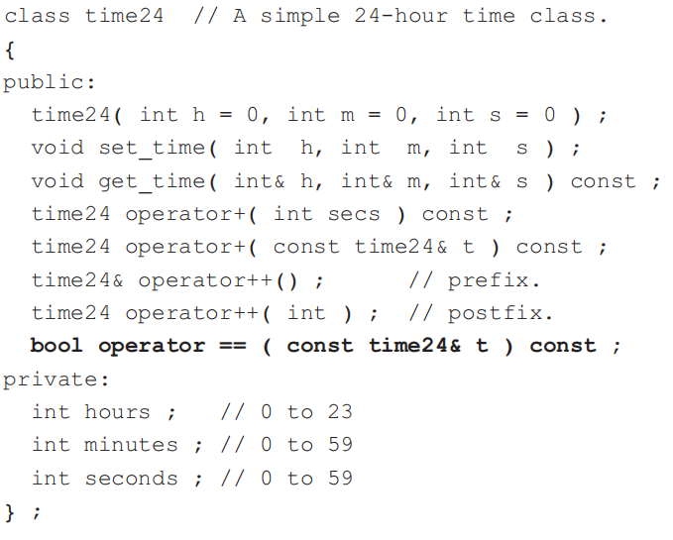
Homework
2. Modify the time24 class to include an overloaded relational operators for less than <, greater than > and not equal to !=. The corresponding overloaded function needs to be given.

Slide 59
Homework
3. Modify the time24 class to include an overloaded operator -=. The corresponding overloaded function needs to be given. The prototype for the new member function is:

Slide 60
Homework
4. Write a function template largest_element() that returns the largest value in an array. The array may contain elements of any one data type. The function has two parameters. The first parameter is the name of the array and the second parameter is the integer number of elements in the array. The return type of the function is the same type as its first parameter.

Slide 61
Homework
5. Write a function template locate() that finds and returns the first position of a value in an array. The array may contain elements of any one data type. The function has two parameters. The first parameter is the name of the array and the second parameter is a variable of the same type as the first parameter. If the value does not exist in the array, -1 is returned.

