Slide 1
Lecture 12: Files and Streams
Harbin Institute of Technology（Shenzhen）
School of Computer Science and Technology Zhang Meishan (mason.zms@gmail.com)
Copyright：Harbin Institute of Technology，Su Xiaohong， sxh@hit.edu.cn

Slide 2
Overview
Input/output class hierarchy
Basic I/O operations
Random access
Object and Binary I/O

Slide 3
12.1 Input/output class hierarchy
The input-output statements used so far were those that read data from the keyboard and displayed data on the screen.
A program stores the data from the keyboard in the computer’s memory.
When the program terminates, the data is lost and must be reentered every time the program is run.
File stream input and output
Files use external storage devices, such as hard disks and USB keys to store data.
These are permanent storage devices that allow data to be stored after the program terminates.

Slide 4
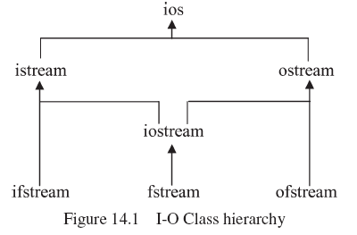
12.1 Input/output class hierarchy
C++ has no built-in input/output (I/O) commands. In C++ the I/O commands are included in a class library.
The base class ios contains data members to indicate conditions such as whether a stream object is opened for input or output and whether the end of the file has been reached.

Slide 5
12.1 Input/output class hierarchy
The derived class istream extends the base class by adding member functions to input data from a stream.
This class provides basic input processing by including overloaded operators >> for reading the built-in data types (char, int, float etc.) from a stream.
The derived class ostream contains member functions to output data to a stream.
This class provides basic output processing by including overloaded insertion operators (<<) for writing built-in data types to a stream.
The stream cout is an object of this class and is normally attached to the screen.

Slide 6
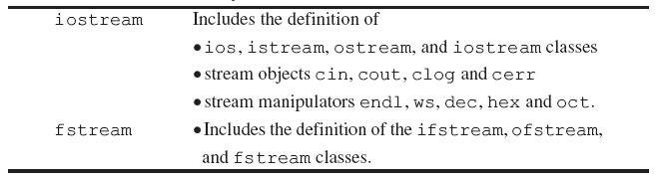
12.1 Input/output class hierarchy
The class ifstream is derived from istream and is used to create input file objects.
The class ofstream is derived from ostream and is used to create output file objects.
The class fstream is used to create file objects that can be used for both input and output.
The definition of the library classes is contained in the header files iostream and fstream

Slide 7


12.2 Basic I/O operations
Opening a file
first create an instance of the appropriate class
After creating an instance of the appropriate class, the file object must be opened to associate it with a file stored on a hard disk or some other storage device.
Creating an instance of a file object and opening a file can be combined into one statement by using the ifstream and ofstream class constructors.

Slide 8
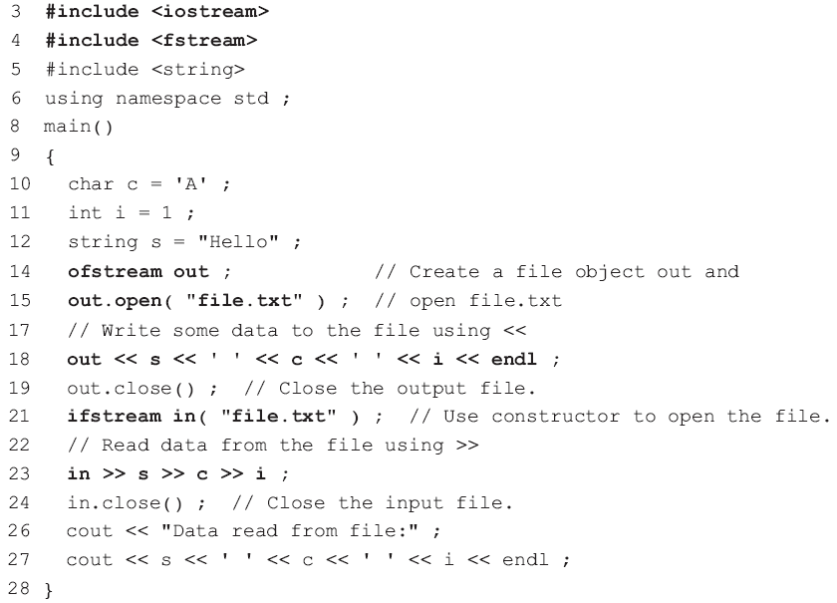
12.2 Basic I/O operations
Line 14 creates an instance out of an output file object.
Line 15 associates out with the external file file.txt and opens the file for processing. If the file does not exist, by default it will be created in the same folder (directory) as the program.
Line 18 outputs some data to the file stream using << in the same way that data would be sent to the stream cout.
The ifstream constructor is used on line 21 to open file.txt for input processing.
Line 23 is similar to the way data is input from the keyboard, except in instead of cin.

Slide 9
12.2 Basic I/O operations
File error checking: possible errors
No space being available on an output device
Attempting to open a non-existent file for reading.
The ios class contains member functions that can be used to check for errors.
Since ifstream and ofstream are inherited from ios, these functions are available for use with ifstream and ofstream objects.
It is good practice to check for errors when opening a file!

Slide 10
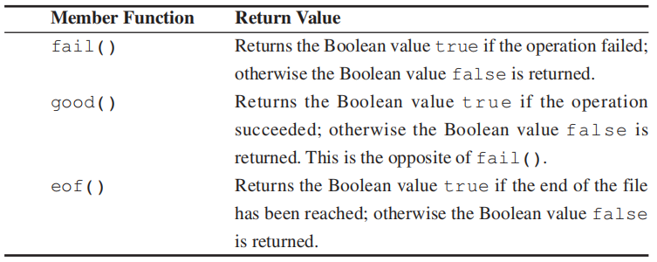
12.2 Basic I/O operations
The member function fail() to check for errors when opening a file.
A return value of zero indicates success, while a non-zero return value indicates an error.

Slide 11
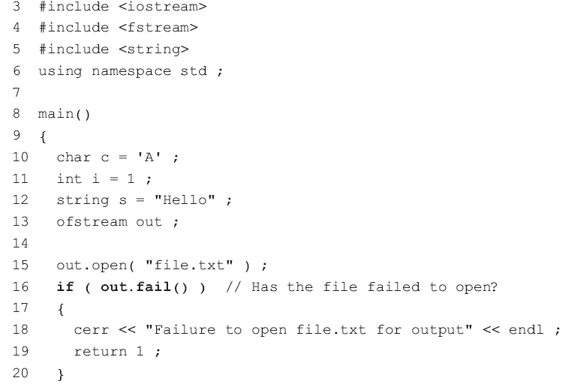
12.2 Basic I/O operations
The additional program statements can be tested by adding a non-existent storage device identifier to the file path, e.g. instead of "file.txt” specify "xx:/file.txt" on lines 15 and 25.

Slide 12
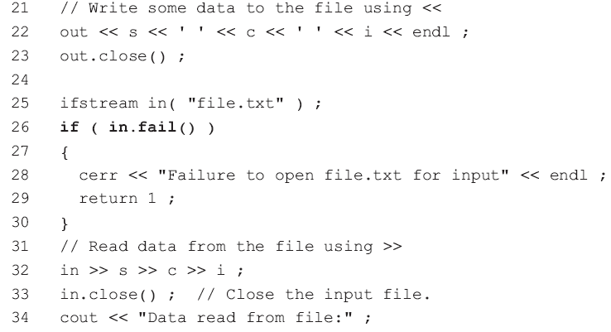

12.2 Basic I/O operations

Slide 13
12.2 Basic I/O operations
When reading data from an input file, it is necessary to be able to detect the end of the file so that processing of the file may stop.
The end of a file may be detected using the ios member function eof() inherited by the ifstream class.
The following program example
demonstrates the use of eof() in making a copy of a text file.
The istream member function get() is used to read a character from the input file
The ofstream member function put() is used to write the character to an output file.

Slide 14
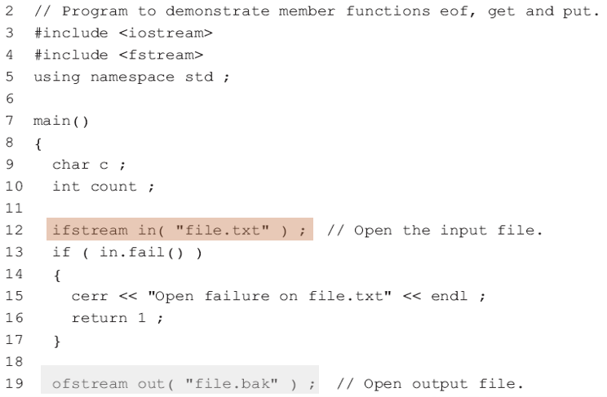
12.2 Basic I/O operations

Slide 15

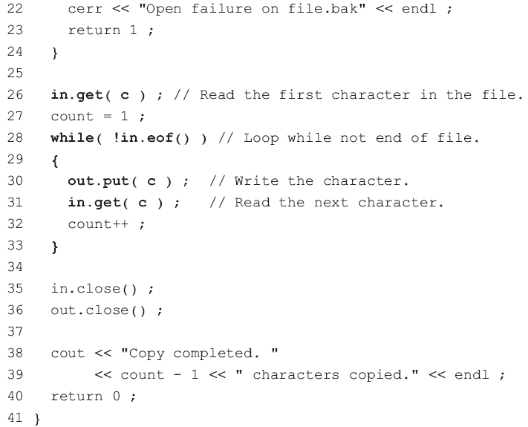

12.2 Basic I/O operations
Line 26 reads the first character of the input file.
Lines 28 to 33 continues to write a character to the output file and read the next character from the input file until the end of the input file is detected.
The program can be improved by using an easier while statement than that used on line 28:

Slide 16
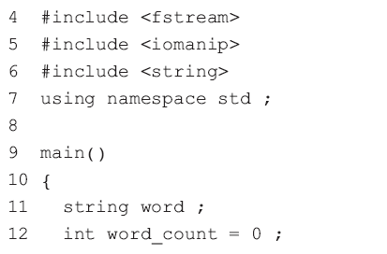
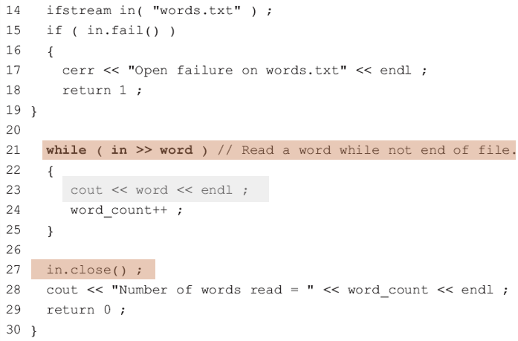
12.2 Basic I/O operations
Detecting the end of file can be applied to any member function that returns a reference to a stream using the stream extraction operator >>
The program assumes that each “word” is delimited by one or more whitespace characters. Whitespace characters are ignored by >>.
The while loop from line 21 to line 25 continues to display each “word” in the file until the end of the file is detected.
When the end of the file occurs, the while loop terminates, the file is closed.

Slide 17
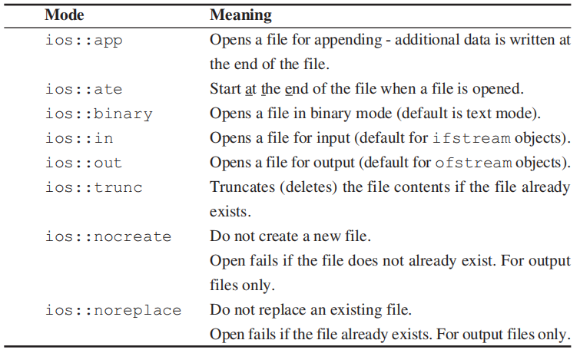
12.2 Basic I/O operations
To append data to the end of a file, the file mode must be specified when opening the file.
The file mode values are specified in the ios class.

Slide 18
12.2 Basic I/O operations
These values may be combined using the bitwise operator OR (|).
open a file for input and output
the default open mode:
for ifstream objects is ios:: in
for ofstream objects is ios::out

Slide 19
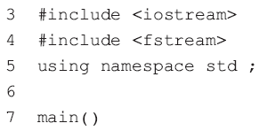
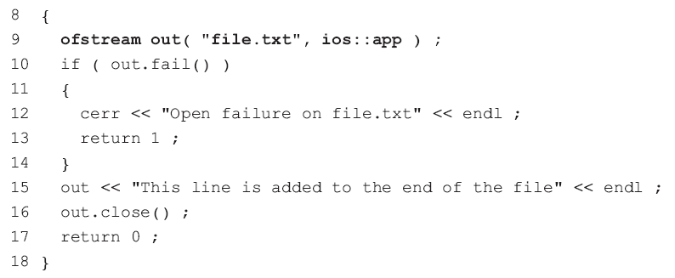
12.2 Basic I/O operations
Program Example : demonstrates appending the line “This line is added to the end of the file” to the file file.txt.

Slide 20
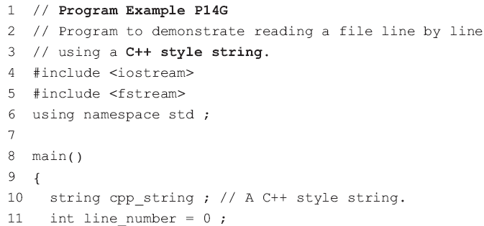
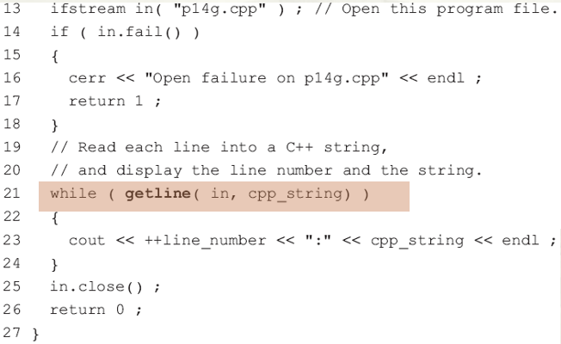
12.2 Basic I/O operations
getline()
An entire line can be read from a file into either a C-string or a C++string using the function getline().

Slide 21
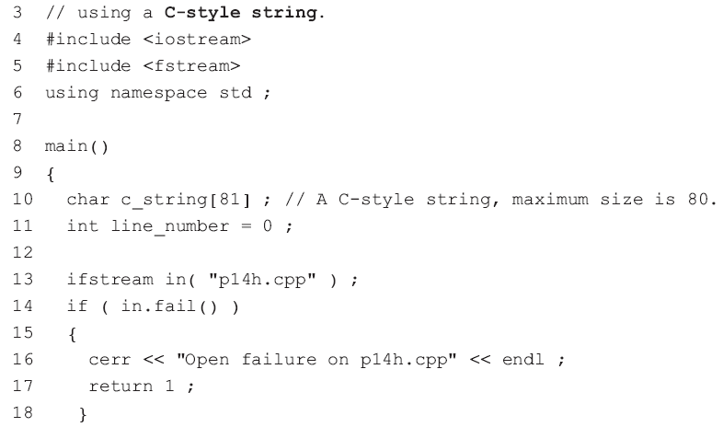
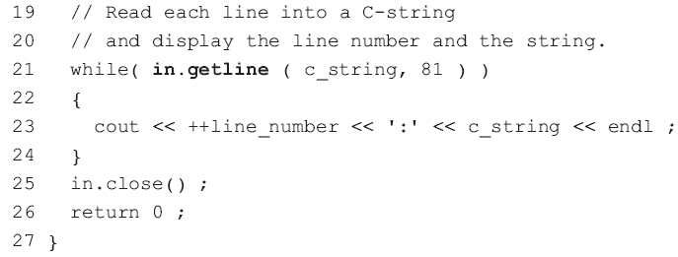
12.2 Basic I/O operations
Program Example: uses a C string for the same purpose

Slide 22
12.3 Random access
serial file processing
With serial file processing, data items are read or written one after the other.
random or direct access
you can move around in a file, reading and writing at any position in the file.
The position in a file is held in the file position marker (FPM).

Slide 23
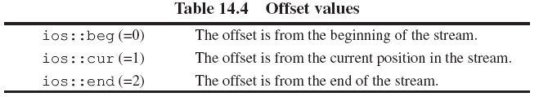
12.3 Random access
seekg() (meaning ‘seek get’) is used to set the FPM for an input file, from where the next input data is read.
The istream member function
This function requires two arguments.
The first argument is an offset that tells the FPM how many bytes to skip.
The second argument specifies the point from where the offset is measured

Slide 24







12.3 Random access
Examples: Open a file containing the characters A to J with
or

Slide 25
12.3 Random access
seekp()
The equivalent function for setting the FPM for an output file is the seek put function
tellg()
Return the current value of the FPM for input streams
tellp()
Return the current value of the FPM for output streams

Slide 26
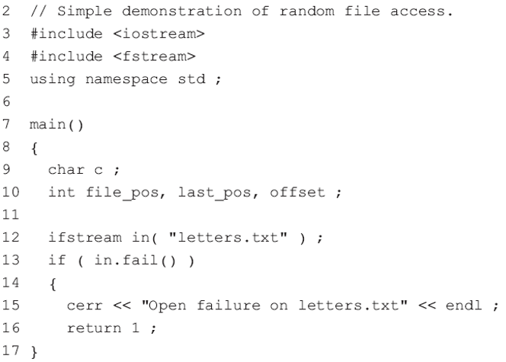
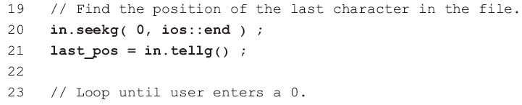
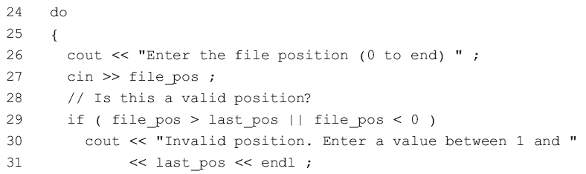
12.3 Random access

Slide 27
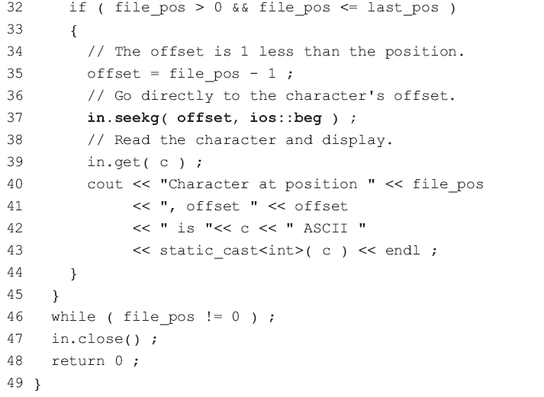
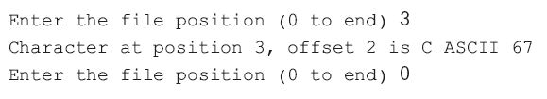
12.3 Random access
Note: the use of casting on line 43 to convert the value of c to its equivalent integer value.

Slide 28
12.4 Object and Binary I/O
Object I/O
We can exploit the >> and << operators, overloading them for keyboard input and screen output operations specific to the time24 class.
No modifications to the time24 class are needed to use disk files instead of the keyboard and screen.

Slide 29
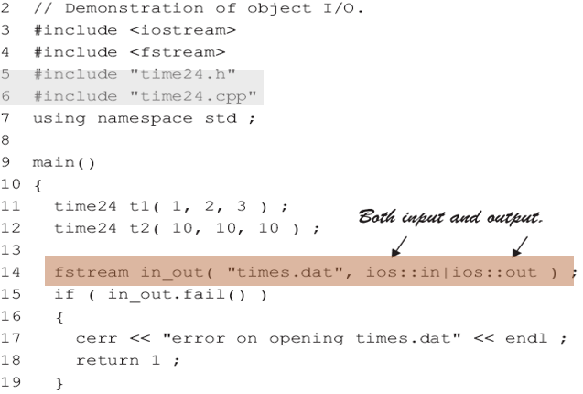
12.4 Object and Binary I/O
The file time24.h included on line 5 contains the time24 class declaration
Line 6 includes the file time24.cpp containing the time24 class member functions
Line 14 opens the file times.dat as an fstream object for input and output.

Slide 30
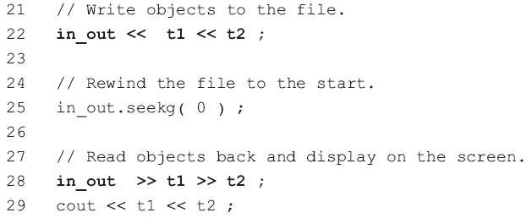
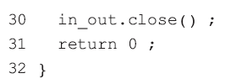
12.4 Object and Binary I/O
Line 22 writes the time24 objects t1 and t2 to the file.
Line 28 reads the objects back from the file and line 29 displays the objects.

Slide 31

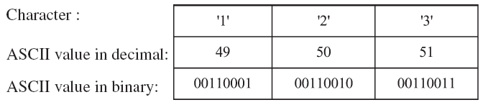
12.4 Object and Binary I/O
Types of files in C++
text (or ASCII) files
numeric data is stored as ASCII characters
binary files.
numeric data is stored in binary format
Example
the variable n occupies 2 bytes of memory.
storing the value of n in a text file requires 3 bytes of memory

Slide 32

12.4 Object and Binary I/O
ASCII file
Each digit of the number requires one byte of storage.
binary file
The digits of a number do not occupy individual storage locations. Instead the number is stored in its entirety as a binary number.
Example:
n=123
n=1234: the same storage
0000100
10010010
An ASCII file would require one more byte to store the extra digit.

Slide 33
12.4 Object and Binary I/O
write()
The two-argument istream member function
Be used to write an object in binary format.
The first argument is the address of the block of memory where the object is stored and the second argument is the size of the block in bytes.
The object must be stored in one contiguous block of memory
The object cannot have a pointer data member to dynamically allocated memory.
The class cannot have any string data members, since the string class uses a pointer data member.

Slide 34

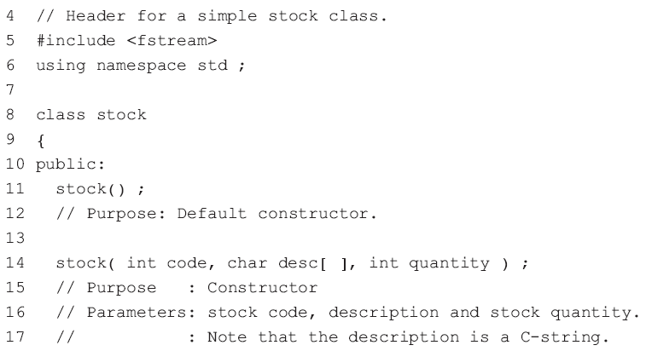
12.4 Object and Binary I/O
The file stock.h

Slide 35
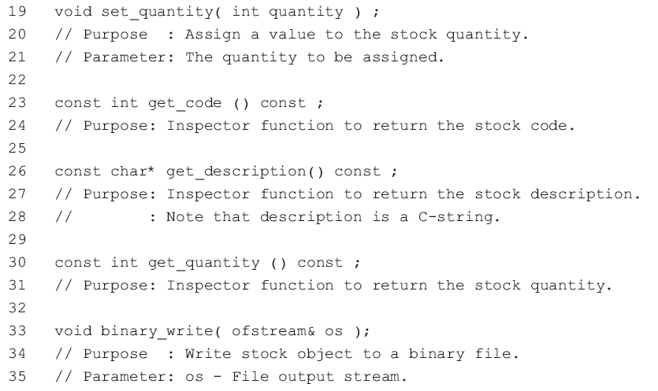
12.4 Object and Binary I/O
The file stock.h

Slide 36
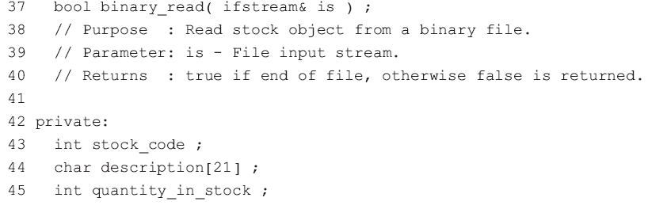
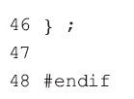
12.4 Object and Binary I/O
The file stock.h

Slide 37
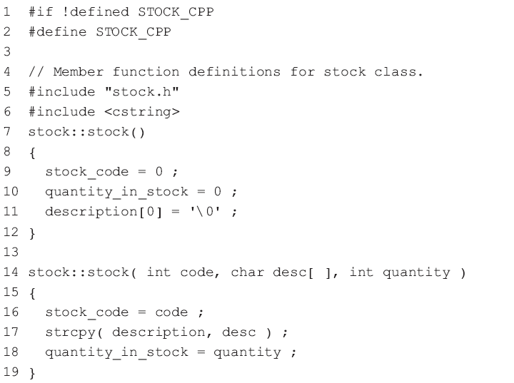
12.4 Object and Binary I/O
The file stock.cpp

Slide 38
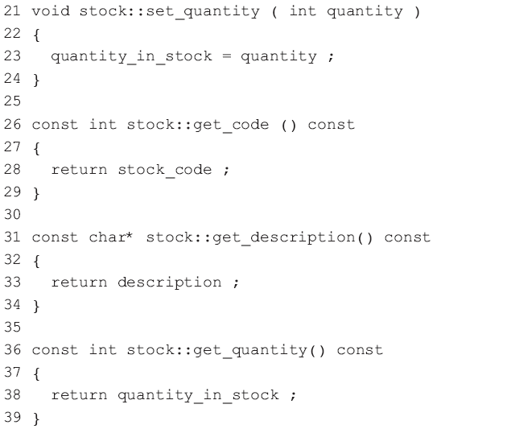
12.4 Object and Binary I/O
The file stock.cpp

Slide 39
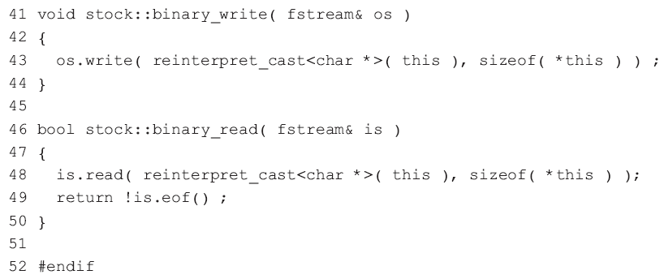
12.4 Object and Binary I/O
The file stock.cpp

Slide 40
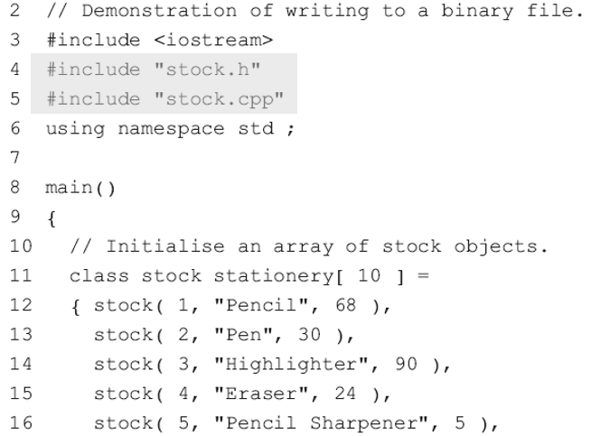
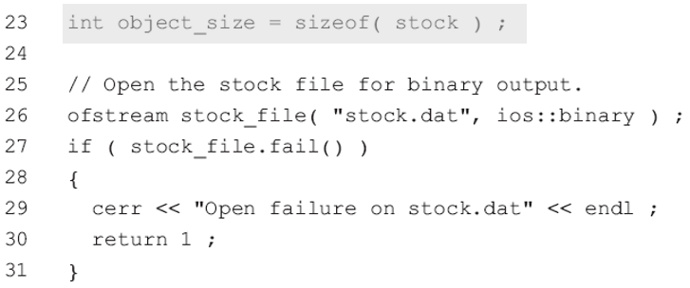
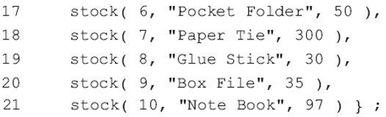
12.4 Object and Binary I/O
Line 23 calculates the second argument in write(), the number of bytes in the memory block

Slide 41
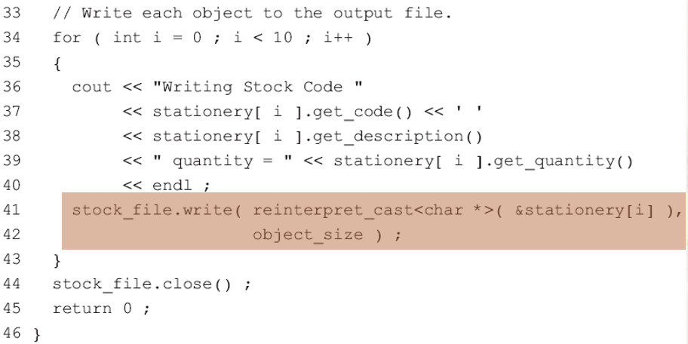
12.4 Object and Binary I/O
The write() function on line 41 treats the stock object as a block of memory bytes or characters, which it copies from the memory to a disk file without converting to ASCII.

Slide 42
12.4 Object and Binary I/O
The first argument in write() is a pointer to a character string.
The object is treated as a block of characters, so the address of the ith stock object, &stationery[i], is cast to a pointer to a character string by
The reinterpret_cast allows any pointer type to be converted to any other pointer type.
The second argument in write() is the number of bytes in the memory block

Slide 43
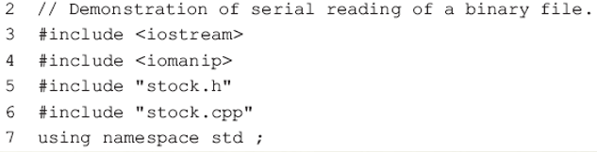
12.4 Object and Binary I/O
Serial reading of objects from a binary file read()
The istream member function
Be used to read an object’s data from a binary file into memory.
This function uses the same arguments as write()

Slide 44
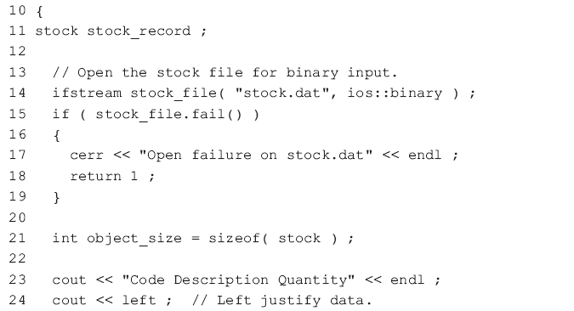
12.4 Object and Binary I/O

Slide 45
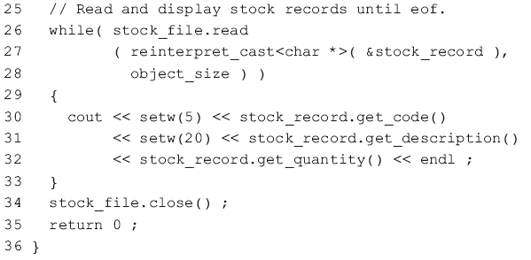
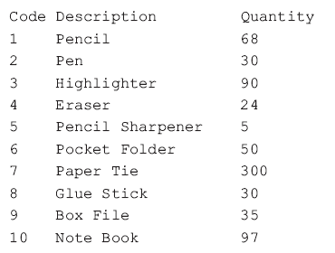
12.4 Object and Binary I/O

Slide 46
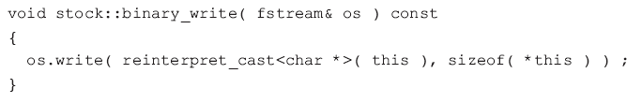
12.4 Object and Binary I/O
Binary I/O as class member functions
Binary I/O is made easier for the users of a class (the client programmers) if the details of the read and write functions are “hidden” in class member functions.
stock.cpp
The built-in pointer this is a pointer to the object that invoked the member function, i.e. stationery[i]
sizeof( *this ) is equivalent to
sizeof ( stationery[i] )

Slide 47
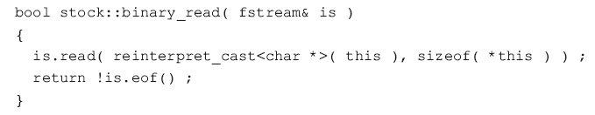

12.4 Object and Binary I/O
stock.cpp
In addition to reading an object from the input stream, binary_read() returns false if the end of the file has been reached, otherwise it returns true.

Slide 48
12.4 Object and Binary I/O
To make stock_file an fstream object as required by the function bool stock::binary_read().

Slide 49
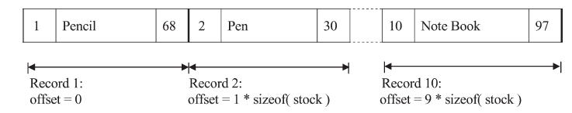
12.4 Object and Binary I/O
The layout of the file as created by previous program
Relative file
The stock code is related to the position of the record in the file,
stock code 1 is the first record,
stock code 2 is the second record ,
stock code 3 is the third record ,
……
The offset of a stock record in the file can be calculated by subtracting 1 from the stock code and multiplying the result by the size of the stock record.

Slide 50
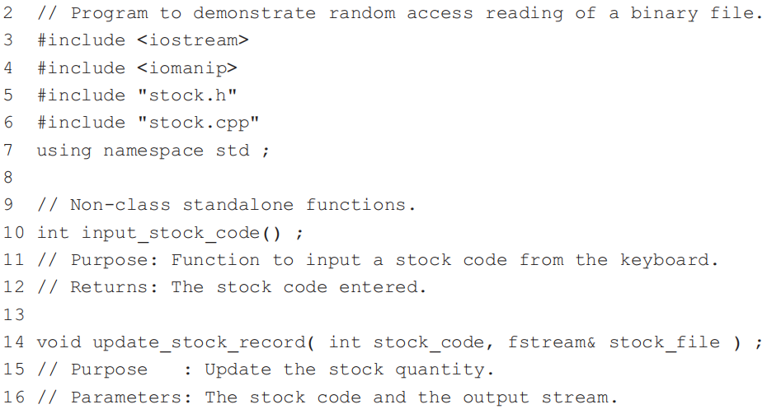
12.4 Object and Binary I/O

Slide 51
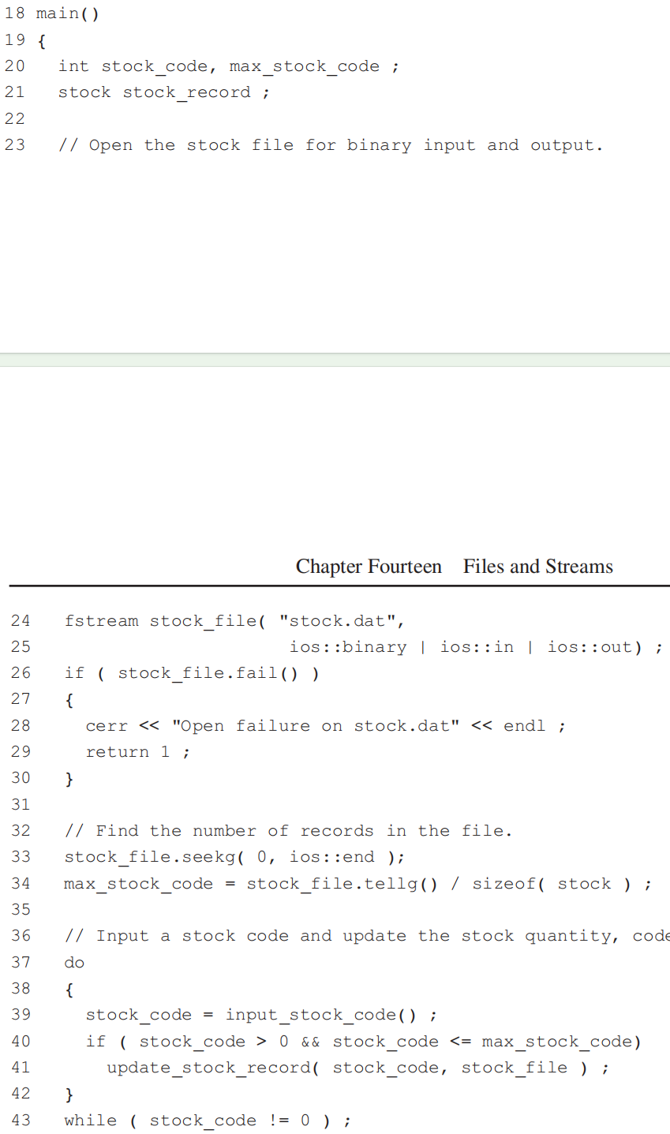
12.4 Object and Binary I/O

Slide 52
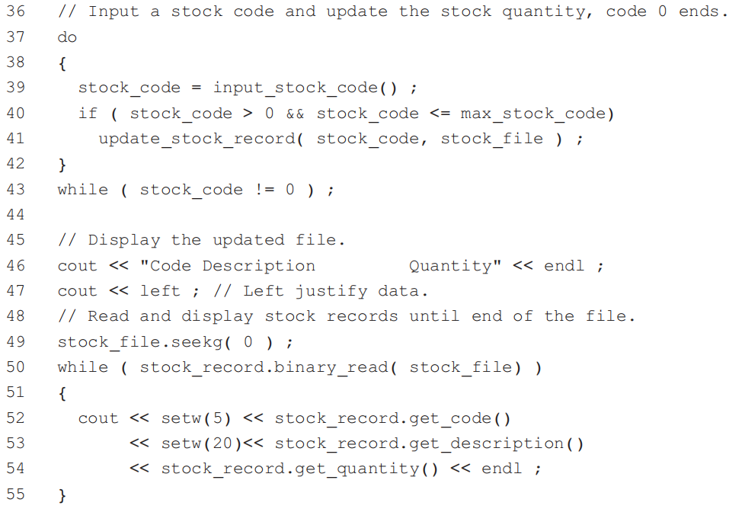
12.4 Object and Binary I/O
After the updating of the file is complete, the entire file is displayed. This is done by first moving back to the start of the file on line 49, and then displaying each stock record.

Slide 53
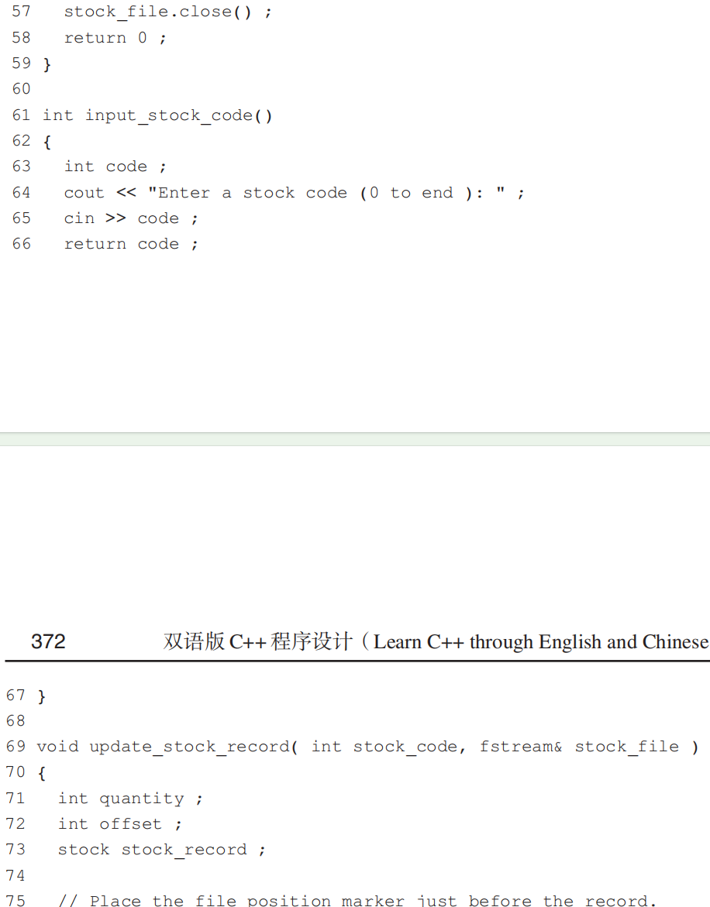
12.4 Object and Binary I/O

Slide 54
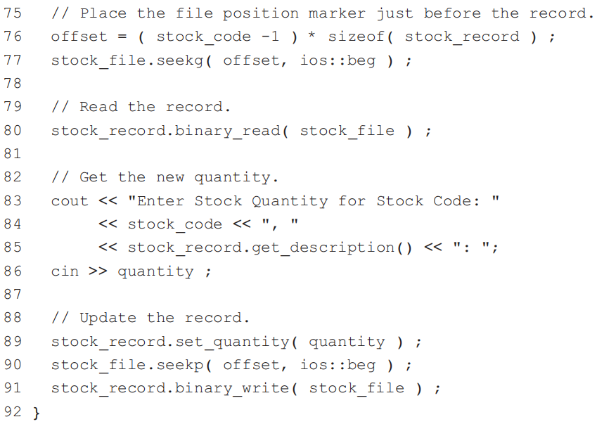
12.4 Object and Binary I/O
The stock record corresponding to the entered stock code is retrieved by calculating the offset of the record in the file, moving the file position marker to the start of the record, and reading the record.

Slide 55

Thank you for
your attention !
Q&A
ZhangMeiShan

Slide 56

Homework
1. Write C++ statements to open the following files:
2. Which mode would you use for the following?
(a) updating existing data in a file
(b) appending new data to the end of a file
(c) deleting the contents of an existing file before writing new data to it.

Slide 57
Homework
3. Write a program to count the number of characters and the number of words in a text file.
4. Write a program to remove blank and zero length lines from a text file. An input file and an output file are required.
5. Write a program to compare two text files and display any differences between the files.

Slide 58

Homework
6. What does the file alpha.txt contain after this program is run?

Slide 59
Homework
7. A shift cypher is a simple method for encrypting text. The cypher works by replacing each letter in the text with the letter that occurs a certain distance from it in the alphabet. Non-alphabetic characters are not encrypted. For example, ABcD is encrypted to BCdE when the distance is 1; xYZ1 is encrypted to zAB1 when the distance is 2. Write a program to encrypt a text file with a distance specified by the user. An input file and an output file are required.

Slide 60
Homework
8. Write a program to merge two text files containing surnames into a single text file. Each line of the files contains a surname, followed by a space and a first name. Assume the files are sorted in ascending order of surnames.

