Slide 1
Lecture 2: Basic Syntax
Harbin Institute of Technology（Shenzhen）
School of Computer Science and Technology Zhang Meishan (mason.zms@gmail.com)
Copyright：Harbin Institute of Technology，Su Xiaohong， sxh@hit.edu.cn

Slide 2
Overview
Variable
Constants
Memory and size
Basic statements

Slide 3
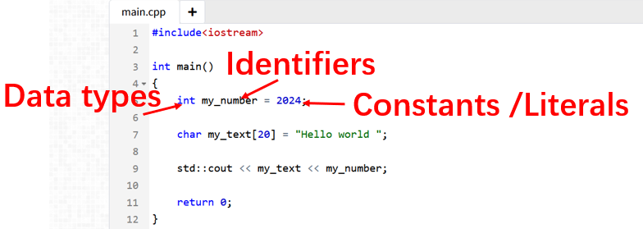
An Opening Example
Basic Syntax: Data, Statements, Operators, Include, Names, ……

Slide 4
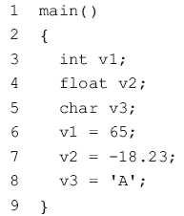
2.1 Variables
Data in C++： Variables ； Constants
Variables：can vary its values in a program
main( ) marks the point where a C++ program starts to execute and must appear once
defines the name and type of variables
assign value to variables
The program statements are contained within the braces { and }
Each statement ends with ’ ;’

Slide 5

2.1 Variables
A variable must be defined before it can be used. A variable is defined by giving it a data type and a name
A variable can be given any name, called an identifier in C++, provided it is within the following rules
An identifier can only be constructed using letters, numerals or underscores (_).
An identifier must start with a letter or an underscore.
An identifier cannot be a C++ keyword. A keyword is a word that has a special meaning.
An identifier can contain any number of characters, but only the first thirty-one characters are significant to the C++ compiler.
A variable is like a box in the memory of the computer.

Slide 6
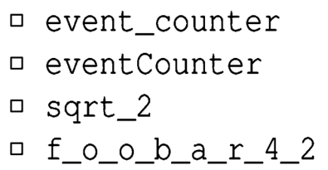


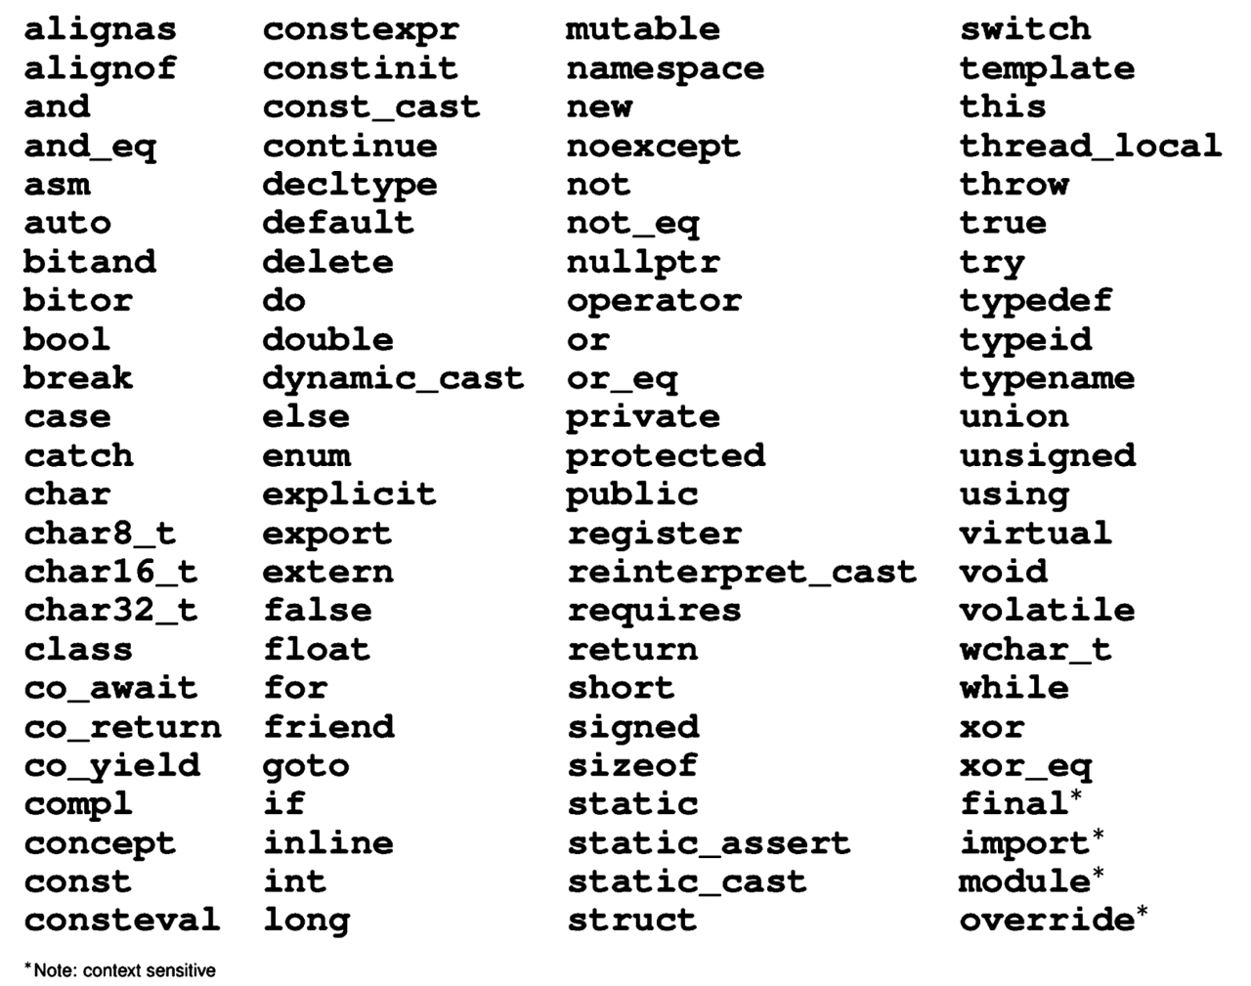
2.1 Variables
Example of valid identifiers:
Identifiers are case sensitive：
Identifiers cannot be any of reserved keywords：

Slide 7
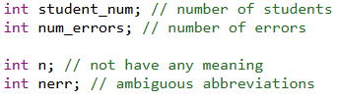

2.1 Variables
Identifiers are better to be with good naming convention.
Function naming, variable naming, and file naming should be descriptive, with fewer abbreviations. Use descriptive naming wherever possible to make code easy to understand.
Camel case： The first letter of the variable name is lowercase, and the first letter of each subsequent word is capitalized without underscores.

Slide 8


2.1 Variables
Identifiers are better to be with good naming convention.
Underscore case：Words are separated by underscores. Variable names are usually in all lowercase.
Use easily understandable abbreviations: If abbreviations are necessary to simplify variable names, ensure that the abbreviations are common, easily understandable, and comment in the code to explain their meanings.

Slide 9
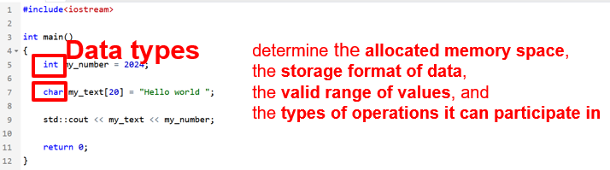

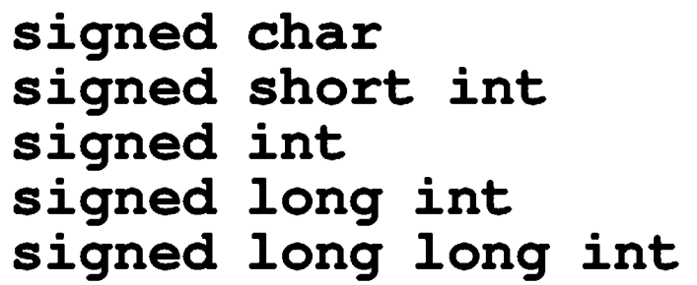
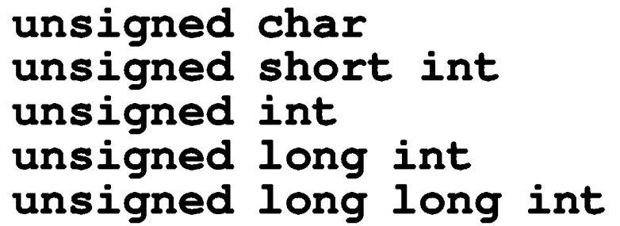
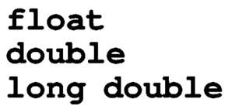

2.1 Variables
Data types
Boolean type
Integer type (signed and unsigned)
Floating-point types
Character types

Slide 10
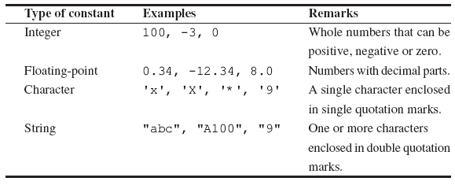
2.2 Constants
Constants：does not change its value in a program.
int
float
char
string

Slide 11
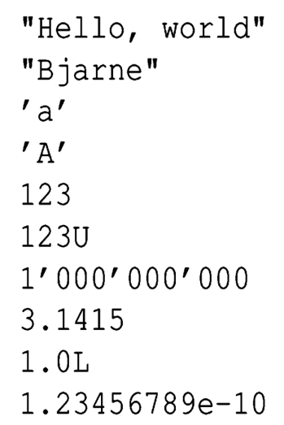
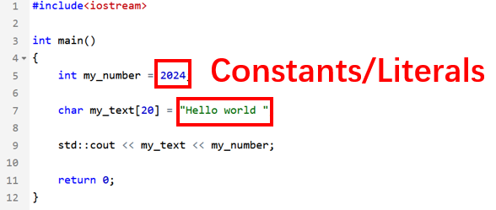

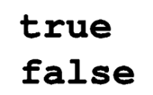

2.2 Constants
Boolean literals:
Pointer literal:

Slide 12
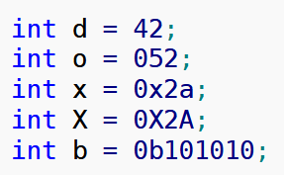
Integer literal types
2.2 Constants
Prefixes which indicates the base. For example, 0x10 indicates the value 16 in hexadecimal having prefix 0x.
Decimal-literal (base 10):- a non-zero decimal digit followed by zero or more decimal digits(0, 1, 2, 3, 4, 5, 6, 7, 8, 9). For example, 56, 78.
Octal-literal (base 8):- a zero followed by zero or more octal digits(0, 1, 2, 3, 4, 5, 6, 7). For example, 045, 076, 06210.
Hex-literal (base 16):- 0x or 0X followed by one or more hexadecimal digits(0, 1, 2, 3, 4, 5, 6, 7, 8, 9, a, A, b, B, c, C, d, D, e, E, f, F). For example, 0x23A, 0Xb4C, 0xFEA.
Binary-literal (base 2):- 0b or 0B followed by one or more binary digits(0, 1). For example, 0b101, 0B111.
Question: what are the values stored inside the following variables?

Slide 13
2.2 Constants
Integer literal types
Suffixes which indicates the data type.
For example, 12345678901234LL indicates the value 12345678901234 as an long long integer having suffix LL.
int:- No suffix are required because integer constant are by default assigned as int data type.
unsigned int: character u or U at the end of integer constant.
long int: character l or L at the end of integer constant.
unsigned long int: character ul or UL at the end of integer constant.
long long int: character ll or LL at the end of integer constant.
unsigned long long int: character ull or ULL at the end of integer constant.

Slide 14
2.2 Constants
Integer literal types
Suffixes which indicates the data type.
For example, 12345678901234LL indicates the value 12345678901234 as an long long integer having suffix LL.
int:- No suffix are required because integer constant are by default assigned as int data type.
unsigned int: character u or U at the end of integer constant.
long int: character l or L at the end of integer constant.
unsigned long int: character ul or UL at the end of integer constant.
long long int: character ll or LL at the end of integer constant.
unsigned long long int: character ull or ULL at the end of integer constant.

Slide 15
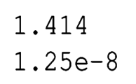
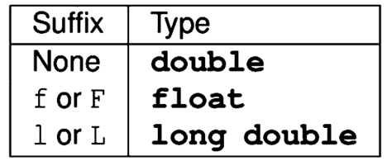
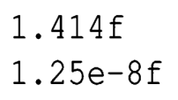
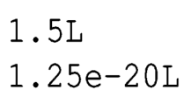
Floating-point literal types
2.2 Constants
1.25 × 10⁻⁸
s × r ^{j}
Significand s
Exponent j
Radix (base) r
1.25 × 10⁻⁸
1.25 × 10⁻²⁰

Slide 16
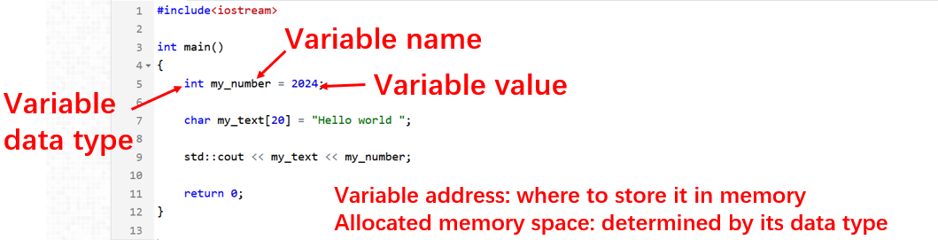
Review: variable properties
2.3 Memory and Size

Slide 17
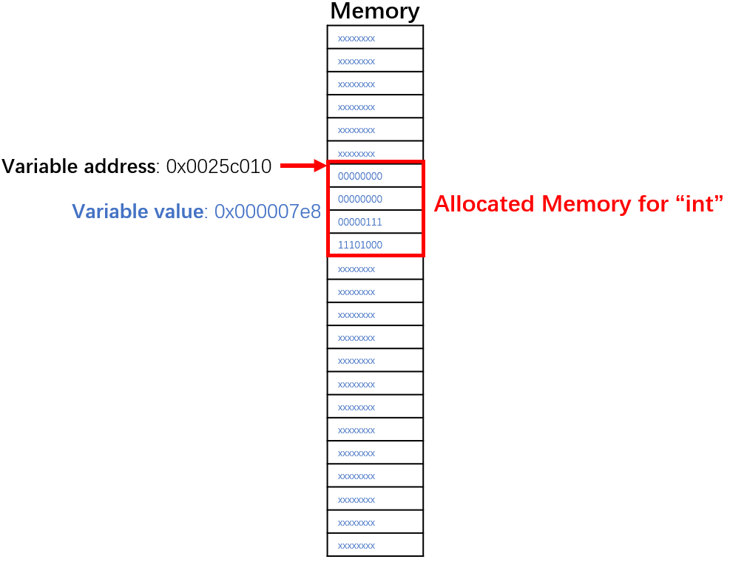
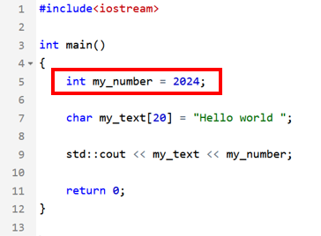
2.3 Memory and Size
Variable memory
First address and size

Slide 18
2.3 Memory and Size
Boolean type
Integer type
(signed and unsigned)
Floating-point types
Character types
(Note that char is distinct type from signed char and unsigned char)
1 Bytes
Typical size (differs by systems)
1 Bytes
2 Bytes
4 Bytes
8 Bytes
8 Bytes
4 Bytes
8 Bytes
16 Bytes
1 Bytes

Slide 19
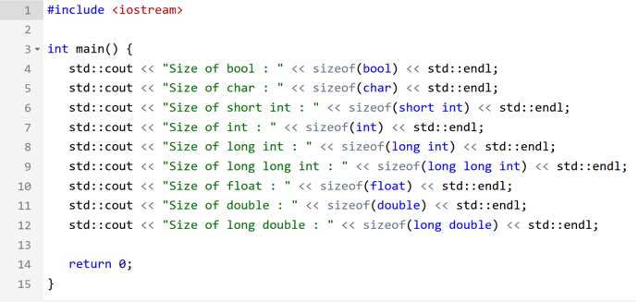
2.3 Memory and Size
sizeof operator determines the size, in bytes, of a variable or data type;
Can be used to get the size of classes, structures, unions and any other user defined data type.

Slide 20
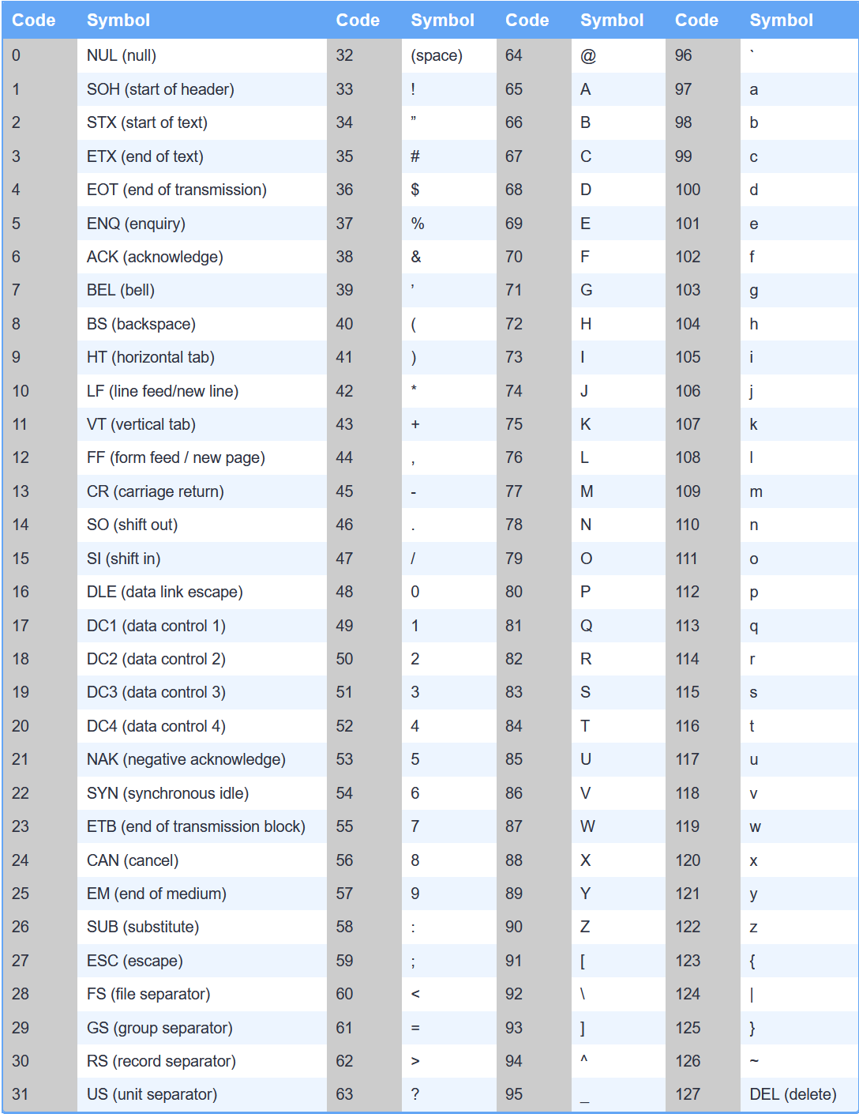
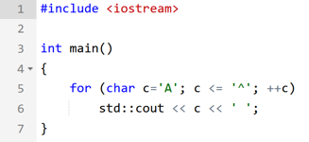
2.3 Memory and Size
Character encoded in 1 Byte
ASCII stands for American Standard Code for Information Interchange, and it defines a particular way to represent English characters (plus a few other symbols) as numbers between 0 and 127

Slide 21
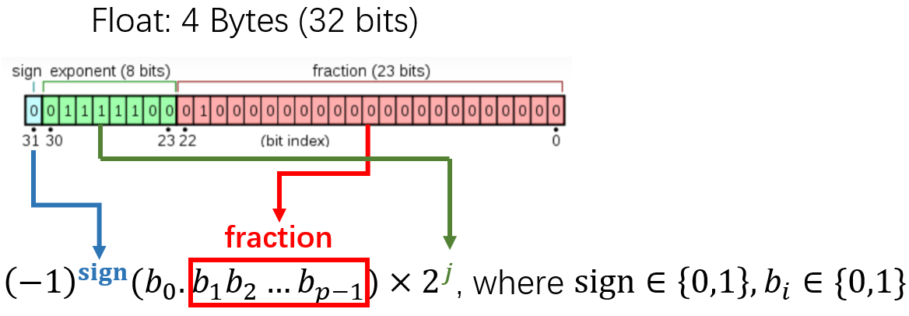
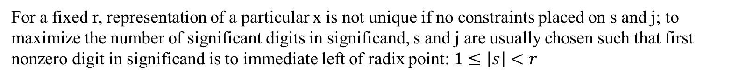
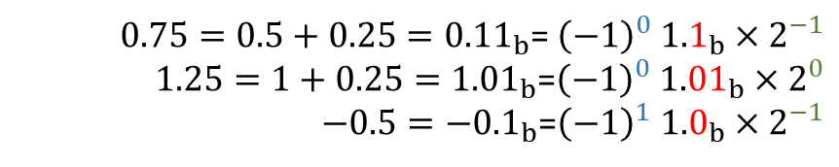
2.3 Memory and Size
Floating-point types
A floating-point number x = s × r ^{j}
Significand s with p significant bits
Exponent j
Radix r, and typically r = 2
$0.75=0.5+0.25={0.11}_{b}$= ${\left(−1\right)}^{0} {1.1}_{b}×2^{−1}$
$1.25=1+0.25={1.01}_{b}$=${\left(−1\right)}^{0} {1.01}_{b}×2^{0}$
$−0.5=−{0.1}_{b}$=${\left(−1\right)}^{1} {1.0}_{b}×2^{−1}$
For a fixed r, representation of a particular x is not unique if no constraints placed on s and j; to maximize the number of significant digits in significand, s and j are usually chosen such that first nonzero digit in significand is to immediate left of radix point: $1≤\left|s\right|<r$

Slide 22
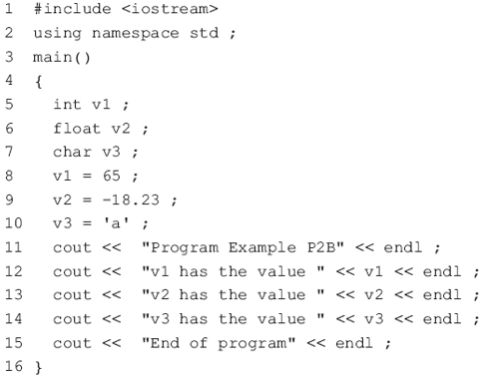
2.4 Basic Statements
Simple output to the screen
Never forget the semicolon!
#include <iostream.h>：
make iostream.h available to the program.
It contains some C++ statements to make it easy to perform input and output
using namespace std: available std available the program, otherwise std::cout, std::endl
cout： sends the data to cout
the stream insertion operator << is used to insert a string of characters into the output stream object cout
a string of characters: letters or numbers enclosed in “ ”
The variable name is not in quotation marks
endl： go the start of the next line on the screen

Slide 23
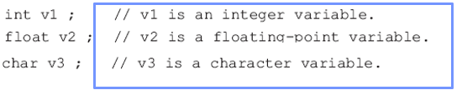
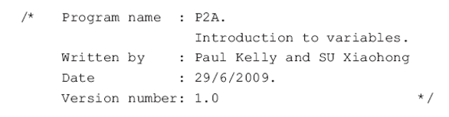
2.4 Basic Statements
Comments
Comments are added to a C++ program to make it more readable for the programmer
completely ignored by the compiler.
comments start with the characters // and end at the end of the line.
C-style comments begin with the characters /* and end with the characters */ is also used in C++
Get into the habit of using comments !
Bad comments can lead to confusion !

Slide 24

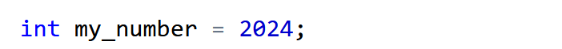

2.4 Basic Statements
Variable definition operations
Definition introduces identifier for variable
Each identifier must be declared before it can be used
Variables of the same type can be declared together

Slide 25
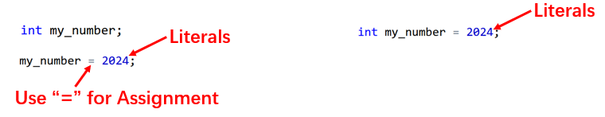
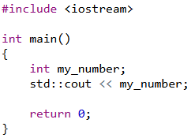
2.4 Basic Statements
Variable assignment operations
Initialize a variable
What is value stored inside a variable if it is declared but not initialized?
Using the values of uninitialized variables can lead to unexpected results
C/C++ does not automatically initialize most variables to a given value, the default value is whatever (garbage) value happens to already be in that memory address!

Slide 26
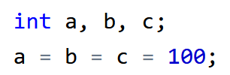

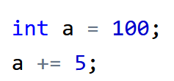
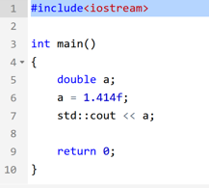
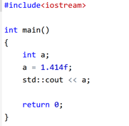
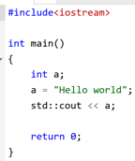
2.4 Basic Statements
Variable assignment operations
Multiple assignment
Compound assignment
(more details in next lecture)
Consistency of data types

Slide 27
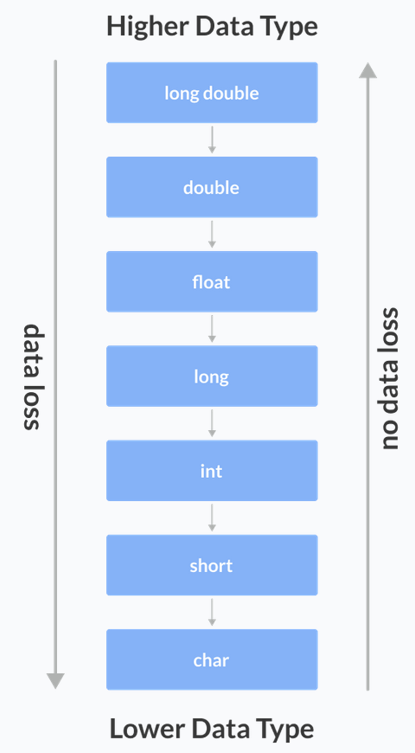
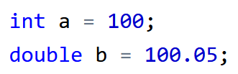



2.4 Basic Statements
Data type conversion
Automatic conversion
Explicit conversion
Conversion from int to double
Conversion from double to int Data Loss!
C-style Type Casting

Slide 28

Thank you for
your attention !
Q&A
ZhangMeiShan

Slide 29
Homework
1.Which of the following are valid C++ variable names? If valid, do you think the name is good mnemonic(i.e. reminds you of its purpose)?
(a) stock_code (b) money$ (c) Jan_Sales (d) X-RAY
(e) int (f) xyz (g) la (h) invoce_total
(i) John’s_exam_mark
2.Which of the following are valid variable definitions?
(a) integer account_code; (b) float balance; (c)decimal total;
(d) int age; (e) double int;

Slide 30
Homework
3.Write variable definitions for each of the following:
(a) integer variables number_of_transactions and age_in_years
(b) floating-point variables total_pay, tax_payment, distance and average
(c) long integer variables record_position and count
(d) a character variable account_type
(e) a double variable gross_pay

Slide 31
Homework
4. Write a C++ program to assign values to the variables in exercise 3 and display the value of each variable on a separate line.

