Slide 1
Lecture 3: Operators and Constants
Harbin Institute of Technology（Shenzhen）
School of Computer Science and Technology Zhang Meishan (mason.zms@gmail.com)
Copyright：Harbin Institute of Technology，Su Xiaohong， sxh@hit.edu.cn

Slide 2
Overview
Arithmetic operators
Assignment operators
Operator precedence
Constants

Slide 3

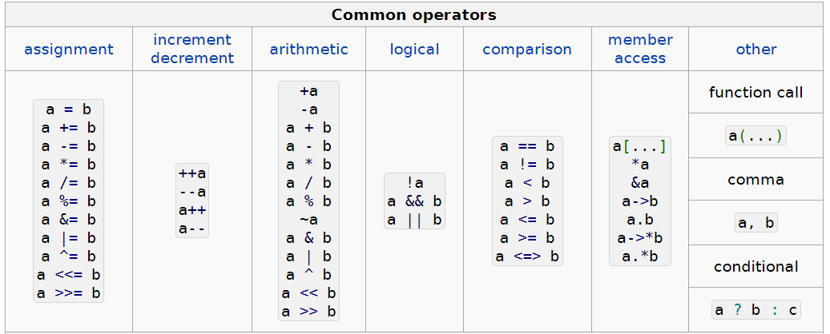
Background
Why? Need for computation (heavy work load)
Type of C++ Operators
Arithmetic operators
Assignment operators
Logical/relational operators
Member and pointer operators

Slide 4
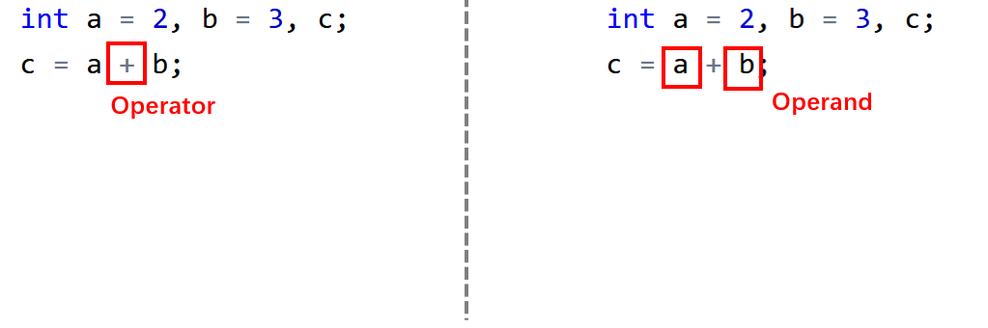
Background
Syntax: Operator and operand
Example: 2 + 3 = ?

Slide 5
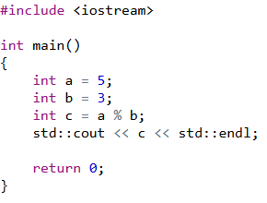
3.1 Arithmetic Operators
Popular arithmetic operators
Addition | + | Subtraction | -
Multiplication | * | Division | /
Modulus | %
Integer type: + - * / %
Floating-point type: + - * /
Character type: like integers (ASCII)

Slide 6
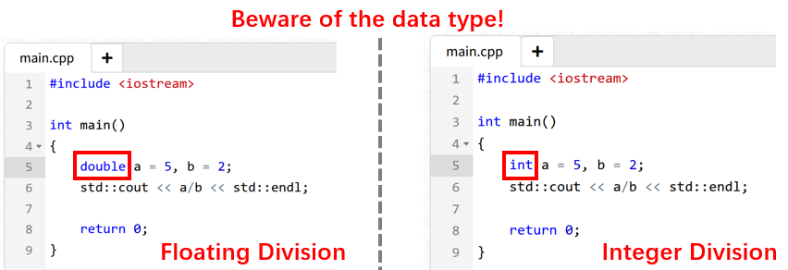
3.1 Arithmetic Operators
Division /
Example: 5 / 2 = ?

Slide 7
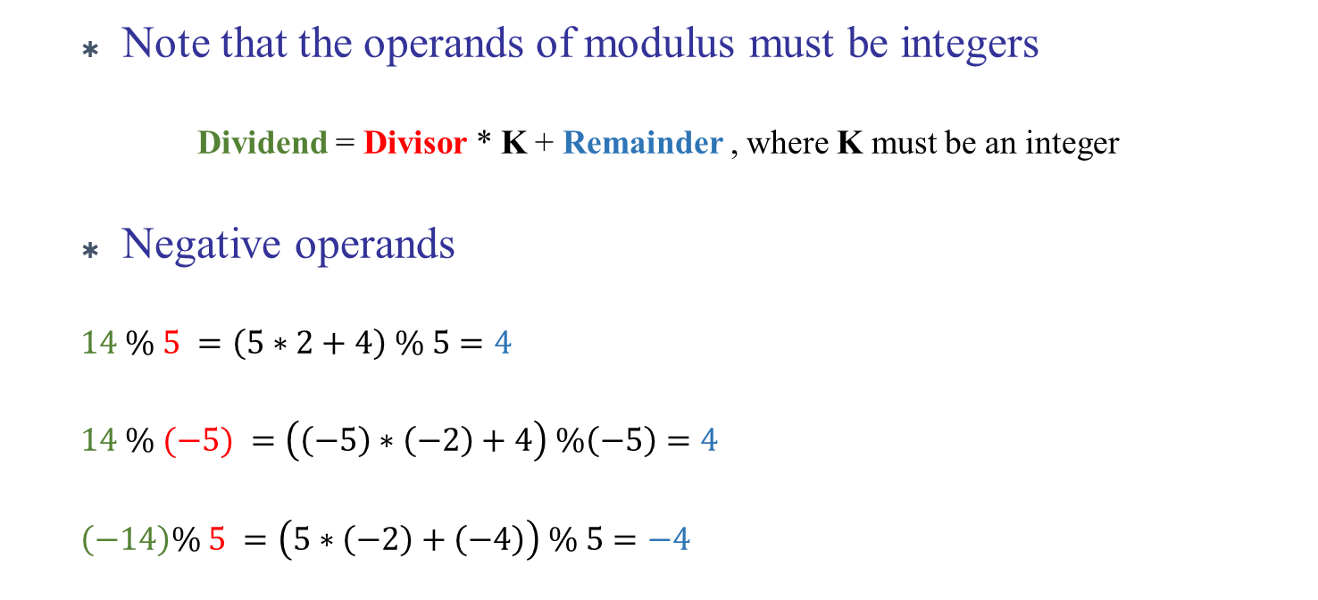
3.1 Arithmetic Operators
Modulus %
Note that the operands of modulus must be integers
Dividend = Divisor * K + Remainder , where K must be an integer
Negative operands
$14 \% 5 =\left(5∗2+4\right) \% 5=4$
$14 \% (−5) =\left(\left(−5\right)∗\left(−2\right)+4\right) \%\left(−5\right)=4$
$\left(−14\right)\% 5 =\left(5∗\left(−2\right)+\left(−4\right)\right) \% 5=−4$

Slide 8
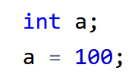
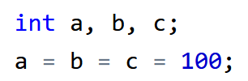

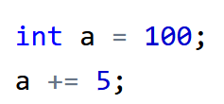
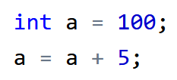
3.2 Assignment Operators
Simple assignment
Multiple assignment
Compound assignment
Associativity: right-to-left
Shorthand assignment operator

Slide 9
3.2 Assignment Operators
Compound assignment
Compound operator | Equivalent arithmetic operation
a += b | a = a + b
a -= b | a = a - b
a *= b | a = a * b
a /= b | a = a / b
a %= b | a = a % b
Note that no space is allowed between the two symbols of a compound operator (for example, no space between ‘+’ and ‘=’ )
Using compound operator to improve code readability and compile efficiency

Slide 10
3.2 Assignment Operators
Increment and Decrement
Increment a=a+1
a++ ++a
Decrement a=a-1
a-- --a
Post-increment/decrement
a++ a--
Pre-increment/decrement
++a --a
Value increased/decreased by 1 after
the other operations are done
Value increased/decreased by 1 before
executing the other operations

Slide 11


3.2 Assignment Operators
Increment and Decrement
Pre-increment
Post-increment
a = 4, b = 4
Value of a increased by 1 before assigning it to b
a = 4, b = 3
Value of a increased by 1 after assigning it (originally a = 3) to b
Avoid using more than one increment/decrement operations in the same line of code

Slide 12
3.3 Operator precedence
Arithmetic expression containing more than one operators
Computation order
Determined by the order of precedence
From left to right for operators with the same precedence
Example: 5 + 8 / 2 = ?

Slide 13
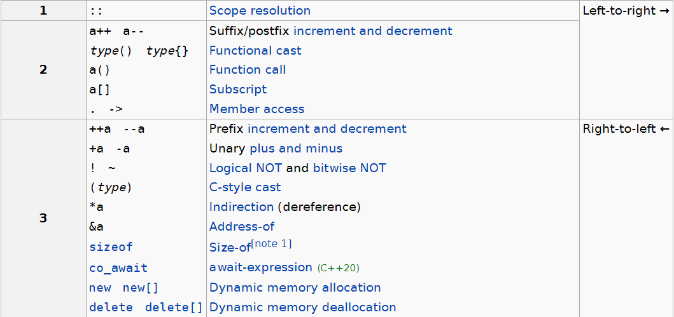
3.3 Operator precedence
Special operators

Slide 14
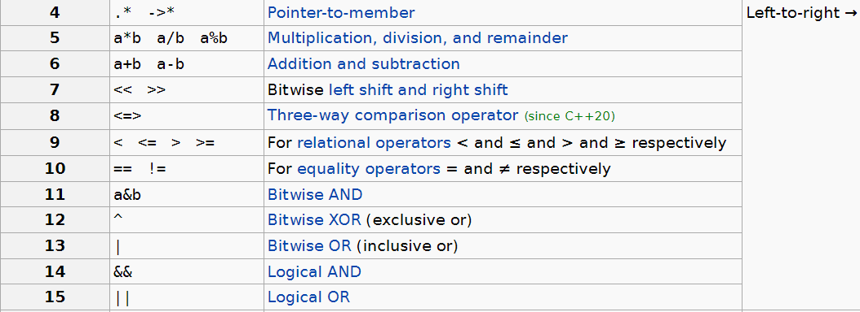
3.3 Operator precedence

Slide 15
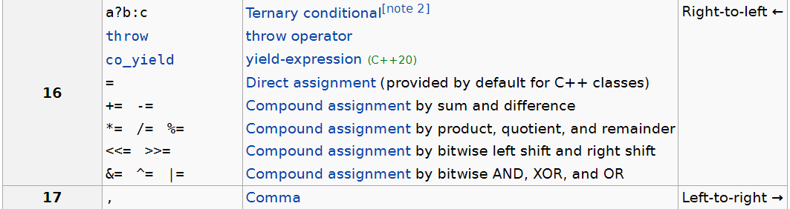
3.3 Operator precedence

Slide 16







3.3 Operator precedence
So: 5 + 8 / 2 = ?
Others:

Slide 17
3.3 Operator precedence
So: 5 + 8 / 2 = ?
Others:
12
1
3
10
0
12
24

Slide 18

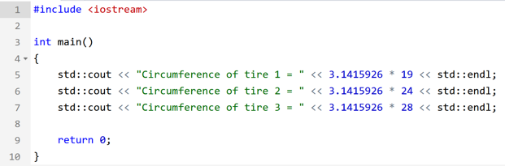


3.4 Constants
Consider the task: Writing a program that can calculate a tire circumference based on measured diameter
D3 = 28
D2 = 24
C = $π∗$ D
$π$ = 3.1415926
D1 = 19
Circumference C
Diameter D

Slide 19
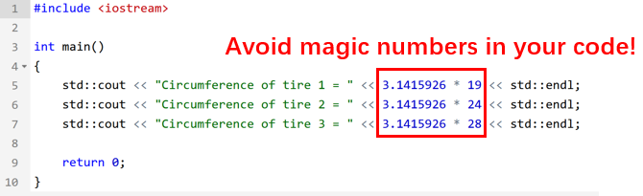
3.4 Constants
Should avoid creating magic numbers(unspecified numbers appearing in the code)
Code readability
Prone to mistakes, especially when the numbers need to be changed
How to avoid magic numbers?
Define constants: marco or const variable

Slide 20

3.4 Constants
Syntax
In C++, the preprocessor directives are special commands that are used to instruct the preprocessor. It begins with a ‘#’ symbol and tells the preprocessor to the modify source code before compilation.
When the preprocessor encounters the macro name in our code, it will be replaced by the specified value
Generally we capitalize the entire marco name
#define MACRO_NAME replacement_value

Slide 21
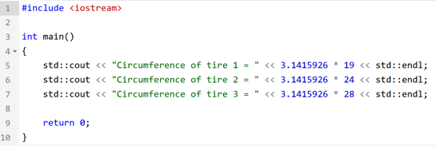
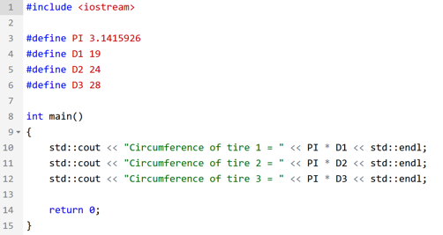
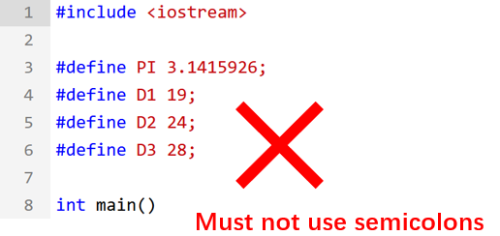
3.4 Constants
preprocessor replace macro with the specified value
Notice！

Slide 22
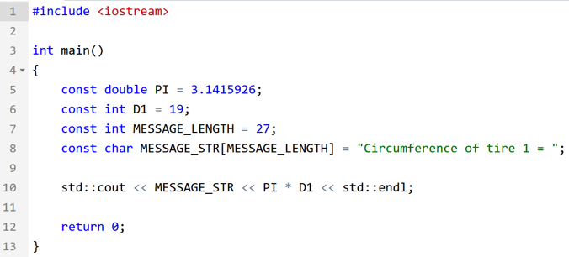
3.4 Constants
Const variable
Can use the const keyword instead of the #define preprocessor directive to define constant values.
The const keyword specifies that a variable's value is constant and tells the compiler to prevent the programmer from modifying it
Can define the data type of the constant
Values defined with const are subject to type checking
One can specify the size of an array with a const variable (or marco)

Slide 23

Thank you for
your attention !
Q&A
ZhangMeiShan

Slide 24
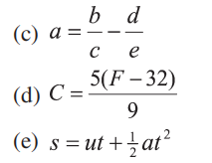



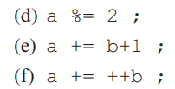
Homework
1. Convert the following mathematical equations into valid C++ statements :
2.Assuming the following, what is the value of a, b and c after each of the following statements?

Slide 25

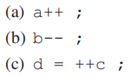
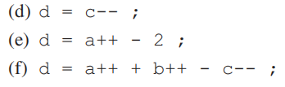
Homework
3.Assuming the following, what is the value of a, b, c and d after each of the following statements?

Slide 26
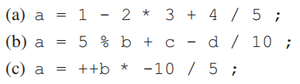
Homework
4. Place parentheses around the following expressions to indicate the order of evaluation :
5. Write a program to compute (a) the volume and (b) the surface area of a box with a height of 10 cm, a length of 11.5 cm, and a width of 2.5 cm.

