Slide 1
Lecture 4: Simple IO
Harbin Institute of Technology（Shenzhen）
School of Computer Science and Technology Zhang Meishan (mason.zms@gmail.com)
Copyright：Harbin Institute of Technology，Su Xiaohong， sxh@hit.edu.cn

Slide 2
Overview
Simple input and output
Manipulator operators
Single-character input and output
Different types of function output

Slide 3
4.1 Simple Keyboard Input & Output
Data Stream
Data stream objects are used to perform basic input and output of data to and from various devices such as the keyboard and the screen.
A stream is a data communication object connected to an input or output device.
cout: standard output stream associated with SCREEN
<<:The insertion operator is used to write data to cout.
cin :standard output stream associated with KEYBOARD
>>: The extraction operator is used to read data from keyboad.

Slide 4

4.1 Simple Keyboard Input & Output
The << operator inserts the data that follows it into the stream that precedes it.
In the examples above, it inserted the literal string Output sentence, the number 120, and the value of variable x into the standard output stream cout.
Notice that the sentence in the first statement is enclosed in double quotes (") because it is a string literal, while in the last one, x is not.

Slide 5
4.1 Simple Keyboard Input & Output
The double quoting is what makes the difference; when the text is enclosed between them, the text is printed literally;
When they are not, the text is interpreted as the identifier of a variable, and its value is printed instead.
For example, these two sentences have very different results:

Slide 6
4.1 Simple Keyboard Input & Output
Multiple insertion operations (<<) may be chained in a single statement:
This statement would print the text “This is a single C++” statement
Chaining insertions is especially useful to mix literals and variables in a single statement:
If age = 24 and the zipcode = 90064, the output would be:

Slide 7


4.1 Simple Keyboard Input & Output
What cout does not do automatically is add line breaks at the end, unless instructed to do so.
For example, take the following two statements inserting into cout:
The output would :
If newline mark is required, the statements should be:

Slide 8


4.1 Simple Keyboard Input & Output
Alternatively, the endl manipulator can also be used to break lines.
For example:
This would print:

Slide 9
4.1 Simple Keyboard Input & Output
In most program environments, the standard input by default is the keyboard, and the C++ stream object defined to access it is cin.
For formatted input operations, cin is used together with the extraction operator, which is written as >> (i.e., two "greater than" signs).
This operator is then followed by the variable where the extracted data is stored.

Slide 10

4.1 Simple Keyboard Input & Output
The first statement declares a variable of type int called age, and the second extracts from cin a value to be stored in it.
This operation makes the program wait for input from cin; generally, this means that the program will wait for the user to enter some sequence with the keyboard.
The keyboard are only transmitted to the program when the ENTER (or RETURN) key is pressed.

Slide 11
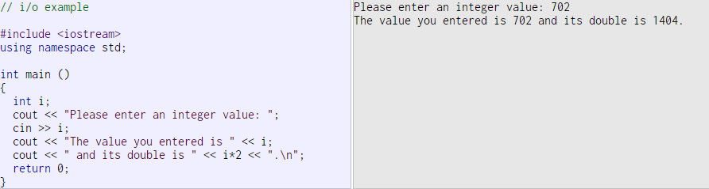
4.1 Simple Keyboard Input & Output
The extraction operation on cin uses the type of the variable after the >> operator to determine how it interprets the characters read from the input
If it is an integer, the format expected is a series of digits, if a string a sequence of characters, etc.

Slide 12

4.1 Simple Keyboard Input & Output
Extractions on cin can also be chained to request more than one datum in a single statement:
This is equivalent to:
In both cases, the user is expected to introduce two values, one for variable a, and another for variable b.

Slide 13

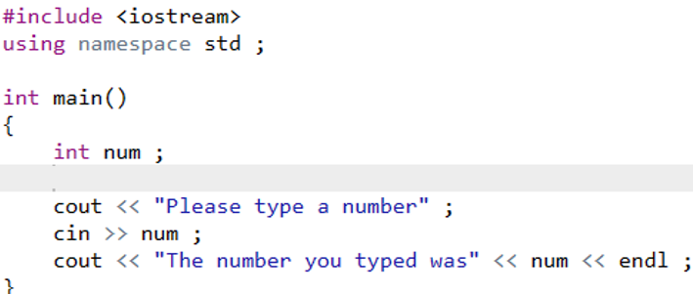



4.1 Simple Keyboard Input & Output
Example:
Read a number from the keyboard and store it in the variable num.

Slide 14
4.2 Manipulators
Manipulators are used to modify input and output data streams.
Typical manipulators: endl, setw, setfill, fixed, setprecision
endl：skip to the start of a new line on the screen
setw：set the width of a data field which is the number of columns that the data item occupies on the screen；
setfill：change the “padding” character from a space to any other character.
cout << endl << endl << “endl can be used anywhere” << endl;

Slide 15
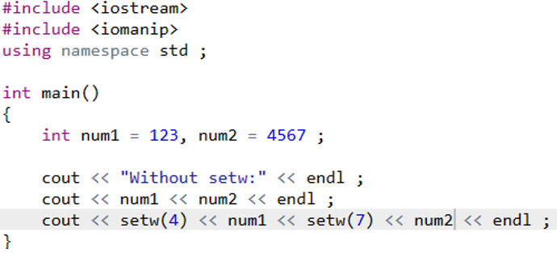
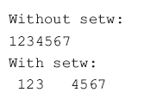
4.2 Manipulators: setw
Example: How to use manipulators
#include <iomanip>
It is required for any manipulator, like setw, that has a value in parentheses.
If the field width is set too small to display a value, the width is automatically expanded so that all the digits in the value are displayed

Slide 16
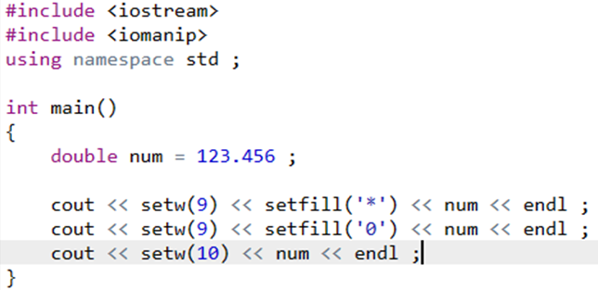

4.2 Manipulators : setfill
Example: How to use manipulators
Unlike setw ,which applies only to the next data item in the output stream, the setfill manipulator remains in effect for all subsequent the fill character remains 0.

Slide 17
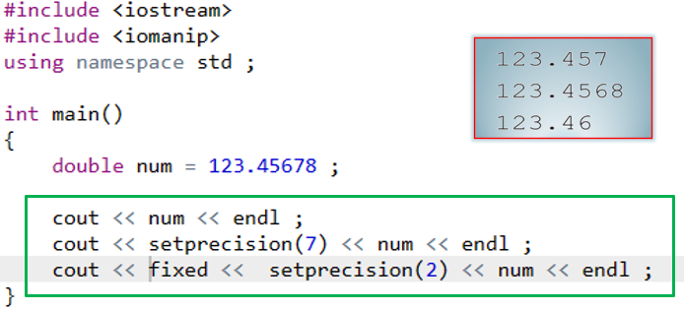
4.2 Manipulators: setprecision
Example: How to use manipulators
setprecision：the total digits to reserve before and after the decimal point (default is 6)
With fixed preceding, it sets the digits to reserve after the decimal point
Both fixed and setprecision remain in effect for subsequent insertions into the output stream

Slide 18

4.3 Single-character input and output
Character Input and Output
The following code segment inputs a character from the keyboard to the variable ch, ignoring whitespace characters.
Whitespace: space, tab, newline, enter, etc.

Slide 19
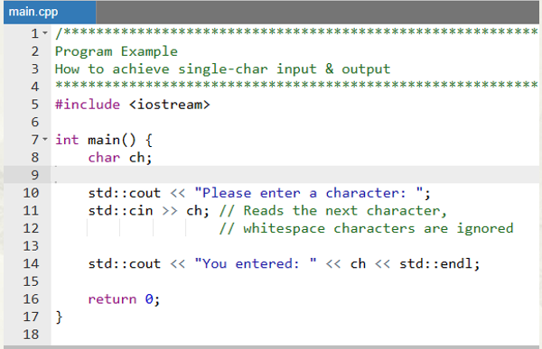
4.3 Single-character input and output
Example
cin >> ch
Please enter a character:
a
You entered: a

Slide 20
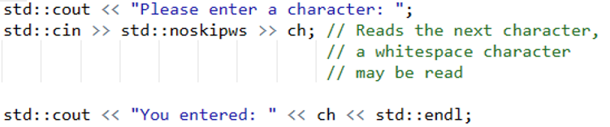
4.3 Single-character input and output
Character Input and Output
Using the manipulator noskipws.(no skip whitespaces).
Please enter a character:
a
You entered:

Slide 21
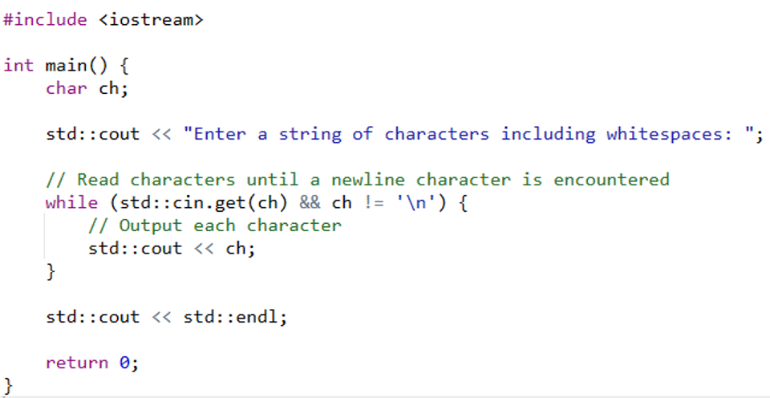
4.3 Single-character input and output
Character Input and Output
Alternatively, the function get( ) associated with the cin can be used.
Enter a string of characters including whitespaces: a b c d
a b c d

Slide 22
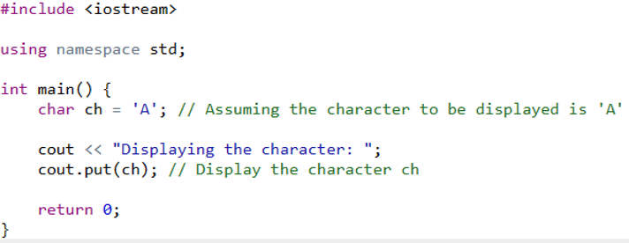
4.3 Single-character input and output
Character Input and Output
Similarly, the output stream object cout has a member function put( ) that can be used to display a character.

Slide 23
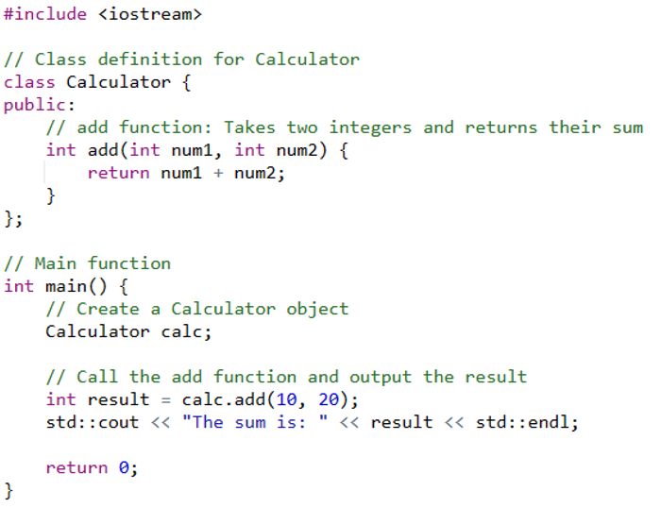
4.4 Different types of function output
Example: output of type int

Slide 24
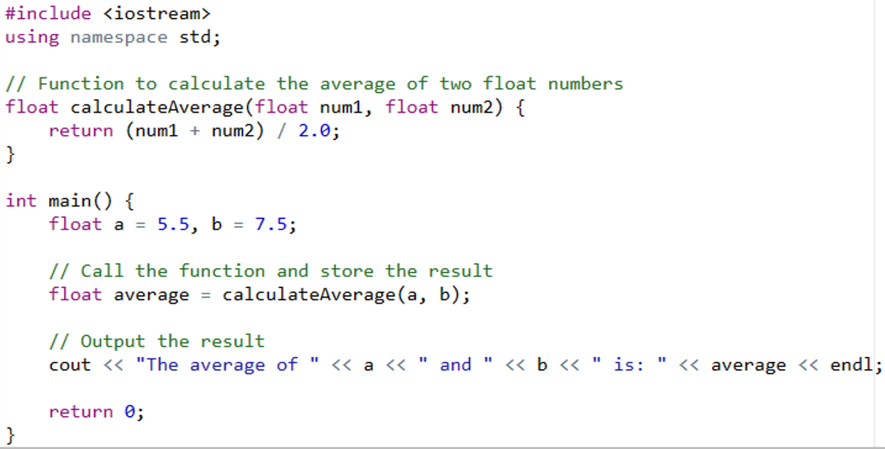
4.4 Different types of function output
Example: output of type float

Slide 25
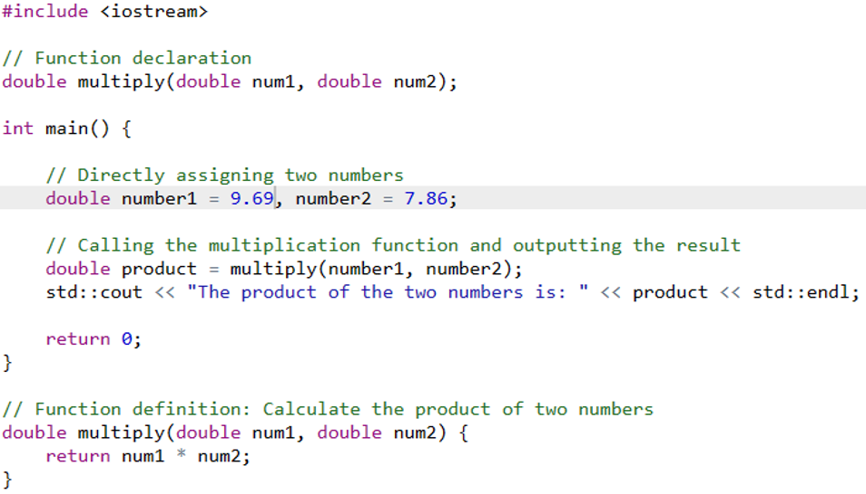
4.4 Different types of function output
Example: output of type double

Slide 26

Thank you for
your attention !
Q&A
ZhangMeiShan

Slide 27
Homework
1. Write a program to input four numbers and display them in reverse order.
2.Write a program to input three floating-point numbers from the keyboard and to calculate (a) their sum and (b) their average. Display the results to three decimal places.

Slide 28
Homework
3.Write a program to accept a temperature in degrees Fahrenheit and convert it to degrees Celsius. Your program should display the following prompt:
Enter a temperature in degrees Fahrenheit:
You will then enter a decimal number followed by the Enter key. The program will then convert the temperature by using the formula
Celsius = (Fahrenheit - 32.0 ) * (5.0 / 9.0)
Your program should then display the temperature:
The temperature in degrees Celsius is:

