Slide 1
Lecture 5: Selection and Iteration
Harbin Institute of Technology（Shenzhen）
School of Computer Science and Technology Zhang Meishan (mason.zms@gmail.com)
Copyright：Harbin Institute of Technology，Su Xiaohong， sxh@hit.edu.cn

Slide 2
Overview
Relational Operators
Logical Operators
Selection
Iteration

Slide 3
Background
Sequence program construct
Top-to-bottom: execute one statement after the other
Only the simplest of problems can be solved
statement 1
…
sequence construct
statement i
…
statement n

Slide 4
Background
Selection and iteration program constructs
statement 1
statement 2
True
…
statement i+1
statement i
selection construct
False
statement i+2
…
statement n

Slide 5
Background
Selection and iteration program constructs
statement 1
statement 2
…
True
iteration construct
statement i+1
statement i
False
statement i+2
…
statement n

Slide 6
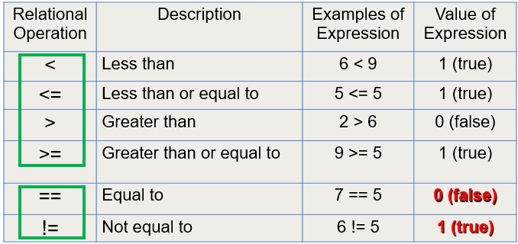
5.1 Relational Operator
Relational operator

Slide 7
5.1 Relational Operator
Precedence
high
arithmetic operation
relational operation >, <, >=, <=
relational operation ==, !=
...
assignment operation
low
Combination order: left to right

Slide 8
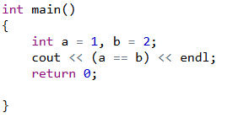
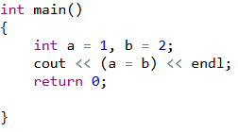
5.1 Relational Operator
Equivalence in judgement: use ==, not =
Output: 0(False)
Output: 2

Slide 9
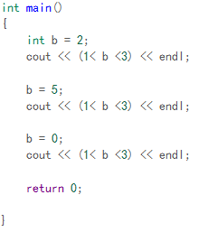
5.1 Relational Operator
Continuous use of relational characters may not yield the results you need!
Output:
Due to the left-to-right associativity of relational operators, the expression 1 < b is evaluated first, resulting in a boolean value, either 0 or 1.
Both 0 and 1 are less than 3, so regardless of the value of b, the output result will be 1.

Slide 10
5.2 Logical Operators
precedence
&& (AND) and || (OR) joins two simple conditions.
&&: The result is only true when both simple conditions are true.
||: The result is true if either or both are true.
! (NOT) : reverse a given condition
If the result is true, then it becomes false,
If it is false, then it becomes true.

Slide 11



5.2 Logical Operators
Logical operators
Symbol Description
&& AND: both are true
|| OR : one of the two is true
! NOT
a | b | a && b | a || b | !a | !b
0 | 0 | 0 | 0 | 1 | 1
0 | 1 | 0 | 1 | 1 | 0
1 | 0 | 0 | 1 | 0 | 1
1 | 1 | 1 | 1 | 0 | 0

Slide 12
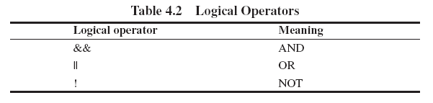
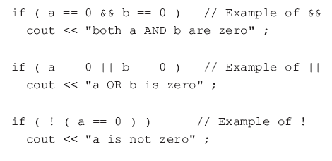
5.2 Logical Operators
Logical operators

Slide 13
5.2 Logical Operators
Logical operators
1.i > j > k
* It's legal in C++, but it's probably not what you expect it to say
* Equivalent to (i > j) > k, does not test whether j is between i and k
* Different from (i > j) && (j > k)
2.Judgment ‘ch’ is an uppercase English letter
'Z' >= ch >= 'A' false
(ch >= 'A') && (ch <= 'Z')
3.Judgment CH is a numeric character
(ch >= '0') && (ch <= '9’)

Slide 14
5.3 Selection
The if statement
starts with the keyword if followed by an expression in parentheses
If the expression is true, then the statement following the if is executed.
If the expression is untrue, then the statement following the if is not executed.

Slide 15
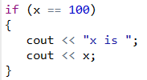
5.3 Selection
The if statement
If you want to include more than a single statement to be executed when the condition is fulfilled, these statements shall be enclosed in braces ({}), forming a block:
As usual, indentation and line breaks in the code have no effect, so the above code is equivalent to:

Slide 16
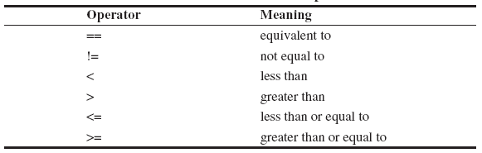
5.3 Selection
The if statement
starts with the keyword if followed by an expression in parentheses
relational operator

Slide 17
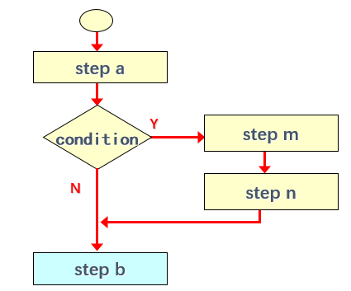
5.3 Selection
The if statement
step a
if (condition is true)
{
step m
step n
}
step b

Slide 18
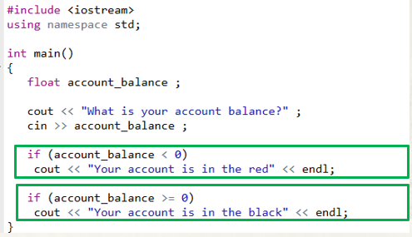

5.3 Selection
The if statement
Running Results

Slide 19
5.3 Selection
The if-else statement
With an if-else there is choice of executing one or other of two statements.
if （expression）
true
false
statement 1
else
statement 2
statement …

Slide 20
5.3 Selection
The if-else statement
Selection statements with if can also specify what happens when the condition is not fulfilled, by using the else keyword to introduce an alternative statement. Its syntax is:
where statement1 is executed in case condition is true, and in case it is not, statement2 is executed.

Slide 21
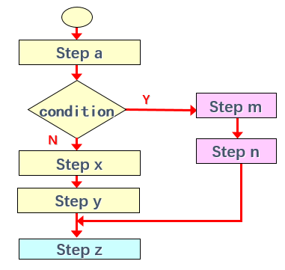
5.3 Selection
The if-else statement
Step a
if (condition is true)
{
Step m
Step n
}
else
{
Step x
Step y
}
Step z

Slide 22

5.3 Selection
The if-else statement
This prints x is 100, if indeed x has a value of 100; but if it does not, and only if it does not, it prints x is not 100 instead.

Slide 23
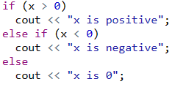
5.3 Selection
The if-else statement
Several if + else structures can be concatenated with the intention of checking a range of values. For example:
This prints whether x is positive, negative, or zero by concatenating two if-else structures.
Again, it would have also been possible to execute more than a single statement per case by grouping them into blocks enclosed in braces: {}.

Slide 24
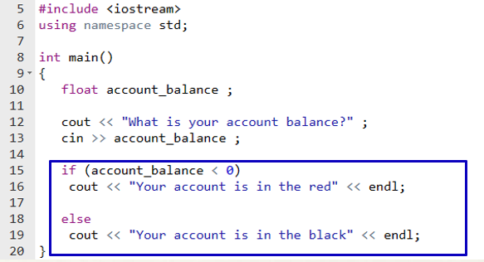
5.3 Selection
Program Example
If the value of account_balance is less than 0,line 16 is executed;
Otherwise the line 19 is executed.

Slide 25
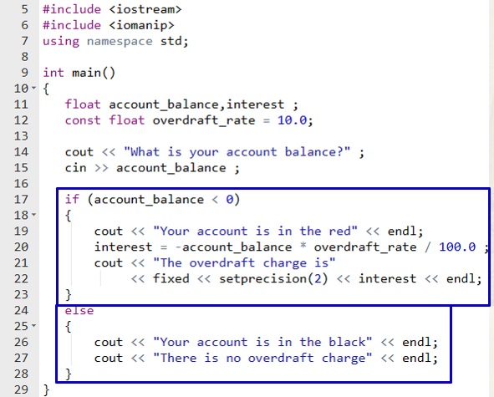

5.3 Selection
Compound statements：A compound statement is one or more statements enclosed in braces { and }.
Running Results
The statements within a compound statement are usually indented for appearance purposes.

Slide 26


5.3 Selection
Nested if statements
When an if statement occurs within another if statement。

Slide 27
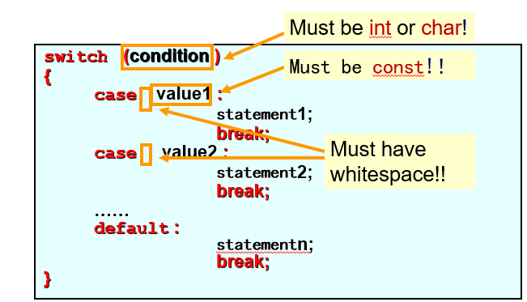
5.3 Selection
switch statement
equivalent to a series of if-else statements
keyword : switch, case

Slide 28
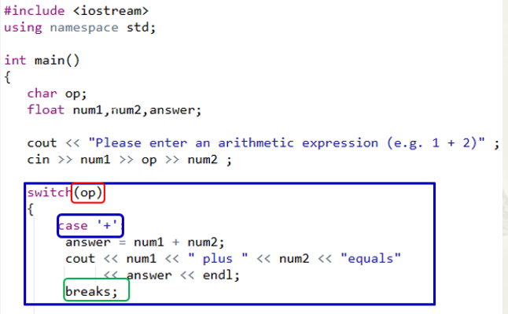
5.3 Selection
Switch statement
“op” must be of type char or int.
1 The value of “ op” is compared with each “case” value in turn
2 Statements following “case” will be executed if matched
3 “break” statement terminates the switch statement.

Slide 29
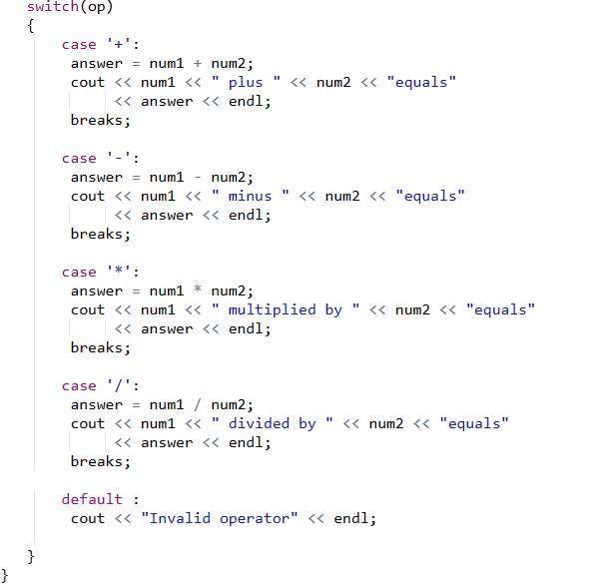
5.3 Selection
Switch statement
If no case matches the value of “OP”, the default case is executed

Slide 30
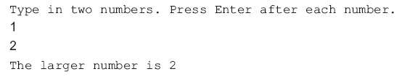
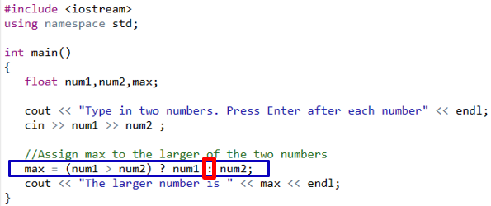

5.3 Selection
The conditional operator ?:
a short form of if-else.

Slide 31
5.4 Iteration
iterative control statements
the while statement
the do-while statement
the for statement
The while statement
while (expression)
if value of the expression is true
{
statement 1;
…
statement n;
}
otherwise
other statements;

Slide 32
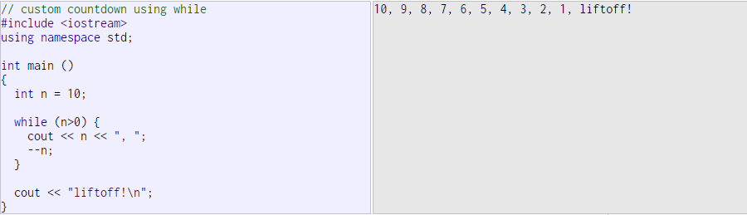
5.4 Iteration
The while statement
The while-loop simply repeats statement while expression is true. If, after any execution of statement, expression is no longer true, the loop ends, and the program continues right after the loop.

Slide 33
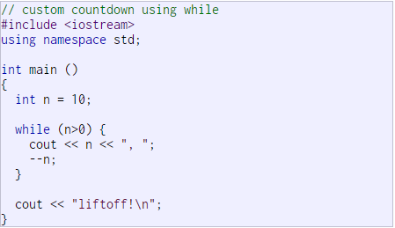
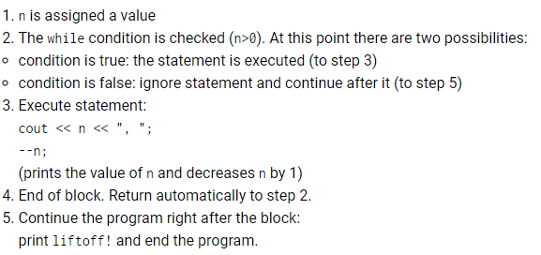
5.4 Iteration
The while statement

Slide 34
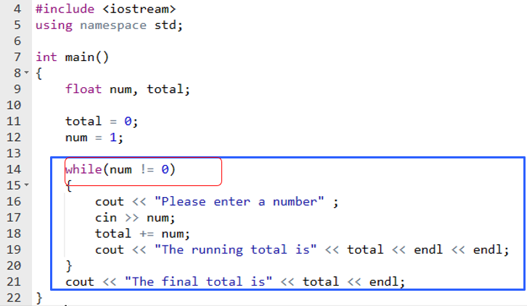
5.4 Iteration
The sequence in a while loop:
1. Evaluate the control expression.
2. If the control expression is true, execute the statements in the loop and go back to 1.
3. If the control expression is false, exit the loop and execute the next statement after the loop.
The statements 16~19 enclosed within { } are executed repeatedly if the control expression “num != 0” is true.
The repeated execution statements is called a program loop.

Slide 35
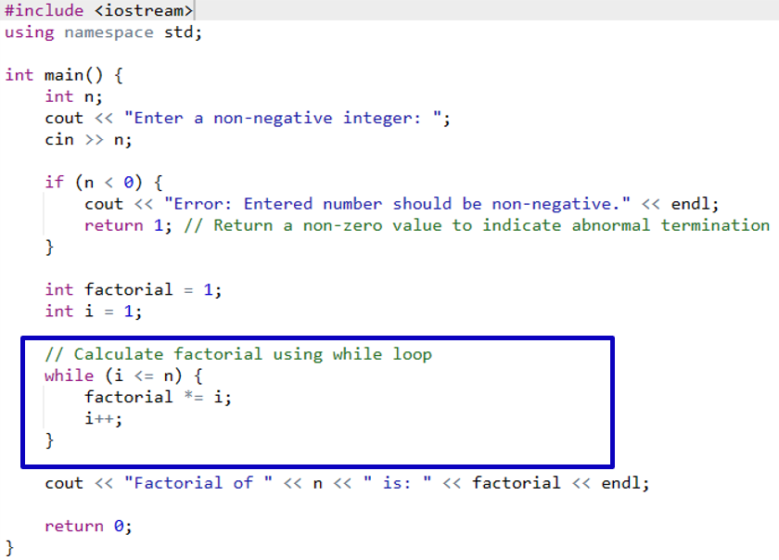

5.4 Iteration
Program Example: Factorial calculation
factorial *= i
equals to
factorial = factorial *i

Slide 36
5.4 Iteration
the statements in a do-while loop are executed at least once
The do-while loop
1. Execute the statements in the loop.
2. Evaluate the control expression.
3. If the control expression is true then go back to 1.
4. If the control expression is false then exit the loop and execute the next statement after the loop.
do
{
statement 1;
…
statement n;
}
if value of the expression is true
It behaves like a while-loop, except that condition is evaluated after the execution of statement instead of before, guaranteeing at least one execution of statement, even if condition is never fulfilled.
while (expression)
otherwise
other statements;

Slide 37
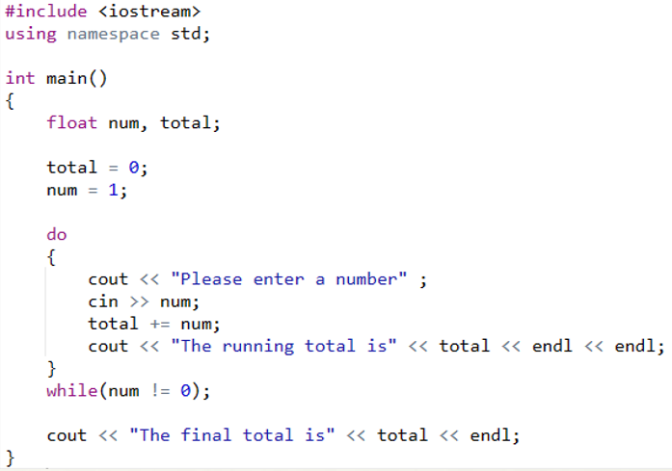
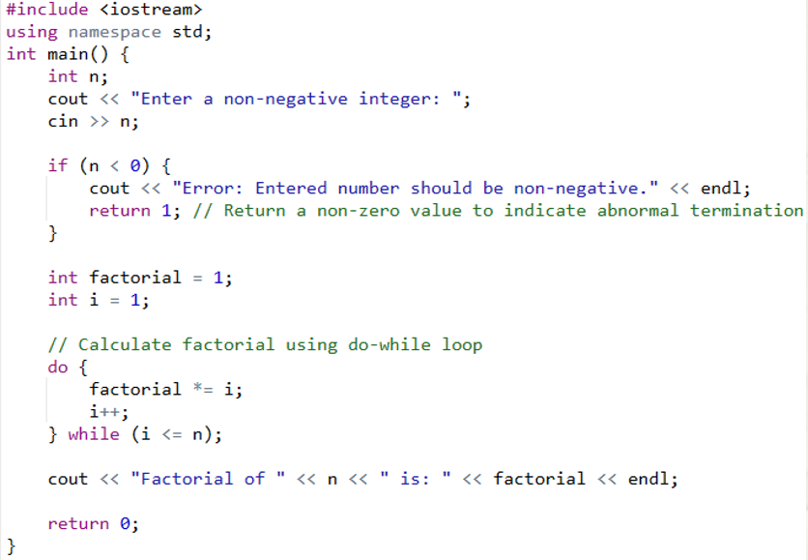
5.4 Iteration
The do-while statement

Slide 38
5.4 Iteration
The for statement
initial expression;
executed once at the beginning of the loop
continue condition;
loop continues while the it is true;
loop terminates when it becomes false;
increment expression
executed at the end of every pass through the loop
for(“initial”; ”continue”; ”increment”)
if value of “continue” is true
otherwise
{
statement 1;
…
statement n;
}
other statements;

Slide 39
5.4 Iteration
The for statement
The for loop is designed to iterate a number of times. Its syntax is:
Like the while-loop, this loop repeats statement while condition is true.
But, in addition, the for loop provides specific locations to contain an initialization and an increase expression, executed before the loop begins the first time, and after each iteration, respectively.
Therefore, it is especially useful to use counter variables as condition.

Slide 40
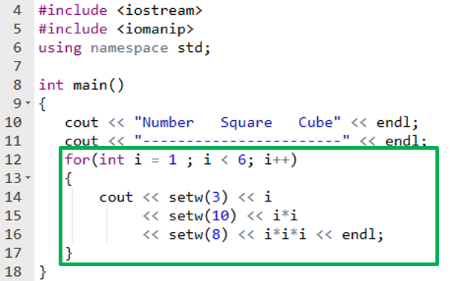
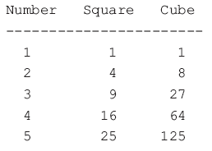
5.4 Iteration
Program Example
Running Results
The statements 13~17 enclosed within { } are executed 5 times
{ } is used to clearly show the body of the loop.

Slide 41
5.4 Iteration
The for statement
It works in the following way:
1.initialization is executed. Generally, this declares a counter variable, and sets it to some initial value. This is executed a single time, at the beginning of the loop.
2.condition is checked. If it is true, the loop continues; otherwise, the loop ends, and statement is skipped, going directly to step 5.
3.statement is executed. As usual, it can be either a single statement or a block enclosed in curly braces { }.
4.increase is executed, and the loop gets back to step 2.
5.the loop ends: execution continues by the next statement after it.

Slide 42

5.4 Iteration
Some specific features
variable i could also be defined before the for statement
i starts at 10 and is decremented at the end of each pass
multiple expressions separated by commas in the for statement
Any or all of the three expressions may be omitted from a for statement, ; must always be present
for(;;) { ……} create an infinite loop because there is no condition to end the loop.

Slide 43
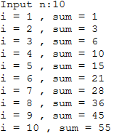
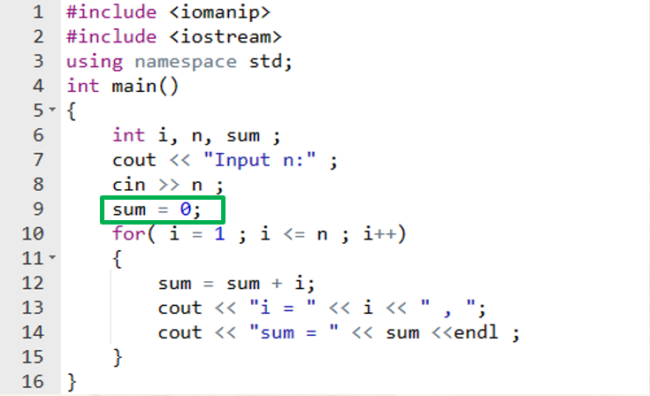
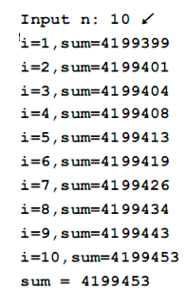
5.4 Iteration
Program Example
Running Results
The statements 11~13 enclosed within { } are executed n times
Why should sum = 0 ?

Slide 44
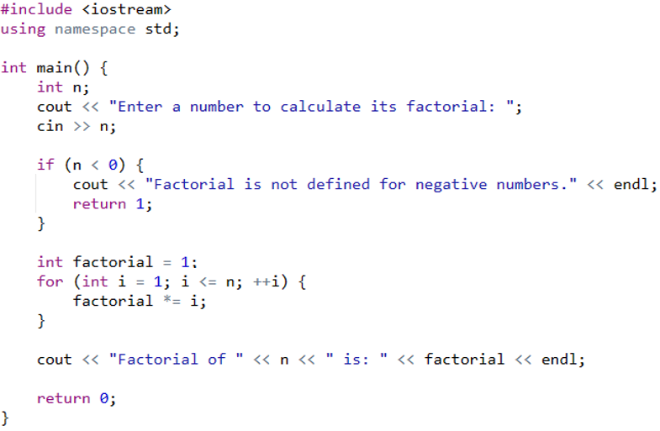
5.4 Iteration
Program Example: Factorial calculation

Slide 45
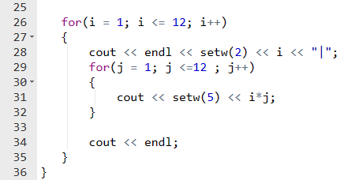
5.4 Iteration
Nested loops: When a loop is contained within another loop
The outer loop (lines 26~35) starts with i at 1
Line 28 displays a | at the left of the screen
The inner loop (lines 29~32) is then executed with j starting at 1 and ending when j exceeds 12.
Each iteration of the inner loop displays a number in the multiplication table.
When the inner loop is completed, the outer loop regains control, and i is incremented to 2.

Slide 46
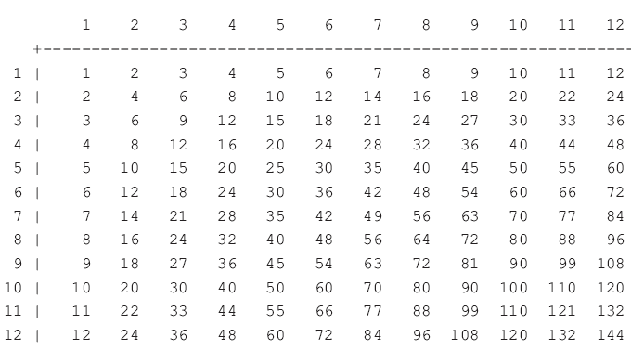
5.4 Iteration
Nested loops: When a loop is contained within another loop
Running Results

Slide 47

Thank you for
your attention !
Q&A
ZhangMeiShan

Slide 48
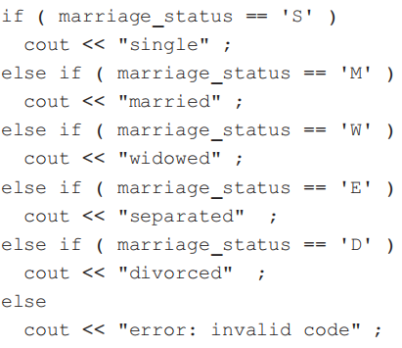
Homework
1. Rewrite the following if-else using a switch statement:

Slide 49
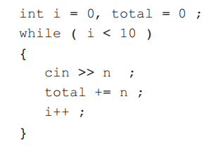
Homework
2. In a triangle, the sum of any two sides must be greater than the third side. Write a program to input three numbers and determine if they form a valid triangle.
3. Rewrite the following using a for loop.

Slide 50
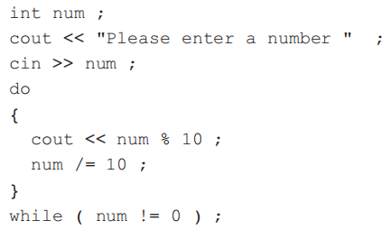
Homework
4. What is displayed when the following program is run and the number 1234 is entered?
5. Write a program to find the sum of all the odd integers in the range 1 to 99.

Slide 51

Homework
6. Write a program to display the following triangles:
Input the size of the triangles from the keyboard.

