Slide 1
Lecture 6: Arrays and Structures
Harbin Institute of Technology（Shenzhen）
School of Computer Science and Technology Zhang Meishan (mason.zms@gmail.com)
Copyright：Harbin Institute of Technology，Su Xiaohong， sxh@hit.edu.cn

Slide 2
Overview
Arrays
Structures
Enumerated data types
Sort
Find

Slide 3

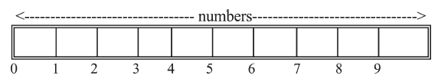
6.1 Arrays
Array ：a group of variables of the same data type
Define
Store
Dimension of the array: the number of elements in an array
Array index (or subscript) :The position of an element in an array
The index of the array numbers starts with 0

Slide 4


6.1 Arrays
Array
How to refer to a particular element ?
use the array name and the index in brackets
How to access the last element?
or ?
52
√
×

Slide 5

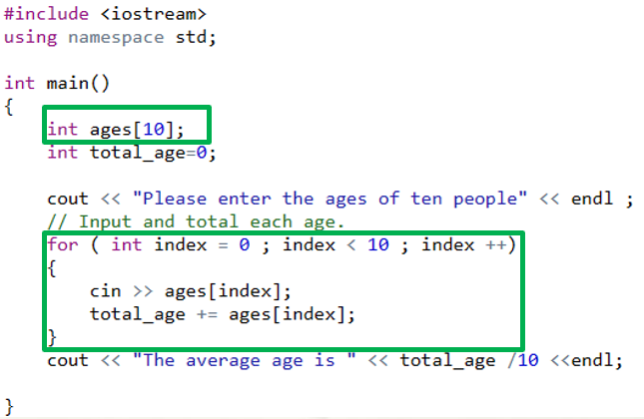
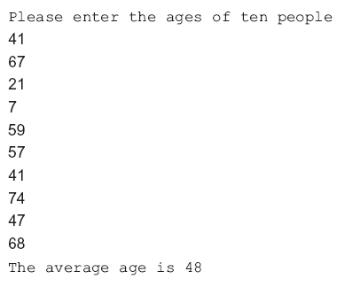
6.1 Arrays
Program Example
define ages as an array of 10 integers
format:
The for loop is used to read each element of the array and add them to total_age.

Slide 6
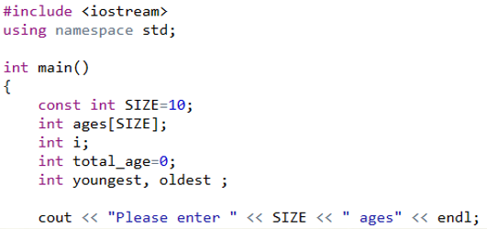
6.1 Arrays
Program Example: find the minimum and maximum values in an array
define a constant integer SIZE and an array “ages” with size SIZE
symbolic constant
The const keyword is used in the definition to specify that its value cannot be changed.
The identifier is usually written in uppercase.
Using a symbolic constant makes the program easier to modify.

Slide 7
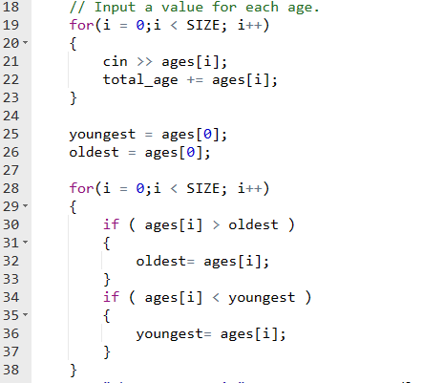
6.1 Arrays
Program Example
The for loop reads in values into the array ages and totals them up.
The for loop compares each element in the array with the values youngest and oldest.
When ages[i] larger than oldest, its value is assigned to oldest.
When ages[i] less than youngest , its value is assigned to youngest .
The smallest element of the array is in youngest and the largest is in oldest when the loop is completed.

Slide 8
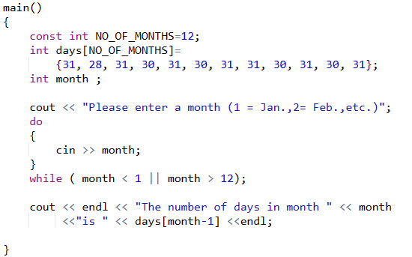
6.1 Arrays
Initializing an array
Define and initialize an array days.
The initial values in the array are separated by , and placed between { }.

Slide 9

6.1 Arrays
Initializing an array
When the list of initial values is less than the number of elements in the array, the remaining elements are initialized to 0.
If an array is defined without specifying the number of elements and is initialized to a series of values, the number of elements in the array is taken to be the same as the number of initial values.
||

Slide 10
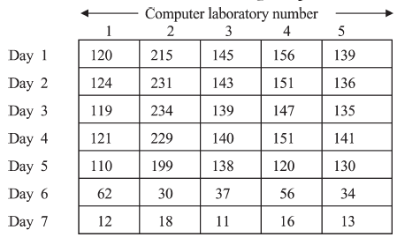
6.1 Arrays
Two-dimensional arrays
A two-dimensional array has more than one row of elements

Slide 11


6.1 Arrays
Two-dimensional arrays
Define: enclose each dimension of the array in brackets
Access an element: specify the row and the column
The row number starts at 0 and ends at 6
The column number starts at 0 and ends at 4.

Slide 12
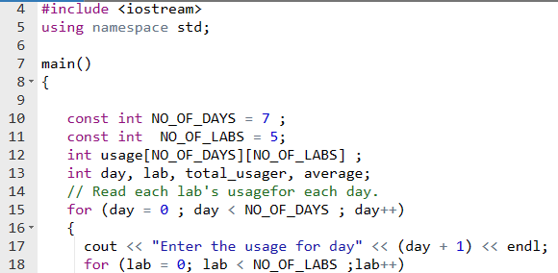
6.1 Arrays
Program Example: reads in the number of students using the five laboratories over seven days
Symbolic constant NO_OF_DAYS and NO_OF_LABS.
Define a two-dimensional array usage with NO_OF_DAYS rows and NO_OF_LABS columns.

Slide 13
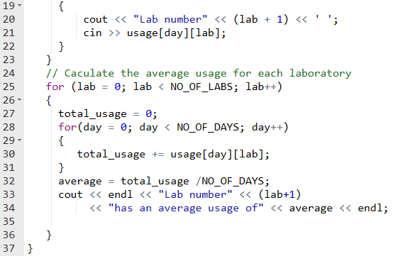
6.1 Arrays
Program Example
The for loop reads in values into the array usage[][].
The for loop totals every column of array usage and average them.

Slide 14
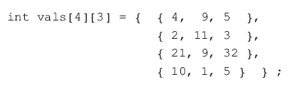
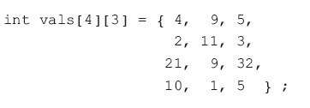
6.1 Arrays
Initializing a two-dimensional array
Initialized by enclosing the initial values in braces
Place the initial values of each row on a separate line or add braces in each row to improve readability

Slide 15
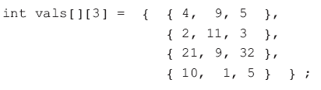

6.1 Arrays
Initializing a two-dimensional array
Omit the first dimension
Compiler will calculate the number of rows
Missing values are initialized to 0
Note that the first dimension is required here, why?

Slide 16
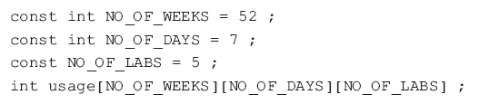

6.1 Arrays
Multi-dimensional arrays
Define arrays with any number of dimensions
The elements of this array are accessed by using three subscripts

Slide 17
6.2 Structures
Arrays are suitable for storing sets of homogeneous data
For example, a student’s test scores
For items of information that are logically related but each item may have a different data type?
A student’s number and test scores
Logically related items of information that may have different data types can be combined into a structure

Slide 18
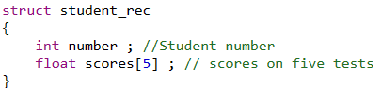
6.2 Structures
Declaring a structure
Step1 : Declare a structure template:
structure tag: name of the structure
structure member: each item in a structure
A structure template consists of the reserved keyword struct followed by the name of the structure.

Slide 19

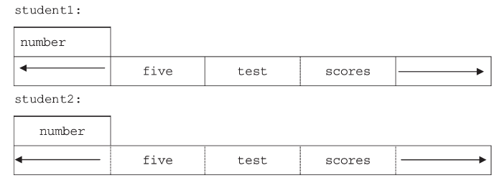
6.2 Structures
Declaring a structure
Step 2 : define variables with the type declared
define student1 and student2 to be of the type struct student_rec

Slide 20
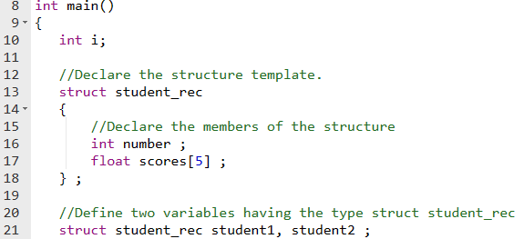
6.2 Structures
Program Example

Slide 21
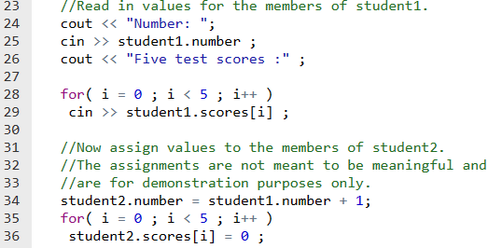
6.2 Structures
Program Example

Slide 22

6.2 Structures
Declaring a structure
Access members of a structure variable: with the member selection operator “.”

Slide 23
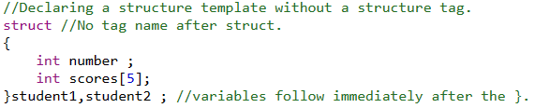
6.2 Structures
Another declaration form of a structure

Slide 24
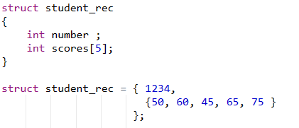
6.2 Structures
Initializing a structure variable
Place their initial values in braces to initialize a structure

Slide 25
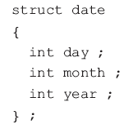
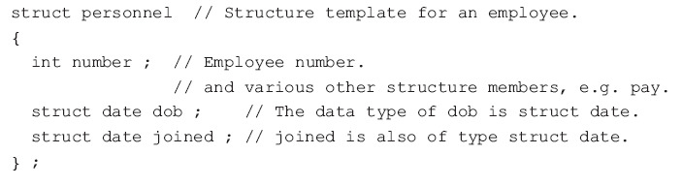
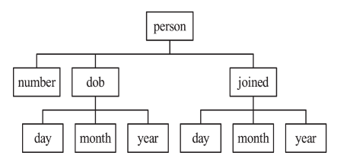



6.2 Structures
Nested structures
A structure that contains another structure as one of its members.

Slide 26

6.2 Structures
typedef allows to define a synonym for a built-in or a programmer defined data type
Use typedef to define a synonym DATE for struct date:

Slide 27

6.2 Structures
Example: Define a five-element array persons.
Each element of this array is of the type struct personnel with members number, dob and joined
The members dob and joined are themselves structures and have members day, month and year.
Which member will be accessed ?
persons[0].number ?
persons[4].joined.year ?

Slide 28

6.3 Enumerated data types
An enumerated data type is used to describe a set of integer values.
These statements declare the data type response to have one of three possible values: no, yes, or none.
answer is defined as an enumerated variable of type response.
The names enclosed in { and } must be integer constants
The value of no is 0; the value of yes is 1; the value of none is 2….
Name of the enumerated data type defined
response is called the enumeration tag

Slide 29
6.3 Enumerated data types
Another definition form
when the enumerated data type and the enumerated variables are defined together, the enumeration tag is optional
Arrays of enumerated data type
Values other than 0, 1, and 2 can also be used

Slide 30
6.4 Sort
Sorting algorithm
-- Sorting by exchange
-- Sorting by selection

Slide 31
6.4 Sort
"Sorting by exchange," also known as "Bubble Sort," can be described in a few steps:
Step One: Comparing Adjacent Elements
Start from the beginning of the list and compare each pair of adjacent elements.
Step Two: Swapping Positions
If the preceding element is greater than (or equal to) the succeeding element, swap their positions. This ensures that the larger element moves towards the end of the list.
Step Three: Repeat Until Sorted
Repeat steps one and two until all elements in the list are arranged in ascending (or descending, depending on the implementation) order.
The core idea of this algorithm is to continually compare adjacent elements and swap their positions if necessary until the entire list is sorted.

Slide 32
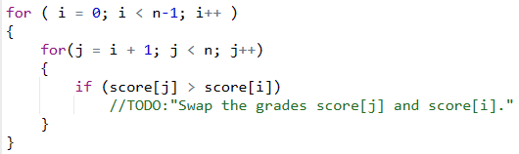
6.4 Sort
Sort by exchange :
Sorting a one-dimensional array storing student grades.

Slide 33
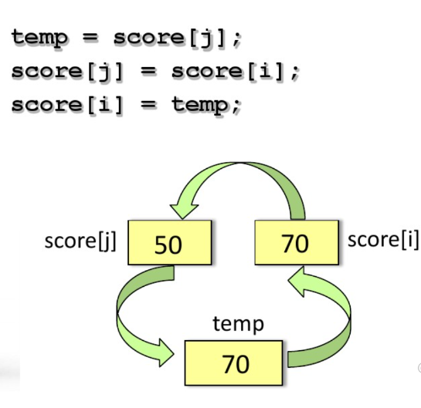
6.4 Sort
Do a two-number swap:

Slide 34
6.4 Sort
Sorting by selection is a straightforward sorting algorithm that sorts an array by repeatedly finding the minimum element from the unsorted part and moving it to the beginning.
1.Step One: Iterate through the array to find the minimum element.
2.Step Two: Swap the minimum element with the first element of the unsorted part.
Step Three: Move the boundary of the unsorted part one element to the right.
Step Four : Repeat steps 1-3 until the entire array is sorted.
This process continues until all elements are sorted, with each iteration reducing the size of the unsorted portion of the array by one element.

Slide 35
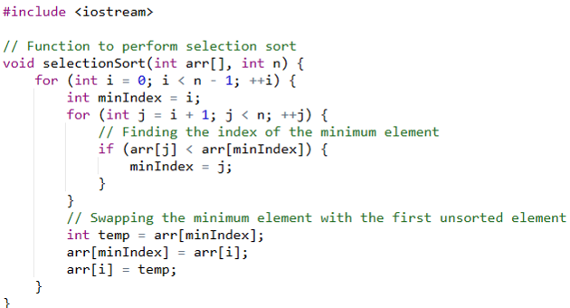
6.4 Sort
Sort by selection :
Sorting a one-dimensional array storing student grades.

Slide 36
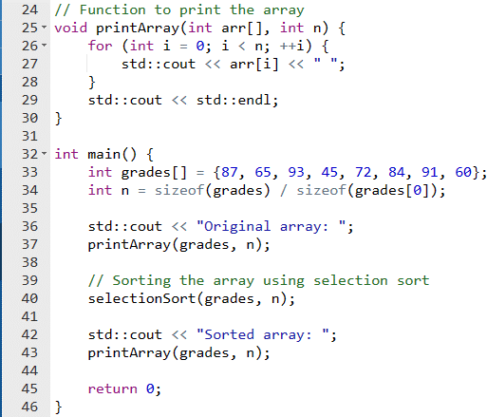

6.4 Sort
Sort by selection :

Slide 37
6.5 Find
Searching algorithm
-- Linear search
-- search in half

Slide 38
6.5 Find
Sequential search, also called linear search, involves scanning through each element in a list until finding the target element or reaching the end. It's a simple method for locating elements in an array.
Start: Begin at the first element of the list.
Comparison: Compare the target element with the current element being examined.
Check: If the current element matches the target element, the search is complete, and the index of the element is returned.
Continue or Terminate: If the current element does not match the target element, move to the next element in the list. Repeat the comparison process until either the target element is found or the end of the list is reached.
End: If the target element is not found in the list, return a message indicating that the element is not present.

Slide 39
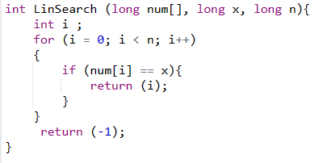
6.5 Find
Linear search:
Don’t have to sort beforehand

Slide 40
6.5 Find
Search in Half , also called Binary Search. Searching in half divides the search space in two and identifies the containing half of the desired item. Here are the steps:
1.Initialize: Start with a sorted list.
2.Divide and Compare: Check the midpoint of the list against the target.
3.Narrow Down: Based on the comparison, discard half of the list each time.
4.Repeat: Keep dividing and comparing until the target is found or the search space is empty.
5.Result: Return the index if found, otherwise indicate absence.

Slide 41
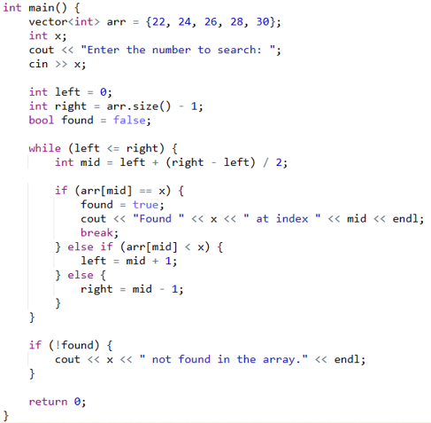
6.5 Find
Binary search：
should be sorted
Number to find
Not found

Slide 42
6.5 Find
Search value x = 28
x >num[mid] low = mid+1
x = num[mid] Find
Array subscripts | 0 | 1 | 2 | 3 | 4
First Loop | 22 | 24 | 26 | 28 | 30
 | low |  | mid |  | high
Second Loop | 22 | 24 | 26 | 28 | 30
 |  |  |  | low(mid) | high

Slide 43
6.5 Find
Search value x = 27
x >num[mid] low = mid+1
x < num[mid] high = mid - 1
Array subscripts | 0 | 1 | 2 | 3 | 4
First Loop | 22 | 24 | 26 | 28 | 30
 | low |  | mid |  | high
Second Loop | 22 | 24 | 26 | 28 | 30
 |  |  |  | low(mid) | high
Third Loop | 22 | 24 | 26 | 28 | 30
 |  |  | high | low
Now, low < high .Loop ended ,not found

Slide 44

Thank you for
your attention !
Q&A
ZhangMeiShan

Slide 45
Homework
1. Write statements to define each of the following:
(a) a one-dimensional array of floating-point numbers with ten elements
(b) a one-dimensional array of characters with five elements
(c) a two-dimensional array of integers with seven rows and eight columns
(d) a 10 by 5 two-dimensional array of double precision numbers
(e) a 10 by 8 by 15 three-dimensional array of integers.

Slide 46
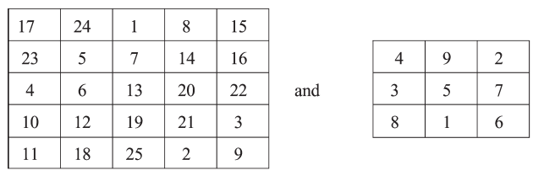
Homework
2. In a magic square the rows, columns and diagonals all have the same sum. For example:
Write a program to read in a two-dimensional integer array and check if it is a magic square.

Slide 47
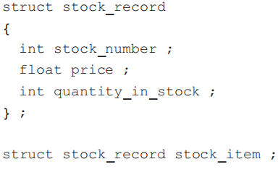
Homework
3. Given the following definitions,
write statements to
(a) assign a value to each member of stock_item
(b) input a value to each member of stock_item
(c) display the value of each member of stock_item

Slide 48
Homework
4. Create an enumerated data type for each of the following:
(a) the days of the week: Monday, Tuesday, Wednesday, and so on
(b) the months of the year
(e) the points on a compass.

Slide 49
Homework
5. Given the array [22, 3, 1, 9, 6, 12, 8], provide the sorting results for each round of selection sort. For example, given the array [3, 2, 1], the sorting results for first round is [1, 2, 3].

