Slide 1
Lecture 7: String
Harbin Institute of Technology（Shenzhen）
School of Computer Science and Technology Zhang Meishan (mason.zms@gmail.com)
Copyright：Harbin Institute of Technology，Su Xiaohong， sxh@hit.edu.cn

Slide 2
Overview
C-strings
C-string input and output
C-string functions
C++ strings
Character classification

Slide 3


7.1 C-strings
C-string： a string is an array of characters (elements of type char) with the null character '\0' in the last element of the array
string literal
A sequence of characters enclosed in double quotation marks
It is not necessary to specify the number of characters
The compiler automatically inserts the null character '\0' after the last character of a string literal
The string literal "Hello“ actually contains 6, rather than 5,characters.

Slide 4



7.1 C-strings
If specify the size of the array and the string is shorter than this size, the remaining elements of the array are initialized with the null character '\0'.
To include a double quote inside a string precede the quote with a back slash (\).

Slide 5


7.1 C-strings
The newline ('\n') escape sequence can be used in place of endl to advance to a new line.
If a string is too long to fit onto a single program line, it can be broken up into smaller segments.

Slide 6
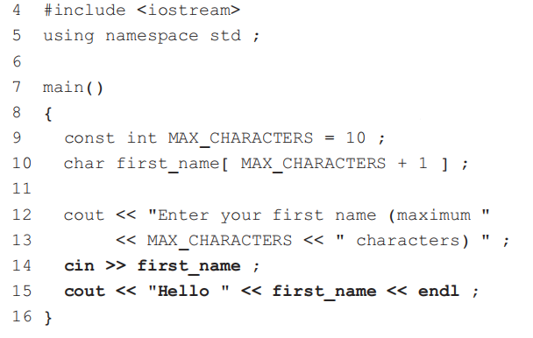



7.2 C-string input and output
Remember that the number of elements in the char array must be one more than the number of characters in the string.
Program Example: a simple demonstration of C-string input and output.
The extraction operator >> read the characters up to ( but not including) the space character after John.

Slide 7
7.2 C-string input and output
If the user does types in more than 10 characters, what will happen?
The array first_name will overflow, the excess characters will overwrite other areas of memory, and the program will probably malfunction.
getline() function
To allow for this possibility and also to allow for whitespace characters in the input.

Slide 8
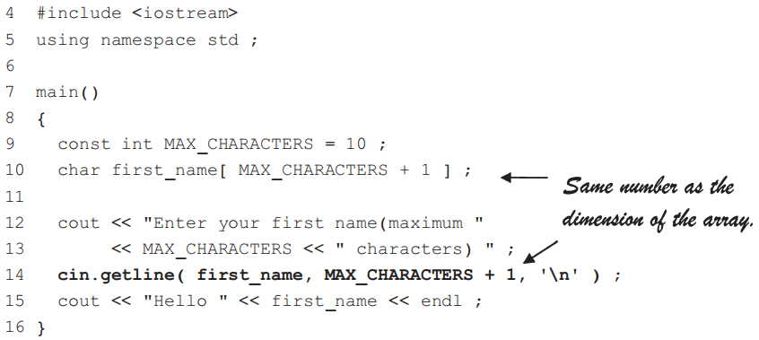
7.2 C-string input and output
Program Example
getline()
reads characters from cin until either the user presses the key '\n' or 10 characters have been read
'\n' is called the delimiter, when the delimiter is omitted, it is assumed to be '\n‘.
'\0' is automatically added to the end of a string

Slide 9
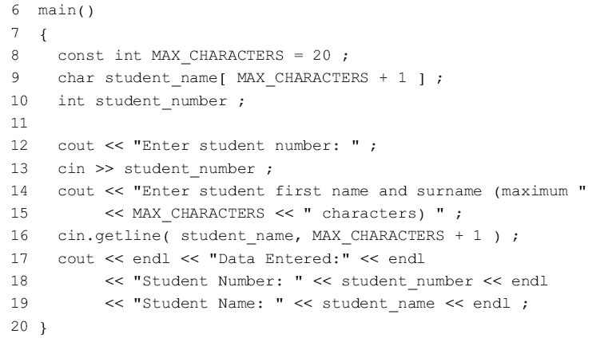



7.2 C-string input and output
Program Example
This line seems to be skipped and no name is read in. Why?
Line 13 stops reading into the numeric variable student_number as soon as a non-numeric character is read.
Enter key is pressed after typing 12345 is left in the input stream, which is then read by getline() on line 16 into student_name..

Slide 10
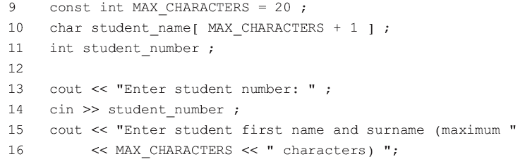

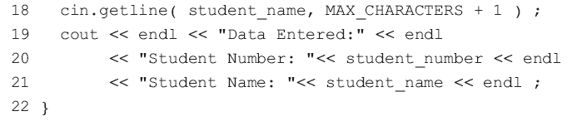
7.2 C-string input and output
Program Example: How to correctly read data into student_name
Solution 2:
discard or ignore all characters in the input stream up to and including the newline character '\n'.
Solution 1:
Read the newline character '\n‘ into a ‘dummy’ character variable. However, if an extra space is entered after the student number, the space is read into the variable dummy, and '\n' is left in the input stream.

Slide 11
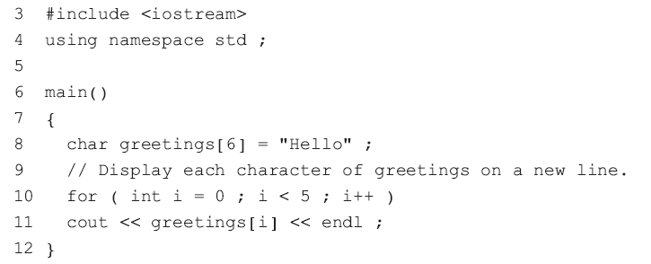
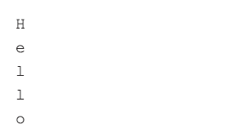
7.2 C-string input and output
Program Example: display each character of the string "Hello" on separate lines
Solution:
Each character of a C-string can be accessed using an index

Slide 12

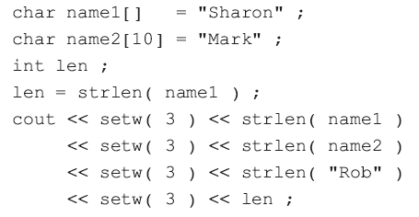
7.3 C-string functions
C++ has inherited a library of C-string functions
How to use these functions?
Finding the length of a C-string
strlen(): returns the number of characters in a C-string, excluding the null character '\0'.

Slide 13
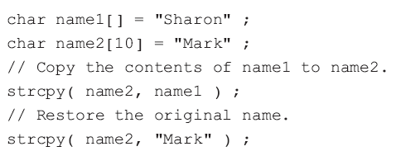
7.3 C-string functions
Copying a C-string
strcpy( destination, source )
copies the contents of a C-string source to another C-string destination.
Remark:
A '\0' must be at the end of the string.
‘destination’ string is assumed big enough to hold the string being copied to it.

Slide 14

7.3 C-string functions
C-string concatenation
strcat( str1, str2 )
concatenates a C-string str2 to the end of the C-string str1
Both str1 and str2 must be null-terminated
Enough memory must be allocated to str1 to hold the result of the concatenation

Slide 15
7.3 C-string functions
Comparing C-strings
strcmp( str1, str2 )
compares two null-terminated C-strings str1 and str2.
This function returns:
a negative value, if str1 < str2,
0 , if str1 == str2,
a positive value, if str1 > str2.

Slide 16
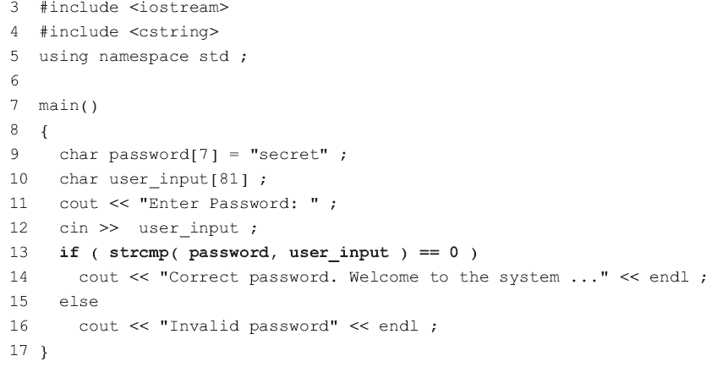
7.3 C-string functions
Program Example

Slide 17
7.3 C-string functions
strncat( str1, str2, n )
Appends the first n characters of the C-string str2 to the C-string str1.
strncmp( str1, str2, n )
Identical to strcmp( str1, str2 ), except that at most, n characters are compared.
strncpy( str1, str2, n )
Copies the first n characters of str2 into str1.

Slide 18
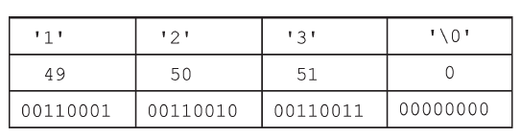

7.3 C-string functions
Converting numeric C-strings to numbers
The storage of a numeric C-string: in the ASCII representation
"123“
The storage of an integer value: in binary
123

Slide 19


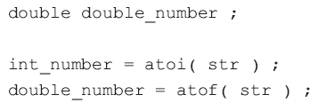
7.3 C-string functions
atoi() : C-string to an integer
atol() : C-string to a long integer
atof() : C-string to a double float.
Remark:
Ignore any leading whitespace characters
Stop converting when a character that cannot be part of the number is reached.
atoi() will stop when it reaches a decimal point
atof() will accept a decimal point, because it can be part of a decimal number.

Slide 20
7.3 C-string functions
Function | Remark
strlen(str) | Finding the length of a C-string str
strcpy(str1, str2) | copies the contents of a C-string str2 to str1
strcat( str1, str2 ) | concatenates a C-string str2 to the end of the C-string str1
strcmp( str1, str2 ) | compares two null-terminated C-strings str1 and str2.
strncat( str1, str2, n ) | Appends the first n characters of the C-string str2 to str1.
strncmp( str1, str2, n ) | Identical to strcmp, except that at most n characters are compared.
strncpy( str1, str2, n ) | Copies the first n characters of str2 into str1.

Slide 21
7.4 C++ strings
Common errors in C-strings:
Attempting to access elements outside the array bounds
Not using the function strcpy() to one C-string to another
Not using strcmp() to compare two C-strings.
…
C++ strings
The string data type is not built into C++
In C++, the string data type is defined by a class

Slide 22
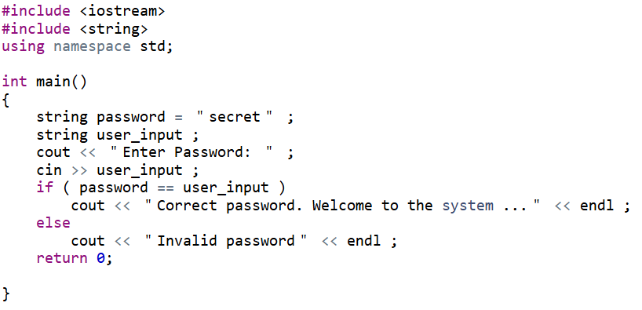
7.4 C++ strings
Program Example
Remark:
C++ strings are compared using ==, <, >,etc instead of strcmp() in C-strings.
C++ has many useful string member functions.

Slide 23
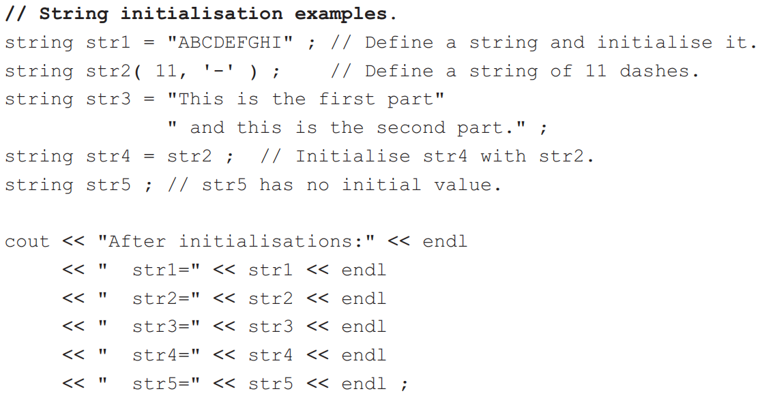
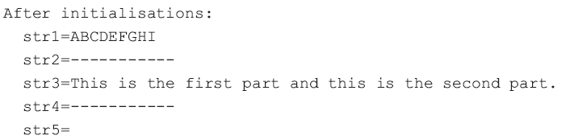
7.4 C++ strings
string initialization and assignment
str2 shows how to assign a C++ string with a number of identical characters
The string that is being assigned can be on two or more lines.
str5 is called an empty string.

Slide 24
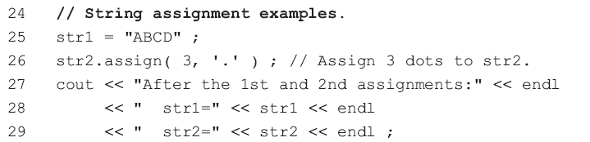

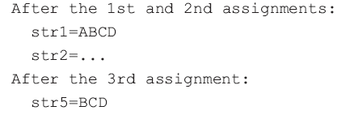
7.4 C++ strings
string initialization and assignment
line33 assign(): assign part of str1 to str5.
str1 is the string to assign from
1 is the starting position
3 is the number of characters to assign

Slide 25
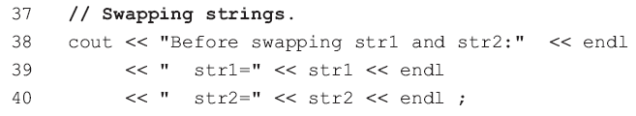
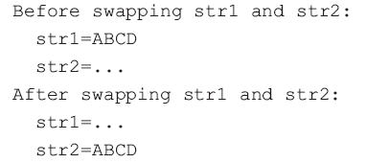
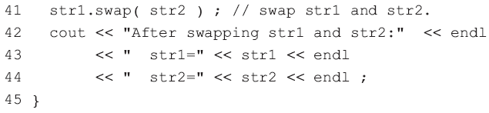
7.4 C++ strings
string swap

Slide 26

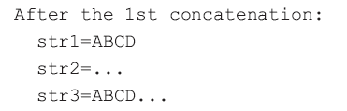





7.4 C++ strings
string concatenation

Slide 27
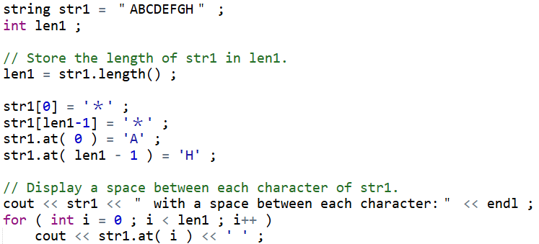

7.4 C++ strings
string length, string indexing and sub-strings
Change the first and last characters
Check the index value to ensure it is not out of range by at().

Slide 28
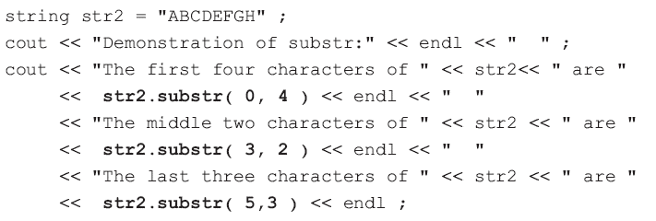
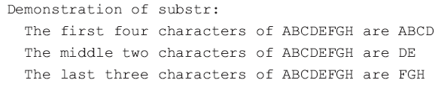
7.4 C++ strings
substr() can extract part of a C++ string.
The 1st argument is a starting position
2nd argument is the number of characters to extract.

Slide 29
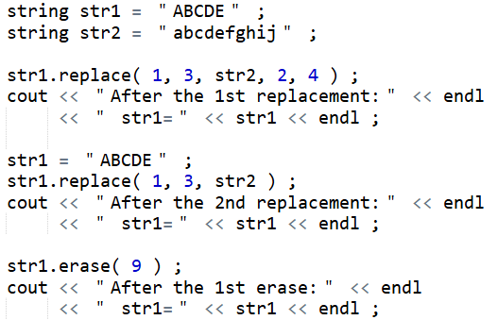

7.4 C++ strings
string replace, erase, insert and empty strings
Character at position 0 is the first character.
Replace 3 characters from str1 starting at the 2nd character position with 4 characters from str2, starting at the 3rd character position.

Slide 30


7.4 C++ strings
string replace, erase, insert and empty strings
Erase from the 10th character position to the end of str1.

Slide 31
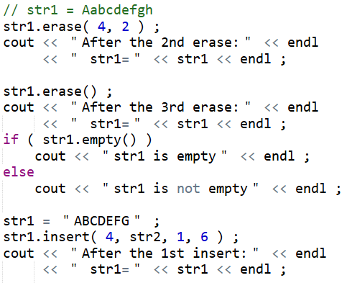



7.4 C++ strings
Erase 2 characters starting at the 5th character position.
Erase the entire string.
Judge whether str1 is empty?
Starting at the 2nd character of str2, insert 6 characters at the 5th character position of str1.

Slide 32
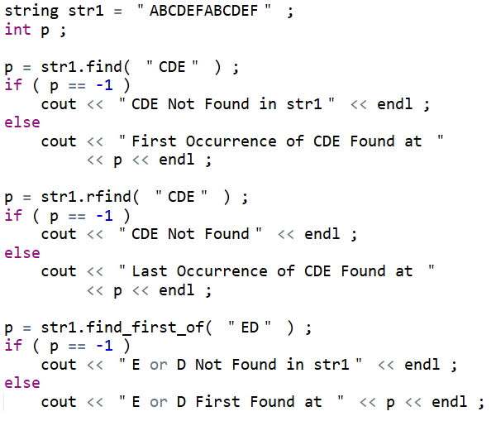
7.4 C++ strings
string searching
Hold the position of the first occurrence of "CDE" in str1. If "CDE" is not in str1, p = -1.
Reverse find the last occurrence of "CDE".
Find the first occurrence of any one of a number of characters.

Slide 33
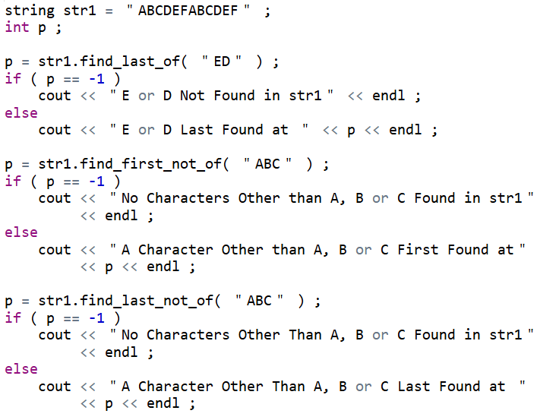
7.4 C++ strings
string searching
Find the last occurrence of any one of a number of characters.
Find the first occurrence of any character that is not one of a number of characters.
Find the last occurrence of any character that is not one of a number of characters.

Slide 34
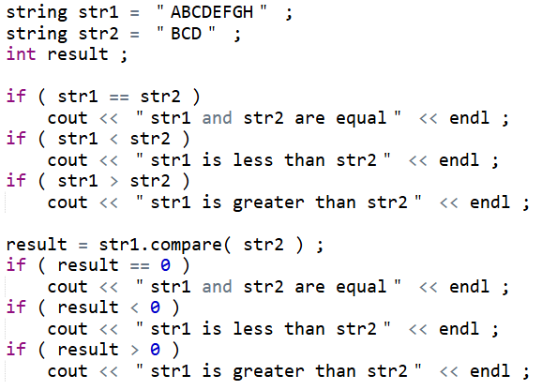
7.4 C++ strings
string comparisons
C++ strings can be compared with the standard comparison operators : ==, !=, <=, >= < and >
result is < 0 if the first differing character in str1 is less than the character in the same position in str2.
result is 0 if all the characters of str1 and str2 are equal and the two strings are the same length.
Otherwise result is > 0.

Slide 35
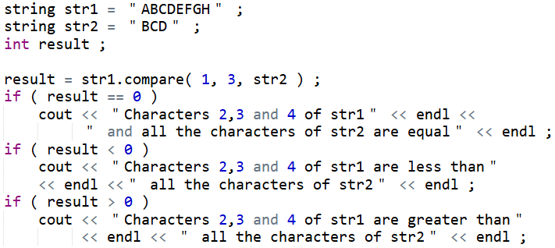

7.4 C++ strings
string comparisons
Compares a 3-character substring of str1 starting at the second character with all the characters of str2.

Slide 36
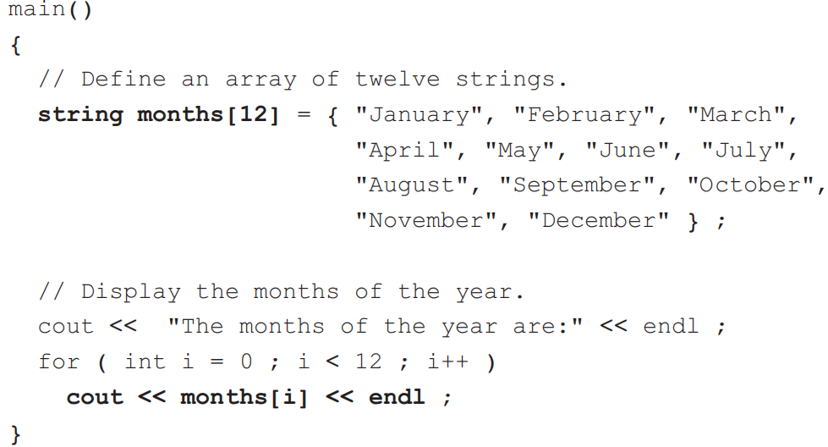
7.4 C++ strings
Just like any other data type, arrays of C-strings and arrays of C++ strings can be defined. Arrays of C++ strings are much easier to work with.

Slide 37
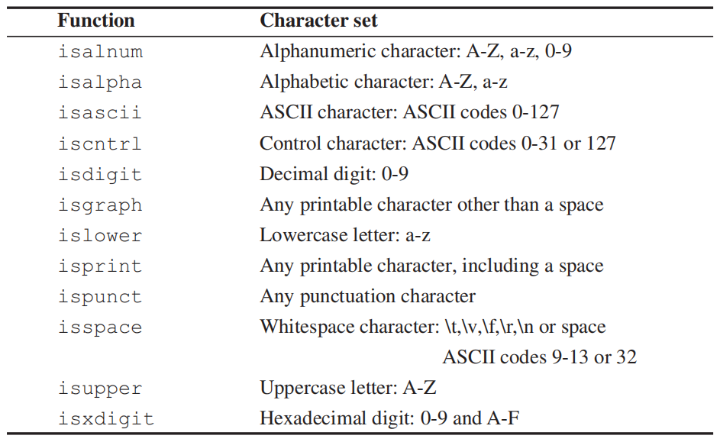
7.5 Character classification
There are a number of C++ functions that can be used to test the value of a single character. These functions return a true (non-zero integer) value or a false (zero integer) value depending on whether or not the character belongs to a particular set of characters.

Slide 38
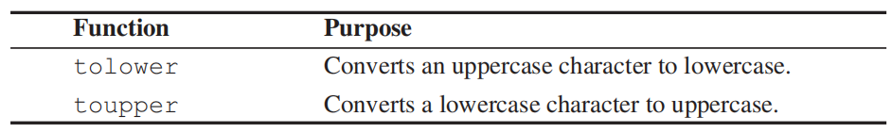
7.5 Character classification
C++ has also two further functions that are used to covert the case of a character: tolower and toupper.

Slide 39
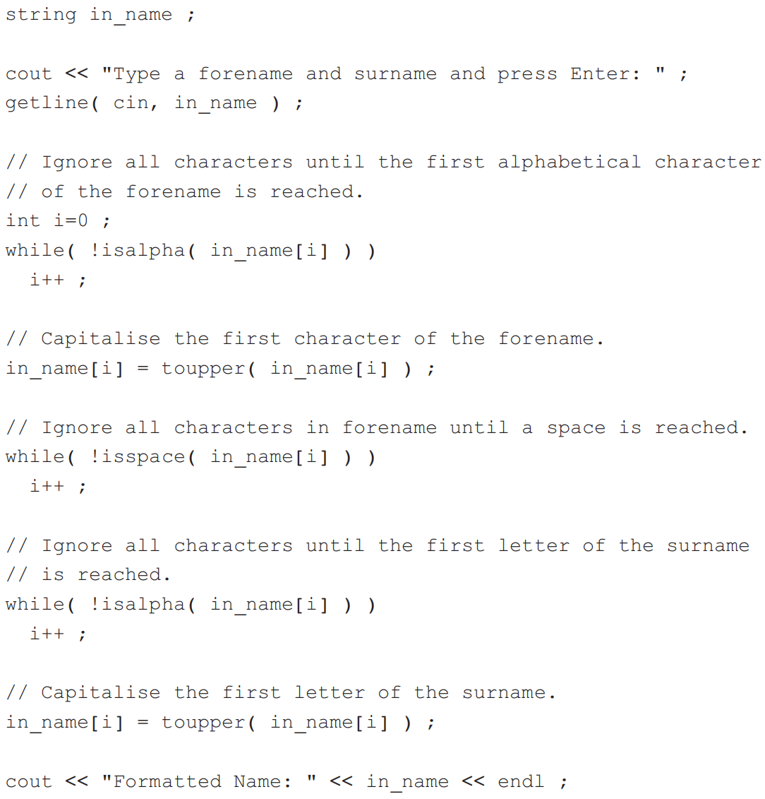

7.5 Character classification
A sample run of this program:

Slide 40

Thank you for
your attention !
Q&A
ZhangMeiShan

Slide 41
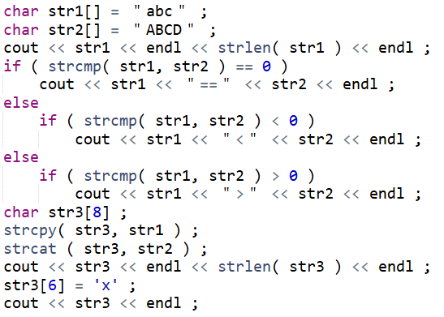
Homework
1. What is the output from the following program segment?

Slide 42
Homework
2. Modify exercise 1 to use C++ strings rather than C-strings.
3. Given the following:
char c_str1[18] ;
char c_str2[6] = ＂abcde＂ ;
what is in c_str1 after each of the following?
(a ) strcpy( c_str1, ＂A string＂ ) ;
(b) strcat( c_str1, ＂ of text.＂ ) ;
(c) strncpy( c_str1, c_str2, 1 ) ;

Slide 43
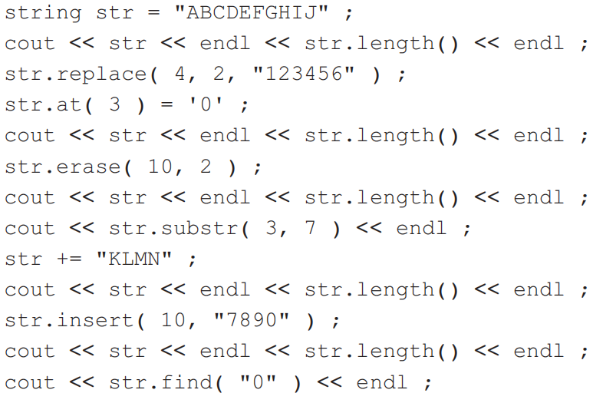
Homework
4. Write a program to input a C-string from the keyboard and replace each space in the string with the character '_'.
5. What is the output from the following program segment?

Slide 44
Homework
6. Write a program to input a string. If every character in the string is a digit ('0' to '9'), then convert the string to an integer, add 1 to it, and display the result. If any one of the characters in the string is not a digit, display an error message.

