Slide 1
Lecture 8: Functions
Harbin Institute of Technology（Shenzhen）
School of Computer Science and Technology Zhang Meishan (mason.zms@gmail.com)
Copyright：Harbin Institute of Technology，Su Xiaohong， sxh@hit.edu.cn

Slide 2
Overview
Function
Function arguments
Parsing arguments
Mathematical functions
Function overloading
Recursion
The scope of a variable

Slide 3
8.1 Function
A function is a block of statements called by name to carry out a specific task
In order to reduce the complexity of programs, they have to be broken into smaller, less complex parts.
Functions and classes are the building blocks of a C++ program.

Slide 4
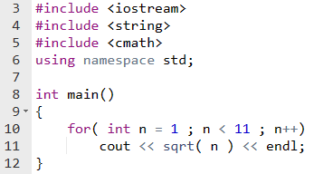
8.1 Function
Functions in the standard library: built-in, pre-written in C++
Line 11 calls the function sqrt() to calculate the square root of the value in the variable n

Slide 5
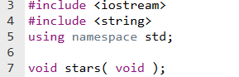

8.1 Function
C++ allows a programmer to write functions ownly.
Like variables, functions must be declared before they are used.
Line 7 declares stars to be a function
The first void on line 7 declares the type of the function stars()
The second void informs the compiler that ‘stars’ will not receive any data from the calling program. The second void is optional.
-----prototype of the function stars()----
Return nothing
Receive nothing

Slide 6
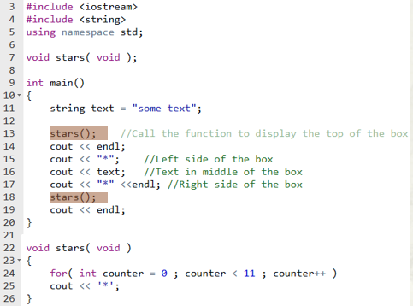
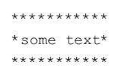
8.1 Function
Program Example
Running Results
Lines 22 to 26 define the function
Line 22: function header
Line 24- 25: function body

Slide 7
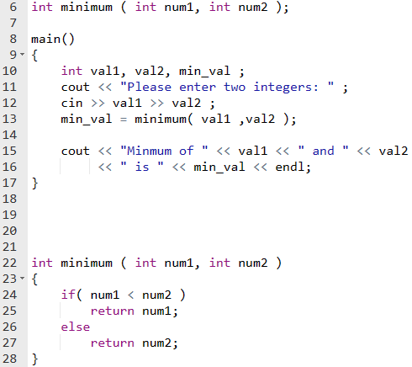
8.1 Function
To define and call a function with return value, you should notice:
function prototype
function header

Slide 8


8.1 Function
The general format of the return statement:
Examples:
These two blocks are equivalent:

Slide 9

8.1 Function
A function call can be used anywhere in a program where a variable can be used

Slide 10
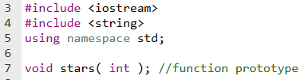
8.2 Function arguments
Function star() can display 11 asterisks, then how to display a variable number of asterisks?
New function stars():
take a value passed to it and display the number of asterisks specified in that value.

Slide 11
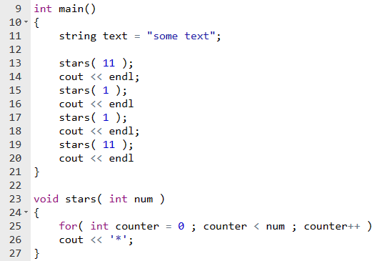
8.2 Function arguments
Program Example
Remark
This number is called an argument
Received by the parameter num declared as an integer in line 23
Remark
The parameters of a function are known only within the function.
Line 25 of the function stars() now uses the variable num to decide how many times * is displayed.

Slide 12
8.2 Function arguments
A new program specifies:
the number
character to display

Slide 13
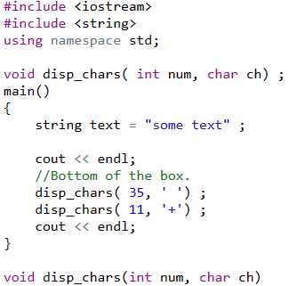
8.2 Function arguments
disp_chars() uses two parameters:
num (the number of times to display a character)
ch (the character to display)
Return nothing
Receive an int and an char

Slide 14
8.2 Function arguments
The variable names used in the prototype are often the same as those used for the parameters in the function header.
It is good practice to place comments after the function prototype to describe the function and its parameters.
The prototype and the accompanying comments are known as the function interface.

Slide 15



8.2 Function arguments
A function parameter that is not passed a value can be assigned a default value.
The second argument is omitted.
These two are equivalent.
If a parameter is provided with a default value, all the parameters to its right must also have a default value.
×
√

Slide 16
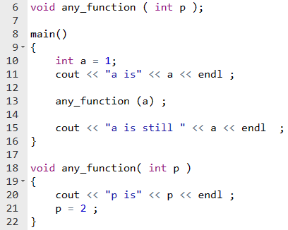

8.3 Passing arguments
Passing by value
A copy of the argument values is passed to the function parameters
The value of the argument cannot be changed within the function
A copy of the value of a is passed to p
Running Results
Changing the value of p has no effect on a

Slide 17
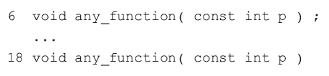
8.3 Passing arguments
The value of the parameter can be prevented from change within a function by making it a constant.
To do this, place the keyword const before the parameter in the function prototype and function header .

Slide 18


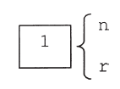

8.3 Passing arguments
Passing by reference: A reference is a synonym or an alias for an existing variable.
A reference to a variable is defined by adding & after the variable’s data type.
A reference must always be initialized when it is defined
r is a reference to n
n and r both refer to the same value
r is not a copy of n, but is merely another name for n
A change to n will also result in a change to r

Slide 19
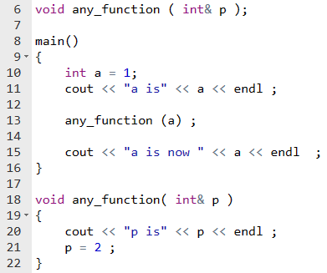
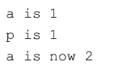
8.3 Passing arguments
Program Example
a and p refer to the same storage location
Running Results
Changing the value of p also changes the value of a

Slide 20
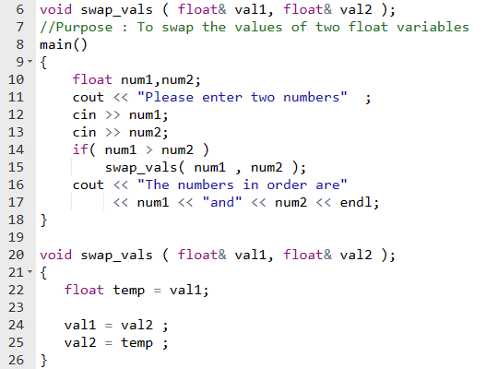

8.3 Passing arguments
Arguments passed by reference
local variable
The variable temp is a local variable to the function swap_vals().
Local variables are known only within the function where they are defined.

Slide 21
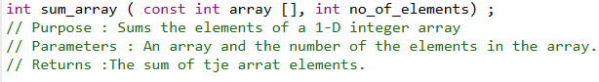
8.3 Passing arguments
Arrays can only be passed by reference to a function.
To avoid the overhead of copying all the elements of an array, that passing by value would entail
Program Example: contains a function sum_array() that sums the elements of an integer array passed to it from main().

Slide 22
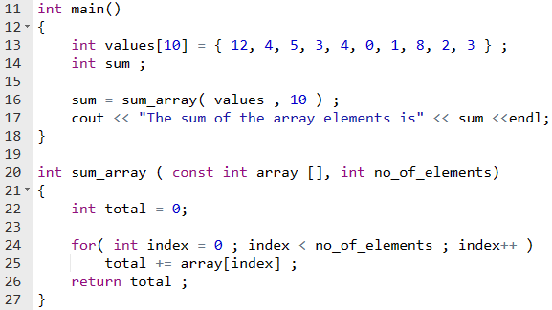
8.3 Passing arguments
Line 16 calls sum_array() to calculate the sum of the values in the array values.
The arguments are the name and the number of elements in the array.
In line 20 array is a reference to values. Because arrays can only be passed by reference, & is not required.

Slide 23
8.3 Passing arguments
[ and ] are necessary to indicate that the parameter is a reference to an array.
The number of elements is not required in the brackets for a one-dimensional array to handle different size array.
Const informs the compiler that within the function sum_array(), array is read-only and cannot be modified.

Slide 24
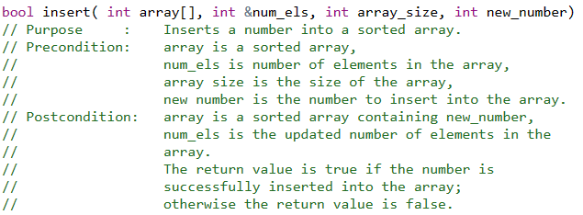
8.3 Passing arguments
an alternative way of commenting a function
Instead of comments listing the parameters and return value, pre and post condition comments are used.
In the pre condition comment, the conditions that must exist before a function may be successfully called are listed.
In the post condition comment, the conditions that will exist after the function is called are listed.
Call the function insert

Slide 25

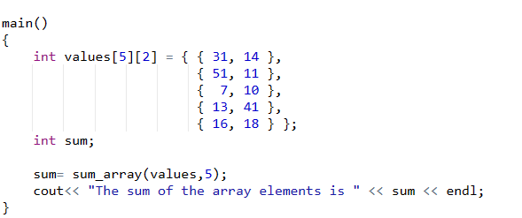
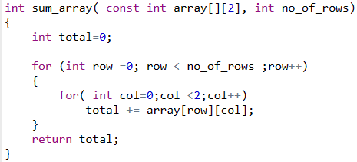
8.3 Passing arguments
When a multi-dimensional array is passed to a function, the function parameter list must contain the size of each dimension of the array, except the first.
Running Results

Slide 26
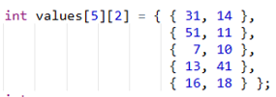

8.3 Passing arguments
The elements of a two-dimensional array are stored row by row in contiguous memory locations.
Any element array[i][j] in this situation has an offset i*2 + j from the starting memory location of array[0][0].
In order to calculate the offset, the number of columns (= 2) is required; hence the need for the compiler to know the value of the second dimension

Slide 27
8.3 Passing arguments
Passing a structure variable to a function
pass a copy of the member values to that function, this means that the values in the structure variable cannot be changed within the function.
The values in a structure variable can only be changed from within a function if the variable is passed by reference to the function.

Slide 28
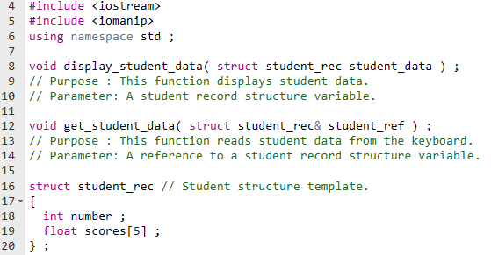
8.3 Passing arguments
Program Example
When a structure template is defined outside main(), it makes the structure template global.
This means that the structure template is known in main() and in display_student_data() and get_student_data().

Slide 29
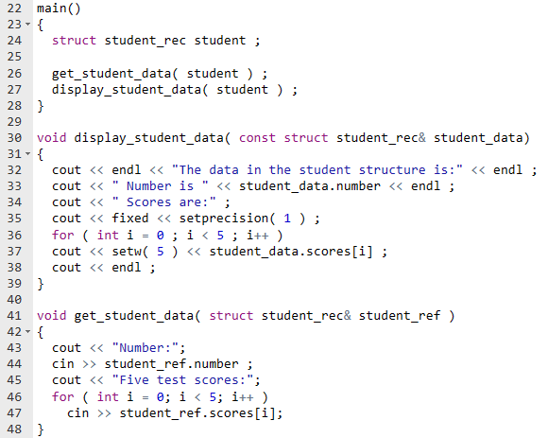
8.3 Passing arguments
Program Example
demonstrates passing a structure variable by value and passing a structure variable by reference to two different functions.
When a structure variable is passed by value to a function, the entire structure data must be copied to the function parameter.
For a large structure, this is a significant overhead and it is preferable to use a reference.
If the argument isn‘t changed by the function, the const keyword should be used.

Slide 30
8.3 Passing arguments
The same considerations should be kept in mind when using strings as arguments as when using structure variables as arguments, i.e. passing a string by value means copying all the characters of the string to a function parameter.
To avoid this overhead it is preferable to pass strings by reference.

Slide 31
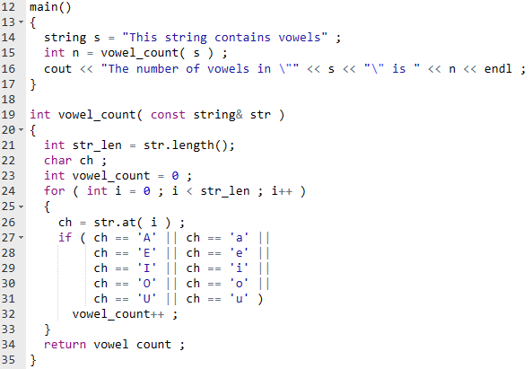
8.3 Passing arguments
demonstrates passing a C++ string by const reference to a function that counts the number of vowels in the string.
Running Results

Slide 32
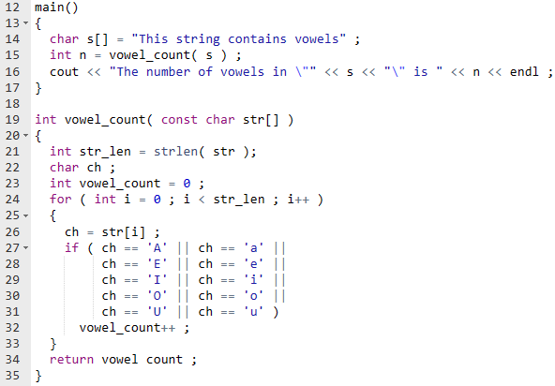
8.3 Passing arguments
To use C-strings instead of C++ strings in program, the following modifications must be made to the program.

Slide 33
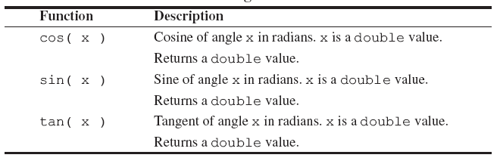
8.4 Mathematical functions
To use any of the mathematical functions place the statement #include <cmath> at the start of the program.
Some trigonometric functions

Slide 34
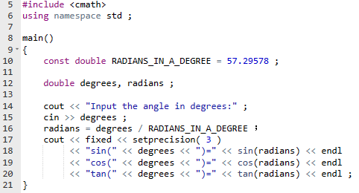
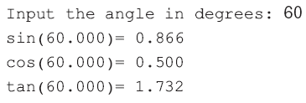
8.4 Mathematical functions
Program Example: demonstrates sin(), cos() and tan() functions.

Slide 35
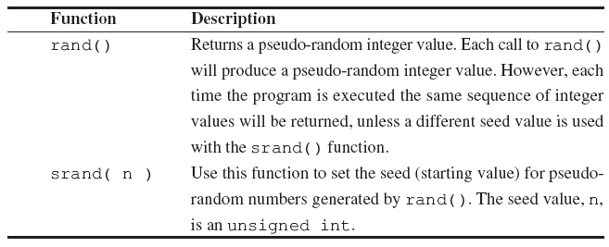
8.4 Mathematical functions
Pseudo-random number functions
To use the pseudo-random generating functions rand() and srand(), place the statement #include <cstdlib> at the start of the program.

Slide 36
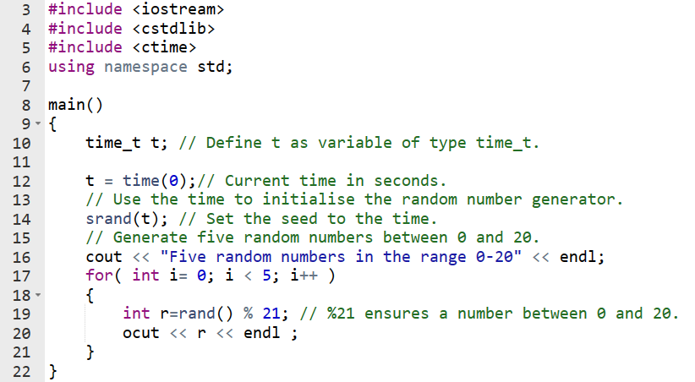
8.4 Mathematical functions
Program Example
Line 12 assigns to t the current time (measured in seconds since midnight on 1 January 1970, GMT) which is used as the random number seed on line 14.
Without line 14, the program displays the same sequence of random numbers every time the program is run.

Slide 37
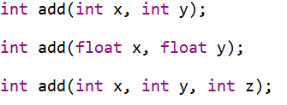
8.5 Function overloading
Function overloading is used when there is a need for two or more functions to perform similar tasks, but where each function requires a different number of arguments and/or different argument data types.

Slide 38
8.5 Function overloading
Using different functions with the same name in a program is called function overloading and the functions are called overloaded functions.
Function overloading requires that each overloaded function have a different parameter list, i.e. a different number of parameters or at least one parameter with a different data type.

Slide 39
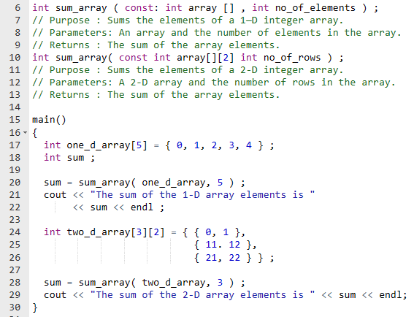
8.5 Function overloading
Program Example
The compiler decides which of the two sum_array() functions to call based on matching arguments with parameters.

Slide 40
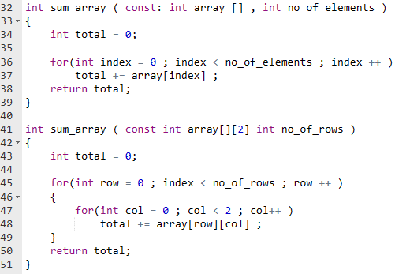

8.5 Function overloading
Program Example…continued
Running Results

Slide 41
8.6 Recursion
Recursion is a programming technique in which a problem can be defined in terms of itself. The technique involves solving a problem by reducing the problem to smaller versions of itself.

Slide 42

8.6 Recursion
The factorial of a positive integer is the product of the integers from 1 through to that number.
(a) 0!=1. This is called the base case.
(b) For a positive integer n, factorial n is n times the factorial of n-1.This is called the general case clearly indicates that factorial is defined in terms of itself.

Slide 43
8.6 Recursion
Using the definition, factorial 3 is calculated as follows:
The value of n is 3 so, using (b) above, 3! = 3 * 2!
Next find 2! Here n = 2 so, using (b) again, 2! = 2 * 1!
Next find 1! Here n = 1 so, using (b) again, 1! = 1 * 0!
Next find 0! In this case using (a), 0! is defined as 1.
Substituting for 0! gives 1! = 1 * 1 = 1.
Substituting for 1! gives 2! = 2 * 1! = 2 * 1 = 2.
Finally, substituting for 2! gives 3! = 3 * 2! = 3 * 2 = 6.

Slide 44
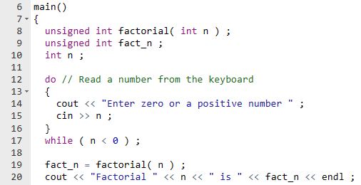
8.6 Recursion
Program Example

Slide 45
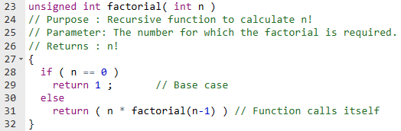
8.6 Recursion
Program Example
Note that
● Every recursive function must have at least one base case which stops the recursion
● The general case eventually reduces to a base case.

Slide 46
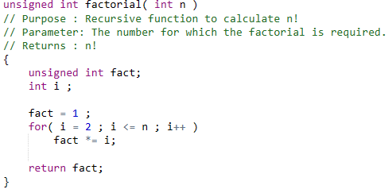
8.6 Recursion
The factorial function could be written using iteration
The recursive version will execute more slowly than the iterative equivalent because of the added overhead of the function calls.
The advantage of the recursive version is that it is clearer because it follows the actual mathematical definition of factorial.

Slide 47
8.7 The scope of a variable
The scope of a variable refers to the part of the program in which a variable can be accessed.
block scope
global scope
Block scope
A block is one or more statements enclosed in braces { and } that also includes variable declarations.
A variable declared in a block is accessible only within that block.

Slide 48
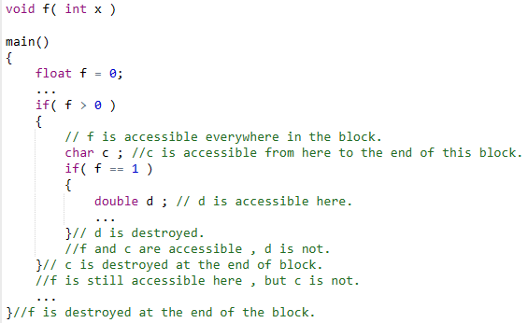
8.7 The scope of a variable
Block scope
The scope of the variable f

Slide 49
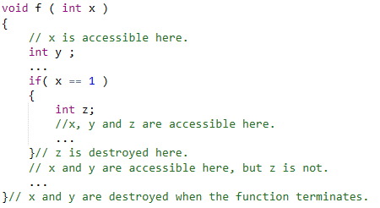
8.7 The scope of a variable
continued
The scope of the variable x , y

Slide 50
8.7 The scope of a variable
continued
The scope of the variable z

Slide 51
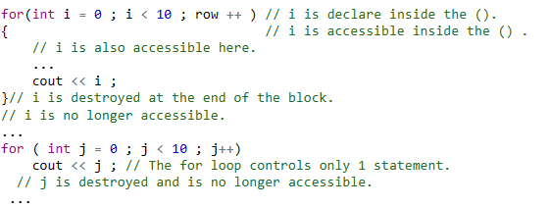
8.7 The scope of a variable
Variables declared inside the parentheses of a for are accessible within the parentheses, as well as in the statement(s) contained in the for loop.

Slide 52
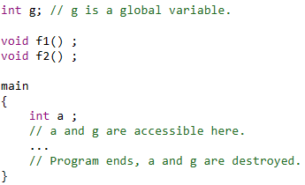
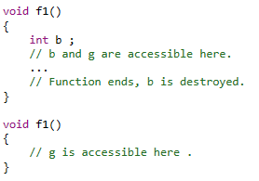
8.7 The scope of a variable
Global scope
A variable declared outside main() is accessible from anywhere within the program and is known as a global variable.

Slide 53

8.7 The scope of a variable
Global scope
A variable declared outside main() is accessible from anywhere within the program and is known as a global variable.
Because global variables are known, and therefore can be modified, within every function, they can make a program difficult to debug and maintain.
Global variables are not a substitute for function arguments. Apart from its own local variables, a function should have access only to the data specified in the function parameter list.

Slide 54
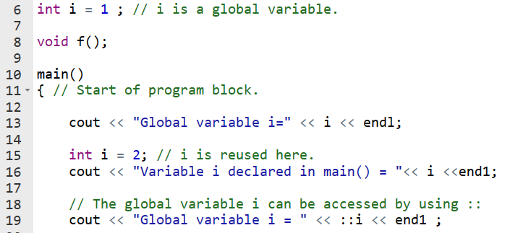
8.7 The scope of a variable
Reusing a variable name
It is permissible to give a variable the same name as another variable in another block. This is known as name reuse.
If a variable is declared in an inner block and if a variable with the same name is declared in a surrounding block, the variable in the inner block hides the variable of the surrounding block.

Slide 55
8.7 The scope of a variable
Reusing a variable name
It is permissible to give a variable the same name as another variable in another block. This is known as name reuse.
If a global variable is hidden by a local variable, the global variable can still be accessed using the unary scope resolution operator ::

Slide 56

Thank you for
your attention !
Q&A
ZhangMeiShan

Slide 57
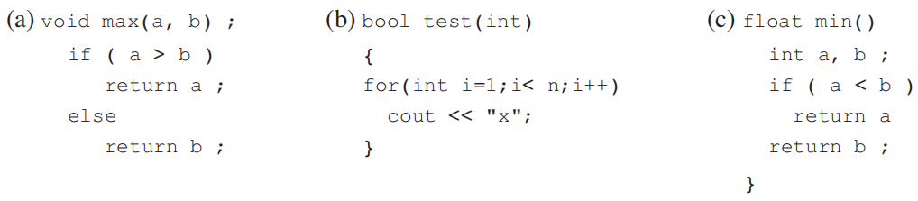
Homework
1. What is wrong with each of the following functions?

Slide 58
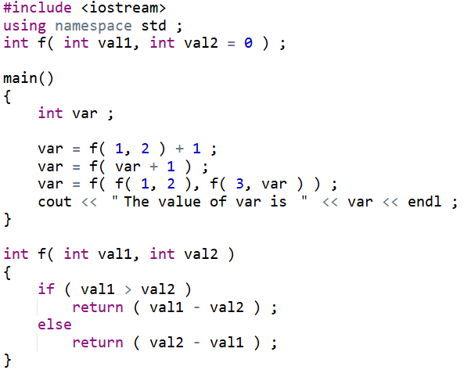
Homework
2. What is the output from the following?

Slide 59
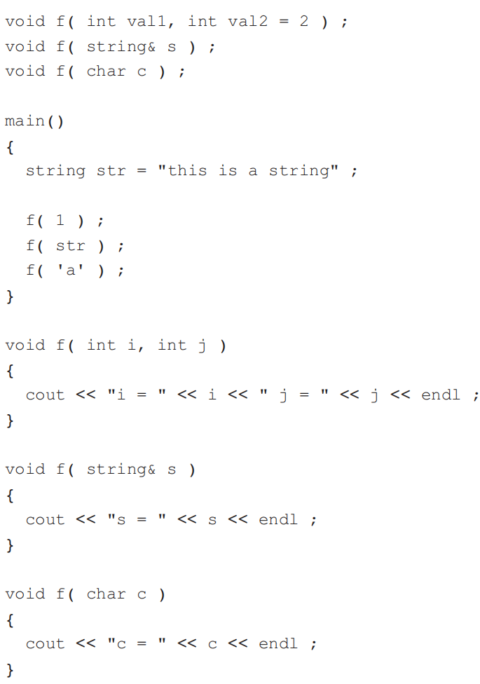
Homework
3. What is the output from the following?

Slide 60
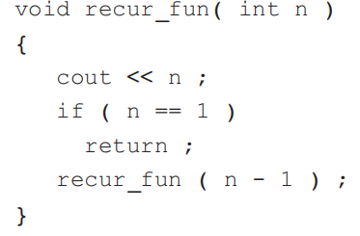
Homework
4. (a) Write a function to return the minimum value in an integer array. (b) Overload the function in (a) with a function to return the minimum value in a floating-point array.
5. What does this recursive function do?

