Slide 1
Lecture 9: Objects and Classes
Harbin Institute of Technology（Shenzhen）
School of Computer Science and Technology Zhang Meishan (mason.zms@gmail.com)
Copyright：Harbin Institute of Technology，Su Xiaohong， sxh@hit.edu.cn

Slide 2
Overview
Basic of object and class
Construct a class
Constructors
Class properties

Slide 3
9.1 Basics of Object and Class
An object is a component of a program that knows
how to perform certain actions
how to interact with other parts of the program.
An object consists of
one or more data values, which define the state or properties of the object
functions that can be applied to the object
The functions associated with an object represent what can be done to the object and how the object behaves.

Slide 4
9.1 Basics of Object and Class
Example：a computer game
A player will have data values to represent certain attributes, e.g. the state of their health or the weapons they possess.
A player must be able to perform functions such as walk, run, attack an enemy, and rescue the fair maiden to win.

Slide 5
9.1 Basics of Object and Class
A class is a general category that defines:
The characteristics that an object of that category contains. The characteristics are called properties or class data members.
The functions that can be applied to objects of that category. The functions are also called class member functions or methods.
Encapsulation
A class defines both the type of data and the operations that can be applied to that data.
Including both the data and functions into one unit, the class, is called encapsulation.

Slide 6
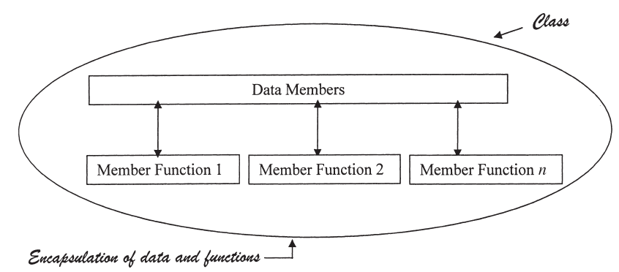
9.1 Basics of Object and Class
class
encapsulation of data and functions

Slide 7
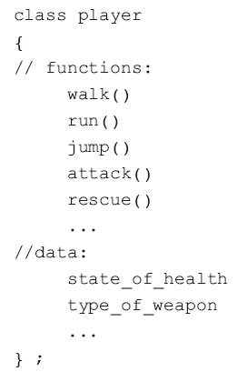
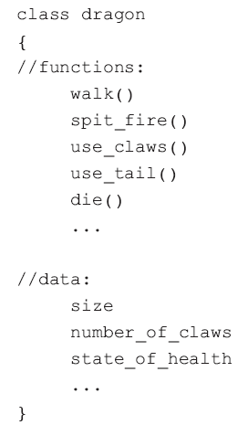
9.1 Basics of Object and Class
In our computer adventure game a player class may be defined as:
Note:
This is only a pseudo(not real)-code representation of the class used for explanatory purposes only.

Slide 8
9.1 Basics of Object and Class
A class and instance of the class
A class is a blueprint or a template that can be used to create many instances of the class.
An instance of a class is the actual object, created from the template, that can be manipulated by the member functions of the class.
The difference between a class and an instance of a class (an object) is like the difference between a noun and a proper noun.
person is a noun, John Smith is a proper noun
Person is the class and John Smith is the object.

Slide 9


9.1 Basics of Object and Class
Example: the adventure game
The following statement creates an instance of a dragon:
A class member function is called using the member selection operator (a dot):
Here george is an instance or an object of the dragon class.
The data in the parentheses represent initial values for some of the data members of george, e.g. size and number_of_claws.

Slide 10
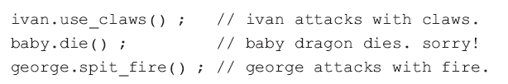
9.1 Basics of Object and Class
Example: the adventure game (continued)
Any number of dragon objects can be created.
Each dragon can perform different functions independent of each other.

Slide 11
9.1 Basics of Object and Class
To summarize:
An object is an instance of a class
An object has:
an identity, i.e. its name
a state, i.e. its data members
a behavior, i.e. its member functions.

Slide 12
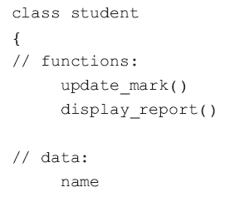
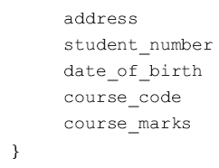
9.1 Basics of Object and Class
An example: A student class
Some of the properties (class data members) that define a student are the name, the address, the student number, the date of birth, the course and the course mark.
Some of the functions (class member functions or methods) that can be performed on a student are to update the student’s course mark, display a progress report and so on.
A student object is a specific instance of the student class.
Students in a course such as John Smith or Liu Wei are instances of the student Class.

Slide 13
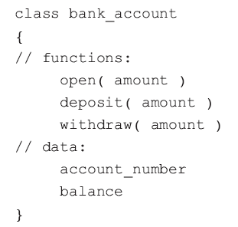

9.1 Basics of Object and Class
An example: A bank account class
A bank account has an account number and a balance.
Operations on a bank account class are to open the account with an amount of money and to deposit and withdraw money from the account.
These operations will be represented by class member functions such as open ( amount ), withdraw( amount ) and deposit( amount).

Slide 14
9.2 Constructing a class in C++
Abstraction
Each software object is a simplification of its real world counterpart.
In the computer adventure game, each software object behaves only in some respects as its real-world counterpart.
there may be no need for a player to eat, drink or sleep in the game.
The bank account class describes only the characteristics and operations that are relevant for the purposes of the program.
Abstraction is used in our everyday lives.

Slide 15
9.2 Constructing a class in C++
Abstraction
Abstraction is used in our everyday lives.
A lecture timetable will contain a subject, a lecturer’s name, a room number and a time.
On the timetable, the room where the lecture is to be held is represented simply by a number.
For a student, details of the room are unnecessary and are therefore not given.
For a college administrator the size of the room is relevant and so would be included in an abstraction for the purposes of college administration.

Slide 16
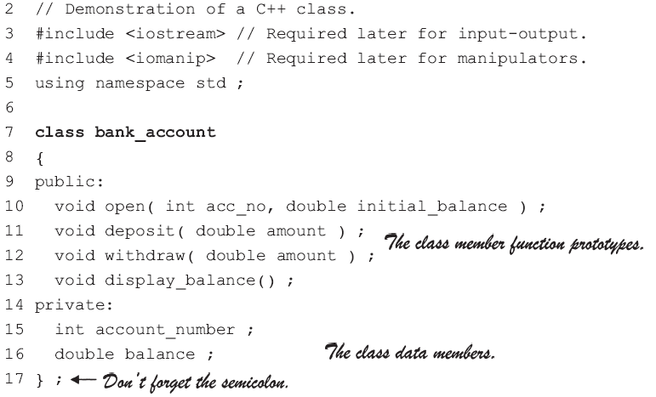
9.2 Constructing a class in C++
Program Example
On line 7, following the keyword class, the class is given the name bank_account
Lines 10 ~13 declare the member functions of the class
Lines 15 and 16 declare the data members of the class.
The members of the class are divided into private and public members.
The keywords private and public specify the access control level for the data and function members of the class.
The class member function prototypes.
The class data members.
Don’t forget the semicolon.

Slide 17
9.2 Constructing a class in C++
Information hiding
The private data members are accessible only to member functions of the class and unavailable to any functions that are not members of the class.
Members declared with public access are accessible in any part of a program.
A public member function can be called from any part of a program, while a private member function can only be called from within member functions of the same class.
The public member functions are known as the public interface in class.

Slide 18
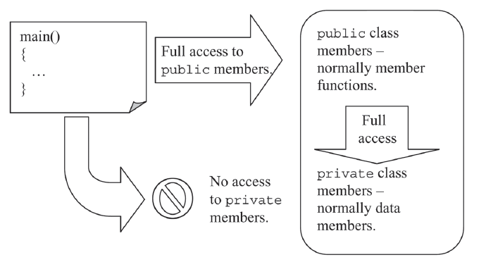
9.2 Constructing a class in C++

Slide 19
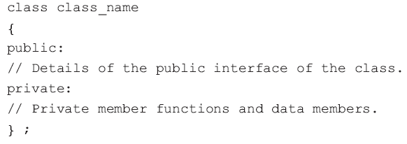
9.2 Constructing a class in C++
The general format of a class
Generally, data members of a class are all private and the member functions of the class are all public.
The public section is usually placed at the start of the class before the private section.

Slide 20
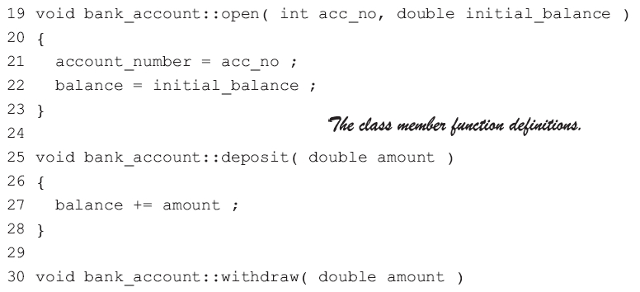
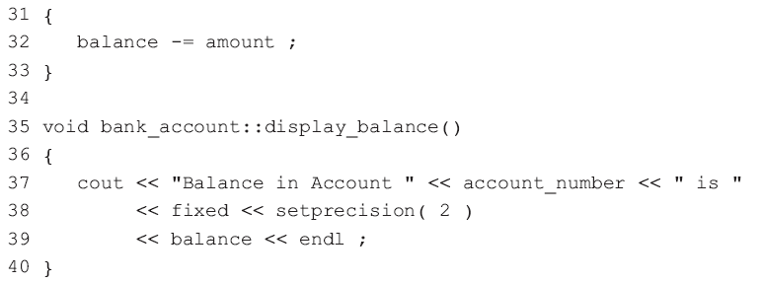
9.2 Constructing a class in C++
The class member functions must be defined
The class function definitions.

Slide 21
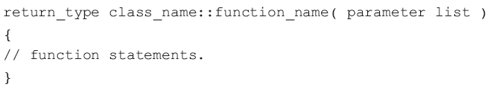
9.2 Constructing a class in C++
A class member function has the general format:
The scope resolution operator :: is used here to specify that a function is a member of a class.

Slide 22
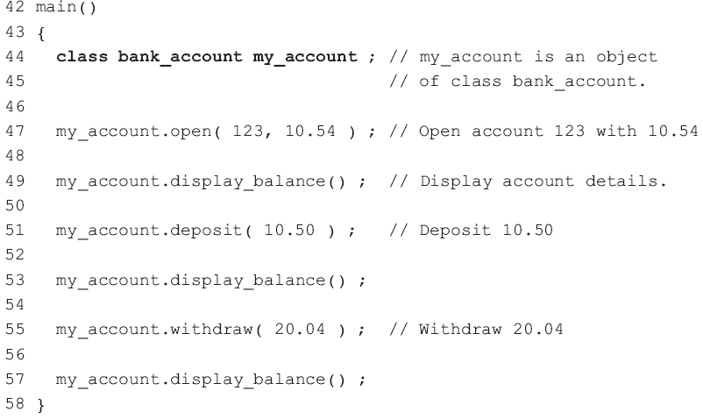
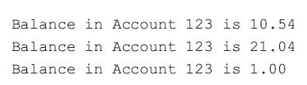
9.2 Constructing a class in C++
To use the bank_account class, place the class and member function definitions before main().
The objects of the class are defined and used in main().
Line 44 creates a bank_account object called my_account
Line 47 initializes the data members of the class by calling the member function open() with values for the account_no and balance

Slide 23
9.2 Constructing a class in C++
C++ built-in data types
Each data type has a unique range of allowable values and a set of allowable operations and functions.
The implementation details of the data types are hidden from the programmer. This is called data abstraction.

Slide 24
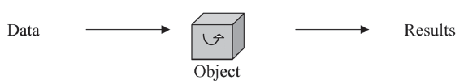
9.2 Constructing a class in C++
Abstract Data Type (ADT)
The bank account class defines a new data type that is not built into the C++ language.
Once written, it is not necessary to know the details of how each of the class member functions work.
know how to call the public member functions of the class such as open(), deposit()and withdraw().

Slide 25
9.3 Constructors
Constructor
a class member function that has the same name as the class
be automatically called when an object of the class is created
frequently used to provide the private data members of the object with initial values.
Example:
The private account_number and balance are assigned their initial values in open().
a constructor is added to the bank_account class in place of the open() member function.

Slide 26
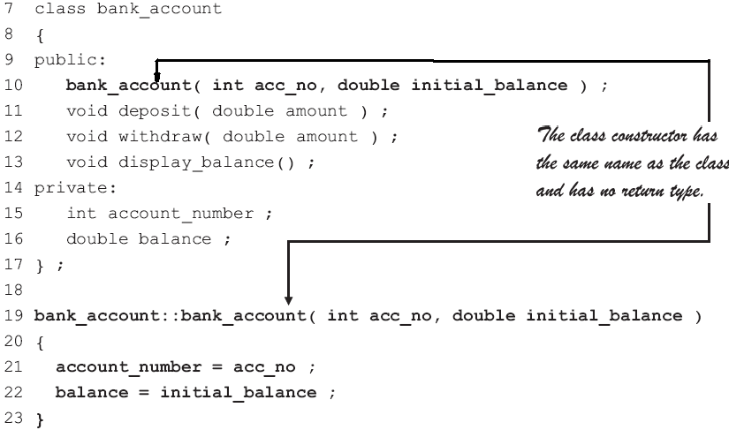
9.3 Constructors
Program Example
The constructor is never explicitly called and therefore cannot return a value.
That’s why a class constructor has no return type, not even void.
The class constructor has the same name as the class and has no return type.

Slide 27
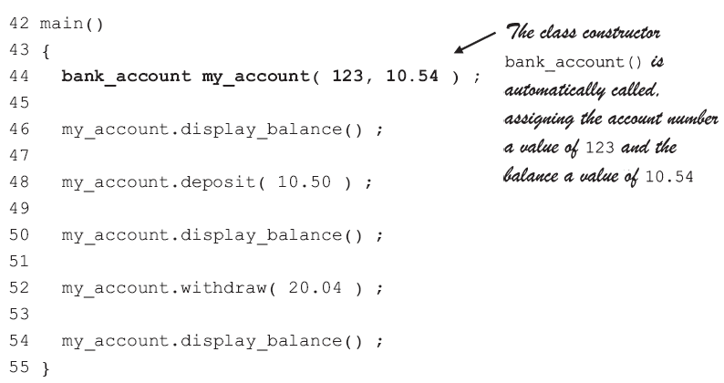
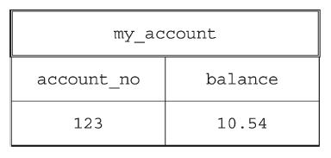

9.3 Constructors
Rewriting main() to make use of the class constructor
The class constructor bank_account() is automatically called, assigning the account member a value of 123 and the balance a value of 10.54.
Line 44 of this program creates an object called my_account with these values:

Slide 28
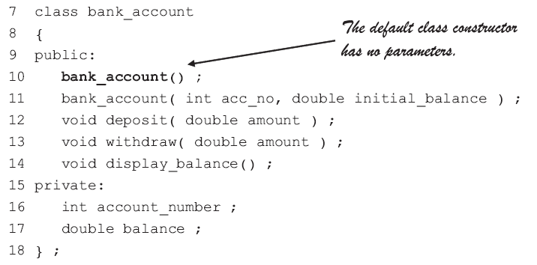
9.3 Constructors
A default class constructor is a constructor that has no parameters.
The default class constructor has no parameters.

Slide 29
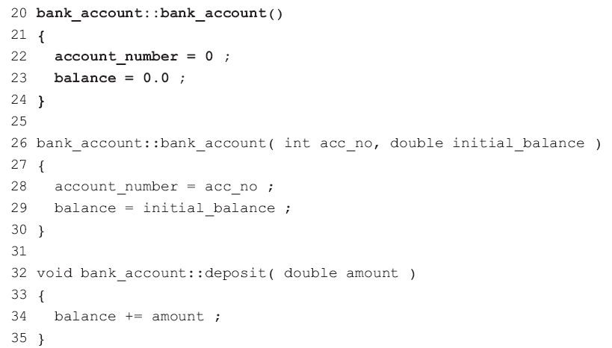
9.3 Constructors
Program Example

Slide 30
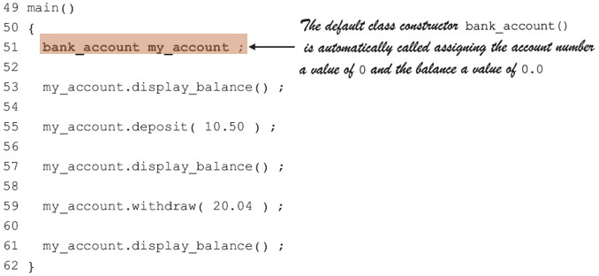
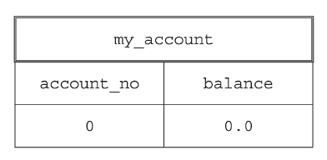
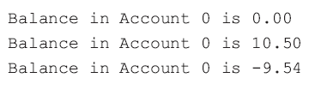
9.3 Constructors
Program Example…continued
The default class constructor bank_account() is automatically called assigning the account number a value of 0 and the balance a value of 0.0

Slide 31
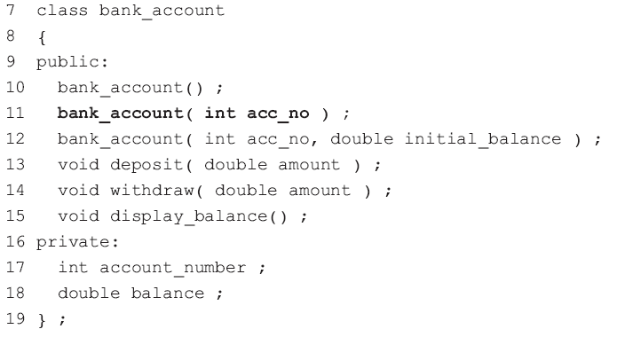
9.3 Constructors
Constructors can be overloaded
There can be several constructors within a class, each with a different number of parameters

Slide 32
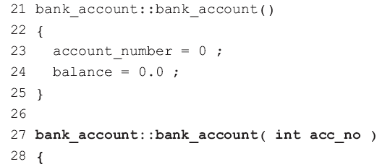
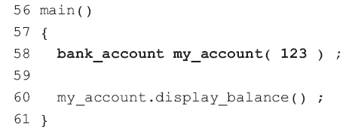
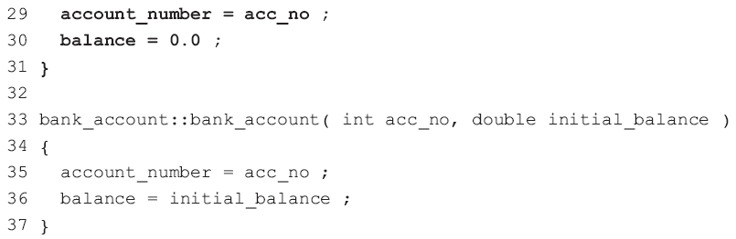
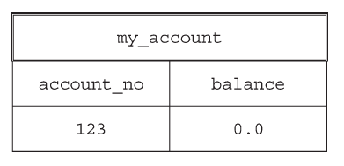
9.3 Constructors
Only one argument given when the object my_account is being created
the class constructor on lines 27 to 31 is called, assigning 123 to the account number and 0.0 to the balance.

Slide 33
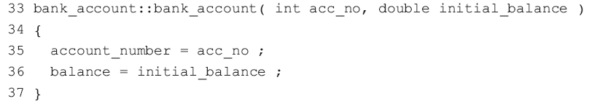
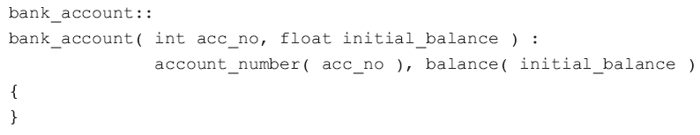
9.3 Constructors
A data member initialization list is frequently used in constructors in place of assignment statements.
No statements left in this constructor
The chain brackets {} are still required

Slide 34
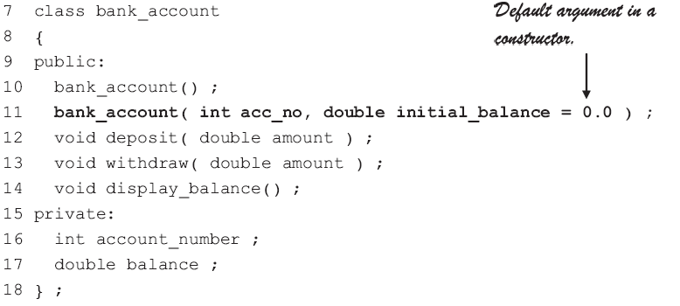
9.3 Constructors
Constructors are functions, default arguments can also be used in constructors
Default argument in a constructor.

Slide 35
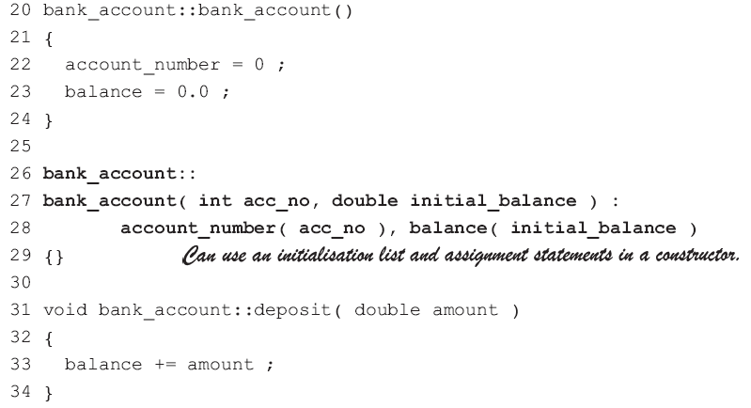
9.3 Constructors
Can use an initialization list and assignment statements in a constructor.

Slide 36
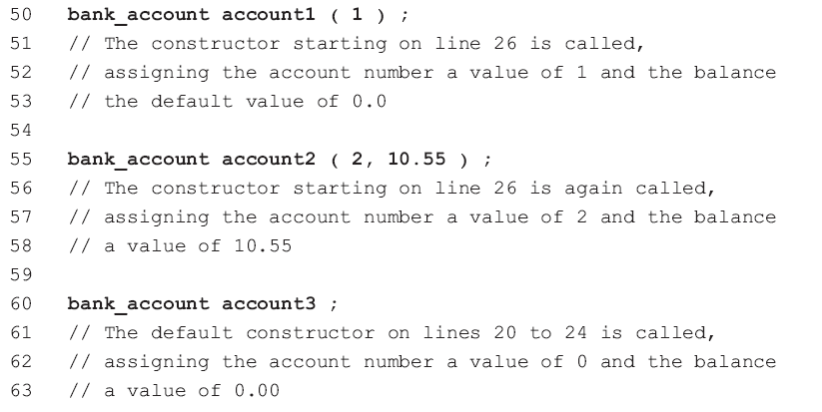

9.3 Constructors

Slide 37
9.4 Class properties
static class data members
A static class data member is independent of all the objects that are created from that class.
Only one copy of a static data member exists and is shared by all objects of a particular class.
The value of the static data member is therefore the same for all the class objects.
If even one of the objects of a class modifies the value of a static data member, then the value of the static data member changes for every object of that class.

Slide 38
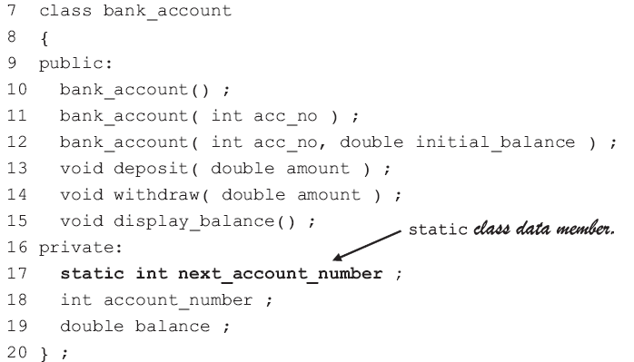
9.4 Class properties
static class data member.

Slide 39
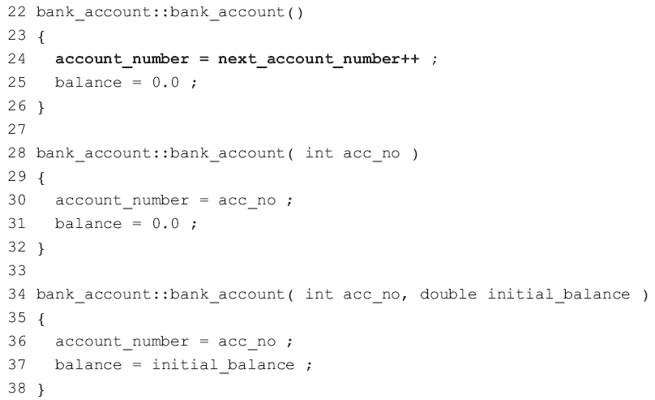
9.4 Class properties

Slide 40
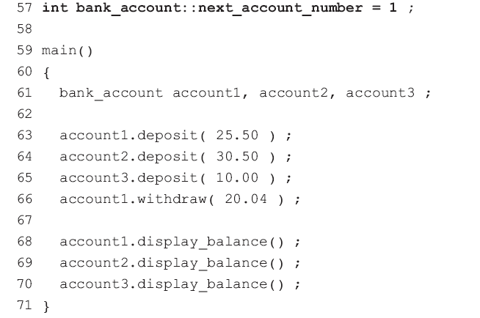
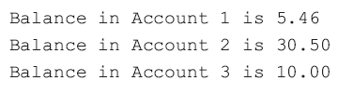
9.4 Class properties
A static data member is initialized outside the class and outside main()
next_account_number occurs only once and is shared by all objects of the class and bank account objects.

Slide 41
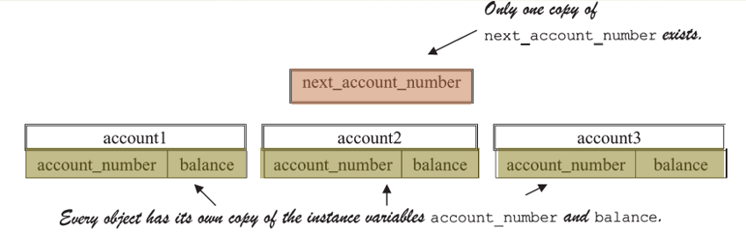
9.4 Class properties
Only one copy of next_account_number exists.
Every object has its own copy of the instance variables account_number and balance.
class variable:
Associated with a class rather than an object
instance variables
Associated with instances of the class and are called.

Slide 42
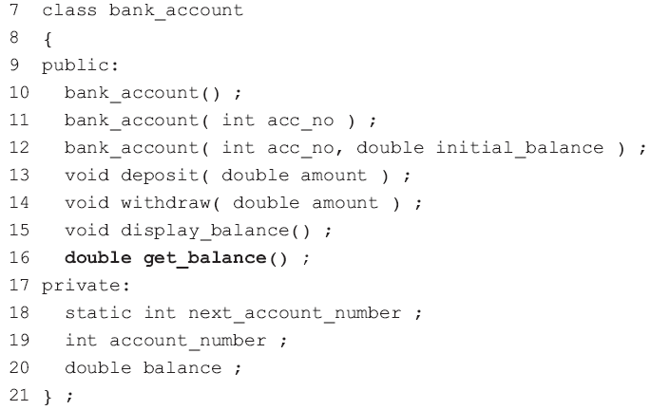
9.4 Class properties
A class member function can return a value using a return statement

Slide 43
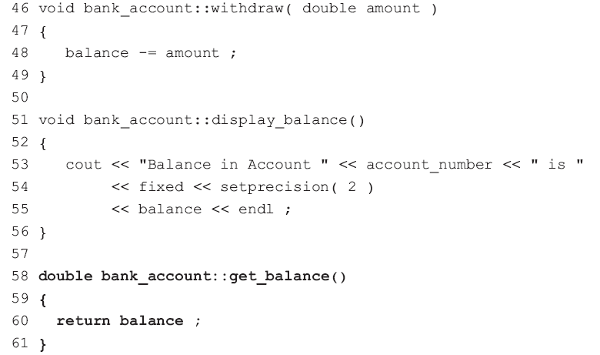
9.4 Class properties

Slide 44
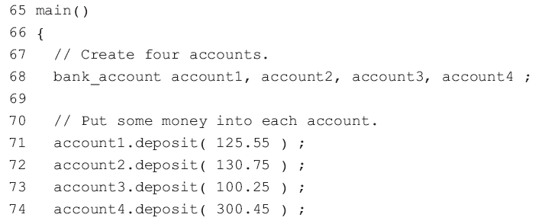
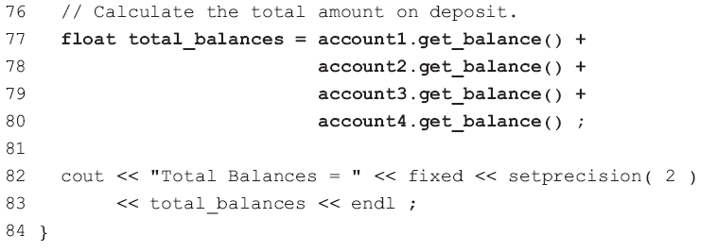
9.4 Class properties
inspector or accessor function
The member function get_balance(), Inspector functions allow private data members of a class to be inspected from outside the class.
mutator function
The class member functions deposit() and withdraw(). Mutator functions change the values of the private data members of a class.

Slide 45

9.4 Class properties
Inline functions are useful in cases like this where you want to use a function but don’t want the function overheads
The member functions of a class can be made inline by preceding the function header with the keyword inline.
An alternative way of making a member function inline is to include the function definition in the body of the class.

Slide 46
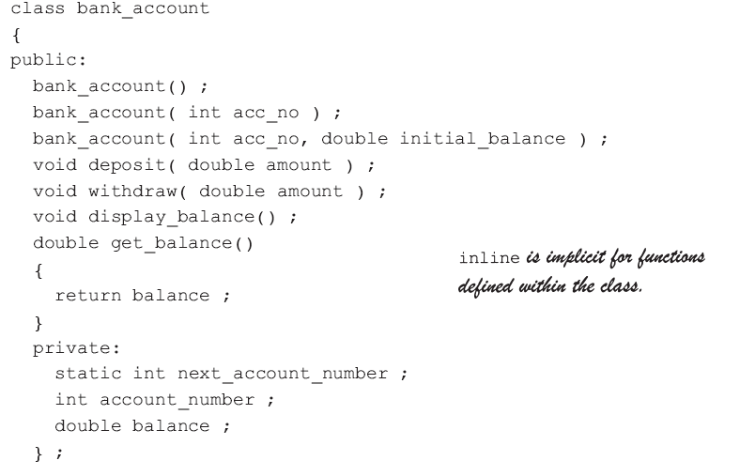
9.4 Class properties
A disadvantage of making functions inline by moving their definitions into the class is that the class becomes ‘crowded’ with details.
inline is implicit for functions defined within the class.

Slide 47
9.4 Class properties
class public interface: a list of the member functions of the class and how they can be used.
The public interface starts at public and ends at the keyword private.
A programmer using a class should only have to read the public interface in order to use the class;
To make the public interface easier to read, comments should be included explaining the purpose of the functions, their parameters and their return values.
class implementation: details in the private section and in the member functions

Slide 48

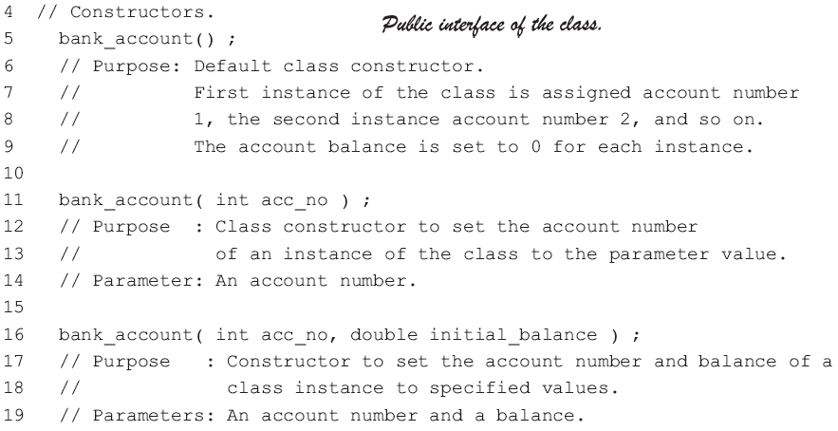
9.4 Class properties
Public interface of the class.

Slide 49
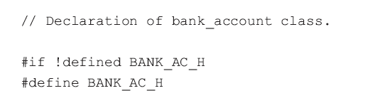
9.4 Class properties
Separation of class interface and class implementation
It is not possible in C++ to completely separate the public interface of a class from its implementation.
In C++, the class declaration is normally placed in a header file (e.g. bank_ac.h) and the member functions are normally placed in a separate file (e.g. bank_ac.cpp).
file bank_ac.h:
The lines beginning with # are standard preprocessor directives used to prevent multiple inclusions of the header file into a program.

Slide 50
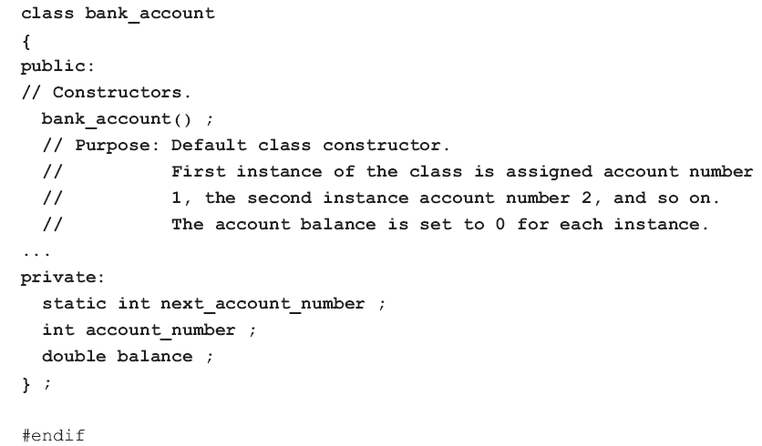
9.4 Class properties
bank_ac.h:

Slide 51
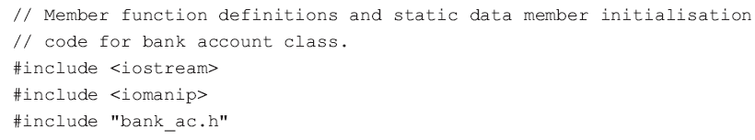
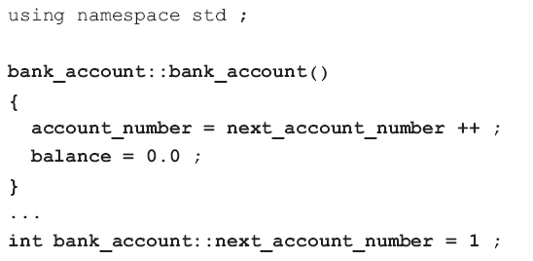
9.4 Class properties
Placing the member functions into bank_ac.cpp:

Slide 52
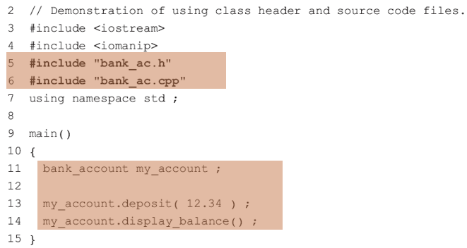
9.4 Class properties
Using these two files, we can write:
Lines 5 and 6 are preprocessor directives that incorporate the bank account header and source files into the program.
The quotes around the file names on lines 5 and 6 tell the compiler that the files to be included are in the same directory as the program.

Slide 53
9.4 Class properties
Use of namespaces in header files
A program may contain many classes and functions #included from many different header files.
An element in one of the header files may have inadvertently been given the same name as an element in another header file (result in a compiler error).
namespace: a named block of statements in a program.
Within a namespace, an identifier name must be unique although the name may be previously used in other namespaces.

Slide 54



9.4 Class properties
classlib1.h classlib2.h

Slide 55

9.4 Class properties
Ways to distinguish between the two versions of alpha in a program.
use the scope resolution operator (::).

Slide 56

9.4 Class properties
Ways to distinguish between the two versions of alpha in a program.
with the using statement.
This form of the using statement provides access to a specific element in a namespace.

Slide 57


9.4 Class properties
Access to all the elements of a namespace can be achieved with a second form of the using statement:
The std namespace is used throughout the examples in this book.
The standard library classes, functions and objects like cin and cout are defined in this namespace.

Slide 58

Thank you for
your attention !
Q&A
ZhangMeiShan

Slide 59
Homework
1. Write a class declaration for each of the following classes. Include the member functions assign_data() to assign values to the data members and display_data() to display the values of the data members.
(a) A class current_date with integer data members day, month, and year.
(b) A class current_time with integer data members hours, minutes, and floating point data member seconds.
Create an object of each of the above classes in main().
Use assign_data() to assign values to the data members of each object.
Display these values on the screen using display_data().

Slide 60
Homework
2. Add a default constructor to each class in exercise 1.
3. Modify the classes developed in exercise 1 as follows:
(a) Add a member function increment_date() to the current_date class that adds one day to the current date.
(b) Add a member function increment_time( s ) to the current_time class that adds s seconds to the current time.

Slide 61

Homework
4. The following is a class for recording the position of a motorised robot.

Slide 62

Homework
The following is a demonstration of the class robot:
Write the member functions left(), right(), forward(), back(), goto() and return_to_base().

