Slide 1
Lecture 9 (b): Class Inheritance
Harbin Institute of Technology（Shenzhen）
School of Computer Science and Technology Zhang Meishan (mason.zms@gmail.com)
Copyright：Harbin Institute of Technology，Su Xiaohong， sxh@hit.edu.cn

Slide 2
Overview
Inheritance and its syntax
Inheritance Constructor
Protected class members
Types of inheritance

Slide 3
9.1 Inheritance and its syntax
Inheritance is one of the fundamental concepts of object-oriented programming.
Inheritance allows a new class to be constructed using an existing class as a basis.
The new class incorporates or inherits the data members and member functions of the existing class.
Additional data members and member functions can be added to the new class, there by extending the existing class.
The existing class is known as the base class.
The new class is known as the derived or inherited class.

Slide 4
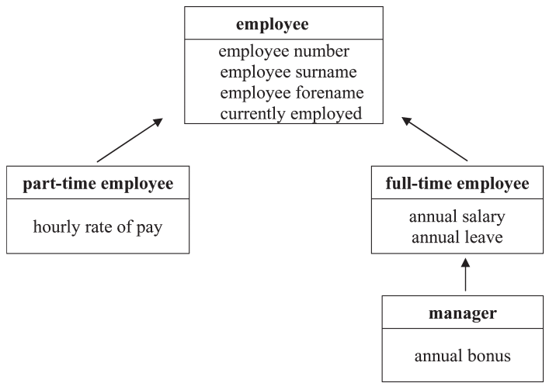
9.1 Inheritance and its syntax
How to implement this inheritance Hierarchy?
Do we need to define employee number, surname, forename, employed for each class?

Slide 5
9.1 Inheritance and its syntax
Employees in the company are either part-time or full-time. The employee number and name are common to both types of employee.
Whether the person is currently employed or is a past employee is also common to both types of employees.
Part-time employees are paid an hourly rate .
full-time employees are on a salary and are allowed an annual paid leave.
Managers are also full-time employees, who in addition to their annual salary and paid leave are also paid an annual bonus.

Slide 6
9.1 Inheritance and its syntax
Employees class is known as the base.
the base class is not modified in any way and is simply used as a basis for writing the derived class.
This is called reusability (the base class is being reused) and is a major goal of object-oriented programming.
The derived class can, in turn, be used as a base class from which other classes may be derived, thus creating a class hierarchy.

Slide 7
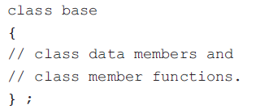
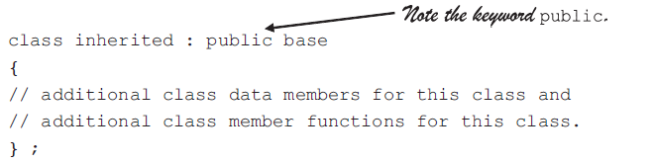
9.1 Inheritance and its syntax
In its simplest form, inheritance is used by first defining the base class:
Then the derived classes are defined (this is the same as defining any class. ):

Slide 8

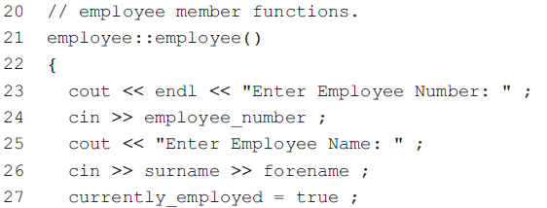
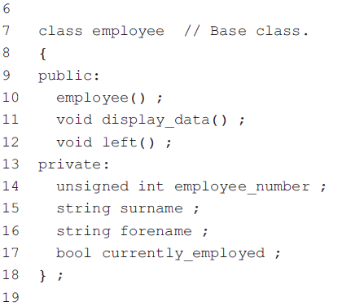

9.1 Inheritance and its syntax

Slide 9
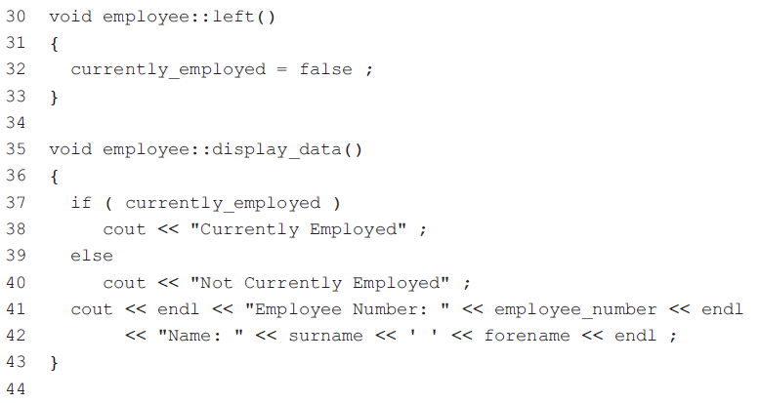
9.1 Inheritance and its syntax

Slide 10
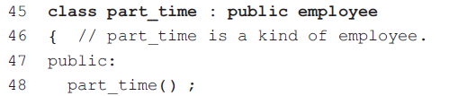
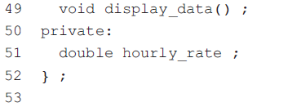
9.1 Inheritance and its syntax
derived class.
Inheritance creates a hierarchy of related classes (types) which share code and interface.
code reusability
class part_time : public employee
Syntax:
class DerivedClassName : access-level BaseClassName
access-level specifies the type of derivation
private by default,
public
protected

Slide 11
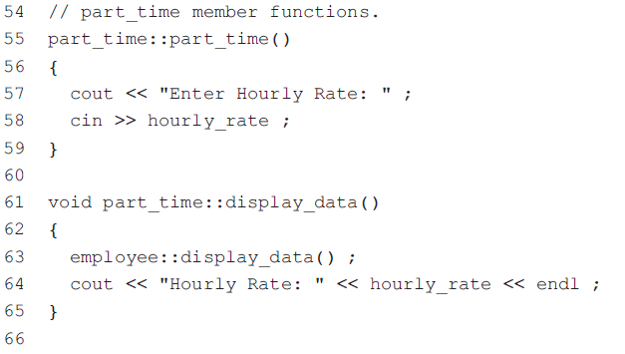
9.1 Inheritance and its syntax
A derived class can override methods defined in its parent class. With overriding,
the method in the subclass has the identical signature to the method in the base class.
a subclass implements its own version of a base class method.

Slide 12
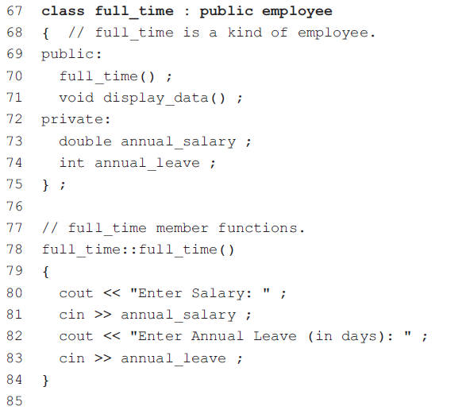
9.1 Inheritance and its syntax

Slide 13
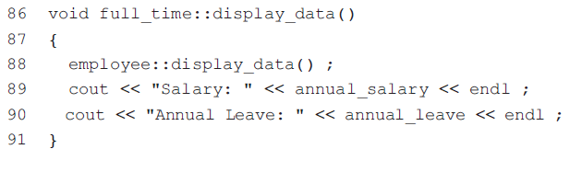
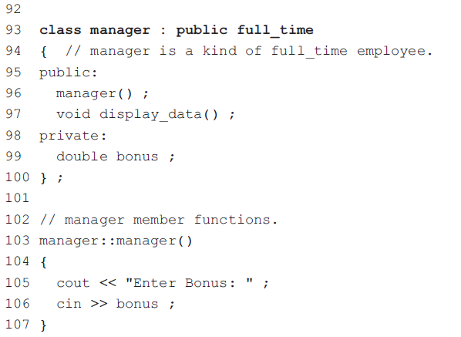
9.1 Inheritance and its syntax

Slide 14
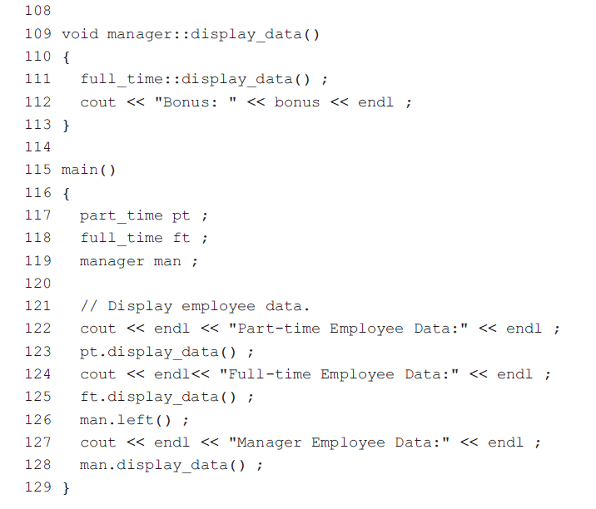
9.1 Inheritance and its syntax
The base class default constructor is automatically called from the derived class.
Which display_data() is called??

Slide 15
9.2 Inheritance Constructor
How to initialize the data members of objects ?
part_time pt( 123, "Smith", "John", 5.12 ) ;
full_time ft( 124, "Jones", "Mary", 21500, 21 ) ;
manager man( 125, "Other", "A.N.", 32000, 30, 9500 ) ;

Slide 16
9.2 Inheritance Constructor
To allow for initialization of an object when it is created, a constructor with a parameter list is required.
When a derived object is created, it should take care of the construction of the base object by calling the constructor for the base class.
The base class default constructor is automatically called from the derived class.
When an object has initial values, the initialization of the base class object is done by the use of an initialization list in the derived class constructor.

Slide 17
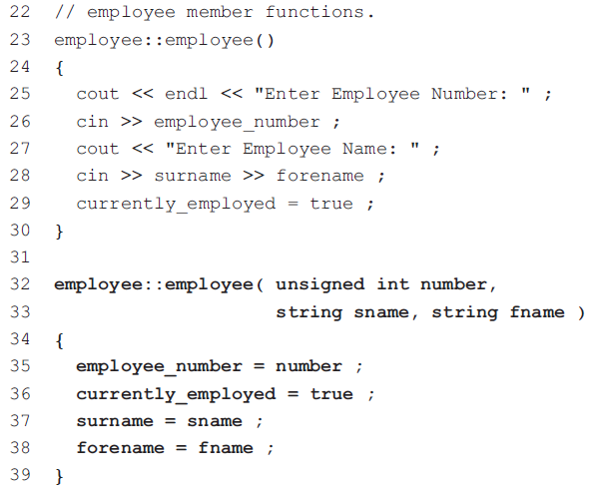
9.2 Inheritance Constructor

Slide 18
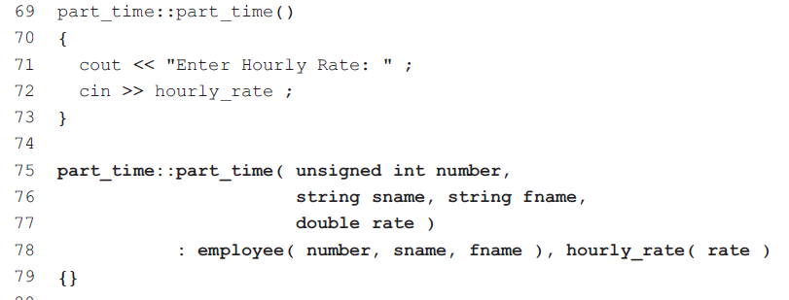
9.2 Inheritance Constructor

Slide 19
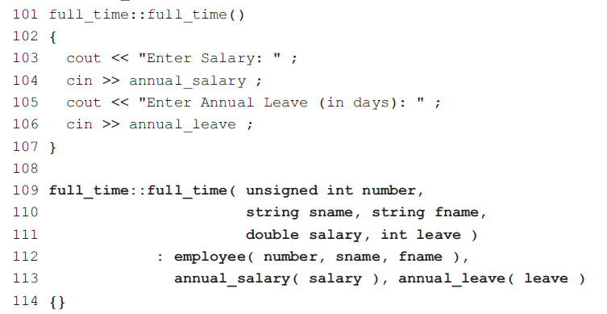
9.2 Inheritance Constructor

Slide 20

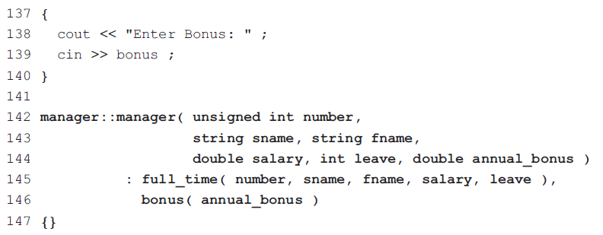
9.2 Inheritance Constructor

Slide 21
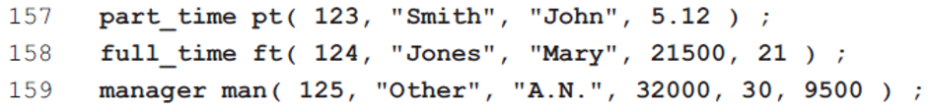
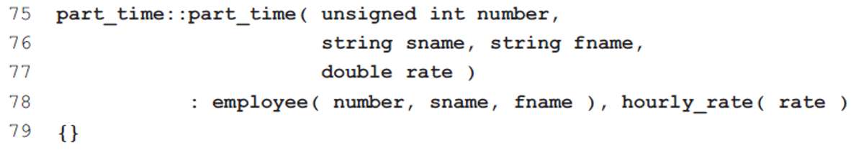
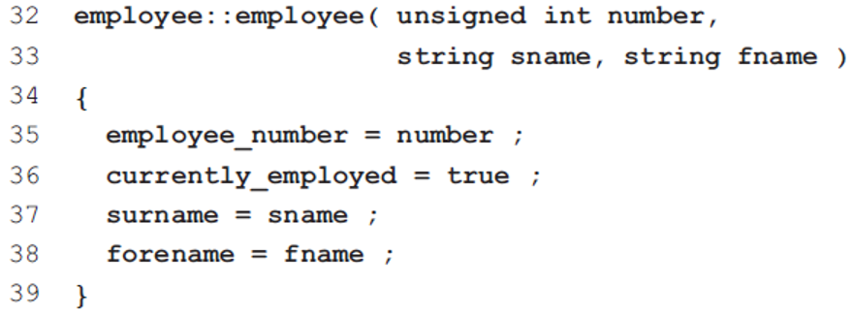
9.2 Inheritance Constructor
Line 157 now initializes the object pt with the values in the parentheses.
The constructor on lines 75 to 79 is called.
The expression employee (number, sname, fname) in the initialization list on line 78 is an explicit call to the base class constructor on lines 32 to 39.

Slide 22
9.3 Protected class members
The keywords private and public are used to control access to both the data members and the member functions of a class.
A private data member or member function of a base class cannot be accessed from a member function of a derived class, thus ensuring that the principle of data hiding is upheld.
In practice it can be convenient to share data between a base class and a derived class.

Slide 23
9.3 Protected class members
There are two ways of doing this. One possibility is to change the access level of the relevant private members to public, thus allowing the derived class the required access to these members.
this violates the principle of data hiding by making the data members available for uncontrolled modification from any part of the program.
To get over this problem, C++ has a third level of access known as protected access.
This level of access allows derived classes (and only derived classes) to have access to specified base class members.

Slide 24
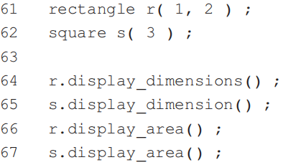
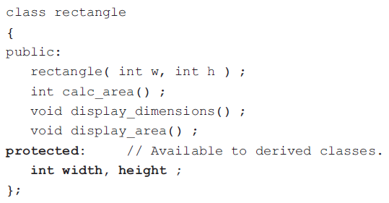
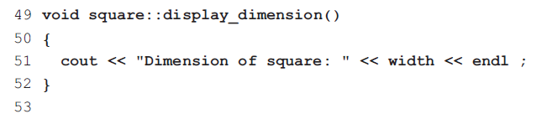
9.3 Protected class members
Line 61 defines a rectangle object r with sides of width 1 and height 2.
Line 62 defines a square object s with sides of size 3.
Line 64 displays the dimensions of the rectangle and line 65 displays the dimension of the square.
In order to display the dimension of the square, line 51 requires access to the base class data member width.
This is achieved by making width a protected data member by placing it in the protected section of the class.

Slide 25
9.3 Protected class members
If a base class member is declared as private, then this member is not accessible outside the base class, not even from a derived class.
Protected members are accessible from within a base class and from within any of its derived classes.
Public members (usually member functions) are accessible from any part of the program.

Slide 26

9.4 Types of inheritance
The access rights of a base class member within a derived class can also be specified when the derived class is declared.
Public inheritance specifies that the access rights of the inherited members will be the same as they were in the base class.
Protected inheritance makes all public members in the base class become protected members in the derived class.
With private inheritance, all the public and protected members of the base class become private in the inherited class.

Slide 27
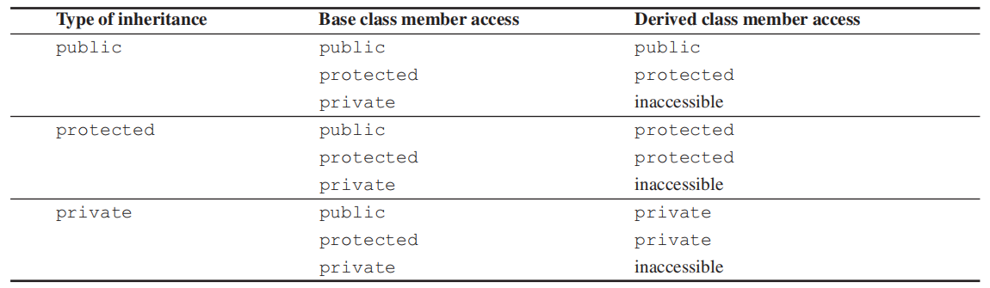
9.4 Types of inheritance
The three types of inheritance are summarized as follows:
Protected members in the base class remain protected members in the derived class.
Private inheritance is specified by using the keyword private.
In all cases, whether it is public, protected or private inheritance, private members in a base class are inaccessible in a derived class.

Slide 28

Thank you for
your attention !
Q&A
ZhangMeiShan

Slide 29
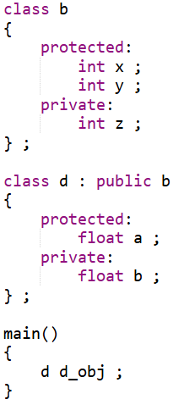
Homework
1. In the code segment below, how many data members has the object d_obj?

Slide 30
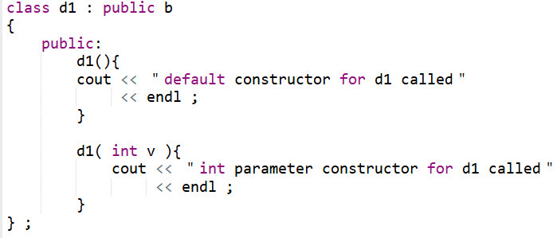
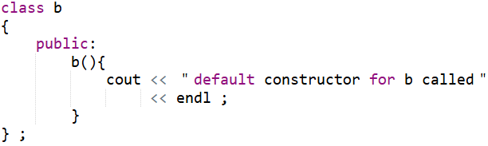
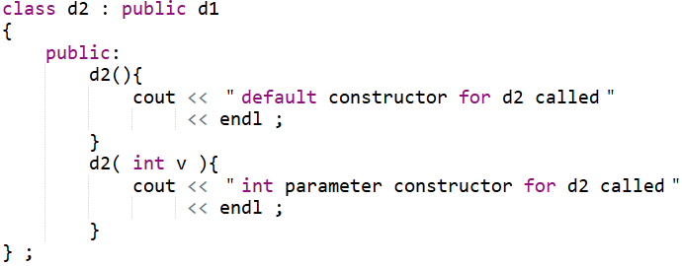
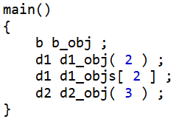
Homework
2. What is the output from the following program segment?

Slide 31
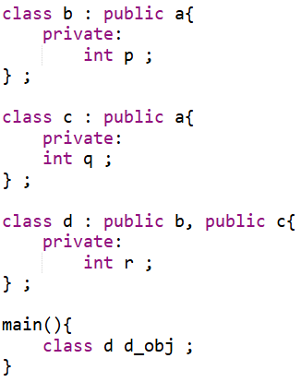
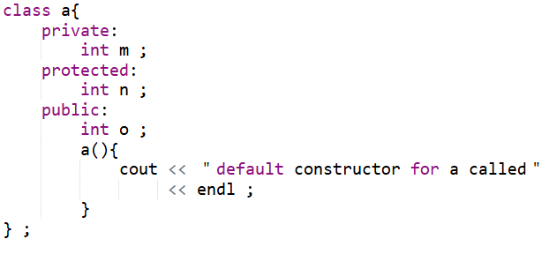
Homework
3. (i) How many copies of the data member m, n and o does an object of class d inherit?
(ii) How many times is the constructor
in the base class a called for the object d_obj?

Slide 32
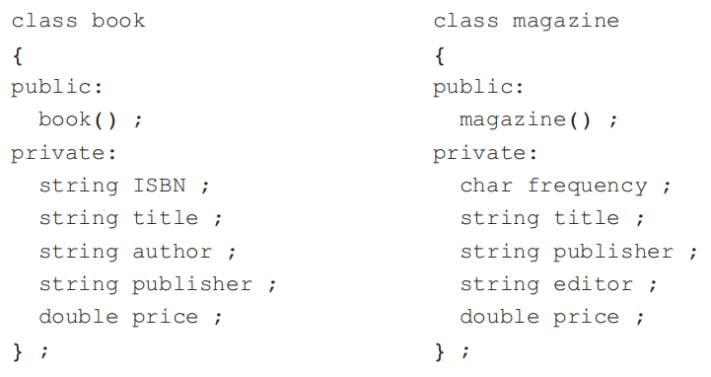
Homework
4. Place the following two classes into a class hierarchy so that they inherit from a common base class:
Write the base class with its constructor.

Slide 33
Homework
5. From the book class of exercise 4, use inheritance to derive a library_book class. This class will contain details of when a book was borrowed and by whom. For identification purposes, each library user has a six-digit library number.

