Slide 1

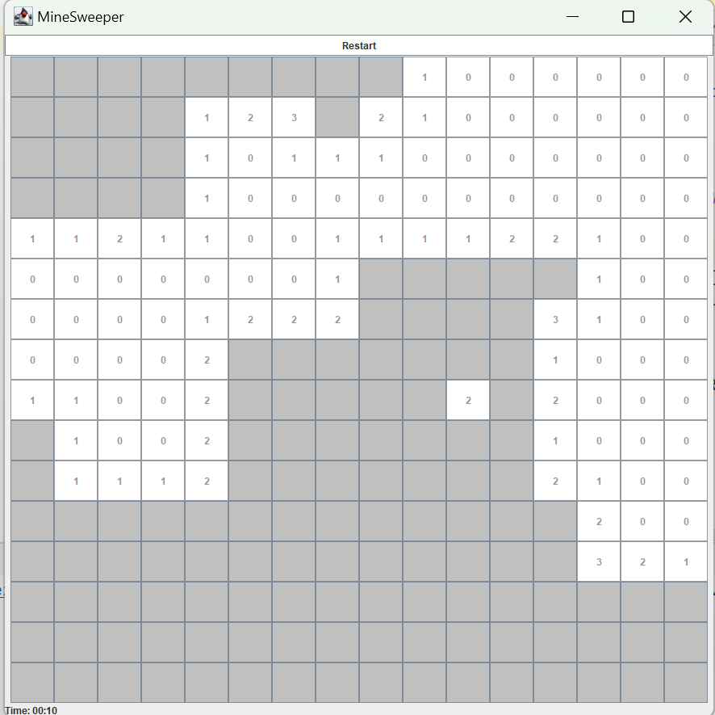
13rD FEB 2025
MineSweeping
Relax, play, and enjoy—anytime, anywhere!
PREPARED BY
Mengyao Zhang, Anting Zhu, lingjia Li, Nuan Leng, Xintong Du, Yuanxi Luo

Slide 2
Outline
MineSweeping
Problem Descriptions
Problem Observations
Competitive Products Analysis
Core Functions
Innovative Features
Visual Design introduction

Slide 3

Part1 Problem Descriptions
Unveiling Data Science
User Description
relaxing
mentally engaging
easy to pick up
play in short sessions
involve logical thinking

Slide 4
Part1 Problem Descriptions
Unveiling Data Science
Problem Description
Complex rules and demand much time
2. Too simple and boring
3. Heavy system requirements
？

Slide 5
Part2 Problem Observations
MineSweeping
Current User Solutions
Types | Shortcomings
Social media and short videos | can be addictive, affect study efficiency
Web-based mini-games | vary in quality, require frequent online loading, contain excessive advertisements
Existing puzzle games | become monotonous or mentally demanding
Other time-dependent games | do not support pausing and resuming progress

Slide 6
Part2 Problem Observations
MineSweeping
User Preferences: the primary goal is relaxation
not too simple, not too difficult
Need for fragmented time playability
Smooth experience
shorter loading time
no advertisements
even no need for internet connection

Slide 7
Part 3 Competitive Products Analysis
MineSweeping
1. Classic Windows Version
A classic puzzle game from Windows 3.1 to XP, where players uncover tiles while avoiding mines using numerical clues. It features Beginner (9×9), Intermediate (16×16), and Expert (30×16) difficulty levels.
2. Minesweeper Online
A web-based Minesweeper with customizable board sizes, leaderboards, and timer challenges. It retains classic mechanics while adding modern online features.

Slide 8
Part 3 Competitive Products Analysis
MineSweeping
 | Customizable board | Timer System | Online Multiplayer | Sound Effects | Difficulty Selection | Leaderboard
Our Java Minesweeper | ✔️ | ✔️ | ❌ | ✔️ | ✔️ | ❌
Classic Windows Version | ✔️ | ✔️ | ❌ | ❌ | ✔️ | ✔️
Minesweeper Online | ✔️ | ✔️ | ✔️ | ✔️ | ✔️ | ✔️

Slide 9
Part 3 Competitive Products Analysis
MineSweeping
1. Development Language & Platform
2. Game Logic & Functionality
3. Performance & Compatibility

Slide 10
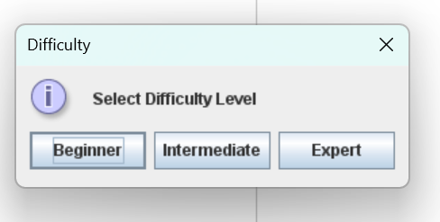
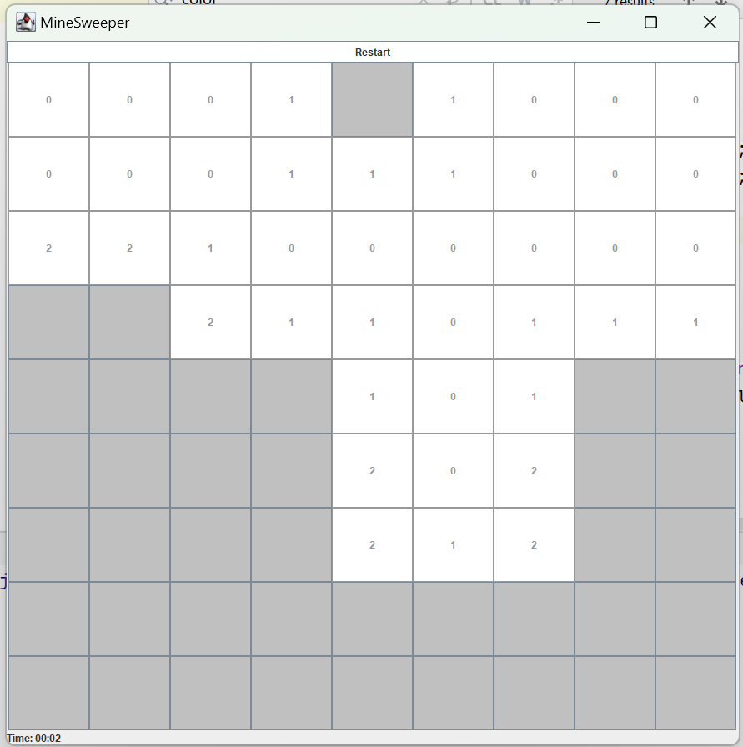
Part 4 Core Functions
MineSweeping
1.
Difficulty Levels: Beginner, Intermediate, Expert
The game offers three difficulty levels, allowing players to choose how challenging the game will be.
2.
Normal Gameplay Process:
Once the game starts, the grid is filled with hidden cells. The goal is to uncover cells without triggering any bombs.

Slide 11
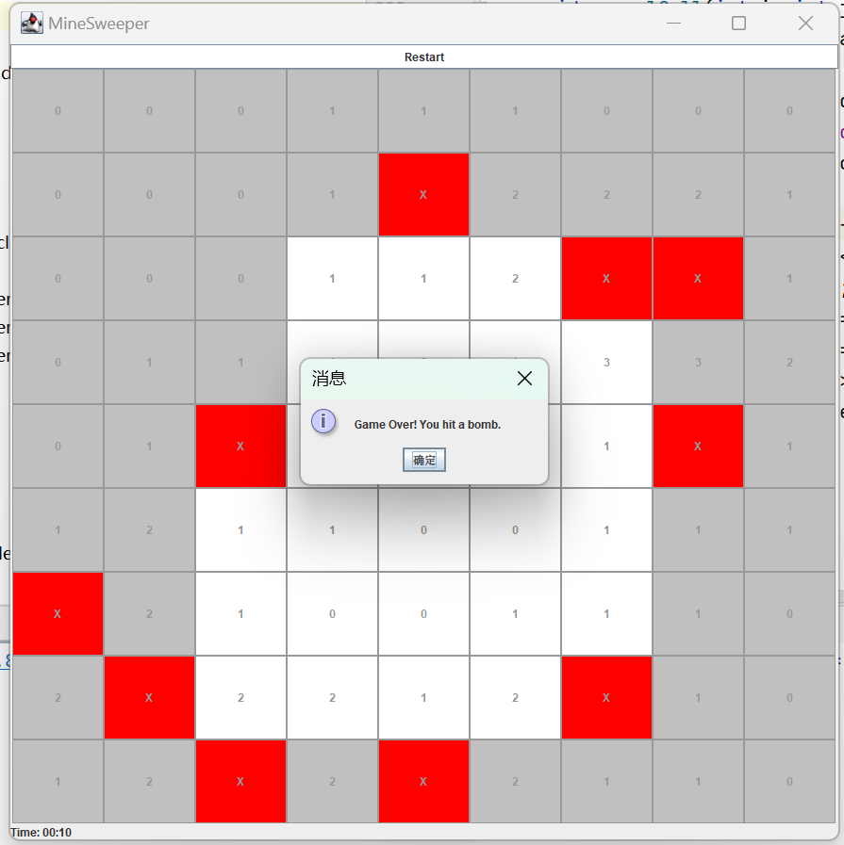
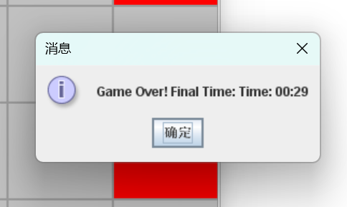
Part 4 Core Functions
MineSweeping
3.
Bomb Hit:
When the player clicks on a cell containing a bomb, the game ends. A message box will appear, indicating "Game Over! You hit a bomb."
Timer :
If the player wins or loses, a message will appear showing the final time taken.Displays "Game Over! Final Time: Time: XX:XX".
4.

Slide 12
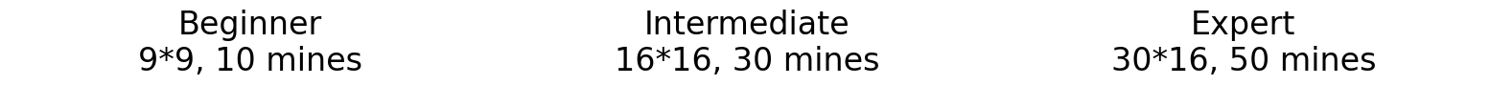
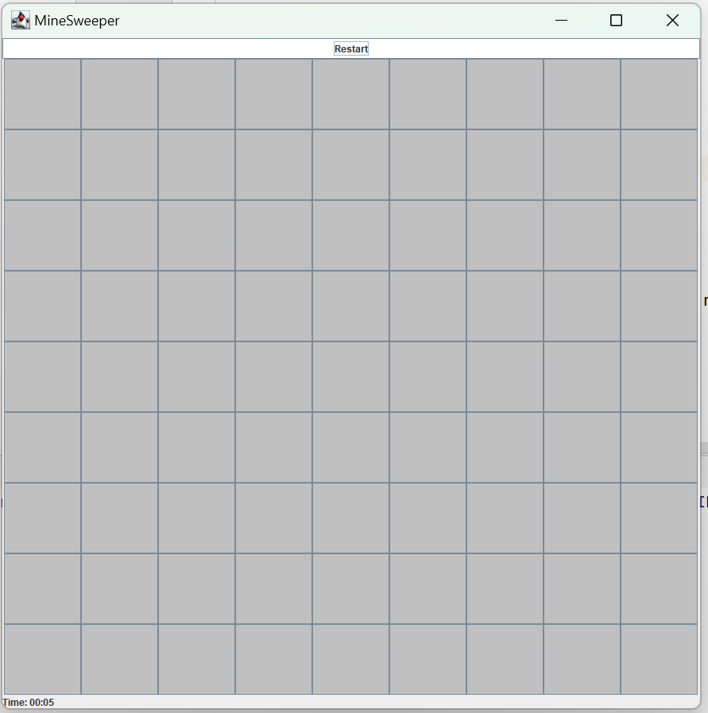
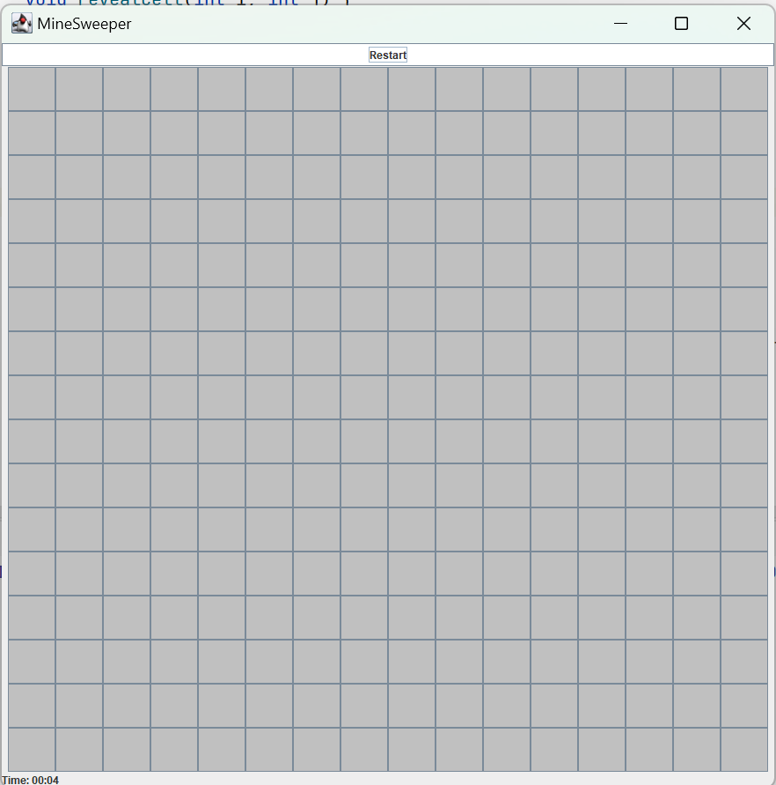
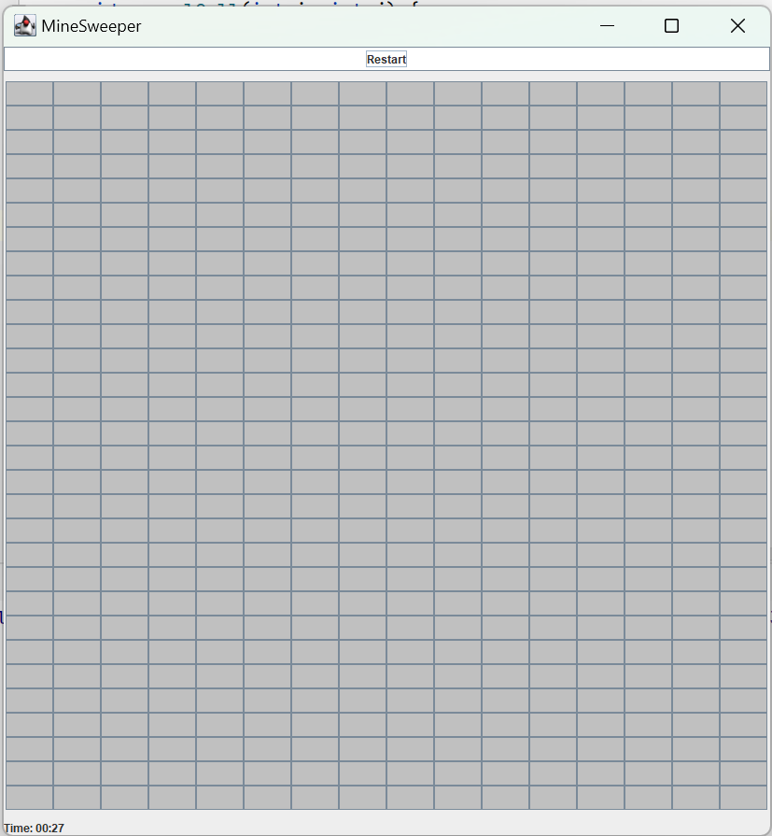
Part5 Innovative Features
MineSweeping
Different Difficulty Levels:

Slide 13
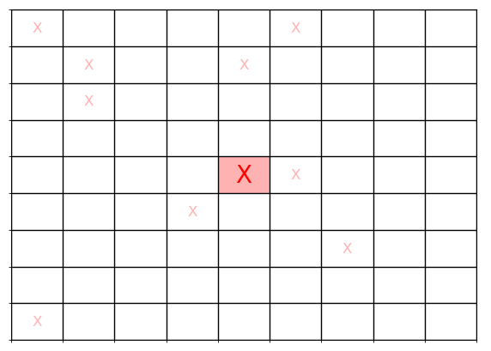
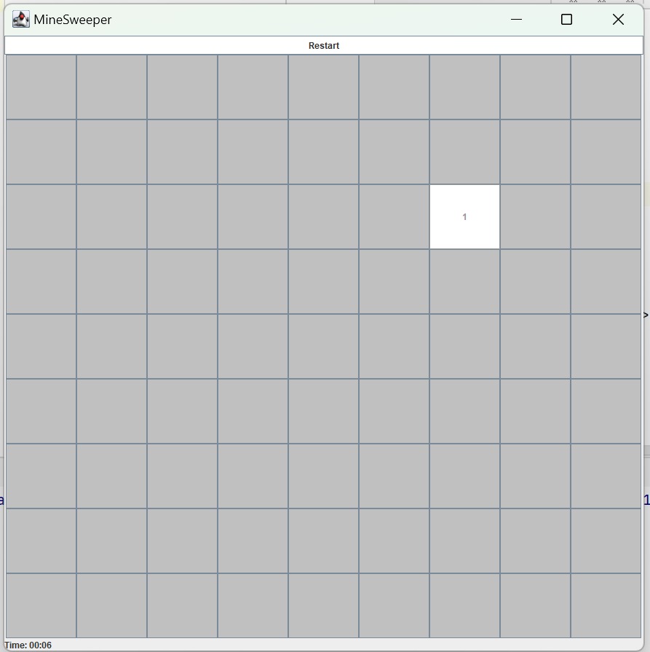
Part5 Innovative Features
MineSweeping
First Click Safety:
First Click on Mine
(Red Number)
First Click on Safe Area
(Black Number)

Slide 14
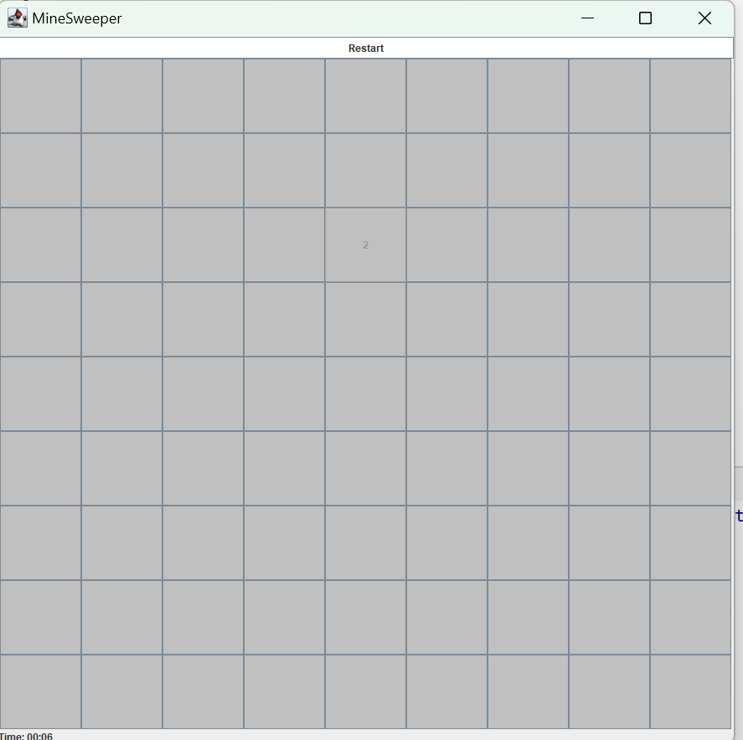
Part6 Visual Design
MineSweeping
Unopened → Light Gray
Opened → White
Mine → Red

Slide 15
Part6 Design Advantages
MineSweeping
Clear Visual Hierarchy for Better Readability.
Aligns with Classic Minesweeper Visuals.
Enhances Player Experience & Reduces Eye Strain

Slide 16
13rD FEB 2025
MineSweeping
Relax, play, and enjoy—anytime, anywhere! Download now and transform your break time into a refreshing and enjoyable moment!
PREPARED BY
Mengyao Zhang, Anting Zhu, lingjia Li, Nuan Leng, Xintong Du, Yuanxi Luo

