Slide 1
Software Architecture
(2025)

Slide 2
Outline
Software Architecture
Quality Attributes & Tactics
Architecture Patterns
Identifying ASRs
Designing Software
Architecture
Documenting Software
Architecture
Microservice Architecture
AI-native Application
Architecture
Domain-Driven Design
Enterprise & Business
Architecture

Slide 3
Software Architecture in General
What is software architecture?
Structure, Elements, Relationships, Design
What does a software architect do? Liaison, Software engineering, Tech. knowledge, Risk mgmt.
Where do architectures come from?
NFRs, ASRs, Quality Requirements; Stakeholders, Organisations, Technical Environments … Architecture (4+1) Views
Logical view, Process view, Physical view, Development view + Use case scenarios … Architectural activities and process

Slide 4
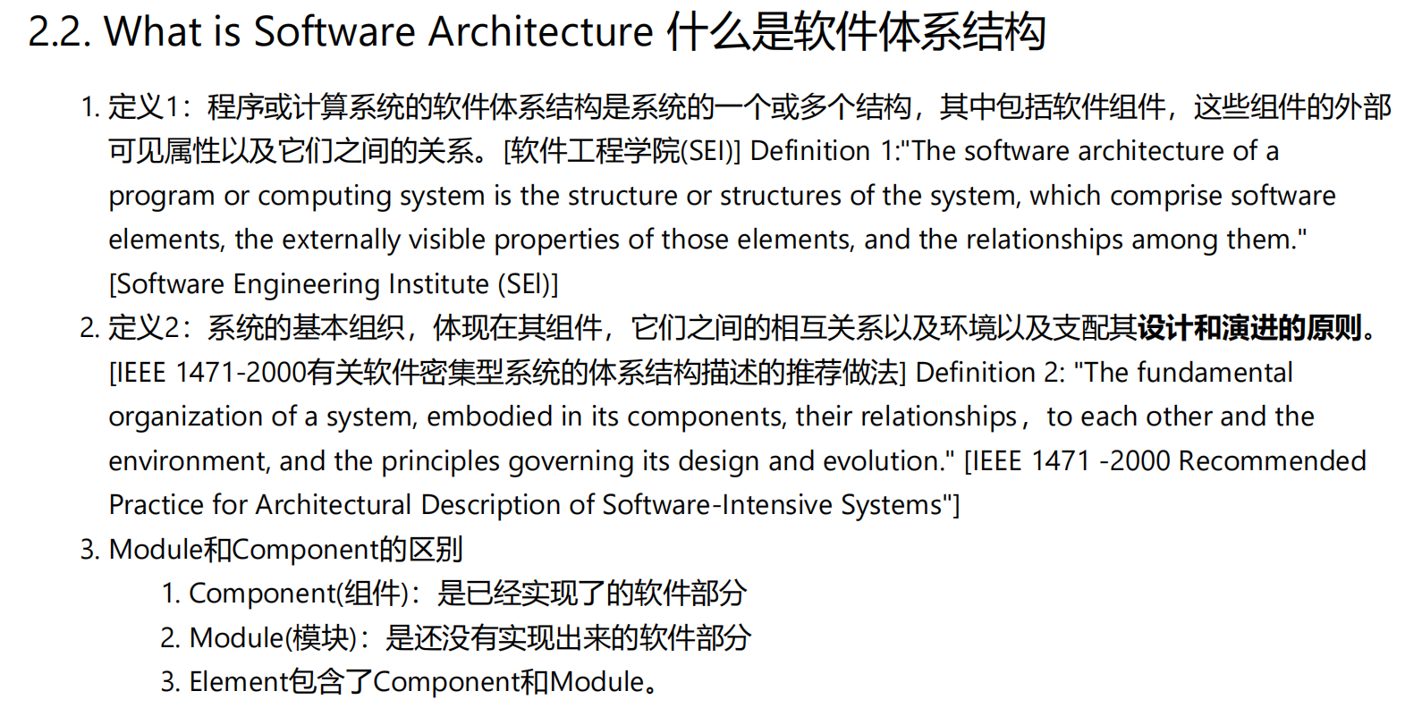
What is software architecture?
Structure, Elements, Relationships, Design

Slide 5
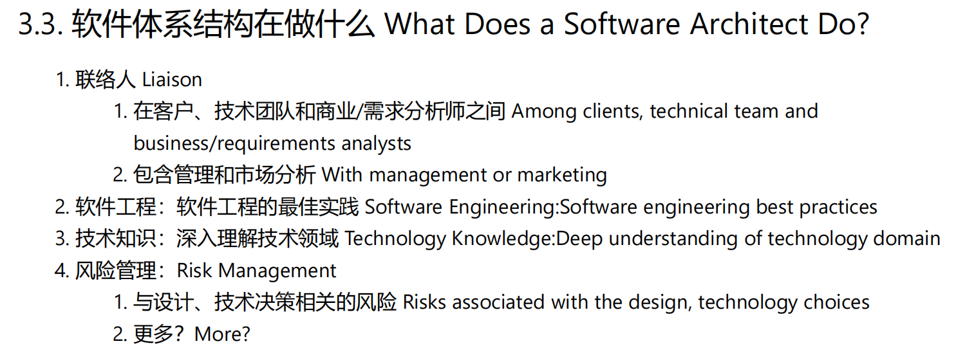
What does a software architect do?
Liaison, Software engineering, Tech. knowledge, Risk mgmt.

Slide 6
Where do architectures come from?
NFRs, ASRs, Quality Requirements; Stakeholders, Organisations, Technical Environments …

Slide 7
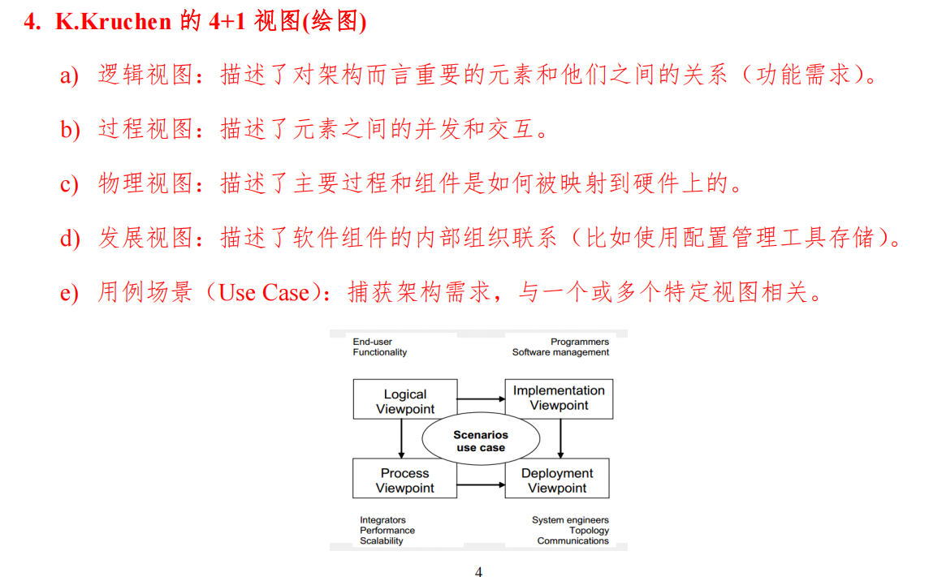
Architecture (4+1) Views
Logical view, Process view, Physical view, Development view + Use case scenarios …

Slide 8
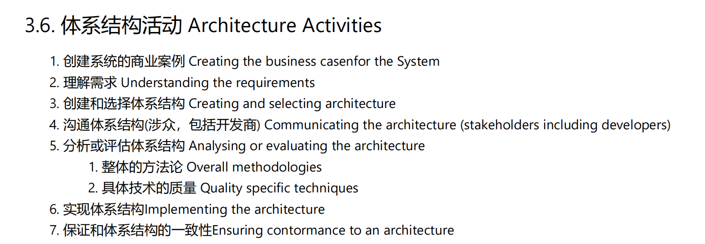
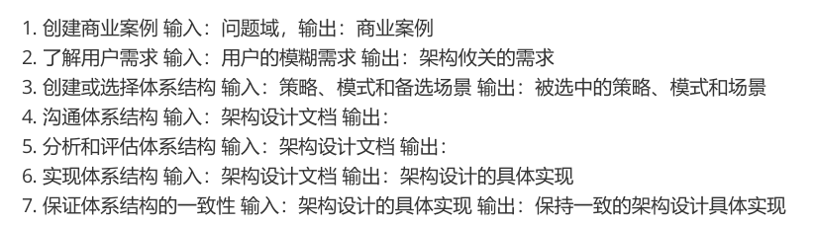
Architectural activities and process

Slide 9
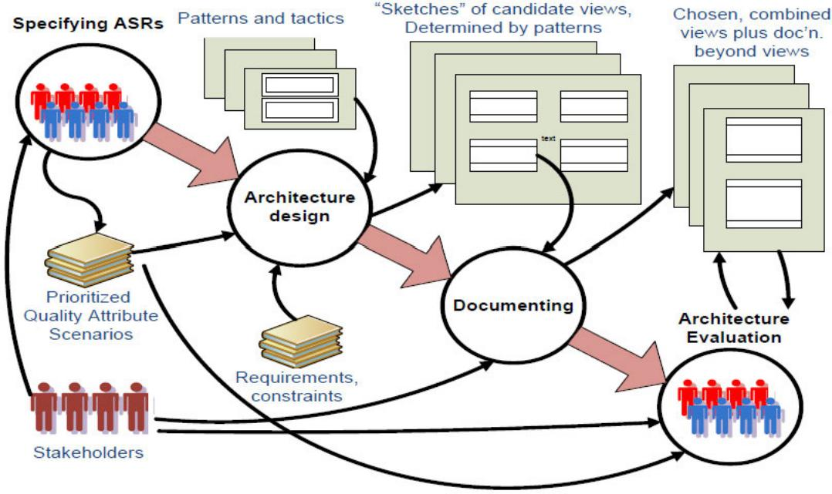
Architecture Process

Slide 10
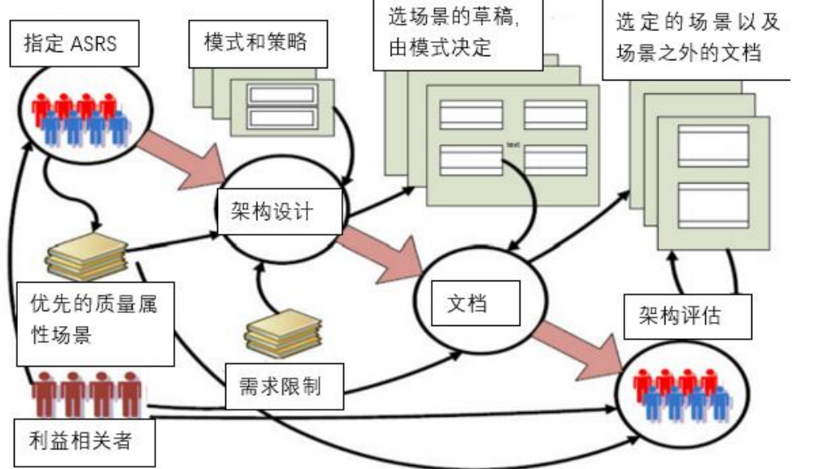

Slide 11
Quality Attributes & Tactics
Software Requirements
Functional requirements, Quality requirements (~NFRs), Constraints
Quality Attributes & Tactics
Internal vs. External Attributes
Modeling quality attribute scenarios: Source, Stimulus, Artefact, Environment, Response, Measure Availability, Interoperability, Modiﬁability, Performance, Security, Testability, Usability, X-ability… Tactics for quality attributes
Categories of architecture design decisions

Slide 12
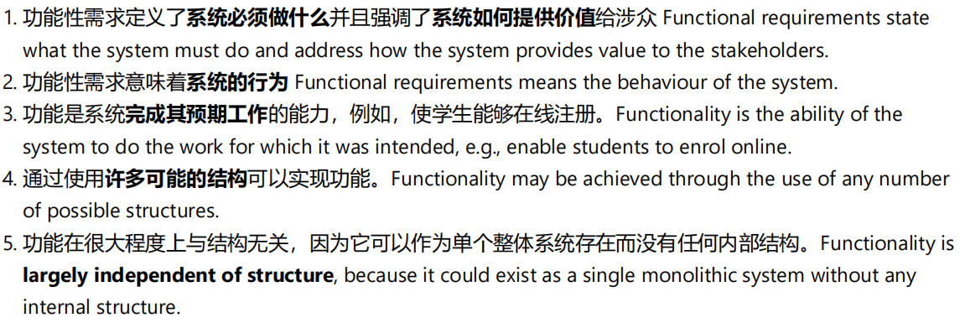
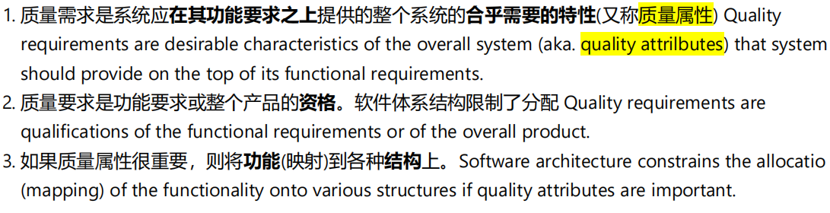
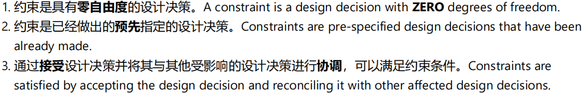
Software Requirements
Functional requirements, Quality requirements (~NFRs), Constraints
1.功能性需求 Functional Requirements
2.质量需求 Quality Requirements/质量属性/体系结构要求
3.约束 Constraints

Slide 13
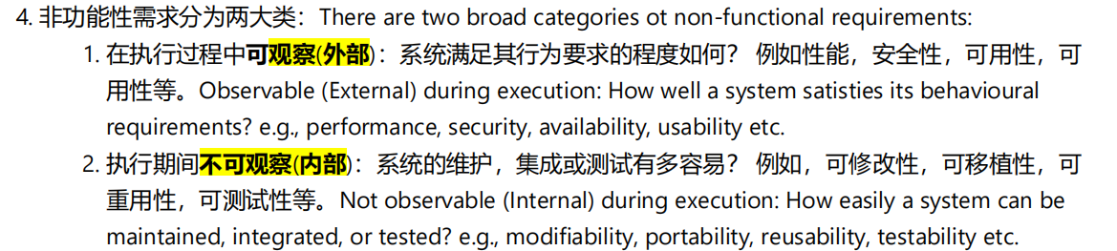
Quality Attributes & Tactics
Internal vs. External Attributes
Modeling quality attribute scenarios: Source, Stimulus, Artefact, Environment, Response, Measure Availability, Interoperability, Modiﬁability, Performance, Security, Testability, Usability, X-ability… Tactics for quality attributes
Categories of architecture design decisions

Slide 14
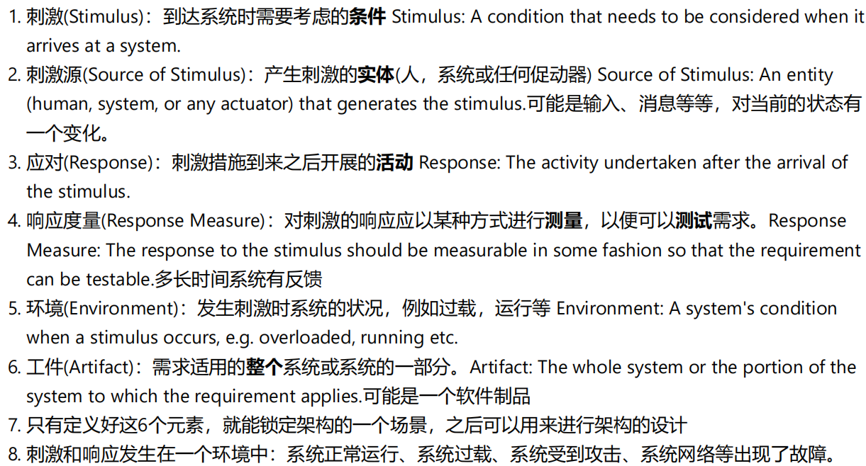
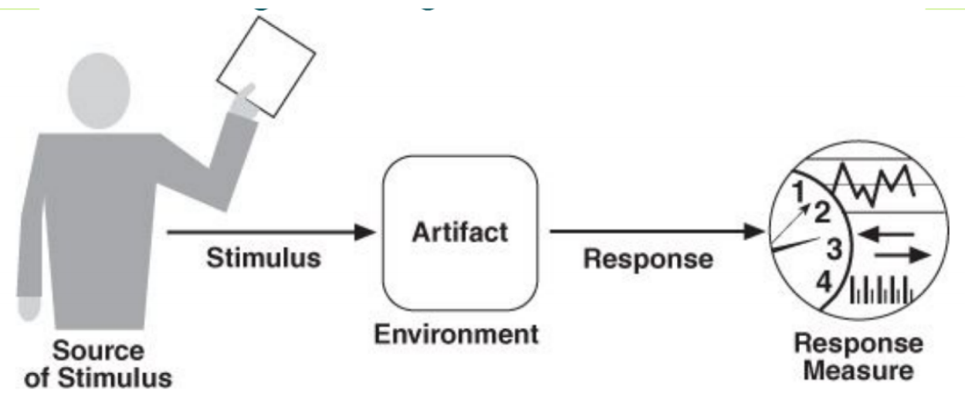
质量属性方案建模 Modeling Quality Attribute Scenarios

Slide 15
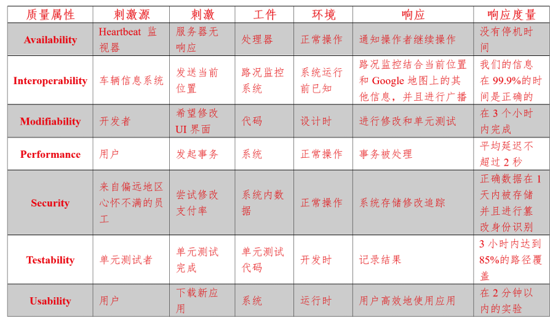
Availability, Interoperability, Modiﬁability, Performance, Security, Testability, Usability, X-ability…
每一个质量属性的详细解释：
概念
计算方式
建模质量属性场景
通用方案，见打印材料

Slide 16
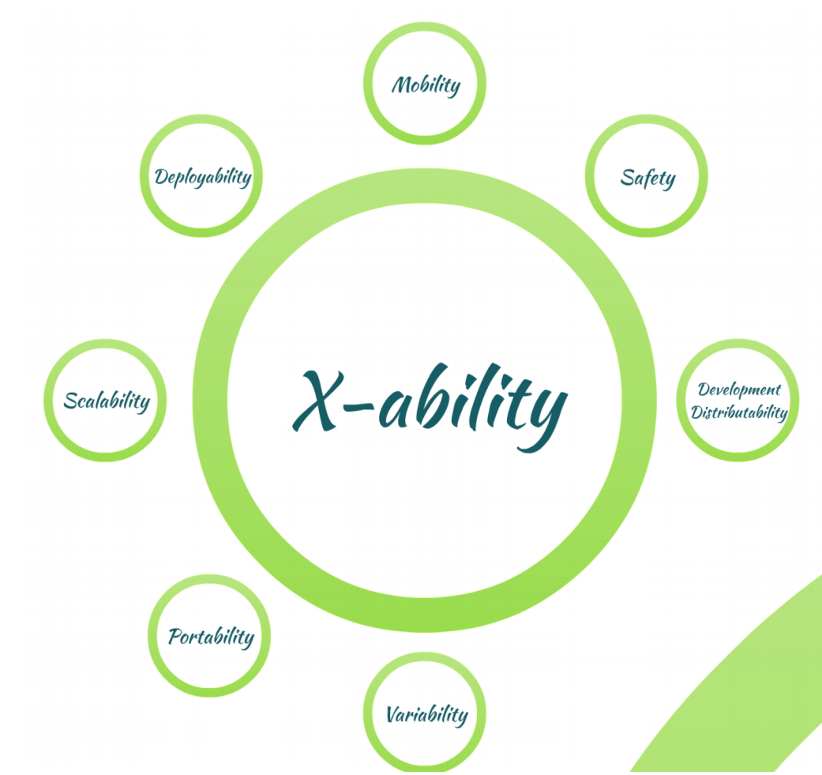

Slide 17
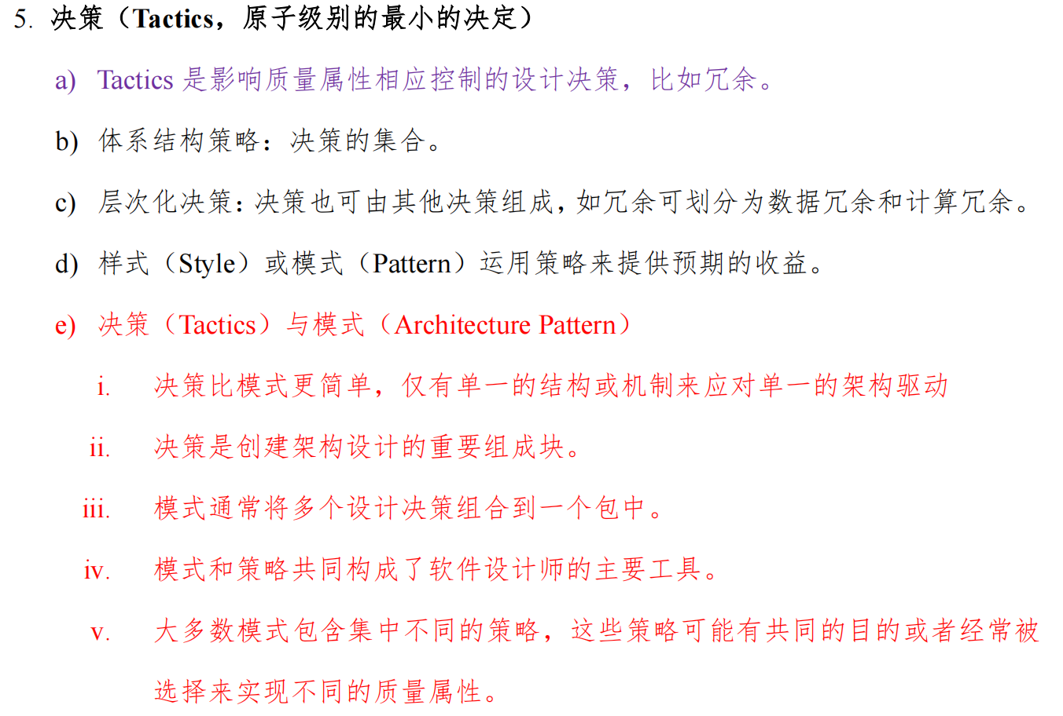
Tactics for quality attributes

Slide 18
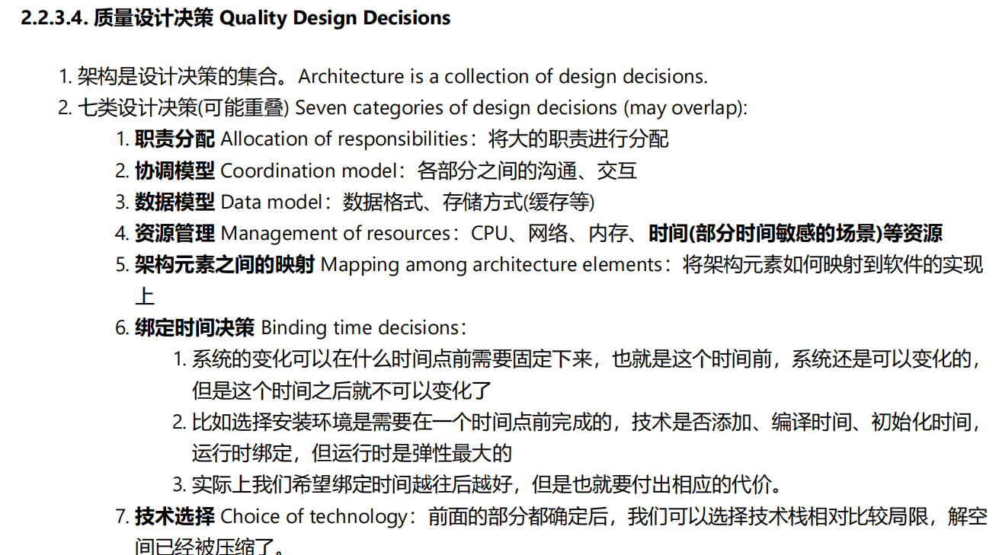
Categories of architecture design decisions

Slide 19
Architecture Patterns
Architecture Patterns
Context, Problem, Solution: elements + relations + constraints
Module Patterns
Layered pattern (micro-kernel pattern)
Component-Connector Patterns
Broker pattern, Model-view-controller pattern, Pipe-and-Þlter pattern, Client-server pattern, Peer-to-peer pattern, Service-oriented pattern, Publish-subscribe pattern, Share-data pattern
Allocation Patterns
Map-reduce pattern, Multi-tier pattern
Patterns vs. Tactics

Slide 20
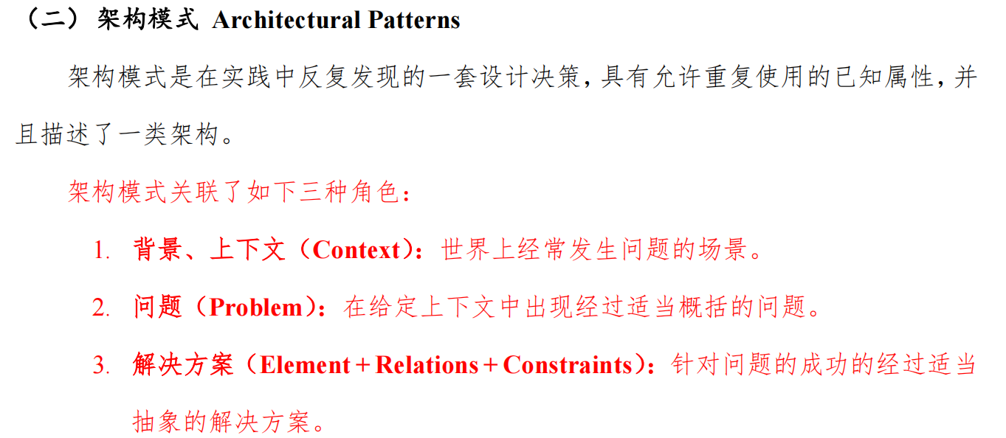
Architecture Patterns
Context, Problem, Solution: elements + relations + constraints

Slide 21
Module Patterns
Layered pattern (micro-kernel pattern)
Component-Connector Patterns
Broker pattern, Model-view-controller pattern, Pipe-and-Þlter pattern, Client-server pattern, Peer-to-peer pattern, Service-oriented pattern, Publish-subscribe pattern, Share-data pattern
Allocation Patterns
Map-reduce pattern, Multi-tier pattern

Slide 22
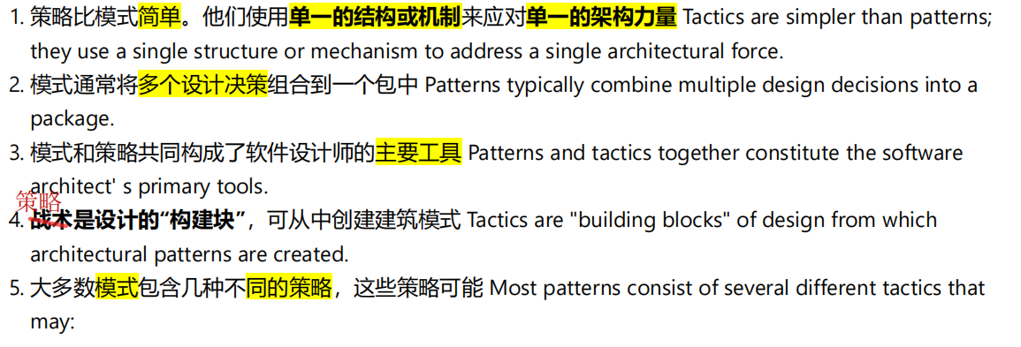
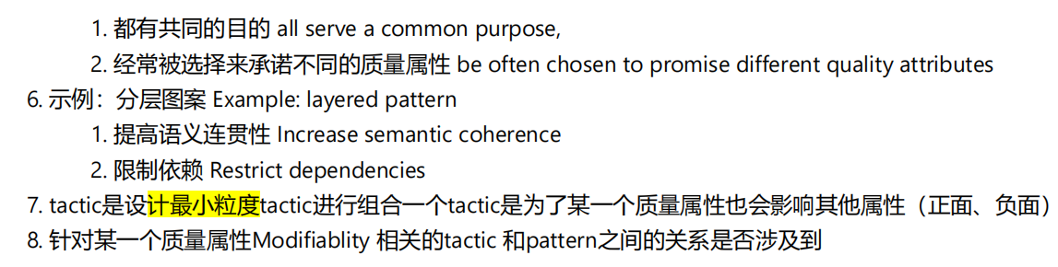
Patterns vs. Tactics

Slide 23
Identifying ASRs
Architecturally Signiﬁcant Requirements
Functional requirements, Quality requirements, Constraints How to gather and identify ASRs?
Requirement Docs, QA Workshop (interviews), Business goals Utility tree (Ranked scenarios: Importance vs. Difﬁculty)

Slide 24
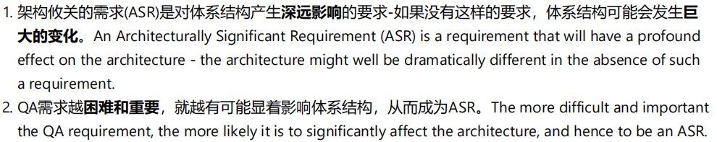
Architecturally Signiﬁcant Requirements
Functional requirements, Quality requirements, Constraints

Slide 25
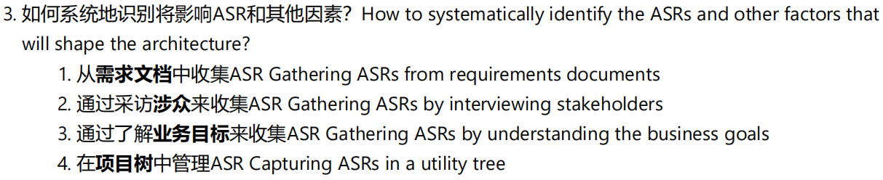
How to gather and identify ASRs?
Requirement Docs, QA Workshop (interviews), Business goals
Utility tree (Ranked scenarios: Importance vs. Difﬁculty)

Slide 26
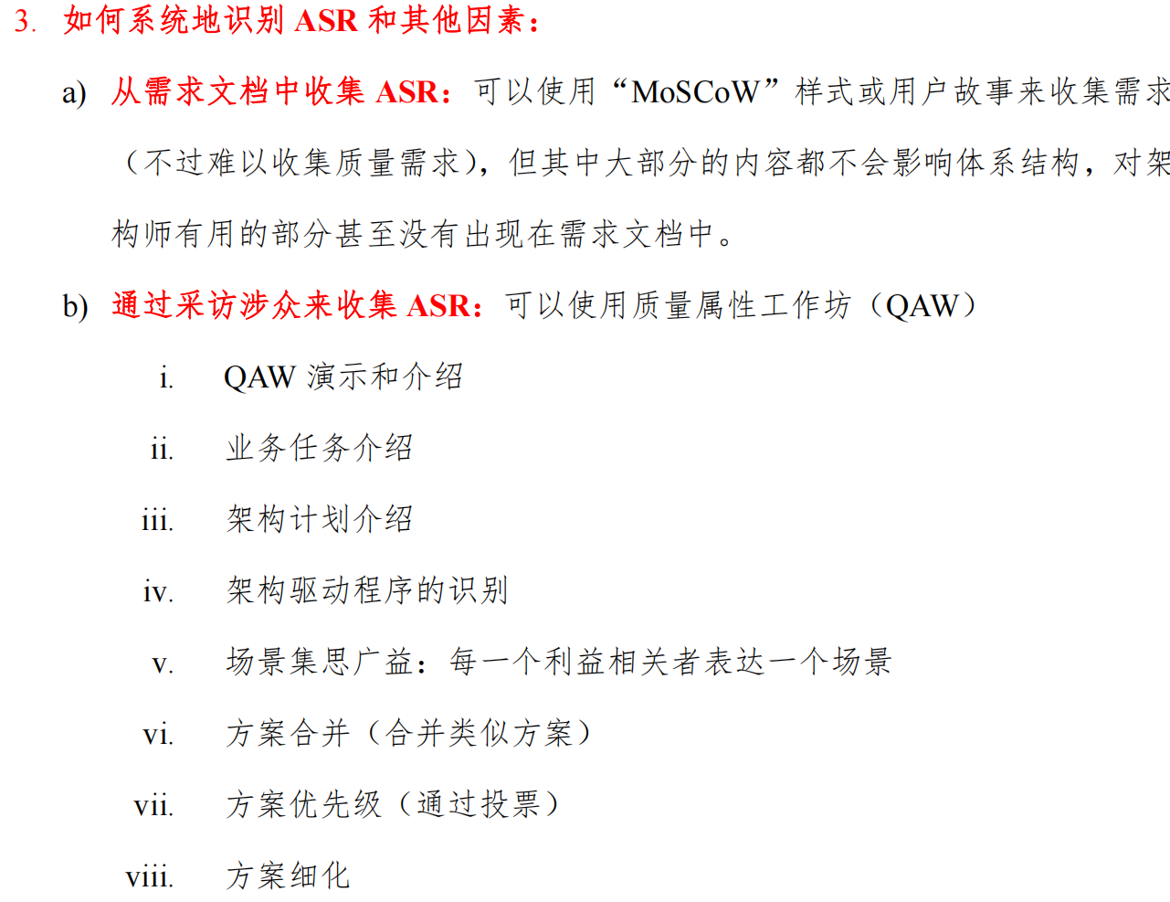
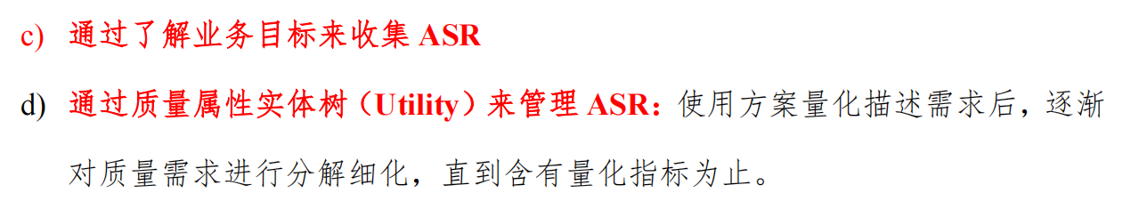

Slide 27
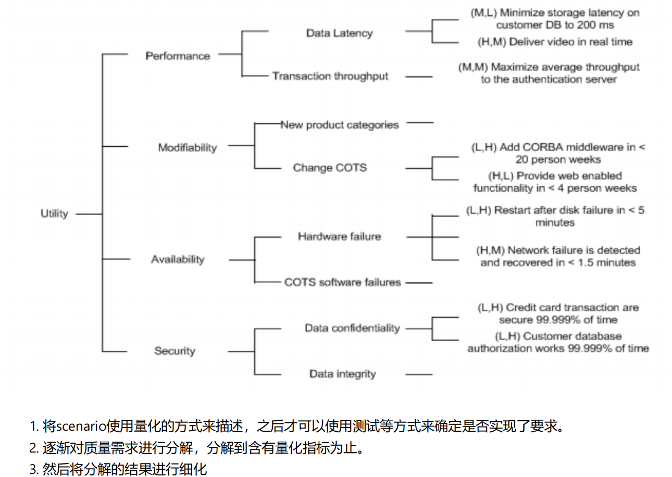

Slide 28
Designing Architecture
General Design Strategy
Abstraction, Decomposition, Divide & conquer, Generation and test, Iteration, Reuse Categories of design decisions
Responsibilities, Coordination, Data, Resources, Elements mapping, Binding time, Technology Architectural drivers
Functional requirements, Quality attribute requirements, Constraints, The type of system that is being designed, Design objectives, Concerns
主要是硕士的内容？

Slide 29
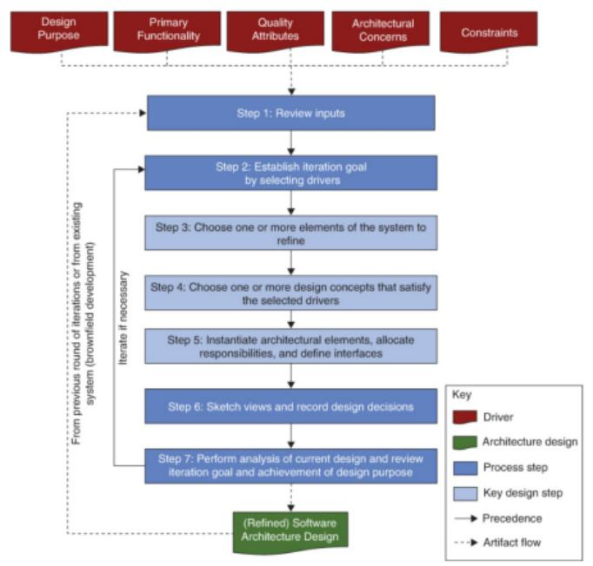
Designing Architecture
Attribute-Driven Design (ADD 3.0)

Slide 30
Documenting Architecture
Views and Beyond
Views:
Styles (viewpoints), patterns and views
Structural views: module views, component-and-connector views, allocation views
Quality views
Documenting views: 1. build stakeholder/view table, 2. combine views, 3. prioritise & stage Info. beyond views: documentation info & architecture info (mapping between views)
Documentation package: views + beyond

Slide 31
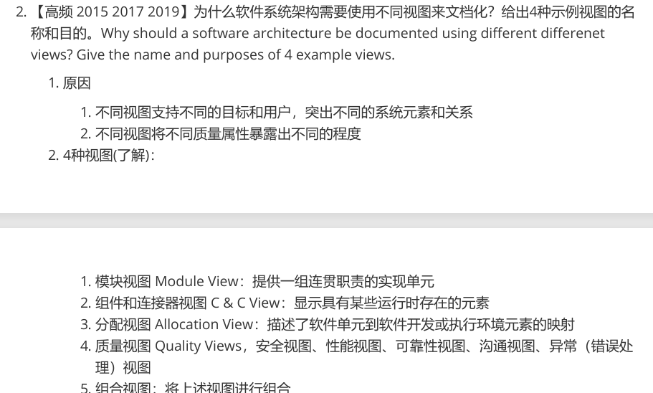

Slide 32
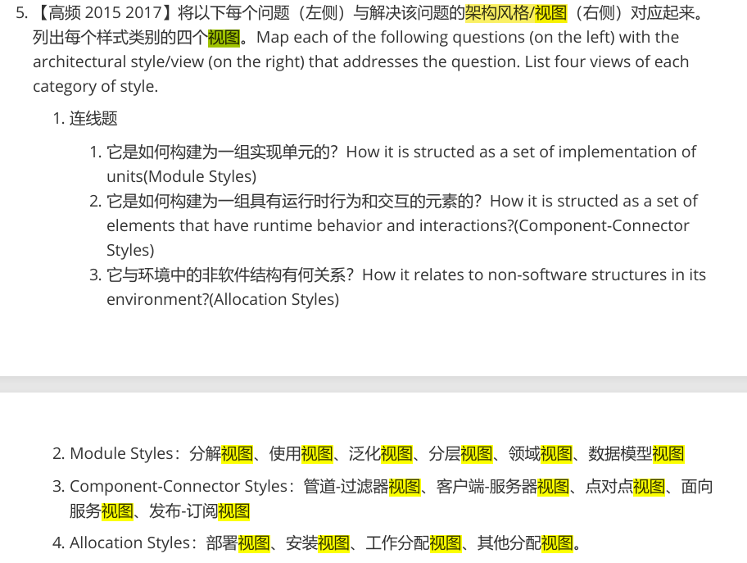

Slide 33
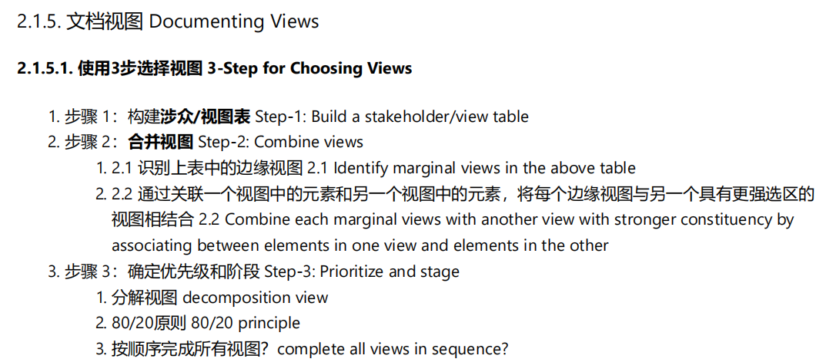
Documenting views: 1. build stakeholder/view table, 2. combine views, 3. prioritise & stage

Slide 34
Microservices Architecture
核心特征
微服务的六大特性、架构对比
微服务设计模式
挑战问题、模式和模式语言
拆分设计模式
通信模式
部署模式
运维模式……
1. 通过服务组件化
2. 围绕业务能力组织
3. 内聚和解耦
4. 去中心化
5. 基础设施自动化
6. 服务高可用设计与演进式演进

Slide 35
AI-native Application Architecture
核心特征
以模型驱动和数据为中心、Agent 协作、数据闭环、云原生集成 关键组件与工具链实践
AI 网关（Higress）、配置与发现（Nacos）、可观测性（OTel） ……
典型场景与客户实践
内部工具（阿里云通义 App）、企业服务（零一万物）、工业场景 … 未来规划
智能体平台、MCP 协议生态、多模态能力

Slide 36
Enterprise Architecture
核心定义
涵盖范围、结构化、分解战略目标、管理系统复杂度、标准化 方法论
TOGAF、业务组件建模、数据建模
实践与工具
案例、建模/开发/治理工具
AI 融合
设计辅助、智能治理、分工升级

Slide 37
Domain-Driven Design
核心框架
战略设计：子领域，限界上下文，统一语言
战术设计：聚合，领域事件，资源库/⼯⼚ 关键实践与案例
设计原则、事件风暴建模、领域模型设计 AI 与 DDD 协同
AI for DDD：领域模型、代码骨架与测试用例
DDD for AI：为 AI 明确逻辑输入、简化AI 模型训练范围

Slide 38
Final Exam
总评成绩 = 平时成绩* 40% + 期末考试* 60%
内容占比：架构设计50% + 设计模式50%
题型：简答题、设计分析题
英文题目、中文或英文答题
个别题目可能需画图
基础内容60%
进阶内容40%

