Slide 1
Programming in C++
郑 滔 zt@nju.edu.cn 费904
潘敏学 mxp@nju.edu.cn 费927
https://www.tiobe.com/tiobe-index/

Slide 2

Why is C still necessary?
开发效率
运行效率
易用性和安全性
trading balance
Q1：硬件如此便宜，有必要让软件更快吗？
功耗
Q2：难道不能发明一种同样快的语言，但没有C语言那么多的坑？
Linux, Window, MacOS，Unix，Vxworks

Slide 3
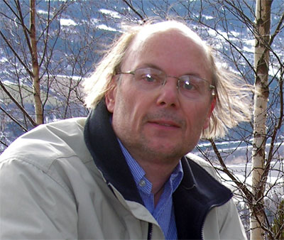
Why is C++ still necessary?
它填补了编程领域一个重要的“生态位”：需要有效使用硬件和管理高复杂性的应用程序
Direct mapping of language constructs to hardware facilities
Zero-overhead abstraction
“Zero overhead”
• What you don’t use, you don’t pay for
• What you do use, you couldn’t hand-code any better
C vs C++
超集
C++支持 C 所支持的全部编程技巧
任何 C 程序都能被 C++ 用基本相同的方法编写，并具备同等开销（时间、空间）
Bjarne Stroustrup

Slide 4
ACM 1978
HOPL History of Programming Languages
1993
A history of C++: 1979–1991
2007
Evolving a language in and for the real world:
C++ 1991-2006
2021
Thriving in a crowded and changing world:
C++ 2006–2020

Slide 5
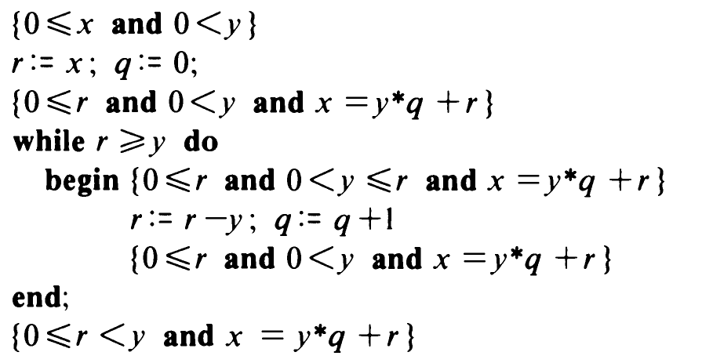
Programming
calculus
{ Q } S { R }
The Science of programming David Gries
The Art of Computer Programming Donald Ervin Knuth
{ y>0}
r:=x; q:=0;
while r>y
begin
r = r-y;
q:=q+1;
end;
{ x=y*q+r}
{ y>0}
r:=x; q:=0;
while r ≥ y
begin
r = r-y;
q:=q+1;
end;
{ x=y*q+r and r<y}
{ x ≥ 0 and y>0}
r:=x; q:=0;
while r ≥ y
begin
r = r-y;
q:=q+1;
end;
{ x=y*q+r and r<y}
r:=x; q:=0;
while r>y
begin
r = r-y;
q:=q+1;
end;
    “The process of prepairing programs for a digital computer is especially attractive, not only because it can be economically and scientifically rewarding, but also because it can be an aesthetic experience much like composing poetry or music。”
    “In many cases people are not able to appreciate the full beauty of such an algorithm unless they also have some knowledge of a computer's machine language; the efficiecy of the corresponding machine program is a vital factor that cannot be divorced from the algorithm itself.”

Slide 6
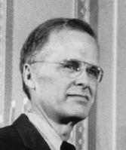
Programming Paradigm
Imperative programming
Procedural-Oriented
  based upon the concept of the procedure call
Object-Oriented
  The theory of concepts, and models of human interaction with real world phenomena
John Backus，
1977

Slide 7
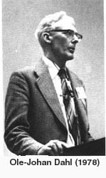
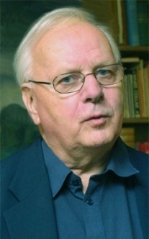
背景
1962, Kristen Nygaard(KN), initiated a project
Simulation Language
UNIVAC
选择
FORTRAN or ALGOL60?
Ole-Johan Dahl
Kristen Nygaard
2001
the block structure
good programming security
European patriotism
Simula I
入手
break out of the strict LIFO regime of block instances
措施
A procedure-like activity declaration
Explicit process pointers for dynamic naming and referencing
A mechanism for accessing
mechanisms for the scheduling and sequencing of processes
实现
writing a new runtime system（garbage collector）
compiler extensions：block prex“ SIMULA”，兼容Algol60

Slide 8
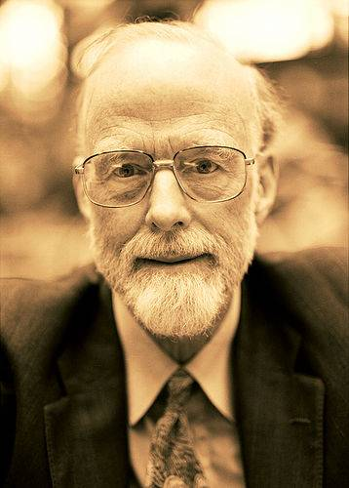
思考
Class / Object
activity/process: useful for programming and system design in general
objects belonging to different classes having common properties
Tony Hoare : Class and Subclass
方法
Class
resume operator is a basic coroutine call defined for whole language
inheriting
Simula 67
more
bottom up program design
top down oriented mechanism through a concept of "virtual procedures“
Tony Hoare :"abstraction function“
garbage collector
Tony Hoare
OO paradigm

Slide 9
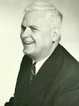
Programming Paradigm
declarative programming
Functional
  assume you have lots of little helper functions that interests in synthesizing one large result
  Lisp/Scheme/Erlang/Haskell
Alonzo Church
John Backus，
1977
Can Programming Be Liberated from the von Neumann Style?
A Functional Style and Its Algebra of Programs

Slide 10
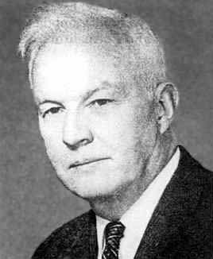

Functional programming
Q1、Given a two lists of sorted numbers, produce a sorted list of all the numbers
Type definition:
listMerge :: List int -> List int -> List int
Code:
listMerge [] [] = []
listMerge a [] = a
listMerge [] b = b
listMerge (a:as) (b:bs) = if a < b
then a: listMerge as (b:bs)
else b: listMerge (a:as) bs
Scheme
Haskell
(define sum-of (numlist)
(if (null?numlist) 0
(+ (car numlist)
(sum-of (cdr numlist)))) )
map
Q2、Write a function to check if a string is the prefix of another
type definition:
prefix :: List Char -> List Char -> Bool
Code:
prefix [] (b:bs) = Ture
prefix (a:as) [] = False
prefix (a:as) (b:bs）= if a == b
then prefix as bs
else Fasle
Scheme
(define fib (n)
(if (or (= n 0)
(= n 1)) n
(+ (fib (- n 1))
(fib (- n 2)))))
1:1:2:3:5:zipWith (+) fib (tail fib)

Slide 11
Programming Paradigm
Logical
  Automatic proofs within artificial intelligence
  Based on axioms, inference rules, and queries
  prolog

Slide 12
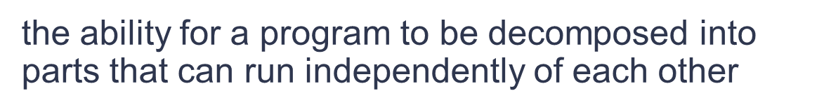
Programming Paradigm
Concurrent programming
Generic programming
a programming paradigm that aims to develop efficient and reusable software libraries.
It focuses on finding commonalities among similar implementations of the same algorithm and providing suitable abstractions so that a single, generic algorithm can cover many concrete implementations.

Slide 13
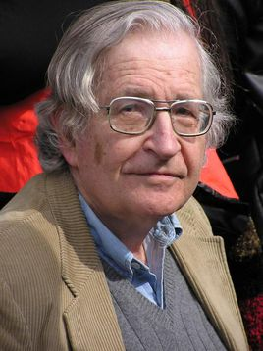
Language
{V_{N}} U {V_{T}}
<ID> ::= <L> |<ID> <LD>
<LD> ::= <L>|<D>|
<LD><AL|
<LD><D>
<L> ::= _|a|b| …… X|Y|Z
<D> ::= 0| ……| 8 | 9
Deduct
Reduce
  Syntax
  Avram Noam Chomsky MIT
    1955
    RG FA
    CFG PDA
    CSG LBA
    PSG TM
Backus–Naur Form
EBNF/语法图
letter = [a-zA-Z]
digit = [0-9]
identifier = letter (letter|digit)*
G=（V_{N}，V_{T}，P，Z）
nat = [0-9]+
signedNat = (+|-)?nat
Number = signedNat(. nat)?(E signedNat)?
ad hoc

Slide 14
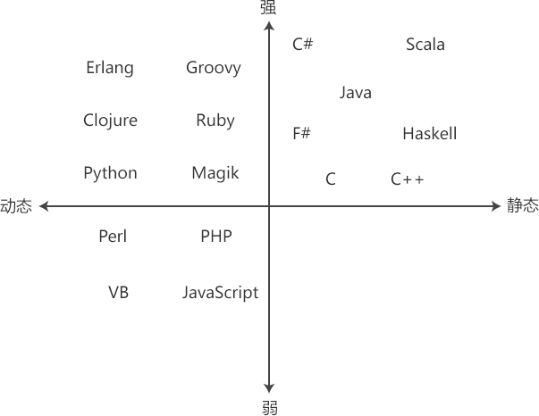
Language
Semantics
Strong/Weak
ADT
Static/Dynamic
Value
Computation
Control Flow
Memory Layout
Runtime Environment
Pragmatics

Slide 15
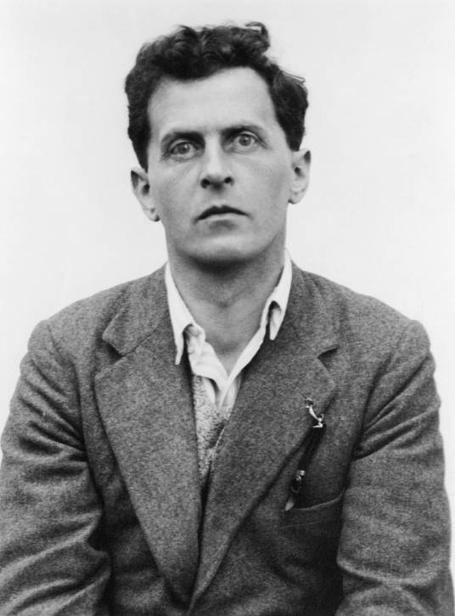
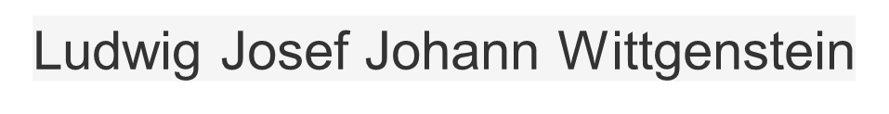
"The limits of my language mean the limits of my world.”
http://www.stroustrup.com/
https://isocpp.org/std/the-standard

Slide 16
Other Materials
Design Patterns: Elements of Reusable Object-Oriented Software, Erich Gamma, Richard Helm, Ralph Johnson, and John Vlissides, Addison-Wesley, 1994, ISBN-13: 978-0201633610
Effective C++ : 50 Specific Ways to Improve Your Programs and Designs, Scott Meyers, Addison-Wesley, 1998, ISBN 0-201-92488-9
More Effective C++: 35 New Ways to Improve Your Programs and Designs, Scott Meyers, Addison-Wesley, ISBN 0-201-63371-X
Effective Modern C++：42 Specific Ways to Improve Your Use of C++11 and C++14 , Scott Meyers, Addison-Wesley, ISBN: 9781491903995
Pattern-oriented Software Architecture (5 Volumes)
  Hans Rohnert, Frank Buschmann, Michael Stal, Douglas C. Schmidt,
Thinking in C++ (2nd Edition)
Bruce Eckel, Prentice Hall, ISBN: 0139798099, 2000

