Slide 1
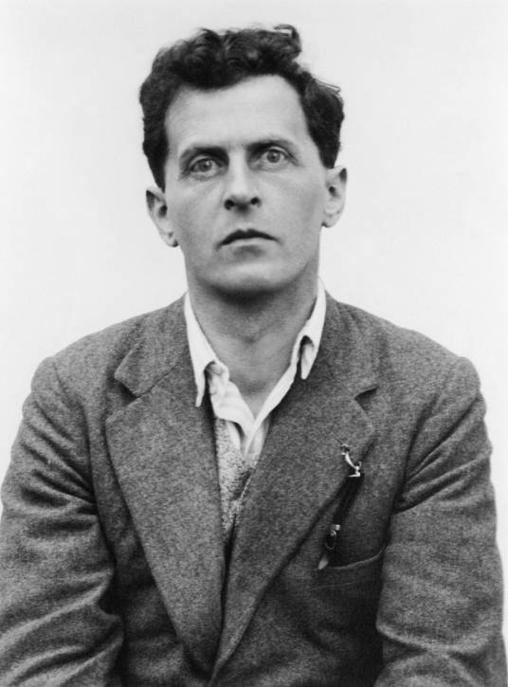
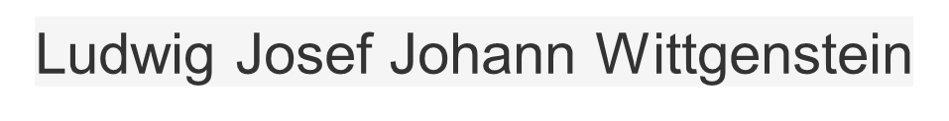
"The limits of my language mean the limits of my world.”
http://www.stroustrup.com/
https://isocpp.org/std/the-standard

Slide 2
Other Materials
Design Patterns: Elements of Reusable Object-Oriented Software, Erich Gamma, Richard Helm, Ralph Johnson, and John Vlissides, Addison-Wesley, 1994, ISBN-13: 978-0201633610
Effective C++ : 50 Specific Ways to Improve Your Programs and Designs, Scott Meyers, Addison-Wesley, 1998, ISBN 0-201-92488-9
More Effective C++: 35 New Ways to Improve Your Programs and Designs, Scott Meyers, Addison-Wesley, ISBN 0-201-63371-X
Effective Modern C++：42 Specific Ways to Improve Your Use of C++11 and C++14 , Scott Meyers, Addison-Wesley, ISBN: 9781491903995
Pattern-oriented Software Architecture (5 Volumes)
  Hans Rohnert, Frank Buschmann, Michael Stal, Douglas C. Schmidt,
Thinking in C++ (2nd Edition)
Bruce Eckel, Prentice Hall, ISBN: 0139798099, 2000

Slide 3
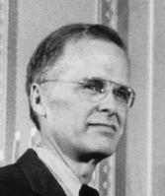
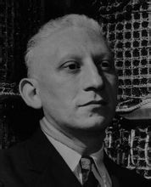

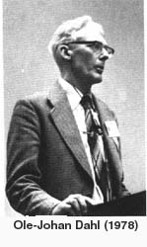
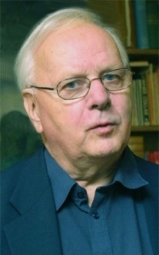

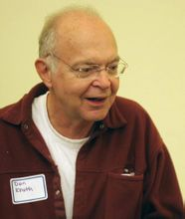

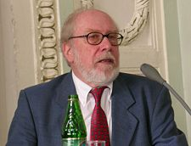
ＦＯＲＴＲＡＮ
Alan J．Perlis ，
1958,1966
E.W.Dijkstra
1960,1972
John Backus，
1953, 1977
Algol 60
Ole-Johan Dahl
Kristen Nygaard
1962,2001
PL/1
BCPL
Simula 67
C
Dennis Ritchie
Ken Thompson
1972,1983
Algol 68
C With Classes
C. A. R. Hoare
1966,1980
Donald E.Knuth
1965,1974
ANSI C
C++
1985
Niklaus Wirth
1966, 1994
C++20

Slide 4
C++的诞生
史前 1979
  研究分布式系统的系统软件组织 Cambridge ph.D
    设计：隔离良好的模块组合为软件
    实验：细节繁杂的模拟器 IBM/360
  实现
    Simula 第一阶段
    BCPL 第二阶段
灾难
Linker
      优点
        良好的可读性
        co-routine（pseudo-parallel）
        类的层次结构
        类型表达能力强
        编译捕捉类型错误能力强
        缺点
        性能差
        原因
        运行中的类型检查
废料收集 cost 80%
不适合大程序
低级编程错误
设计缺陷
X
PASCAL?
没有合适工具，绝不冲击一个问题
      Debug难

Slide 5
C++的诞生
思考
  科学观
    设计
      程序组织 Simula
    效率
      连接规则简单、灵活（异构语言） BCPL
    移植性
      不能依赖复杂的运行系统
    其他
      protected、const、区分初始化和赋值、异常
  哲学观、历史观
    存在主义
  文学观
    幽默感
愿望：带有Simula类的Algol68
以C为基础实现
源于OS
索伦·克尔凯郭尔
（Soren Aabye Kierkegaard）
实验更重要
不是科学家的玩物
不是证明一种观点，而是解决一个问题
风格多样，而不是“真理之路”

Slide 6
C++的诞生
方言
带类的C 1979
  UNIX 内核分布到局域网 Bell Lab
    内核模块化
    流量分析
  本质
    组织 class
    计算 C
    舍弃并行，走向通用
    舍弃复数、矩阵、字符串等
    兼容C 没有housekeeping
  工具
    Cpre： C + class
    16 projects 1980
    lib + job system
接近机器
接近问题
PASCAL 类型检查
Algol68 运算符重载
引用
块内变量声明
BCPL 注释 //
Ada 模板
namespace
异常 Ada、Clu、ML
1985
某些语言结构不安全
灵活、高效、可用、可移植
不能舍弃C中“危险” 、“丑陋”特性
而付出效益的代价

Slide 7
C++的诞生
    Linker 连接兼容性 重于 代码兼容性
      分别编译
      类型安全
      方便与其他语言实现的模块连接
        不能附加DB（如：散列）
    稳步前进
      实现+测试
      自我应用
      逐步推广
编译一致性保障 头文件
非论文式
1982

Slide 8
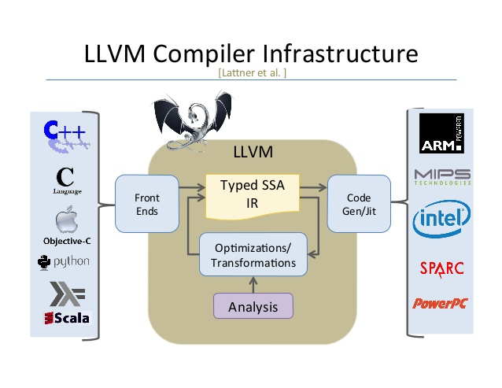
C++的诞生
Source Code
Al Aho
C++ 1983
  影响语言设计的因素
    用户 产业界+大学
    运行环境 硬件+OS
    避免提供工具
  Cfront
标准化
  ANSI 1994
  ISO 1998
观点
cPP
(c预处理)
前端
Cpre?
Cfront
高效
高度可移植性
cc
?
后端
  好的语言不是设计，而是成长起来的
  相比数学，与工程、社会学、哲学的关系更紧密
  亲历实验，依赖老练的程序员
  正交性要让位于有用性和效率
Object Code
COST

Slide 9
1979 C with Classes
First non-research user
Language: classes, constructors/destructors, public/private,
simple inheritance, function argument type checking
Library: tasks (coroutines and simulation support)
vector parameterized with macros
“Remember the Vasa!”
1985 TC++PL1
First commercial release
Language: virtual functions, operator overloading, references, const
Library: complex arithmetic, stream I/O
FUTURE
Improved Unicode support
Support for simple graphics and simple user interaction
Support for new kinds of hardware
Exploration of improved styles and implementations of error-handling
Pursue the goal of a completely resource-safe and type-safe C++
Support a wide variety of hardware well
Maintain C++‘s record of stability (compatibility)
1989-91 TC++PL2
ANSI and ISO
Language: abstract classes, multiple inheritance, exceptions, templates
Library: iostreams (but no tasks)
1998 TC++PL3
C++98 the first ISO C++ standard
Language: namespaces, named casts(static_cast、reinterpret_cast、const_cast), dynamic_cast, RTTI
Library: the STL (containers and algorithms), string, bitset
2011 TC++PL4
Language: memory model, auto, for, constexpr, lambdas, user-defined literals, nullptr, move constructor
Library: threads and locks, future, unique_ptr, shared_ptr, array,
time and clocks, random numbers, unordered containers (hash tables), ...
2014 C++14
2017 C++17
Language: generic lambdas, digit separators,
local variables in constexpr func, ...
Library: user-defined literals, ...
Language: structured bindings, variable templates,
template argument deduction from constructors, ...
Library: file system, scoped_lock, shared_mutex (reader-writer locks)
any, variant, optional, string_view, parallel algorithms, ...
2020 C++20
2023
Language: Static reflection facilities
FP style pattern matching
Contracts
Library：coroutines
A modular standard library
executors
Networking
Language: concepts, modules, coroutines, three-way comparisons,
improved support for compile-time computation, ...
Library: concepts, ranges, dates and time zones, span,
formats, improved concurrency and parallelism support, ...

Slide 10
Resources
Community
No center to the C++ community
no talent
no desire
disorganized
fragmented
Apple、Borland、GNU、IBM、Microsoft、Zortech
Conference
Early (Absorbed/Mutated into general “OO” or “SD” conference)
Nowday (has C++ user’s Group)
CppCon The C++ Foundation
C++ Now BoostCon
Meeting C++
ACCU Association of C/C++ Users
QT、NDC、std::cpp

Slide 11
Declaration
Will
Problem driven
C++’s development should be driven by needs of specific real-world problems.
Simple
C++ should be grown by generalization from simple, efficient, easy-to-use solutions.
Efficient
The C++ language and standard library should obey the zero-overhead principle.
Stable
Don’t break my code!
Never
Experts only
A facility has to serve all the experts’ needs from the start.
Imitative
We need this facility because it is popular in “language X”.
Theoretical
Language theory says that a language must have this feature.
Revolutionary
This feature is so important that we must break compatibility or deprecate
“the bad old ways” of doing things.

Slide 12
Structural Programming
Data Structure＋Algorithm
ADT
Abstract Data Type
Associativity
Priority
Type conversion
Evaluation order
coersion
casting
Overflow
Precision
Side Effect

Slide 13
{int i = 123456789;
short s = static_cast<short>(i);
cout << i << " " << int2B(i) << endl;
cout << s << " " << short2B(s) << endl; }
static_cast<>()
{ float f = 1.25;
short s = static_cast<short>(f);
cout << f << " " << endl << float2B(f) << endl;
cout << s << " " << endl << short2B(s) << endl;
}
123456789 00000111010110111100110100010101
-13035 1100110100010101
1.25
00111111101000000000000000000000
1
0000000000000001
cout << "testing from int to float:" << endl;
cout.precision(20);
int y = ~(1 << 23);
cout << "before :" << y << " " << int2B(y) << endl;
float y1 = float(y);
cout << "after :" << y1 << " " << float2B(y1) << endl;
testing from int to float:
before :-8388609 11111111011111111111111111111111
after :-8388609 11001011000000000000000000000001
{ float f = 7.25;
short s = static_cast<short>(f);
cout << f << " " << endl << float2B(f) << endl;
cout << s << " " << endl << short2B(s) << endl;
}
7.25
01000000111010000000000000000000
7
0000000000000111
cout << "testing from int to float:" << endl;
cout.precision(20);
int y = ~(1 << 24);
cout << "before :" << y << " " << int2B(y) << endl;
float y1 = float(y);
cout << "after :" << y1 << " " << float2B(y1) << endl;
testing from int to float:
before :-16777217 11111110111111111111111111111111
after :-16777216 11001011100000000000000000000000
{short s = 45;
float f = static_cast<float>(s);
cout << s << " " << short2B(s) << endl;
cout << f << " " << float2B(f) << endl;
}
45 0000000000101101
45 01000010001101000000000000000000

Slide 14
int x=10;
int *p = &x;
cout << " x " << &x << x << endl;
cout << " p " << &p << p << endl;
cout << "*p " << p << *p << endl;
const int c=128;
int * q = const_cast<int *>(&c);
*q = 111;
cout << " c " << &c << c << endl;
cout << " q " << &q << q << endl;
cout << "*q " << q << *q << endl;
const_cast<>()
Name Addr Value
std::string int2B( int n) {
std::string s = "";
for (int i = 31; i >= 0; i--)
s += (n & (1 << i)) ? '1' : '0';
return s;
}
const
x 0012FF7C 10
p 0012FF78 0012FF7C
*p 0012FF7C 10
reinterpret_cast<>()
std::string float2B_1(float f) {
int* x = reinterpret_cast<int*> (&f);
std::string s = "";
for (int i = 31; i >= 0; i--)
s += ((*x) & (1 << i)) ? '1' : '0';
return s;
}
Name Addr Value
c 0012FF74 128
q 0012FF70 0012FF74
*q
0012FF74
111
Why？

