Slide 1
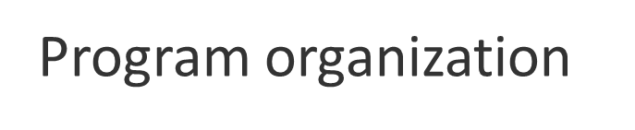
Header file
const
declaration
type def
inline
preprocessing
const double pi=3.14;
a.h
extern float salary;
const.h
extern void show();
#include “a.h”
extern float salary;
const double pi=3.14;
#include “const.h”
extern void show();
#include “const.h”
程序级
const double pi=3.14;
static
int count=0;
static
int count=0;
文件级
static
void process()
{
salary = 100;
for(…)
{ ……
char c;
……
}
show();
}
static
int k=0;
float salary=0;
Scope
void show()
{ …. }
static
void process()
{ int i=0;
while (…)
{ ……
char c;
……
}
}
函数级
块级
void main()
{ int x; …….;
}
a.cpp
b.cpp

Slide 2
namespace
两种形式
  declaration
  directive
namespace L
{
int k;
void f(int);
……
}
using L::k;
using L::f;
k=0;
f(6);
using-declaration
using namespace L;
k=0;
f(6);
using-directive
在约束作用域方面，替代static

Slide 3
namespace-details
  namespace American_Telephone_and_Telegraph {…… }
  …….
  namespace ATT = American_Telephone_and_Telegraph
别名
全局
开放
可嵌套
重载
  int a;
  namespace X
  { int a;
  void f()
  { int a=0;
  a++;
  X::a++;
  ::a++;
  }
  }
  namespace A
  { int a;
  …….
  }
  …….
  namespace A
  { void f() ;
  …….
  }
  namespace L1
  { int a;
  …….
  namespace L2
  { void f() ;
  …….
  }
  }
  ……..
  L1::L2::f();
  using namespace L1;
  L2::f();
  namespace B
  { void f(int) ;
  …….
  }
  void f();
  using namespace A;
  void g()
  {
  f(‘1’);
  }
  using namespace B;
  …….
  using namespace A;
  …….
  void g()
  {
  f(‘1’);
  }
  namespace A
  { void f(char) ;
  …….
  }
X
不建议在同一作用域两次使用using-directive

Slide 4
namespace
Simplest example
#include <stdio.h>
int main()
{
printf(“hello, world\n”);
}
//stdio.h
namespace std {
…
int printf( const char *, …);
…
}
using namespace std;
//stdio
namespace std {
…
int printf( const char *, …);
…
}
优先考虑 using-declaration

Slide 5
Cpp
#include <stdio.h>
extern double sqrt(double);
int main()
{
printf("The square root of 2 is %g\n",sqrt(2));
fflush(stdout);
return(0);
}
Cpp 编译预处理
  与作用域、类型、接口等概念格格不入
    潜伏于环境
    穿透作用域
设想
  置换
The square root of 2 is 1.41421
gcc -7 -Dsqrt=rand -Dreturn=exit
The square root of 2 is 6.93232e-310
应用方式丰富
很难为其的找到具有更好的结构且高效的替代品

Slide 6
Cpp
#define Func(x,y) x##y
Func(my,_f)();
// my_f();
Func(your,_f)();
#include
  Make interface definitions available
  Compose source text
#define
  Symbolic constants
  Open subroutines
  Generic subroutines
  Generic “types”
  Renaming
  String concatenation
  Special purpose syntax
  General macro processing
#ifdef
  Version control
  Commenting out code
#pragma
  Control of layout
  Informing the compiler
const
inline
template
template
namespace
#define Conn(x,y) x##y
#define ToString(x) #x
#define ToChar(x) #@x

Slide 7
宏
#include <iostream> using namespace std; #define ARRAY_SIZE(arr) (sizeof(arr) / sizeof(arr[0])) #define FOR_EACH(arr, fn) do { \ for (int i = 0; i < ARRAY_SIZE(arr); i++) { \ (fn)(arr[i]); \ } \ } while (0) void print_int(const int i) { cout << i << endl; } int main() { int arr[1]; FOR_EACH(arr, print_int); }

Slide 8
Cpp
ANSI
__FILE__，__LINE__，__DATE__,__TIME__, __STDC__
__COUNTER__,__INCLUDE_LEVEL__
#if
#else
#elif
#endif
#ifdef
#ifndef
#ifndef MY_PRINTF_VERSION
#define MY_PRINTF_VERSION 1
#endif
#if MY_PRINTF_VERSION == 1
void printf(char *str)
{ ... }
#elif MY_PRINTF_VERSION == 2
int printf(char* fmt, char* args, ...)
{ ... }
#endif
#include
  Make interface definitions available
  Compose source text
#define
  Symbolic constants
  Open subroutines
  Generic subroutines
  Generic “types”
  Renaming
  String concatenation
  Special purpose syntax
  General macro processing
#ifdef
  Version control
  Commenting out code
#pragma
  Control of layout
  Informing the compiler
const
inline
template
template
namespace
IDE
#define Conn(x,y) x##y
#define ToString(x) #x
#define ToChar(x) #@x

Slide 9
Generic Programming
Reusable
Type-safe
Algorithm
Data Structure

Slide 10
#include <stdio.h>
#include <stdlib.h>
typedef struct Stack {
int* array;
int capacity;
int top;
} Stack;
void _init(Stack * stack, int capacity) {
stack->array = (int *)malloc(sizeof( int ) * capacity);
stack->capacity = capacity;
stack->top = -1;
}
void push(Stack* stack, int data) {
if (stack->top + 1 >= stack->capacity) {
printf("Stack is full\n");
return;
}
stack->array[++stack->top] = data;
}
int pop(Stack* stack) {
if (stack->top < 0) {
printf("Stack is empty\n");
return 0;
}
return stack->array[stack->top--];
}
void _release(Stack* stack) {
free(stack->array);
stack->capacity = 0;
stack->top = -1;
}
C Solution
#define CREATE_STACK(T) \
Stack_##T{ \
T
\
\
\
Stack_##T; \
void Stack_##T##_init(Stack_##T * stack, int capacity) { \
T
T
// 使用宏创建一个整型类型的栈
CREATE_STACK(int)
CREATE_STACK(double)
int main() {
Stack stack1;
_init(&stack1, 5);
push(&stack1, 1);
push(&stack1, 2);
push(&stack1, 3);
printf("Pop element: %d\n", pop(&stack1));
printf("Pop element: %d\n", pop(&stack1));
_release(&stack1);
return 0;
}
Stack_int stack1;
Stack_double stack2;
Stack_int_init(&stack1, 5);
Stack_int_push(&stack1, 1);
Stack_int_pop(&stack1);
Stack_int_release(&stack1);
Stack_double_init(&stack2, 5);
Stack_double_push(&stack2, 1.0);
Stack_double_pop(&stack2));
Stack_double_release(&stack2);

Slide 11
#include <stdio.h>
#include <stdlib.h>
// 利用宏定义一个通用的栈结构
#define CREATE_STACK(T) \
typedef struct Stack_##T { \
T* array; \
int capacity; \
int top; \
} Stack_##T; \
\
void Stack_##T##_init(Stack_##T * stack, int capacity) { \
stack->array = (T*)malloc(sizeof(T) * capacity); \
stack->capacity = capacity; \
stack->top = -1; \
} \
\
void Stack_##T##_push(Stack_##T* stack, T data) { \
if (stack->top + 1 >= stack->capacity) { \
printf("Stack is full\n"); \
return; \
} \
stack->array[++stack->top] = data; \
} \
\
T Stack_##T##_pop(Stack_##T* stack) { \
if (stack->top < 0) { \
printf("Stack is empty\n"); \
return 0; \
} \
return stack->array[stack->top--]; \
} \
\
void Stack_##T##_release(Stack_##T* stack) { \
free(stack->array); \
stack->capacity = 0; \
stack->top = -1; \
}
// 使用宏创建一个整型类型的栈
CREATE_STACK(int)
CREATE_STACK(double)
int main() {
Stack_int stack1;
Stack_int_init(&stack1, 5);
Stack_int_push(&stack1, 1);
Stack_int_push(&stack1, 2);
Stack_int_push(&stack1, 3);
printf("%d\n", Stack_int_pop(&stack1));
printf("%d\n", Stack_int_pop(&stack1));
Stack_int_release(&stack1);
Stack_double stack2;
Stack_double_init(&stack2, 5);
Stack_double_push(&stack2, 1.0);
Stack_double_push(&stack2, 2.0);
Stack_double_push(&stack2, 3.0);
printf("%f\n", Stack_double_pop(&stack2));
printf("%f\n", Stack_double_pop(&stack2));
Stack_double_release(&stack2);
return 0;
}
C Solution

Slide 12
#include <stdio.h>
#include <stdlib.h>
#define CREATE_STACK(T) \
typedef struct Stack_##T { \
T* array; \
int capacity; \
int top; \
} Stack_##T; \
\
void _init(Stack_##T * stack, int capacity) { \
stack->array = (T*)malloc(sizeof(T) * capacity); \
stack->capacity = capacity; \
stack->top = -1; \
} \
\
void _push(Stack_##T* stack, T data) { \
if (stack->top + 1 >= stack->capacity) { \
printf("Stack is full\n"); \
return; \
} \
stack->array[++stack->top] = data; \
} \
\
T _pop(Stack_##T* stack) { \
if (stack->top < 0) { \
printf("Stack is empty\n"); \
return 0; \
} \
return stack->array[stack->top--]; \
} \
\
void _release(Stack_##T* stack) { \
free(stack->array); \
stack->capacity = 0; \
stack->top = -1; \
}
C++ Solution
CREATE_STACK(int)
CREATE_STACK(double)
int main() {
Stack_int stack1;
_init(&stack1, 5);
_push(&stack1, 1);
_push(&stack1, 2);
_push(&stack1, 3);
printf("%d\n", _pop(&stack1));
printf("%d\n", _pop(&stack1));
_release(&stack1);
Stack_double stack2;
_init(&stack2, 5);
_push(&stack2, 1.0);
_push(&stack2, 2.0);
_push(&stack2, 3.0);
printf("%f\n", _pop(&stack2));
printf("%f\n", _pop(&stack2));
_release(&stack2);
return 0;
}

Slide 13
宏的缺点
代码可读性差
难调试
需显式写出类型参数
手动实例化

Slide 14
#include <stdio.h>
#include <stdlib.h>
template<typename T>
struct Stack {
T* array;
int capacity;
int top;
};
template<typename T>
void _init(Stack<T> * stack, int capacity) {
stack->array = (T*)malloc(sizeof(T) * capacity);
stack->capacity = capacity;
stack->top = -1;
}
template<typename T>
void _push(Stack<T>* stack, T data) {
if (stack->top + 1 >= stack->capacity) {
printf("Stack is full\n");
return;
}
stack->array[++stack->top] = data;
}
template<typename T>
T _pop(Stack<T>* stack) {
if (stack->top < 0) {
printf("Stack is empty\n");
return 0;
}
return stack->array[stack->top--];
}
template<typename T>
void _release(Stack<T>* stack) {
free(stack->array);
stack->capacity = 0;
stack->top = -1;
}
template: placeholder
C++ template
Turing Complete
int main() {
Stack<int> stack1;
_init(&stack1, 5);
_push(&stack1, 1);
_push(&stack1, 2);
_push(&stack1, 3);
printf("Pop element: %d\n", _pop(&stack1));
printf("Pop element: %d\n", _pop(&stack1));
_release(&stack1);
Stack<double> stack2;
_init(&stack2, 5);
_push(&stack2, 1.0);
_push(&stack2, 2.0);
_push(&stack2, 3.0);
printf("Pop element: %f\n", _pop(&stack2));
printf("Pop element: %f\n", _pop(&stack2));
_release(&stack2);
return 0;
}

Slide 15
template<typename T>
concept DataAvailable = !std::is_pointer<T>::value;
template <DataAvailable T>
#include <stdio.h>
#include <stdlib.h>
template<typename T>
struct Stack {
T* array;
int capacity;
int top;
};
template<typename T>
void _init(Stack<T> * stack, int capacity) {
stack->array = (T*)malloc(sizeof(T) * capacity);
stack->capacity = capacity;
stack->top = -1;
}
template<typename T>
void _push(Stack<T>* stack, T data) {
if (stack->top + 1 >= stack->capacity) {
printf("Stack is full\n");
return;
}
stack->array[++stack->top] = data;
}
template<typename T>
T _pop(Stack<T>* stack) {
if (stack->top < 0) {
printf("Stack is empty\n");
return 0;
}
return stack->array[stack->top--];
}
template<typename T>
void _release(Stack<T>* stack) {
free(stack->array);
stack->capacity = 0;
stack->top = -1;
}
template<typename T, typename = std::enable_if_t<!std::is_pointer<T>::value>>
template<typename T> requires (!std::is_pointer<T>::value)
int main() {
Stack<int> stack1;
_init(&stack1, 5);
_push(&stack1, 1);
_push(&stack1, 2);
_push(&stack1, 3);
printf("Pop element: %d\n", _pop(&stack1));
printf("Pop element: %d\n", _pop(&stack1));
_release(&stack1);
return 0;
}
Stack<const char*> stack11;
init(&stack11, 5);
const char* s11 = "aaa";
const char* s12 = "bbb";
const char* s13 = "ccc";
push(&stack11, s11);
push(&stack11, s12);
push(&stack11, s13);
printf("Pop element: %s\n", _pop(&stack11));
printf("Pop element: %s\n", _pop(&stack11));
_release(&stack2);

Slide 16
concept
compile-time predicates for specifying requirements on template arguments
编译期可以返回bool型的表达式语句
约束类模板和函数模板的模板类型和非类型参数的命名要求
Overload resolution
argument-dependent lookup
template argument deduction
1、Building the set of candidate functions.
2、Trimming the set to only viable functions.
3、Analyzing the set to determine the single best viable function
(this may involve ranking of implicit conversion sequences)

Slide 17
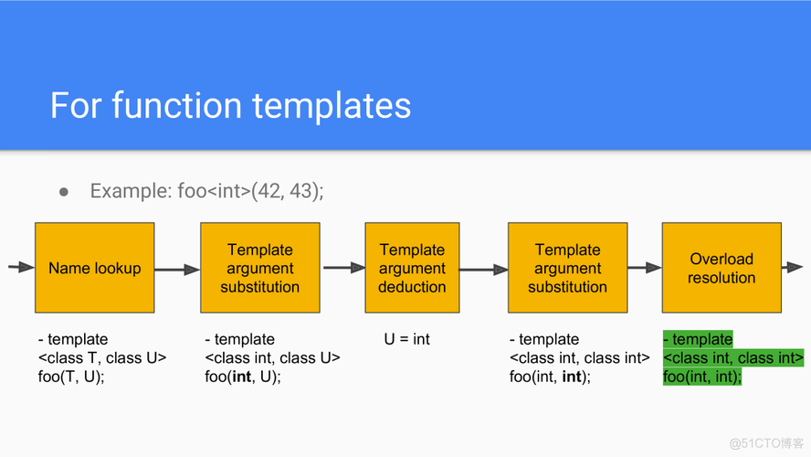

Slide 18
class module_good
{
public:
const char* get_name() {}
};
class module_bad
{ public:
int * get_name;
};
<type_traits>
？has_get_name<module_good>::result;
std::is_member_function_pointer<decltype(&module_good::get_name)>::value
？has_get_name<module_bad>::result;
template<typename T>
struct has_get_name {
typedef char true_t[1];
typedef char false_t[2];
template <typename T2,const char *(T::*)()>
struct func_matcher;
template <typename T2>
static true_t& test(func_matcher<T2,&T2::get_name>*){}
template <typename T2>
static false_t& test(...){}
enum {
result = (sizeof(test<T>(NULL)) == sizeof(true_t))
};
};
SFINAE
编译器不应该抛出大量错误，而应该继续尝试其他可用的重载
template <typename T2,const char *(module_good ::*)()>
struct func_matcher
(func_matcher< module_good, & module_good ::get_name>*);
sizeof(test(NULL))
true
result = (sizeof(test< module_good >(NULL)) == sizeof(true_t))

