Slide 1
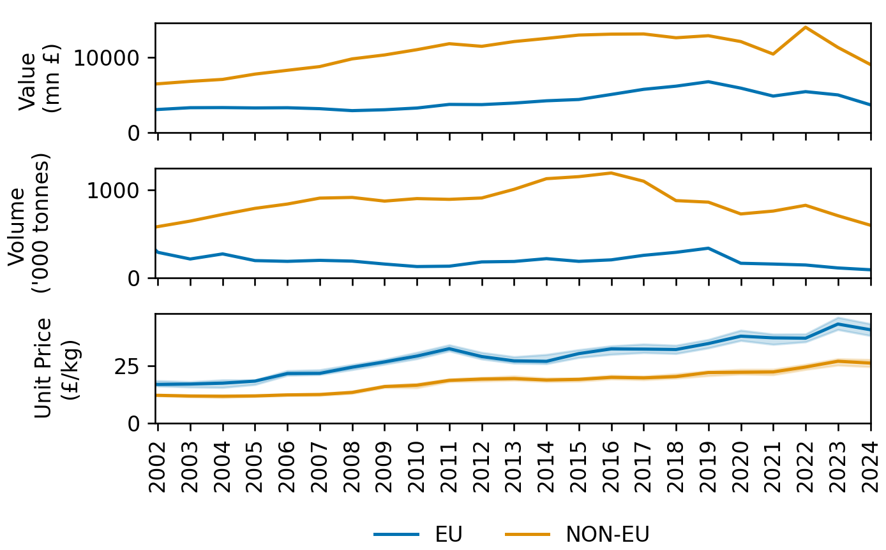
Annual Data – UK EU / NON-EU Imports

Slide 2
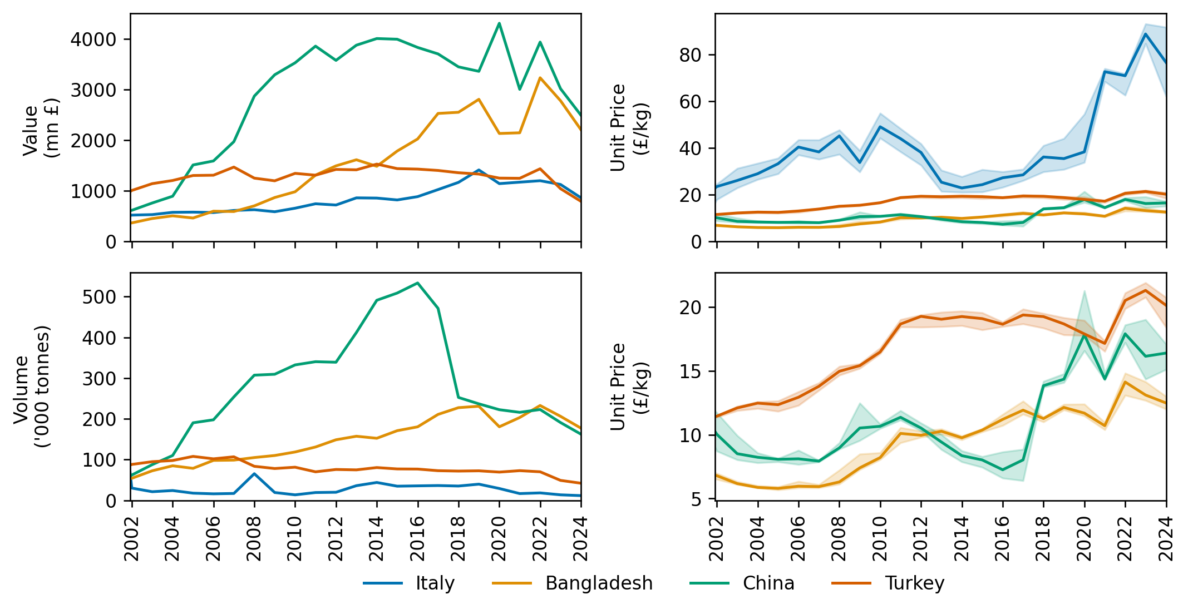
Annual Data – UK Country Specific Imports

Slide 3
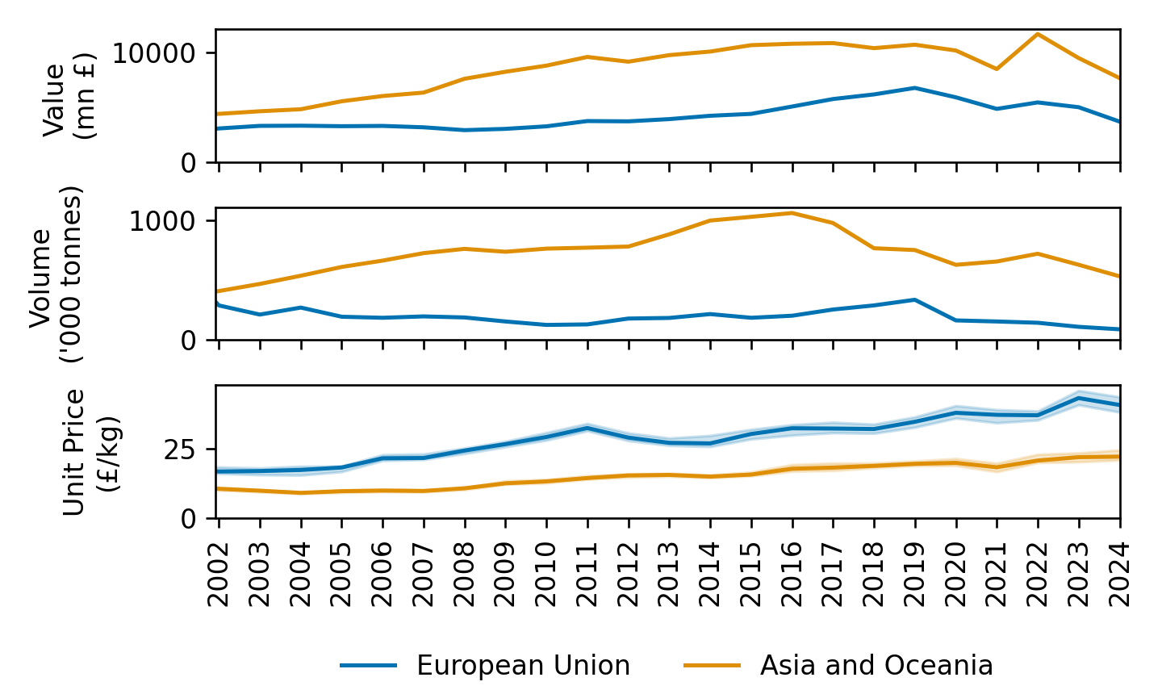
Annual Data – UK EU / Asia Imports

Slide 4
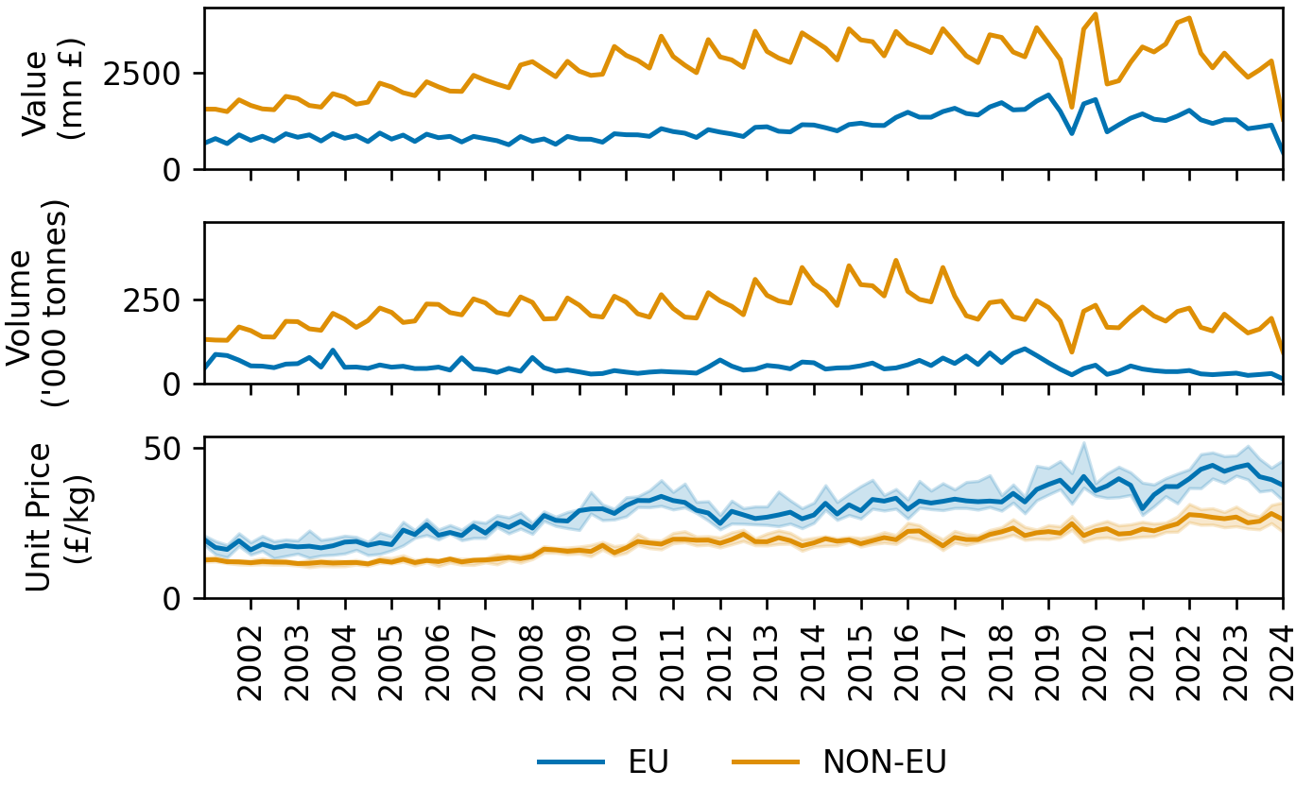
Quarterly Data – UK EU / NON-EU Imports

Slide 5
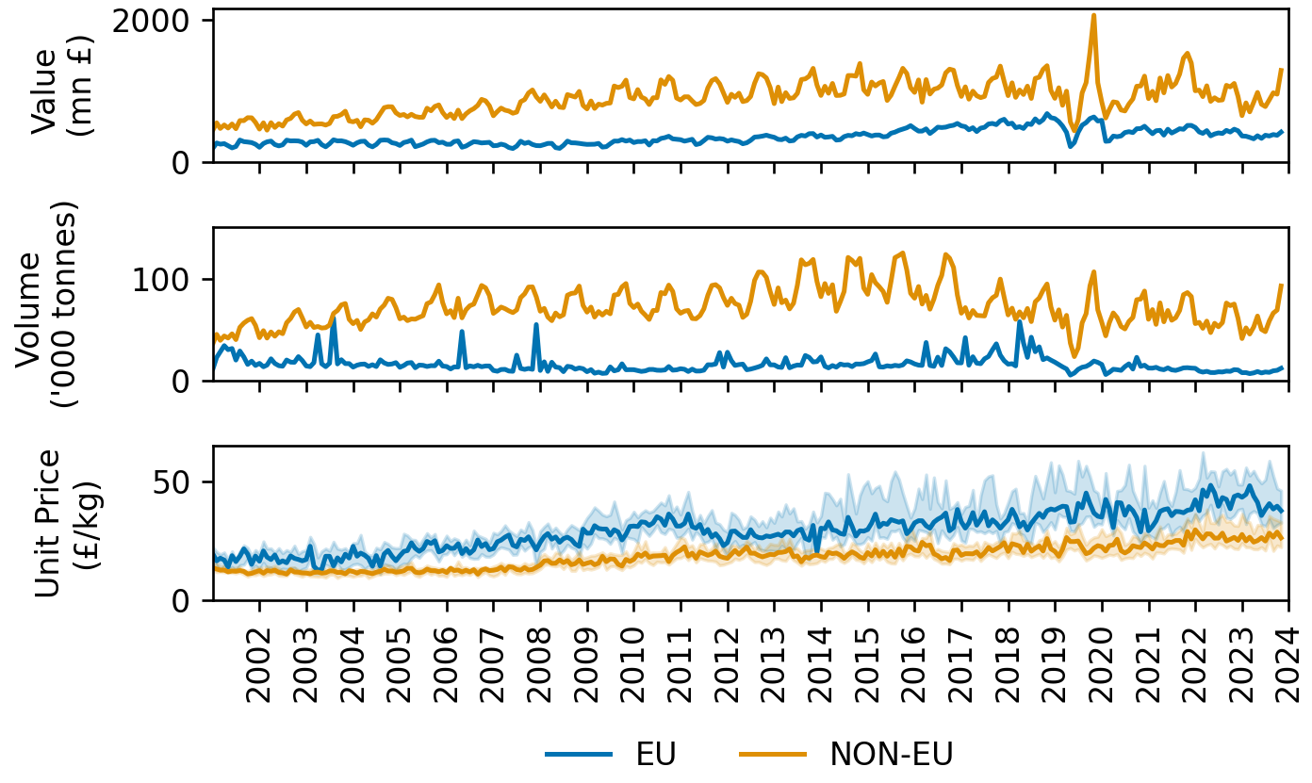
Monthly Data – UK EU / NON-EU Imports

