Slide 1
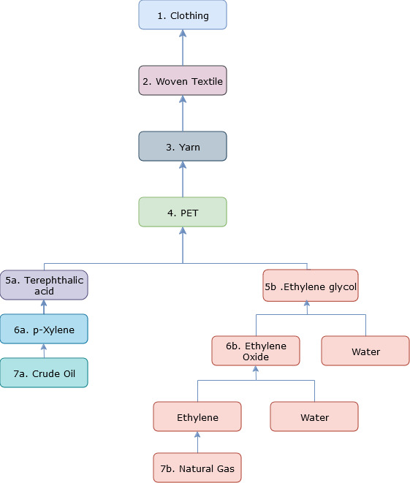

Slide 2
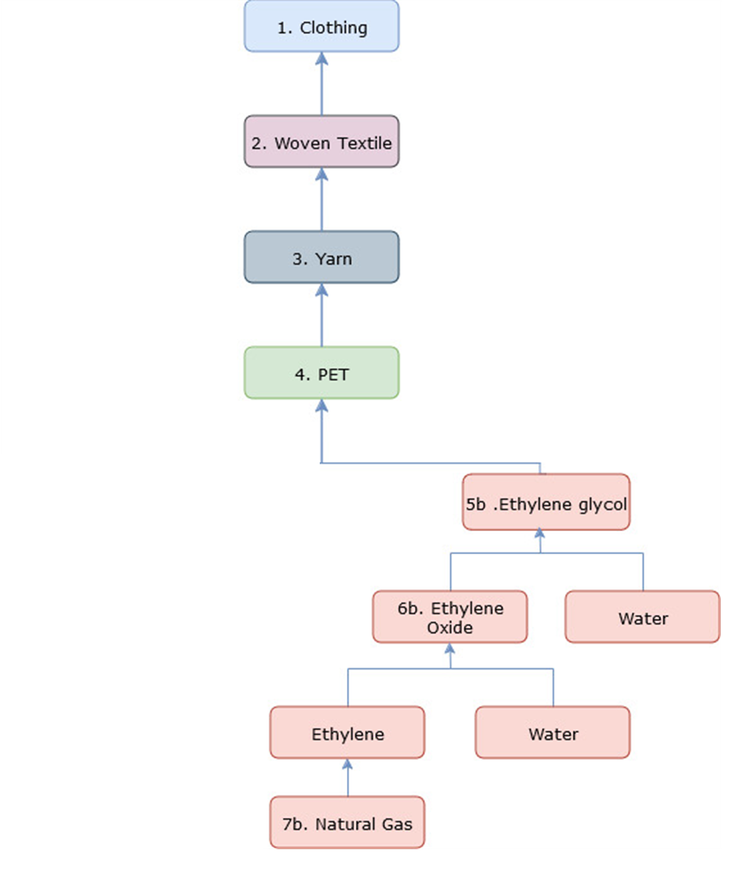
Saudi oil and gas largely produced by Saudi Aramco.
It is majority state-owned but is publicly listed.
Natural gas is transported by pipeline to be processed by SABIC.
SABIC subsidiary United (Jubail United Petrochemical Company) is the main producer of ethylene glycol.
Nearby ports are:
Jubail (commercial)
King Fahd (Industrial) and
Dammam (Industrial)

Slide 3
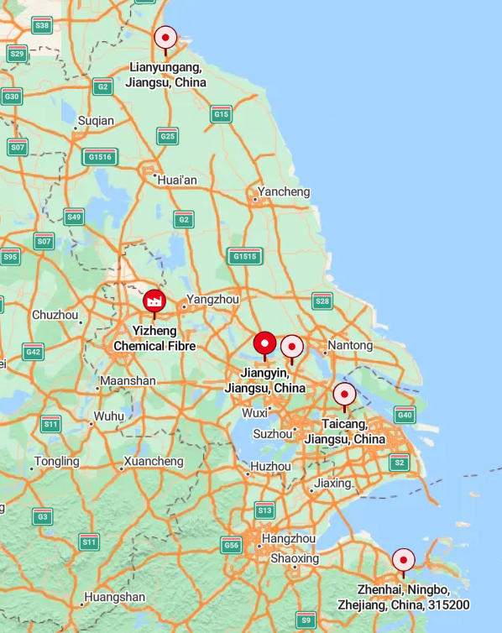
Yizheng Chemical Fibre is the largest producer of polyester fibres.
They are publicly listed and a subsidiary of Sinopec.
Nearby ports and daily (Feb 2022) ethylene glycol inventories are:
Zhangjiagang (418 kt)
Jianyin & Changzhou (134 kt)
Taicang (85 kt)
Ningbo (51 kt)
SA to Zhangjiagang, CN – 23 days.

Slide 4
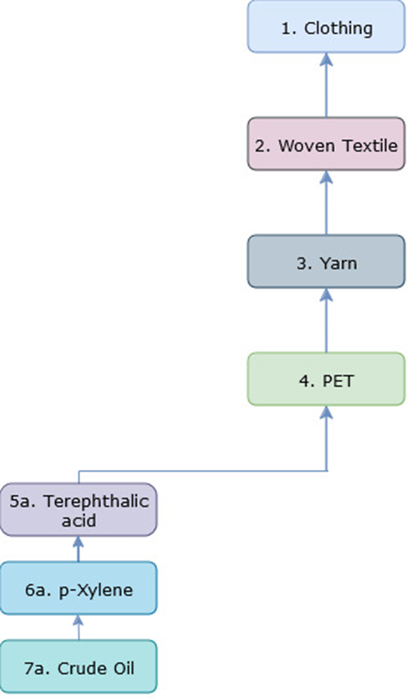
Saudi, UAE and Kuwait export to SK and Japan.
The main receiving oil ports are:
Ulsan, SK
Gwangyang, SK
Chiba, JP, and
Kawasaki, JP.
Yinzheng Chemical Fibre production capacity of terephthalic acid is several million tonnes pa.
So, assume the Xylene is being shipped into the same ports as before.

Slide 5
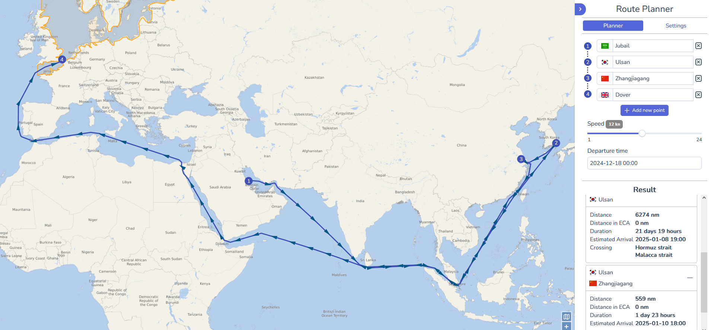
17 Days
2 Days
37 Days

Slide 6
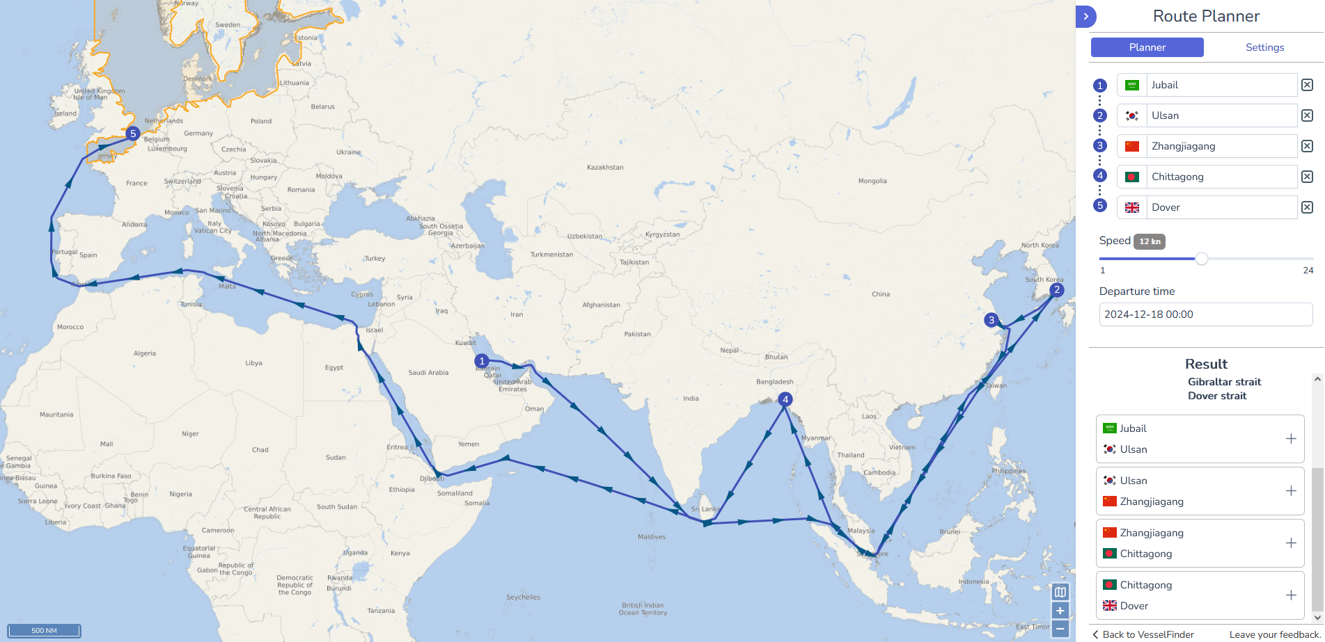
17 Days
2 Days
13 Days
28 Days

