Slide 1
ELEVATOR DISPATCH SIMULATION
Two problems: model the demand, then dispatch it
First generate a realistic stream of requests — then decide which car serves each one.
1
MODEL THE WORKLOAD
2
THE DISPATCH PROBLEM
How do requests arrive?
Which car serves each request — and how does it move?
Poisson(λ) arrivals in discrete time, plus an origin–destination traffic pattern — a synthetic trace, and the scheduler never peeks ahead.
An online, capacity-constrained assignment. Two axes: dispatch (which car — 5 policies) and motion (how it sequences stops — LOOK).
generator.py
dispatch/ · motion/
Problem 2 in one line: an online, capacity-constrained dispatch problem — stateful servers, costly switching, no peek-ahead. Same class as load-balancing requests across a worker pool.
Notes:
I break the problem in two. First, model the workload: requests arrive as a Poisson process in discrete time with an origin-destination traffic pattern - that's the generator, and the scheduler never sees the future. Second, the dispatch problem: given that stream, which car serves each request and how does that car sequence its stops. That second problem is an online, capacity-constrained assignment with two axes - dispatch (which car, the high-leverage decision, five policies) and motion (how it moves, fixed at LOOK). Dispatch is where the leverage is.

Slide 2
ARCHITECTURE
A pure, I/O-agnostic core with swappable adapters
Trace loader
trace_loader.py
Writers
writers.py
CORE
models.py
engine.py
motion/ · dispatch/
metrics.py
Generator
generator.py
Plots
plots.py
input: a trace → output: metrics
Scheduler plugs in: Motion ⊕ Dispatch
The core never touches files, DB, or UI — pure input → output.
compute (metrics) / save (writers) / render (plots) are separated.
One core, many drivers: CLI (1 run), demo (18 runs), Phase-2 grid.
Phase-2 grid loops the same core over 100 seeds — no changes needed.
Notes:
Hexagonal design: a pure core - the domain model (models.py: Request, Passenger, Elevator), the engine, the policies, and metrics - that only maps a trace to metrics, surrounded by swappable adapters. The two-axis scheduler plugs in through interfaces. This is why Phase 2 can redirect outputs to a database without touching the simulation.

Slide 3
DISPATCH — THE MAIN AXIS
Five policies, ordered by how much information they use
uses: nothing
Rotate through cars in order — ignores position entirely (naive baseline).
Round-robin
uses: position + direction
Classic “Figure of Suitability” — close cars heading the right way score higher.
Nearest-car
uses: geography
Split the building into banks; a request goes to its zone’s nearest car.
Zone-based
uses: + load + ETA
Score each car by distance + direction + backlog + route-ETA; take the cheapest.
Cost-function
uses: the whole batch, jointly
Optimal assignment of all pending requests at once (scipy) — the benchmark.
Hungarian
→ more information used → smarter routing (but heavier compute)
Notes:
The dispatch policies form a ladder of increasing information. Round-robin uses nothing; nearest-car adds position and direction; zone-based adds geography; cost-function adds load and route-ETA; Hungarian solves the whole batch optimally as a benchmark. All balance against each car's committed backlog.

Slide 4
MOTION — THE FIXED AXIS
How one car sequences its own stops
LOOK
used
FCFS
baseline
Sweep one direction, serve every stop on the way, reverse when nothing’s ahead.
Efficient — batches nearby stops into one pass.
Starvation-free — the sweep reaches every floor.
Serve stops in strict passenger arrival order, wherever they are.
Thrashes — bounces across the building (24 → 3 → 20 …).
Far more travel per passenger — the cost of ignoring position.
Design decision: motion is fixed at LOOK — near-solved and low-leverage. The real gains are in dispatch. FCFS is kept only as a baseline to show the gap.
Notes:
Motion is the low-leverage axis, so I fix it at LOOK, the classic elevator sweep: efficient and starvation-free. FCFS is the thrashing baseline that shows why smart motion matters, but I don't vary it; the leverage is all in dispatch.

Slide 5
SETUP
Assumptions & configuration — modeling a real office building
System / building
config.py · SystemConfig
Deliberate simplifications
16 elevators · 25 floors
capacity 10 · dwell 2 ticks
all cars start at the lobby
Assignment is immediate + irrevocable (never re-routed once made).
Dwell is a flat cost per stop (no per-passenger door time).
All cars start at the lobby, every pattern (a small transient).
Fungible fleet — any car serves any floor (zoning is software-only).
No peek-ahead — the scheduler sees only requests that have arrived.
Constant speed, 1 floor per tick (no acceleration).
Workload (Poisson Process)
cli.py · generator.py
up-peak · λ = 3 per tick
900-tick window · seed 42
≈ 2,700 passengers
Scheduler
config.py + cli.py
cost weights 1.0 / 2.0 / 0.5 / 1.5
aging 0.1 · zones = 3
1 tick ≈ 2 seconds
Notes:
The config models a real office building - 16 cars, 25 floors - in a morning up-peak, with lambda tuned so cars run busy but not saturated. The simplifications are deliberate and defensible; each is something I could relax. These settings produce the numbers on the next slide.

Slide 6
WORKLOAD DETAIL
Traffic patterns — three workloads
defined in generator.py · cli.py
Same building & λ; only origin/destination changes. Uniform{a..b} = every floor in [a,b] equally likely (n = 25 floors).
PATTERN
WHEN
SOURCE (pickup)
DEST (dropoff)
↑ morning rush
1 (lobby, fixed)
Uniform{2..n}
up_peak
↓ evening exodus
Uniform{2..n}
1 (lobby, fixed)
down_peak
↕ midday interfloor
Uniform{1..n}
Uniform{1..n} (≠ source)
uniform
Only origin/destination changes — λ, seed, and the building are held constant. This is exactly why the best dispatch policy flips by pattern (→ Results): position discriminates cars only when pickup floors vary.
Notes:
Three traffic patterns, same building and same arrival rate - only the origin and destination distributions change. Up-peak: everyone enters at the lobby and rides up (morning). Down-peak: everyone rides down to the lobby (evening). Uniform: random floor to floor, the midday interfloor case. This is the key to the results: when all pickups are at the lobby (up-peak), position can't tell cars apart; when pickups are spread (down-peak, uniform), position-aware dispatch wins.

Slide 7
DATA MODEL
models.py — the domain “nouns” (pure data)
Pure data types; all behaviour lives in the engine and policies.
Request
frozen · immutable
Elevator
one per arrival — the raw request
a car's live runtime state
fields id · submit_tick · source · dest
derived direction · distance
state current_floor · direction · state
holds onboard[] · targets{} · capacity · dwell
methods is_full() · free_slots
Passenger
wraps a Request
the request's lifecycle + timing
Enums
adds assigned_elevator · pickup · dropoff
derived wait · travel · total · state
Direction UP · DOWN · IDLE
ElevatorState IDLE · MOVING · DWELLING
PassengerState WAITING · ONBOARD · DELIVERED
Notes:
models.py defines the domain nouns as pure data. Request is the immutable input row. Passenger wraps a Request and adds the mutable lifecycle stamps plus derived timing. Elevator is a car's runtime state including its onboard list and target floors. Enums label direction and states. All behaviour lives elsewhere - these types never advance time.

Slide 8
THE ENGINE
One tick at a time — how the simulation advances
run_sim() spins this 6-step loop, advancing the clock one tick until the building empties.
1
LOG
2
ADMIT
3
DISPATCH
4
SERVICE
5
MOVE
6
ADVANCE
positions
(before move)
arrivals at t
→ unassigned
policy picks
a car → waiting
alight, then
board (≤ cap)
one floor to
next target
t + 1;
drained? stop
↻ repeat every tick — until all passengers are delivered (stall-detector + hard cap = safety nets)
Two design choices: (1) SERVICE before MOVE — a car already on your floor boards you before driving off. (2) Each car's targets are re-derived every tick from its committed passengers. Steps 3 & 5 are where your dispatch & motion policies plug in.
Notes:
The engine is a plain while-loop. Each tick runs six steps: log positions, admit new arrivals, dispatch them to cars, service the current floor (alight then board), move each car one floor, then advance and check termination. Two subtle choices: service happens before move, and each car's targets are re-derived fresh every tick from its committed passengers. Steps 3 and 5 are where the dispatch and motion policies are called.

Slide 9
MEASUREMENT
Metrics — reading summary_stats.json
computed in metrics.py
TIME — per passenger (ticks)
EFFICIENCY — whole fleet
wait = pickup − submit; time to board (+ p90/p95 tail)
total_distance Σ of all floor-moves · total fleet work
travel = dropoff − pickup; time onboard
stops_made count of door-open service events
total = wait + travel; total in-system (the objective)
utilization_rho busy ÷ (ticks × cars) · fraction of time busy
POOLING — how well cars share
throughput delivered ÷ ticks · delivery rate
distance_per_passenger total_distance ÷ delivered · lower = better
passengers_per_stop delivered ÷ stops · higher = more sharing
Reading the example (round-robin, up-peak): total avg 121 · ρ 0.96 · passengers_per_stop 1.05 → the fleet runs near-flat-out yet serves ~1 rider per stop. Busy, but barely pooling — the round-robin fingerprint.
Notes:
The metrics fall into three groups, all computed in metrics.py from the finished run. Per-passenger TIME: wait, travel, total (min/max/avg; wait also carries p90/p95 as the fairness tail). Fleet EFFICIENCY: total distance travelled, stops made, utilization rho (fraction of time cars are busy), and throughput. POOLING: distance per passenger (lower is better) and passengers per stop (higher is better). The example shows round-robin's signature - high utilization but ~1 passenger per stop, so busy but not pooling.

Slide 10
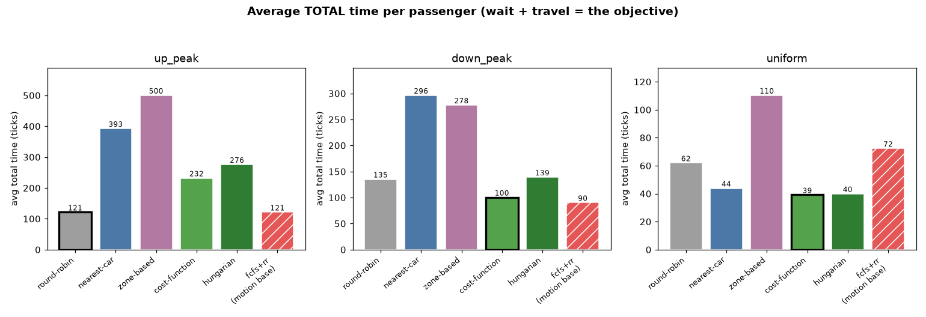
RESULTS
The best policy depends on the traffic pattern
THE FINDING
It depends on whether pickup floors are concentrated or spread.
Up-peak (all at lobby) → round-robin wins.
Spread / interfloor → cost-function & Hungarian win (≈ 3× on wait).
No universal winner
Zone-based fragments
Engineering rigor
The dispatch ranking flips with the traffic — position awareness pays off only when origins vary.
Walling off a fungible 16-car fleet consistently hurts (lowest utilization).
2 bugs caught by testing (load concentration, FCFS deadlock); load validated as Poisson.
Notes:
Headline: there is no universal best policy. When every pickup is at the lobby (up-peak), position can't distinguish cars and round-robin's blind even-spread is near-optimal. When pickups are spread (down-peak, interfloor), cost-function and Hungarian win by up to 3x on wait. Zone-based fragments the fleet. Two real bugs were caught by testing.

Slide 11
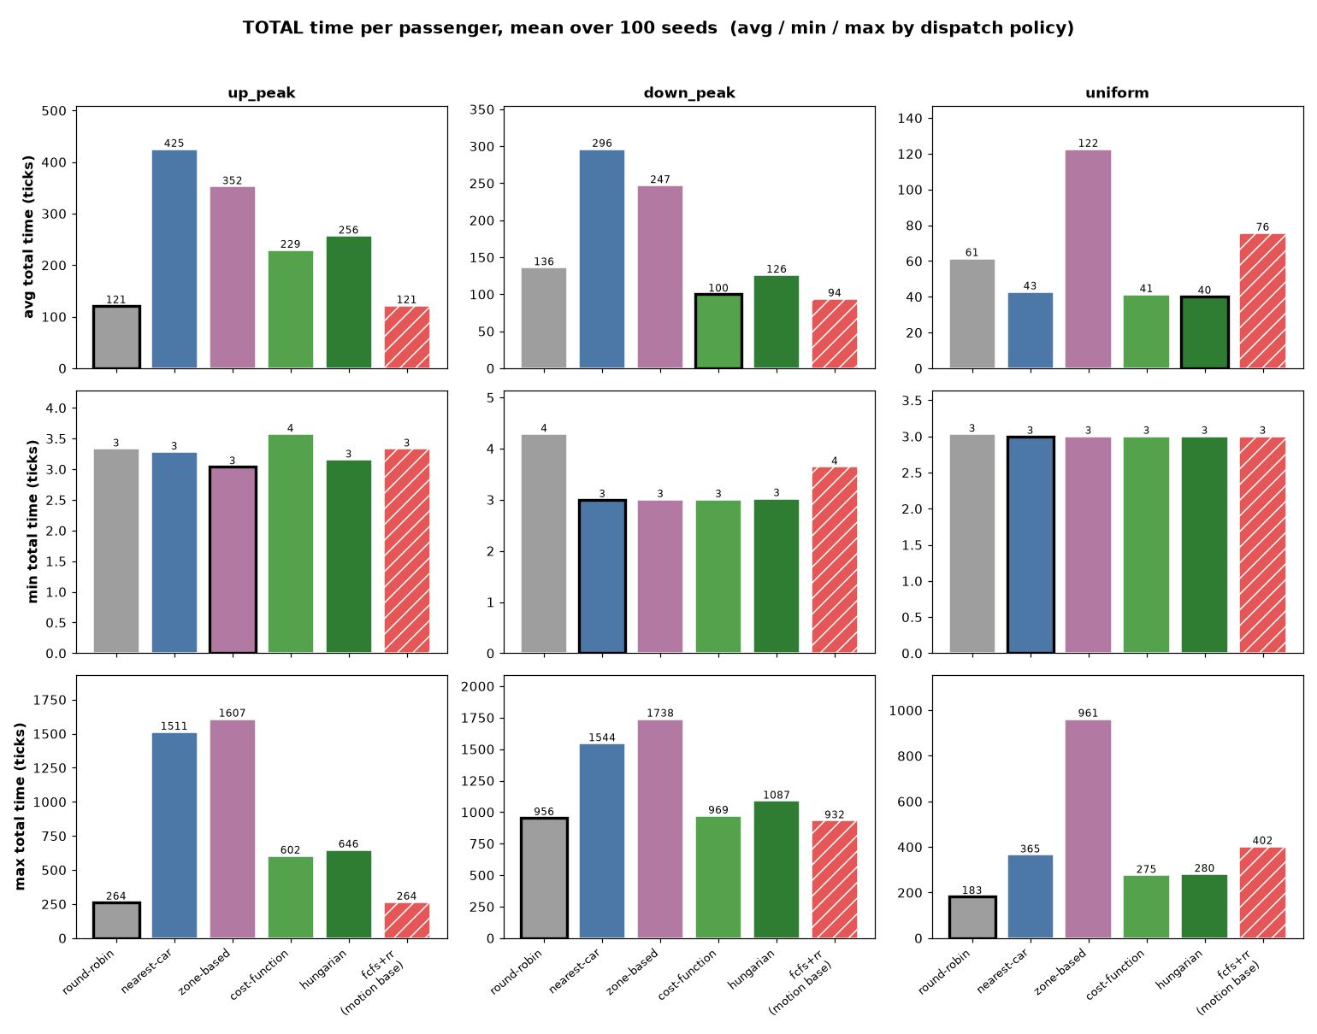
REPLICATED RESULTS · 100 SEEDS
Total time — the objective, confirmed across seeds
READING THE CHART
Finding holds across 100 seeds: up-peak → round-robin (121); down-peak → cost-function (100); uniform → cost-fn / Hungarian tie (≈40).
The max row is the real tell: the smart policies’ worst-case total runs ≈2–3× lower than nearest-car / zone.
Up-peak tightest for round-robin & fcfs: blind even-spread never lets one car fall far behind (max ≈264).
Min ≈ 4 for everyone — the luckiest rider is near-constant, so that row barely separates policies.
Notes:
Total time is the objective (wait+travel). Averaged over 100 seeds the single-trace finding holds: round-robin wins up-peak, cost-function wins down-peak, cost-fn and Hungarian tie on uniform. The max row shows the smart policies' worst case is 2-3x better on the spread patterns.

Slide 12
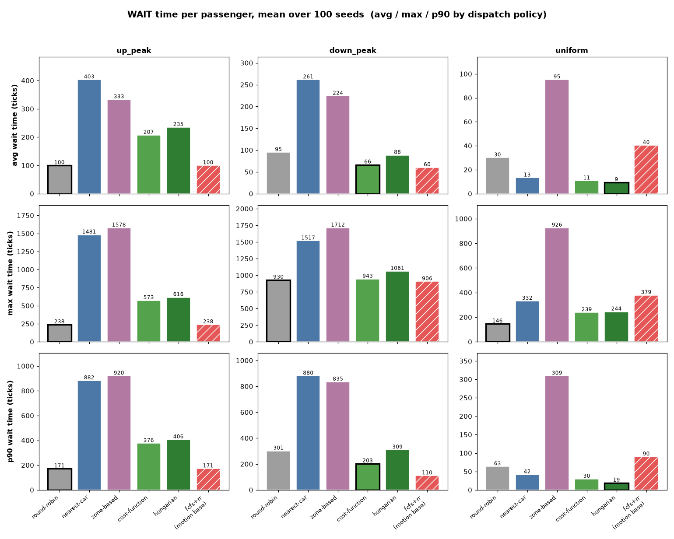
REPLICATED RESULTS · 100 SEEDS
Wait time — where the policies actually separate
READING THE CHART
Wait is the axis that decides winners — travel is nearly flat, so almost the entire objective gap is wait.
Spread pickups → smart policies slash the tail: uniform p90 wait is 30 (cost-fn) / 19 (Hungarian) vs 309 (zone).
Zone-based has the worst tail everywhere — fragmenting a fungible fleet strands the unlucky rider.
Up-peak flips it: round-robin wins even the p90 tail (171) — every pickup shares the lobby.
Notes:
Wait is where the policies separate. On the spread-pickup patterns the position-aware policies cut the p90 fairness tail by up to 10x versus zone-based. On up-peak, where all pickups are at the lobby, round-robin wins even the tail.

Slide 13
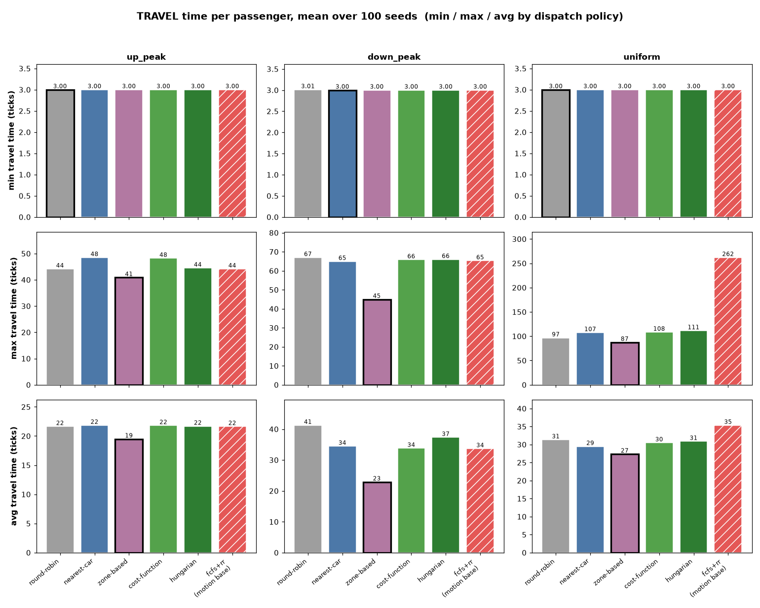
REPLICATED RESULTS · 100 SEEDS
Travel time — a flat, low-leverage axis
READING THE CHART
Once onboard, motion is solved: LOOK sequences stops well no matter which car dispatch picked, so avg travel clusters tightly.
This is why the policy gaps live in wait, not travel.
fcfs+rr max travel on uniform = 262 (vs ≈ 90–110 for LOOK) — the FCFS motion penalty: arrival-order stops thrash the car across the building.
Zone’s low avg travel is a fragmentation artifact — shorter rides because cars are under-used, not smarter routing.
Notes:
Travel time is a flat, low-leverage axis: once a passenger is onboard, LOOK handles the stop order regardless of dispatch, so avg travel barely moves across policies. That's why the policy differences all live in wait. The one exception is FCFS motion, whose worst-case onboard ride on uniform is far longer because it thrashes.

Slide 14
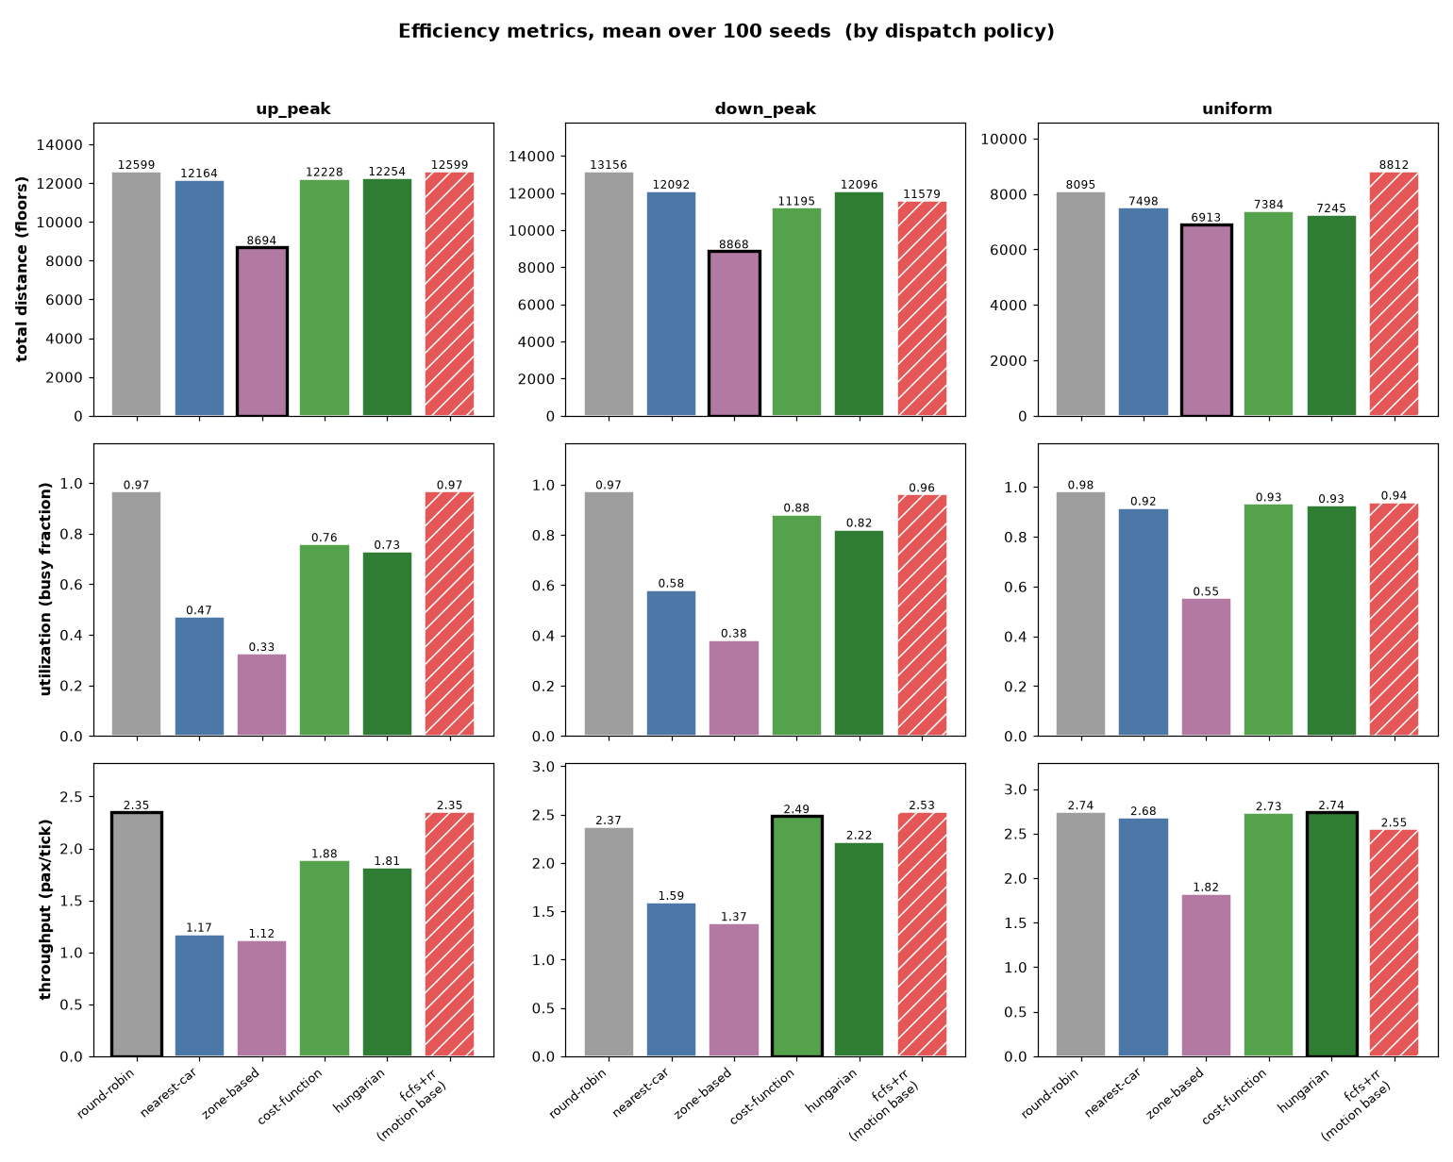
REPLICATED RESULTS · 100 SEEDS
Efficiency — utilization is the real diagnostic
READING THE CHART
Utilization explains the time results: the winners (round-robin, cost-fn, fcfs) keep ρ ≈ 0.9+.
Idle fleets lose: nearest-car & zone park cars (ρ 0.33–0.58) — the direct cause of their bad wait.
Low distance is a trap: zone “moves least” only because a third of its cars sit idle.
ρ is left unmarked on purpose (very high ρ can mean near the congestion cliff); throughput tracks who drains fastest.
Notes:
Efficiency reinforces the objective from the supply side. The policies that win on time are the ones that keep utilization high. Nearest-car and zone leave cars parked, which is exactly why they lose. Low total distance is a trap - it means idle cars, not efficiency. Utilization is left unmarked because very high rho can mean near the congestion cliff.

Slide 15
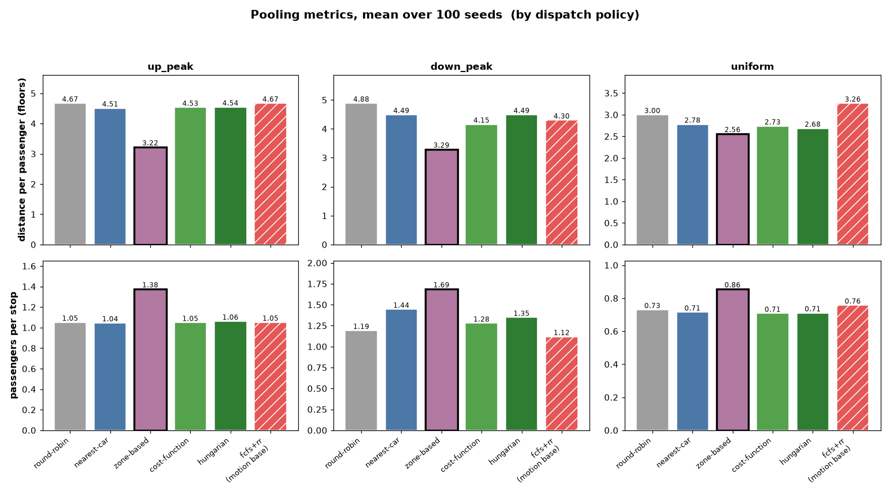
REPLICATED RESULTS · 100 SEEDS
Pooling — when good numbers mislead
READING THE CHART
Zone-based “wins” both pooling rows — lowest distance-per-passenger, highest passengers-per-stop.
But it’s a fragmentation artifact: it packs riders into fewer cars, so the cars that do run are fuller.
Read pooling against utilization: zone looks pooling-efficient precisely because it under-uses the fleet.
passengers-per-stop < 1 on uniform — spread pickups mean many single-rider stops for every policy.
Notes:
Pooling repeats the cautionary pattern. Zone-based looks like the best pooler - lowest distance per passenger, highest passengers per stop - but only because it concentrates riders into fewer cars while the rest of the fleet idles. Pooling metrics must be read alongside utilization, or they reward exactly the fragmentation that hurts wait time.

Slide 16
HEAD-TO-HEAD · WHY THE WINNER FLIPS
Round-robin vs cost-function — the gap is always wait
Mean over 100 seeds (ticks). Top table = time decomposition; bottom = fleet & pooling. ρ = utilization · thru = throughput · d/pax = distance per passenger · p/stop = passengers per stop.
up_peak
▶ round-robin wins
down_peak
▶ cost-fn wins
uniform
▶ cost-fn wins
wait
travel
total
wait
travel
total
wait
travel
total
round-robin
99.7
21.6
121.3
round-robin
94.6
41.2
135.9
round-robin
30.1
31.3
61.4
cost-fn
207.2
21.8
228.9
cost-fn
66.4
33.8
100.2
cost-fn
10.7
30.5
41.2
ρ
thru
d/pax
p/stop
ρ
thru
d/pax
p/stop
ρ
thru
d/pax
p/stop
round-robin
0.97
2.35
4.67
1.05
round-robin
0.97
2.37
4.88
1.19
round-robin
0.98
2.74
3.00
0.73
cost-fn
0.76
1.88
4.53
1.05
cost-fn
0.88
2.49
4.15
1.28
cost-fn
0.93
2.73
2.73
0.71
Gap 107.6 · 100% wait
Gap 35.7 · 79% wait
Gap 20.2 · 96% wait
The total gap is almost entirely WAIT every time (100% / 79% / 96%) — the other columns barely move.
The bottom table shows why: on up-peak cost-fn’s utilization collapses to ρ 0.76 (every pickup at the lobby → it idles cars) so it loses; on down-peak & uniform it holds ρ 0.88–0.93 and even pools better (d/pax ↓, p/stop ↑), so it wins. Throughput & travel are otherwise a wash — position-aware matching only pays when pickup floors vary.
Notes:
Head-to-head of the two regime winners, now with the full metric table per pattern. For all three patterns the round-robin vs cost-function total gap is almost entirely wait. The bottom table explains the mechanism through utilization: on up-peak cost-function idles cars (rho 0.76) because every pickup is at the lobby, so it loses; on down-peak and uniform it holds high utilization and pools better, so it wins. Throughput and travel are a wash.

Slide 17
WHAT I’D EXPLORE NEXT
From a working simulator to a decision tool
1
Re-dispatch
2
Adaptive batching / up-peak mode
Let a long-waiting passenger move to a fresher car — gives aging real teeth and fixes the smart policies’ peak under-utilization.
Deliberately pool more riders per car under heavy load, the way real buildings switch modes.
3
Per-pattern weight tuning
4
Error bars & λ-sweep
Grid-search the cost-function weights against the metrics for each traffic pattern.
The 100-seed grid reports means only. Add per-metric SE / confidence intervals across seeds, then sweep λ to trace the utilization cliff (1/(1−ρ)).
Notes:
Next steps: re-dispatch is the big one - it activates aging and fixes peak under-utilization. Adaptive batching mimics real up-peak modes. Weight tuning per pattern. The 100-seed replicated grid is already done (previous five slides); the remaining statistical work is error bars / confidence intervals and a lambda-sweep to expose the congestion cliff.

