Slide 1
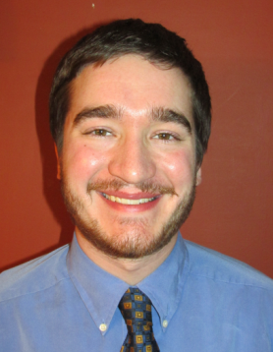
Code Like it Matters: Writing Code That's Readable and Shareable MWSUG TT04
Paul Kaefer
IT Data Analyst/SAS® Developer at UnitedHealthcare in MN
B.S., Computer Engineering & M.S., Computational Sciences
Marquette University
While pursuing master’s, worked for Marquette University GasDay, a business housed in a research lab that develops software for natural gas forecasting
After earning M.S., spent five months volunteering at the Ifakara Health Institute in Tanzania, leading statistics/R and technical English communication workshops

Slide 2
Code Like It Matters: Writing Code That's Readable and Shareable MWSUG 2017 –TT04
Paul Kaefer
IT Data Analyst/SAS® Developer
UnitedHealthcare

Slide 3
Today’s Agenda
Introduction
Why write readable and shareable code?
Best practices for writing
Code standards
Best practices for sharing
Conclusion
Discussion
You are encouraged to interrupt with questions.

Slide 4

Introducing me
B.S., Computer Engineering, 2013
M.S., Computational Sciences (a.k.a. applied math/data science), 2015
Both degrees from Marquette University
Pursued M.S. while working at Marquette University GasDay
Small business housed in research lab
Natural gas demand forecasting for about 21% of U.S. industrial, commercial, and residential gas consumption
Five months volunteering at Ifakara Health Institute in Tanzania
Taught workshops on technical English writing, stats, and R code

Slide 5
Why can I be trusted?
Recent degree in computer engineering
I have experience with MATLAB, Java, C, python, R, SAS®, and more
➔ what I’m presenting can be translated to each
Data Analysis Team Lead at GasDay
Maintained large research codebase
Helped with migration & training for version control
Interfaced with Software Development Team & learned from their best practices
I use what I’m presenting daily at my current job

Slide 6
Coding Like It Matters
Coming from a background in software engineering, I see gaps in the SAS field
SAS programmers across the board who may work as sole developer or silo on larger team
Many SAS contractors who also might work alone or deliver code they developed alone
Let’s bridge the gap!
software engineering best practices + writing SAS code

Slide 7
Disclaimers
The aim of this paper and presentation is to start the discussion
Some concepts presented should be treated as suggestions
Your organization may have their own opinions or existing standards
I am presenting what I consider best practices, but I acknowledge that there are other ways of doing things.

Slide 8
What do we mean by “readable” and “shareable”?
readable – clarity in the structure and content of the code
shareable – how quickly and easily someone new can understand and modify your code
These have similar meanings
How “pretty” is your code? And is its function self-explanatory?

Slide 9
Why write readable and shareable code?
Software developers often share their code with others
Sometimes one of those “others” is your future self
Have you revisited code months or years later and wondered why you wrote it that way?
Our code might be adapted or modified by a new team member, or someone on another team
Sometimes this is known in advance
Often we can’t predict: move to another team, new project maintainer, etc.
Things change
Database URL
Column/variable format
Structure of input/configuration file

Slide 10
Best practices for writing code
Modularity: write code so it is multi-purpose and can be repurposed
e.g., macro variables for filenames and date values
Comments, comments, comments!
I recommend using a header template
Explain concisely what functions and steps do
Use “sort by customer ID” instead of “do a sort”
Avoid explaining obvious lines
Avoid keeping many lines of commented-out code
If expecting reuse later, move it to a macro function
If it’s a change, use version control (stay tuned for later slides)
Notes:
Avoid comments for obvious lines like “add 1” or “initialize variable to zero”

Slide 11
Functions/keyboard abbreviations
If you write generic functions that can be reused in other processes, save them
For example, code to initialize variables based on dates, code to produce a summary report/file of output datasets, or code to send emails
Shared drive or common folder if others can use them
Templates can be given keyboard abbreviations in SAS
I store a program header that my team uses
I store code to convert dates to numbers and vice-versa
see, e.g. sasCommunity.org/wiki/Abbreviations/Macros

Slide 12
Coding Standards
Open-source projects and big software companies have these
Can be quite strict (in some cases, can’t commit code that doesn’t conform)
Usually agreed upon early, but can be amended later
Learned through documentation and code review (to be discussed)
Main points:
Be consistent. This enables unity across code and projects.
Follow examples from the field
Follow applicable standards, like ISO 8601 for dates
Be consistent. Your coding style is like a brand.
Notes:
ISO 8601 example : internationally-recognized; removes ambiguity between day vs. month, etc., and IS SORTABLE!

Slide 13
Code Standards: Tables and Variables
useCamelCaseForVariables or use_underscores_to_separate_words
Pick a standard and go with it
Maybe camelCase for variables and underscores for tables?
Use descriptive names
You get 32 characters; use them!
More flexibility for macro variables and functions
e.g., table: <data source>_<subset or area>_<specific purpose>_<datestamp>_<version>

Slide 14
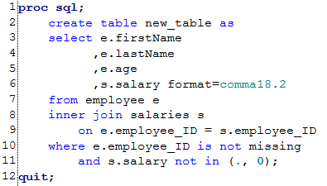
Code Standards: Format Your Code
No need to use all capitals (a.k.a., “angry text message”)
Use whitespace to make it easy to read:
Put commas before variable names
There is some debate here; I find this is easier to line up, see differences with CASE WHEN, and see where commas are missing
see, e.g., sasCommunity.org/wiki/Anatomy_of_a_SQL_query

Slide 15
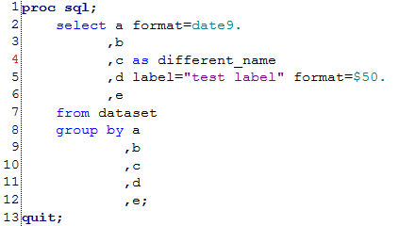

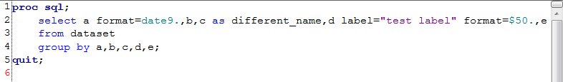

Code Standards: Queries, continued
In the same vein, don’t list variables on one line
group by a,b,c,d,e,f,g,h,i,j,k,l,m,n,o,p,q,r,s,t,u,v,w,x,y,z
vs. separate lines, to match select clause

Slide 16
Code Standards: whitespace and font
Back to whitespace: use spaces instead of tabs
Some debate and difference in preference
I recommend setting one tab = four spaces
In EG: Program >> Editor Options >> (insert spaces for tabs & set size = 4)
Spaces will preserve across editors (e.g., Notepad++ or UltraEdit) and when viewing code in terminal/vim
Prevent formatting frustrations when you modify text and tabs change width
Helps if you code in multiple languages, e.g., python where spaces matter
Also recommend using a monospace font
Default in EG and most code editors
Recommend across ANY programming language

Slide 17
Code Standards: Miscellaneous
Enable line numbers
SAS Program >> Editor Options
Makes it MUCH easier to debug & discuss code
Use semicolons at the end of the line
Having a line with only a semicolon is useless
Some languages error if it’s on the next line
Don’t make your lines too long
Various sources recommend 80 characters [1]
I recommend keeping it so you never have to scroll left-right using a standard monitor

Slide 18
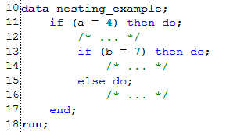
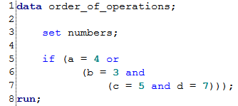
Code Standards: Last Slide
Order-of-operations
Equations, etc. will follow Parentheses, Exponents, Multiplication, Division, Addition, Subtraction (PEMDAS)
If it is complicated (e.g., nested subqueries and complicated IF statements), be liberal with parentheses
indent further for each level of nesting
Interim datasets should ALSO have descriptive names
Typically written to WORK library
May be stored in a data folder separate from main outputs

Slide 19
Best Practices for SHARING your code
Good, concise documentation
Comments, as previously discussed
External guide/manual/architecture documentation
e.g., might have a separate guide for users than for developers
Debugging code can count as documentation
could have macro variables like debug = on;
(when debug = off; certain code won’t run)
Meaningful variable names
Version control!

Slide 20
Version Control
How many of you use version control?

Slide 21
Version Control
How many of you use version control?
ALL HANDS SHOULD BE UP!!

Slide 22
Version Control
All programmers should use version control
Whether you’re on a team, or coding alone
Even useful in other fields (writing/editing, anybody who makes presentations or has a resume)
Rudimentary strategy
code.sas, code_v2.sas, code_new.sas, code_old.sas, …
Highly discouraged.
Use software like git, Subversion (svn), Mercurial, etc.
GitHub is a great example
Some learning curve, but the basics can be taught in < 1 hour
Existing & future integration with SAS EG & SAS Studio
Makes sharing easier
Saves you over and over (story time…)
Notes:
Mention integration: upcoming, enhanced features; what that means for workflows
Story of reporting process: had to produce a file with a different format in different sections
Original code (when I started) outputted them separately
I wrote code to concatenate the rows with different structure into the same set, and automate across all reports
My boss said, “do you remember doing that?” I hadn’t! But the more he said, the more I realized I should check my notes.
I went back, realized I had accidentally overwritten, BUT was committed in the repository. So I reverted and rested, relieved.

Slide 23
Version Control: The Basics
Version control software saves changes (iterations), not full copies
Ideal for code; not for binary files (.zip, .pdf, .egp, etc.), though you can include them
Lets you quickly compare any two versions, or see changes made since the last commit
When you have saved changes, you prepare a commit. This is a set of changes that can be pushed to the master copy. Then other team members can pull the latest changes from the master.
Depends somewhat on the software you use
Subversion is centralized, so everyone commits to the master
Git is decentralized; you can commit locally until ready to push
see also sasCommunity.org/wiki/Version_control

Slide 24
Version Control: Best Practices
Save code as raw .sas files, not in .egp
You can commit .egp files, but won’t be able to compare changes
Use a master script with %INCLUDE instead of the graphical program flow
Descriptive commit messages
Not “changed code”
Say “added filter on historical customer purchases”
Explain everything “fixed issue with … and wrote code to …”
Can be multiple lines
Reference commit number (Subversion) or hash (git)
Documentation can say “This feature was added in commit 77” or “commit 0c93e1af6” (git hash)
Tags can be used to preserve code as it was on a particular date or for a specific release (i.e., tag for v4.0)

Slide 25
Code Review
This really helps with developing a culture of standards
Best for teams collaborating on same codebase
Can be a formal review, in a conference room with a projector
Software tools allow asynchronous review
Log on to review site daily and spend some time reviewing code
Helps encourage a spirit of collaboration and collective learning
Use constructive criticism
Critiques on code should not be personal attacks
We can all learn from each other

Slide 26
Conclusions
Does this sound useful?
I hope I haven’t overwhelmed you…
Use this as a starting point
If you leave with one or two “gems”, I’m happy
You may disagree with me!
Different standards or existing practices by organization/field
Above all, be consistent!

Slide 27
Further reading
This presentation and paper are available at sasCommunity.org/wiki/Code_Like_It_Matters
Clean Code: A Handbook of Agile Software Craftsmanship, Robert Martin
sasCommunity.org/wiki/Good_Programming_Practice_for_Clinical_Trials
sasCommunity.org/wiki/Style_guide_for_writing_and_polishing_programs

Slide 28
Discussion
Does your team/organization have any standards or practices
not mentioned here?
What ideas presented are new or unfamiliar to you? How can I help?

Slide 29

Thank You!
Paul Kaefer
UnitedHealthcare
Minnetonka, MN
(952) 979-7347
paul_kaefer@uhc.com
sasCommunity.org/wiki/User:paulkaefer
@paulkaefer

