Slide 1

THINK Before You Type… Best Practices Learned the Hard Way
Marje Fecht
Prowerk Consulting
Notes:
1
Over the past 35 years, I have been delivering information using SAS and other tools.
I have BOTH written and inherited a lot of CODE and PROCESSES and have seen (and CREATED) the good – the bad – and the REAL ugly.
Today's presentation represents some of my learnings from the past 35 years.
Hopefully, you can each take away a best practice to help you avoid the UGLY.
See if any of these scenarios are familiar…

Slide 2
Is this familiar?
You leave a meeting with a new project TO DO
you sit down at your computer - and start programming . . .
a day later and lots of code on the screen, you try to remember the real purpose of your latest task.
Or, worse, you finish your task only to find that it is not what was requested.
Notes:
You escape from a meeting before you get assigned anything more – GRAB a coffee – and start typing.
You are really having fun trying out all the cool new tricks you learned at the latest SAS users group…
By the next morning – you were successful with the new technology but haven't a clue if what you produced has any relation to what was requested.
OR – you deliver it only to be told this isn't what they wanted.

Slide 3
Is this familiar?
You deliver the quick adhoc and move to the next task.
A month later, someone wants the adhoc again - with just a wee variation.
WHAT? You thought you would never look at that code again ☹
Generalization was the last thing on your mind and now you have to FIND and then dig through all that code…

Slide 4
Lesson Learned
Discipline and planning aren’t always easy but they pay off in the long run!

Slide 5
Introduction
This presentation focuses on best practices to help you minimize effort and maximize results.
What are some of the benefits you might enjoy?
Reusable / repeatable processes
Modularity and generalization of code
Speed to market
Consistent results (via code sharing)
Satisfaction that you delivered value to the original team (before they all change jobs) !

Slide 6
Example 1: The Quick ADHOC
Have you ever QUICKLY written code assuming it will never be used again??
Is it now 5 years later and the quickly developed SPAGHETTI CODE is still in production?
Worse still – does the code require YOUR time to tweak every time you run it?
And, even worse, have others COPIED the code and put it into their production processes (and even given you credit for the nasty code )?

Slide 7
Example 1: The Quick ADHOC Lessons Learned
There is no such thing as the quick adhoc!
Maintaining code is a big time-consumer and time-waster. Avoid writing code that requires continual maintenance!
Build an inventory of requests – it will come in handy!

Slide 8
Example 1: The Quick ADHOC Lessons Learned
And the BEST Lesson Learned….
Most people do not know what is already available to them… Over 25% of requests have the information already available and waiting to be consumed!

Slide 9
Example 1: The Quick ADHOC Recommendations
Utilize an Inventory system, and assign Request IDs
Document the details of the request
Send back to the requester, for confirmation
Add the information to your inventory
Use the documentation as comments in your program
Generalize the code for re-use.

Slide 10
Example 1: The Quick ADHOC Numbering System
Utilize a numbering system to assign a Request ID
it helps you identify all components
Specifications
Programs
Data files
Logs
Results / Reports
Emails.
it helps in communications with the requester - use the Request ID in email subject.

Slide 11
Example 1: The Quick ADHOC Document Details
Write a brief description of the request.
What is the population of interest (ie: what subset of data is being requested? )
Is there a particular time frame?
If this is a report, what might it look like
Rows and Columns
Format (dynamic vs static)
Metrics / measurements
Quantities / statistics desired.
Send this document to the requester and ask for written confirmation.

Slide 12
Example 1: The Quick ADHOC File Naming
Use a file naming convention for all files. Include:
Request ID
Version Date - yyyymmdd format for easy sorting
Request information such as requester or focus of request
Example: VINT07_AB_IAV_20141102.sas
which follows the format:
RequestID_Requester_Product_yyyymmdd.sas

Slide 13
Example 1: The Quick ADHOC Generalize!!
Before you start writing code, think . . .
What could change about this request in the future?
Are there generalizations that could enable easy code RE-use?
If the request is time-specific or if it focuses on just a subset of the available population, chances are good that you can generalize the code so that it can be easily adapted to future requests.

Slide 14
Example 1: The Quick ADHOC Benefits
These steps may add 15-30 minutes to the task, but you
confirmed that you understood the request, rather than delivering something off target (and the rewrite would take FAR more than 15-20 minutes)
built a program that can be adapted to future requests
have a tracking log (inventory) to reference when future requests roll-in.
The discipline and planning will pay off!

Slide 15
Example 2: Repeatable Processes
Have you inherited a time-consuming process or code that takes forever to “get ready” to use??
Does the process rely heavily on copy-paste?
Does that process not only need to continue but it also has to be replicated?

Slide 16
Example 2: Repeatable Processes Lessons Learned
A repeatable process
is only truly repeatable
if it is designed
to be repeatable!

Slide 17
Example 2: Repeatable Processes Scenario
Suppose you produce reports that use the same logic, extracts, and reporting formats on a regular basis for each new product / campaign / region. The programs and results are similar except for :
Dates
Inclusion / exclusion criteria
Title and footnote text
Search logic
Output locations
Report contents
etc.

Slide 18
Example 2: Repeatable Processes Current Approach
Do you suffer from Copy-Paste-syndrome?
Do you find the code you want to use, copy it, and paste it into a new Program?
What do you do when changes are needed? Finding EVERY place you used the code can be tough.
Consider creating SOURCE MODULES that can easily be re-used.

Slide 19
Example 2: Repeatable Processes Better Approach
Design the process as truly repeatable.
identify code components that are reusable
isolate and generalize those components and identify them as includable modules
document the input that each module requires
Create a driver program that provides macro variable input for the current scenario and then calls (%include) the appropriate modules
Note: a repeatable process requires extensive testing to confirm that changes accommodate all drivers that call the modules.

Slide 20
Example 2: Repeatable Processes Modular Code
*** Driver Program – specify appropriate values for parameters;
%let type = cheque; *** Campaign Type;
%let prestart = 01OCT2013; *** Pre campaign period;
%let prestop = 31DEC2013; *** End campaign period;
%let poststart = 01JAN2013; *** start tracking;
%let poststop = 30JUN2013; *** expire date;
%let title = "January 2013 - Introduce Low Rates";
%let products = ('VRS', 'GQL', 'BGO', 'DLA');
%let codes = ('015', '119', '214');
*** run standard extract and reporting programs;
%include 'CampaignReportingExtract_&type._2014_01_10.sas';
%include 'CampaignReportingOutput_&type._2014_01_13.sas';

Slide 21
Example 2: Repeatable Processes Modular Code
The driver / source approach works great, until your source code changes. Then, you need to find all drivers that are calling the source, and you need to change the date stamp in the %include.
To avoid changing the version in 100’s of drivers, use a placeholder reference in your drivers so that the most current source program is called.
Not fun!

Slide 22
Example 2: Repeatable Processes Modular Code
Example: Create a program that references the latest source version:
CampaignReportingExtract_cheque_CurrentPgm.sas
*** calls latest version of source program;
%include 'CampaignReportingExtract_cheque_2014_01_10.sas';

Slide 23
Example 2: Repeatable Processes Modular Code
*** Driver Program – specify appropriate values for parameters;
%let type = cheque; *** Campaign Type;
%let prestart = 01OCT2013; *** Pre campaign period;
%let prestop = 31DEC2013; *** End campaign period;
%let poststart = 01JAN2014; *** start tracking;
%let poststop = 30JUN2014; *** expire date;
%let title = "January 2014 - Introduce Low Rates";
%let products = ('VRS', 'GQL', 'BGO', 'DLA');
%let codes = ('015', '119', '214');
*** run standard extract and reporting programs;
%include 'CampaignReportingExtract_&type._CurrentPgm.sas';
%include 'CampaignReportingOutput_&type._CurrentPgm.sas';

Slide 24
Reusable Code
This driver-source example is a simple one, but demonstrates modularization and "hands-off" code.
A few further notes:
There are no limits to the # of %includes you can use
If you want the code from a %include to display in your log, use the SOURCE2 option
In addition to %include, reusable modules may be
Macros
Format Libraries.

Slide 25
Example 2: Repeatable Processes Successes
When reporting upgrades occur (new metrics / revised formats / new SAS features), they immediately roll out to all reports that are still running in production.
Obviously, this requires
end-to-end testing

Slide 26
Example 3: New Projects
Do you work on large projects that take so long to complete, that no one can remember why they were requested in the first place?
Worse still, do the results provide no value when they are finally delivered?
Use an iterative / phased approach that gets results in front of the requesters quickly, so that your efforts add value early in the project lifecycle.

Slide 27
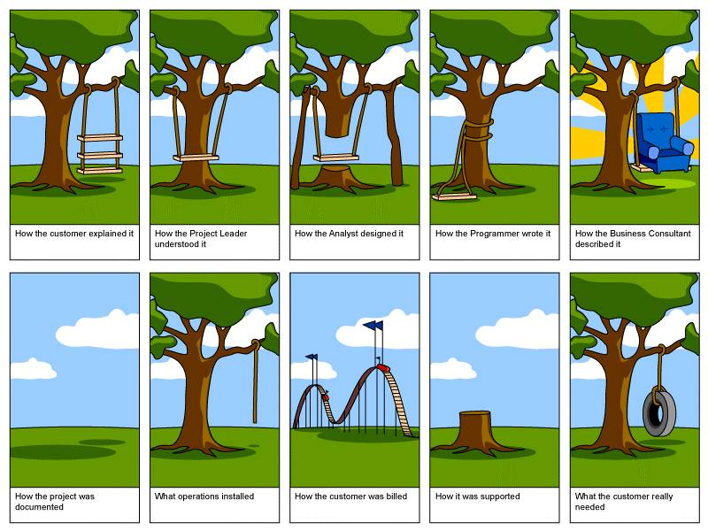
Example 3: New Projects

Slide 28
Example 3: New Projects - Lessons Learned
You are NOT just a programmer… You can add value and decrease time-to-market by providing structure and content to the process.
Do not sit back and play order taker. Take an active role in new projects by providing structure and encouraging:
well designed specifications
phasing – deliver key results quickly to get buy-in and maintain project focus.

Slide 29
Example 3: New Projects - Specifications
Gather information - meet with intended business users of your results
What decisions will be made (questions answered) with what you deliver?
Requirements – what do they think they want?
Prioritization of needs (to help with phasing) – What do they perceive to be the most important pieces?
Format and delivery channel for results: How do they want to receive the information?

Slide 30
Example 3: New Projects - Specifications
Document and share your findings, including
Phasing (so that you can deliver results quickly, get buy-in, and keep project sponsors happy)
Content and Expected Results for each phase
Approximate timing for each phase ( based on specifications as stated)
Cost estimates of each phase, if appropriate.
Exclusions / inclusions / population of interest
Metrics / Dimensions / hierarchies – including perceived definitions
Usability considerations
IT Concerns / Red Flags.

Slide 31

Example 3: New Projects Specifications – Approval
Do NOT begin any next steps until you receive approval / sign-off on final specifications

Slide 32
Example 3: New Projects - Research
Understand the data
For the metrics, determine ranges / expected answers
Identify data experts for help with validation
What definitions and calculations are required?
Are there data anomalies to be documented / considered?
Are there other reports / projects that are similar? If yes,
what is different about the current project?
what can be borrowed?

Slide 33
Example 3: New Projects – Code Plan
Start with comments that detail your approach, including the steps needed to reach your end results.
Be granular - with a phased approach many steps will come later in the process. Comments will help you remember what is next ☺ .
Use an OUTLINE format and Include the Phase numbers, so that you avoid building code before you should.
Include your plans for:
Locations for logs, output, programs – in development, test and production environments
Data sources and validation notes (from Research step)
Details of calculations
Plan for EXPANSION . . . Build-in generalizations.

Slide 34
Example 3: New Projects Code Development
GENERALIZE the code, whenever possible
MODULARIZE - If you borrow code, do NOT copy / paste. Instead, consider “including the step” via a macro call or %include
Include documentation of validation efforts, so you don’t forget what you learned
Save and review Logs. Utilize proc printto and include date-time stamps in the file names
Use Version control for programs, logs, results. Incorporate program version information into the report footnotes – so you can link results to the code and be able to roll-back to something that worked ☺

Slide 35
Example 3: New Projects Testing / Validation
Compare your results to the valid values, ranges, and expected results from the Research phase (use proc univariate or similar tools, to validate data values)
Test your programs to confirm that the logic is properly handling all possibilities
View samples of the intermediate datasets, to confirm that values, sequences, etc. make sense
Use proc compare to confirm changes between code versions. Confirm appropriateness of
Variable formats, lengths, and labels
Dataset attributes.

Slide 36
Example 3: New Projects Deliver a Phase
As each phase of results becomes available
Freeze the code version(s) and do not touch!!
Publish the results, and announce to the requesters. Request feedback on
Any data concerns
Usability of report format and contents.
While you await feedback, you can begin back at Code Plan for the next phase.

Slide 37
Example 3: New Projects – Production
For processes that run regularly, document the production process
When and how does it run? (automatically vs manual process)
What data / information (e.g., dependencies) needs to be available before it can run?
How do users know when information is ready?
Consider automated email alerts
Consider centralized (web?) publishing of information.
Maintain version control
Include date of last update in the file names so that you can locate and troubleshoot as needed.
Maintain a modifications section in code comments - what changes were introduced (and by whom on what date).

Slide 38
My Top 5 Suggestions
Always write your code as generically as possible
Use a phased approach, which includes delivering important results quickly (for buy-in)
Participate in meetings – do not become an order taker - work directly with the information consumer
Use code comments liberally, including starting with a code plan (in the form of comments)
THINK before you type!

Slide 39
Discipline and planning
aren’t always easy
but they pay off
in the long run!

Slide 40
Thank You!
Marje Fecht
Prowerk Consulting
Marje.Fecht@Prowerk.com

