Slide 1

Cross-Cultural Measurement Equivalence of the WPPSI-IV
Ou Zhang, Jessie Miller & Tom Cayton, Pearson
Xiaobin Zhou, Curriculum Associates

Slide 2

Introduction
Background: Canada and the U.S. have consistently demonstrated differences in overall intelligence when measured using Wechsler intelligence scales (i.e., WISC-IV, WAIS-IV, WPPSI-IV). Most recently, mean standard scores between Canada and U.S. standardization samples on the WPPSI-IV ranged from 0.1 to 5.4 points in FSIQ across age groups
Differences in standardized intelligence scores between Canada and U.S. have been attributed to differences in demographic composition of the two countries.
However, in order to accurately compare standard scores on measures of intelligence across the U.S. and Canada it is important to ensure the score differences observed are not the result of differences in the measurement of intelligence across the two countries.
Notes:
The most recent publication in the line of Wechsler Scales of Intelligence Tests – WPPSI-IV – demonstrated a typical IQ discrepancy between the Canadian and US standardization samples. WPPSI-IV FSIQ scores differed by 0.1 to 5.4 standard score points between the two countries, and this is consistent with previous findings of FSIQ score differences in the WISC-IV and WAIS-IV
Results indicate that the mean FSIQ differences between the Canadian and U.S. samples are 5.2 points for the 2:6–3:11 age band and 1.9 points for the 4:0–7:7. Thus, Canadian children are performing better than U.S. children, on average, and these differences are greater for the younger children in the standardization samples. In the previous edition of the WPPSI (WPPSI–III), standard score differences between Canada and the U.S. were also greater for the younger age band (4.5) than the older age band (3.9), however the magnitude of the Canada-U.S. differences have increased for the youngest children in the sample and decreased for the oldest children from WPPSI–III to WPPSI–IV.

Slide 3
Present Study
Multi-group (Multiple Sample) Confirmatory Factor Analysis is used to test the assumption that two groups do not differ in the measurement of a construct (or set of constructs).
The purpose of the present study is test for measurement equivalence (ME) of the WPPSI-IV between Canada and the U.S.
Notes:
Why are we looking at the WPPSI-IV? It’s our most recent measure of intelligence, and has also shown the biggest discrepancy in IQ scores between CDN and the U.S. compared to previous publications.

Slide 4
Method - Samples
The U.S. and CDN standardization samples collected during the WPPSI-IV standardization were used.
  The detailed description of the these samples can be found in the WPPSI-IV technical manuals for U.S. and CDN.
CDN Normative sample: N=880, ages 2:6-7:7, stratified according to the 2006* CDN Census using sex, age, ethnicity, geography and parent education level
U.S. Normative Sample: N=3735, ages 2:6-7:7, stratified according to 2010 U.S. Census using sex, age, ethnicity, geography and parent education level
Notes:
*Note: 2006 CDN census was used because at the time (and still now) the 2011 census was not yet available
Canada Younger Group N=282; Canada Older Group N=581
U.S. Younger Group=1049; U.S. Older Group N=2631

Slide 5
Method - Overview
Three sets of Multi-group CFAs were examined
  Overall sample (2:6-7:7 yr. olds)
  Younger sample (2:6-3:11 yr. olds)
  Older sample (4:0-7:7 yr. olds)
Overall age group
  Model specification = 1 second-order factor; 3 first order factors; 7 indicators
    Only 3 first-order factors common across all ages (VCI, WMI, VSI)
Younger age group
  Model specification = 1 second-order factor; 3 first order factors; 7 indicators
Older age group
  Model specification = 1 second-order factor; 5 first order factors; 15 indicators
Notes:
Subtests included VCI (Information, Receptive Vocabulary, Picture Naming); VSI (Block Design, Object Assembly); WMI (Picture Memory, Zoo Locations)
All subtests available for younger group included in the model (i.e., not just subtests contributing to Primary Index Scales)

Slide 6
Method - Analyses
We compared nested models via a “Likelihood ratio test” by evaluating the change in chi-square with degrees of freedom difference
Evaluation Criteria: Chi-square difference test for nested models, CFI, RMSEA, SRMR, AIC
SAS PROC CALIS function used for analyses.
Notes:
CFI = Comparative Fit Index (excellent fit is > .95)
RMSEA = Root mean square error of approximation (excellent fit is < .05; good fit is .05-.07)
SRMR = Standardized root mean square residual (excellent fit is 0.0)
AIC = Akaike information criterion (a parsimony adjusted index. smaller values indicate better model)

Slide 7
Procedure
Step 1: an omnibus test of the equality of the covariance matrices across groups
  If covariance matrices do not differ across groups, then ME is established and further tests of equivalence in the measurement model are not necessary
Step 2: Configural invariance
  Also known as the Baseline Model and the model against which subsequent models are compared
Step 3: Metric invariance
  First order factor loadings
  Second order factor loadings

Slide 8
Measurement Invariance
Step 4: Scalar invariance
  Intercepts of indicators
  Intercepts of latent variables
  Disturbances of first order factors
Step 5: Strict invariance
  Residuals (the uniqueness associated with each indicator, i.e., the 7 subtests)
  A test of the equality of the reliability associated with the measurement of each observed variable when the factor variances are equal
  Difficult to achieve and not necessary to test differences in factor structure or latent means

Slide 9
Measurement Invariance
Only metric and scalar invariance are required in order for us to be able to compare mean score differences between CDN and the U.S.
Strict invariance of the “uniquenesses” (i.e., residuals) is not necessary.

Slide 10
Step 1 Results
Step/Model no. | Description | χ² | df | CFI | RMSEA | RMSEA 90% CI | SRMR | AIC
1 | Equality of variance/covariance matrices | 93.53 | 13 | 0.9931 | 0.0518 | [0.042,0.062] | 0.0132 | 207.5322

Slide 11
Results
We could stop here after Step 1 given the excellent model fit statistics when testing for equivalence of the covariance matrices [χ² (13) = 93.53; CFI = .99; RMSEA = 0.052; SRMR = 0.01]
However the RMSEA 90% CI upper boundary was 0.06 so to be conservative we proceeded to further tests of ME
Notes:
*Chi square test of significance is highly reactive to large sample sizes

Slide 12
Results
Step/Model no. | Description | χ² | df | CFI | RMSEA | RMSEA 90% CI | SRMR | AIC | Model comparison | Δχ² | Δdf | p-value
1 | Equality of variance/covariance matrices | 93.53 | 13 | 0.9931 | 0.0518 | [0.042,0.062] | 0.0132 | 207.5322 | - | - | - | -
2 | Configural Invariance | 93.53 | 16 | 0.9934 | 0.0458 | [0.037,0.055] | 0.0132 | 201.5322 | - | - | - | -
3 | first-order factor loadings invariant | 95.02 | 19 | 0.9935 | 0.0417 | [0.034,0.05] | 0.0138 | 197.0189 | 3 vs 2 | 1.4866 | 3 | 0.6854
4 | first- second- factor loadings invariant | 98.32 | 22 | 0.9935 | 0.0388 | [0.031,0.047] | 0.0154 | 194.3172 | 4 vs 3 | 3.2983 | 3 | 0.3479
5 | Intercepts of measured variables invariant | 100.17 | 28 | 0.9938 | 0.0334 | [0.027,0.041] | 0.0156 | 184.1714 | 5 vs 4 | 1.8542 | 6 | 0.9326
6 | Intercepts of measured variable first-order factor invariant | 103.97 | 31 | 0.9938 | 0.0319 | [0.025,0.039] | 0.0163 | 181.9700 | 6 vs 5 | 3.7986 | 3 | 0.2840
7 | disturbances of first-order factor invariant | 105.05 | 34 | 0.9939 | 0.0301 | [0.024,0.037] | 0.0162 | 177.0456 | 7 vs 6 | 1.0757 | 3 | 0.7830
Notes:
Χ² The chi Square statistic was significant at each step/model, which is not unexpected given the highly reactive nature of the Chi square to sample sizes over 1000.
NOTES: Δχ² ⁼ delta chi square or the change in chi square statistic; Δdf change in degrees of freedom; p-value for the chi square difference test

Slide 13
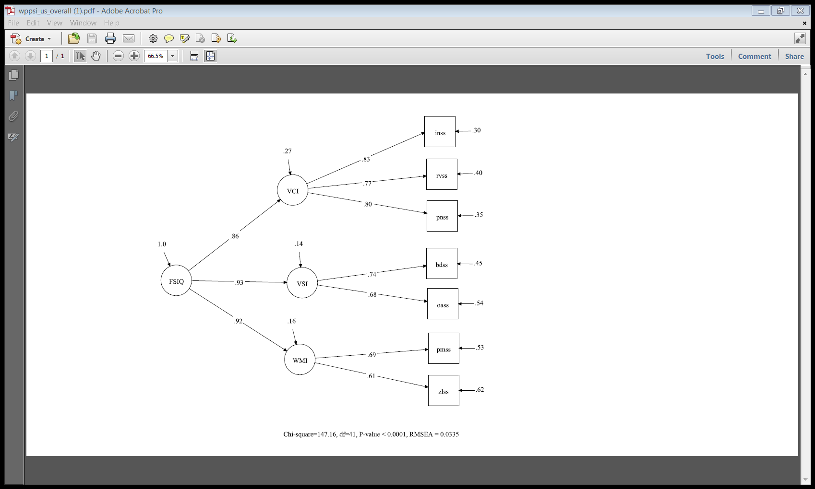
3-Factor Model for overall group
Numbers reflect U.S. sample
Notes:
The numbers depicted in this figure represent numbers from the U.S. sample (CDN sample was comparable) for Model 8 using children ages 2:6-7:7 (younger and older age bands combined)

Slide 14
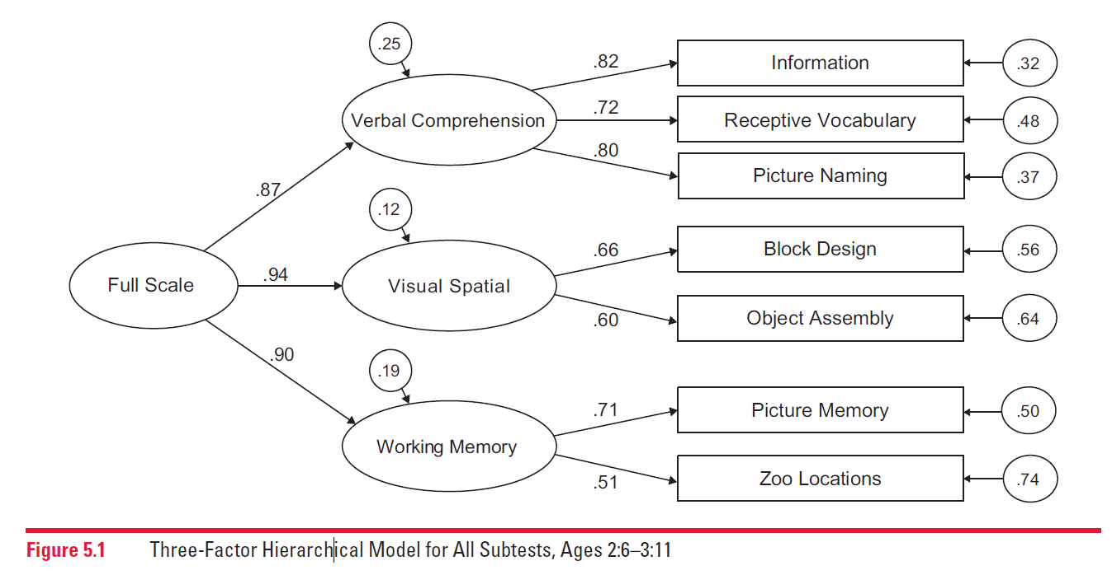
3-Factor Model for younger group in the U.S.
Comparable to the model depicted in the U.S. technical manual for all subtests in the 2:6-3:11 age band
Notes:
Same pattern of factor loadings in this model as in the figure/model on the previous slide. Example: Information has strongest factor loading in both figures/models for VCI; Block Design is higher in both figures for VSI; Picture Memory is higher in both figures/models for WMI
The model depicted above was for the younger age band for all subtests in the U.S. standardization sample (taken from the U.S. technical manual). The U.S. technical manual does not report on a model for all subtests with both younger and older age bands combined so this is the closest comparison model.

Slide 15
Results
When we tested for measurement equivalence by looking separately at both the younger age band (2:6-3:11) and older age band (4:0-7:7), the results were similar – i.e., equivalent models

Slide 16
Results
Younger (2:6 – 3:11)
Model no. | Description | χ² | df | CFI | RMSEA | RMSEA 90% CI | SRMR | AIC
1 | Equality of variance/covariance matrices | 31.26 | 13 | 0.9944 | 0.0460 | [0.025,0.067] | 0.0142 | 145.2584
Older (4:0 – 7:7)
Model no. | Description | χ² | df | CFI | RMSEA | RMSEA 90% CI | SRMR | AIC
1 | Equality of variance/covariance matrices | 768.96 | 155 | 0.9739 | 0.0497 | [0.046,0.053] | 0.0235 | 998.9566

Slide 17
Conclusions
According to Vandenberg and Lance (2000), “measurement equivalence is a logical prerequisite to the evaluation of substantive hypotheses regarding group differences…” and “violations of measurement equivalence assumptions are as threatening to substantive interpretations as is an inability to demonstrate reliability and validity”

Slide 18
Conclusions
The results of this study indicate that cross-group comparisons between Canada and the U.S. (on concepts measured by the WPPSI-IV) can be interpreted as substantive differences rather than differences due to measurement error or measurement variability.
Moreover the results presented here offer further support to the construct validity of the WPPSI-IV given the demonstration of measurement equivalence across two independent samples of children.

Slide 19

Primary contact:
Ou Zhang, Ph.D.
Research Scientist
Psychometrics, Pearson ou.zhang@pearson.com

