Slide 1

Home Credit Default Risk Prediction CS 6140 Machine Learning
Northeastern University
Name: Qi Zhang
Email: zhang.q@husky.neu.edu

Slide 2
Background
Use ML models to predict home credit risk (positive/negative) by selected features
To help company’s lending services
Highly challenging, many missing values
Implement and improve current models:
Kaggle Featured Prediction Competition

Slide 3
Data Analysis
Target Analysis
Binary values: 1, 0
Get targets’ distribution
Features Analysis
Information gains of all features
Join more tables to get more features
Convert original features
Multiply value of feature “ext_source_2”
Divide numeric features to 2 parts
Combine different categorical features

Slide 4
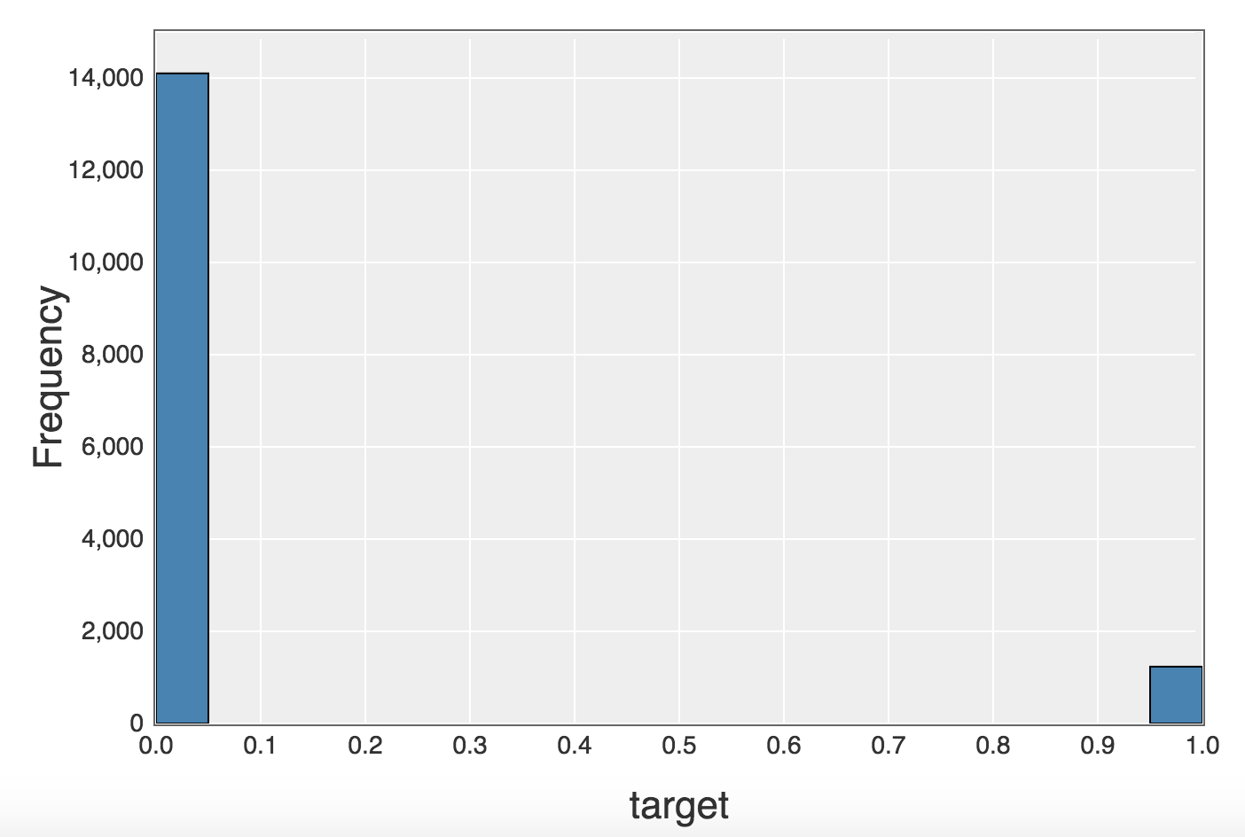
Target Analysis

Slide 5
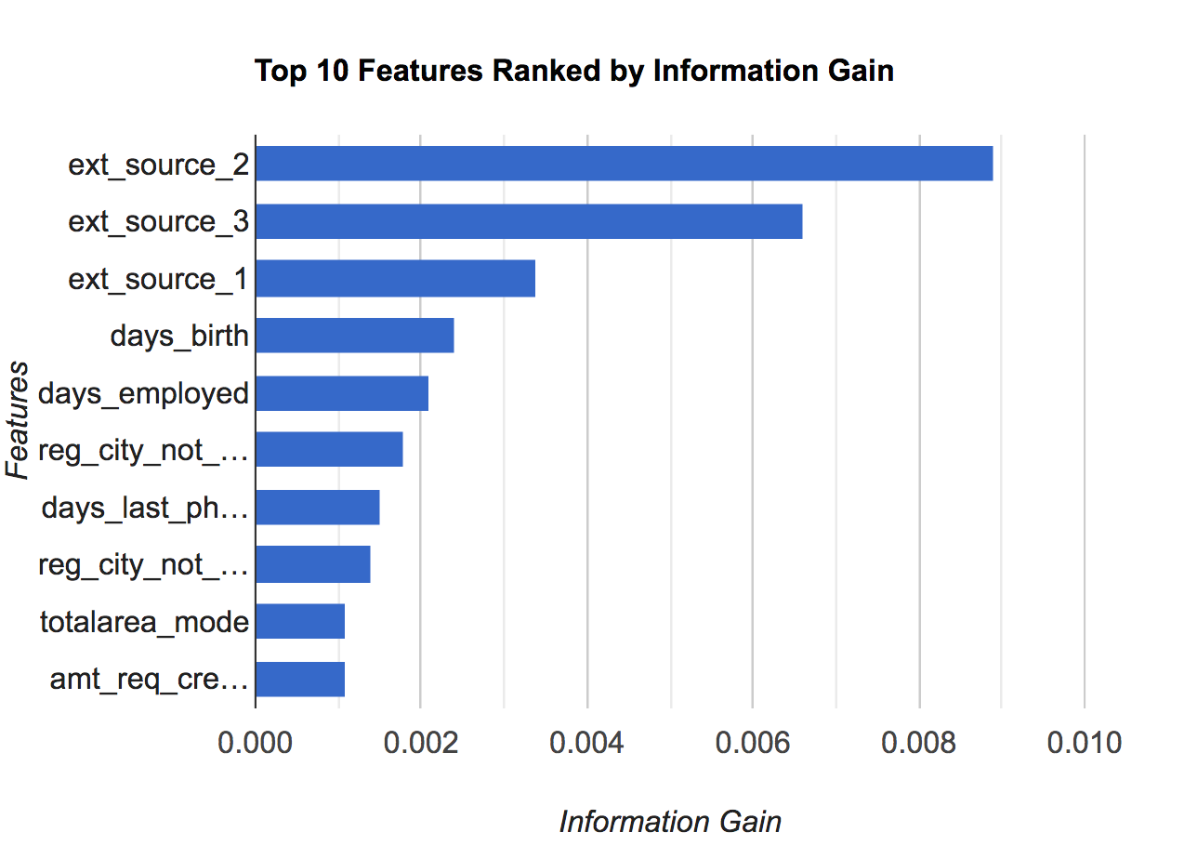
Features Analysis

Slide 6
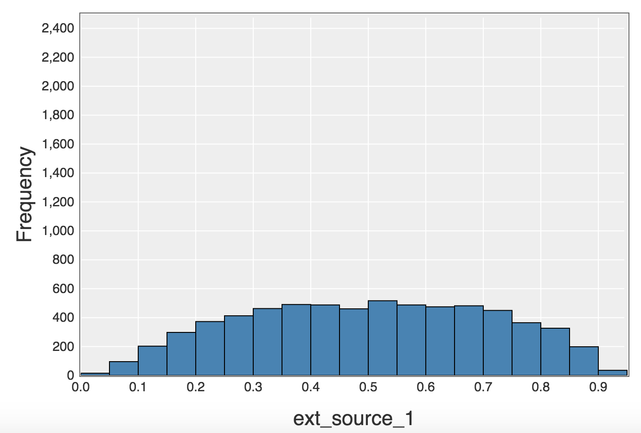
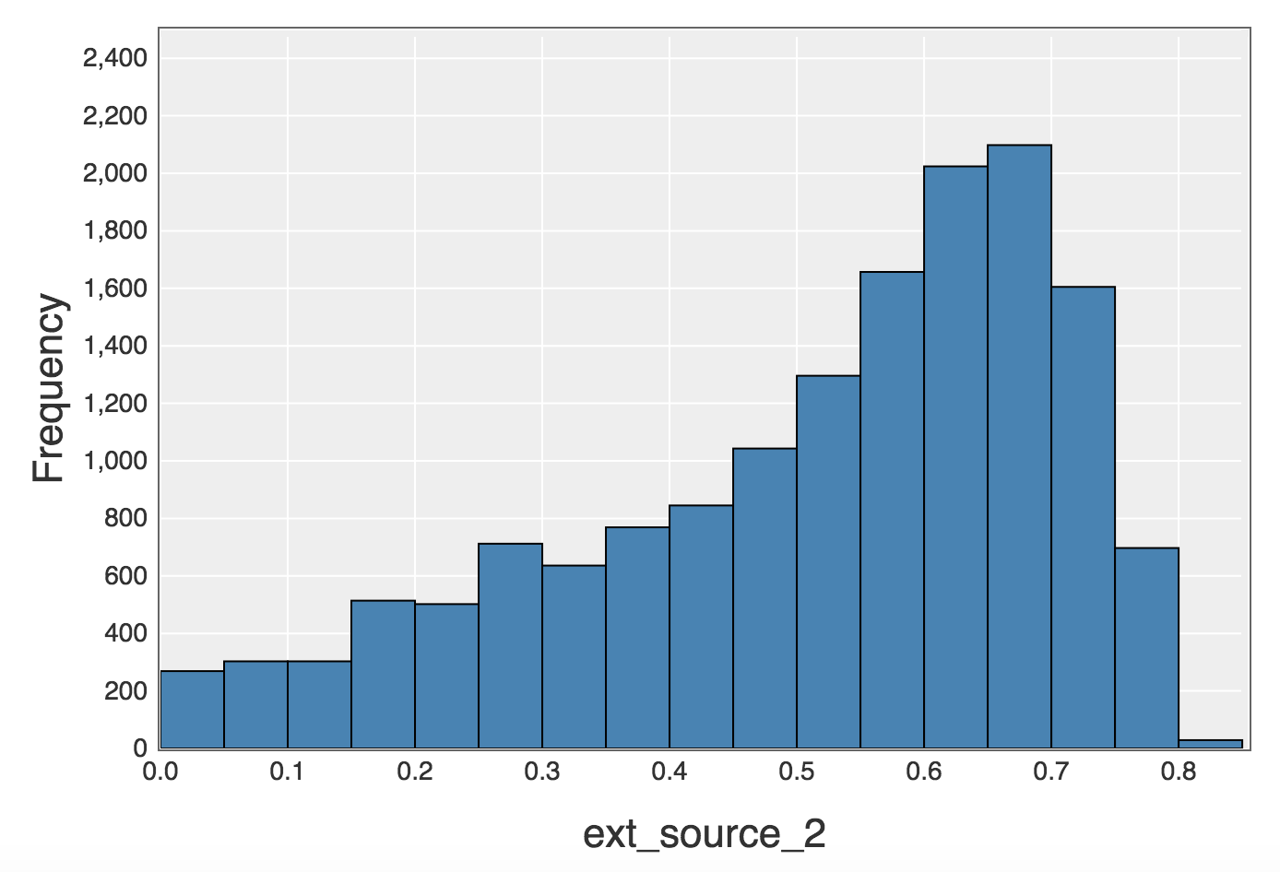
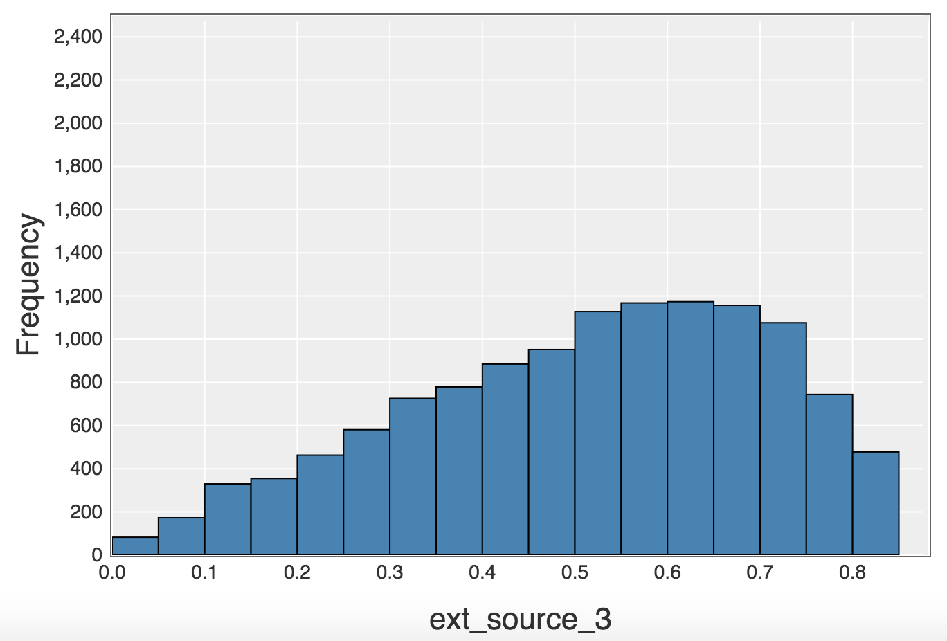
Features Analysis

Slide 7
Related Research
Mining the customer credit using classification and regression tree and multivariate adaptive regression splines
Credit Risk Assessment using Statistical and Machine Learning: Basic Methodology and Risk Modeling Applications link
A new fuzzy support vector machine to evaluate credit risk link
Consumer credit-risk models via machine-learning algorithms
5. Credit Risk Evaluation with Least Square Support Vector Machine link

Slide 8
Selection of ML Models
Linear Regression
Easy implement, suitable for continuous targets
Logistic Regression
Easy implement, suitable for binary targets
Decision Tree
More complex computation, high time complexity

Slide 9
Implementation of Logistic Regression
Extract data from database by SQL query
Filling missing values with mean values
Normalize dataset by z-normalize method
Set up parameters (learning rate, threshold,sample size)
Calculate the grad of features
Update weights for each feature
Repeat until the converge of weights or threshold
Predict target values

Slide 10
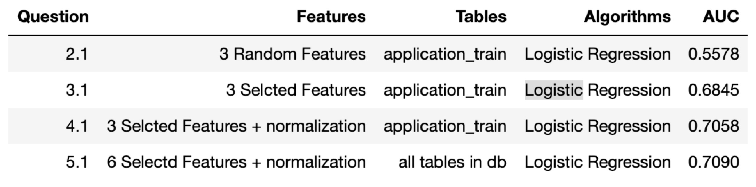
Result Analysis

Slide 11
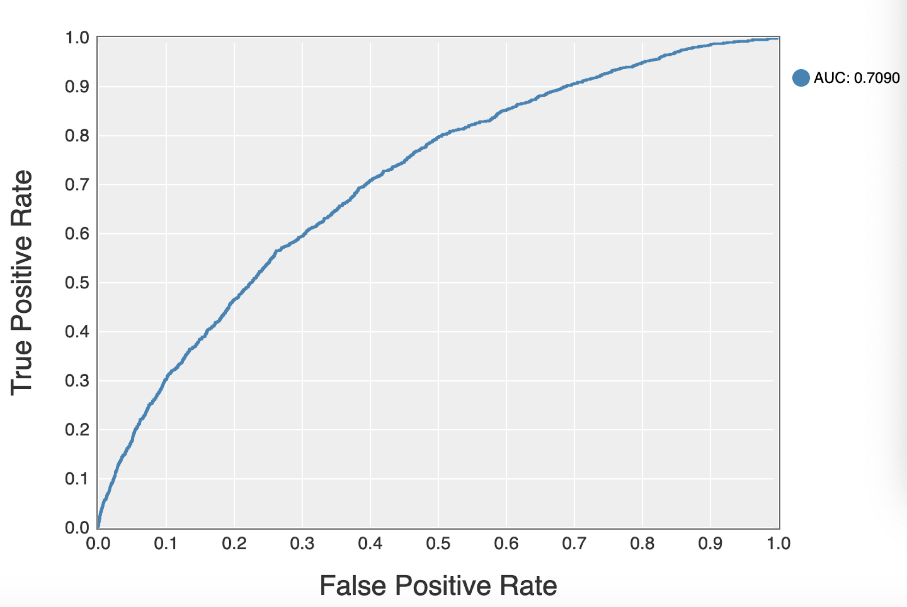

Slide 12
Conclusion/Findings
Logistic regression can do a relatively good job in prediction of credit risk. Using this model, I can obtain the AUC of 0.709.
Feature selection plays a very important role in prediction. By just modifying selected features, the AUC can be improved apparently.
Normalization and aggregation on dataset can help in improve prediction performance.
The performance of the logistic regression can not be improved further probably because of the existence of a lot of missing data.

Slide 13
To be continued ...
More Data Processing Methods
Join more tables, Combination of different numeric features, Convert categorical features
Implement more advanced models:
Ensemble learning
AdaBoost
XGBoost
Deep Learning
Neural Network
Representation Learning

Slide 14
Thank You !

