Slide 1
The Role of the physicality in reproducing a sequence of colors

Slide 2
Tablet button Physical button

Slide 3
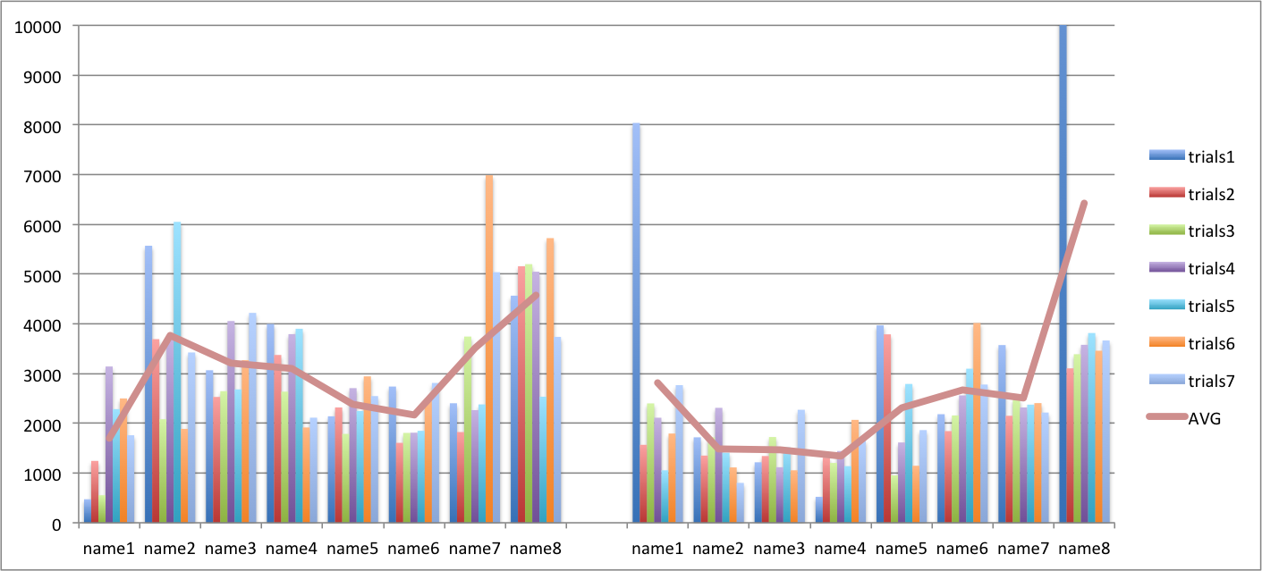
Experiment Chart

Slide 4
Summary
8 participants
7 Rounds
Random sequences of 4 color and 8 color
Procedure :
Participants try on the tablet according to the color sequence for 7 trials then take a break, do the same on with the physical button.
Result : AVG is 3 seconds on Tables, 2 seconds on Physical button for repeating 8 color sequence

Slide 5
Questions?

