Slide 1
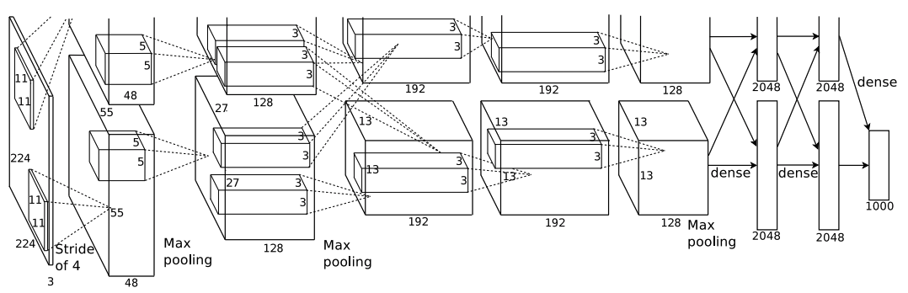
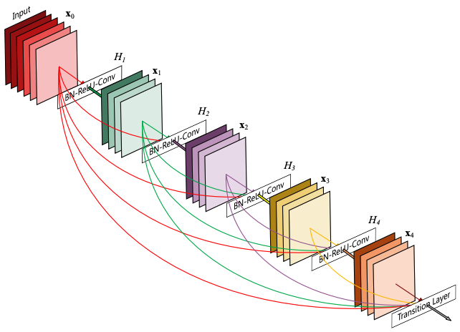
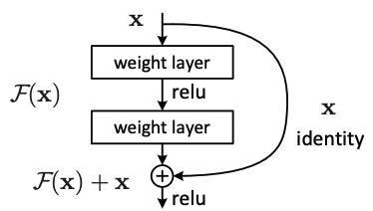

Slide 2
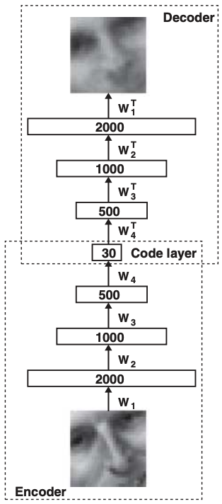
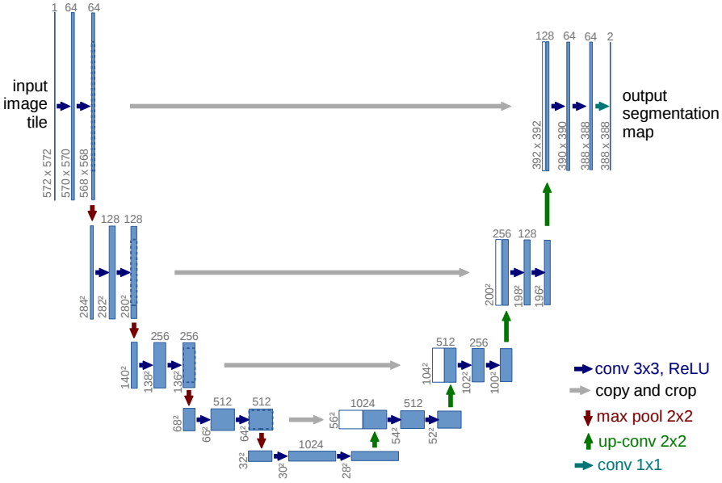
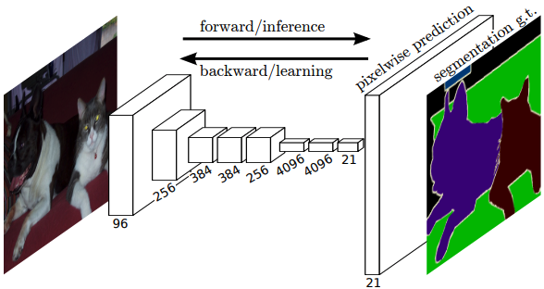

Slide 3

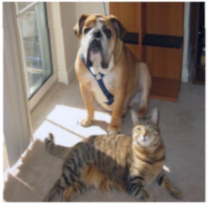

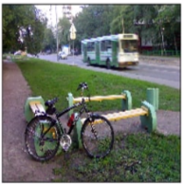
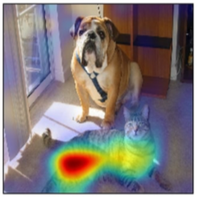
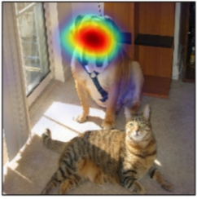
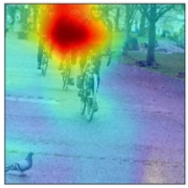
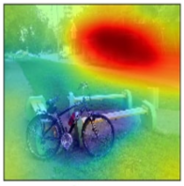

Slide 4

Layer i
image
$3×3$ Conv2d
Layer 1, stride=2
BatchNorm2d
Layer 2, stride=2
Leaky ReLU
Layer i, stride=2
...
Layer m, stride=2
Layer (m+1), stride=1
...
Layer j
Layer 7
Global Average Pooling
concat
fc-1
Notes:
d模型结构

Slide 5



BasicBlock
image
input
$3×3$ Conv2d, stride=2-BatchNorm2d-ReLU
$3×3$ Conv2d, stride=2
BasicBlock 1
BatchNorm2d
BasicBlock 2
ReLU
1x3 Conv2d, stride=2
BasicBlock 3
$3×3$ Conv2d, stride=1
BatchNorm2d
BatchNorm2d
BasicBlock 4
Global Average Pooling
Addition
output
fc-1
Notes:
c模型结构

Slide 6









































$$1$$
$$64$$
$$64$$
$$64$$
$$3$$
$$3$$
$$128×128$$
$$128×128$$
$$128×128$$
$$128×128$$
$$128×128$$
$$128×128$$
$$128$$
$$128$$
$$256$$
$$128$$
$$64×64$$
$$64×64$$
$$64×64$$
$$64×64$$
$$64×64$$
$$256$$
$$256$$
$$512$$
$$256$$
$${32}^{2}$$
$${32}^{2}$$
$${32}^{2}$$
$${32}^{2}$$
$${32}^{2}$$
$3×3$, stride=1, Conv2d, ReLU
$$512$$
$$512$$
$$1024$$
$$512$$
$3×3$, stride=2, Conv2d
$2×2$, stride=2, ConvTranspose2d
$${16}^{2}$$
$${16}^{2}$$
$${16}^{2}$$
$${16}^{2}$$
$${16}^{2}$$
$1×1$, stride=1, Conv2d
$$1024$$
$$Tanh$$
$$8^{2}$$
copy and concat
Notes:
u模型结构

