Slide 1
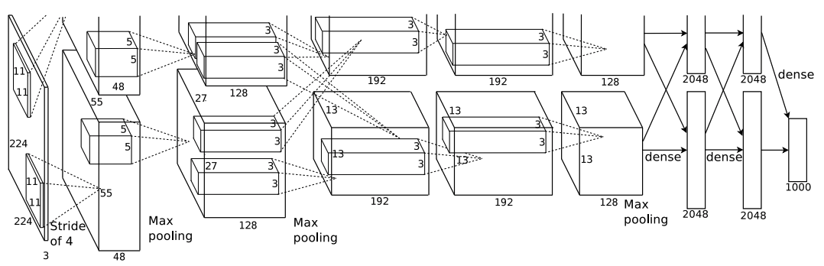
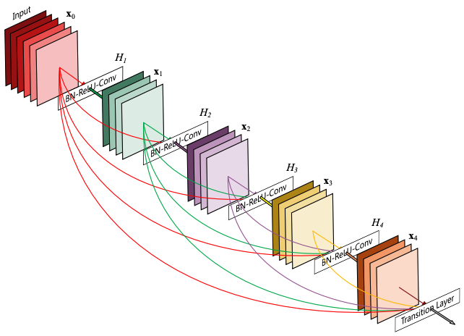
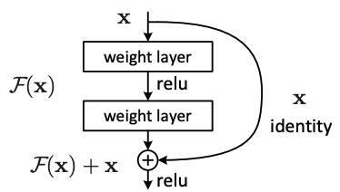

Slide 2
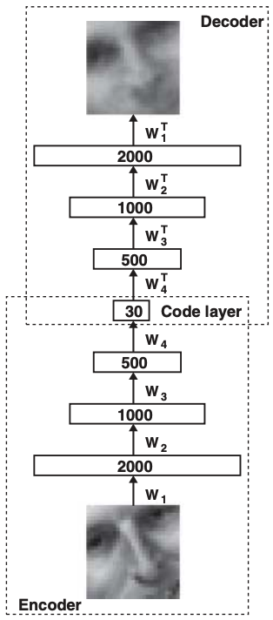
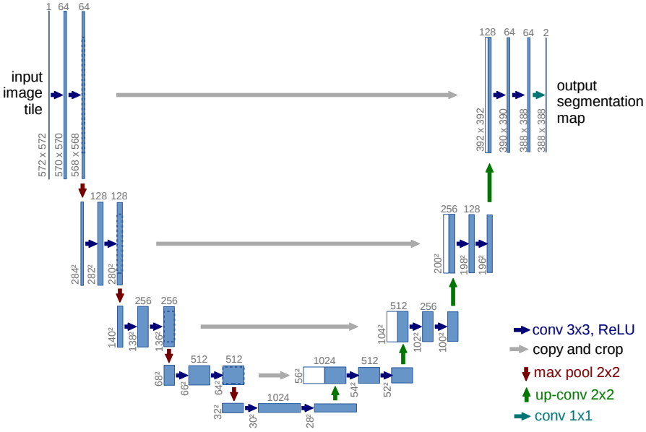
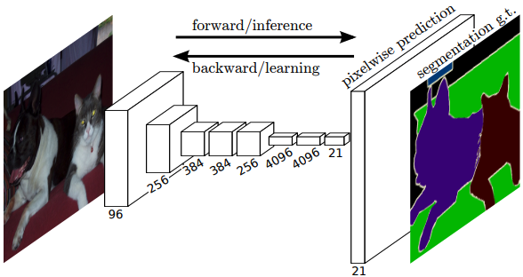

Slide 3

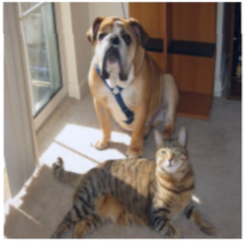

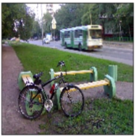
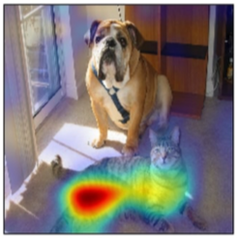
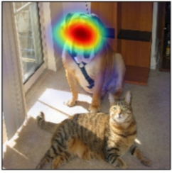
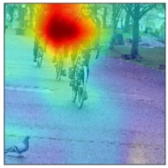
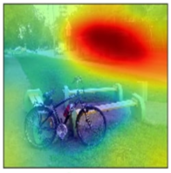

Slide 4










DownConv2d $i$
image
DownConv2d $1$
$3×3$ Conv2d, stride=2
DownConv2d $2$
BatchNorm2d
...
Leaky ReLU
DownConv2d $m$
Conv2dBlock $(m+1)$
Conv2dBlock $j$
...
$3×3$ Conv2d, stride=1
Conv2dBlock $j>m+1$
BatchNorm2d
Conv2dBlock $(j+1)$
Leaky ReLU
Global Average Pooling
DownConv2d block to downsample.
Conv2dBlock to capture elaborated features.
concat
fc-1
Notes:
d模型结构

Slide 5



BasicBlock
image
input
$3×3$ Conv2d, stride=2-BatchNorm2d-ReLU
$3×3$ Conv2d, stride=2
BasicBlock 1
BatchNorm2d
BasicBlock 2
ReLU
3x3 Conv2d, stride=2
BasicBlock 3
$3×3$ Conv2d, stride=1
BatchNorm2d
BatchNorm2d
BasicBlock 4
Global Average Pooling
Addition
output
fc-1
Notes:
c模型结构

Slide 6










































$$3$$
$$64$$
$$64$$
$$128$$
$$64$$
$$3$$
$$3$$
$$128×128$$
$$128×128$$
$$128×128$$
$$128×128$$
$$128×128$$
$$128×128$$
$$128$$
$$128$$
$$256$$
$$128$$
$$64×64$$
$$64×64$$
$$64×64$$
$$64×64$$
$$64×64$$
$$256$$
$$256$$
$$512$$
$$256$$
$${32}^{2}$$
$${32}^{2}$$
$${32}^{2}$$
$${32}^{2}$$
$${32}^{2}$$
$3×3$, stride=1, Conv2d, ReLU
$$512$$
$$512$$
$$1024$$
$$512$$
$3×3$, stride=2, Conv2d
$2×2$, stride=2, ConvTranspose2d
$${16}^{2}$$
$${16}^{2}$$
$${16}^{2}$$
$${16}^{2}$$
$${16}^{2}$$
$1×1$, stride=1, Conv2d
$$1024$$
$$Tanh$$
$$8^{2}$$
copy and concat
Notes:
u模型结构

Slide 7
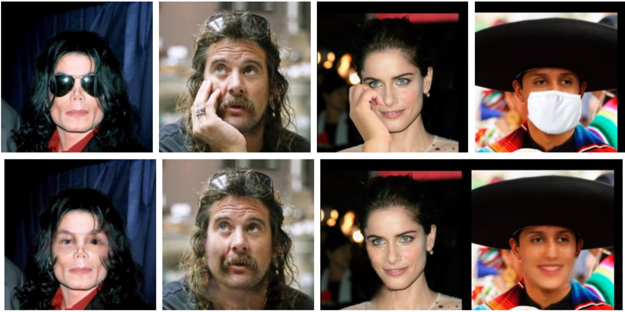

Slide 8
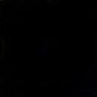
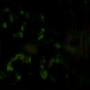
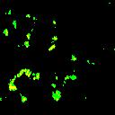
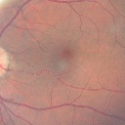
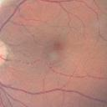
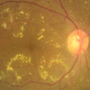
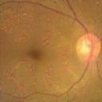
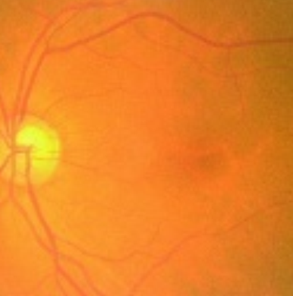
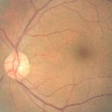
Classifier Network
normal/abnormal
Difference between
Encoder-decoder’s
input and output
Generator
Discriminator Network
Normal and abnormal images
Fake normal
real/fake
Real normal
Notes:
17.7 厘米
2.96 厘米

Slide 9
Classifier Network
normal/abnormal
Difference between
Encoder-decoder’s
input and output
Generator
Normal and abnormal images
Fake normal
Notes:
17.7 厘米
2.96 厘米

Slide 10
Generator
Discriminator Network
Normal and abnormal images
Fake normal
real/fake
Real normal
Notes:
17.7 厘米
2.96 厘米

Slide 11
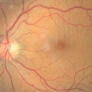
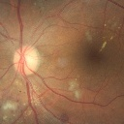
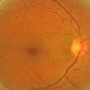
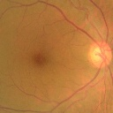
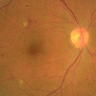
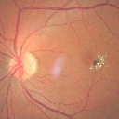
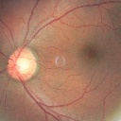
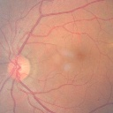
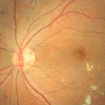
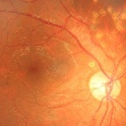
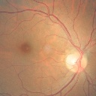
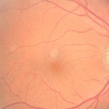

Slide 12
