Slide 1
A more efficient way
to detect DNB in a large network
Ruochi Zhang from HILab
zrc720@gmail.com

Slide 2
steps
01
02
03
04
PART1
PART2
PART3
PART4
The next work
The theory of DNB
The time is limit
The parallel computing to detect DNB

Slide 3
PART1
My understanding of DNB theory
Important significance
Fewer datas
Model-free
Merely requires a few samples in each sampling period, in stark contrast to the consecutive time-series data over the entire period required by the traditional methods
Early-warning signal which indicating an imminent bifurcation
or sudden deterioration before the critical transition occurs
This model-free method based on measured individual data, can detect specific signals for each individual or potentially apply this method to personalized medicine

Slide 4
steps
01
02
03
04
PART1
PART2
PART3
PART4
The next work
The theory of DNB
The time is limit
The parallel computing to detect DNB

Slide 5
PART2
The core of detecting DNB
SD
.
PCC
inner
CI =
———————
PCC
outer

Slide 6


Part2
Algorithm complexity
1
suppose n is the number of nodes
SD: O(n)
.
2
The average standard deviations (SDs) of molecules in this group drastically increase.
SD
PCC
inner
—————————
CI =
PCC(inner): O(n )
2
3
A group of molecules’s average Pearson’s correlation coefficients
PCC
outer
PCC(outer): O(n )
2
4
The average PCCs of molecules between this group and any others

Slide 7
Part2
Our solution for this problem
Time complexity is a limit for us to find a DNB in a large network

Slide 8
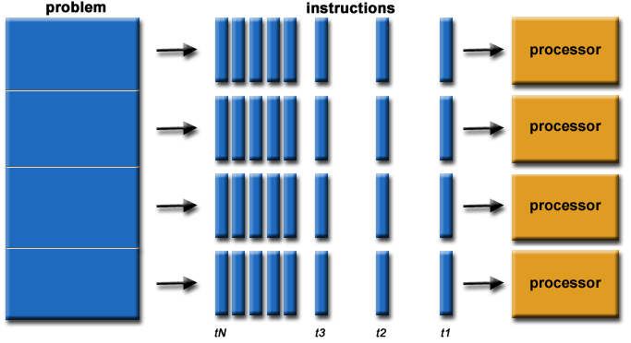
Part2
Our solution for this problem
Parallel Computing

Slide 9
steps
01
02
03
04
PART1
PART2
PART3
PART4
The next work
The theory of DNB
The time is limit
The parallel computing to detect DNB

Slide 10
Part3
Design idea of Parallel Algorithm
cluster
get n clusters
The most time-consuming
process
calculate CI
for every cluster
We map n clusters
to n cpu core
Sampling Points
time 1
time 2
time 3
time 4

Slide 11
pART3
Performance Comparison
RAW DATA OF LIVE CANCER
aFTER VAR AND T-TEST FILTER
clusters of each sampling point
Period 1:
Period 1:
1242 nodes
35 clusters
10729 nodes
Period 2:
Period 2:
953 nodes
35 clusters
5 samples
Period 3:
Period 3:
962 nodes
38 clusters
Period 4:
Period 4:
5 Sampling points
919 nodes
34 clusters
Period 5:
Period 5:
845 nodes
37 clusters

Slide 12
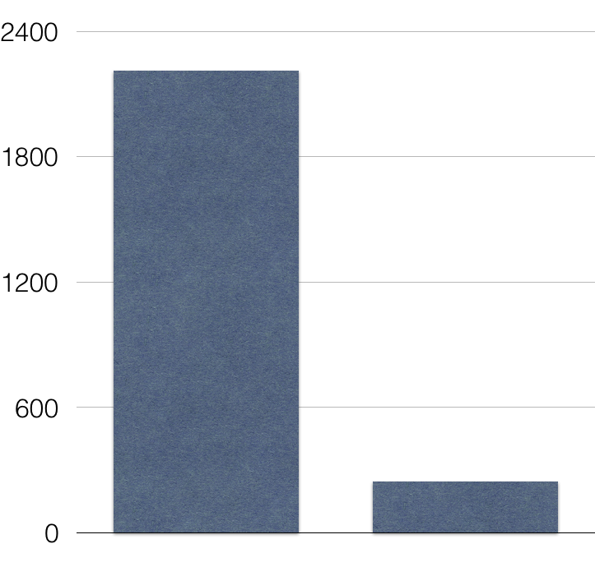
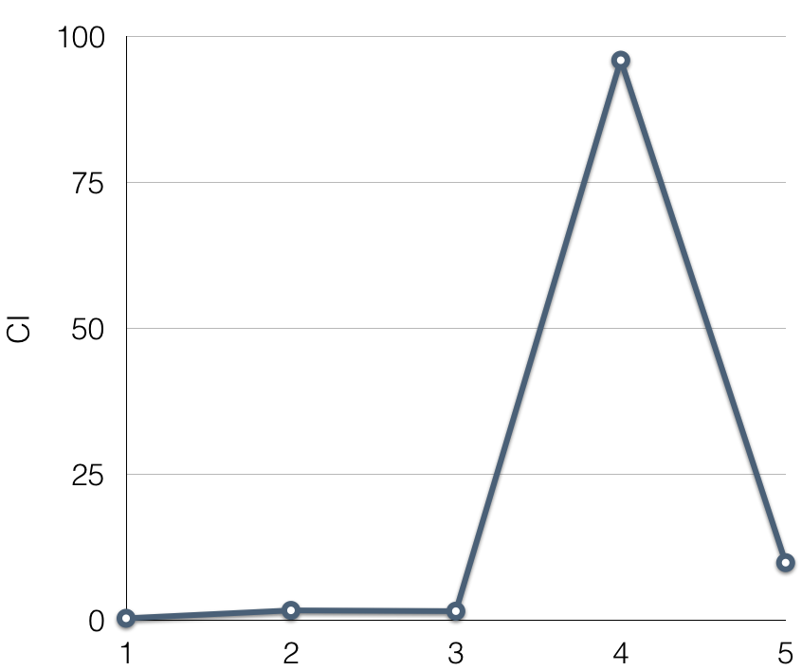
pART3
Performance Comparison
single process
multiple processes
Sampling points

Slide 13

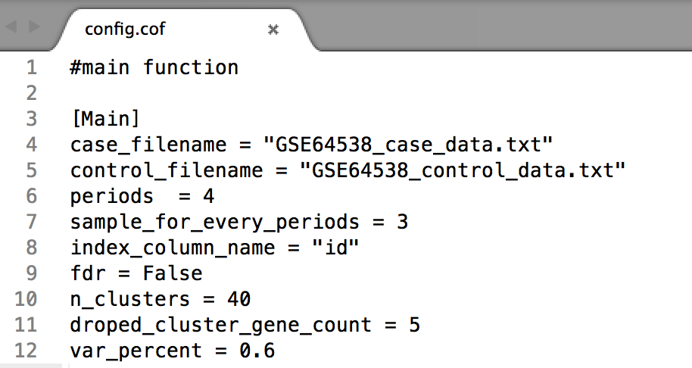
PART3
We hava made the detecting algorithm a software
Just need to modify the configure file，then click run

Slide 14
steps
01
02
03
04
PART1
PART2
PART3
PART4
The next work
The theory of DNB
The time is limit
The parallel computing to detect DNB

Slide 15

pART4
The next work
Step 1
Step 2
Step 3
A GUI Software
Test the dataset of human group coming from different altitude
……
From GSE73996
651 samples from 40 populations has been genotyped using the Affymetrix platform Axiom_GW_Hu_SNP.r2

