Slide 1
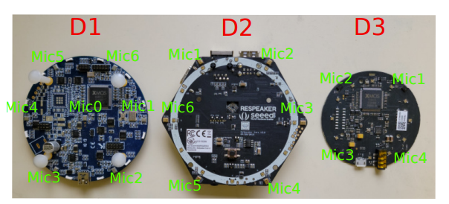
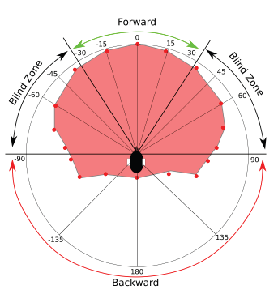
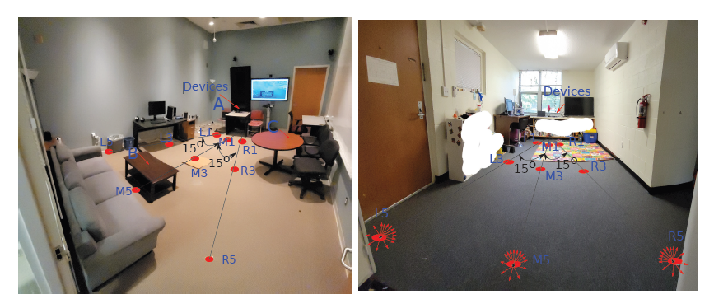
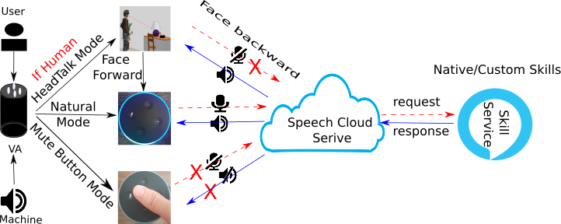
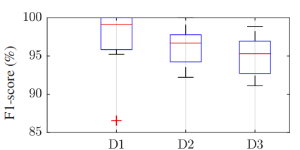
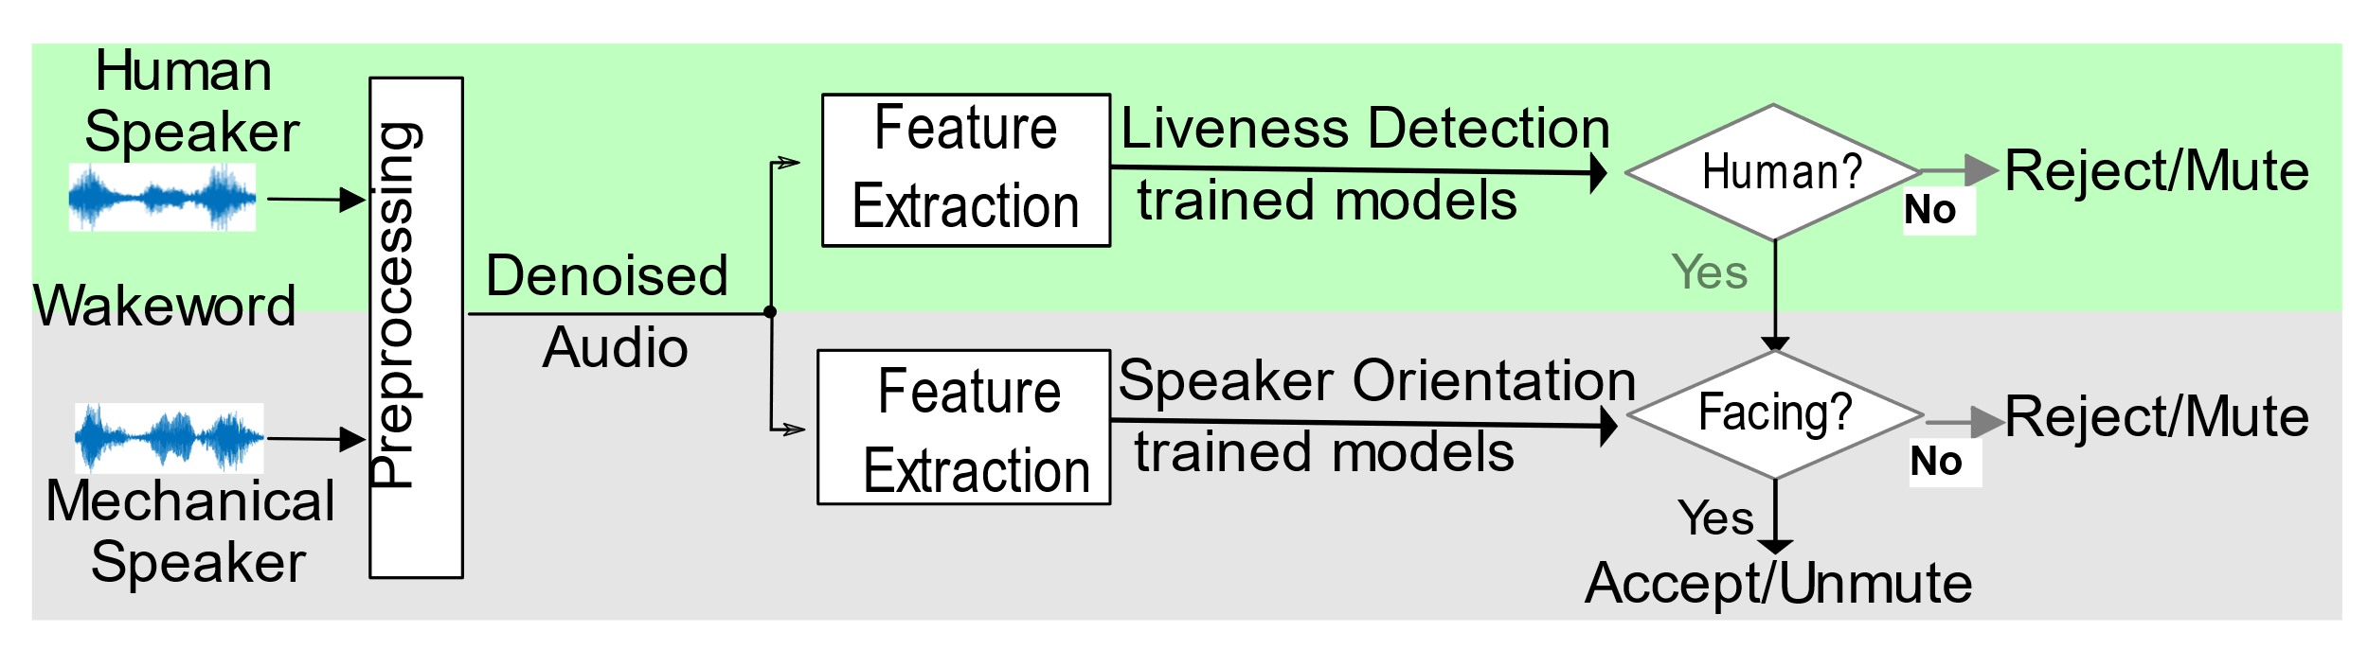
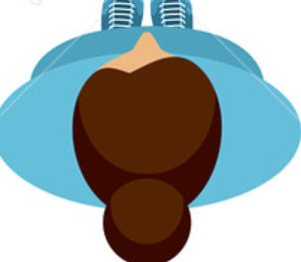
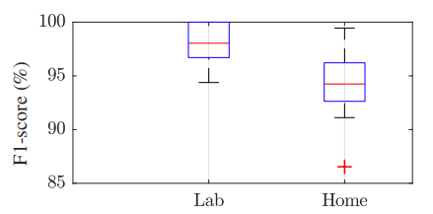
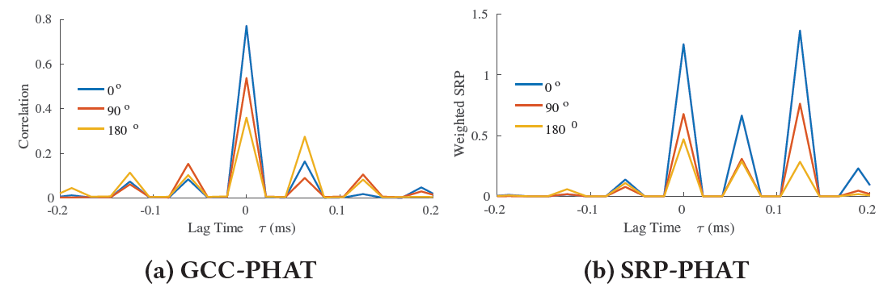



The always-on nature of VAs triggers misactivation!
Enhancing Security and Privacy Control for Voice
Assistants Using Speaker Orientation
Evaluation
Shaohu Zhang
szhang42@ncsu.edu
Aafaq Sabir
asabir2@ncsu.edu
Anupam Das
anupam.das@ncsu.edu
Motivation
VAs can be misactivated by suboptimal wakeword and background chat.
Visual gaze plays an important role in interpersonal communication. People tend to look at each other when chatting.
We propose a device-free and non-obtrusive acoustic sensing system called HeadTalk, a speaker orientation–aware privacy control approach.
Human Field-of-View ( FoV )
Experiment across three prototypes
1
Lab and home setup
3 devices: UMA-8 USB mic array, ReSpeaker Core v2.0, and ReSpeaker USB mic array;
3 wake words: "Hey Assistant!", "Computer" and "Amazon";
3 different time frame: day, week and month;
2 rooms: lab and home;
3 distances: 1 meter, 3 meters and 5 meters;
14 angles: 0◦, +15◦, -15◦, +30◦, -30◦, +45◦, -45◦, +60◦, -60◦, +90◦, -90◦, +135◦, -135◦, 180◦.
Speech propagation FoV in the horizontal plane. 35 degree on both sides of the centerline is referred to as the immediate FoV
Speech Propagation
Overall Accuracy
Generalized Cross Correlation with Phase Transform (GCC-PHAT)
Steered Response Power with Phase Transform (SRP-PHAT)
HeadTalk privacy control vs. Natural mode vs. Mute button mode. HeadTalk mode detects the presence of the wake word, and if spoken while facing the VA, it continues to operate in normal mode, otherwise it mutes the microphones
Reverberation
Microphone
Array
System Design
Directed
Propagation
Performance of different devices
Speaker
HeadTalk consists of two main components including liveness detection and speaker orientation recognition. HeadTalk only accepts the wakeword when the user is facing the device.
Performance of different environments
Takeaway
Voice Command can be used to sense head orientation for privacy control
Potential to make distributed voice interactions more practical and secure
Higher magnitude in the forward direction compared to the backward direction
More detail to download the full draft of the paper

