Slide 1





Identification and Calculation of Horizontal Curves for Low-Volume Roadways Using Smartphone Sensors
Jonathan S. Wood, Ph.D.
Department of Civil and Environmental Engineering
South Dakota State University
Shaohu Zhang
Department of Computer Science
North Carolina State University
Notes:
1

Slide 2
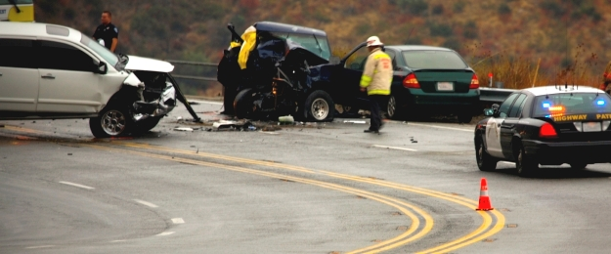
Motivation
Source: http://southcarolinatrial.blogspot.com/2014/07/forensic-investigation-of-motor-vehicle.html
66.4%( 29,796 out of 44,858) of fatal crashes occurred on two-lane roads; 20.1% (7,656 out of 38,046) of fatal crashes involved in single and two-vehicle crashes occurred along horizontal curves (Source: Fatality Analysis Reporting System, 2014)
Most of two-lane roadway carry traffic volumes less than 2,000 vehicles per day.
Notes:
As we known, horizontal curves have higher crash rate. Two–lane roadway are the predominant road type in most countries
According to…, That means, around one hour there is one person would die because of the crash on the horizontal curve
2

Slide 3
Motivation (cont.)
Identifying locations and geometric characteristics of the roadway curves on low-volume roads plays a critical role in crash prediction and prevention.
The Federal Highway Administration (FHWA) has mandated that all transportation agencies (state, local, etc.) survey all roadway horizontal curves by December 31st, 2019
Traditional approaches are costly and time-consuming
$72 per mile for photo/video log; $107 per mile for satellite/aerial imagery
$700 per mile for GPS data logger; $915 per mile for mobile LiDAR
Notes:
therefore,….,However, …It was reported that the average data collection cost per mile
Meantime, This is a particularly important issue given the
3

Slide 4
Limitations of Prior Art
Survey Vehicle
A survey vehicle equipped with a GPS receiver, inertial system, and other sensors (including LiDAR)
High cost
Tedious device/equipment instructions
Image Processing
High-resolution satellite imagery (1 m)
Accuracy greatly relies on image resolution
Requires processing of a large number of high-resolution images
Cannot collect superelevation data
GIS-based tools (large-scale network)
Curve Calculator (ESRI); Curvature Extension (FDOT); Curve Finder (NHDOT)
Rely on high-quality GIS data
The inconsistency of roadway alignment
Difficulty in superelevation data collection
Notes:
Three common methods include
….is a common way to collect roadway data. A survey vehicle equipped with many devices is high cost, in addition, users have to be familiar with
can retrieve geometric characteristics of some typical curves, their drawbacks are that the accuracy greatly relies on
GIS tools can extract and identify horizontal curves from a gis map in large-scale networks
4

Slide 5
Smartphone based Application
Low cost
Off-the-Shelf
Real-time
Embedded sensors
High computational capacity
Smartphones that integrate GPS, IMU and advanced computing technologies have great opportunities for data acquisition in roadway inventory, leading to low-cost and real-time mobile sensor platforms.
Notes:
Smartphone application has many advantages, for example
This richness in sensors enables support for roadway inventory in a low-cost manner
5

Slide 6
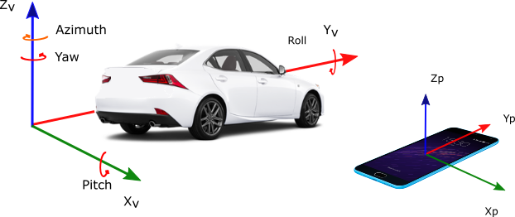
System Architecture and Design
The Coordinate Systems of A Smartphone and A Vehicle
Notes:
The basic concept of this proposed system is to use the rotation rate around Z Axis of gyroscope to identify when the vehicle makes a curve.
6

Slide 7
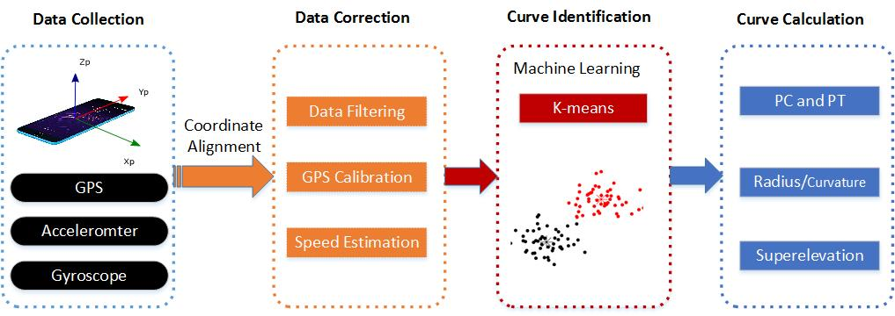
System Architecture and Design(cont.)
Data Collection: takes real time sensor data including the GPS, accelerometer and gyroscope readings from a smartphone .
Data Correction: reduces noise in the collected data and detects the curved roadway segments based on smoothed data
Curve Identification: implements a machine learning algorithm to identify the horizontal curves.
Curve Calculation: measures the radius and superelevation of a curve
Notes:
The proposed system consists four modules…
Data correction module consists data filtering…
7

Slide 8
Methodologies
Butterworth Low-pass Filter
Extended Kalman Filter
K-means Clustering
Chord Offset Method
Superelevation Estimation
Notes:
Now let me talk about
8

Slide 9
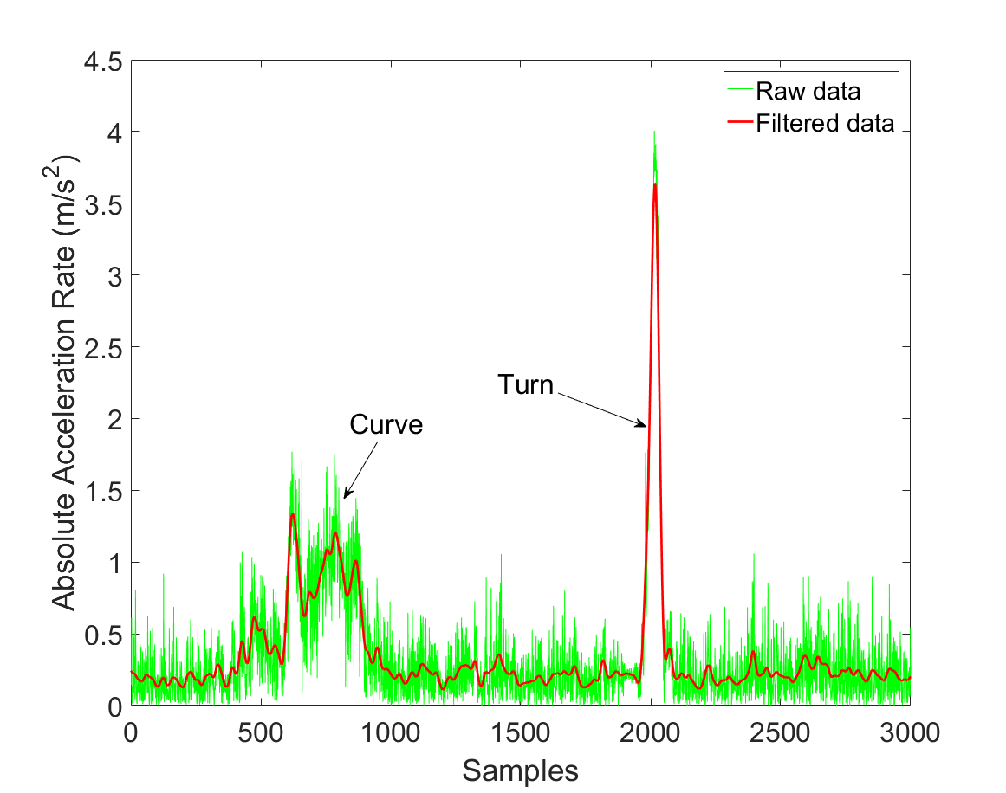
Butterworth Low-pass Filter
Reduces noise of high frequency measurements
Variation of the acceleration rate on X axis
Notes:
The signal obtained from phone sensor is very noise. In order to reduce such noise,
BLF is a well known tool to…
9

Slide 10
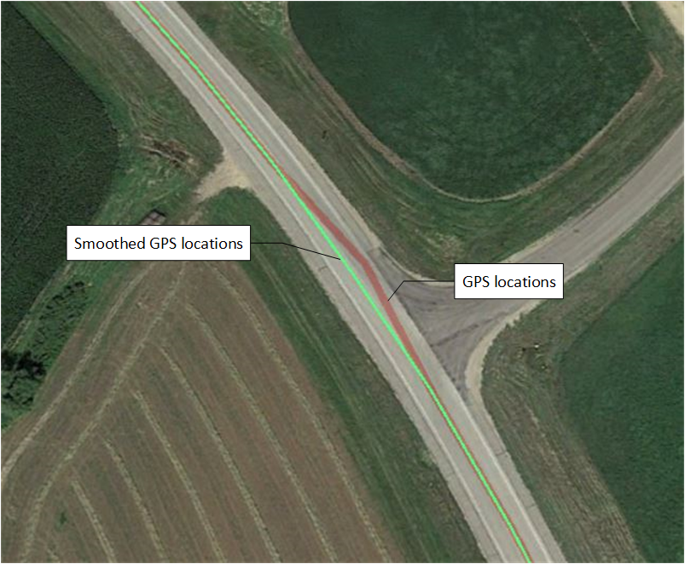
Extended Kalman Filter
Calibrates GPS’s speed and location
Notes:
The accelerate rate and rotation rate can be used to calibrate vehicle’s speed and location when the GPS signals is weak or there is a signal outage.
This figure demonstrates that the GPS accuracy is improved by using the EKF.
10

Slide 11
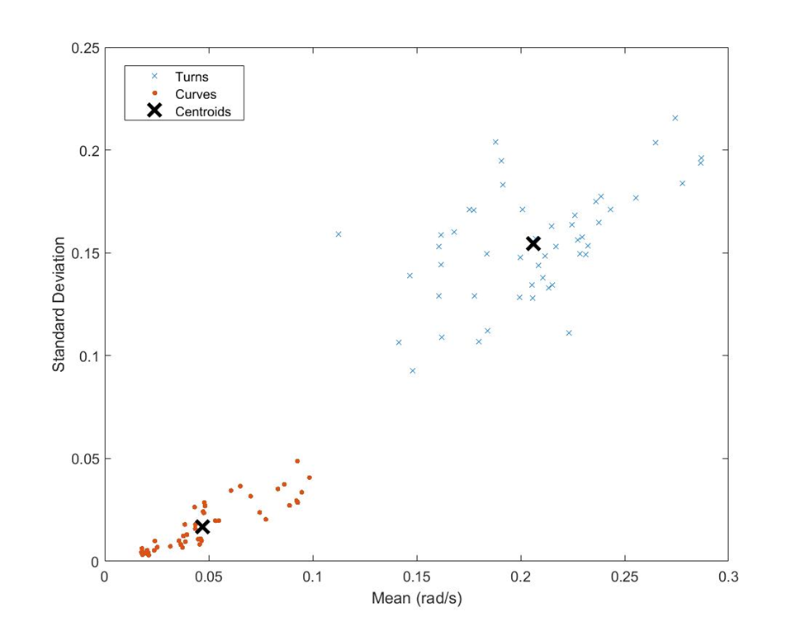
K-means Clustering
Cluster Assignments and Centroids
The standard deviation and mean of the rotation rate were used to train the centroids of clusters(50 curves and 50 turns ).
11
Notes:
As an unsupervised machine learning techniques, K-means aims to partition curves and turns clusters
50 curves and 50 turns were used to train the clustering centroids. Specifically, the standard deviation and mean of the rotation rate were used to train the centroids of clusters. So that I got two centroids for curve and turn, respectively.

Slide 12
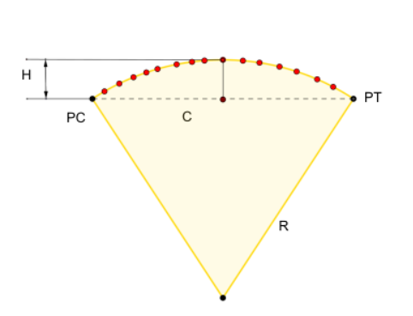
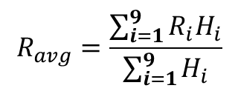
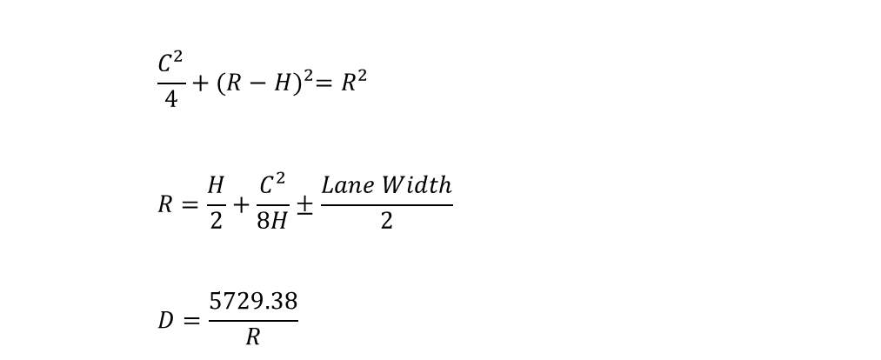
Chord Offset Method
 | $$\frac{C^{2}}{4}+{(R−H)}^{2}=R^{2}$$
 | $$R=\frac{H}{2}+\frac{C^{2}}{8H}±\frac{Lane Width}{2}$$
 | $$D=\frac{5729.38}{R}$$
R: radius of the curve (ft)
C: chord length (ft)
H: middle ordinate (ft)
D: degree of curve
Weighted Average Method:
$$R_{avg}=\frac{\sum_{i=1}^{9}{R_{i}H_{i}}}{\sum_{i=1}^{9}{H_{i}}}$$
12
Notes:
This study used the chord offset method to estimate the radius.
$R$ represents the radius of the circle in feet; $D$is the degree of curve; $C$ is the chord length in feet; $H$ is the middle ordinate in feet.
To improve the accuracy of curve radius estimates, First step, the three neighboring GPS points around the PC and PT can be used to obtain 9 chord lengths $(C)$ and 9 middle ordinate $(H)$ measurements, respectively. Second step, the calculated $R_{i}$was averaged using the weighted average method

Slide 13
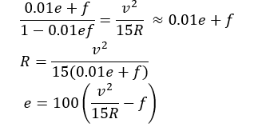
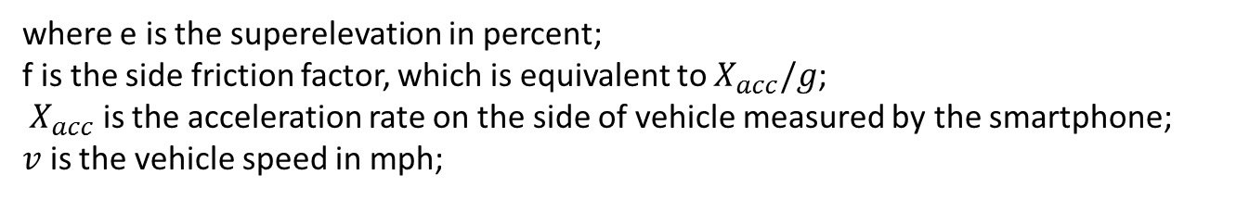
Methodology (cont.)
Superelevation Estimation
where e is the superelevation in percent;
f is the side friction factor, which is equivalent to $X_{acc}/g$;
$X_{acc}$ is the acceleration rate on the side of vehicle measured by the smartphone;
$v$ is the vehicle speed in mph;
13
Notes:
According to the AASHTO Green Book

Slide 14
Field Evaluation
Test Setup
Samsung Galaxy S7 Edge: Android 5 OS
GPS: 1 Hz.
Gyroscope/accelerometer:20 Hz.
Evaluation
Speed Assessment
Curve Identification and Calculation
Notes:
The GPS frequency was collected at 1 Hz. Gyroscope and accelerometer were at 20 Hz
The evaluation includes
14

Slide 15
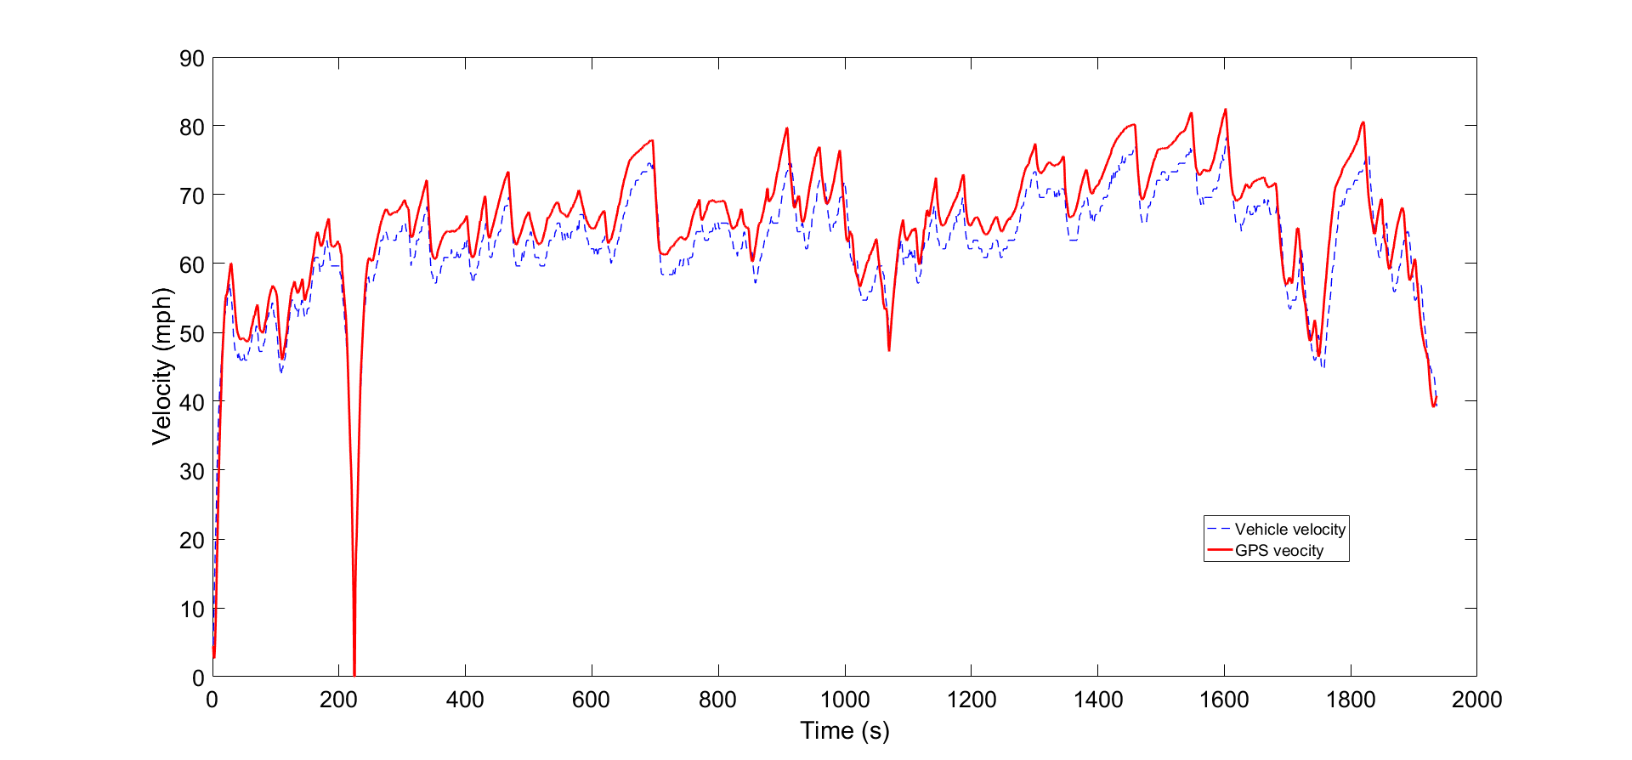
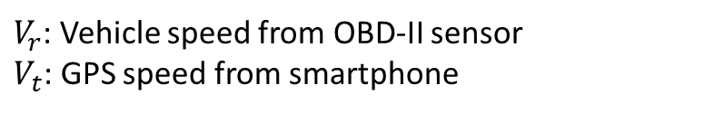

Field Evaluation(cont.)
Speed Assessment
$V_{r}$: Vehicle speed from OBD-II sensor
$V_{t}$: GPS speed from smartphone
Mean Absolute Percentage Error (MAPE) :
 | $$MAPE=\frac{1}{N}\sum_{n=1}^{N}{\left|\frac{ V_{r}− V_{t}}{ V_{r}}\right|}$$
6% difference
Notes:
Vehicle speed plays an important role for the evaluation of superelevation. In order to evaluate the speed accuracy, an On-board Diagnostics (OBD-II) sensor was applied to record the velocity from vehicle speedometer as a reference. This Figure illustrates the profile of the calibrated (i.e. GPS) velocity V_t and the reference (i.e. speedometer) velocity V_r from OBD-II sensor.Mean Absolute Percentage Error (MAPE) is used to evaluate the speed deviation.
The MAPE results indicated that there was approximately 6% difference between the GPS and vehicle speeds. This suggests that the speed precision obtained from smartphone is acceptable

Slide 16
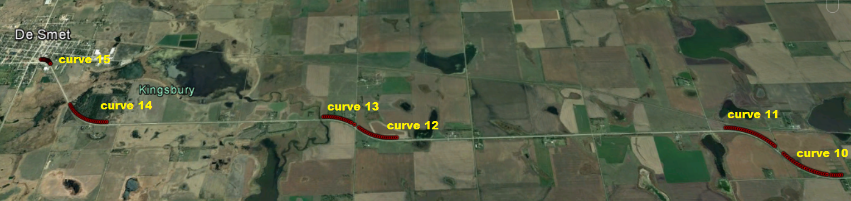
Field Evaluation(cont.)
Curve Identification and Calculation
100 miles long two-lane highway
consider the degree of curve greater than 1 as sharp curves.
A total of 21 sharp horizontal curves covering different radii were conducted.
Roadway inventory data from SDDOT was used to compare with the estimates
Three-runs surveys were measured to evaluate the stability of the system
Notes:
16

Slide 17
Field Evaluation(cont.)
Radius Measurement without Lane Width Adjustment
Notes:
Table shows that the … for the 21 curves
17

Slide 18
Field Evaluation(cont.)
Radius Measurement with Lane Width Adjustment
Notes:
With the lane width adjustment, the accuracy of radius calculation is slightly improved.
18

Slide 19
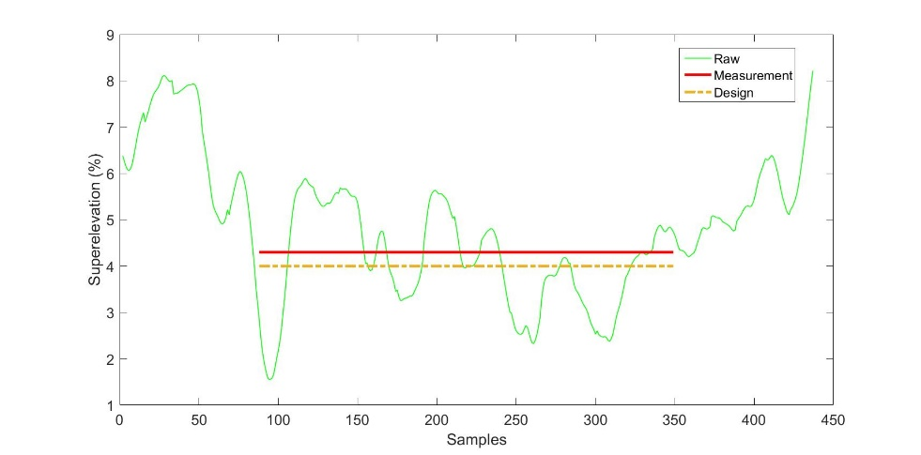
Field Evaluation(cont.)
Evaluation of superelevation
Design: 4%
Measurement :4.2%
Statistical analysis showed that the average of superelevation between the 15th and 90th percentile of the length of curve is consistent with the design superelevation from the SDDOT roadway inventory
Notes:
As we known, drivers might reduce speed when the vehicle is approaching to a curve, which generates more sensor noise. when leaving out of a curve, the vehicle status is more “smooth” due to the reduced speed
19

Slide 20
Field Evaluation(cont.)
Superelevation Evaluation
Notes:
Here, It should be noted that the comparison is between the smartphone measured superelevation and design superelevation, which may be slightly different that as-built superelevation. However, as-build superelevation information was not available.
20

Slide 21
Conclusion
Proposed a mobile system for low-cost collection of a horizontal curve inventory using a standard smartphone
Achieve desirable radius measurement accuracy for sharp curves. (average error 3%)
Adjusting lane width doesn’t have a significant effect on the accuracy of radii estimation.
Multiple runs can achieve higher accuracy.
The accuracy of superelevation relies on the accuracy of curve radius, vehicle speed and acceleration rate from smartphone.
More in the paper (TRB18-04114)
Detailed data analysis
Technical details
Notes:
This study concluded that
Improving their accuracy can achieve more accurate superelevation measurements.
21

Slide 22
Thank you!
Questions?
Notes:
22

Slide 23
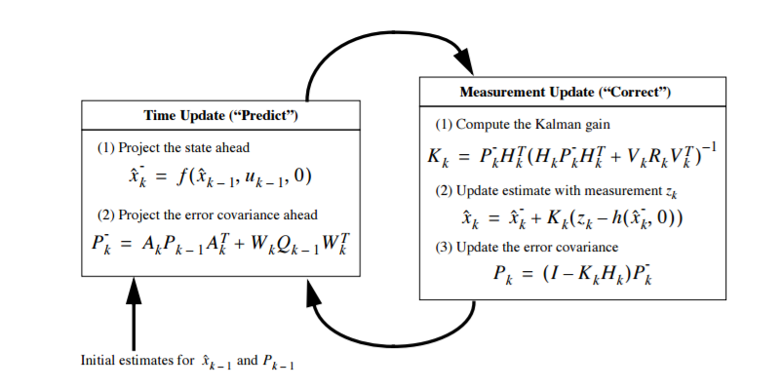
Appendix-Extended Kalman Filter
state model
measurement model
Notes:
The extended Kalman filter (EKF) is the nonlinear version of the Kalman filter, which has been considered a common way in the non-linear state estimation and navigation system
The accelerate rate and rotation rate can be used to calibrate vehicle’s speed and location when the GPS signals is weak or there is a signal outage.
This figure demonstrates that the GPS accuracy is improved by using the EKF.
Prediction process projects forward the current state and error covariance estimates to obtain a priori estimates for the next step;
Correction process is to incorporate the new measurement into the a priori estimate to obtain an improved estimate.
23

