Slide 1

Identification, Calculation and Warning of Horizontal Curves for Low-volume Two-lane Roadways Using Smartphone Sensors
Shaohu Zhang
Thesis Defense
Department of Civil & Environmental Engineering
South Dakota State University
June 19th, 2017

Slide 2
Outline
Motivation
Objectives
Contributions
Literature Review
System Architecture and Design
Methodology
Field Evaluation
Conclusions and Future Work

Slide 3
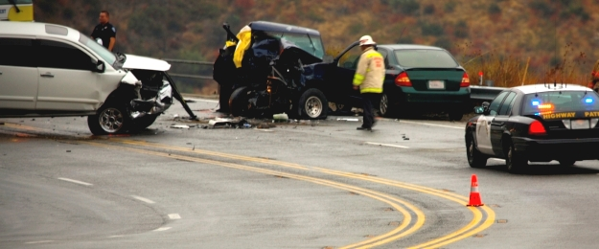


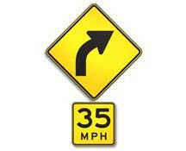
Why is collecting roadway curve information important?
Source: http://southcarolinatrial.blogspot.com/2014/07/forensic-investigation-of-motor-vehicle.html

Slide 4
Motivation
There are more than 3 million miles of two-lane highways, 90% of which carry traffic volumes less than 2,000 vehicles per day, in the United States
66.4%( 29,796 out of 44,858) of fatal crashes occurred on two-lane roads; 20.1% (7,656 out of 38,046) of fatal crashes involved in single and two-vehicle crashes occurred along horizontal curves (Source: Fatality Analysis Reporting System, 2014)
Identifying locations and geometric characteristics of the horizontal curves plays a critical role in crash prediction, prevention, and timely curve warnings that can save lives.
Traditional approaches are costly and time-consuming
$72 per mile for photo/video log
$107 per mile for satellite/aerial imagery
$700 per mile for GPS data logger
$915 per mile for mobile LiDAR
Notes:
Two–lane roadway are the predominant road type in most countries
According to… therefore,….,However,

Slide 5
Motivation (cont.)
The Federal Highway Administration (FHWA) has mandated that all transportation agencies (state, local, etc.) survey all roadway horizontal curves by December 31st, 2019
All components of a smart transportation infrastructure need to be connected, monitored, and automated in order to work effectively and efficiently.
A variety of traffic control devices (TCDs) are installed at horizontal curves to warn drivers of turning direction and reduced speed. It is expected that drivers heed these warnings. However, the ability of a driver to see a TCD can be compromised by inclement weather, low light conditions, vandalized signs, or missing signs
Notes:
There is high demand for curve information on rural roads for the engineering design and safety management. This is particularly important given that…
In addition,
Such as pavement markings and traffic signs
Many crashes can be attributed to human errors such as recklessness and distraction. However, human errors can be potentially avoided if drivers receive advanced warnings.

Slide 6
Motivation (cont.)
Low cost
Off-the-Shelf
Smartphone based
Application
Real-time
Embedded sensors
High computational capacity
Smartphones that integrate GPS, IMU, BLE and advanced computing technologies have great opportunities for data acquisition in Intelligent Transportation Systems (ITS), and for vehicle-to-infrastructure (V2I) communication, leading to low-cost and real-time mobile sensor platforms.
Notes:
Smartphone application has many advantages

Slide 7
Objectives
The goal of this study is to provide an off-the-shelf smartphone based application to collect horizontal curve data in a low-cost manner and prevent crashes by providing drivers with timely information about road hazards, including sharp curves.
The objectives are to design, test, and evaluate smartphone technologies and wireless communications for acquiring, processing, and analyzing sensor data and providing users with curve information.
This study proposed an automated low-cost mobile road inventory system (C-Finder) for two-lane horizontal curve, and a prototype smartphone system (C-Alert) that tracks driver position, computes arrival time at an imminent hazard (e.g., sharp curve), and alerts drivers through HUD technology.
Notes:
To meet these objectives, there are two main steps
Two smartphone applications, C-Finder and C-Alert, were proposed. C-Finder is a low-cost mobile road inventory system for two-lane horizontal curves. C-Alert is a prototype smartphone system

Slide 8
Objectives(cont.)
Defining the System Architecture and Functional Requirements
C-Finder
accounts for and reduces sensor measurement errors and outliers;
reduces the location error caused by the weak GPS signals or GPS outage;
detects horizontal curves and calculates their parameters accurately and reliably;
minimizes in-vehicle distractions to drivers;
provides timely, meaningful, and dependable messages;
sustains reliable communication between the HUD and message generator
C-Alert
2) Evaluating the System Reliability and Integration

Slide 9
Contributions
This thesis proposed an automated low-cost mobile road inventory system (C-Finder) for two-lane horizontal curve based on off-the-shelf smartphones. The proposed system is capable of accurately detecting horizontal curves by using machine learning technique.
This thesis evaluated the radius and superelevation of curves using the low-cost smartphone. The experiment illustrated that the proposed approach has relatively high accuracy.
This thesis also developed a prototype smartphone application (C-Alert) that tracks driver position, computes arrival time at an imminent hazard (i.e., sharp curve), and alerts drivers through HUD technology.

Slide 10
Related works
Survey Vehicle
Survey vehicle equipped with a GPS receiver and other sensors such as the LiDAR, laser scanner and accelerator
High cost
Tedious device/equipment instructions
Image Processing
High-resolution satellite imagery (1 m)
Accuracy greatly relies on image resolution
Requiring processing of a large number of high-resolution images
Cannot collect superelevation data
GIS-based tools:
Curve Calculator (ESRI); Curvature Extension (FDOT); Curve Finder (NHDOT)
Rely on high-quality GIS data
The inconsistency of roadway alignment
Cannot collect superelevation data
Notes:
Many researchers have presented some approaches in the identification and calculation of horizontal curves. Three common methods include
….is a common way to collect roadway data. A survey vehicle equipped with many devices is high cost, in addition, users have to be familiar with
The limitations includes
GIS tools can extract and identify horizontal curves from a gis map in large-scale networks

Slide 11
Related works (cont.)
Vehicle-to-infrastructure Communication
The goals of improving safety, comfort, and efficiency of roadway systems motivate further development of wireless communications in ITS
Collision warning systems (CWS)
Lane-keeping assistance systems (LKAS)
Smartphone Applications for ITS
Smartphones are attracting more and more attention from transportation researchers and wireless service providers due to the traffic and travel information they can provide.
Positioning capturing or vehicle tracking
Measure potholes or pavement roughness
Notes:
i.e., vehicles equipped with intelligent systems such as …. for the safety purpose
Recent years, smartphone get more popular, and are attracting more attention from transportation researcher in ITS. For example, GPS can be applied with
Accelerometer can be used to

Slide 12
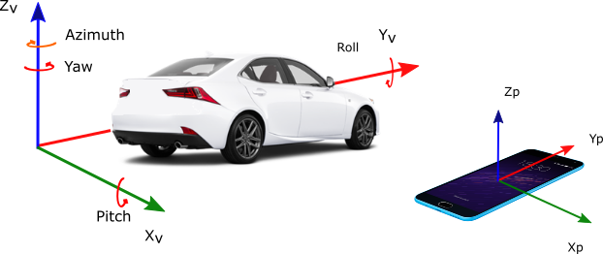
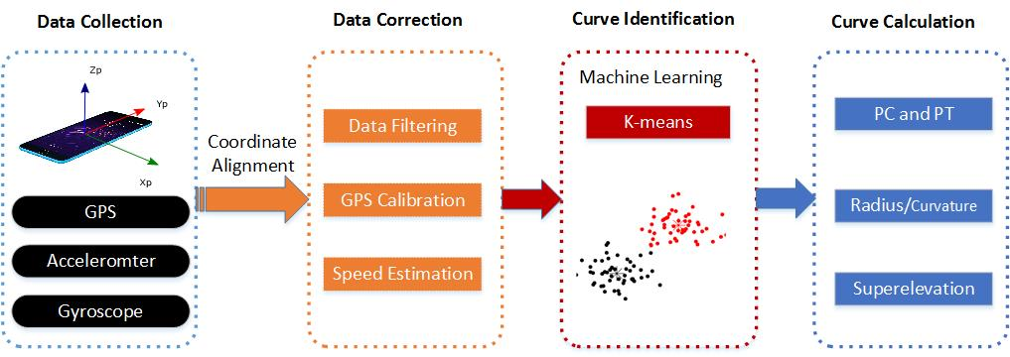
System Architecture and Design
C-Finder
Data Collection: takes real time sensor data including the GPS, accelerometer and gyroscope readings from a smartphone .
Data Correction: reduces noise in the collected data and detects the curved roadway segments based on smoothed data
Curve Identification: implements a machine learning algorithm to identify the horizontal curves.
Curve Calculation: measures the radius and superelevation of a curve
Notes:
The basic idea of C-finder is to use the rotation rate around Z Axis of gyro to identify curve when the vehicle makes a curve.
C-Finder consists four modules…
Data correction module consists data filtering…

Slide 13
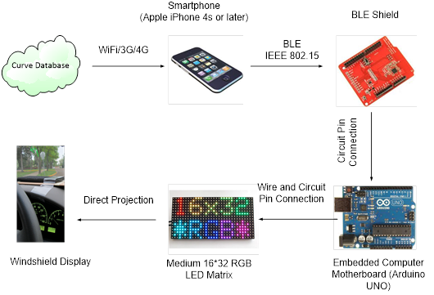
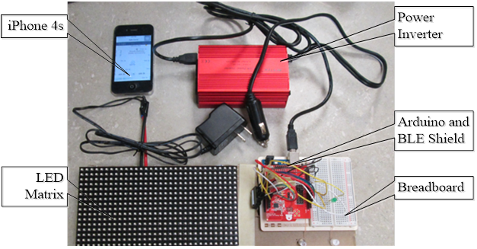
System Architecture and Design (cont.)
C-Alert
C-Alert tracks driver position, computes arrival time at an imminent hazardous location, and sends alerts through HUD.
Smartphone Module
The smartphone is the core of the system because it integrates the GPS, compass, digital map databases, and BLE communication interface
Notes:
C-Alert system includes three modules:

Slide 14
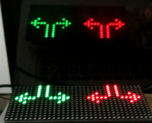
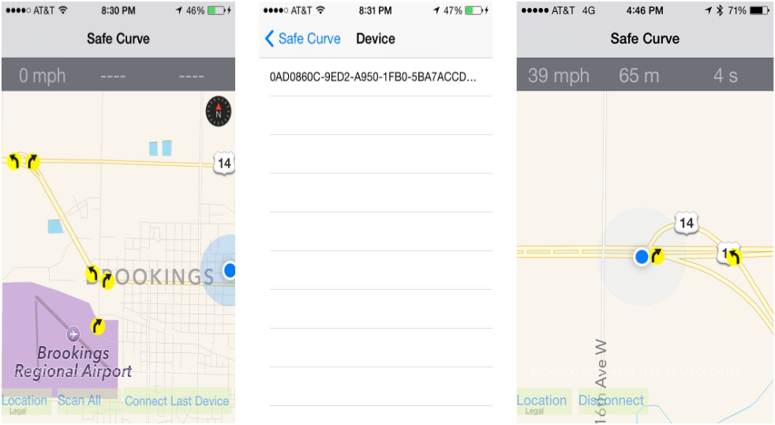
System Architecture and Design (cont.)
Wireless Communication Module
1) consists of the Arduino and BLE board;
2) receives data from the BLE and send operations to control whether LED lights are on or off.
HUD Module
Once the display command is received by the BLE shield and the Arduino board, a program written for Arduino will control the message by sending electronic signals to the LED matrix.
Notes:
The right figure shows that the BLE interface allows the smartphone application to scan, connect, and communicate with the BLE through a universally unique ID
The left figure shows that the LED matrix can clearly project image onto windshield

Slide 15
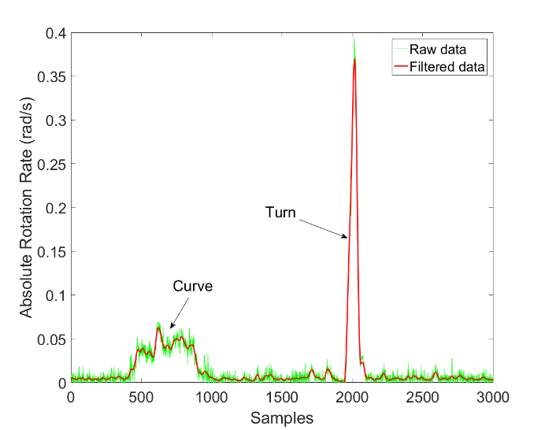
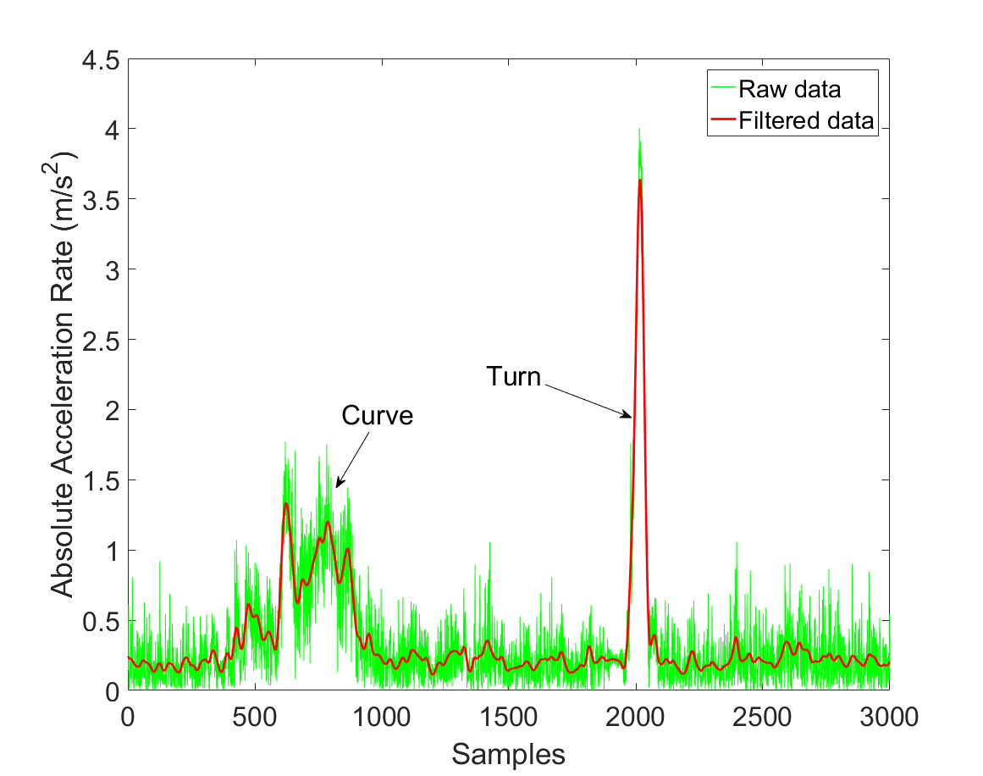
Methodology
Butterworth Low-pass Filter
Reduces noise of high frequency measurements
Figure 4.1 Variation of the Angular Speed around Z Axis
Figure 4.2 Variation of the Acceleration Rate on X axis
Notes:
Now let me talk about
BLF is a well known tool to…

Slide 16

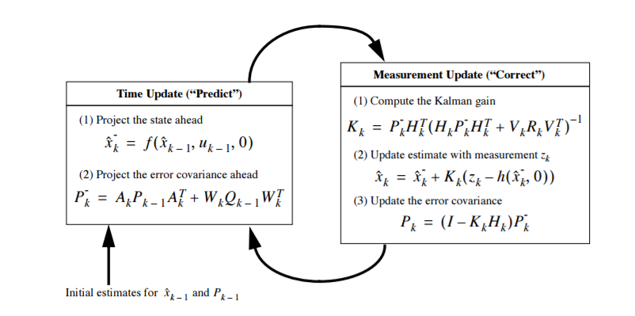
Methodology (cont.)
Extended Kalman Filter
state model
measurement model
Prediction process projects forward the current state and error covariance estimates to obtain a priori estimates for the next step;
Correction process is to incorporate the new measurement into the a priori estimate to obtain an improved estimate.
Notes:
The extended Kalman filter (EKF) is the nonlinear version of the Kalman filter, which has been considered a common way in the non-linear state estimation and navigation system

Slide 17
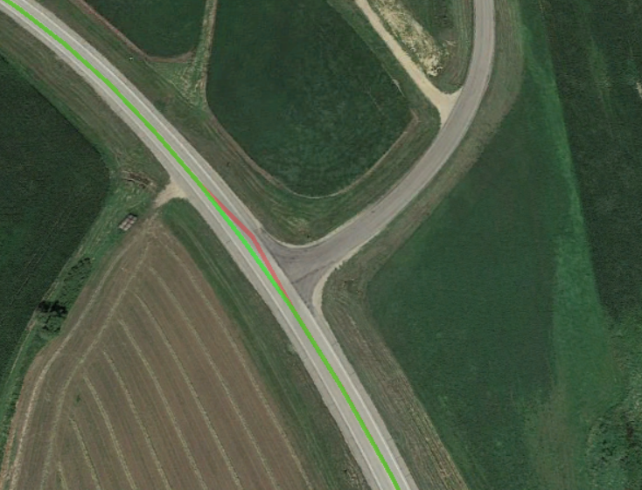
Methodology (cont.)
Extended Kalman Filter
 | $$x=\left\{lat,lon,att,v_{x},v_{y},v_{z},w_{x},w_{y},w_{z},{acc}_{x},{acc}_{y},{acc}_{z} \right\}$$ | (3)
Figure 4.4 Raw GPS Locations (red) vs Smoothed GPS Locations (green)
Notes:
The accelerate rate and rotation rate can be used to calibrate vehicle’s speed and location when the GPS signals is weak or there is a signal outage.
This figure demonstrates that the GPS accuracy is improved by using the EKF.

Slide 18
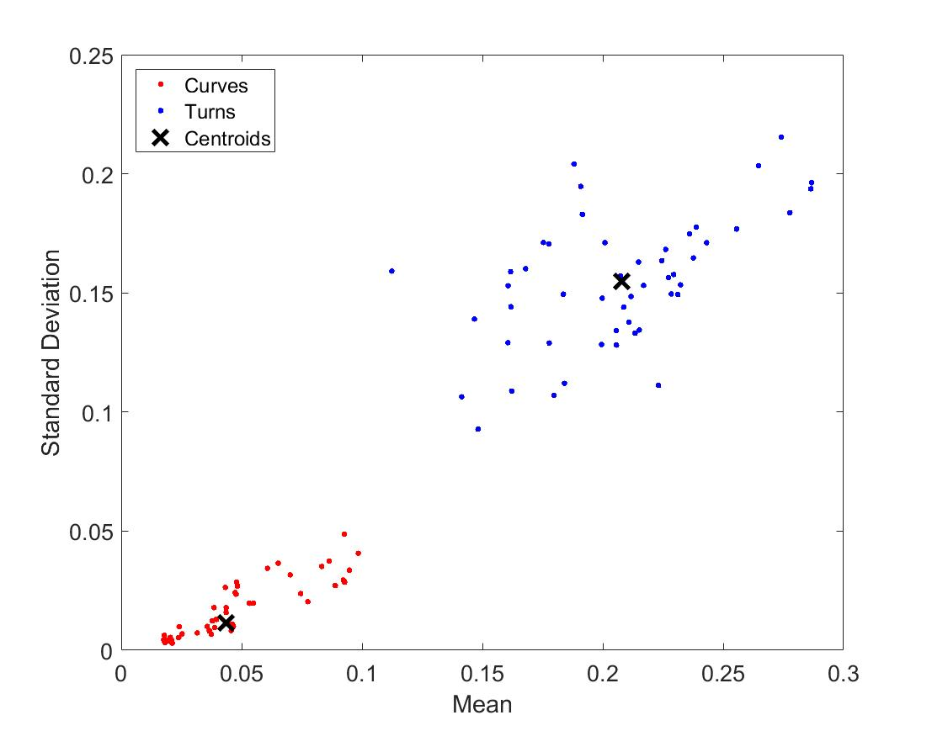
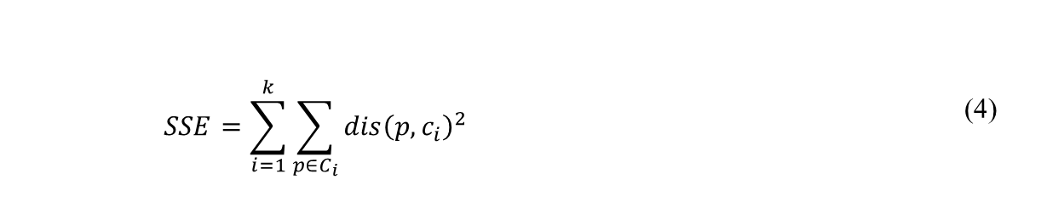
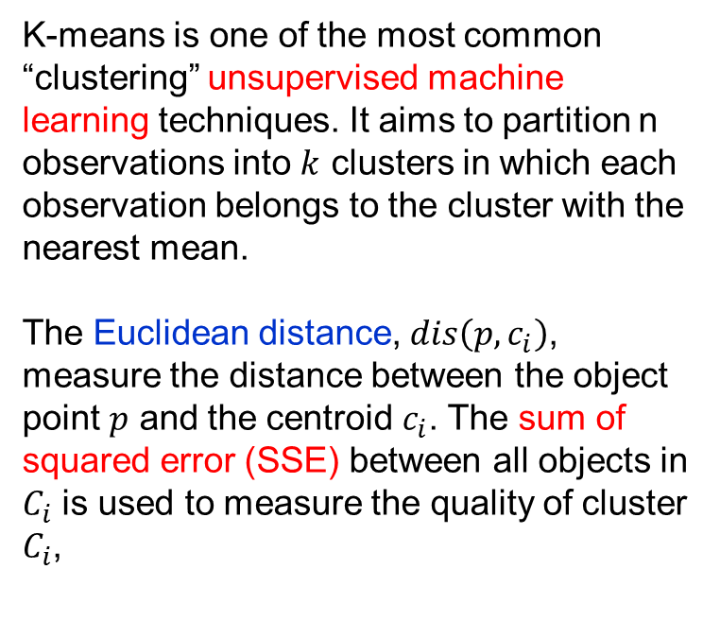
Methodology (cont.)
K-means
K-means is one of the most common “clustering” unsupervised machine learning techniques. It aims to partition n observations into $k$ clusters in which each observation belongs to the cluster with the nearest mean.
The Euclidean distance, $dis\left(p,c_{i}\right)$, measure the distance between the object point $p$ and the centroid $c_{i}$. The sum of squared error (SSE) between all objects in $C_{i}$ is used to measure the quality of cluster $C_{i}$,
Figure 4.5 Cluster Assignments and Centroids
 | $$SSE=\sum_{i=1}^{k}{\sum_{p∈C_{i}}^{ }{{dis\left(p,c_{i}\right)}^{2}}}$$ | (4)
Notes:
As an unsupervised machine learning techniques, K-means aims…
50 curves and 50 turns were used to train the clustering centroids. Specifically, the standard deviation and mean of the rotation rate were used to train the centroids of clusters. So that I got two centroids for curve and turn, respectively.

Slide 19
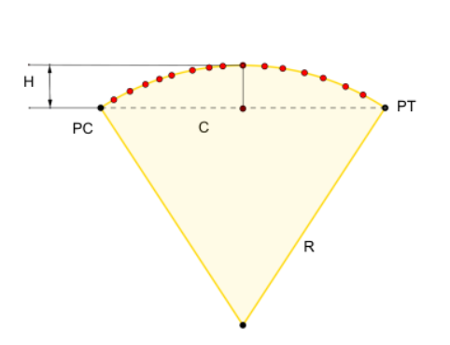
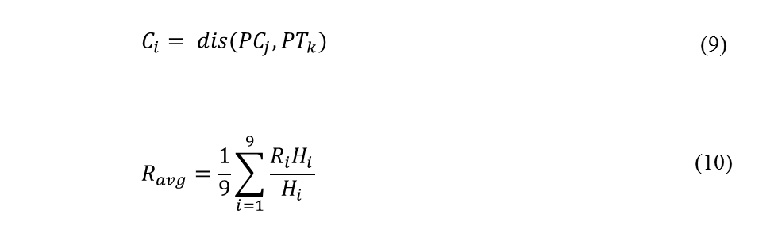
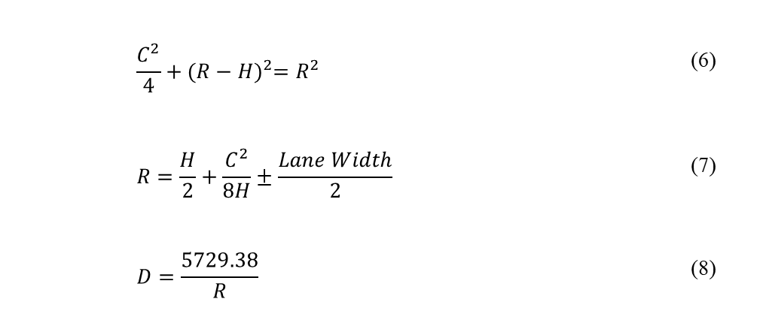
Methodology (cont.)
Chord Offset Method
 | $$\frac{C^{2}}{4}+{(R−H)}^{2}=R^{2}$$ | (6)
 | $$R=\frac{H}{2}+\frac{C^{2}}{8H}±\frac{Lane Width}{2}$$ | (7)
 | $$D=\frac{5729.38}{R}$$ | (8)
 | $$C_{i}= dis({PC}_{j}, {PT}_{k})$$ | (9)
 | $$R_{avg}=\frac{1}{9}\sum_{i=1}^{9}{\frac{R_{i}H_{i}}{H_{i}}}$$ | (10)
Notes:
This study used the chord offset method to estimate the radius.
$R$ represents the radius of the circle in feet; $D$is the degree of curve; $C$ is the chord length in feet; $H$ is the middle ordinate in feet.
To improve the accuracy of curve radius estimates, First step, the three neighboring GPS points around the PC and PT can be used to obtain 9 chord lengths $(C)$ and 9 middle ordinate $(H)$ measurements, respectively. Equation 9 was used to calculate the chord lengths based on the observed data. Second step, the calculated $R_{i}$was averaged using the weighted average method

Slide 20
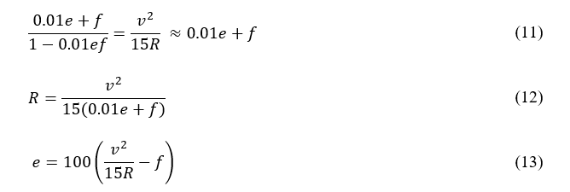
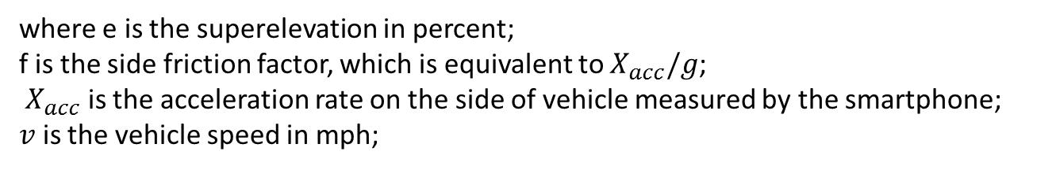
Methodology (cont.)
Superelevation Estimation
where e is the superelevation in percent;
f is the side friction factor, which is equivalent to $X_{acc}/g$;
$X_{acc}$ is the acceleration rate on the side of vehicle measured by the smartphone;
$v$ is the vehicle speed in mph;
Notes:
According to the AASHTO Green Book

Slide 21
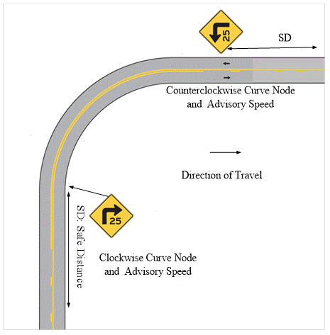

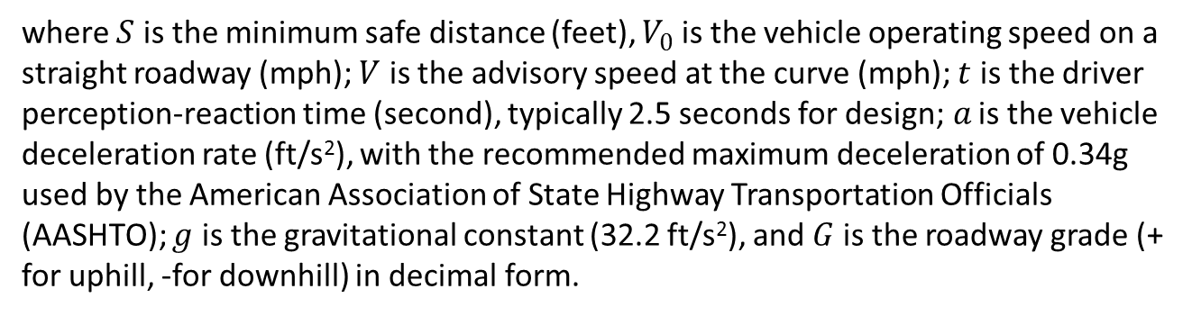
Methodology (cont.)
Warning of Horizontal Curve
where $S$ is the minimum safe distance (feet), $V_{0}$ is the vehicle operating speed on a straight roadway (mph); $V$ is the advisory speed at the curve (mph); $t$ is the driver perception-reaction time (second), typically 2.5 seconds for design;$a$ is the vehicle deceleration rate (ft/s²), with the recommended maximum deceleration of 0.34g used by the American Association of State Highway Transportation Officials (AASHTO); $g$ is the gravitational constant (32.2 ft/s²), and $G$is the roadway grade (+ for uphill, -for downhill) in decimal form.
Notes:
it is important that messages are displayed within the proper time-frame (i.e., not too early/ not too late). Assuming a constant deceleration, the safe distance it takes a driver to perceive, react, and decelerate to the advisory speed of a curve can be calculated in this equation, which is based on the equation of motion using Newtonian physics law.

Slide 22
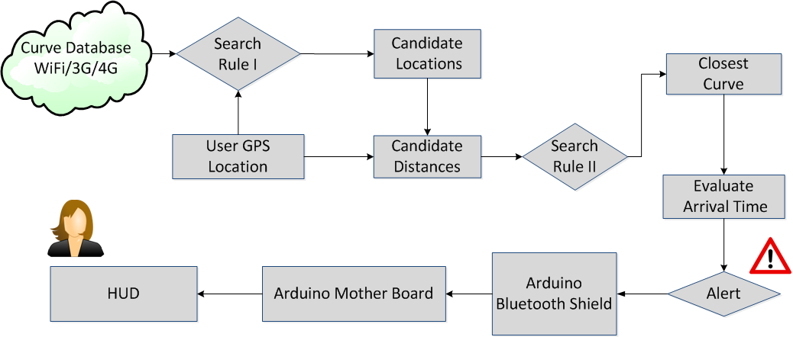
Methodology (cont.)
Warning of Horizontal Curve
Search Rule I obtains curve data from the spatial database and identifies candidate curve locations. Search Rule II identifies the nearest curve location by distance, computes travel time, sends alert commands to HUD, and displays the proper warning.
If the vehicle is operating at a speed within 5 mph above the posted speed limit, the system blinks a red curve arrow once per second. When the vehicle is exceeding the curve’s posted speed limit by 5-10 mph, the red curve sign blinks faster at two times per second. Lastly, if the vehicle’s speed is 10 mph above the posted speed limit, the red curve sign blinks at a faster rate, or four times per second.
Notes:
To determine the nearest curve, the smartphone module implements a two-step search algorithm
Once the vehicle enters the safe distance range, a correspondent warning is shown on the front windshield

Slide 23
Field Evaluation
Test Setup
Samsung Galaxy S7 Edge: Android 5 OS
iPhone 4s: iOS 7
GPS: 1 Hz.
Gyroscope/accelerometer:20 Hz.
Evaluation
Speed Assessment
Curve Identification and Calculation
Assessment of C-Alert.
Notes:
A Samsung Galaxy S7 Edge running Android 5 OS and an iPhone 4s running iOS 7 ware used to evaluate the system performance of C-Finder and C-Alert, respectively. The GPS frequency was collected at 1 Hz. Gyroscope and accelerometer were at 20 Hz
The evaluation includes

Slide 24
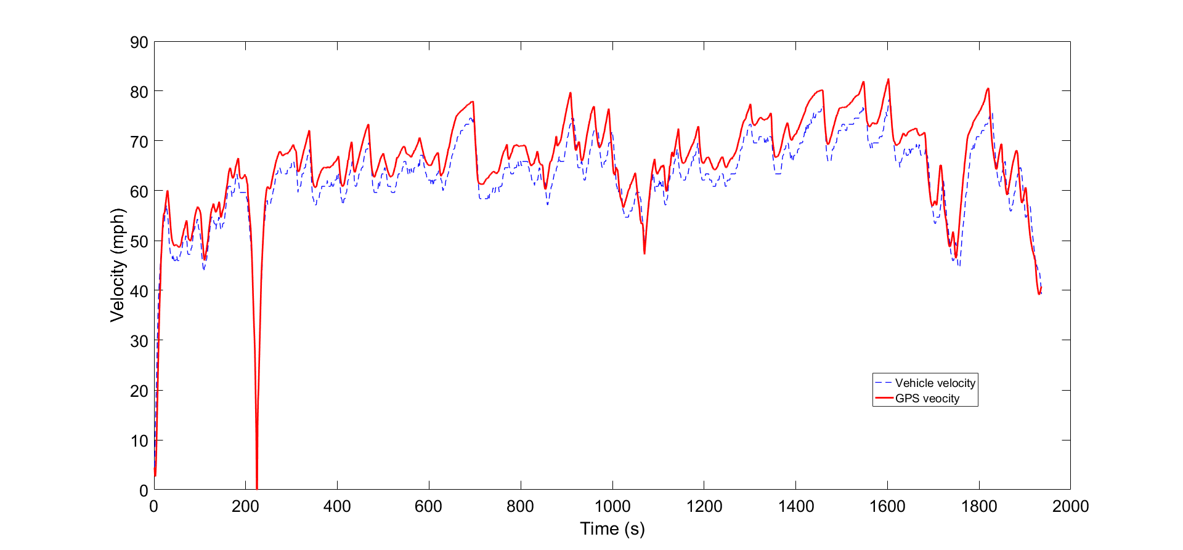
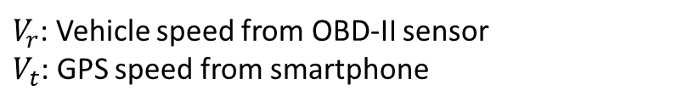

Field Evaluation(cont.)
Speed Assessment
$V_{r}$: Vehicle speed from OBD-II sensor
$V_{t}$: GPS speed from smartphone
 | $$MAPE=\frac{1}{N}\sum_{n=1}^{N}{\left|\frac{ V_{r}− V_{t}}{ V_{r}}\right|}$$ | (16)
Mean Absolute Percentage Error (MAPE) in Equation 16 is used to evaluate the speed deviation. The MAPE results indicated that there was approximately 6% difference between the GPS and vehicle speeds. This suggests that the speed precision obtained from smartphone is acceptable

Slide 25
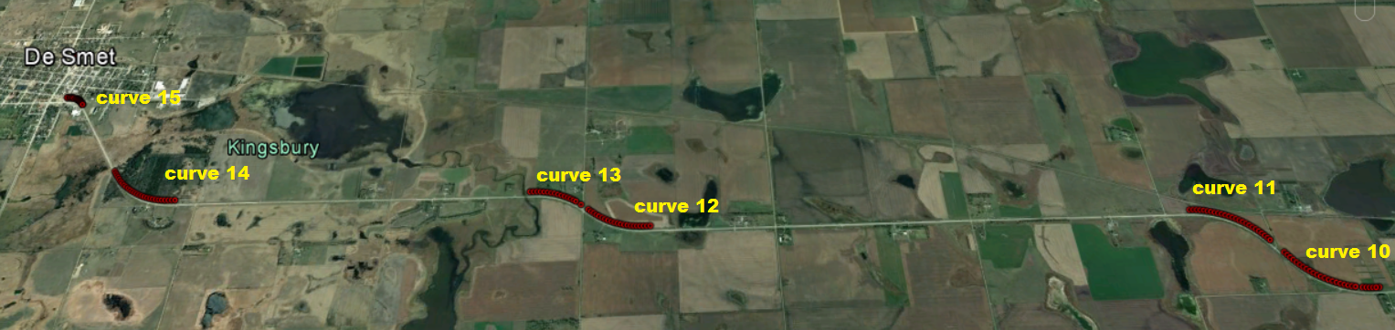
Field Evaluation(cont.)
Curve Identification and Calculation
100 miles long two-lane highway located on Brookings County and Kingsbury County, South Dakota ware selected as the test area for C-Finder. This study considered the degree of curve greater than 1 as sharp curves. A total of 21 sharp horizontal curves covering different radii were conducted.
Roadway inventory data from SDDOT was used to compare with the estimates
Three-runs surveys were measured to evaluate the stability of the system

Slide 26
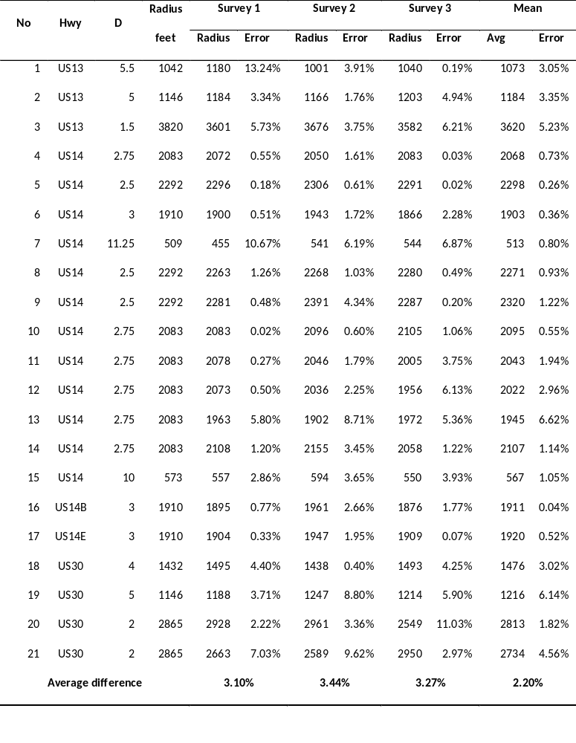
Field Evaluation(cont.)
Table 1. Radius Measurement without Lane Width Adjustment
The result indicated that the average radius difference of three runs is 3.10%, 3.44% and 3.27%, respectively. The mean radius difference is 2.2%.
Notes:
Table 1 shows that the … for the 21 curves

Slide 27
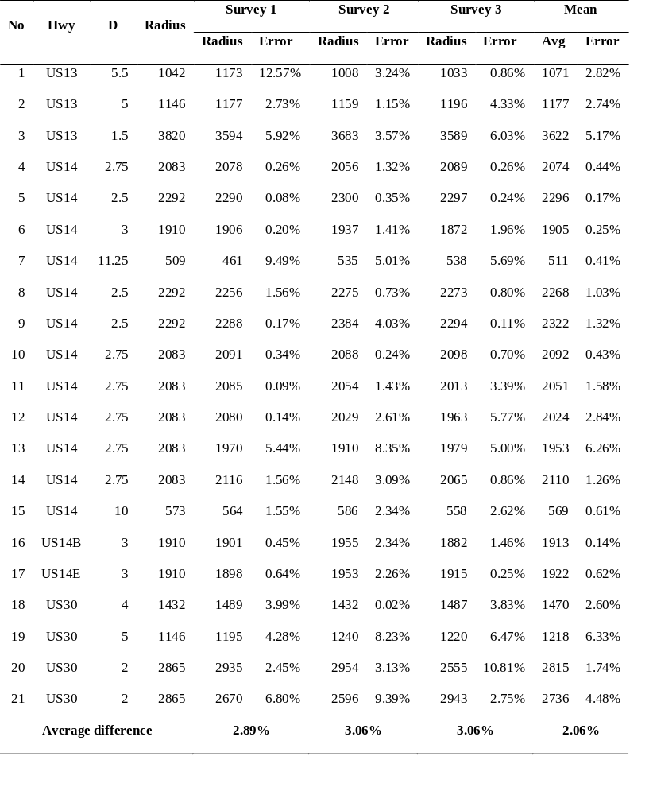
Field Evaluation(cont.)
Table 2. Radius Measurement with Lane Width Adjustment
The average radius difference of three runs is 2.89%, 3.06% and 3.06%, respectively. The mean radius difference is 2.06%.
With the lane width adjustment, the accuracy of radius calculation is slightly improved.

Slide 28
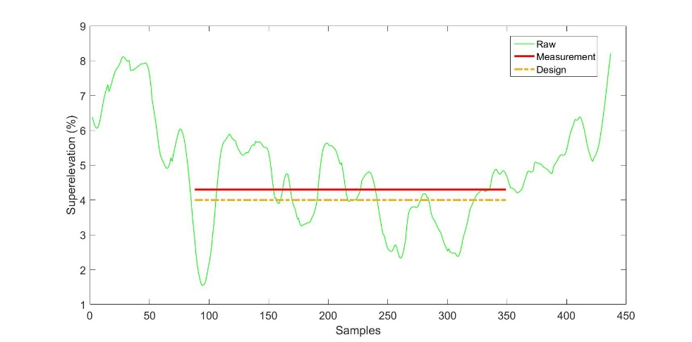
Field Evaluation(cont.)
Evaluation of superelevation
Design: 4%
Measurement :4.2%
Statistical analysis showed that the average of superelevation between the 15th and 90th percentile of the length of curve is consistent with the design superelevation from the SDDOT roadway inventory
Notes:
As we known, drivers might reduce speed when the vehicle is approaching to a curve, which generates more sensor noise. when leaving out of a curve, the vehicle status is more “smooth” due to the reduced speed

Slide 29
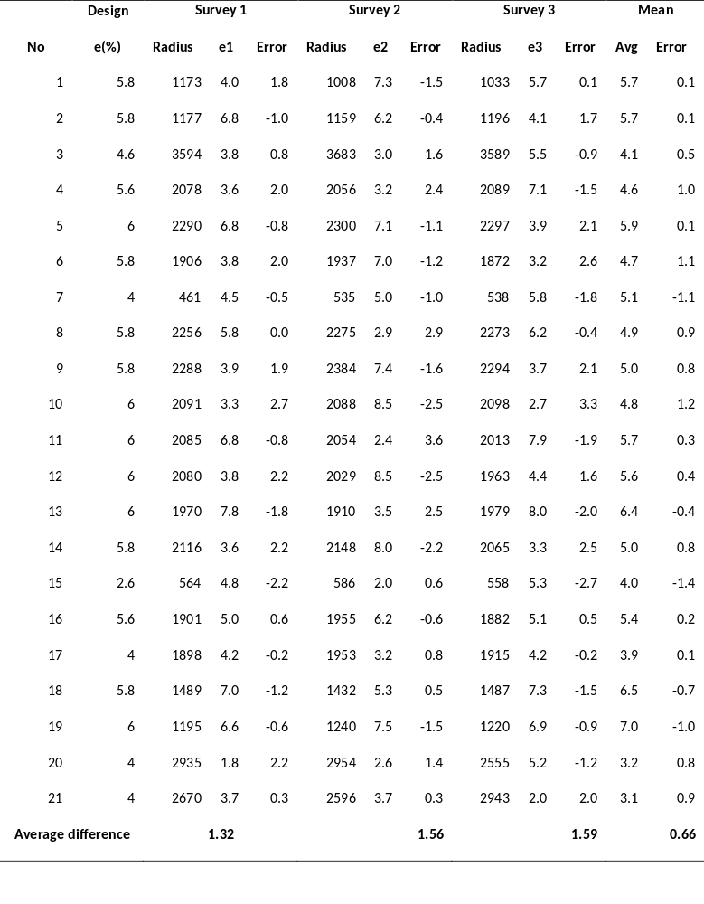
Field Evaluation(cont.)
Table 3 Superelevation Evaluation
In three runs, the average difference between design superelevation and measured superelevation is 1.32%, 1.56% and 1.59%, respectively. The overall superelevation difference is 0.66%.
Notes:
Here, It should be noted that the comparison is between the smartphone measured superelevation and design superelevation, which may be slightly different that as-built superelevation. However, as-build superelevation information was not available.

Slide 30
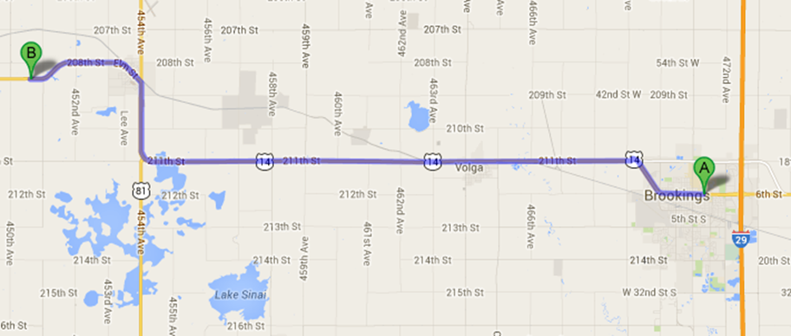
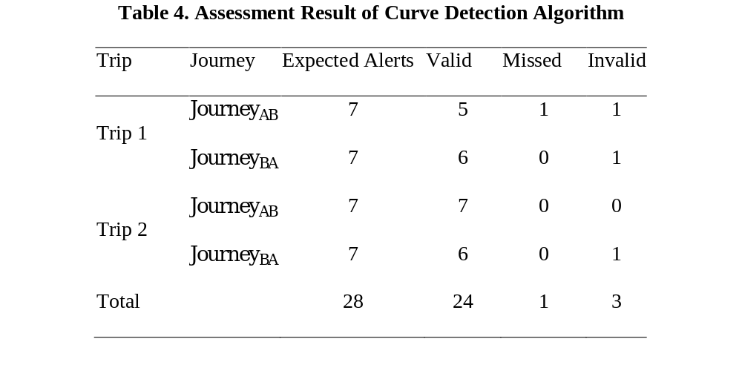
Field Evaluation(cont.)
Assessment of C-Alert
Table 4 shows that 85% of the curves were detected in the field test.
Missing alerts can be attributed to a BLE connection error.
The “Invalid” column refers to incorrect alert. For example, it should be left turning warning but it displays right turning warning. Errors can be attributed to the smartphone’s built-in GPS which dynamically searches location information and identifies the nearest curve by distance.
Notes:
To evaluate C-Alert, a 30-mile test route on US Route 14 was used for the field test. This route has seven horizontal curves.

Slide 31
Conclusions
This study included the design, implementation and evaluation of mobile systems for low-cost real time horizontal curve inventory and warning of horizontal curves. Two smartphone applications, C-Finder and C-Alert, were developed and evaluated
The field test demonstrated the proposed approach (C-Finder) can achieve desirable radius measurement accuracy for sharp curves. The average error is approximately 3%.
Adjusting lane width doesn’t have a significant effect on the accuracy of radii estimation. However, multiple runs can achieve higher accuracy.
Notes:
This study concluded that

Slide 32
Conclusions (cont.)
The accuracy of superelevation relies on the accuracy of curve radius, vehicle speed and acceleration rate from smartphone. Improving their accuracy can achieve more accurate superelevation measurements.
The work proposed a smartphone-based horizontal curve warning system (C-Alert) using GPS, BLE technology, and HUD, the curve warning system uses an economically affordable device (HUD) as well as open source wireless communications that can integrate, reconfigure, and customize various data sources (e.g., state DOT data sources).

Slide 33
Future Work
The GPS frequency from smartphone is only 1 Hz. Increasing the frequency of GPS could potentially improve the radius estimation. GPS/IMU sensor fusion could be applied to increase the frequency of GPS in the future work.
Future work should evaluate C-Alert further under various scenarios and conditions, such as BLE data transmission, GPS accuracy in different conditions (e.g., with internet and without internet, mountainous road, high density road network in urban area), and the algorithm accuracy. Human factors evaluation should also be studied to ensure that the use of this system does not introduce unintended safety issues.
C-Alert is designed for highway horizontal curves, it could also be applied to other areas such as work zones, highway-rail grade crossings, and wrong-way traffic
Notes:
The future work will include

Slide 34
Acknowledgments
I would like to thank my thesis advisor Dr. Jonathan Wood for his excellent guidance, caring, and providing me with great support for doing this research.
Thank all peer students, professors and committee members for helping me my thesis and studies.

Slide 35
Publications
WiTraffic: Low-cost and Non-Intrusive Traffic Monitoring System Using WiFi
Myounggyu Won, Shaohu Zhang, Sang H. Son
Proceedings of the IEEE 26th International Conference on Computer Communications and Networks ( ICCCN'17), 2017
Poster Abstract: WiTraffic - Non-intrusive Vehicle Classification Using WiFi
Shaohu Zhang, Myounggyu Won, Sang H. Son
Proceedings of the 14th ACM Conference on Embedded Network Sensor Systems ( SenSys'16), 2016
Enabling Energy-Efficient Driving Route Detection Using a Built-in Smartphone Barometer Sensor
Myounggyu Won, Shaohu Zhang, Appala Chekuri, Sang H. Son
19th IEEE International Conference on Intelligent Transportation Systems. Rio de Janeiro, Brazil (ITSC'16), 2016
Low-cost Realtime Horizontal Curve Detection Using Inertial Sensors of a Smartphone
Shaohu Zhang, Myounggyu Won, Sang H. Son
84th IEEE Vehicular Technology Conference (VTC'16), 2016
Advanced Curve-speed Warning System Using an In-Vehicle Head-Up Display
Xiao Qin, Shaohu Zhang, Wei Wang
94th Transportation Research Board paper, Washington, D.C. (TRB'15), 2015
Notes:
This is the published works I did during the studies at SDSU .

Slide 36
Thank you!
Questions?

