Slide 1
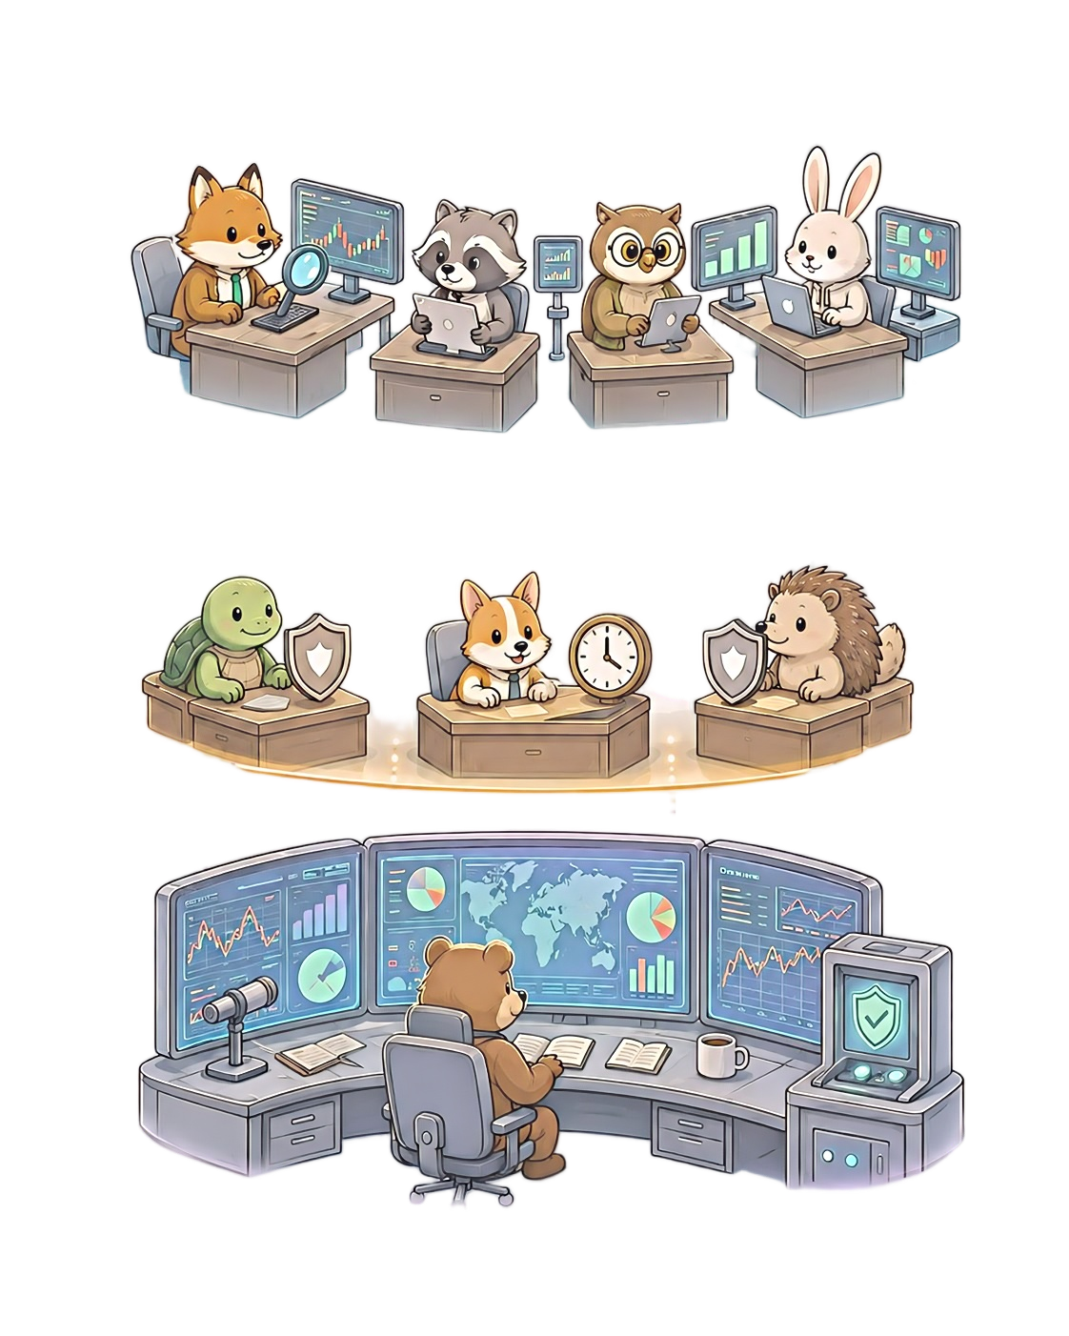





(a) Typical end-to-end trading agent
(b) DarwinTrade: self-evolving trading agent
Analyst
Evolution
Tactical
Evolution
BUY
SELL
HOLD
BUY
SELL
HOLD
Trading Agent
Strategic
Evolution

