Slide 1
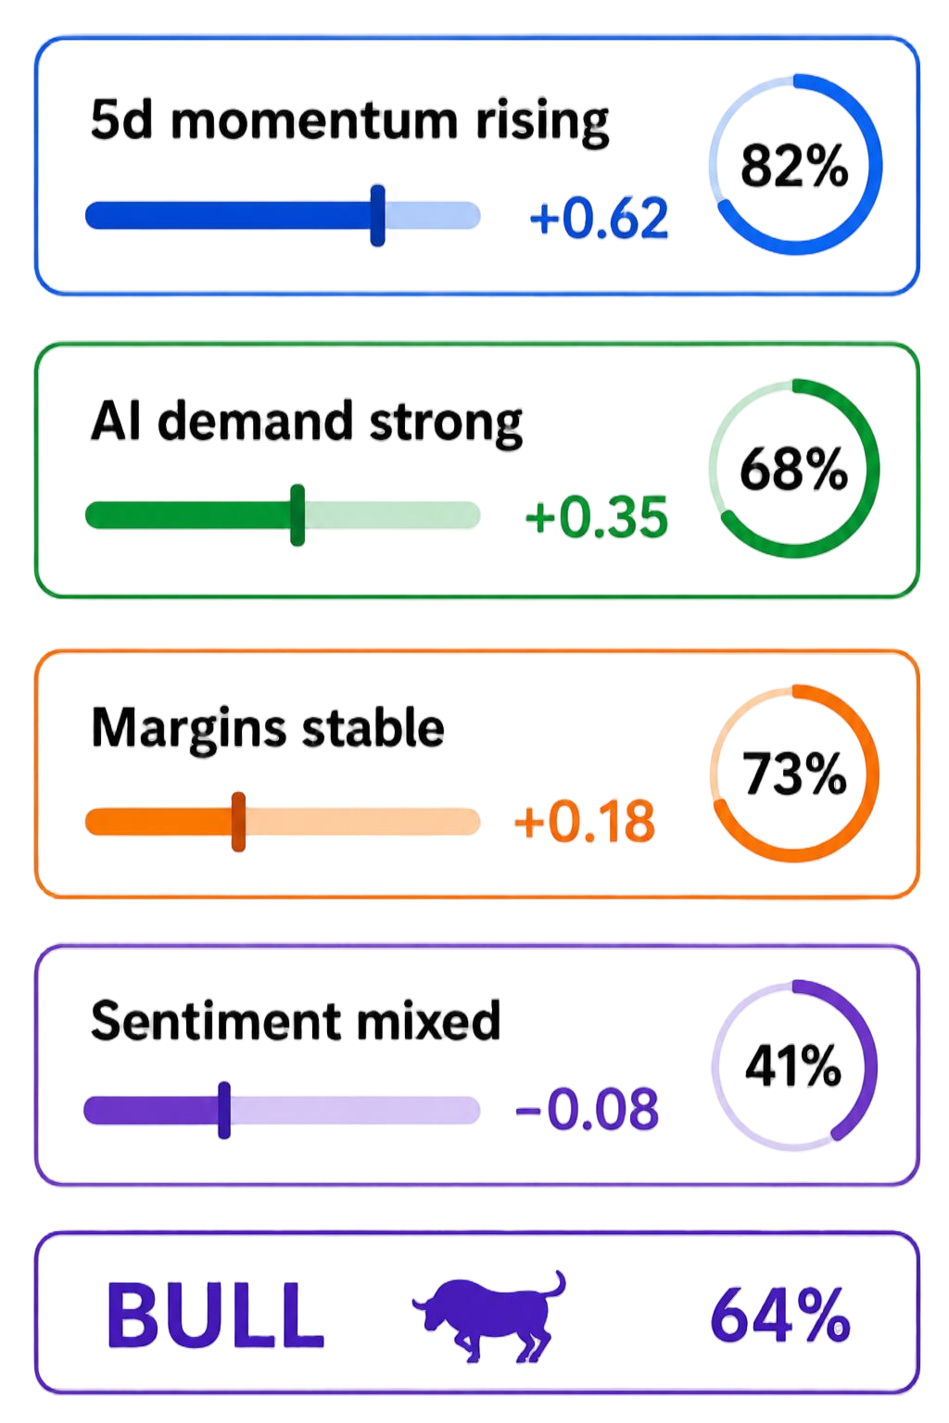









(a) Daily Control Loop
Parallel Analyst Agent Team
Role-weighted Fusion
Optimizer
Execution
Market
Fundamentals
Regime
News
MSFT +6%
AAPL +4%
BA -3%
BUY MSFT
BUY AAPL
SELL BA
Market
News
Social
Fundamentals
consensus: BUY
convictions: 57%
Social
X
…
…
(b) Three-layer Self-evolution
Analyst Evolution
T → T+1
Tactical Evolution
1 - 3 days
Strategic Evolution
20 days
validate views with next-open returns
install short-lived risk guards
diagnose episodes and propose bounded policy edits
Before
After
lookback
agentical review
Market
Market
Episode 1
MSFT
+1.3%
Equity exposure
Equity exposure
Fundamentals
+
Episode 2
Fundamentals
-
News
Low High
AAPL
reduce-only
Low High
Episode 3
TEST
News
Social
AAPL
+4%
AAPL
0%
· · ·
Commit
Rollback
weight
TTL
expired
Social
update regime-specific role trust
reassess effects at TTL expiry
monitor market-relative alpha: commit or rollback

